Slide 1
Project Implementation

Slide 2
We will cover these topics:
Project management
Life cycle management
Business planning
Your questions

Slide 3
Section 1
Planning and Managing Projects

Slide 4
Project Management, Part I
Initiation
  goal setting
  project governance
  roles and responsibilities
Planning
  resource requirements
  deliverables
  stakeholder analysis

Slide 5

Identify Key Stakeholders

Slide 6
Benefits of Stakeholder Analysis
Build awareness
Gather feedback
Build trust
Get support
Expand resources
Understand risks

Slide 7
Project Management, Part II
Execution and control
  work plan and time line (see next slide)
Closing
  final product evaluation
  reporting
  lessons learned – post project review
  transition

Slide 8
Developing Project Timelines
Work breakdown – work packages
  structured activity list
Estimating effort and duration (see next slide)
  balance optimistic and pessimistic estimate
  identify dependencies
    simultaneous
    sequential
  allocate staff to tasks

Slide 9
Project Gantt Chart
Task Name | Duration | Start Date | Finish Date | Dependencies | Resource Needs
PHASE I Task 1 Task 2
PHASE II Task 1 Task 2
PHASE III Task 1 Task 2

Slide 10
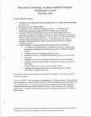


Balance Triple Constraints
requirements
quality
budget
schedule
Notes:
This is the trick in managing projects. As I get older, I am happy to say that I am becoming more critical of my skills. Most of the mistakes I catch are related to time pressure. All the short cuts we take. Some are mechanical – directly related to outcomes, but some are related to interpersonal relations and long-term success of project. Make time for understanding other people’s need and even if you can satisfy them all – at least acknowledge and give them a chance to give you feedback. End with the saying…

Slide 11
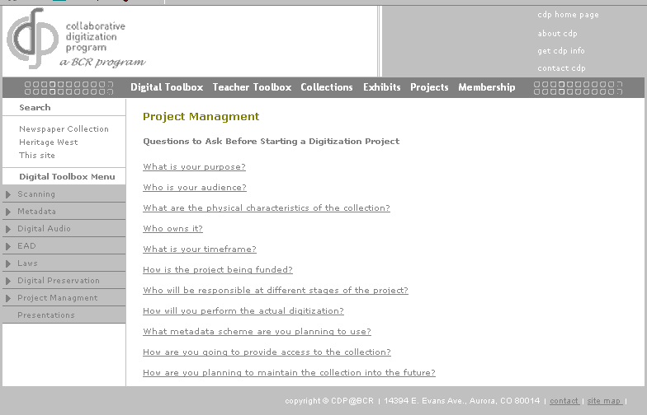
http://www.cdpheritage.org/digital/projectmanagement/index.html

Slide 12
Any Questions?

Slide 13
Section 2
Lifecycle Management

Slide 14
Select
Update
Copyright
Prepare
Archive
Store
Benchmark
DRM
Life Cycle Management
Digitize
Publicize
Process
Assess
Metadata
Deliver
System
Interface

Slide 15
Digital Preservation
Technical strategies
  Bit preservation
  Refreshing
  Migration
  Emulation, technology preservation, digital archeology
Organization strategies
  Policies and best practices
  Technical and organizational infrastructure
  Funding and staffing
  Technology forecasting and risk assessment

Slide 16
Polling Question
Does your institution have a preservation policy?
Yes
No
In the process
Do not need one
Other

Slide 17
If you are interested in preservation issues, see:
Preservation in the Age of Large-Scale Digitization
  http://www.clir.org/activities/details/mdpres.html

Slide 18
Section 3
Business Planning

Slide 19
Components of a Business Plan, Part I
Objectives
Needs assessment
Risk assessment & contingency planning
Service model (see next slide)

Slide 20

Support effective and efficient creation of digital collections
Offer a single-point of entry to services for planning, creation, and management of digital collections
Implement best practices and standards to create digital collections with long-lasting value
Develop a business model to sustain services

Slide 21
DCAPS
DIGITAL MEDIA
Still Image & AV Digitization
Image Processing
Structural and Tech Metadata
Web Design & Programming Application Development
Content Management Systems
METADATA
Metadata Standards
Subject Schemes
Descriptive Metadata
Structural Metadata
Preservation Metadata
Grant Writing
Project Planning & Management
Fiscal Management
Liaison to Public Services, Preservation, Conservation, Digital Preservation, External Vendors, and Other Cornell Service Providers
COPYRIGHT
Education & Awareness
Copyright Clearance
IP & Licensing Consultancies
Digital Rights Management
ELECTRONIC PUBLISHING
ePublishing system development and support
Business model development
TECHNOLOGY SUPPORT
Hardware and Software Selection
Optical Character Recognition
Archiving
Web Hosting
Image Database Management
Storage Management

Slide 22
Components of a Business Plan, Part II
Management team
Communication plan
Financial information & forecasts (see next slide)
  Resources: Staffing, Facilities, Equipment

Slide 23
Fiscal Management
Cost elements
  Planning and management
  Production
  Sustainability
  Research and development
Calculating hourly costs
  Billable hours: 1200 hrs/year
  Direct expenses: Salary, benefits, training, equipment, networking, etc.
  Indirect expenses: Equipment depreciation, service center administration, utilities, etc.

Slide 24

Business Planning for Cultural Heritage Institutions
Liz Bishoff and Nancy Allen
January 2004
http://www.clir.org/pubs

Slide 25
business savvy
knowledge
of users
SUCCESS
digitization
know-how
project management
skills

Slide 26
Lessons Learned
Recognize that every initiative has multiple and ongoing phases – they are not one-time efforts
Understand the evolving needs of your users
Every project requires good financial management
Emotional IQ can be as important as professional competencies
See the forest for the trees
Promote your initiatives – communicate with the key stakeholders

