Slide 1
Metadata &
Content Management

Slide 2
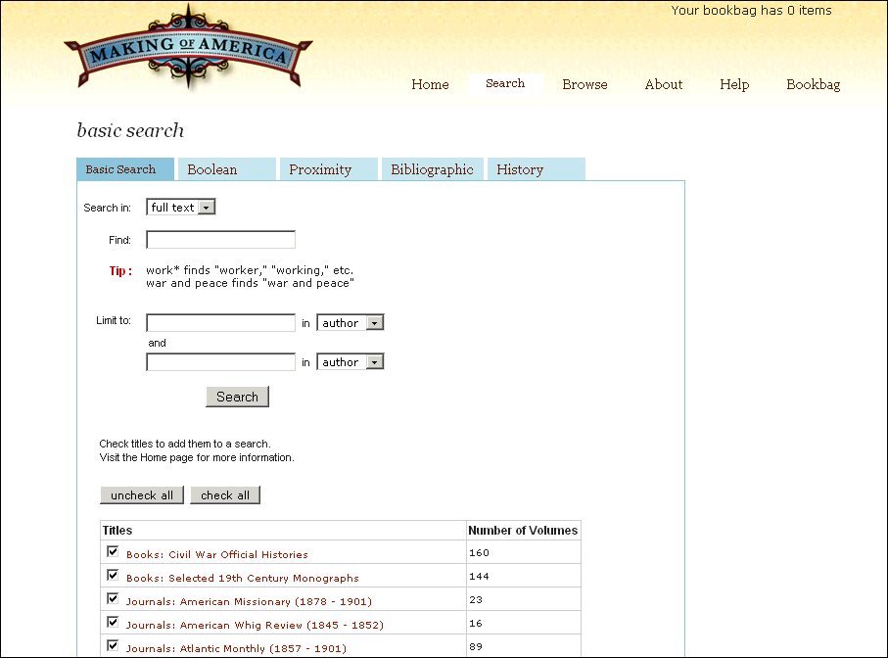

Slide 3
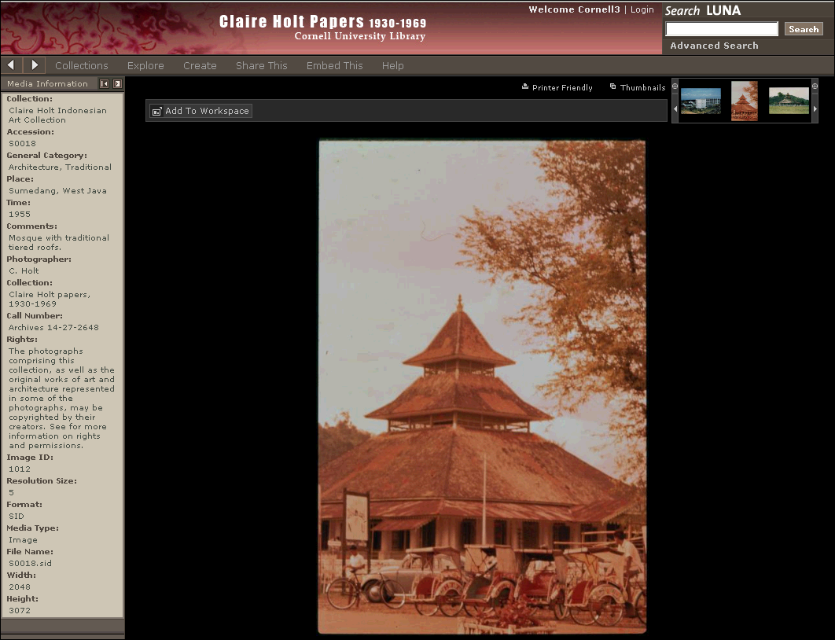

Slide 4
Metadata Decision Making Points
Metadata goals:
  Discover, access, identify, select, navigate, reuse, manage, archive
Metadata types:
  Descriptive, structural, administrative, technical, preservation

Slide 5
Metadata Decision Making Points
Resource discovery
  Institutional
  Consortial
  Web

Slide 6
Metadata Decision Making Points
Metadata standards
  MARC, Dublin Core, VRA Core, Encoded Archival Description (EAD), AACR, Cataloguing Cultural Objects, METS, MPEG 21, Open Archives Initiative (OAI-PMH), Handles, Digital Object Identifiers (DOI), Z39.50
Metadata syntaxes
  Syntaxes: SGML, XML, RDF/XML, XHTML

Slide 7
Descriptive Metadata
  Describe and identify resources
  Enables searching and retrieval
  Faciliates federated or unified searches

Slide 8
Structural Metadata
  Facilitates navigation and presentation of resources
  Internal structure – page, chapter, table of contents
  Describes relationships among items

Slide 9
Administrative Metadata
  Project lead/staff information
  Project governance and mandate
  Copyright issues/ agreement
  General collection information
  Any additional documentation such as licenses or collaborations

Slide 10
Technical Metadata
  Detailed information about your imaging requirements – Z39.87
  Preservation metadata: PREMIS
  EXIF camera data

Slide 11
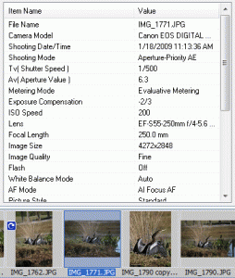

Slide 12
Metadata Creation
Descriptive - describing and identifying information resources
Structural - facilitates navigation and presentation of electronic resources
Administrative - facilitates both short-term and long-term management and processing of digital collections

Slide 13
Metadata Creation
Metadata standards
  DC, VRA Core, Cataloguing Cultural Objects, CO, METS, Open Archives Initiative (OAI), PURL, Handle, Digital Object Identifier (DOI), MPEG 21, Encoded Archival Description EAD
  Syntaxes: XML, SGML, HTML META tags
Resource discovery
  Institutional
  Consortia
  Web

Slide 14
System Development
Repository architectures (see next slide)
  e.g., Fedora
Digital content development platforms
  e.g., ContentDM, Luna Insight, Greenstone
Storage planning and management

Slide 15
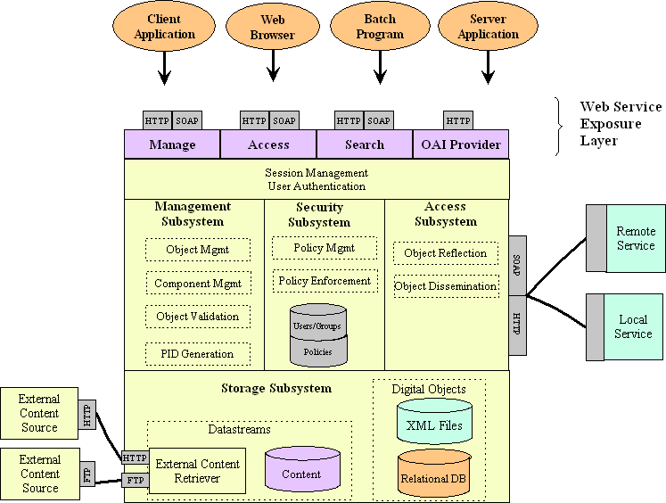
What is a repository system?
Capture, store, index, manage, preserve,
and deliver digital objects.

Slide 16
Factors in Choosing a
Content Management System
Support of archival business requirements
Content type characteristics
Preservation functionality
Usability (staff and end-user)
Search, browse, access features
Development characteristics
Financial sustainability
Digital library infrastructure
Interoperability and support for standards
Institutional policies and practices
Notes:
Improved scholarly communication is at the heart of the ARROW project. The overall purpose is to
encourage open or low-cost access to research output in a copyright environment that protects the
individual’s intellectual property and enhances the impact of their research.

