Slide 1
Post-Processing Tools & Tips
OCR & PDFs

Slide 2
Overview
Software for workflow, file management and quality control
OCR & PDF (Adobe Acrobat & Abbyy FineReader)

Slide 3
Tools & Software
FILE MANAGEMENT | FILE MANIPULATION | FILE RENAMING
TIFFTELLER <$30 | IRFANVIEW free | BULK RENAME UTILITY free

Slide 4
TIFF TELLER
File Name with or without extension
File Path to know the location of the file
Date when the file was modified
Date of creation
Size in kilobytes
Description if any
File type
Width & height in pixels
Physical width & height in inches
Compression
Export results to Excel, txt, csv, …..

Slide 5
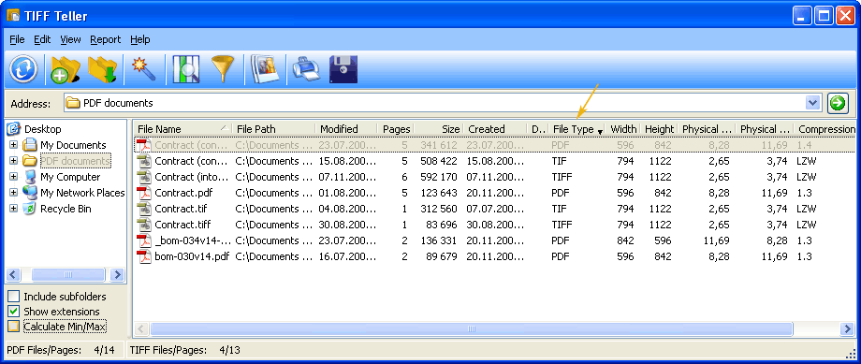
TIFFTELLER http://www.coolutils.com/TIFF-PDF-Page-Count

Slide 6
IRFANVIEW
Batch conversion
  File compression
  Rotations
  Resizing
  Cut/crop
Multipage Tiffs

Slide 7
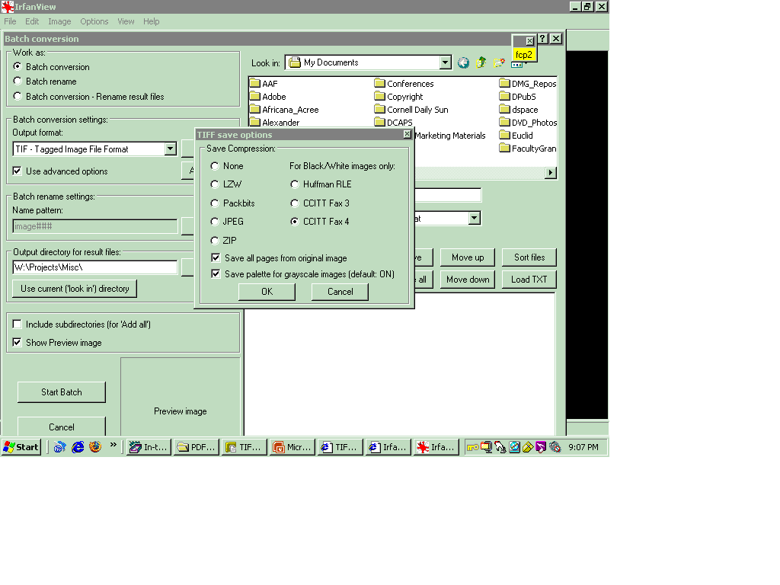
IRFANVIEW http://www.irfanview.com
http://www.irfanview.com/

Slide 8
BULK RENAME UTILITY
Rename files, folders or both
Remove, add or change text in the file names
Perform text substitution
Change the case of file names
Remove characters or words
Remove digits or symbols
Append or prepend text to file names
Append dates in many formats
Append the parent folder's name
Auto-number files with flexible rules
Automatically preview the new names
Directory recursion - process sub-directories too!

Slide 9
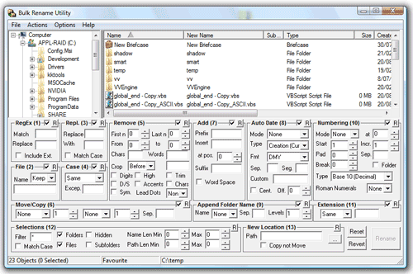
BULK RENAME UTILITY http://www.bulkrenameutility.co.uk/

Slide 10
OCR
Optical Character Recognition
is a type of document image analysis where a
scanned digital image that contains either machine
printed or handwritten script is input into an OCR
software engine and translating it into an editable
machine readable digital text format (like ASCII text).

Slide 11
OCR Accuracy - Dependencies
Scanning
Original item – its nature and condition (paper dirty, torn, foxed, creased, ….)
Printing – typeface, font size, clarity, alignment
Content - OCR engine dictionaries
Output requirements – ASCII text, PDF (under image) or XML

Slide 12


OCR – Grayscale vs. Bitonal capture

Slide 13
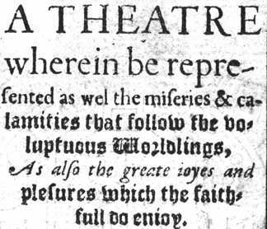
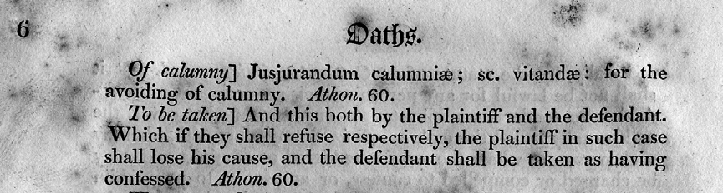
OCR - examples
Type variation
Foxing, text bleedthrough

Slide 14
Abbyy FineReader
Other products
  Commercial (Omnipage)
  OpenSource (OCRopus) - Google
  http://en.wikipedia.org/wiki/Optical_character_recognition
Abbyy engine included in many scan software packages

Slide 15
Abbyy FineReader
Recognition & Layout Retention
  Multiple languages
  Columns, newspaper, charts/tables
Multiple Formats
  Input and save as
Automation

Slide 16
Adobe Acrobat
Adobe Reader – viewing/printing PDFs (free) while Adobe Acrobat – creating/editing ($$)
Optimization
Batch processes
Fast Web View
OCR

Slide 17
Resources
PlanetPDF - http://www.planetpdf.com/
OCR feasibility - http://www.odl.ox.ac.uk/papers/OCRFeasibility_final.pdf

