Slide 1
Photoshop

Slide 2
Photoshop Tools
Tools to use:
  Image resizing (for derivative processing) *
  Crop
  Levels & curves (with adjustment layers) *
  Unsharp mask *
  Profile assignment/conversion *
  Batch processing
Tools to avoid:
  Automated levels
  Brightness/contrast
  Sharpening
  *Can be done as part of a batch process

Slide 3
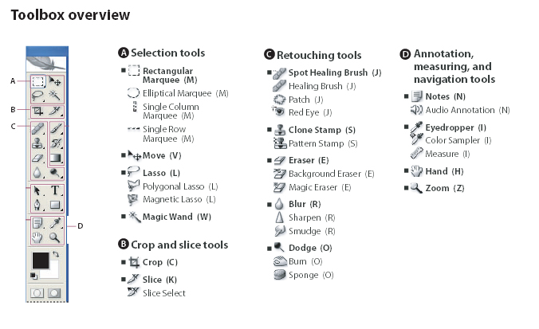
Photoshop Toolbar Overview

Slide 4
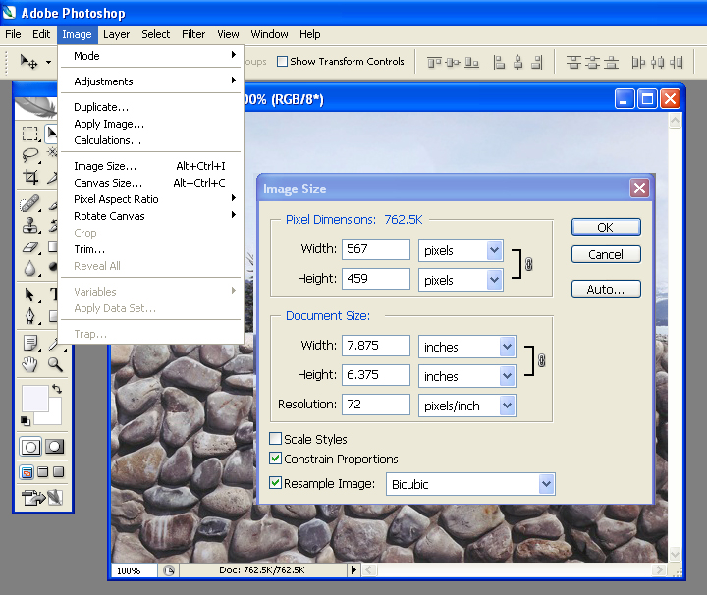
Resizing an Image
Go to Image >Image size
Adjust pixel dimension to required length (make sure constrain proportions is checked)
Alternately, one can adjust the dpi/document size without downsampling by unchecking the “resample image” box

Slide 5
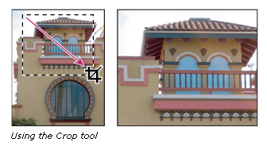
Cropping
Cropping is the process of removing portions of an image to create focus or strengthen the composition. You can crop an image using the Crop tool and the Crop command. You can also trim pixels using the Crop And Straighten and the Trim commands.
Using the Crop tool

Slide 6
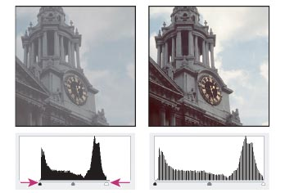
Levels
Do one of the following:
  Choose Image > Adjustments > Levels.
  (Photoshop) Choose Layer > New Adjustment Layer > Levels. Click OK in the New Layer dialog box.
To adjust tones for a specific color channel, choose an option from the Channel menu.
To adjust the shadows and highlights manually, drag the black and white Input Levels sliders to the edge of the first group of pixels on either end of the histogram.
The corresponding pixels in each channel should be adjusted proportionately to avoid altering the color balance.

Slide 7
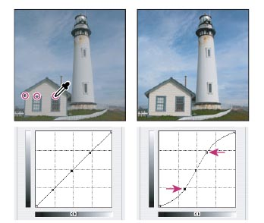
Curves
To adjust tonality with Curves, do one of the following:
Choose Image > Adjustments > Curves.
Choose Layer > New Adjustment Layer > Curves. Click OK in the New Layer dialog box
Add a point along the curve by doing one of the following:
Click directly on the curve.
Lightening the highlights and darkening the shadows is represented by an S-curve where the image contrast is increased.

Slide 8
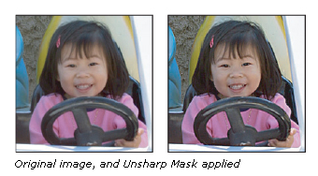
Unsharp Mask
The Unsharp Mask sharpens an image by increasing contrast along the edges in an image. The Unsharp Mask does not detect edges in an image. Instead, it locates pixels that differ in value from surrounding pixels by the threshold you specify. It then increases the contrast of neighboring pixels by the amount you specify. So, for neighboring pixels the lighter pixels get lighter and the darker pixels get darker.
In addition, you specify the radius of the region to which each pixel is compared. The greater the radius, the larger the edge effects.

Slide 9
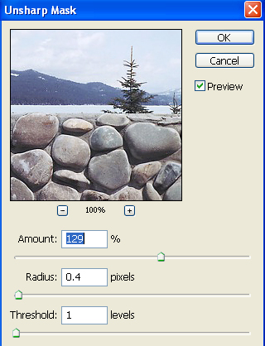
Using Unsharp Mask
Choose Filter > Sharpen > Unsharp Mask. Make sure the Preview option is selected.
Drag the Radius slider or enter a value to determine the number of pixels surrounding the edge pixels that affect the sharpening. The greater the radius value, the wider the edge effects. And the wider the edge effects, the more obvious the sharpening. For high-resolution images, a Radius value between 1 and 2 is usually recommended.
Drag the Amount slider or enter a value to determine how much to increase the contrast of pixels. For high-resolution images, an amount between 80% and 140% is usually recommended.
Drag the Threshold slider or enter a value to determine how different the sharpened pixels must be from the surrounding area before they are considered edge pixels and sharpened by the filter. For instance, a threshold of 4 affects all pixels that have tonal values that differ by a value or 4 or more, on a scale of 0 to 255. So, if adjacent pixels have tonal values of 128 and 129, they are not affected. The default Threshold value (0) sharpens all pixels in the image.

Slide 10
Profile Assignment/Conversion
Assign scanner profile to the master tiff file
  In Photoshop CS and earlier versions navigate to: ‘Image/Mode/ Assign Profile. For Photoshop CS2 and later navigate to: ‘Edit/Assign Profile
  Select “Profile” and the proper device space for your scanner (this profile should be specially created for your individual scanner by running a raw scan of an approved target (MacBeth Colorchecker or IT8 target) through standard profile creation software (ie—inCamera photoshop plug-in).
2. Convert to a working RGB or Grayscale color space (ie- Adobe 1998rgb, sRGB, Graygamma 2.2 for grayscale images).
  In Photoshop CS and earlier versions navigate to: ‘Image/Mode/ Convert to Profile. For Photoshop CS2 and later navigate to: ‘Edit/Convert to Profile. For this example we’ll convert to sRGB space.
  Select the desired destination space and choose: ‘relative colorimetric’ and ‘Adobe’ engine with ‘black point compensation’ and ‘dither’.

Slide 11
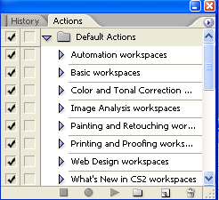
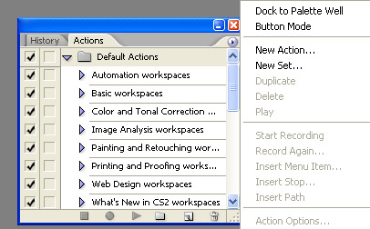
Batch processing
Open “Action” Window : Windows/Actions
Click on Actions arrow:
Choose “New Action”

Slide 12
Batch processing, cont.
Name your action according to processing task (JPEG Derivatives, or TIFF Access Files, etc)
Proceed through opening file, making adjustments (for example, the steps outlined above for creating Access Tiff Files—assigning profiles, converting to profile, resizing, assigning a curve, etc), saving AND CLOSING your file.
Stop Action by clicking on the stop button:

Slide 13
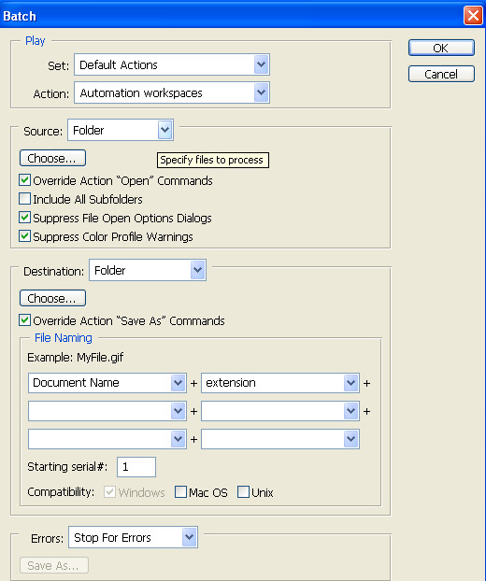
Batch processing, cont.
To use action, go to File/Automate/Batch
Choose Action from drop-down menu
Choose your source folder
Override Action Open Command/
Suppress File Open Commands/
Suppress Color Profile Warnings
Choose your Destination Folder
Override Action “Save As” Commands
Press OK—Photoshop will then batch
process all files in given directory
according to the specifications defined
when action was created.

