Slide 1
Digitization Basics

Slide 2
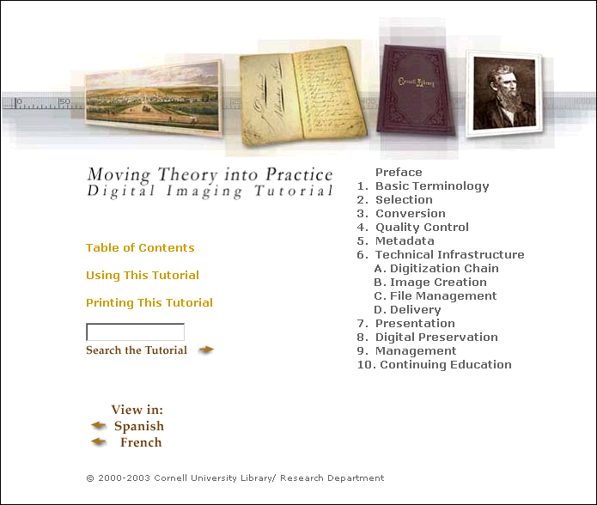
http://www.library.cornell.edu/preservation/tutorial/contents.html

Slide 3
Digitization
Decision-making factors
  Resolution / PPI-DPI
  Bit-depth
  Threshold
  Dynamic range / Histogram
  Image Mode/ Color Space
  File Formats
  Compression Techniques
  Filenaming

Slide 4
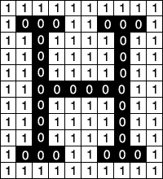
Terminology & Key Concepts
Digital Images are electronic snapshots taken of a scene or scanned from documents, such as photographs, manuscripts, printed texts, and artwork. The digital image is sampled and mapped as a grid of dots or picture elements (pixels).
Pixel Values: As shown in this bitonal image,
each pixel is assigned a tonal value, 0 for black
and 1 for white.
Source: Moving Theory into Practice: Digital Imaging Tutorial

Slide 5
Terminology & Key Concepts
Resolution: Ability to distinguish fine spatial detail dots-per-inch (dpi) or pixels-per-inch (ppi) are common and synonymous terms used to express resolution for digital images. The more pixels per inch, the greater the resolution.
Pixel Dimensions are the horizontal and vertical measurements of an image expressed in pixels. The pixel dimensions may be determined by multiplying both the width and the height by the dpi.
Source: Moving Theory into Practice: Digital Imaging Tutorial

Slide 6
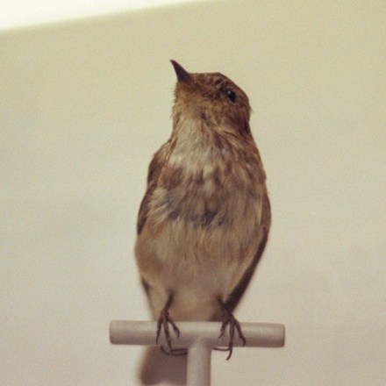


Images at Different Resolutions
2 inches
300 PPI / 600 x 600 pixel dimension
72 PPI / 144 x 144 pixel dimension
30 PPI / 60 x 60 pixel dimension

Slide 7
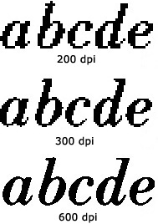
Characters Scanned at Different Resolutions

Slide 8
Terminology & Key Concepts
Bit Depth is determined by the number of bits used to define each pixel. The greater the bit depth, the greater the number of tones (grayscale or color) that can be represented. For example, an image with a bit depth of 1 has pixels with two possible values: black and white. An image with a bit depth of 8 has 2⁸, or 256, possible values. Grayscale mode images with a bit depth of 8 have 256 possible gray values.
RGB images are made of three color channels. An 8 bit per pixel RGB image has 256 possible values for each channel which means it has over 16 million possible color values. RGB images with 8 bits per channel (bpc) are sometimes called 24 bit images (8 bits x 3 channels = 24 bits of data for each pixel).
Bitonal 1 bit
Grayscale 2-8 bit (4 to 256 different shades/tones)
Color 24 bit (8 bits per channel)

Slide 9
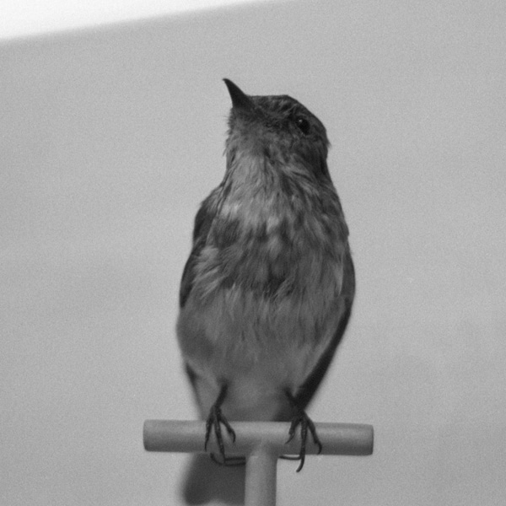

Bit Depth
24 bit image / 8 bits per RGB channel
(16 million possible values)
8 bit image
(256 possible gray values)
1 bit image
(2 possible values)

Slide 10
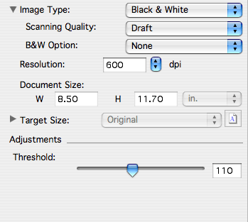
Threshold
When scanning bitmapped images, threshold
adjusts brightness & contrast of an image; density

Slide 11


Effects of Threshold`
threshold = 60
threshold = 100

Slide 12
Dynamic Range & Histograms
Dynamic Range is the range of tonal difference between the lightest light and darkest dark of an image. The higher the dynamic range, the more potential shades can be represented.
Histograms give a quick picture of the tonal range of the image, or the image key type. A low-key image has detail concentrated in the shadows; a high-key image has detail concentrated in the highlights; and an average-key image has detail concentrated in the midtones. An image with full tonal range has a number of pixels in all areas. Identifying the tonal range helps determine appropriate tonal corrections.

Slide 13
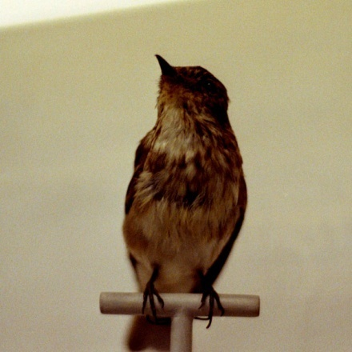
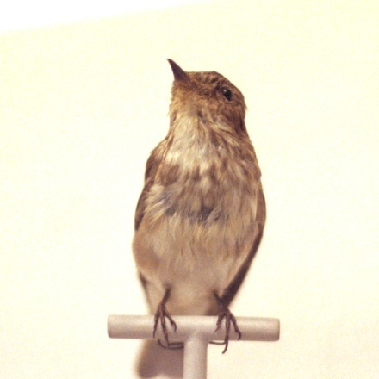
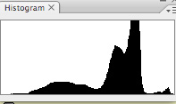
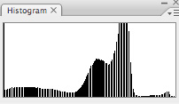
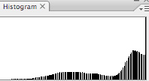
Histograms
A histogram also illustrates how pixels in an image are distributed by graphing the number of pixels at each color intensity level. The histogram shows whether the image contains enough detail in the shadows (shown in the left part of the histogram), midtones (shown in the middle), and highlights (shown in the right part) to make a good correction. Source: Adobe Help

Slide 14
Color Modes
A color model describes the colors we see and work with in digital images. Each color model, such as RGB or CMYK, represents a different method (usually numeric) for describing color.
A color space is a variant of a color model and has a specific gamut (range) of colors. For example, within the RGB color model are a number of color spaces: Adobe RGB, sRGB, ProPhoto RGB, and so on.

Slide 15
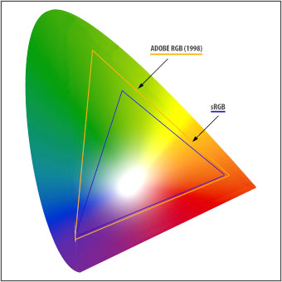
Color Spaces & Gamuts
Human eye can recognize wide range of color
Monitors can display a limited range of colors
Adobe RGB common in graphics applications
S-RGB common on internet & represents what most ink-jet printers can produce

Slide 16
File Formats
Master Files – TIFF standard / JP2 (can have lossless compression, such as LZW)
Access images - GIF and JPEG files are the most common (lossy compression)
Common Image File Formats http://www.library.cornell.edu/preservation/tutorial/presentation/table7-1.html

Slide 17
File Names
Meaningful / Pros | Meaningful/Cons | Non-meaningful / Pros | Non-meaningful / Cons
Easily Identifiable, esp. if separated from original collection | Long and inconsistent filenames Doesn’t sort easily If based on location or call #, risk of those identifiers changing over time | Sorts easily Not tied to a physical location | Hard to identify, should it get separated from original collection Requires database or tracking method (although this is generally recommended/required regardless)
Recommend: A hybrid approach- for example, sequentially
derived value combined with three-letter prefix identifying
collection (ex: ORN_0001.tif)

Slide 18
Methodology
Digitization
  One size does not fit all!
  Flatbed, sheet-feed, digital camera, bound-volume, microfilm, slide, etc.
Image quality
  Image enhancement & color management
  Archival vs. access
  Immediate needs vs. future considerations

Slide 19
Translating Analog to Digital
Step 1: Know your document
  Identify document’s key informational content
  Characterize and measure document attributes: detail, tone, color, other
  Consider other variables: lighting, variations in media

Slide 20
Important Document Attributes
Physical type, size, and presentation
Physical condition and testimony
Document type
Medium and support
Tone Reproduction
Color Reproduction
Detail

Slide 21
Translating Analog to Digital
Step 2: Know your needs
  Determine quality/performance objectives
  Consider both immediate and long-term requirements
  Balance competing factors:
    $, technology, users, protection of originals

Slide 22
Translating Analog to Digital
Step 3: Determine digital equivalencies and corresponding quality metrics
  detail size → resolution → tonal range → bit depth
  Utilize representative test targets (Macbeth Color Chart or Kodak grayscale target)

Slide 23
Physical Type, Size, and Presentation
Use of original or intermediate
Bound vs. single leaf
Physical dimensions

Slide 24
Physical Condition
Potential harm to originals
  Mechanical stress
    Strain on bindings, brittle paper, glass plates
  Light and heat damage
    Light sensitivity, chemical instability
  Competition between physical safety and good image quality

Slide 25
Protecting the Originals
Require on-site imaging and training
Use protective cradles and cool lights
Couple treatment and scanning
Sacrifice image quality

Slide 26
Physical Condition
Effect on conversion requirements
  Darkening pages, fading ink, burn-though, uneven printing, bleed-through, staining, foxing, buckling
  Requires grayscale or color
  Increases cost and file size

Slide 27
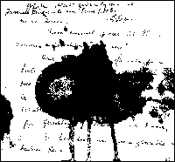
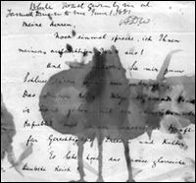
Bitonal vs. Grayscale Capture of Stained Manuscript
Bitonal scan
Grayscale scan

Slide 28
Document Classifications
A. Printed text
B. Manuscript
C. Halftone
D. Continuous tone
E. Mixed

Slide 29
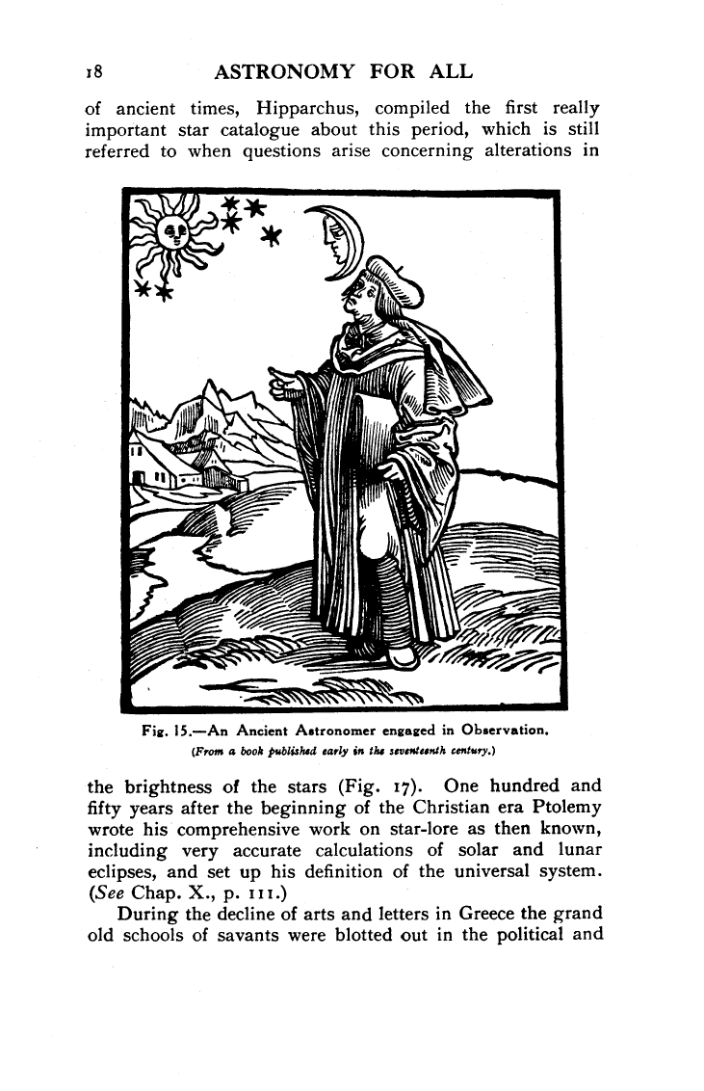
Printed Text
Machine produced, hard- edge representation
Digitization Challenges:
  using sufficient resolution
  capturing oversized documents with fine detail
  handling documents that are uneven, inconsistent, low density, varied tones, or mixed sizes

Slide 30
Characters Scanned at Different Resolutions

Slide 31
Defining Detail in Text
Some printed text requires tonal capture
  Pages badly stained
  Pages exhibit low contrast between text and background
  Fine features not fully resolved
  Pages contain complex graphics or important contextual information

Slide 32
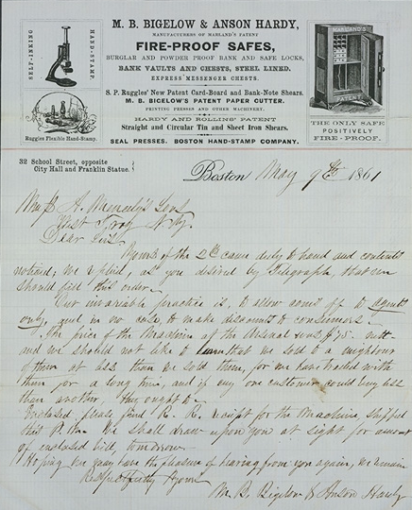
Manuscripts
Hand produced, soft-edge representation
Digitization challenges:
  determining informational content
  capturing an array of media (ink, pencil)
  lack of document consistency slows production

Slide 33
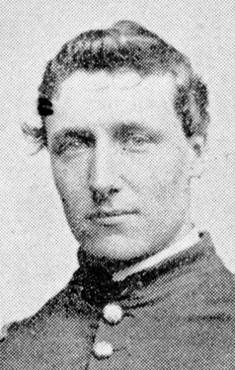

Halftones
Regularly spaced pattern of dots or lines

Slide 34
Halftones
Digitization Challenges:
  Overlapping grids
  Requires additional image processing or greater resolution/bit depth
  Moiré can result at point of capture and at point of presentation

Slide 35
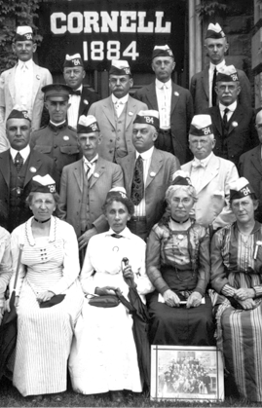
Continuous Tones
Smoothly varying shades
Digitization challenges:
  reducing random, continuous information to samples
  representing color, detail, and dynamic range
  balancing capture requirements against file size

Slide 36
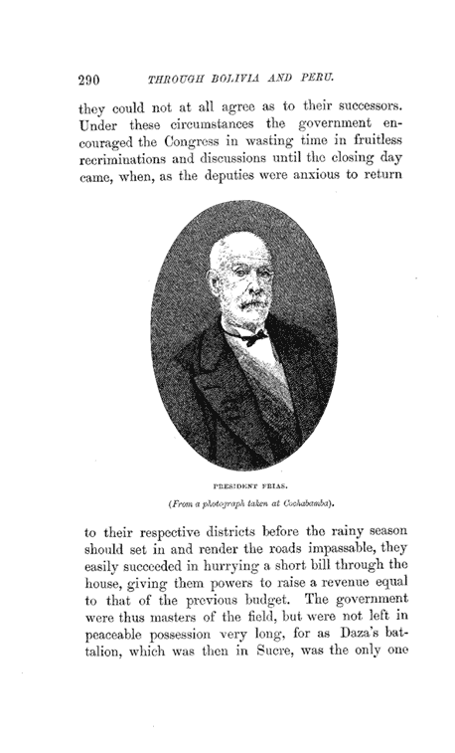
Mixed Documents
Representing more than one category
Digitization challenges:
  complexity of information increases conversion or enhancement requirements
  narrows range of equipment choices
  increases scanning costs/times

Slide 37
Post-digitization
Quality control
  Determine scope and methods
  Procedures and tools
Image processing
  Derivative creation
    Static or multi-resolution formats
    On-the-fly conversion
    Onscreen image quality

Slide 38
Quality Control
Key factors in image quality assessment:
  Resolution
  Color and tone
  Overall appearance
Procedures
  Consistent approach
  Defined scope and methodology
  Control QC environment

Slide 39
Recap: Aligning Document Attributes with Digital Requirements
Identify key document attributes
  Tone, color, and detail
Characterize them, if possible through objective measurements
Determine quality requirements and tolerance levels
Translate between analog and digital and between scanning requirements and scanning performance

