Slide 1
Project Planning

Slide 2
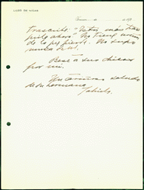
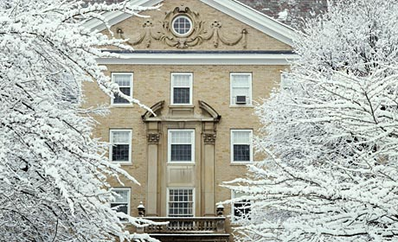
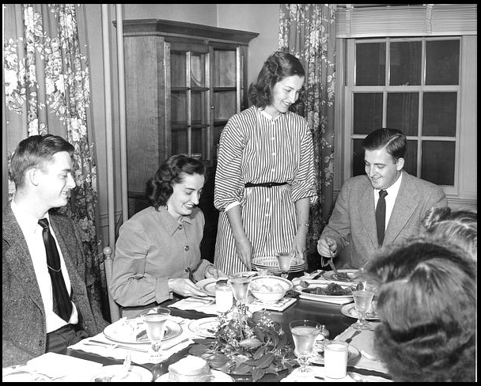
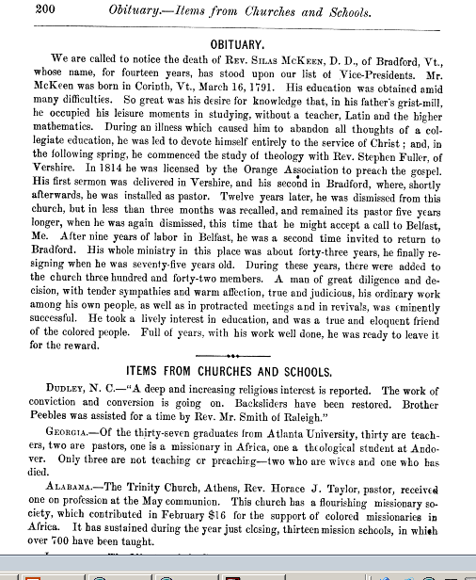

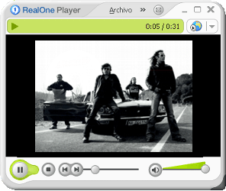

Slide 3
Needs Assessment and Decision-Making
Document type
Condition
Metadata attributes
Selection criteria
Usage restrictions
Relation to other collections
documents
User requirements
Use type
Frequency of use
Use mode
Support needs
users
Staff and skills
Systems, hardware, software
Stakeholders
Organizational guidelines
Master plans and strategies
resources

Slide 4
Plan
Update
Select
Archive
Copyright
Store
Prepare
DRM
Life Cycle
Digitize
Publicize
Process
Assess
Metadata
Deliver
System
Interface

Slide 5
Guiding Principles, Part I
  Prepare a project plan and adhere to the principles of good project management
  Get the support of all key stakeholders
  Make sure that you have the necessary resources – both staff skills and funds
  Be realistic in your estimates for timeline & budget
  Establish clear lines of communication

Slide 6
Guiding Principles, Part I
  Define roles & responsibilities, but avoid single points of failure
  Document all aspects of the project in central space accessible to all
  Secure institutional support for preservation projects before starting
  Consider life cycle issues

Slide 7
Phase I- Set the Stage
Define Goals, including
  Desired outcomes for source material
  Functional requirements for digital assets
Determine selection criteria
Assess copyright
Assess physical characteristics of material
Define audience; establish use cases
Determine preservation plan
Secure funding

Slide 8
Define Goals of Project
  What are the benefits to having the material digitally available?
  Is your main goal to make the material more widely available (access) ?
  Are you looking to replace or supplement originals (preservation)?
  Are you looking for both access & preservation?
  How will it fit your overall organizational goals?

Slide 9
Define outcomes
    Desired outcomes for the source materials
      Do you want to limit future access to source materials?
      Do the objects need conservation treatment?
    Functional requirements for the digital reproductions
      What kind of access do you need to provide to the material?
      How will the material be used?

Slide 10
  Different goals/outcomes determine scope of digitization project, for example:
    Access-only digitization
      may lower scanning requirements
      require less long-term planning (depending on project)
      lower overall costs of project
    Preservation digitization
      will require a robust archiving system
      may require conservation treatment
      may increase your scanning requirements (higher dpi, etc)
      will require institutional support

Slide 11

Determine Selection Criteria
Support learning, teaching, and research
Increased accessibility
Exhibitions/publications
Space savings
Promoting collections
Support new forms of use
Preservation
  Reduce wear and tear
  Reformatting tool

Slide 12
Assess Copyright
Understand copyright limitations
  Digitization
  Access
  Preservation

Slide 13

Review Physical Characteristics
  Handling requirements
  Conservation requirements
  Determine format (slides/ negatives/monographs, etc)
  Color
  Size
  Quality (will influence dpi)

Slide 14
Assess Collection Metadata
Any existing metadata that can be utilized?
Collection or item level data?
What are the discovery, search, and preservation requirements?
What schemas and standards will you use?

Slide 15
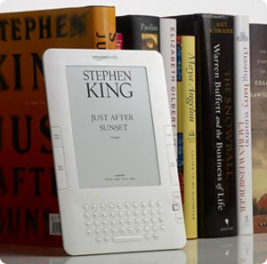
Define Audience
  Consider possible use cases
  Explore delivery options based on user needs
  Explore metadata options based on user needs

Slide 16
Determine Preservation Strategy
  Long-term preservation - Continued access to digital materials, or at least to the information contained in them, indefinitely.
  Medium-term preservation - Continued access to digital materials beyond changes in technology for a defined period of time but not indefinitely.
  Short-term preservation - Access to digital materials either for a defined period of time while use is predicted but which does not extend beyond the foreseeable future and/or until it becomes inaccessible because of changes in technology.

Slide 17
Secure Funding
  Possible sources: grants, foundations, special interest groups
  Consider long-term maintenance costs
  Establish institutional commitment beforehand

Slide 18
Phase 1 Documentation
Goals / Outcomes
Selection Criteria
Rights
Physical condition (assessment)
Metadata assessment
Audience / Use cases
Preservation Strategy
Funding

Slide 19
Phase 2: Scope the Project
Determine material requirements,
including conservation needs
Set Imaging Parameters
Define Master vs. Access Images
Determine Quality Control Metrics
Determine Storage Requirements
Set Metadata & Access Requirements
Determine Delivery Method
Establish Preservation Plan
Project Assessment

Slide 20
Preparation
Conservation
Disbinding
Tagging
Organizing physical volumes, slides, etc.
Safe handling and storage directions
Metadata analysis

Slide 21
Digitization
Benchmark image requirements–
align technical requirements to project goals
  Resolution / PPI-DPI
  Bit-depth
  Threshold
  Color Space / Color Profiles
  File Formats
  Compression Techniques
  File naming

Slide 22
Image Processing
  Master vs Access Files
    Resolution
    Color space
    File formats
  OCR
  Derivative creation
    Static or multi-resolution formats
    On-the-fly conversion
    Batching

Slide 23
    Scanning Methodology
  Capture device
    One size doesn’t fit all- flatbed, overhead, bound book, slide/film scanner
  Scanner settings
    Document type
    Exposure (auto exposure or no?)
    Quality
    ICE or ROC?
    Color management (on or off?)

Slide 24
Quality Control
Key factors in image quality assessment:
  Resolution
  Color and tone
  Overall appearance
Procedures
  Consistent approach
  Defined scope and methodology
  Control QC environment
  Automated & Manual
  Early detection important

Slide 25
Define Metadata Parameters
Metadata types
  Descriptive, structural, administrative, preservation, technical
Metadata standards
  e.g., Dublin Core (DC), Open Archives Initiative (OAI), Persistent URL (PURL), Encoded Archival Description (EAD), etc.
Capitalize on existing metadata!

Slide 26
Determine Access
Mechanism
  Delivery options
    Content DM, DSpace, Greenstone
  Levels of permission and access
  Search mechanism
  Out-of-the-box vs. customized platforms

Slide 27
Preservation
Technical strategies
  Bit preservation
  Refreshing
  Migration
  Emulation, technology preservation, digital archeology
Organization strategies
  Policies and best practices
  Technical and organizational infrastructure
  Funding and staffing
  Technology forecasting and risk assessment
  Securing institutional support!

Slide 28
Determine Budget
  Conservation requirements
  Digitization costs
    Equipment/Software
    Collating/ organizing material
    Scanning
    QC
    Post-processing
    Storage
  Metadata
    Staff
    Software
  Project Management
    Staff
    Software
  Consider long-term maintenance costs

Slide 29
Determine Budget, cont.
On average*
  One third of the effort will be project planning, preservation preparation, management, and oversight
  One third of the effort will be archival description and indexing
  One third of the effort will be the actual digitization
  The actual percentages of time spent on various activities will vary depending on the project
* From Federal Agencies Digitization Guideline, Digitization Activities, Project Planning & Management Outline

Slide 30
Project Assessment
Evaluation
  Plan for outcomes assessment
  Conduct usability and functional testing
  Conduct interface and robustness evaluation
  Refer back to original project goals

Slide 31
Phase 2 Documentation
Material Preparation
Digitization Settings
Image Processing
Quality Control Metrics & Methods
Metadata & content management
Access
Preservation
Budget
Assessment

Slide 32
Success Principles
Conduct needs assessment analysis
Plan for various stages of your initiative
Make time for ongoing assessment
Balance access and preservation needs
Integrate with your technical infrastructure

