Slide 1
AguaClara Advisory Council Meeting
March 5, 2010
Monroe Weber-Shirk

Slide 2
Introductions
What draws you to AguaClara?
What else in your life sparks your interests?

Slide 3
Philosophy…
Connecting with meaning and what motivates us
- A pedagogical experiment
And one example…
Surround yourself with people who can dream

Slide 4
Overview of the day
9:00 – 9:55 State of AguaClara (Monroe)
10:00 Update from Honduras (Dan Smith)
11:00-12:00 University Context (Alice Pell)
12:15 Lunch at Aladdin’s with students
1:30 Meeting with students – reflections
2:30 Meeting with Phil Liu to discuss context and constraints in CEE
3:00 Strategy for the next year
3:30 Wrap up – Summary recommendations and action plan

Slide 5
State of AguaClara
Technology & Educational Advances
5 plants - 15,000 customers
Proven technology
Transition from focus on product development to product development AND dissemination
Dissemination efforts
Team Growth at Cornell

Slide 6
Technology Advances
5 years ago there weren’t ANY non electric options for communities of less than ~10,000 people that could treat water with turbidity greater than 300 NTU
Conventional wisdom says filter turbid water
AguaClara says floc/settle turbid water
We turned conventional wisdom upside down

Slide 7
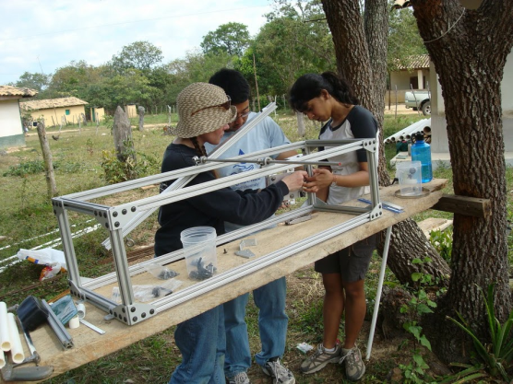
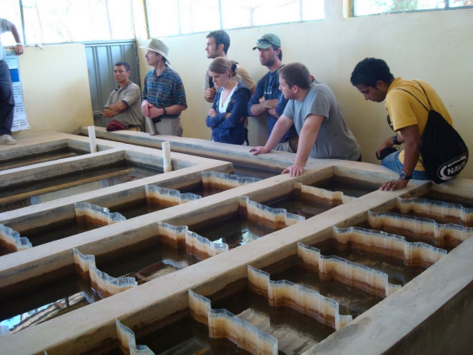
Technology Advances
Chemical dosing
Flocculator design – reversed conventional wisdom on when to use horizontal flow and when to use vertical flow
High rate sedimentation in shallow tanks
Floc blankets

Slide 8
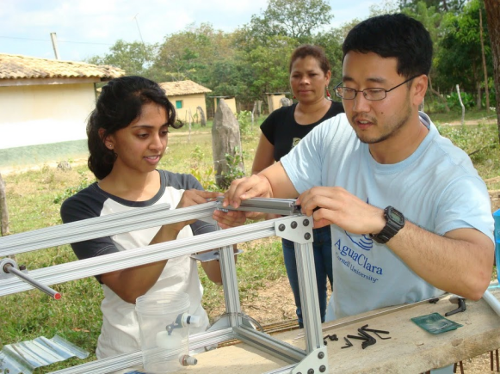
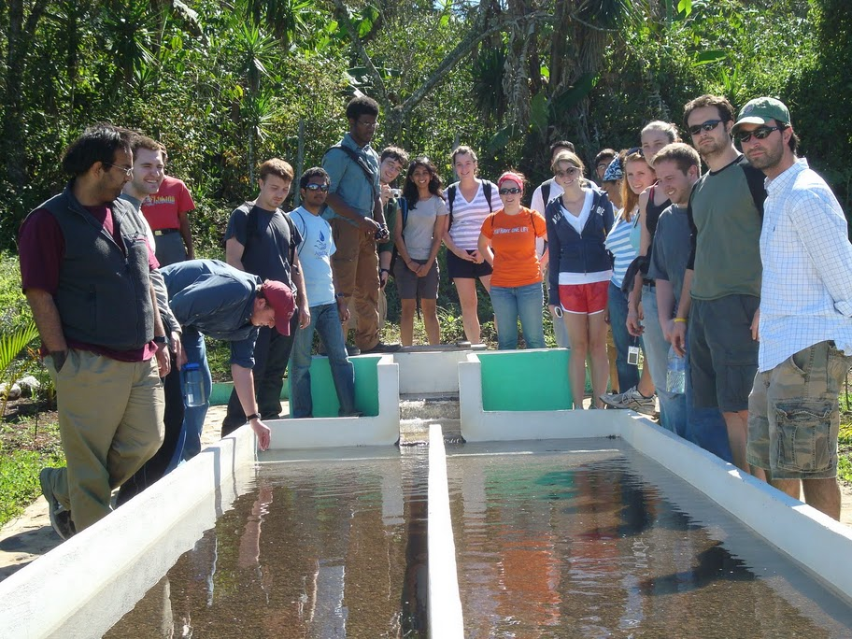
Educational Innovations
Mentor-apprentice roles with students across the spectrum of experience working together
Breaking the barrier between research and education
Connecting research and design to real world application

Slide 9
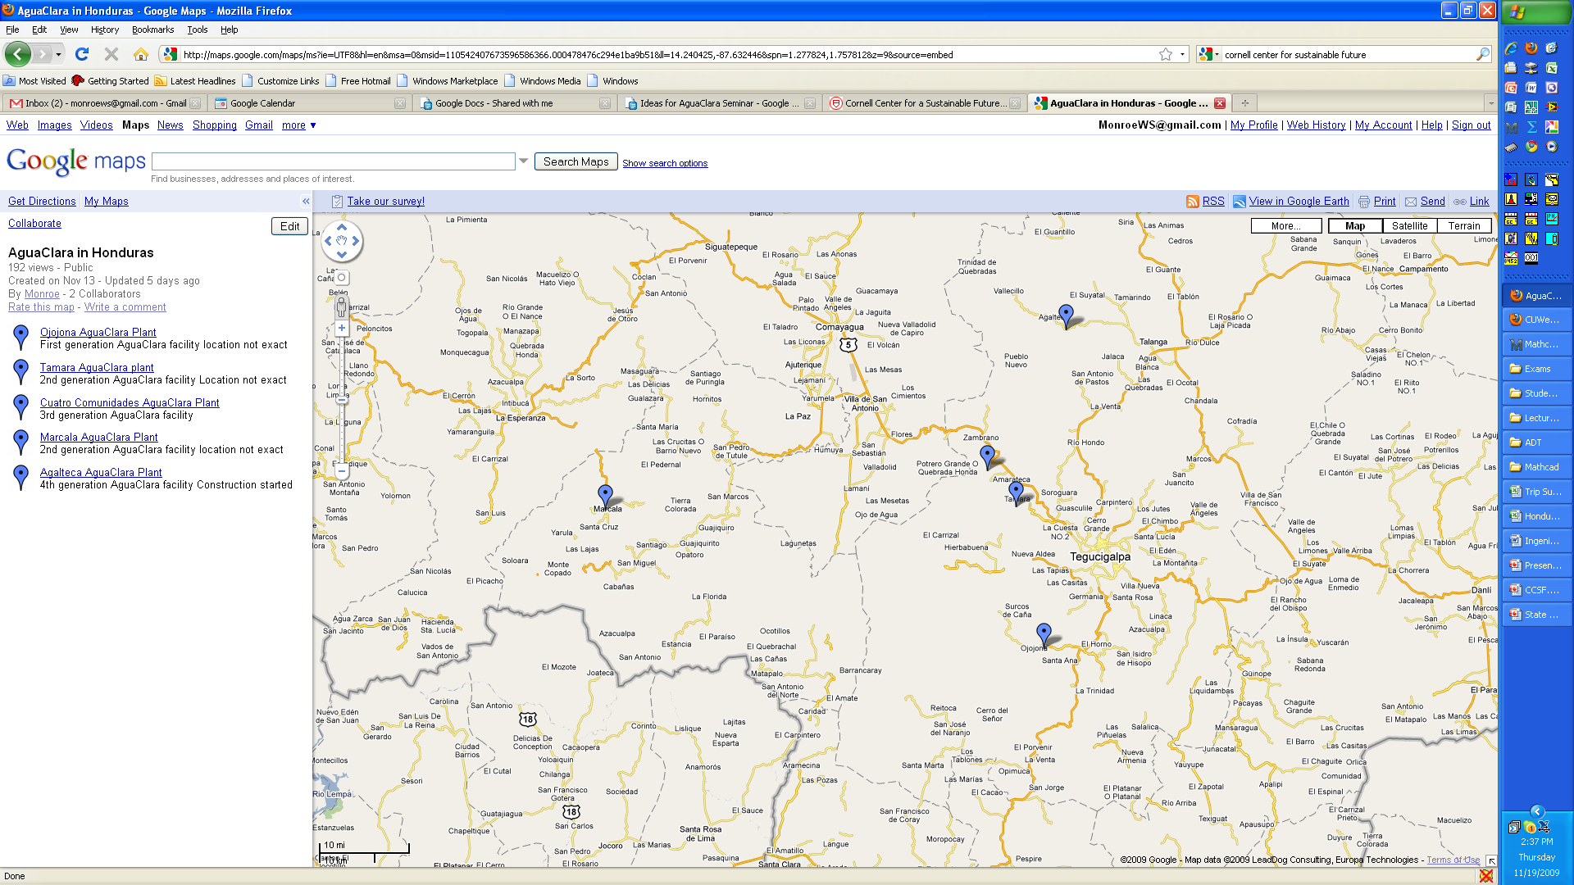
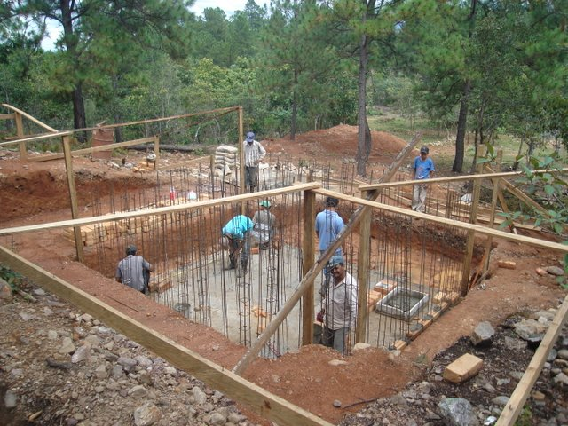
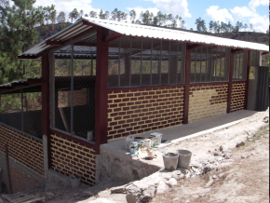
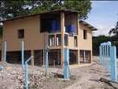
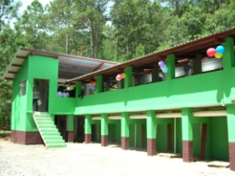

AguaClara in Honduras

Slide 10
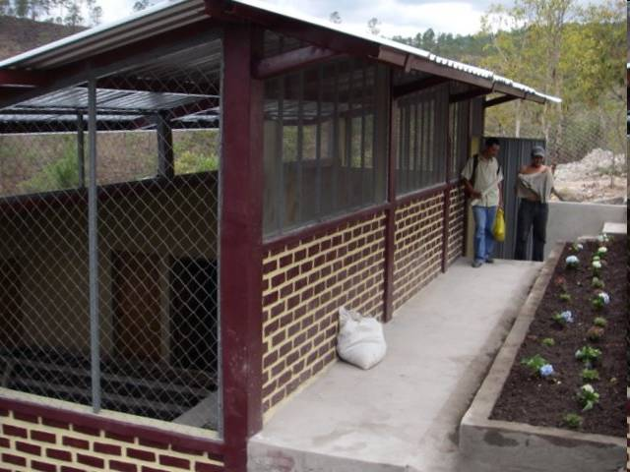
Cuatro Comunidades

Slide 11
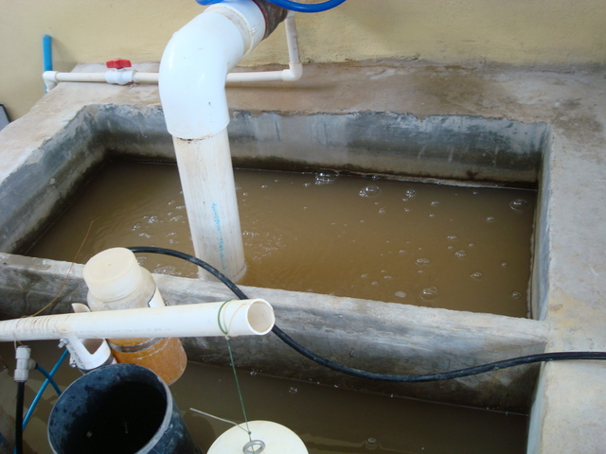
Raw Water (Entrance tank)

Slide 12
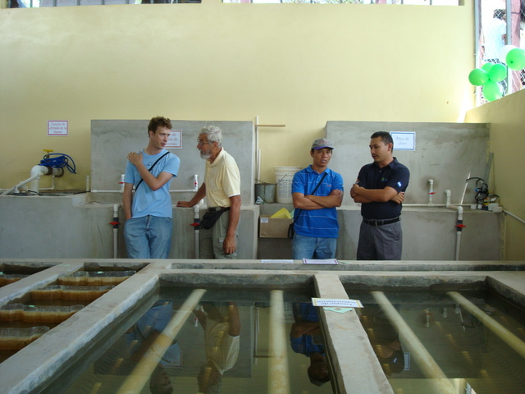

Slide 13
5 plants – 5 years – 15,000 people
Building our reputation
Proving that this new approach works
Creating the knowledge base required to improve the designs
Automating the design algorithms

Slide 14
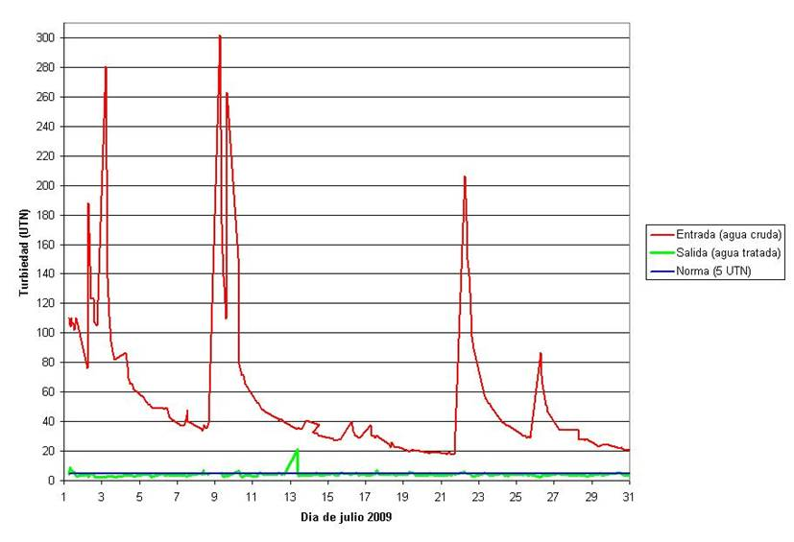
Turbidity Removal: Cuatro Comunidades – July 2009
87.6% of the treated water samples from July 2009 had less than 5 NTU. Raw water turbidity varied between 18 y 302 NTU
Fuente: datos del operador

Slide 15
AguaClara: 4 key ideas
Innovative Design of Municipal Scale Drinking water treatment plants
Free design service – going to a fully automated online client server model (delivering detailed customized designs)
Partnership model – each partner contributing from their expertise
Scalable – replicable dissemination model

Slide 16
AguaClara: 4 key ideas
Resilient and Sustainable Infrastructure
Open Source Design
Partnerships - synergy
Viral spread of the knowledge

Slide 17
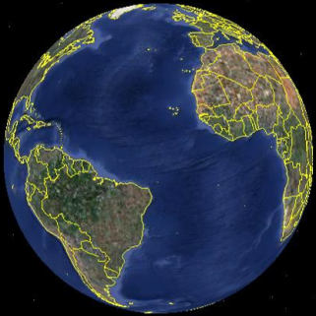
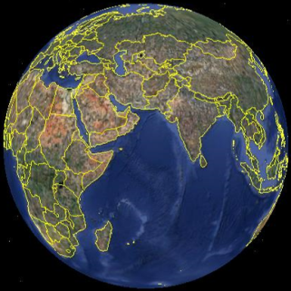
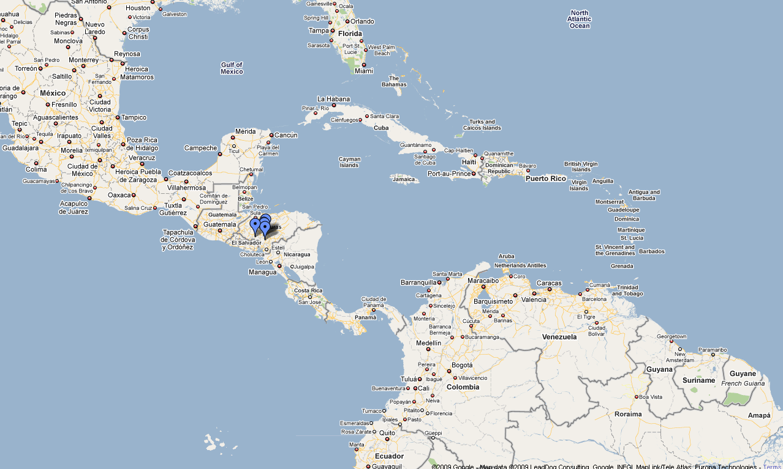
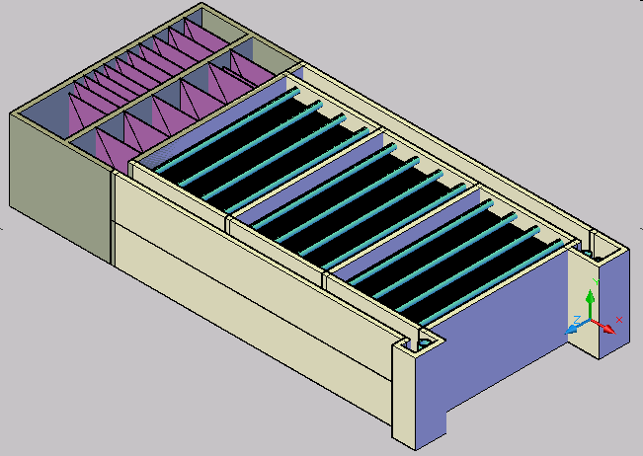

Project Expansion

Slide 18
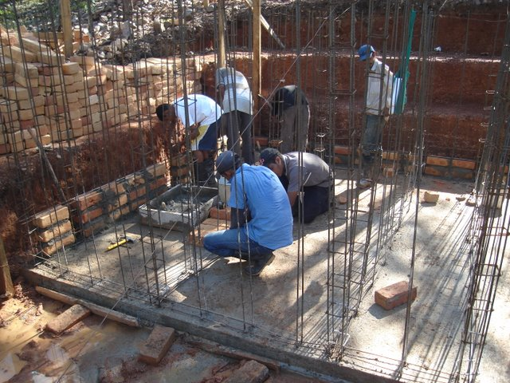
Sustainability
Local materials
Local labor
No electricity or
fossil fuels
Designed with the
operator in mind
Community pays for the chemicals and plant operator

Slide 19
Dissemination Model
AguaClara provides the technology and an online automated design service
Implementation Partners take those designs and work with communities to implement (structural and site design/build/train/operate/transfer)
Implementation Partners share knowledge and train new implementation partners so the spread can be viral

Slide 20
Product Development AND Dissemination
Design specifications report
Error checking on design
Design Review
Increased professionalism
Procedures for implementing innovation including working on design enhancements with a single partner before widespread release

Slide 21
Why is this going to go viral?
Powerful latent demand for clean water by populations that previously assumed they couldn’t afford it
We’ve proven that even communities as small as 1500 can sustain a plant

Slide 22
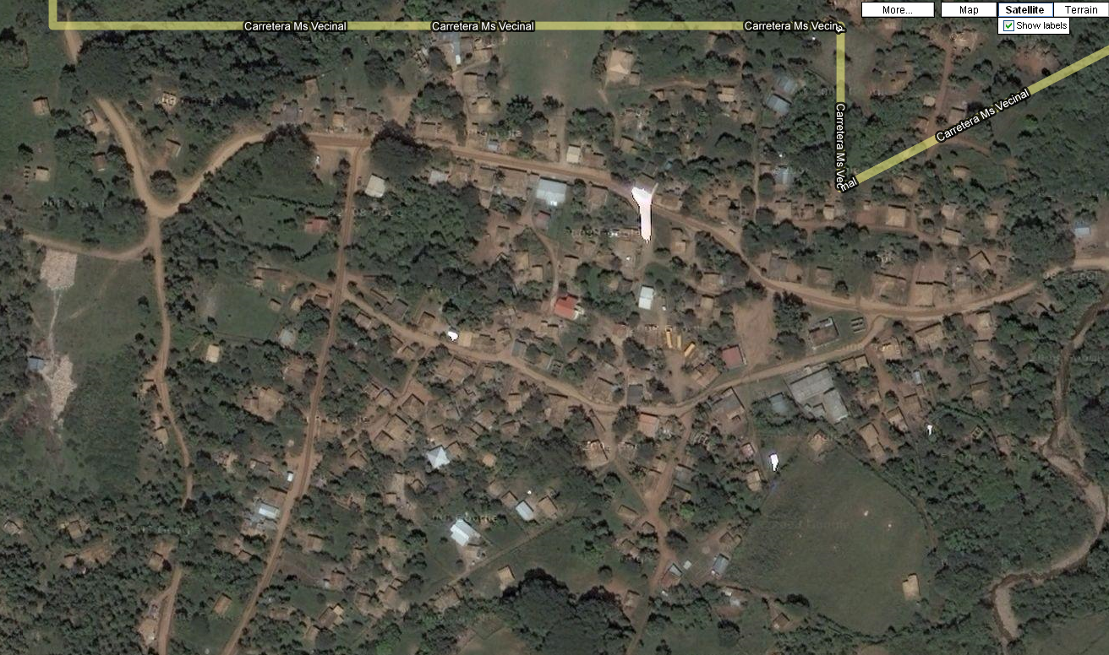
Agalteca – 2000 People

Slide 23
Dissemination Efforts
APP is our most effective lobbying firm
Dan will talk more about efforts from Honduras
Meeting with CARE representatives at Cornell yesterday
Contact with Costa Rica Water and Sewer
Plans to offer a short course in Guatemala in June 2010

Slide 24
Team Growth
Team Project
Theory

Slide 25
Undergraduates in CEE: The Available Pool is Large!
Undergrads in AguaClara

Slide 26
Reflections

Slide 28
Conference Call with Dan Smith
10:00 to 10:55

Slide 30
Meeting with Alice Pell
11:00 to 12:00
Cornell Strategic Plan
Connections to AguaClara
Status of competitive teams at Cornell
Alice Pell

Slide 31
Cornell Strategic Plan (Draft)
Objective 5: Make public engagement a distinctive feature of education at Cornell. [Rationale: Cornell has a unique capacity to interweave public engagement with its educational and research programs for students, given its status and history as a private University with a Land Grant mission. The integration of fundamental science and application, of knowledge and its use for the public good should be a distinguishing feature of Cornell programs.]
a. Explore and assess whether or how “engaging the world” can become a more integral component of educational programs across campus.
b. Strengthen the participation of faculty and faculty leadership in public engagement programs available to students.
c. Ensure that it is easy and efficient for students to become aware of and access information about public engagement opportunities (e.g., service learning, internships) that serve their educational goals.
d. Develop better institutional mechanisms for coordinating off‐campus, nonclassroom teaching and field‐based or service learning opportunities for faculty and students.
e. Evaluate the organizational structures through which Cornell makes available internships, educational work opportunities, and other off‐campus learning to determine how they can be improved.
Alice Pell

Slide 32
Cornell Strategic Plan (Draft)
“Strengthen the educational impact of international opportunities and experiences for students.” (page 5)
“Make public engagement a distinctive feature of education at Cornell” (page 6)
“Encourage faculty to experiment with new pedagogies (e.g. field-based learning) and new technologies,…” (page 8)
“Promote and support educational innovations beyond the classroom (e.g., service learning), …” (page 9)
“Strengthen the educational impact of international opportunities and experiences for students.” (page 9)
Alice Pell

Slide 33
Discussion Questions
What is your personal vision for where AguaClara could evolve to?
Are there aspects of the AguaClara program that Cornell would like to see replicated?
How does “Day Hall” perceive AguaClara?
How could AguaClara be evaluated to ensure that it is well managed and effective?
What does “encourage, promote, support” mean in the near term?
Alice Pell

Slide 34
Other Teams at Cornell
CUSD – was Solar Decathlon – now is Sustainable Design
  Students are looking for a new model that is not competition based
MAE team projects will potentially be cut due to less support from industry
AguaClara provides a completely different model for team based projects.
Alice Pell

Slide 36
Meeting with Students
What drew you to join the AguaClara team?
What are your dreams for AguaClara?
What do you see as challenges/opportunities for AguaClara?
What could improve the experience or the educational value for you?
Reflections on team growth?
Students

Slide 38
Meeting with Phil Liu
What are your dreams for AguaClara?
How does AguaClara connect (or not connect) with the mission and vision of CEE?
What are the concerns or constraints that you perceive as being significant for the AguaClara project?
  the student trip to Honduras
  the blending of research and teaching and the associated administrative difficulties
Phil Liu

Slide 40
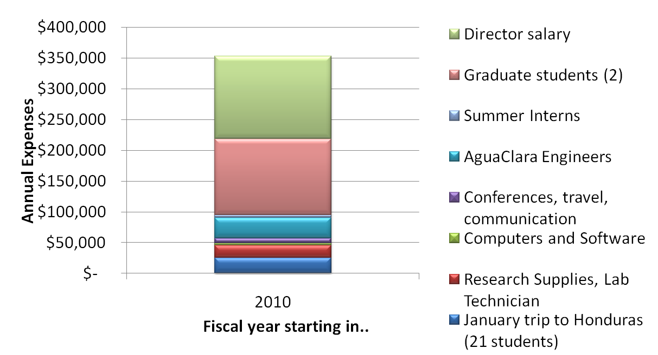
Expenses

Slide 41
Funds for next year
Sanjuan Foundation
EPA P3 $75k proposal (will apply)
NSF funding for two grad students (submitted)
CEE, College, University?
Other strategies for fundraising?

Slide 42
Strategy for the next year
Summer intern at Cornell (Design Team leader who will train new design team during summer and again in the fall) ($3-5k)
AguaClara Engineers (3 applicants at $1150/month, Dan Smith at $1500/month)
Honduras trip 21 students for $25k – should we change the model and require students to pay more of the trip?

Slide 44
Summary recommendations and action plan
Dissemination
Team Growth
Budget
Broader Faculty Base
Challenges of Senior Lecture Status

Slide 45
Dissemination
Technology dissemination strategy as we take steps to move beyond Honduras
Dissemination phase challenges
  We need a high level of professionalism in our engineering work as we begin providing designs to multiple clients.
  Do we need professional staff that would perhaps be part of a new AguaClara organization to review designs and to provide guidance to new implementation partners?

Slide 46
Team growth at Cornell
What is the target size for the team?
If the team grows beyond the target size, what mechanism would we use to limit enrollment
  We are exploring options for acquiring more research space.
  It will not be possible to take all active team members to Honduras (limited to 21 students currently) unless we restructure that trip.

Slide 47
Project space
Project growth has been manageable to date, but we will be challenged to provide adequate research space next year. This year we are “borrowing” the environmental teaching lab during the spring semester. Next year that space will be used by other lab courses.
I have initiated a conversation with Phil Liu and Joe Rowe (chair and administrative manager of CEE, respectively) concerning possible spaces that we could grow into. All potential lab spaces will require some upgrades to be prepared for use by the AguaClara research teams.

Slide 48
Professional AguaClara Organization
Continuity of knowledge
More attention can be given to the project by one person
Less potential for flawed designs
Ease Monroe’s overload
Enhance reputation of project
Cut some of the restraints imposed by having the project be part of Cornell
Allow graduates to continue doing something they love

Slide 49
AguaClara budget - Strategy for securing stable funding
Are there elements of the budget that should be reduced or expanded?
For example, AguaClara Engineering program – should it grow as we begin collaboration with new partners?
How might we achieve a more stable funding base?

Slide 50
Broader Faculty Base
The project is completely dependent on me
I would like the project to be able to continue even if I am not able to direct it

Slide 51
Expanding the AguaClara Advisory Council
Ken Brown April 2008 - April 2011
Larry Harrington April 2008 - April 2011
Len Lion October 2009 - October 2012
Chris Barrett

Slide 52
Next AguaClara Advisory Council Meeting
Yearly?

Slide 53
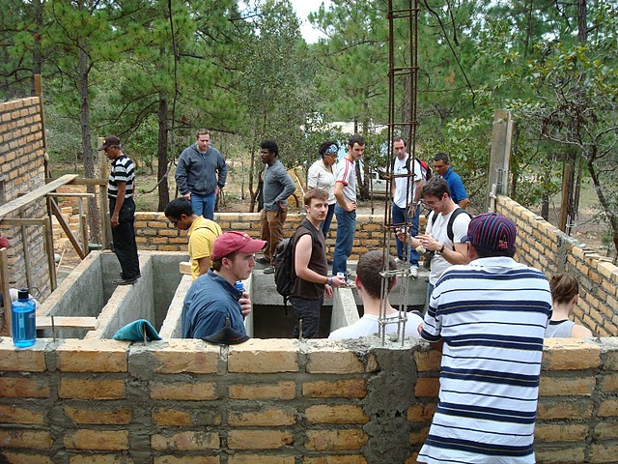
Thank You!

