Slide 1
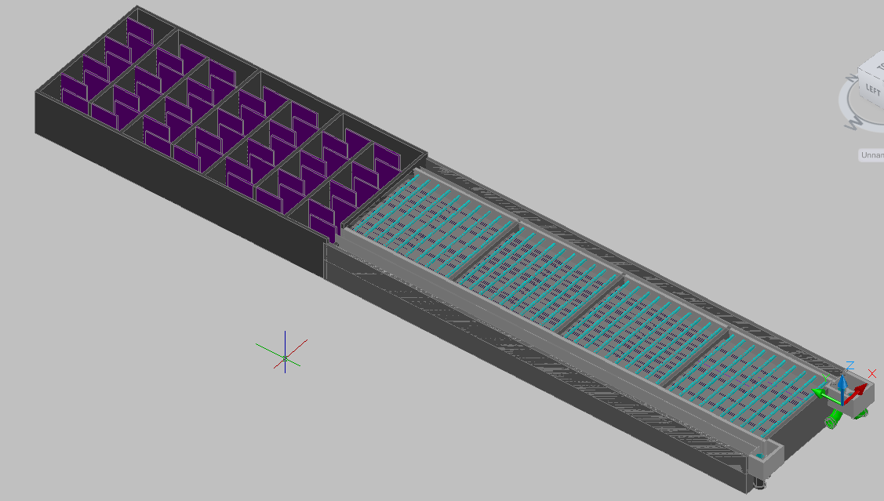
Design Teach In
Spring 2010

Slide 2
Outline
Chemical Storage Tanks: Jon Miron
Entrance Tank and Rapid Mixer: Jeff Katz
Flocculator: Jeff Will, May Sharif, Julie Pierce
Inlet Channel and Manifold: Rami Bechara
Pipe Frame and Lamella: Trang Pham, Mike Liu
Launder: Nanditha Ramachandran, Massielle Begazo
Exit Channel: Rami Bechara
Inlet and Exit Tanks: Andrew Sargent, Andrew Hirshfield
Materials List: Josh Nougaret, Olivia Harris
Documentation: Josiah Pothen, Andrew Smith, Tai Kim
Design Tool: Heather Reed

Slide 3
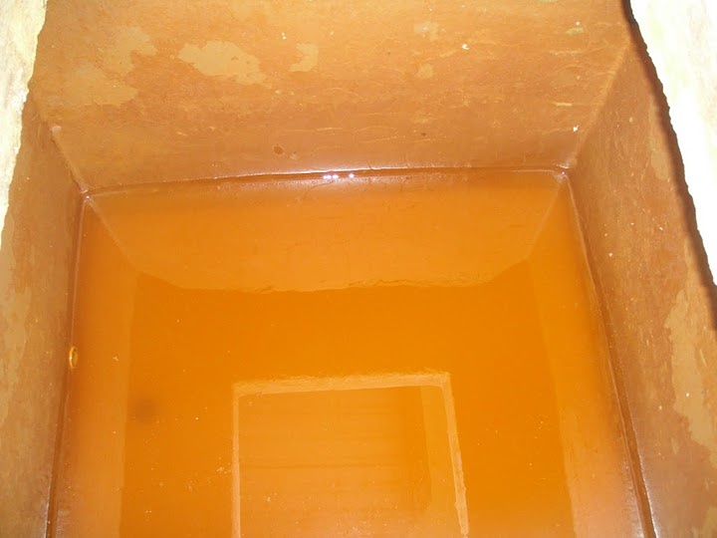
Chemical Storage Tank
What is it?
  Stores Alum used in the plant
Task 1: Add ability for the user to input stock concentration, max alum dose, and minimum tank duration to calculate the size of the tanks

Slide 4
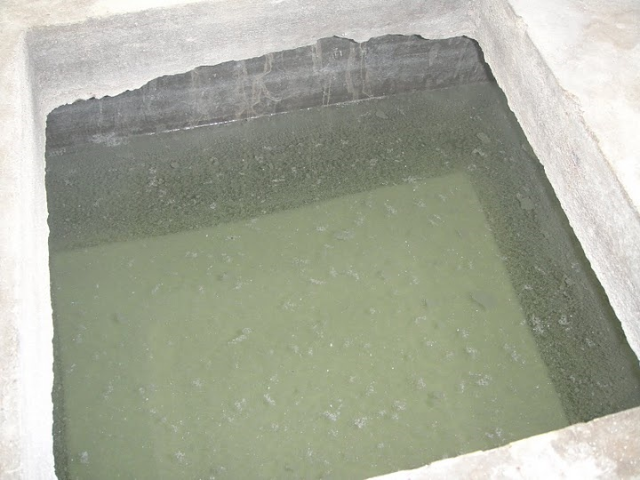
Chemical Storage Tank
Task 2: Draw chemical storage tank at correct elevation

Slide 5
Chemical Storage Tank
Task 3:Draw pipes connecting the storage tanks to the float valve using MathCAD and AutoCAD
  Include a T in a horizontal section of the line with a drain valve that can be used as a sediment trap to reduce the amount of sediment that gets to the float valve orifice

Slide 6
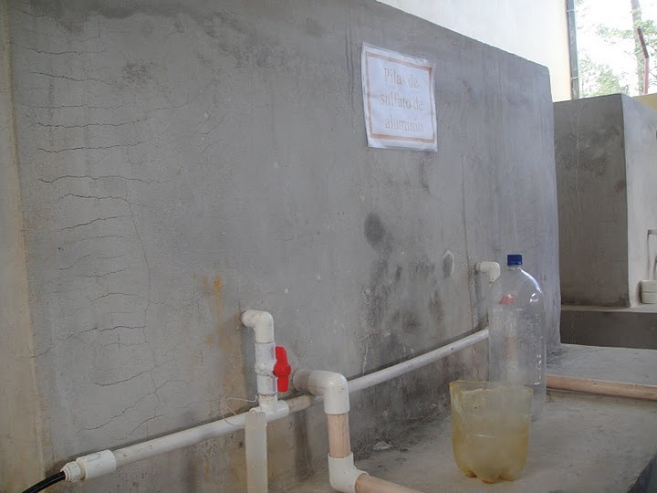
Chemical Storage Tank
Task 4: Add drain lines connected to the very bottom center of the tanks that go to the drain line for the entrance tank and ultimately to the plant drain channel

Slide 7
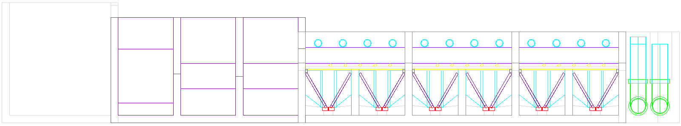
Entrance Tank and Rapid Mixer
Entrance Tank
Rapid Mix System
Well… not exactly.
Image: Monroe’s Rapid Mix ppt

Slide 8
Entrance Tank, what art thou?
Start of our system
Separate channel before the flocculator, same size as single floc channel
Key to the entrance tank: WATER LEVEL
  Requirements for rapid mix
  Head loss throughout system
Grit chamber

Slide 9
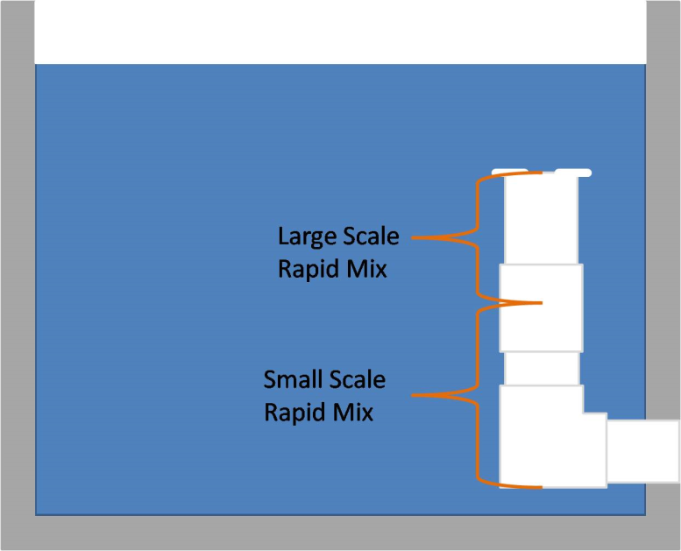
Rapid Mixer, what art thou?
Goal: Distribute alum evenly and achieve small-scale mixing (molecular scale) through raw water
This is now a pipe and orifice system in the entrance tank
Image: CDC

Slide 10
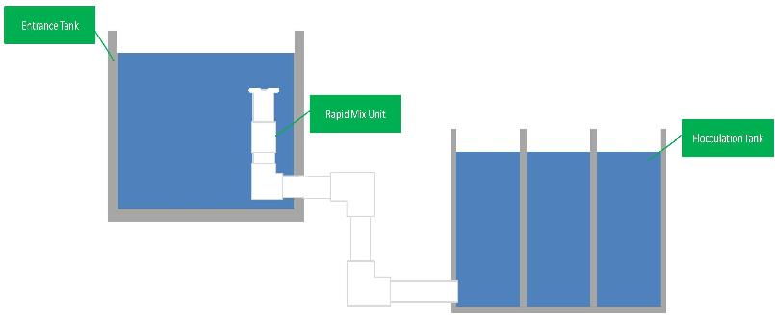
Entrance Tank and Rapid Mixer
10 cm freeboard
Height of weir
at end of tank
40 cm
of water .. To be safe
Need not go to bottom of flocculator
(not to scale)
Image: CDC

Slide 11
Entrance Tank and Rapid Mixer
First, height of the rapid mix system is set
Next, height of water above the entrance tank is determined. This height drives the system. There is 10 cm of freeboard above this.
Micro-mixing orifice designed to provide 40 cm of total plant head loss

Slide 12
Rapid Mixer
Looking to determine pipe size, diameter of macromixing and micromixing orifices, and the number of micromixing orifices
Several assumptions made:
  K_{e} = 1.3
  Circular orifice
  Head loss at maximum plant flow will need to be 30 to 50 cm
  Pipe sizes available
  Pipe length = 2 m
  Energy dissipation rate for micromixing
    ε = 1 W/kg
Not for long

Slide 13
Macromixing Orifice
The macromixing orifice will play a large role in determining the micromixing orifice.
The head loss for the micromixing system will simply be determined by the total head loss required (assumed to be 50 cm), less the head loss determined for the macromixing orifice.
Notes:
Equation is basis of iterative function that return the diameter of the macro-mixing pipe based on available pipe options, plant flow, constraints for macro-mixing head loss and total head loss desired

Slide 14
Micromixing Orifice
Head loss determined for micro-mixer might not actually correlate to a usable diameter, so head loss is plugged and the diameter function is iterated to make sure minimum diameter achieving appropriate head loss is met

Slide 15
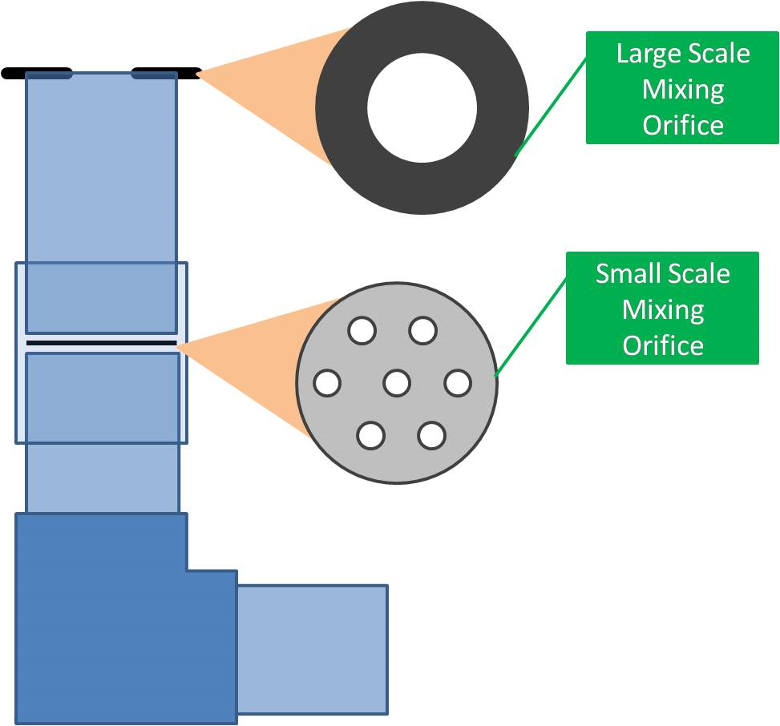

Slide 16
Next Steps
Allow “height” of bottom of entrance tank to be chosen
Integrate with AutoCAD to draw all of this

Slide 17
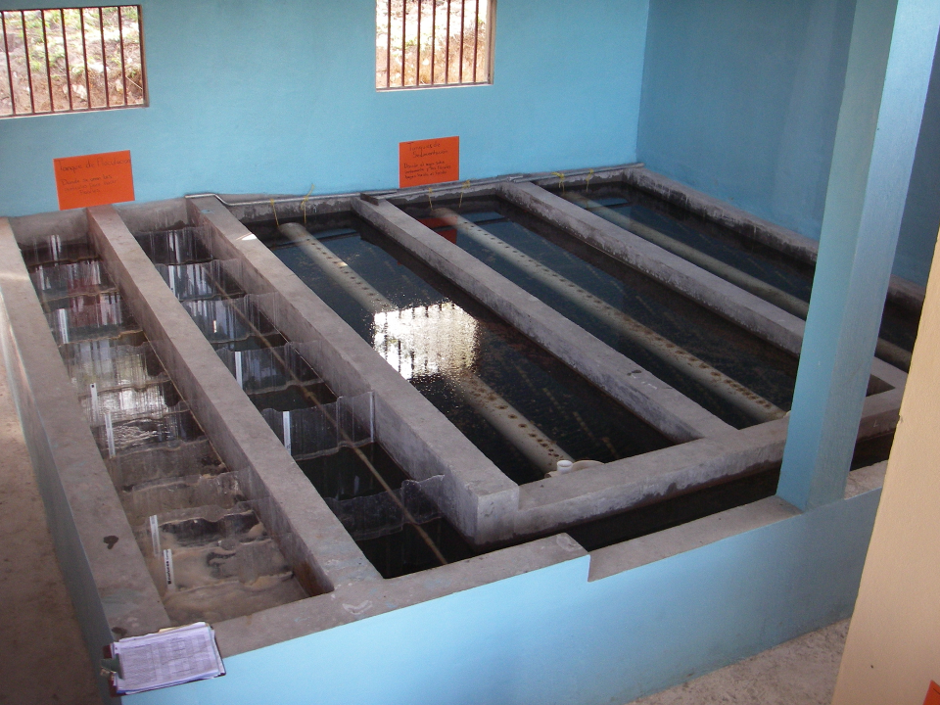
Flocculation

Slide 18
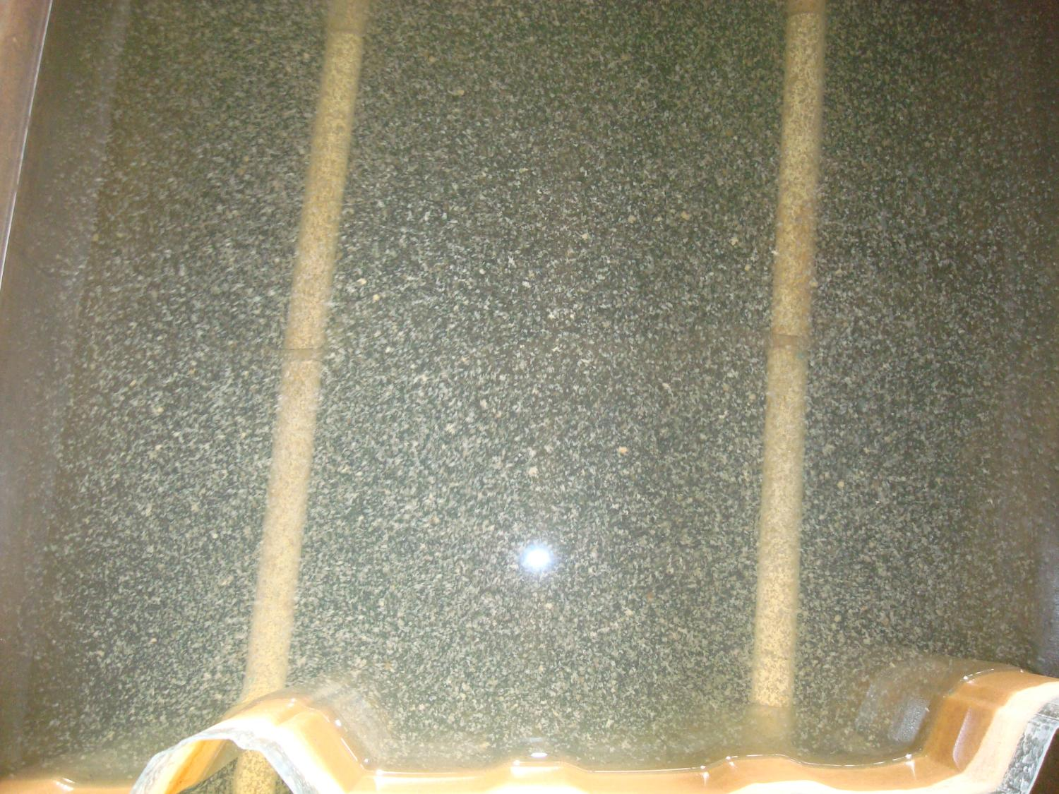

Slide 19
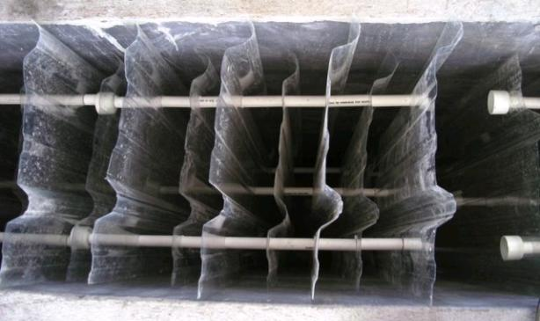
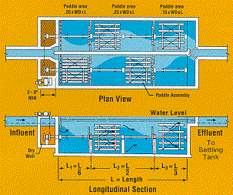
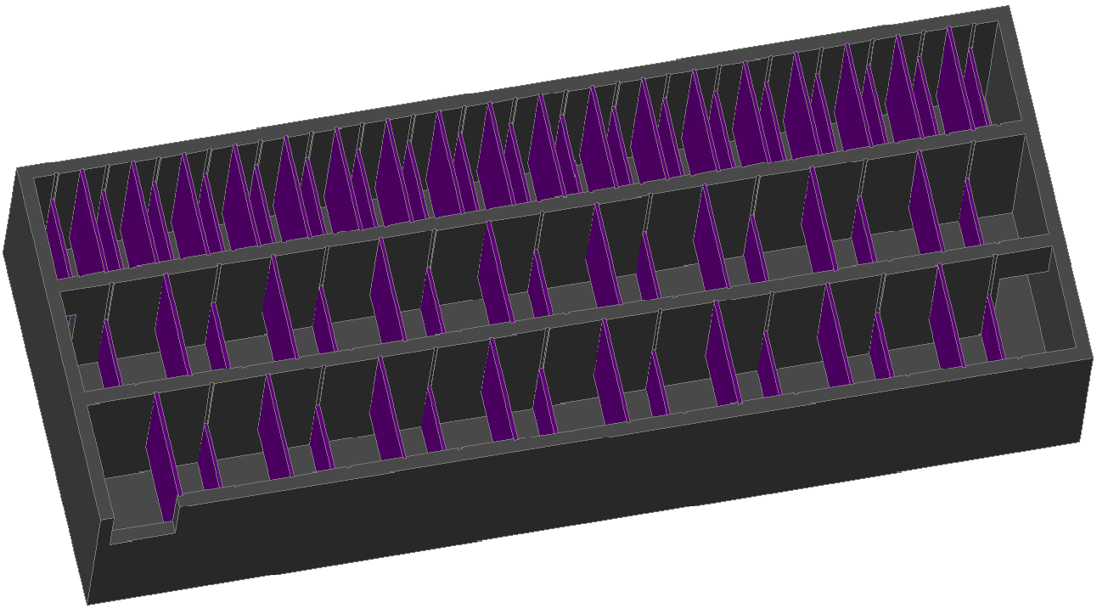
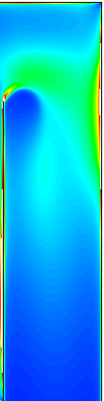
Overview
How Flocculation Works
Types of flocculators
Flocculation Theory
Design Optimization

Slide 20
What are flocs?
A process that transforms tiny particles into big particles!

Slide 21
Flocculation
Requires
  Sticky particles
  Collisions between particles
Increased size is needed for particles to settle by gravity and to filter them
  The bigger the particle, the settling velocity is higher so sedimentation is faster
  It is easier to catch a bigger particle in a filter than a smaller one
Notes:
Alum makes them sticky
Mixing makes them collide

Slide 22
Mechanical Flocculation
Turbulence created by gentle stirring provides:
  Collisions to grow flocs
  Prevention of large flocs from settling so they can grow
Presumed advantage is that collision rate is independent of flow rate (not true for AguaClara plants)

Slide 23
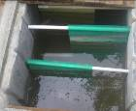
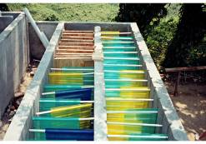
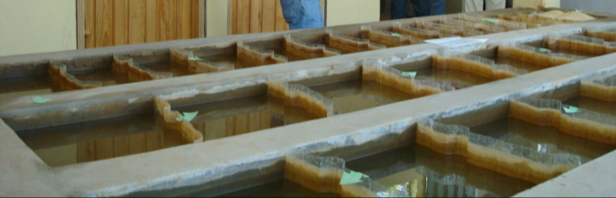
Hydraulic Flocculation
Collisions created by baffles
The advantage is that there is no need for power

Slide 24
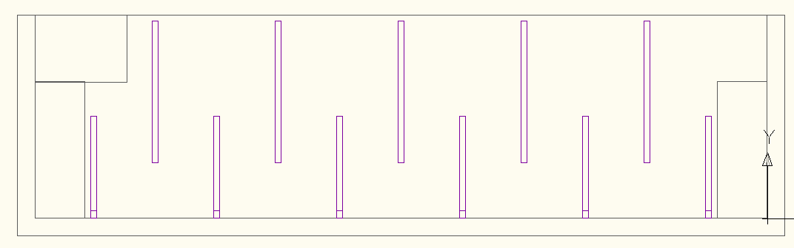
Side View
Upper baffles
Lower baffles
Drain ports
Notes:
planta de 50 Lps con 2 cámaras de sedimentación

Slide 25
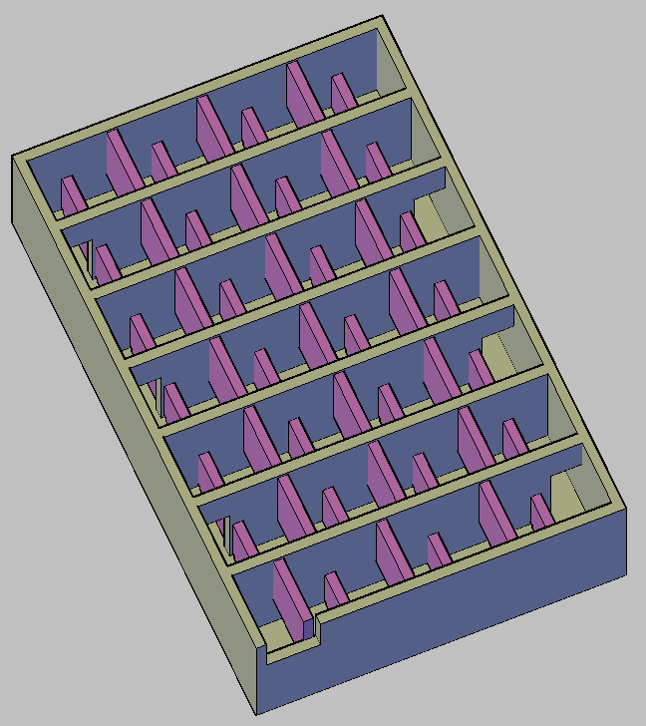
Flocculator Geometry
Rapid mix orifice (not yet drawn)
Channels
Ports between channels
Lower Baffles
Upper Baffles
Exit to sedimentation tank entrance channel

Slide 26
Using Hydraulic Flocculators
Mechanical flocculators are presumed to have more operation flexibility (variable speed motor driving a slow mixing unit)
Poor documentation of design approach for hydraulic flocculators
Prior to AguaClara we didn’t have a design algorithm based on the fundamental physics
If the model doesn’t capture the physics, then it won’t scale correctly
Notes:
Poor documentation leads to the need to design from scratch
Need to use the fundamental physics so that our models work

Slide 27
Flocculation Theory
Flocs are transported to collide with each other by Brownian motion, viscous shear, and turbulent eddies.
Flocs grow in size with each collision
Larger flocs are more vulnerable to breakage due to the fluid forces of drag and shear
Turbulence results when the water changes direction as it flows around each baffle

Slide 28

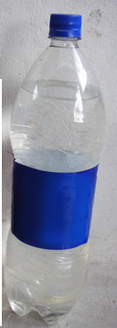
Flocculation Capacity: Collision Potential
The capacity of a flocculator is based on its ability to make collisions between flocs
This design system is the result of years of investigation by the AguaClara team
It is much easier to flocculate high turbidity suspensions than it is to flocculate low turbidity suspensions
Notes:
How well a flocculator works is determined by how many collisions happen
Higher turbidity suspensions result in larger flocs so they collide much easier

Slide 29
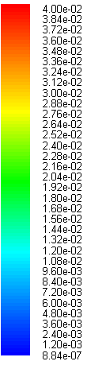
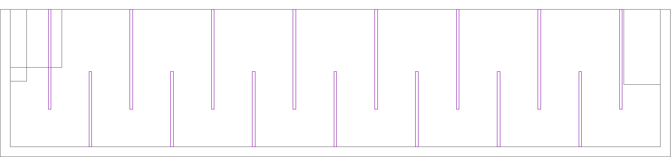

How do we quantify turbulence?
The energy dissipation rate, ε, is a measure of the turbulence
It is in the regions of maximum ε where the flocs are most likely to break, but also collide
mW/kg
Notes:
We want the highest energy disspation possible so that the flocs will settle later and not break up

Slide 30
An interesting design
No this wasn’t AguaClara…

Slide 31

A Few Reflections
The collision potential depends primarily on the flocculator geometry
We can design a flocculator for the maximum flow rate and be fairly confident that the flocculator will also work for lower flow rates.
We also need to use the constraint that we not break the flocs

Slide 32
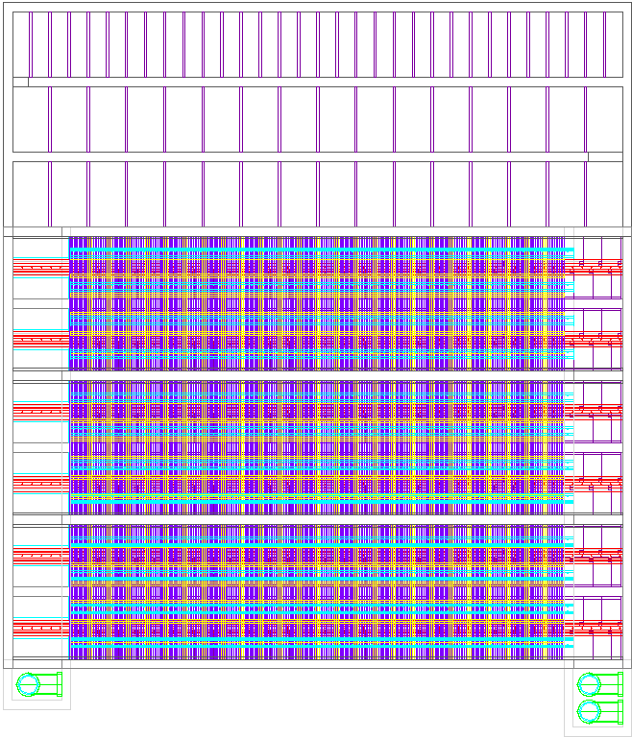
Design Optimization
The length of the flocculator channels matches the length of the sedimentation tank
The height of the water at the end of the flocculator is equal to the height of water in the sedimentation tank
Width of the flocculation channel?
  Minimum
  Material limitations (polycarbonate sheets)
Flocculation
Sedimentation
Top View
Notes:
We try to optimize our designs as much as possible. One example is making the flocculation tanks as long as the sedimentation tanks to maximize the amount of shared wall space. Another is ensuring that the depth of the water at the end of the flocculator is the same as in the entrance tank to the sedimentation tank so that there is no unnecessary head loss. We ensure that there is a minimum width of the flocculation channel so that humans can fit in it for maintenance. The materials we use must also be able to withstand the forces on them.

Slide 33
The Need for Non-Optimal Designs
For small plants the width of the channel will be determined by the need to construct the channel using humans (45 cm)
The space between baffles will be determined by the flow rate, but the height is determined by sedimentation
Small plants will need longer residence time and more baffles to achieve adequate flocculation
Notes:
While we do try to design as optimally as possible, sometimes we can’t. For instance, as I mentioned, the width must accomodate a human. Also, the space between the baffles is determined by flow rate, whereas the height is determined by the level of water in the entrance tank for the sedimentation tank. Also, small plants will need a longer residence time and more baffles to make flocculation work.

Slide 34
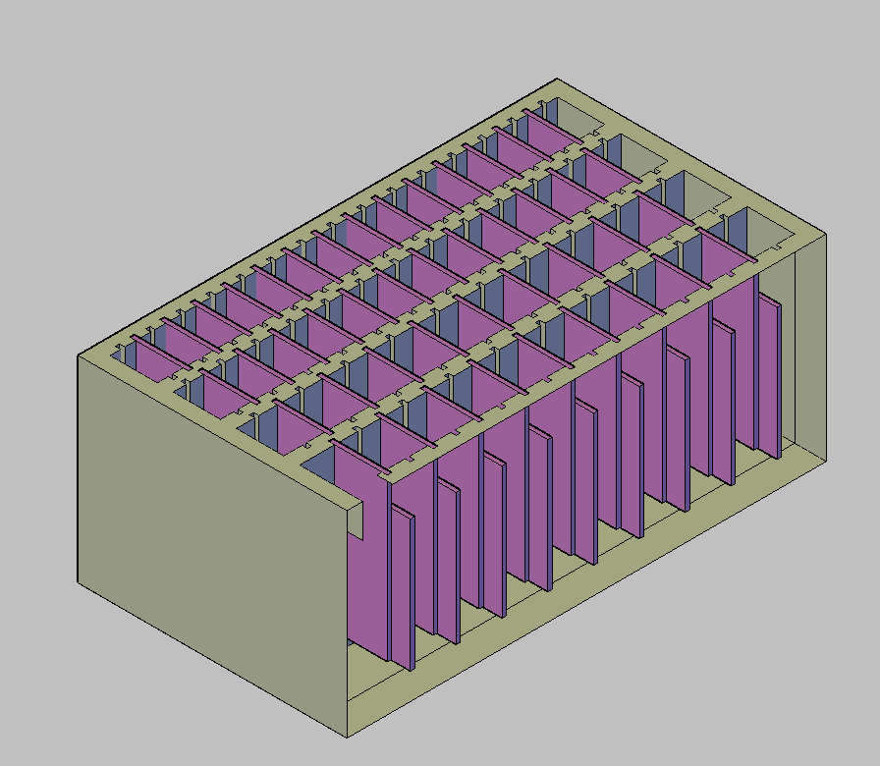
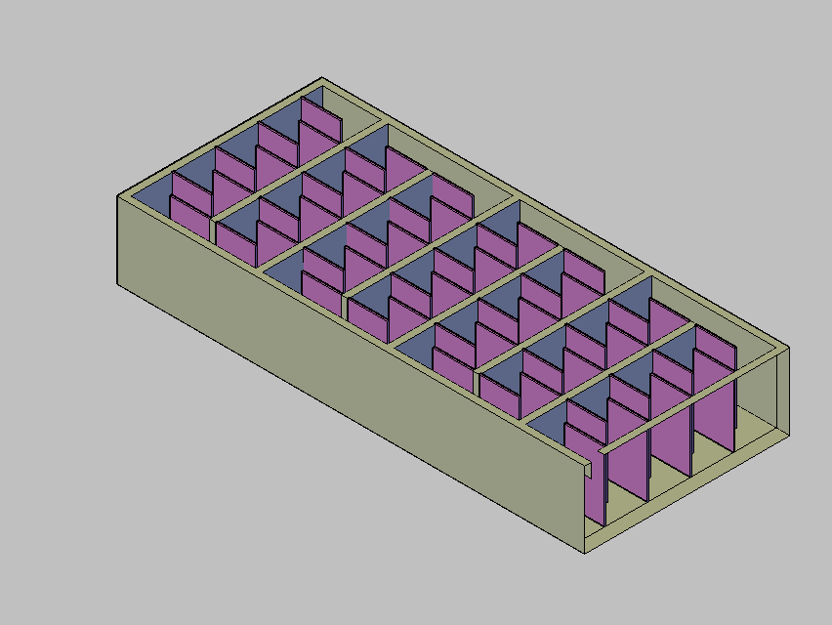
Horizontal vs. Vertical Water Flow in the Flocculators
Vertical Flocculator
Horizontal Flocculator
Low Flow Rates
Need ports on each lower baffle to drain
High Flow Rates
Easier to drain
Notes:
Now I will talk about the difference between horizontal and vertical flocculators. The top view shows the flocculator we have been discussing, a vertical flocculator. The bottom shows a new flocculator that we are designing, the horizontal flocculator. They are essentially the same but rotated. For the vertical flocculator this is the side view. The baffles are placed up and down. For the horizontal flocculator, on the other hand, the same view is from the top. The baffles are placed on the left and right. (Do hand demonstration). Does everyone understand this?

Slide 35
Flocculation Tank Height
Flocculation Tank
Sedimentation Tank
In our current plants, the flocculation tanks are as deep as the sedimentation tank.
The important constraint is that the water level at the end of the flocculator is the same as the water height in the inlet channel of the sedimentation tank so that there is no head loss.
Notes:
One of the challenges we deal with is the height of the flocculation tank. The most important constraint is ensuring that the height of the water at the end of the flocculator is the same as the height in the entrance tank to the sedimentation tank. The easiest way to do this is to make the flocculation tank and sedimentation tank the same height.

Slide 36
Flocculation Tank Height
Since Horizontal Flocculators are easier to drain, we want to build them for smaller flow rates.
Thus, we are creating an algorithm to make the height of the floc tank shorter than the sed tank, but the water level needs to be the same where they meet.
Since we have been excavating into the ground recently, this is a feasible approach.
Flocculation Tank
Sedimentation Tank
Excavate less for shallow floc tank
Ground
Notes:
For small flow rates though, the flocculation tank would be shorter than the sedimentation tank. It would thus need to be raised on a platform, which would cost money because of the construction materials. So, for low flow rates, vertical flocculators are better.

Slide 37
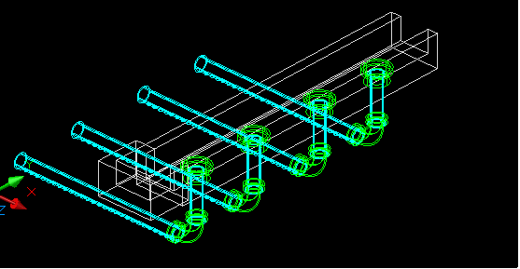
Inlet Channel
Will run along the inlet end of the sedimentation tanks.
2 possible configurations:
Parallel weir: in this case, the channel is wider
Perpendicular weir: must be placed so it can handle the entire flow of the plant.
Must be wide enough to fit the coupling of the manifold entrance pipe. and to avoid floc break-up

Slide 38
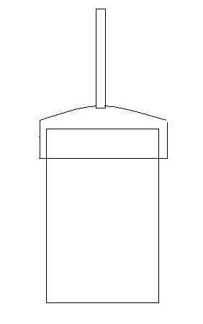
Inlet Channel
Stopping the flow of water into the sedimentation tank.
Pipe to let air out
Cap to cover pipe
Pipe fits into coupling in sed inlet coupling

Slide 39
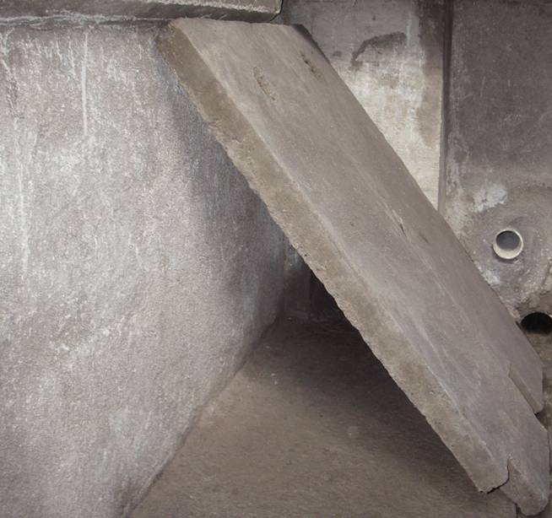
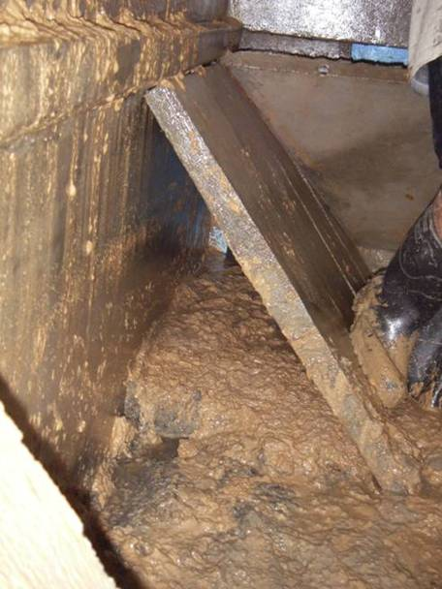
Initial Design
Problems
Velocity inside inlet manifolds very low
Flocs settle inside manifold (NOT IN SED TANK!!!)

Slide 40
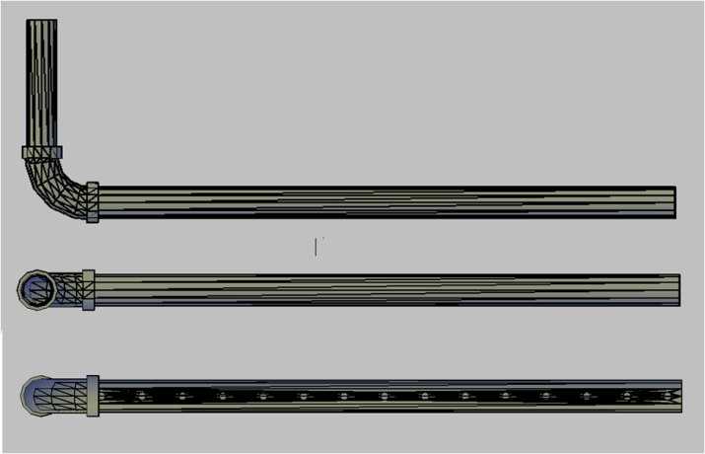
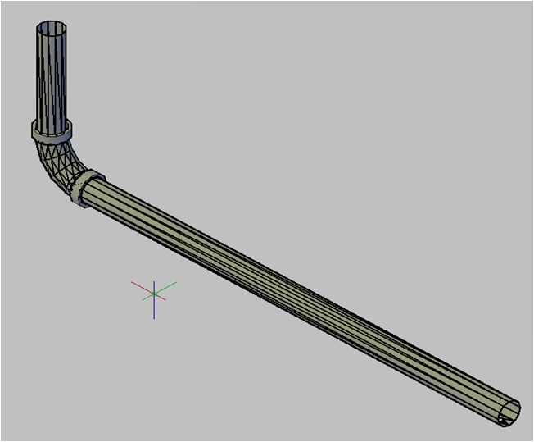
Solution
Inlet Manifold
Circular Inlet Manifold
You buy it, then taper it and drill it
Can replace it easily
Objective
Increase Velocity
Prevent floc settling inside inlet manifold
V.Scour= 0.15 m/s
ED= 7.089 mW/kg
Contraint
Low energy dissipation
Prevent floc breakup

Slide 41
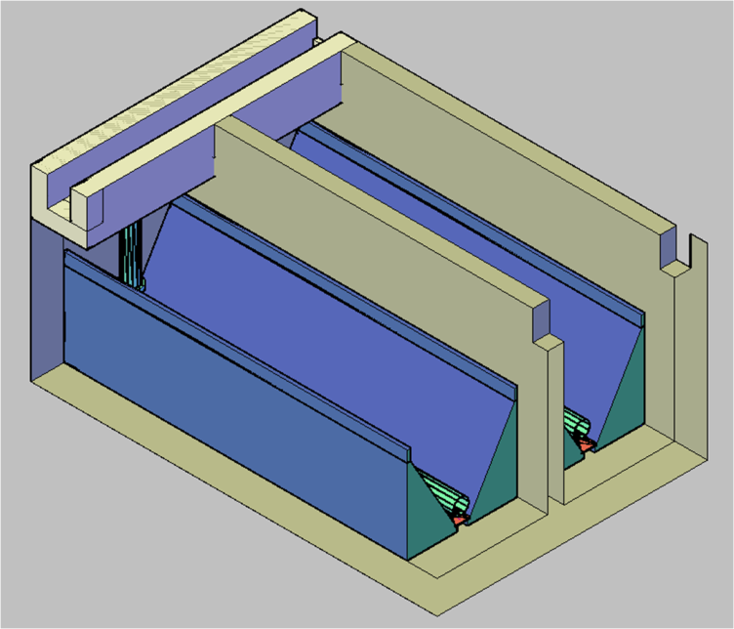
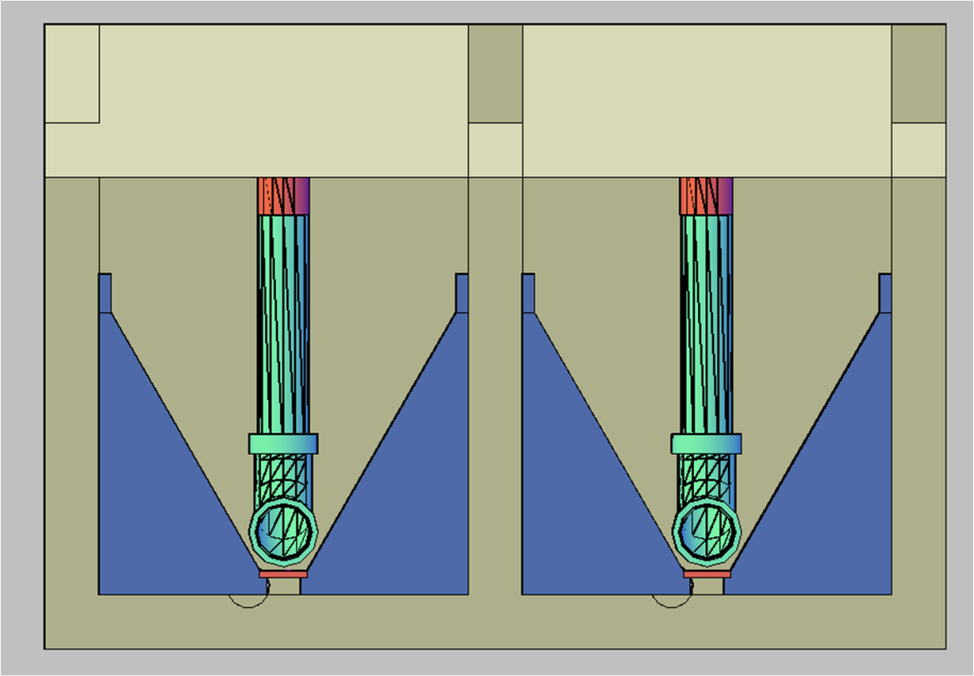
Final Design
Floc Blanket?
New Design for the drain cover and the inlet slopes.
Easy to handle for maintenance
Removable
Easy to replace

Slide 42
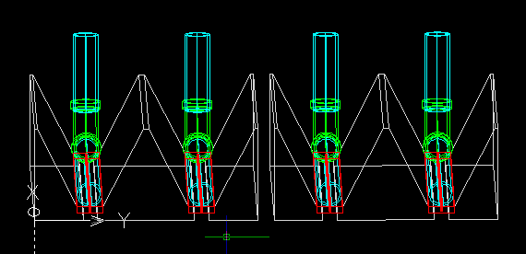
Actual Design

Slide 43
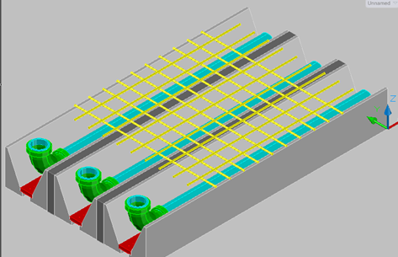
Pipeframe and Lamella
The pipe frame provides support for the lamella
Old design was a simple grid of pipes covering the whole sedimentation tank

Slide 44
Pipeframe and Lamella
New design covers one bay at a time.
It wastes less pipe materials and also adds stability.

Slide 45
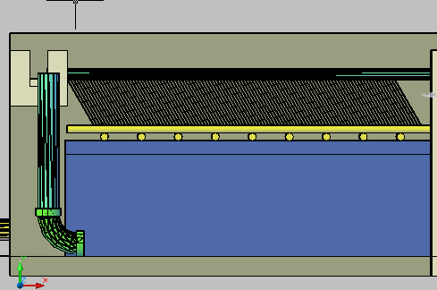
Plate Settlers: Side View

Slide 46
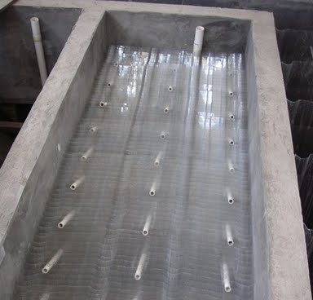
Plate Settlers: Top View
Credit: Monroe Weber-Shirk

Slide 47
Example of Lamella Sedimentation
Credit: Monroe Weber-Shirk

Slide 48
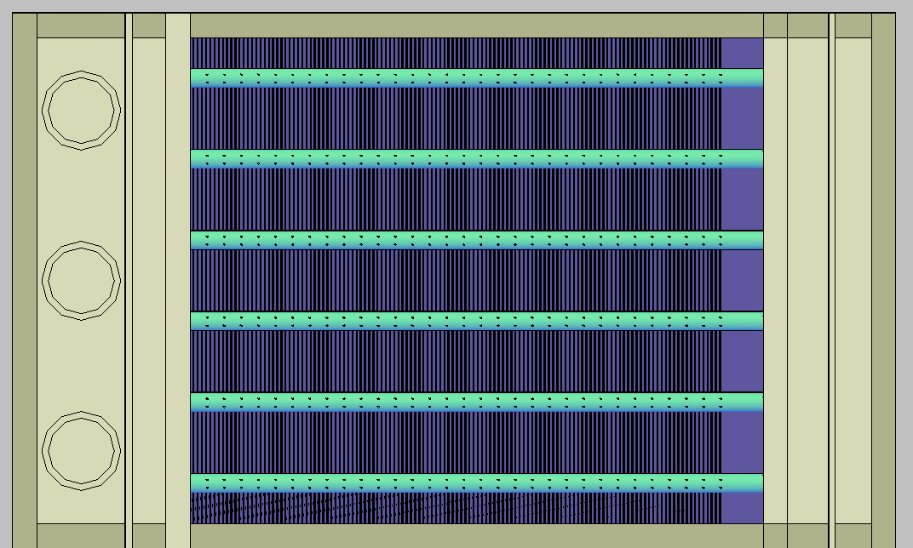
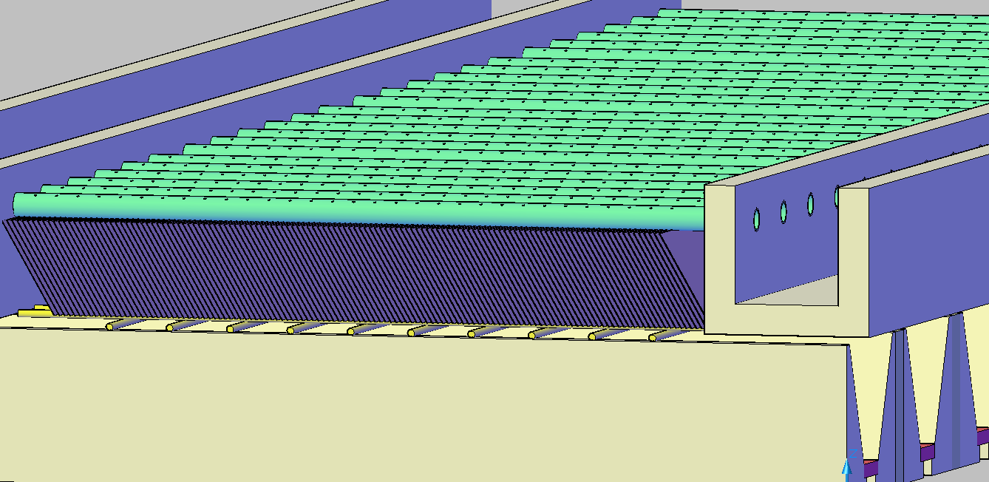
The Launders
Launders
Notes:
Annotate this slide with info what the views of the sed tank
*Explain the what the launder is/it’s function
Point out that the water flows out of it into the exit channel
Pipe going through wall → needs coupling
Coupling was drawn last semester, currently finishing up placing it in the right spot/arraying
Coupling important for 2 reasons:
Pipe going through wall needs coupling
To drain sed tank, need to be able to remove launder and plug hole – need coupling

Slide 49
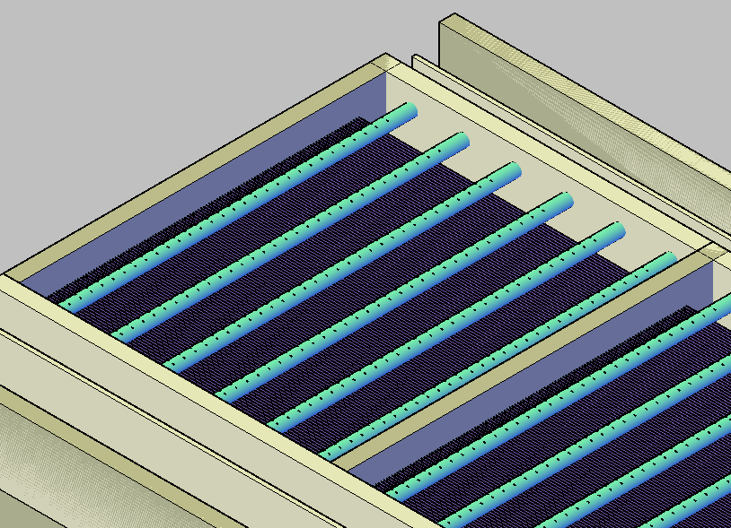
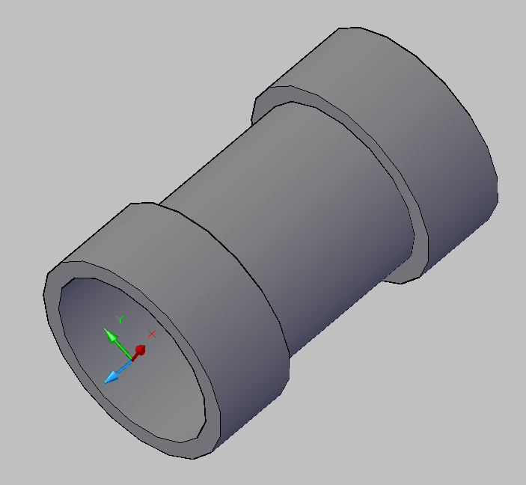
Launder Coupling
Notes:
Pipe going through wall → needs coupling
Coupling was drawn last semester, currently finishing up placing it in the right spot/arraying
Coupling important for 2 reasons:
Pipe going through wall needs coupling
To drain sed tank, need to be able to remove launder and plug hole – need coupling

Slide 50
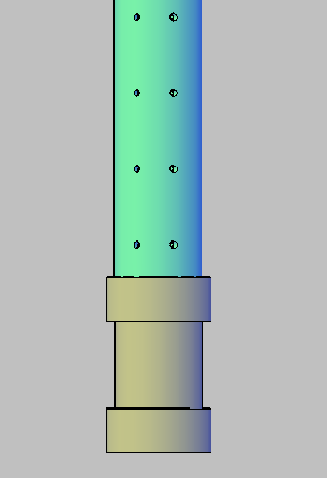
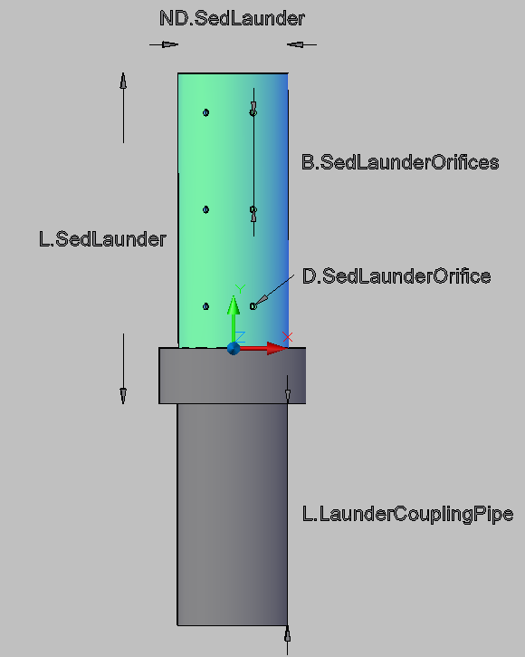
Old & New Couplings

Slide 51
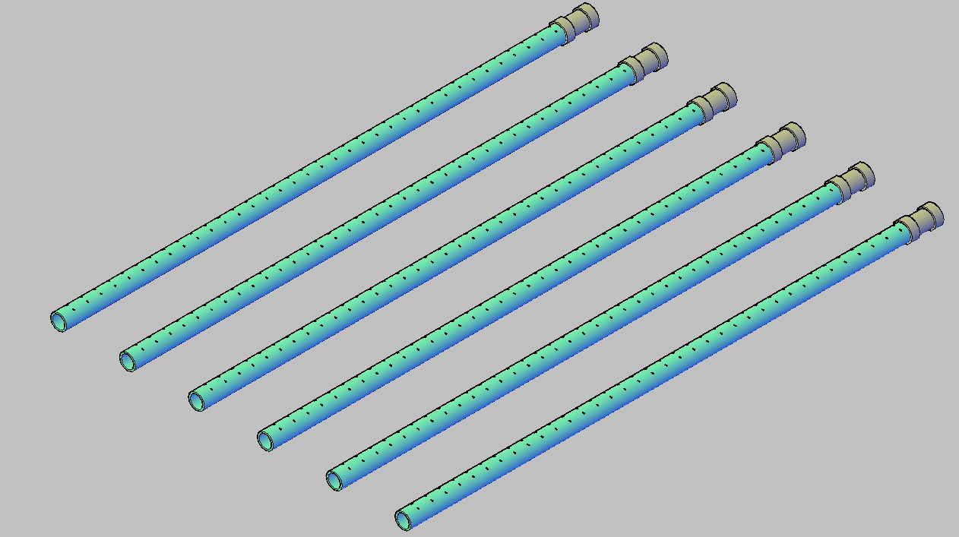
Launders with Couplings!
But what’s holding up the other end?
Notes:
Length of coupling=thickness of wall

Slide 52
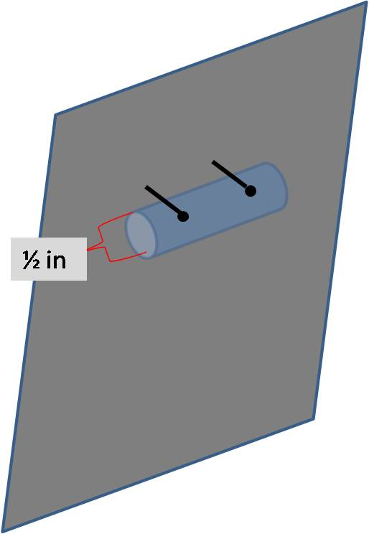

Launder support

Slide 53
Exit Channel
Head Loss in channel twenty times smaller than head loss in launder
Wide enough to fit launder cap and to ensure target head loss.
2 possible configurations based on head loss:
Parallel weir
Perpendicular weir
As long as the inlet channel.
Height of water= that of the inlet channel-Head Loss through the launder

Slide 54
Inlet and Exit Tanks

Slide 55
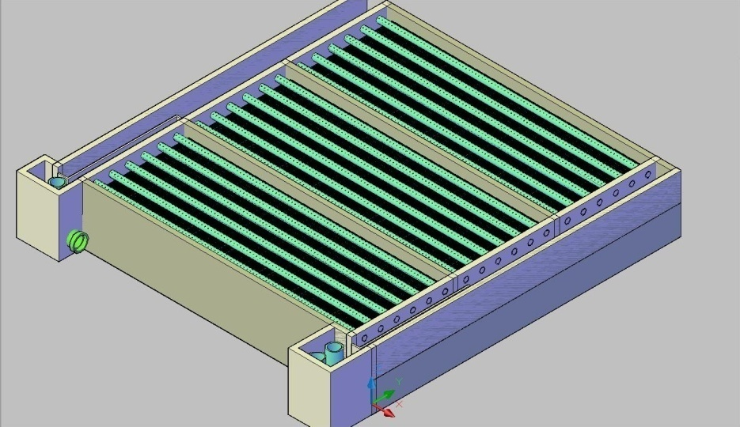
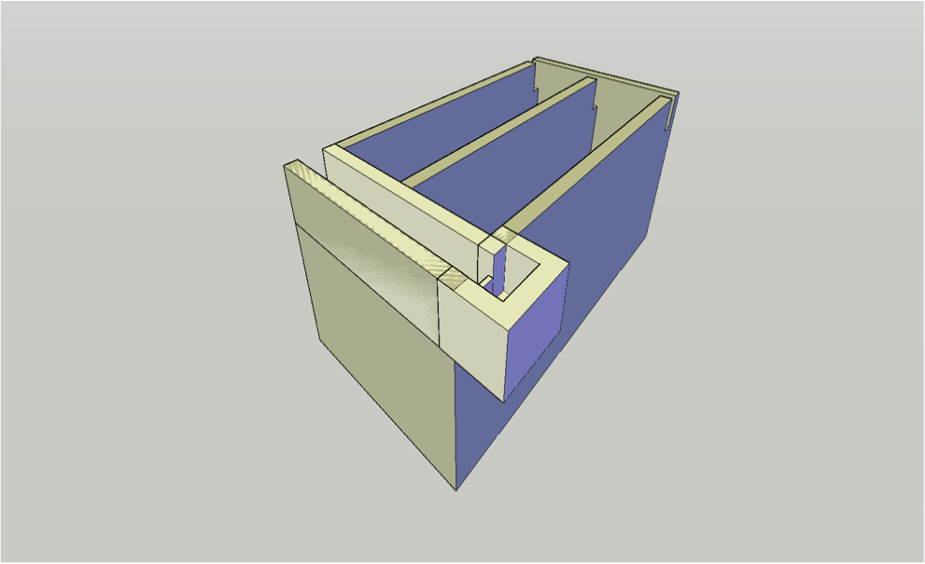
Inlet Tank

Slide 56
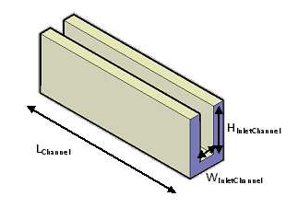
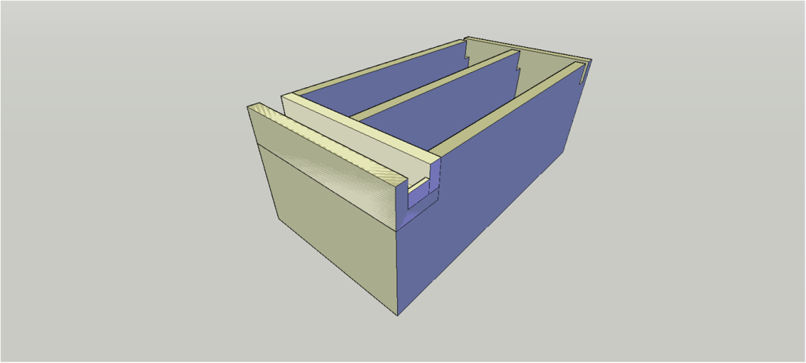

Inlet Tanks

Slide 57
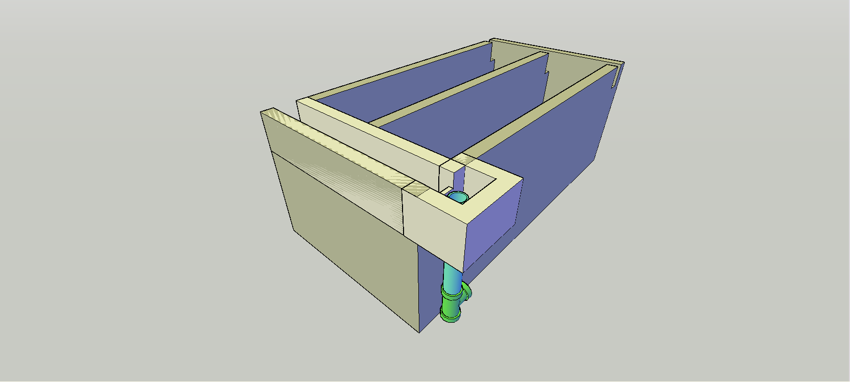

Same design for Exit tank

Slide 58

Future Changes
  More to Code
    Weir plugs
    Connecting pipe and new tee
    Inlet tank dimensions
  Drainage System
    Channel
    Cover
    Drain Valves

Slide 59


Materials List
“Shopping list” to build an AguaClara plant
Notes:
In MathCAD, the Materials list consists of a series of equations for the volumes, areas, and other component specifications
Purpose: (1) to give Hondurans physical quantities they’ll need to determine how much cement, bricks, and other resources to use
(2) to give them an idea of which supplies they’ll need, such as PVC pipes, connectors, etc.

Slide 60


AguaClara Documentation
Why?
Currently no “instruction manual” for engineers and contractors
Documentation makes us more professional
Streamline the construction process
Make it easier to understand our technology.

Slide 61


Documentation
What?
Customized Automated Report
  Processes
  Governing Equations
  Plant Values

Slide 62

Documentation
How?
Microsoft Word
  Fields
    Equations
    CAD Drawings
    Styles
LabView

Slide 63



Slide 64

Documentation
What next?
Progress
  Working on Fields
    Andrew, Josiah
  Generating Content
    Julie

Slide 65
AutoCAD: Paper Space
Goals: Provide simple/clean images of cad drawings with important dimensions and information.
Challenge: How to create layouts (paper space) and add dimensions with AutoCAD commands?

Slide 66
Spring 2010 Tasks
Add multiple layouts with different view points
Show cross sectional views
Provide important information (dimensions, elevations, water levels)
Convert the paper-space images to PDF or JPEG

Slide 67

What is possible now?
Example: Flocculator
• Create a single view port in a layout
• Create layouts with keyboard commands
• Change viewpoints

Slide 68

How can we improve?
Add three viewports in one layout
Set a different view point in each viewport
Show different objects in each viewport
Add information (dimensions, zoom, view points, etc).

Slide 69
Challenges for creating layout
How to work on the paper space:
“Clicking without clicking.”
How to put important dimensions and information in forms of texts in the paper space.
How to convert the paper space images into PDF or JPEG.

Slide 70

Automated Design Tool
Notes:
Allows users to enter limited data, so they can input their unique specifications.
EX: large vs. small water treatment plant, more vs. less flow…
So Honduran engineers enter their parameters and receive a design in just a few minutes.
We hope this’ll make it easier for different people around the world to get water treatment plant designs
Here you can see the user interface of the design tool. Users enter the parameters above in accordance with their plant specifications. There are default values for all parameters as guidance. I will show you two different designs in which we vary the plant flow rate, number of sedimentation tanks, and bays per sedimentation tank. In this design, we used a plant flow rate of 3 Liters/second, and 3 sedimentation tanks with 1 bay per sedimentation tank.

Slide 71
Questions?

