Slide 1

Design Team
Chang Min Oh, Cheuk Hang Hui, Heidi Rausch, Julia Morris, Marlana Hinkley, and Tori Klug

Slide 2
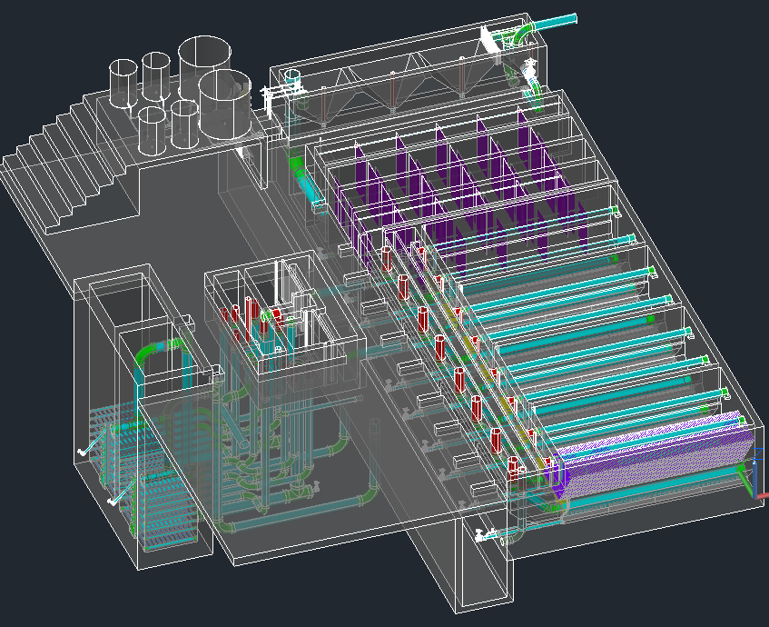

The Drawing

Slide 3
Automated Design Tool
User Inputs
Plant
Design
LabVIEW
AutoCAD
Mathcad
Calculations
MS Word
Mathcad
Drawing Files

Slide 4
Modular Designs
Heidi Rausch

Slide 5
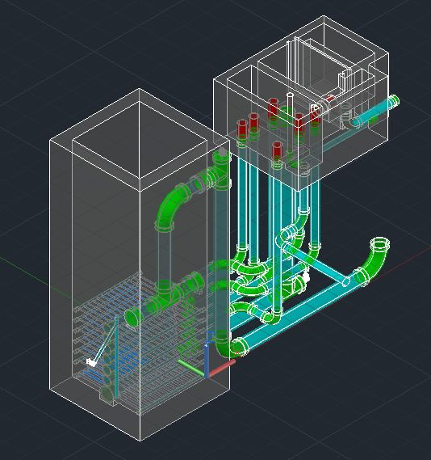
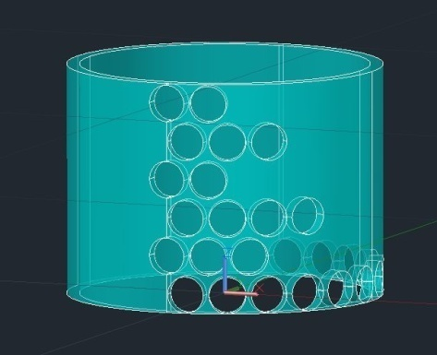
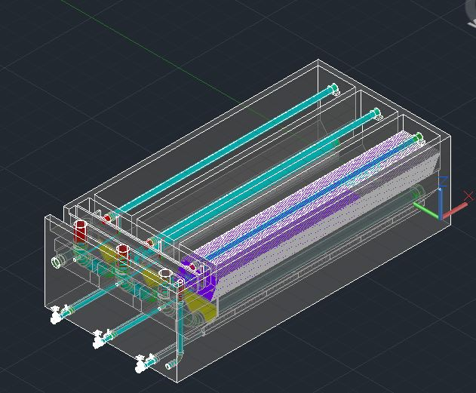
Modular Designs
In the Final Designs folder there is a folder called ADT designs.
Modular designs folders have been created for the LFOM, SRSF, Sed Tank, and for a low flow plant. A flocculator design is currently is progress.

Slide 6
Method Files
Each new folder in ADT designs must have a method.txt file associated with it.
This file communicates between the modular mathcad design file, the user’s online input and the background LabVIEW code.
Also in each modular design folder we may include a design specifications file but this still has to be decided.

Slide 7
New Design Requests Website
We now have a new website for requests.
Each modular design will have its own request page with stock designs and a request form.
Fun New Website!

Slide 8
Low Flow Plant
Julia Morris

Slide 9
Intro
Current design range = 6 L/s – 70 L/s
Want to be able to serve small communities
Need new design for flocculator, sedimentation tank, and filter
Need new layout

Slide 10
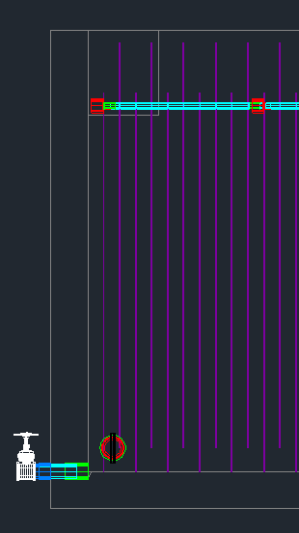
Low Flow Flocculator
H/S is a measure of flocculator efficiency
Optimal H/S is 4
Current Design
  H/S = 28
H
S

Slide 11
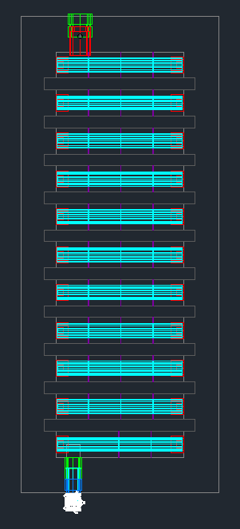
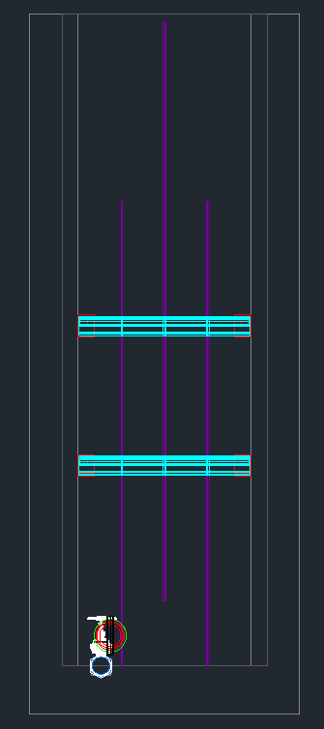
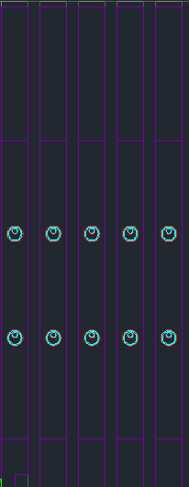
Top View
Front View
Side View
Pipe Spacer – Takes up 60% of Upflow Area
Plastic Baffle
Ferrocement Baffles
Notes:
H/S ratio is too high still…so add pipe obstacles to create more collision potential

Slide 12
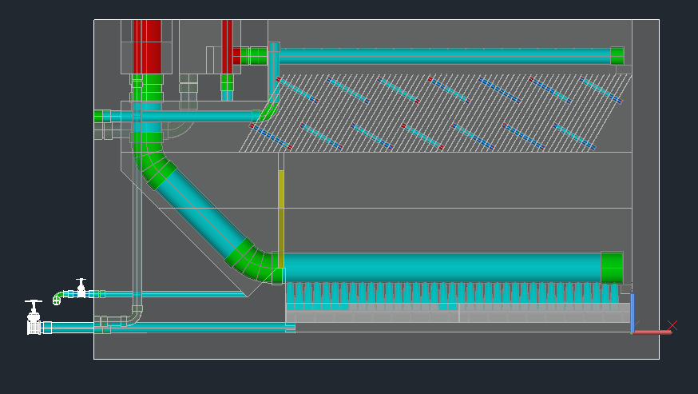
Current Sed Tank Design
Single Sed Tank
Channels are unnecessary

Slide 13
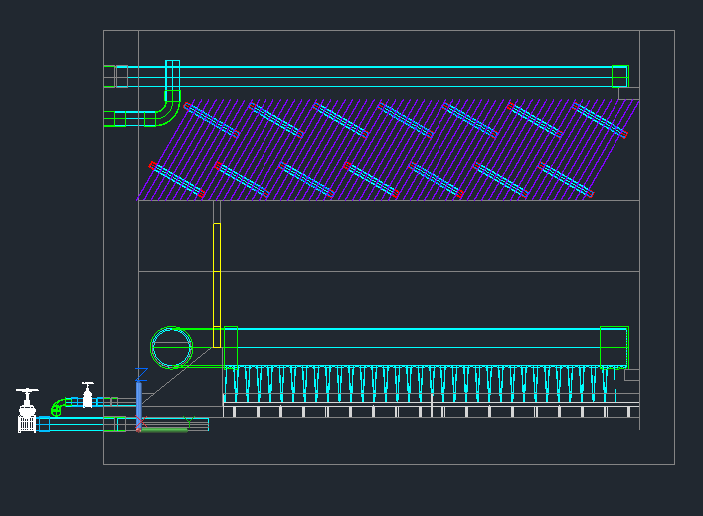
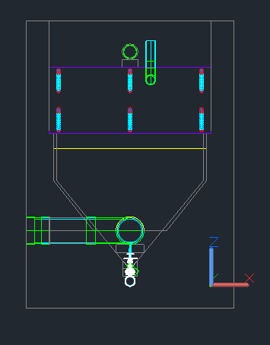
Low Flow Sed Tank
Side View
Front View

Slide 14
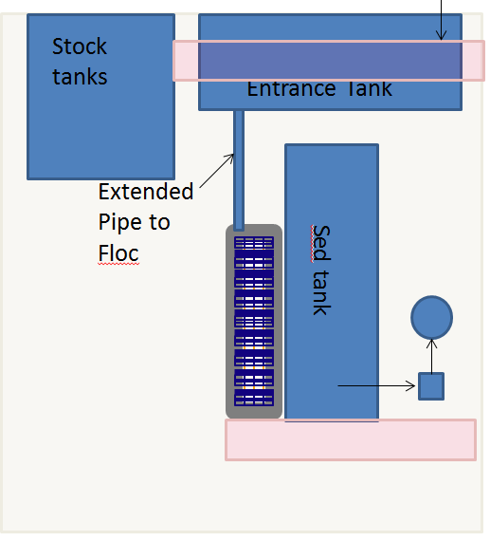
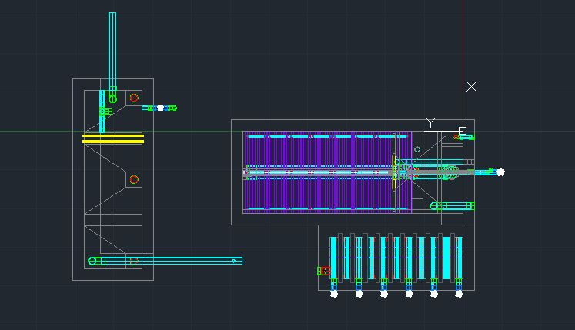
Future Work
Obtain and draw a design for low flow filter
Finalize Plant Layout

Slide 15
High Flow Modifications
Tori Klug

Slide 16
Major Adjustments Needed
Flow control and doser changes
Entrance tank
Flocculator design fix
Sedimentation tank inlet and outlet channels

Slide 17
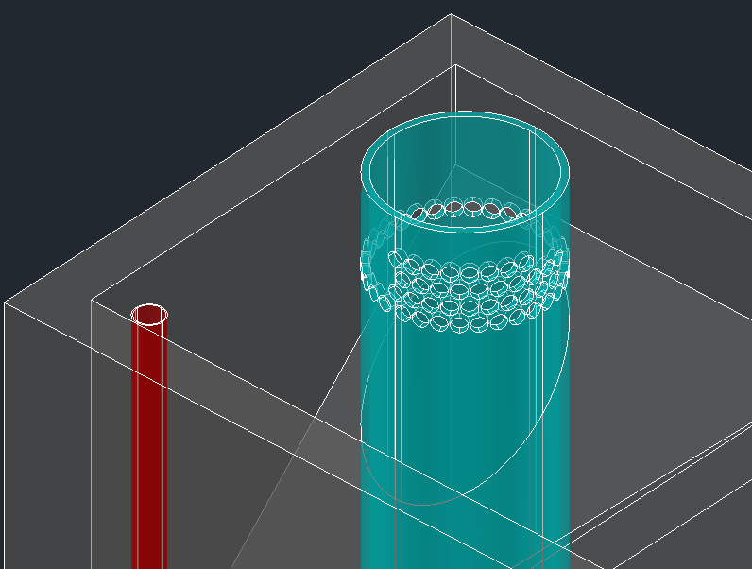
LFOM Changes
Problem: at higher flow rates the LFOM pipe required is too large to be easily found, affordable, and easily used during the construction process in Honduras
Current 90 L/s LFOM design
Notes:
to allow for a linear relationship between height of water in the entrance tank and plant flow rate is
39 L/s LFOM – 15 in

Slide 18
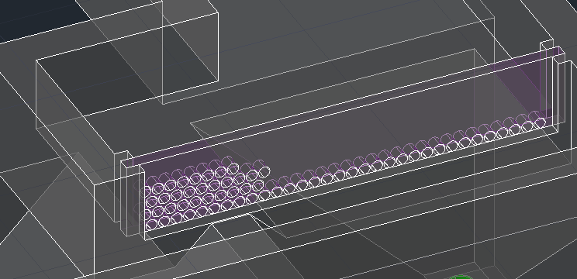
LFOM Changes
Solution: transition to an “LFOM Channel,” or a concrete channel with orifices
  Length of channel determined by number and size of orifices needed in the bottom row of the LFOM
  Must develop equations to quantify mixing and add rapid mix components in channel going to the flocculator
Proposed 90 L/s LFOM Channel design (with many errors to be fixed)
Notes:
LFOM channel design code in the making

Slide 19
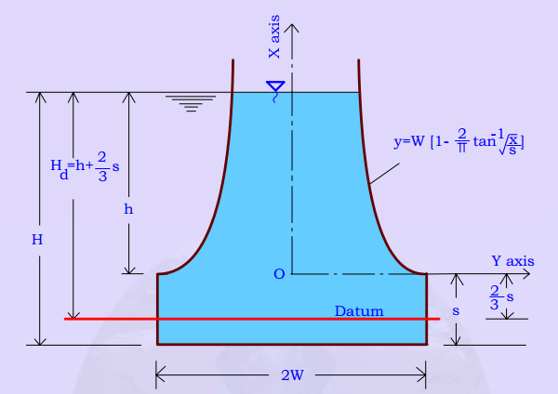
LFOM Changes
Problem: length required for an LFOM channel exceeds length of an entrance tank hopper at approximately 125 L/s
Solution: transition to a double-sided LFOM channel or a Sutro Weir channel (i.e. a channel with a Sutro Weir cut into a plastic sheet on the side)
Sutro Weir with governing equations
Notes:
LFOM channel design code in the making

Slide 20
Coagulant Dosing Tubes
Plant Flow Rate (L/s) | Number of Coagulant Dosing Tubes
50 | 3
100 | 6
150 | 9
200 | 11
250 | 14
300 | 10
350 | 11
400 | 13
450 | 14
500 | 16
Problem: number of tubes needed for coagulant dosing unmanageable at high flow rates
Possible solution: new dosing manifold system could help solve this issue by removing a constraint on length of dosing tubes

Slide 21
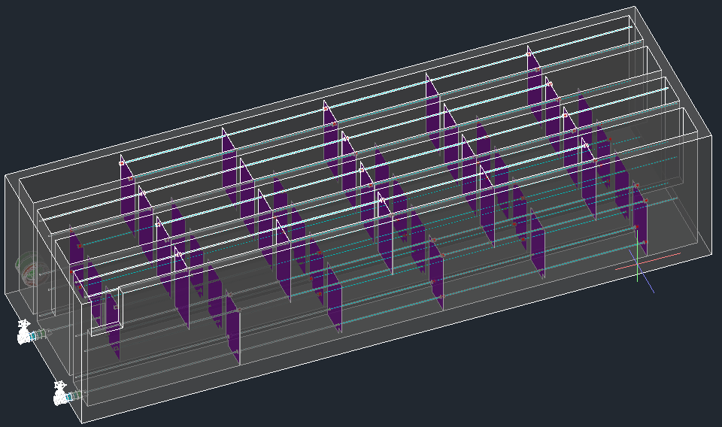
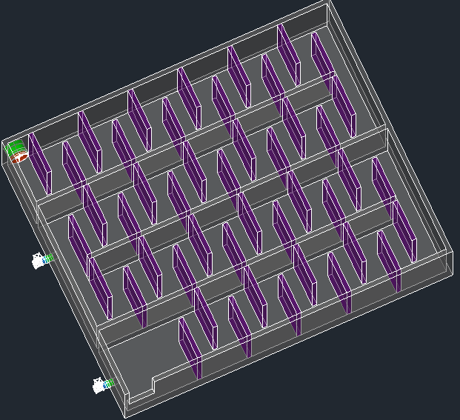
Flocculator Changes
At 199 L/s and higher, horizontal flocculator designed
Drawing code fixed to properly position baffles
Design creates horizontal flocculator with unnecessarily high collision potential—need to fix
Notes:
Almost done – May fixing the design algorithm for horizontal flocculators

Slide 22
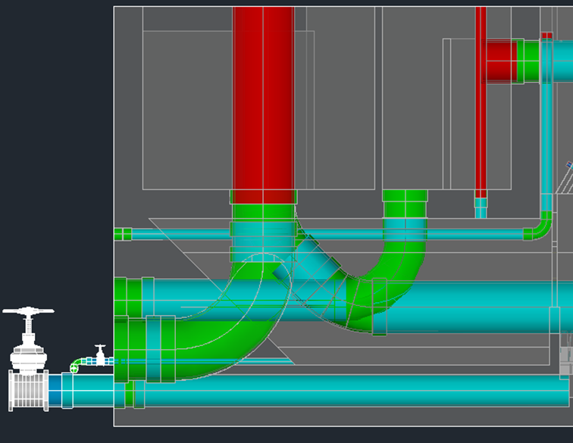
Sedimentation Tank Inlet and Outlet Channel Geometry
Problem: sedimentation tank inlet channel becomes very wide and tall at high flow rates
  Increases overall length of sed tanks
  Inlet channel weir drain pipe is huge!
  Messes up floc hopper geometry – horizontal length too long to allow for draining
Side view of current sed inlet and outlet channels for 200 L/s plant

Slide 23
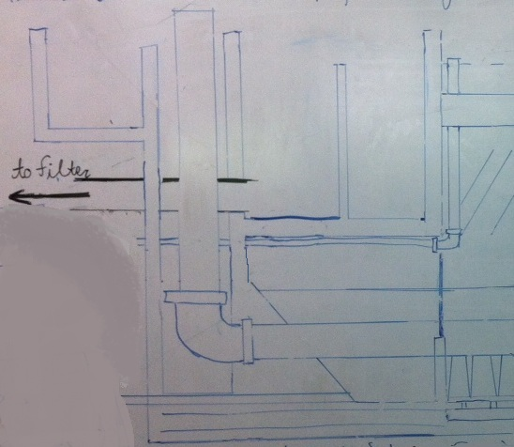
Sedimentation Tank Inlet and Outlet Channel Geometry
Proposed Solution:
Side view of proposed sed inlet and outlet channels for 200 L/s plant

Slide 24
Possibility of More Than One Treatment Train
Pro:
  Would still treat a portion of the water while part of the plant is offline
  Would not have to adjust our current design
Con:
  Wouldn’t optimize for cost
  Might need more than one operator to run multiple plants
Notes:
Ongoing discussion about the possibility of having this as an option
Also the possibility of having one flocculator and doser for a plant, and then two or more sed tank “units” and filter “units”

Slide 25
Future Work
Finishing designing and drawing the LFOM channel and rapid mix components
Evaluate flow control options for even higher flows
Develop transition to double hopper entrance tank
Design sedimentation inlet and outlet channels and consequent changes

Slide 26
Materials List
Chang Min Oh

Slide 27
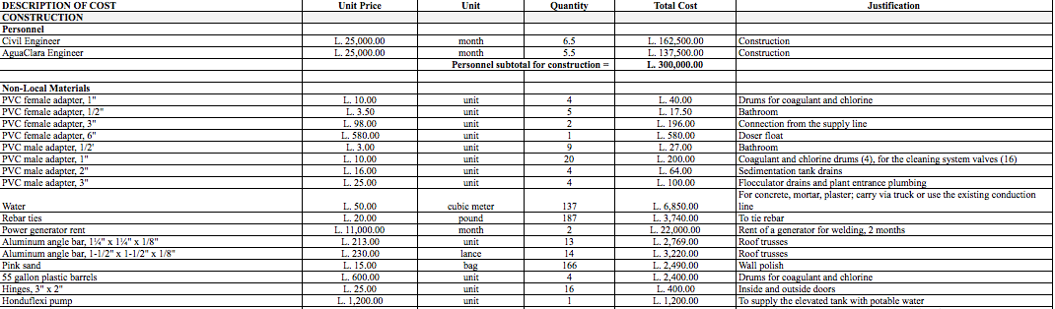
Materials List
Alauca Construction Materials List

Slide 28
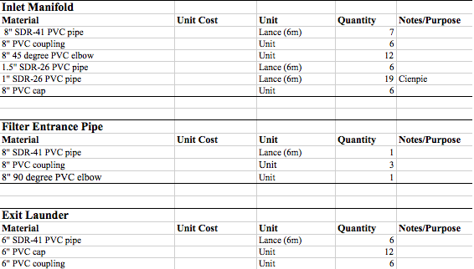
Materials List
San Nicolas Materials List

Slide 29
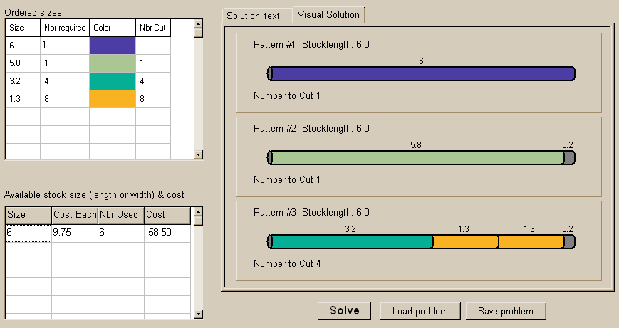
Materials List
Lances Function to save budget
Given different pipe lengths of same nominal diameter,
how can we find the minimum number of pipes to purchase? (i.e. Least Scrap)
CuttingStock Solver

Slide 30
Materials Application
Cheuk Hang Hui

Slide 31
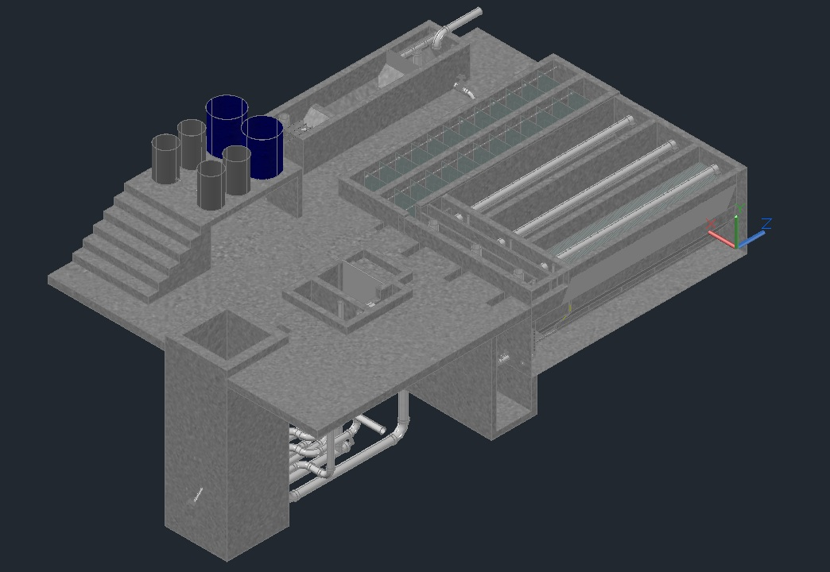
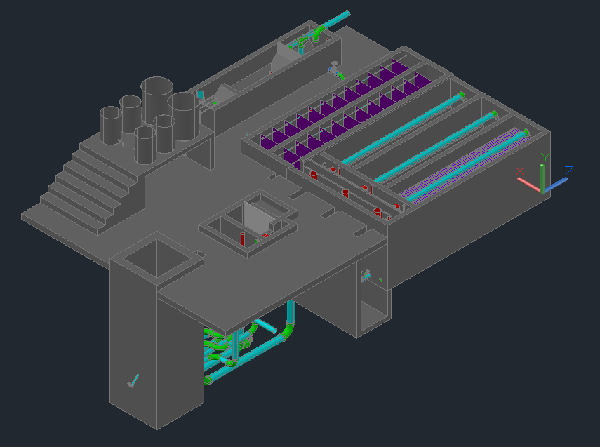
Materials Application

Slide 32
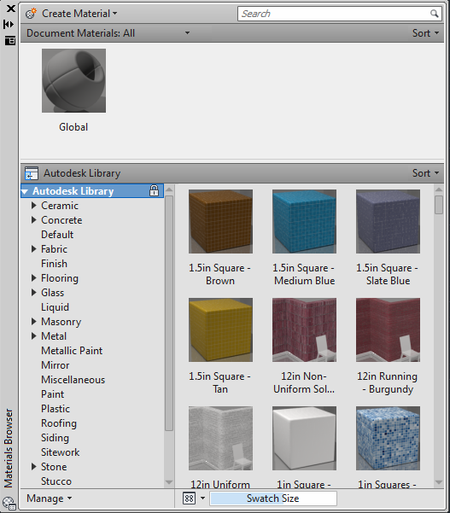
Problems Encountered
No command line to add materials automatically
Materials library renew itself with every new drawing

Slide 33
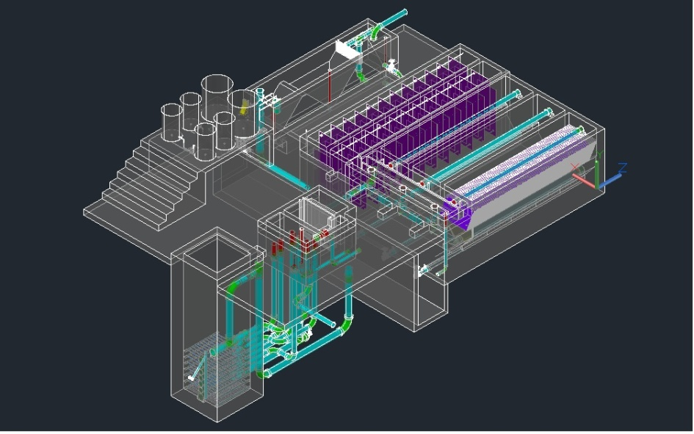

Solution?
Saved Material Library, then manually upload materials
Preload Design Template
Mystery?

Slide 34
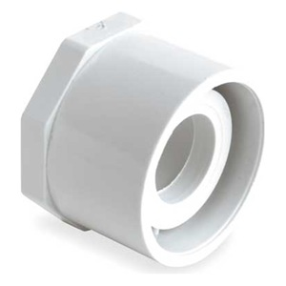
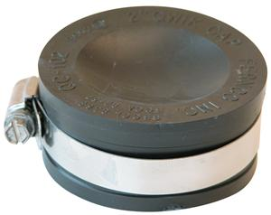
Future Work
Document instructions on how to apply materials to drawings
Expand the pipe database
  Bushing Type Reducers
  Fernco Caps

Slide 35
LFOM Orifice Template and Scale, Calibration Column Scale, and CDC Label
Marlana Hinkley

Slide 36
Challenges
Create an LFOM orifice template to facilitate precise drilling during LFOM fabrication
Create an algorithm that generates a scale suitable for the LFOM, CDC, and Calibration Column

Slide 37
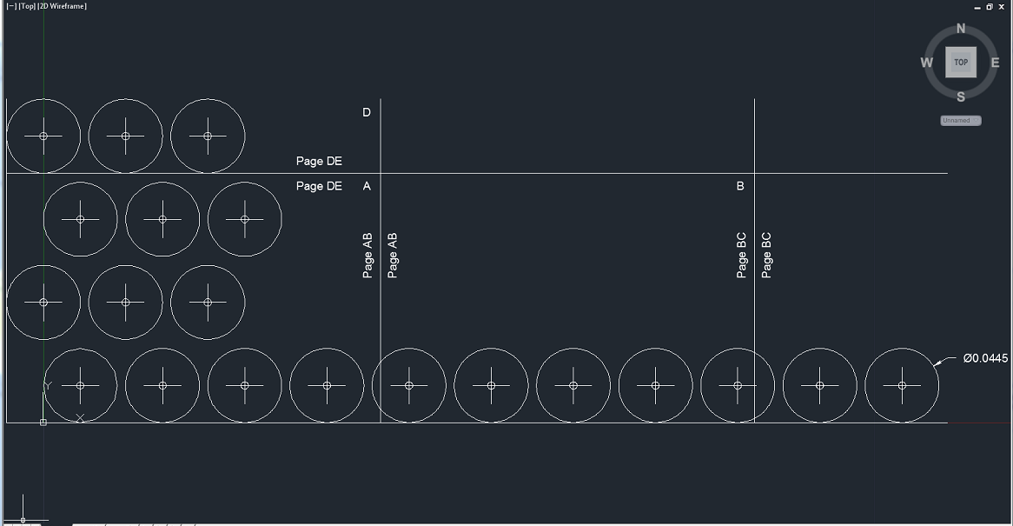
1. LFOM Orifice Template:
Model Space
Current output for 30 L/s flow rate
Hole centers and diameters marked
Delineated into 8.5” x 11” sheets for printing
Current step: Labeling pages to facilitate piecing together on-site

Slide 38
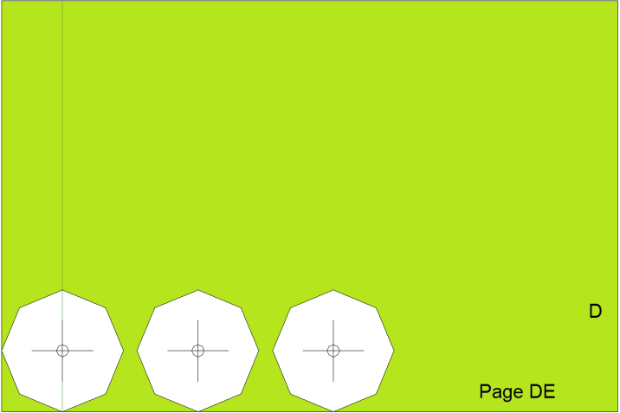
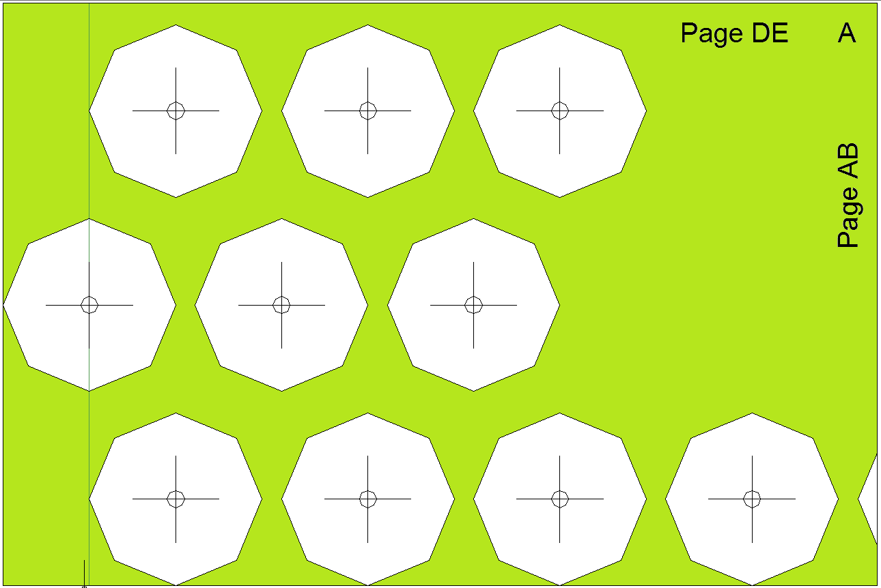
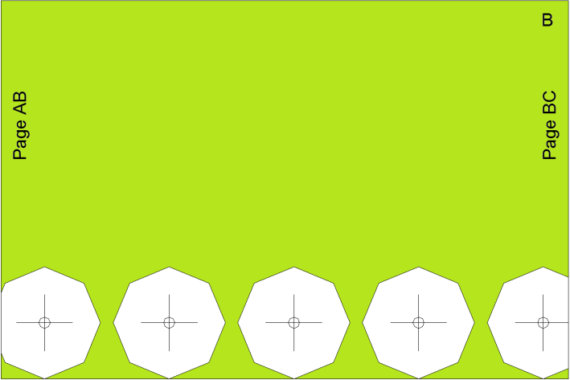
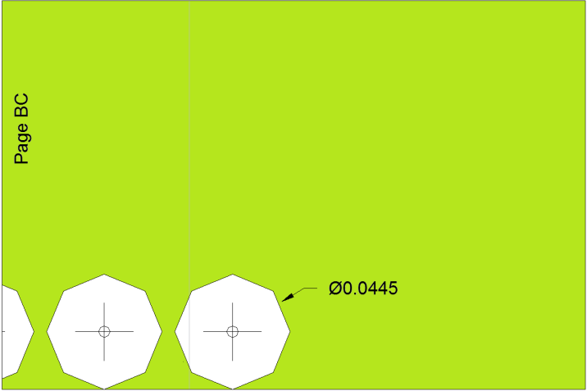
1. LFOM Orifice Template:
Paper Space
Current output in Paper Space for flow rate of 30 L/s
Notes:
Delineation was necessary because there is not a plotter available on-site in Honduras
Problems still to overcome: (1) Correct labeling (notice “Page DE” should be “Page AD” and “Page C” is not labeled)

Slide 39
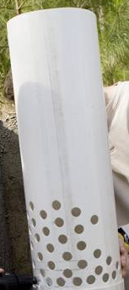
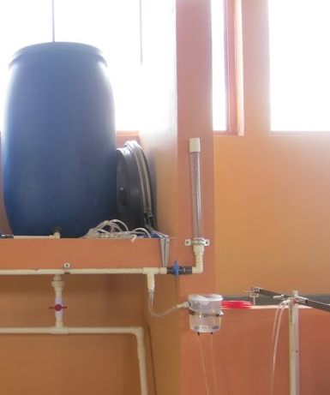
2. Scale for LFOM, CDC, and Calibration Column
LFOM: Scale will be engraved on a thin plaque to be attached to LFOM with brackets
CDC: Waterproof label will be placed on CDC arm and will mark 0-100% for each doser
Calibration column: Label will be placed on the column to facilitate calibrating the doser
Notes:
Code is in preliminary stages

Slide 40
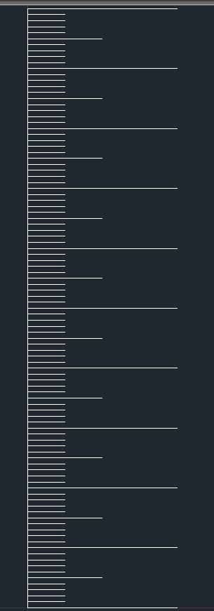
2. Scale for LFOM, CDC, and Calibration Column
The parameters:
  Max and min scale values
  Tick length
  Scale length
  Number of ticks
  Scale orientation
  Font size
Current output for flow rate of 10 L/s
Notes:
Current rendering is not the desired result – only practical for low flow rates and doesn’t include font.
Tick spacing will be determined by the desired number of ticks and each tick will be a certain fraction of the range.
Scale orientation will be horizontal for CDC

Slide 41
Future Work
Edit LFOM template to correctly label pages
  (“Page AD” on first page and Page C labeled)
Adjust scale code to account for all parameters and render desired output in AutoCAD

Slide 42



Questions???
Notes:
Current rendering is not the desired result – only practical for low flow rates and doesn’t include font.
Tick spacing will be determined by the desired number of ticks and each tick will be a certain fraction of the range.
Scale orientation will be horizontal for CDC

