Slide 1
Design Team
Final Presentation

Slide 2
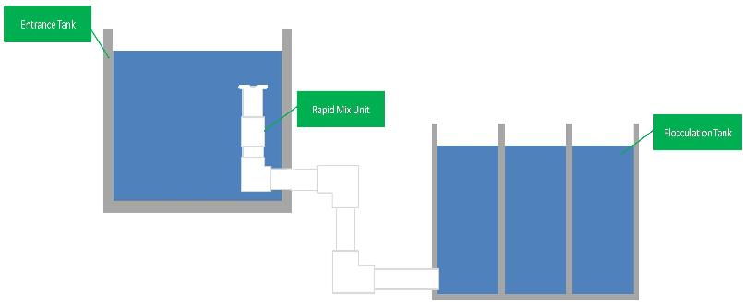
Rapid Mixer for Low Flow Rates
Alum coagulant needed for flocculation
Ensure mixing for proper use of coagulant
Macro-mixing and micro-mixing

Slide 3
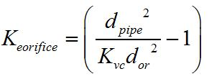

Sizing Orifices
Macro-mixing
  K = 1.3
Micro-mixing
  20 to 50 cm total head loss

Slide 4
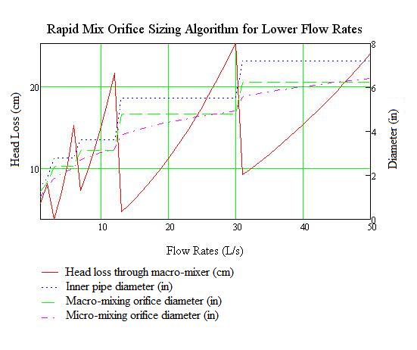
Constraints on macro-mixing orifice size
Head loss through macro-mixing orifice becomes greater than micro-mixing orifice

Slide 5
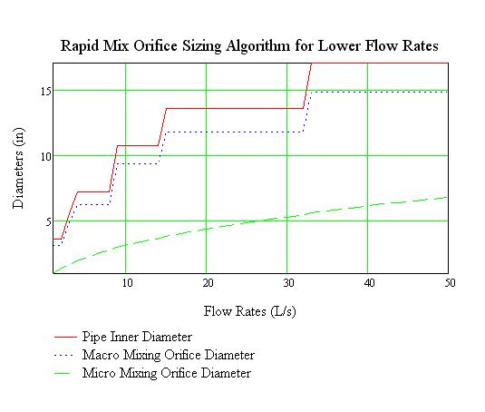
Results
Total Head Loss of 50 cm
Macro-mixing head loss capped at 2 cm

Slide 6
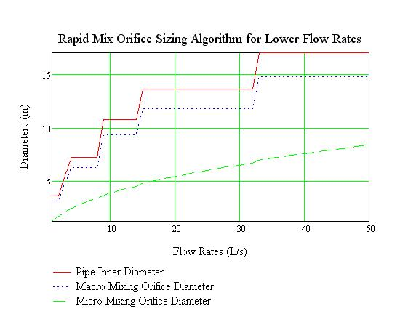
Results
Total Head Loss of 20 cm
Macro-mixing head loss capped at 10 cm

Slide 7
Micro-mixing
Smallest Largest Dimension
Parallel orifices needed to conserve head loss

Slide 8
Further Work
Coding onto AutoCAD
Difference between water level in flocculator and entrance tank must account for rapid mixer head losses
User input

Slide 9
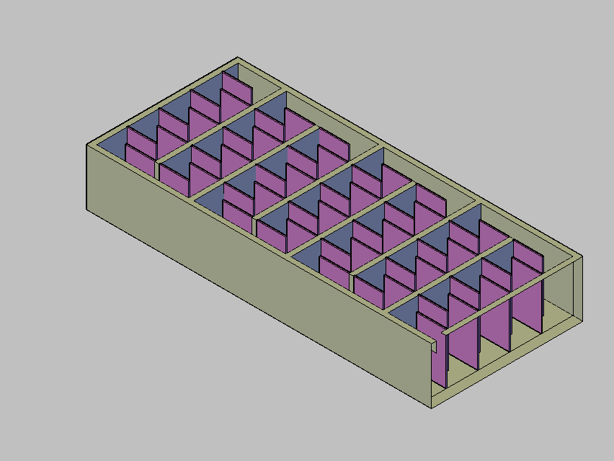
Horizontal Flocculation
Notes:
One of the main things we accomplished this semester was making the code for the horizontal flocculator. The flocculator is shown here.

Slide 10
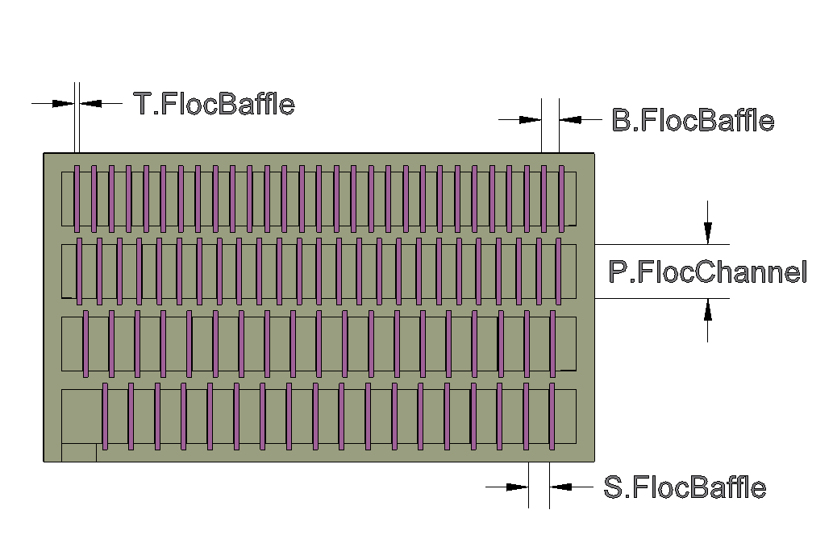
Top View - Vertical
Generic | Vertical | Horizontal
P | W | H
S | S | S
T | H | W
Notes:
This shows the top view of the vertical flocculator. We converted the width and height variables to generic variables so that it would not be as confusing when we switched to horizontal, since what was the width in the vertical flocculator becomes the height in the horizontal flocculator.

Slide 11
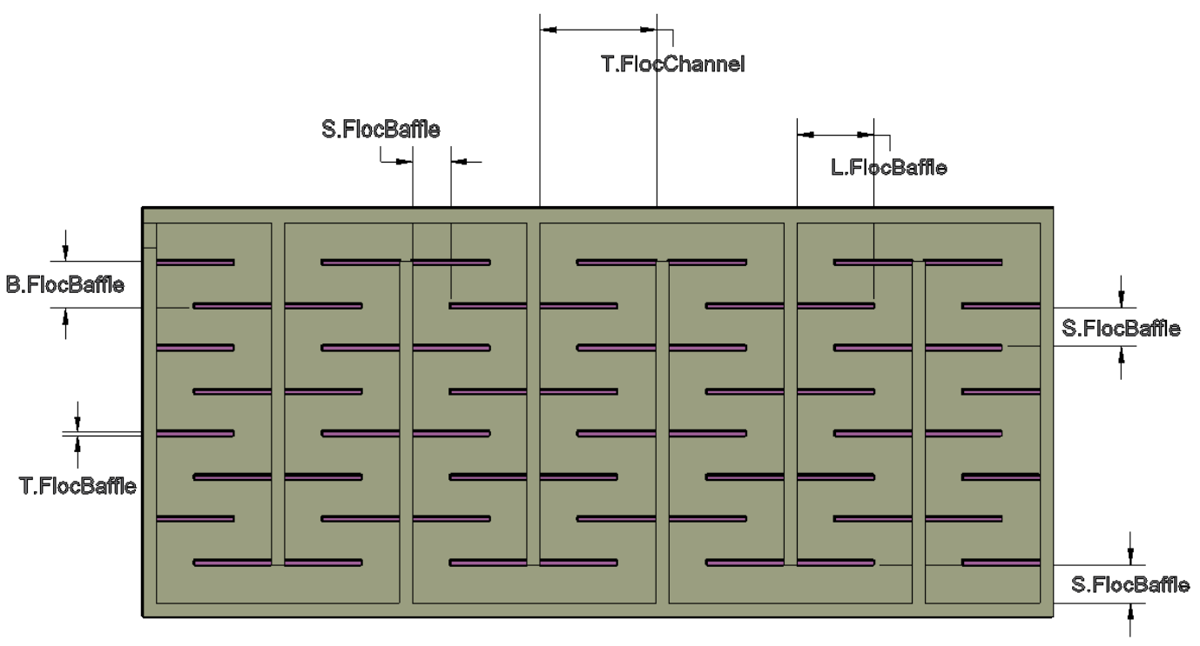
Top View - Horizontal
Generic | Vertical | Horizontal
P | W | H
S | S | S
T | H | W
Notes:
Here is the top view of the horizontal flocculator. One of the big changes that we made is no longer having a port that the water flows through to get from one channel to the next. This was only necessary to maintain the flow pattern for vertical, so in horizontal, it is just an open space. Another change is that the number of baffles is the same in every channel and it is even. This is because tapering is likely not very helpful. Also, for vertical, the water flowed from a low position to another low position for every channel except the last channel. The flow is the same for all channels in horizontal. Another consideration we had to code was switching the positions of the baffles for every other channel so that this flow area connecting the channels would be created. We were able to eliminate the drain slots for the horizontal flocculator since draining should not be a problem.

Slide 12
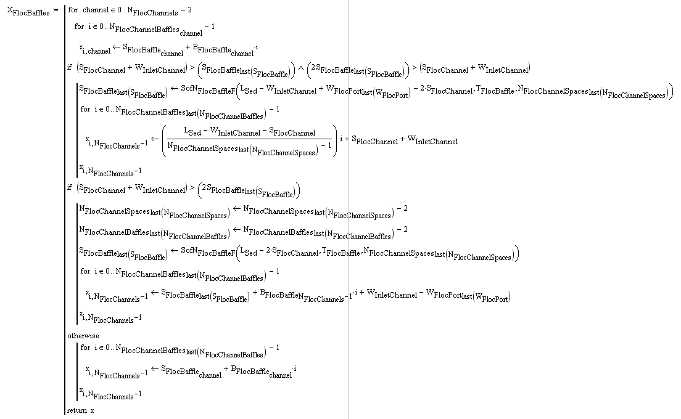
Notes:
Now we will walk through some of the coding we did. Just kidding!

Slide 13
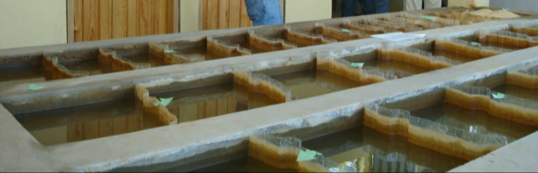
Choosing Between Horizontal and Vertical Flocculation
The current algorithm chooses between vertical and horizontal flocculation based on flow rate. Other constraints may be added later.
Notes:
Right now, the minimum flow rate for horizontal flocculators is about 100 L/s. If we add the option to make shallower flocculators to our design tool, we could design them for lower flow rates.

Slide 14
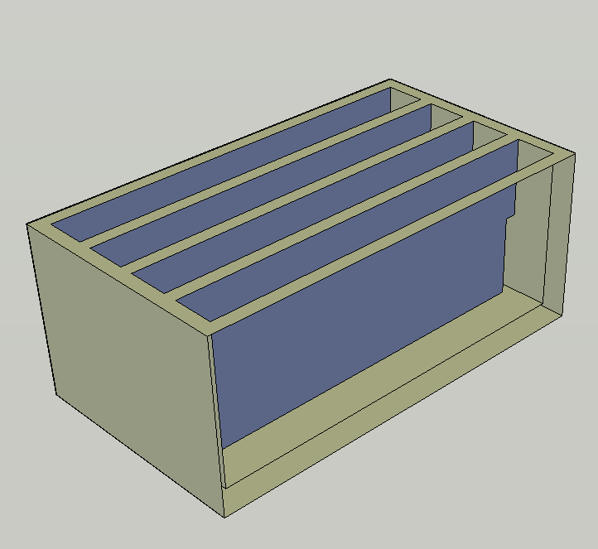
Vertical - Flocculation Tank Walls, Channel Walls, and Channel Ports
Notes:
The outer tank wall is drawn, then the channel walls are drawn and unioned with the tank. The ports between channels are drawn as boxes as well and then subtracted from the single tank object with 1 command.

Slide 15
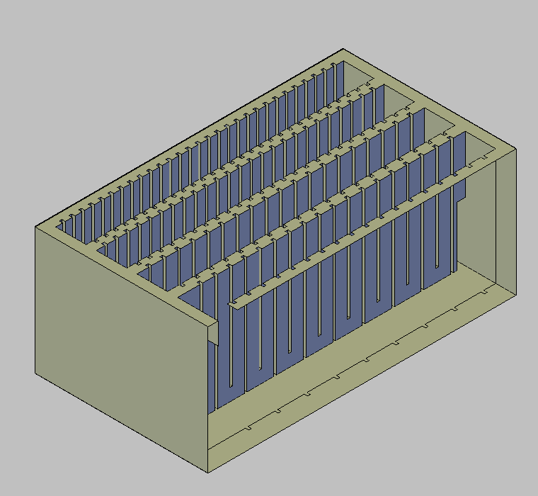
Vertical - Exit Channel Port and Baffle Slots
Notes:
Slots are drawn as 3-D boxes that span the width of the channel plus the extra length into each channel wall. They also vary in height depending on if each baffle is an upper or lower baffle. All of the boxes are drawn at the same time, unioned, and then again subtracted in one command.

Slide 16
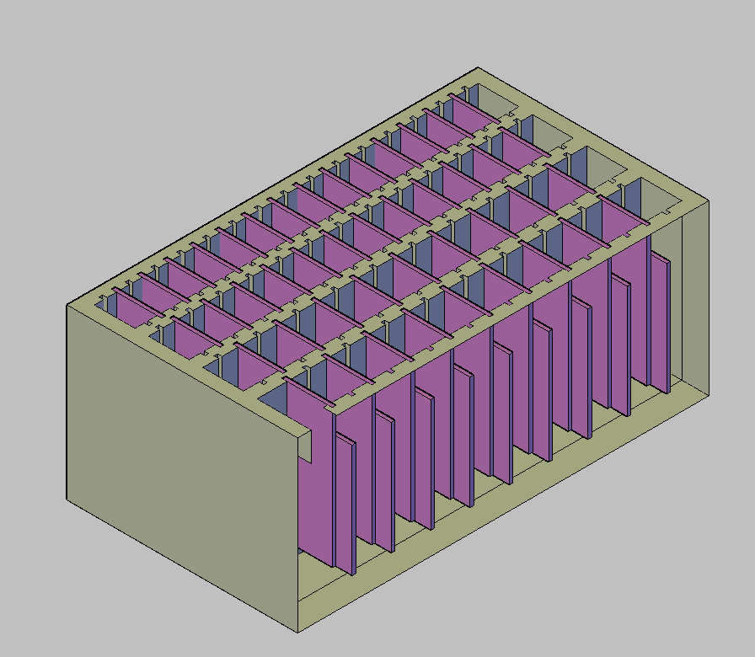
Vertical - Baffles
Notes:
The baffles are then drawn and use the same code that the baffle slots use.

Slide 17
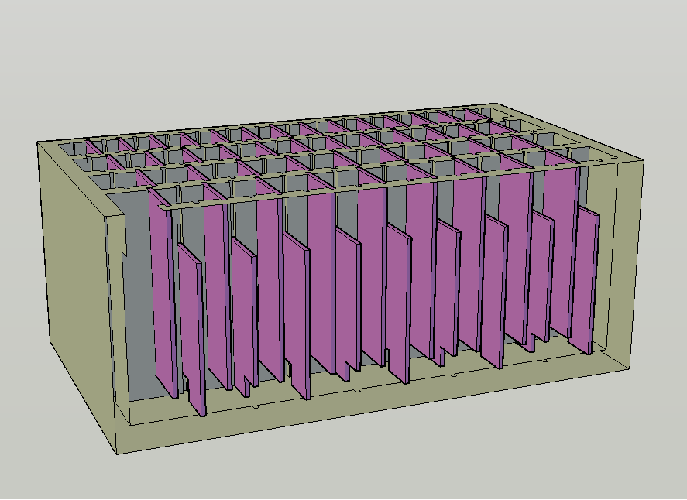
Vertical - Baffle Ports
Notes:
Slots are then drawn, again as boxes, that extend through each lower baffle, alternating sides. These boxes are unioned and then subtracted from the baffles in a single command.

Slide 18
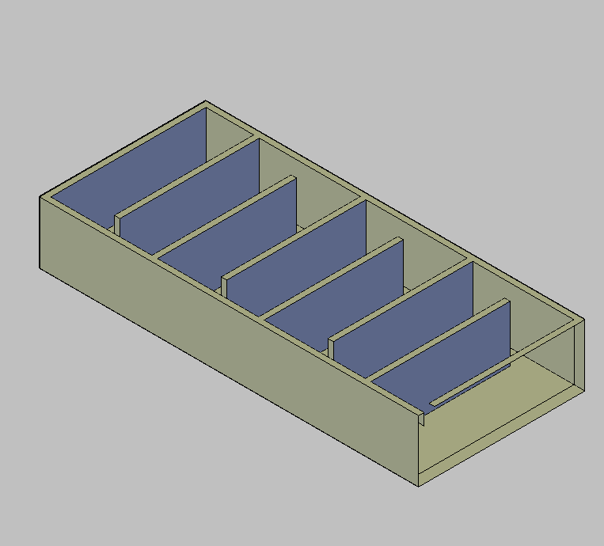
Horizontal - Flocculation Tank Walls, Channel Walls, and Channel Ports
Notes:
Similar to the vertical flocculator, the outer wall is drawn first and then the floc channel walls are drawn in for the full length of the tank. The ports between channels are made in a separate block of code that creates a boxes the height of the floc tank and the thickness of the channel walls with a depth of S.flocBaffle. These boxes are also unioned and subtracted from the tank object in a single command.

Slide 19
Horizontal - Baffles
Notes:
One notable difference between this and horizontal flocculators is that baffle here will always be made of ferrocement and thus not slid into slots; it will be part of the wall. When drawing this, then, the baffles are drawn as separate pieces with no slot, but when building it would all be connected.

Slide 20
Sed Tank Control Pieces
Task: Design control pieces for the inlet chimneys and launders to allow for draining and re-filling the sedimentation tank
Results
  Designed control pieces
  Created algorithm to draw PVC pipe caps
  Updated/wrote code to draw couplings based on two different constraints

Slide 21

Procedure to drain and re-fill the Sedimentation Tank
Notes:
Quick review of the process to drain/re-fill the sedimentation tank

Slide 22
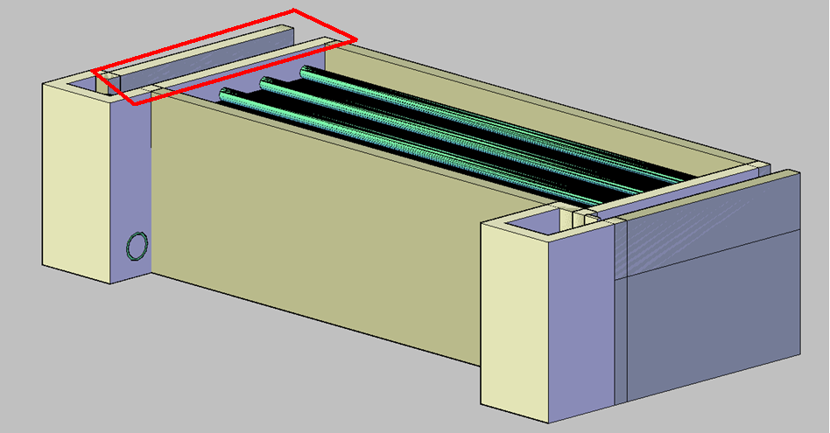
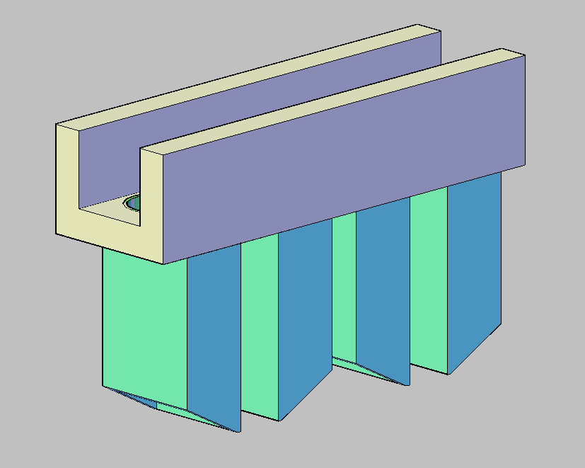
Sed Tank Control Pieces
Notes:
This is the sedimentation tank. We are looking at the inlet channel/chimneys.

Slide 23
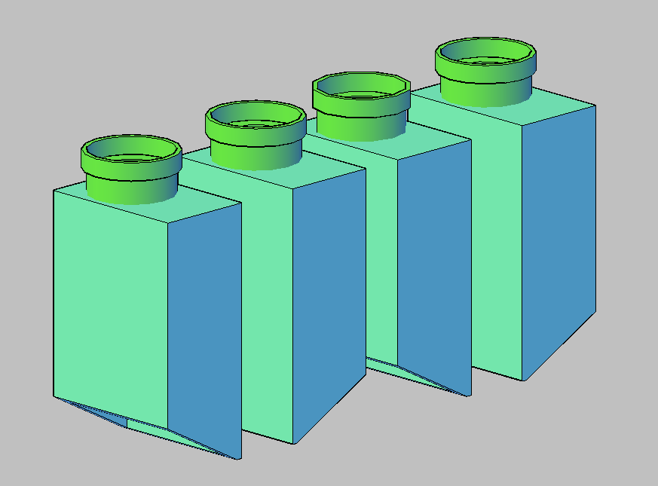
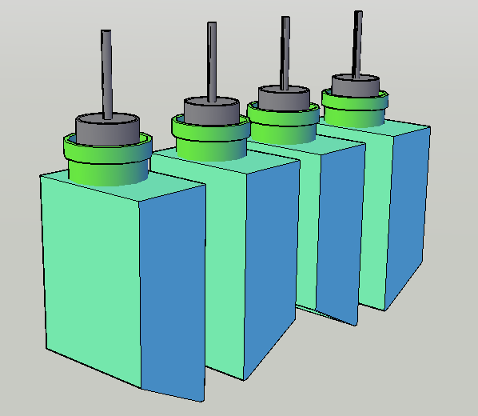
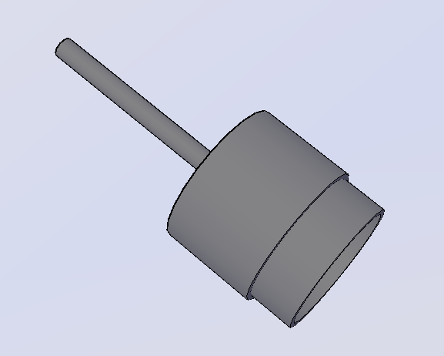
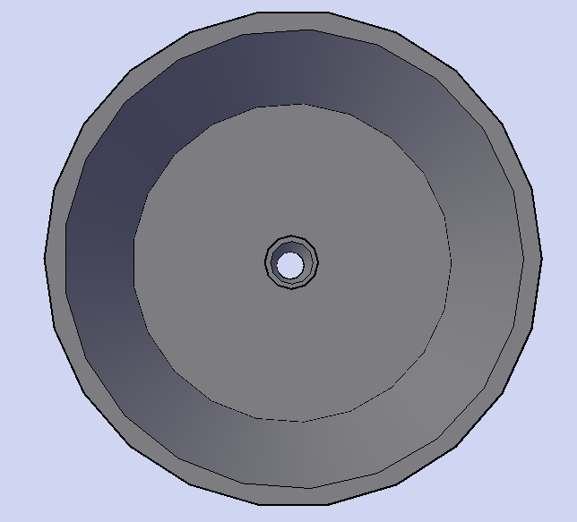
Inlet Chimneys
Notes:
Inlet Chimneys. Once the coupling was adjusted correctly, started designing control pieces to fit into the couplings and stop the flow of water from the inlet channel to the sedimentation tank.
This control piece consists of a short stub of pipe with a PVC pipe cap glued on. The cap has a hole drilled in it with a thin tube of diameter less than 1 inch to
allow for air to escape, and
to act as a handle.
The major hurdle in designing this piece was that prior to this, AguaClara did not have an algorithm for drawing PVC pipe caps. Spent a couple weeks researching caps online, communicating with McMaster and other manufacturing/plumbing companies to find more information on the appropriate types and sizes of caps. Once this research had been completed I added it into the Pipe Database MathCAD file, so now for any Nominal Pipe Size, you can also call the corresponding Diameter and Height of the PVC cap that would fit over it.

Slide 24
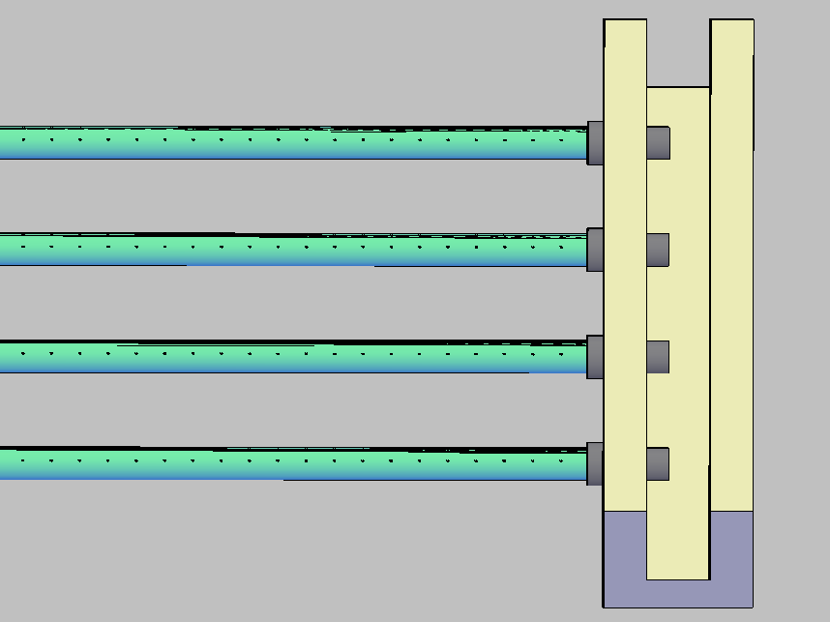
Launder/Exit Channel
Notes:
Also need to stop flow between sedimentation tank and Exit Channel through the launder.

Slide 25
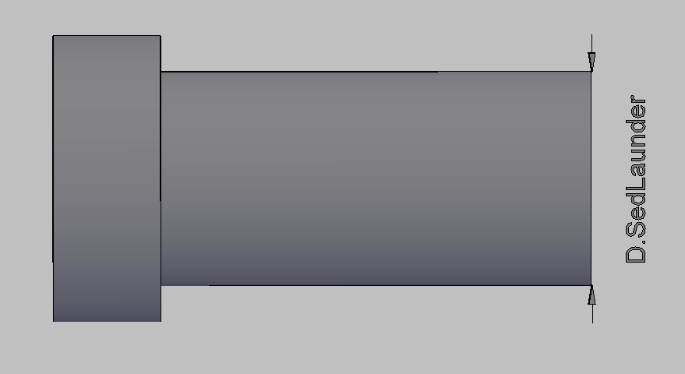
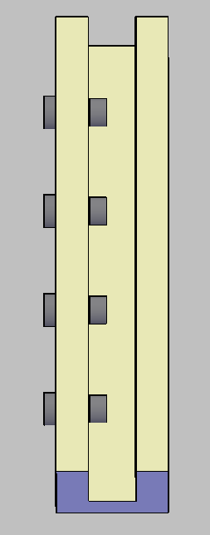

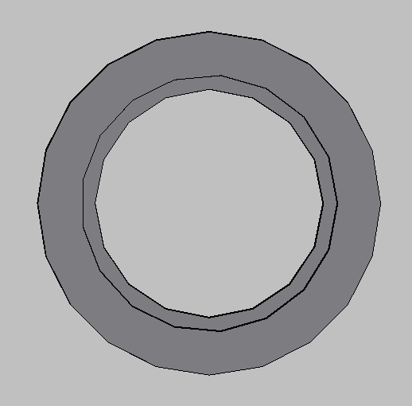
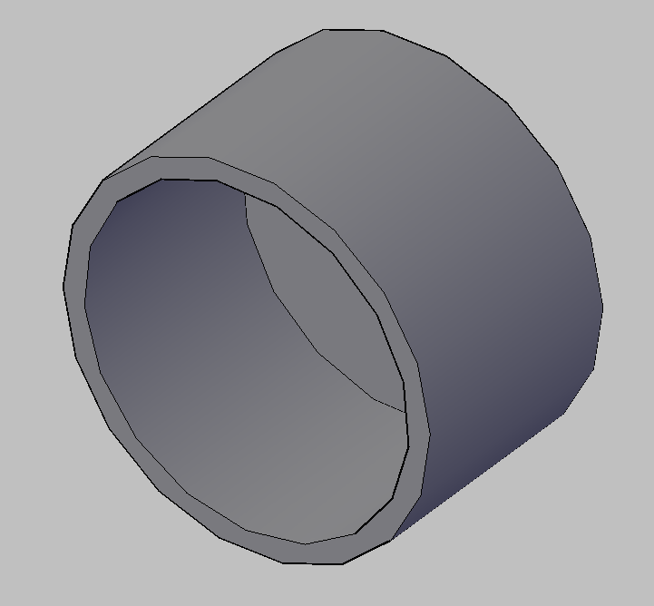
Launder Coupling and PVC Cap
Coupling
PVC Cap
Notes:
Prior to this, our plants were building in couplings for the launder, but we didn’t have it drawn in AutoCAD. That was the first step. Since we had just finished designing the coupling for the inlet chimneys we had something to work off of, however, there was a small difference between the coupling used in the inlet chimney and the one used for the launder that caused some trouble.
For the inlet chimneys, the size of the coupling is determined by the inner diameter of the coupling pipe (determined by the Energy Dissipation to figure out the smallest diameter we can use without breaking up flocs). However, for the launder, the diameter of the launder had already been determined, so the size of the coupling was determined by the outer diameter of the pipe fitting into the coupling – i.e. the inner diameter of the coupling socket. Had to play around with MathCAD functions, etc.
To stop water flow, just fit PVC cap over the coupling pipe on the exit channel side.

Slide 26
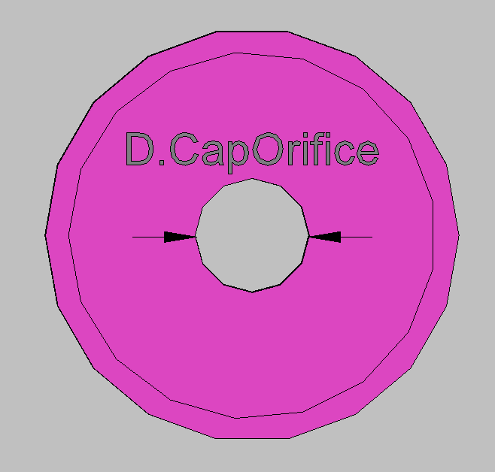
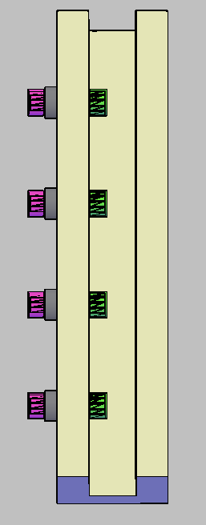
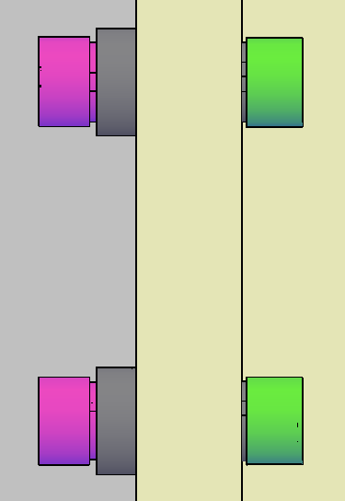
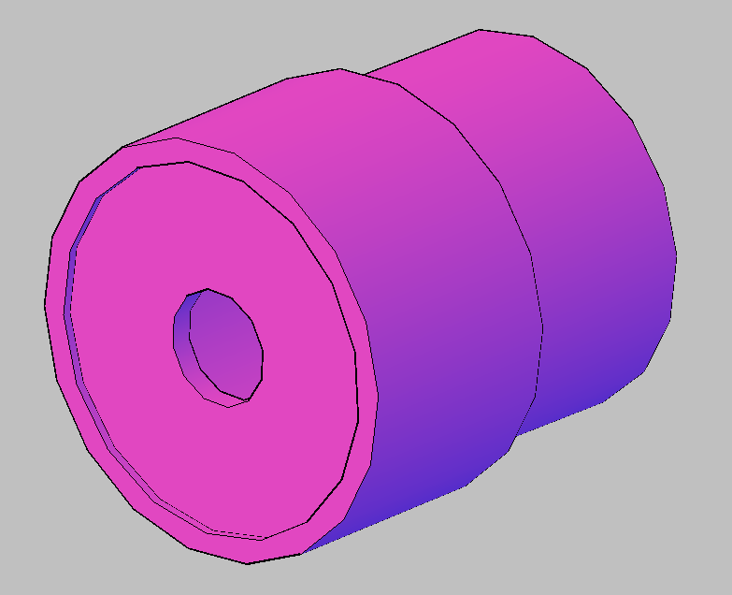
Control Piece
Control Piece
PVC Cap
Q=K_{vc}A(2gh)^{1/2}
D.CapOrifice=(4A/pi) ^{1/2}
Notes:
Remove launder. To refill tank, had to design new control piece. This control piece consists of a short stub of pipe attached to a PVC cap with a hole drilled in the center. The size of the hole is determined by the orifice equation based on the flow rate through the exit channel. This is extremely important because the flow rate through the orifice into the sedimentation tank cannot be higher than the flow rate out of the other tanks. Otherwise the plant water level will drop.

Slide 27
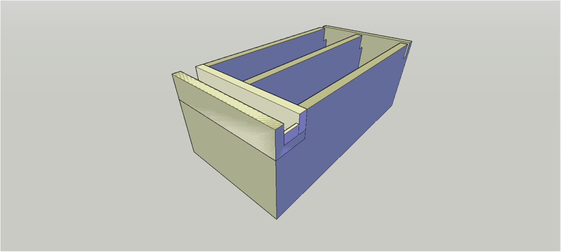
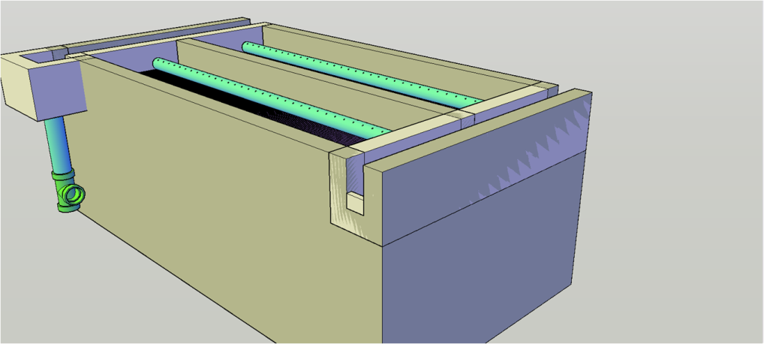
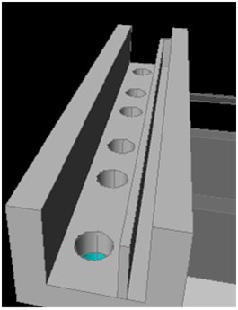
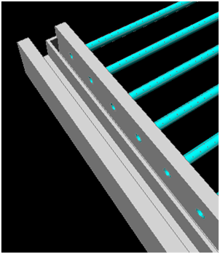
Weir Backround

Slide 28
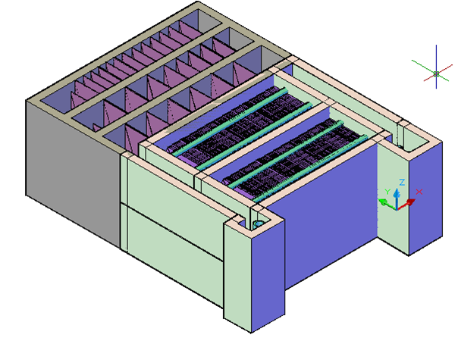
Old Design
Wasted Materials
New Drain System

Slide 29
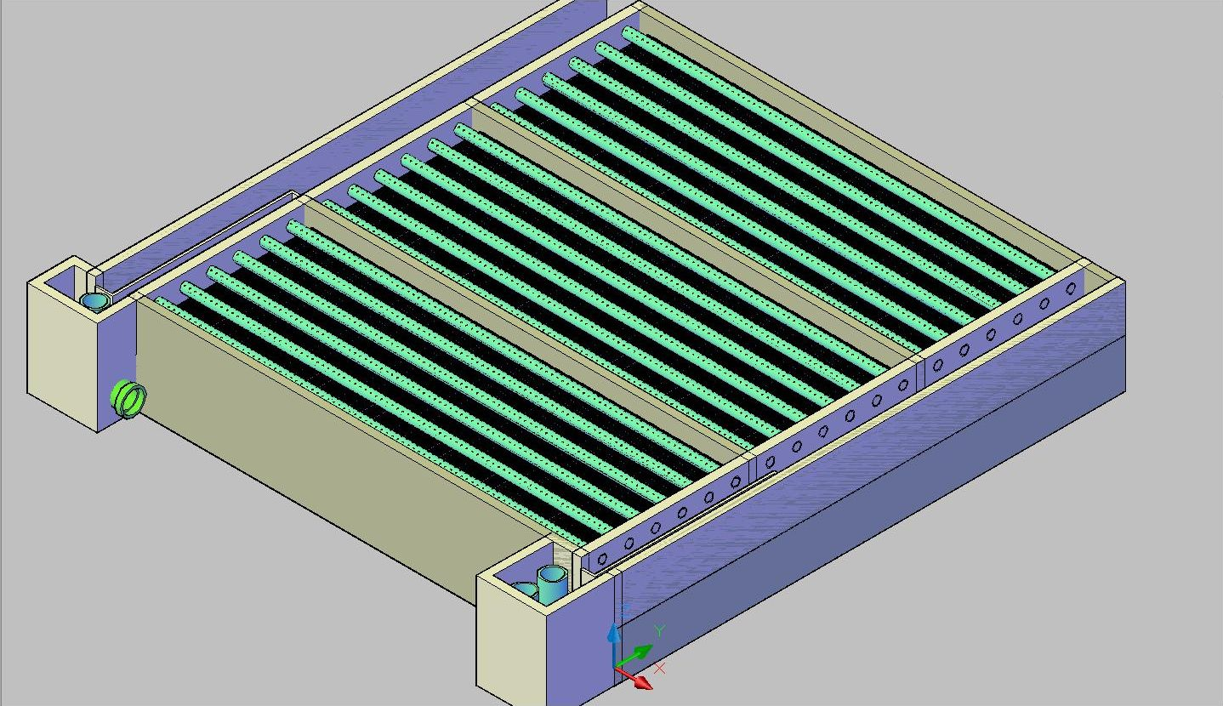
Changes
Waste of material
  Tank heights
  Repositioning
To allow for new drainage system
  Weir elbows
  Weir pipe elevation
  Inlet tank extends too far
Approach
  MathCAD and AutoCAD

Slide 30

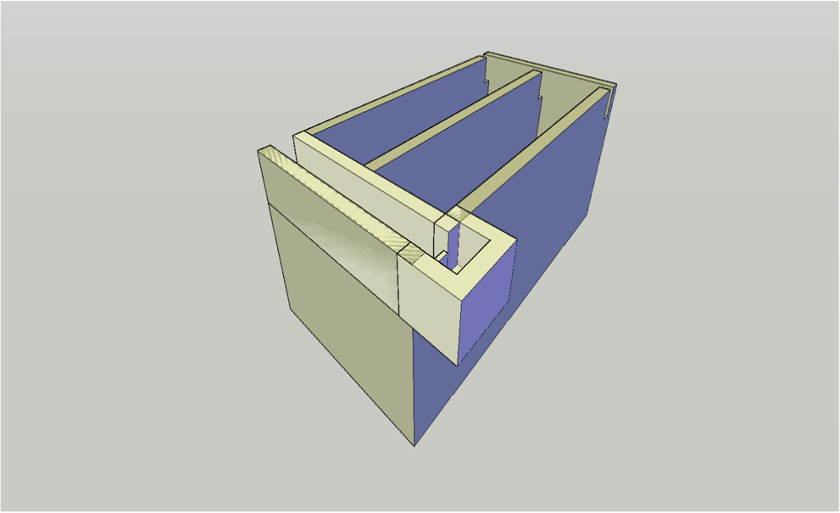
New Inlet Tank

Slide 31
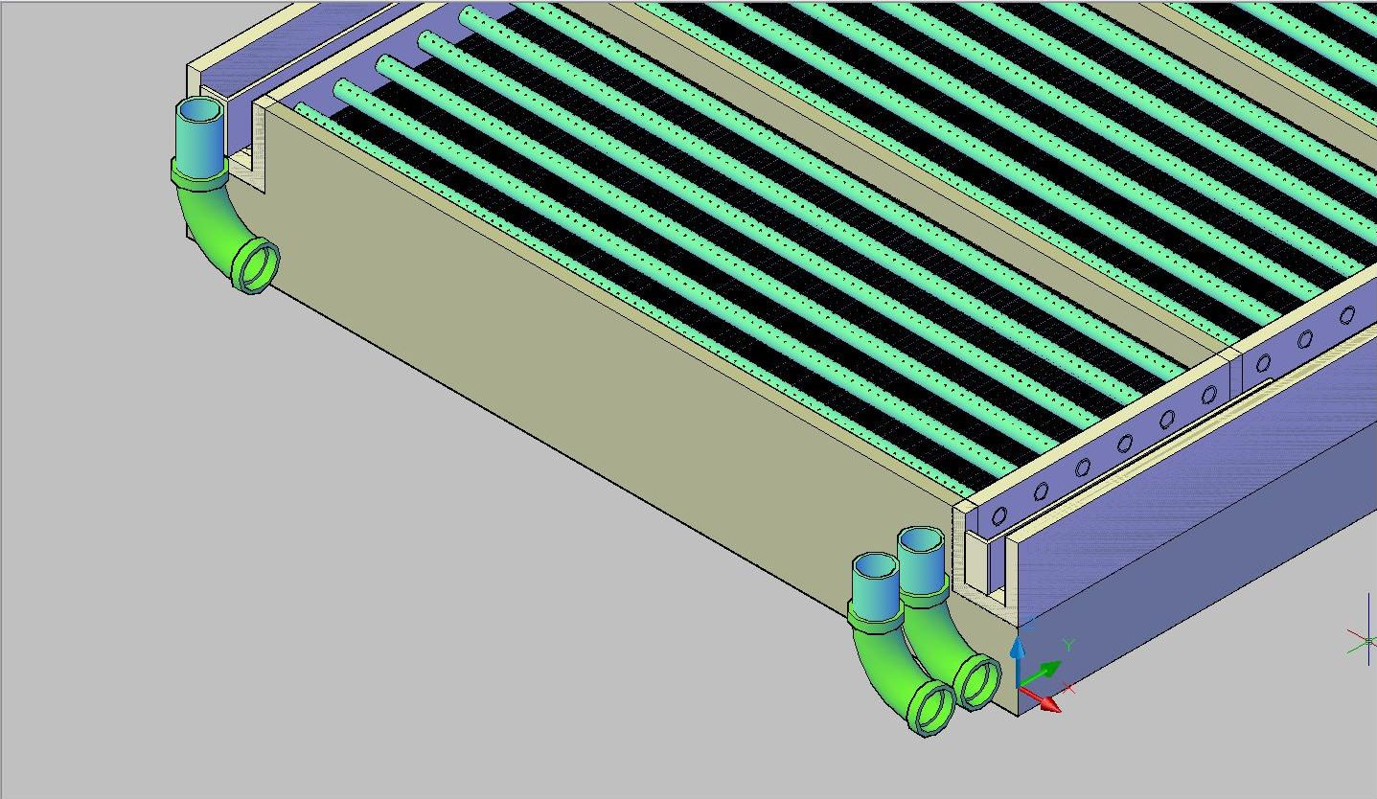
Shape and orientation
Weir Elbows
Waste exit weir should empty in the direction shown
Connect by pipe
Change inlet weir elbow into tee

Slide 32
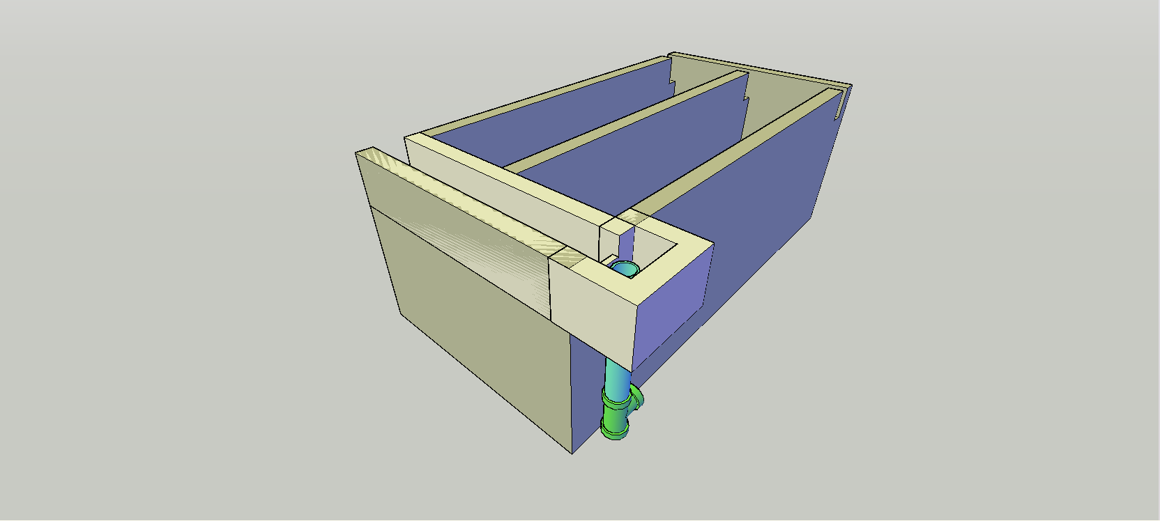
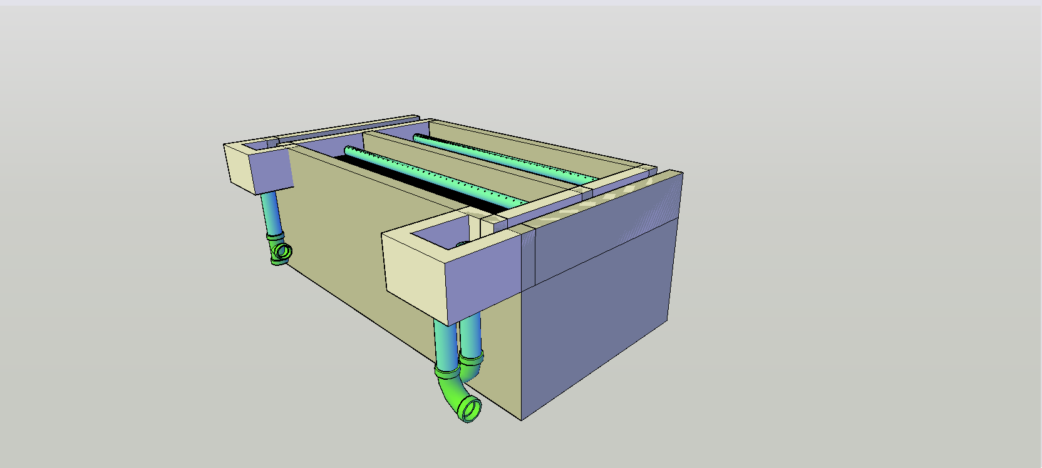

Slide 33
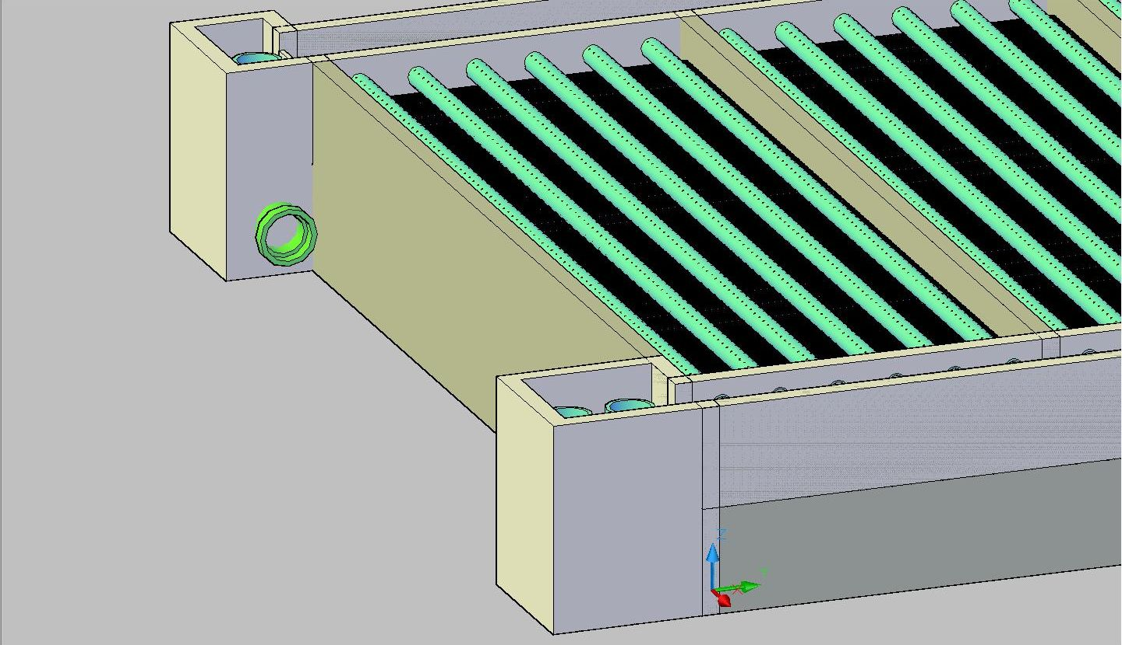
Drainage Plugs
Weir pipes elevated to height of Sedimentation tank

Slide 34

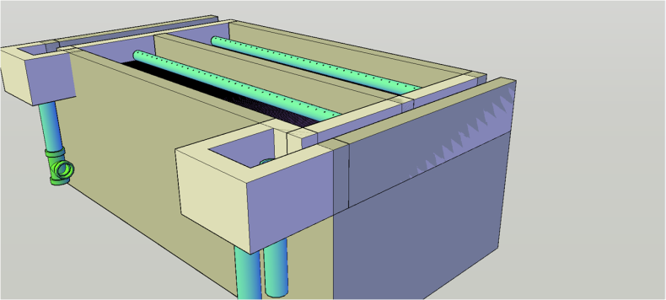
New Design
Future Changes
  More to Code
    Weir plugs
    Connecting pipe
    Inlet tank dimensions
  Drainage System
    Channel
    Cover
    Drain Valves

Slide 35
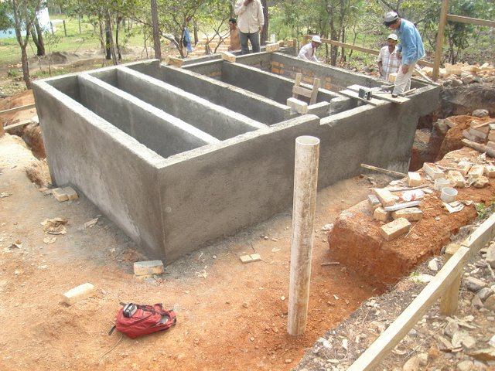
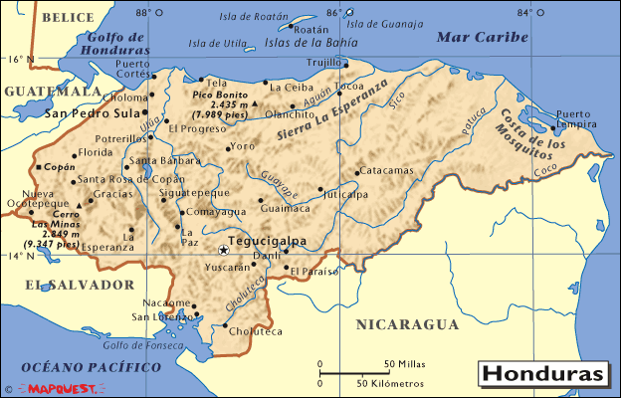
Agalteca

Slide 36
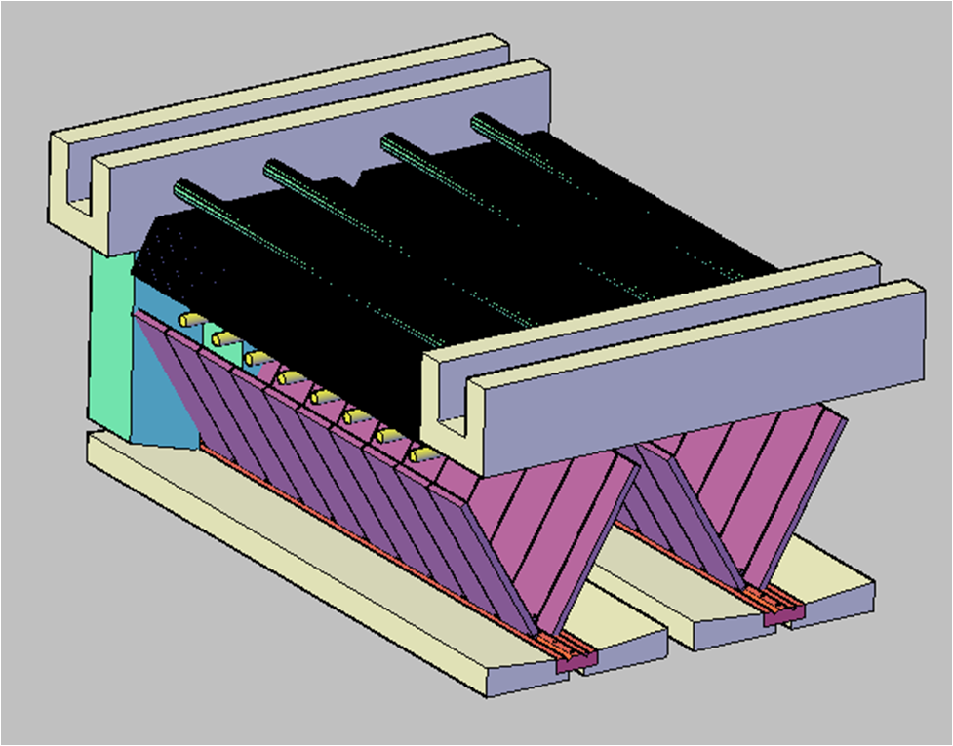
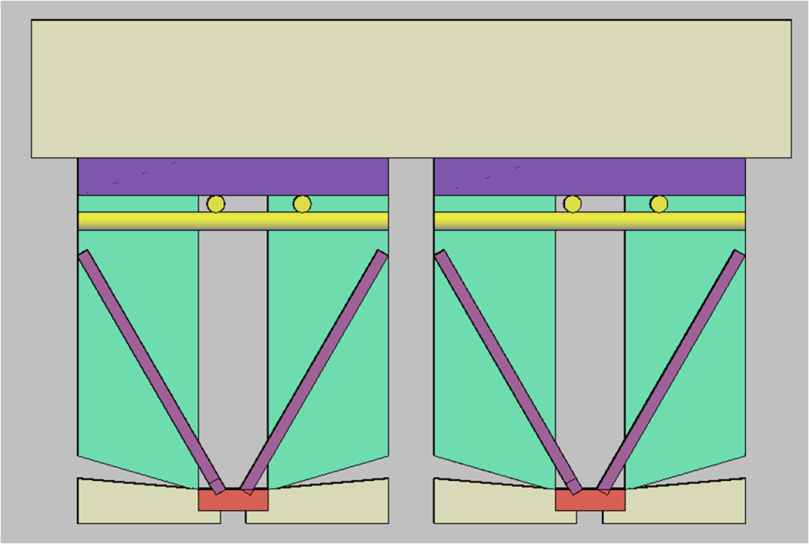
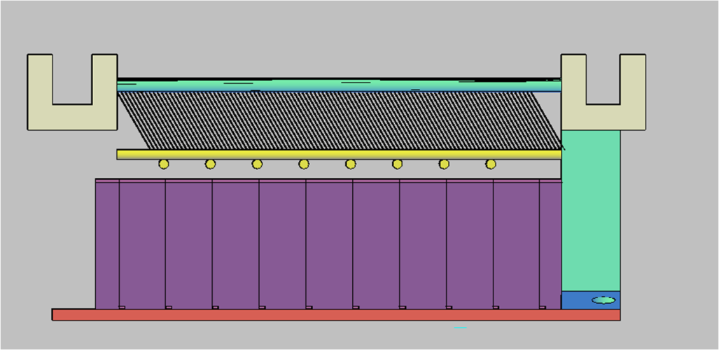
Agalteca
Initial Design

Slide 37
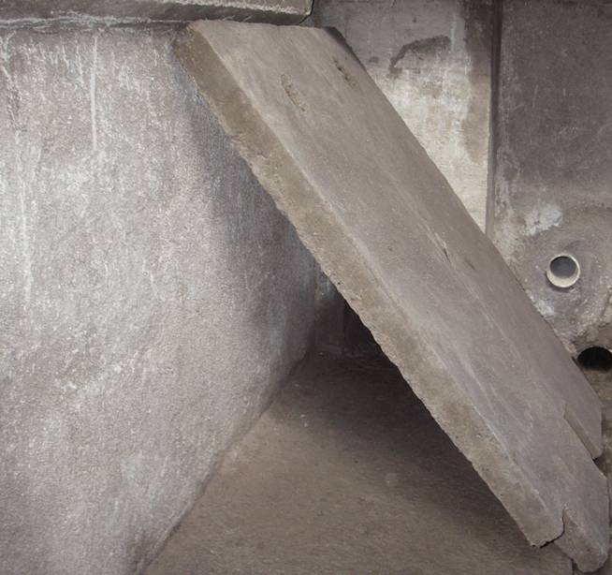
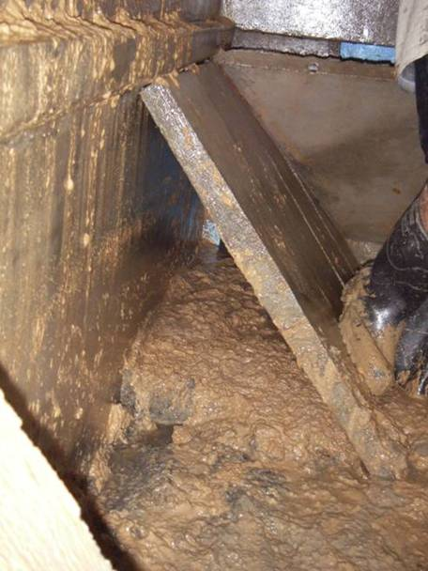
Agalteca
PROBLEMS
Velocity inside inlet manifolds very low
Flocs settle inside manifold (NOT IN SED TANK!!!)

Slide 38
Agalteca
Objective
Increase Velocity
Prevent floc settling inside inlet manifold
Contraint
Low energy dissipation
Prevent floc breakup

Slide 39
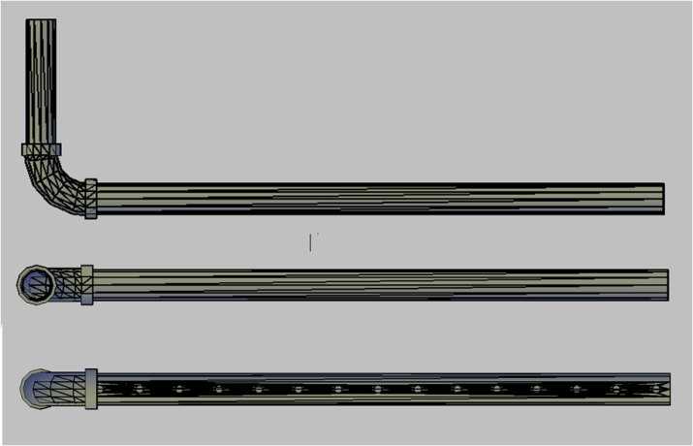


Manifold and Drain Cover Desing
Circular Inlet Manifold
You buy it, don’t have to build it
Can replace it easily
Drain Cover Design
Removable
Easy to replace
Easy to handle for maintenance

Slide 40


Agalteca
Final Design
Velocity Inside Manifold = 0.173 m/s
Energy Dissipation = 7.089 mW/kg

Slide 41

Santa Rosa de Copan

Slide 42
Prefilters
Sludge settling in distribution tank
Filters
PROBLEMS!!!
ΔH~700m
Energy consumption
Rio Higuito
Pump wear

Slide 43

Prefilters
AguaClara Plant
Filters
IDEAS!!!
ΔH~700m
Rio Higuito
Grit chamber

Slide 44

Santa Rosa de Copan

Slide 45

Santa Rosa de Copan
Alternatives

Slide 46


Santa Rosa de Copan
Entrance Tank Design

Slide 47

Santa Rosa de Copan
Final Design

Slide 48
Materials List: Our Task
Update materials list
Meet the needs of the engineers in Honduras
Dividing up total volumes into sub-volumes
Finding surface areas of the walls and floor of individual components
Let them know which materials to use and how much

Slide 49

Inlet Channel

Slide 50

Flocculation Tank

Slide 51

Sedimentation Tank

Slide 52
Recommendations
Go through design schematics for supplementary materials
Input basic values into the ADT to check that outputs are reasonable
Continue updating Materials List equations

