Slide 1
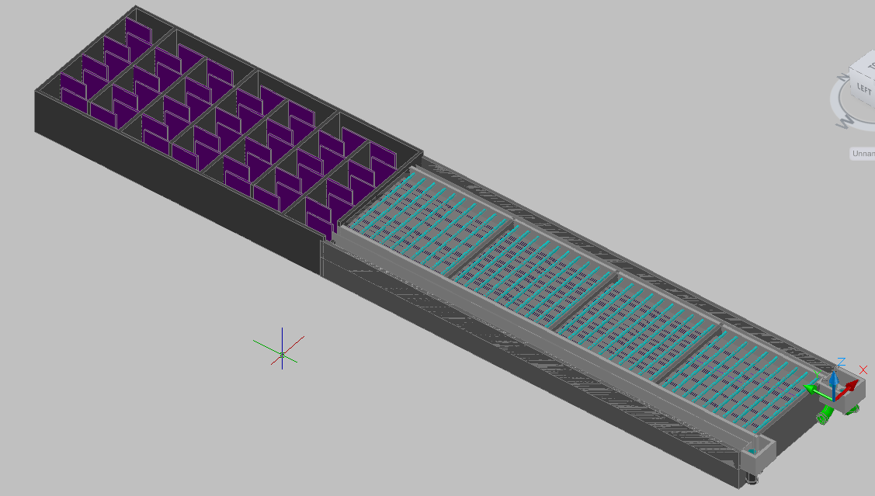
Design Team
Final Presentation

Slide 2
Outline
Chemical Storage Tanks: Jon Miron
Entrance Tank and Rapid Mixer: Jeff Katz
Flocculator: Jeff Will, May Sharif, Julie Pierce
Launder: Nanditha Ramachandran, Massielle Begazo
Pipe Frame and Lamella: Trang Pham, Mike Liu
Inlet and Exit Tanks: Andrew Sargent, Andrew Hirshfield
Documentation: Josiah Pothen, Andrew Smith, Tai Kim

Slide 3
Alum Stock Tank
Jon Miron

Slide 4
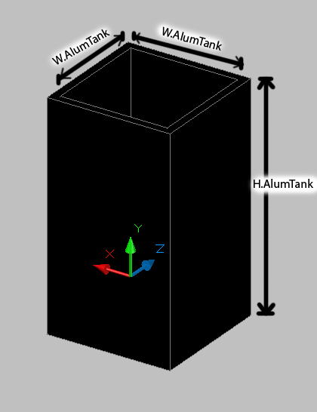
Determine dimensions of tank
Notes:
based off user specified inputs (plant flow rate,time between chemical refills, and concentration of chemical doses

Slide 5
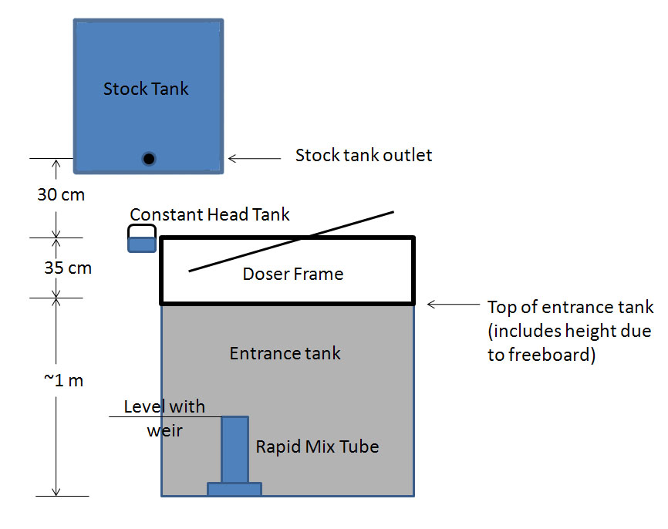
Elevationof Storage Tank

Slide 6
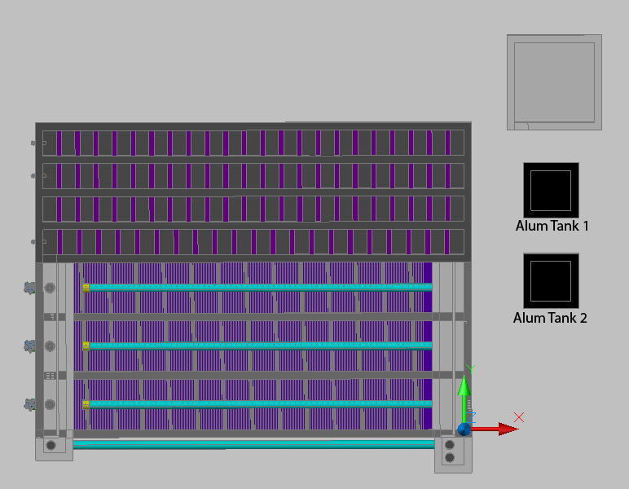
Bird’s Eye view of the water treatment plant

Slide 7
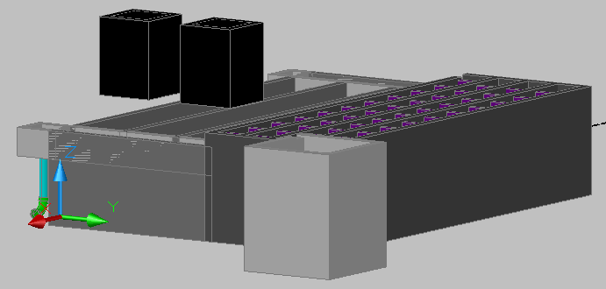
Side view of the water treatment plant

Slide 8
Entrance Tank and Rapid Mixer
Jeff Katz

Slide 9
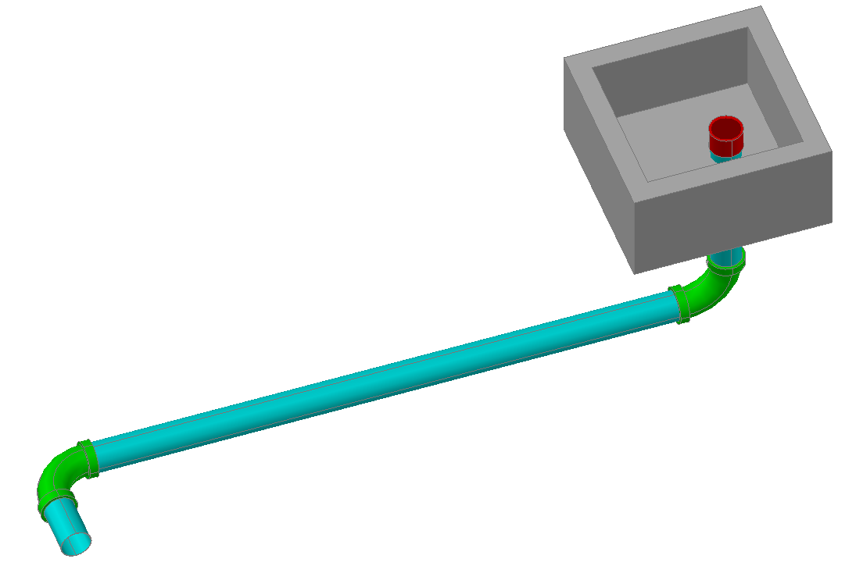
Entrance Tank and Rapid Mixer
Provides the head necessary to drive water through the plant, as well as mixing the alum and raw water on both the macro and micro-mixing scale.

Slide 10
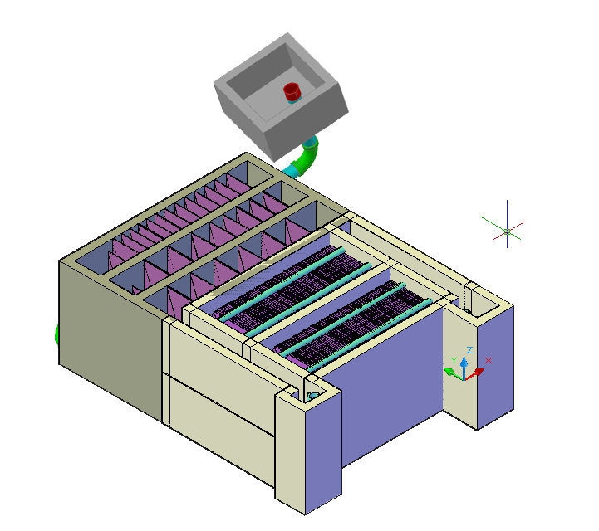
Relative Location
Not to scale

Slide 11
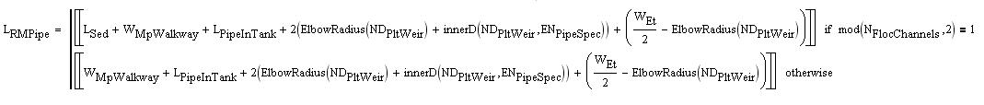
Parts Explained
This entire rapid mix system accounts for a head loss that will provide a total head loss of 40 cm throughout the plant
Top of cap is at height of weir at end of sedimentation tank, so when there is no head there is no flow
L.Sed + W.MPWalkway
If there are an odd number of floc tanks, the pipes and elbows span the length of the flocculator plus the width of a walkway. For an even number of tanks it just spans the walkway.
Connect the rapid mix system to the flocculator

Slide 12
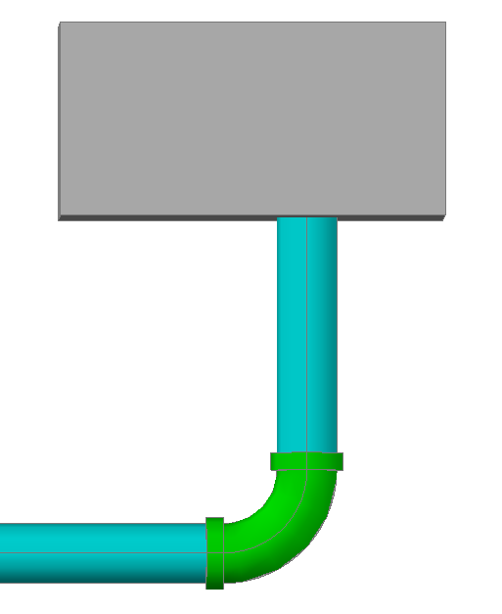
Elevating Bottom of Tank
H.Et
Z.Et
The bottom of the entrance tank doesn’t need to be at the bottom of the flocculator! Save materials, can dig out flocculator
Provides a distance of two pipe diameters beneath the tank (along with the pipe radius and thickness of concrete). Necessary distance for adequate mixing.

Slide 13
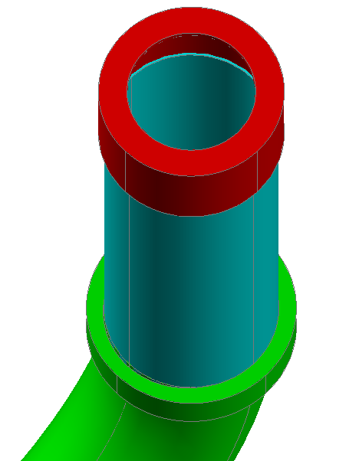
Macro-mix Orifice
ND.RMPipe
MacroMODiameter
CapHeight(ND.RMPipe)
The head loss through the macromix orifice is constrained at a maximum of 5 cm.
The value of the head loss through this orifice determines the head loss that the micromix orifice needs to provide.
L.PipeInTank

Slide 14
Accomplishments
There actually is a rapid mix system. Previous Entrance Tank code was a box with a small channel on the top.
Cap on top of system has hole in it size of macro-mix orifice, providing necessary macro-mixing head loss.
Entire pipe and orifice system should provide a head loss of 40 cm throughout the entire plant (once micromixing orifice is drawn)

Slide 15
Things to Be Fixed
Head loss through rapid mix system treats elbows as lengths of pipe. Head loss is different in an elbow than in straight pipes.
The length of the pipes needed is determined from the nominal diameter of the pipe. This isn’t solved until the end, so ND.PltWeir is used initially. Negligible difference, but if this recursive problem could be solved, it would be more accurate.

Slide 16
Future Work
Coupling issues.
  Thickness of entrance tank needs to be increased, because at current thickness the necessary coupling does not exist. However, increasing the thickness makes the length of the pipe in the tank very small (maybe a length impossible to cut). Need to determine “happy medium” that will establish a coupling and a pipe length that exists.
  Potentially need to increase height of entrance tank to accommodate this

Slide 17
Future Work
Implement the micromixing interface
Split the vertical pipe that runs through the tank into one pipe in the tank to the coupling and one pipe from couplinge to elbow.
Combine Rapid Mix MathCAD files into one

Slide 18
Flocculator
Julie Pierce

Slide 19
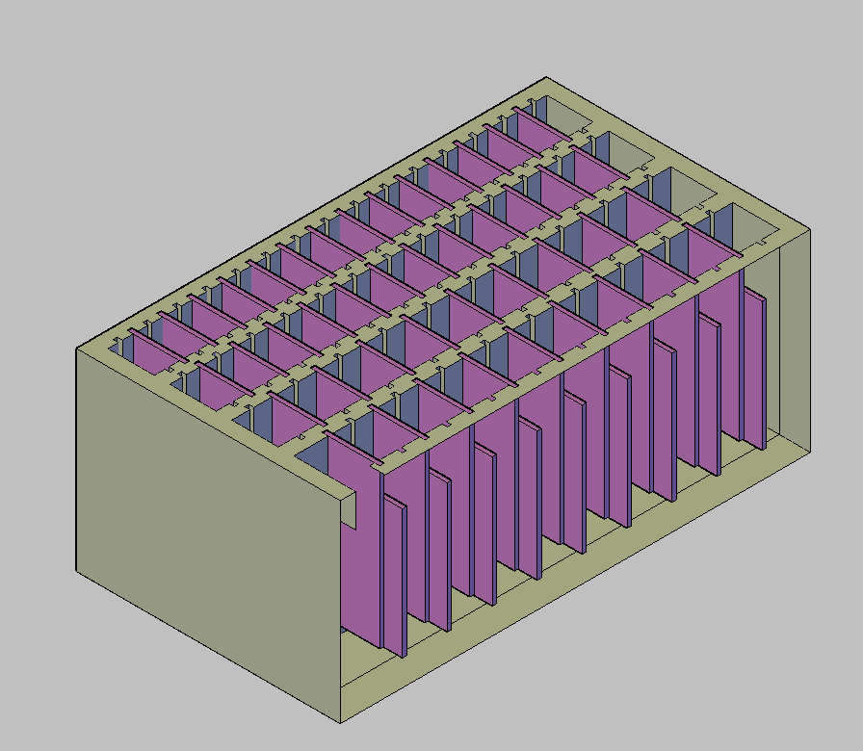
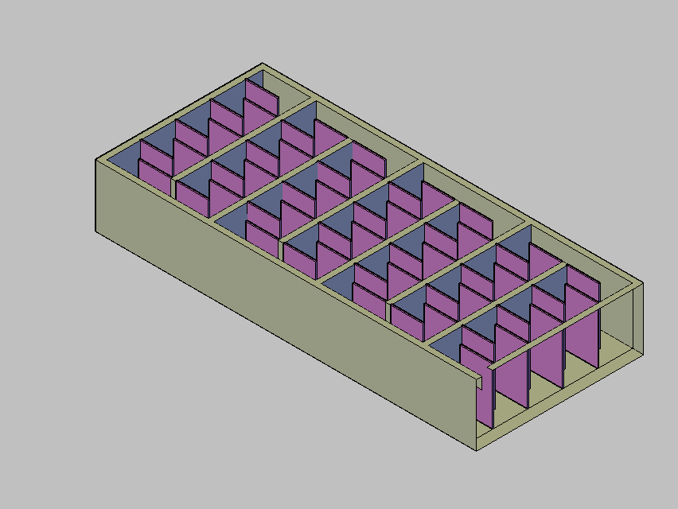
Testing and Implementing Code for Horizontal Flocculator
Vertical Flocculator
Horizontal Flocculator

Slide 20
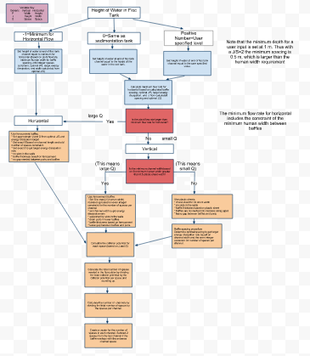
Decision Path for Flocculator Code

Slide 21
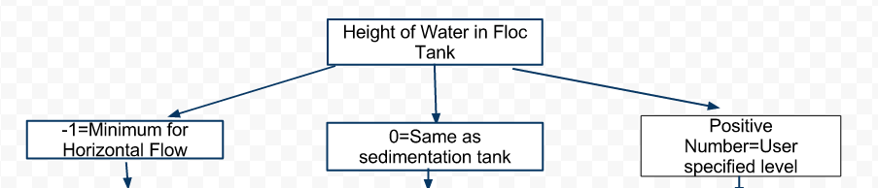
First Step: User Specifies Water Height
-Easier to Drain
-Usually better for high flow rates, but this option allows designs for low flow rates
-Traditional AguaClara design
-Maximizes shared wall space
-User picks height of water based on terrain or other constraints
-Allows more flexibility

Slide 22
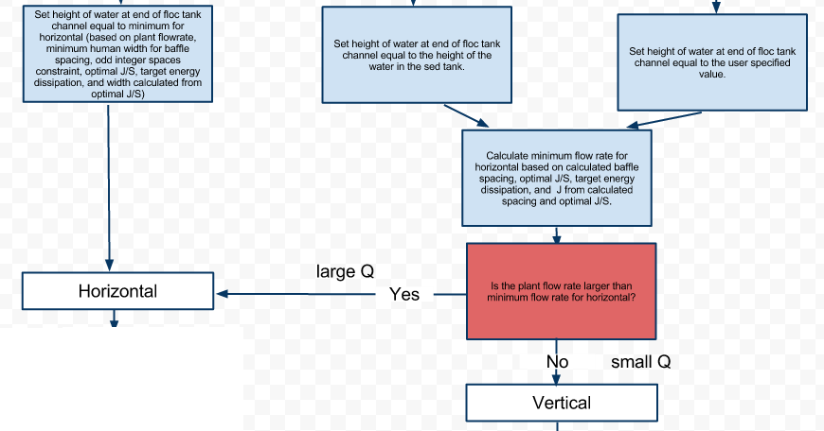
Second Step: Horizontal or Vertical

Slide 23
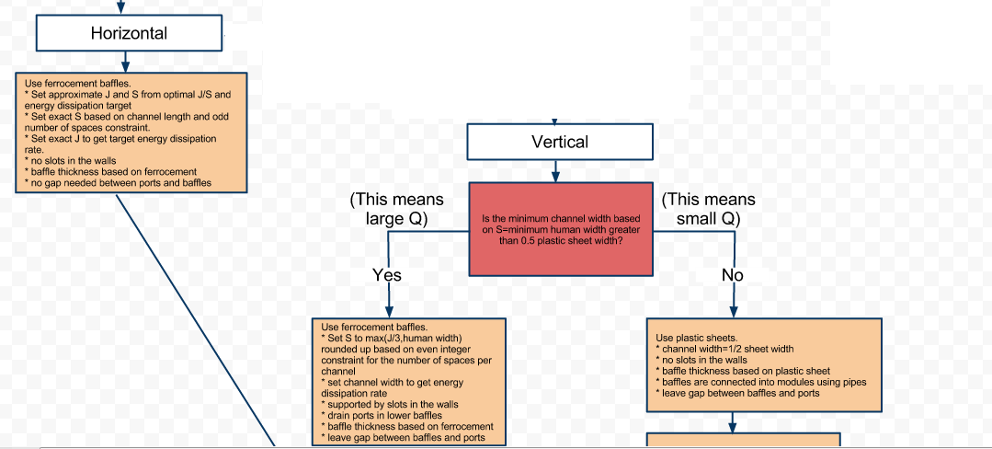
Third Step: Baffle Type

Slide 24
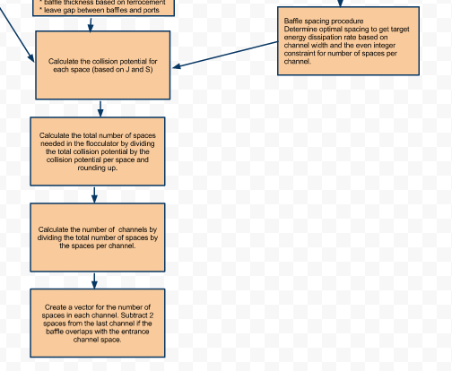
Fourth Step: Baffle Spacing

Slide 25
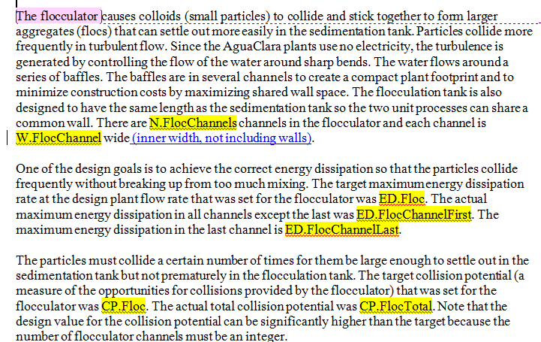
Flocculator Documentation

Slide 26
Drain Valves, Slopes, and Adapters
May Sharif and Jeff Will

Slide 27
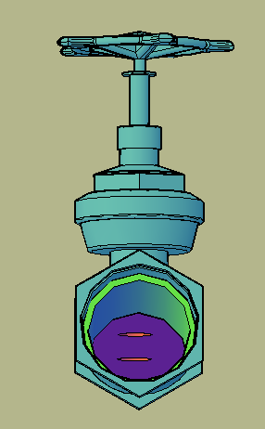
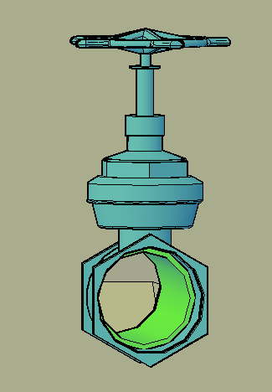
Drain Valves, Slopes, and Adapters

Slide 28
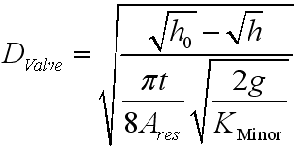
Idealized Diameter

Slide 29
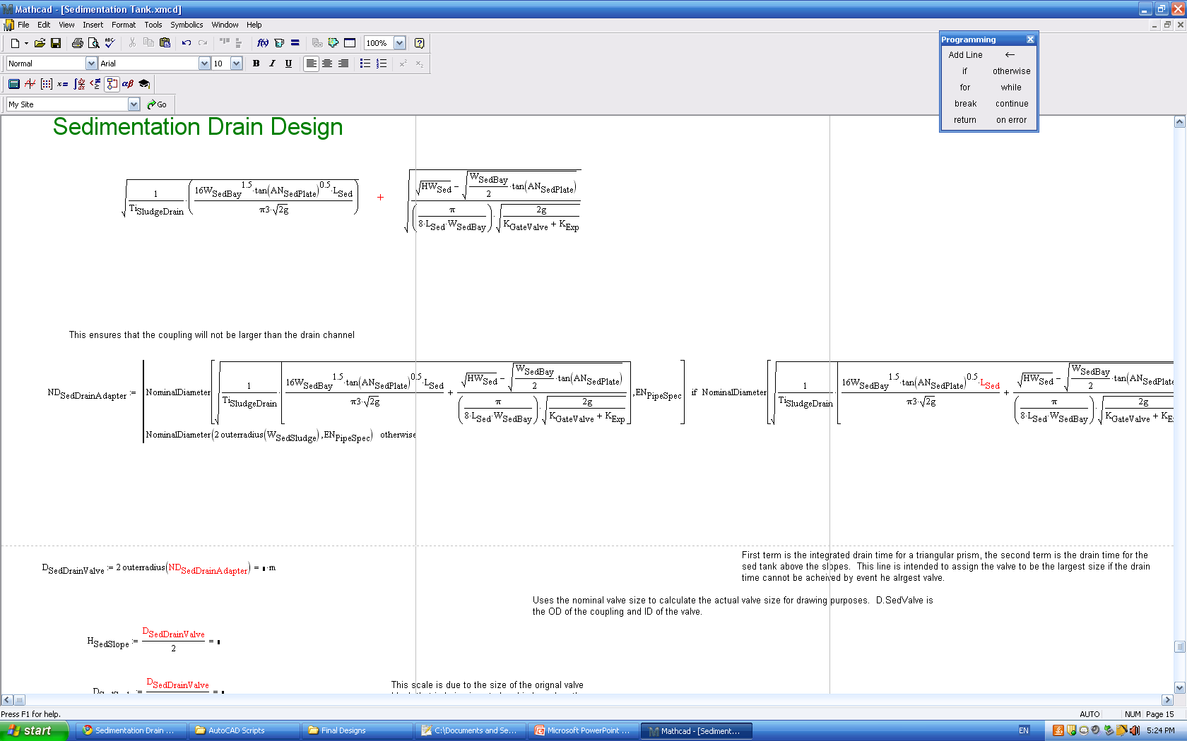
Drain Sizing
Drain time for a rectangular tank
Drain time for an inverted triangular tank
Notes:
Same as port sizing

Slide 30
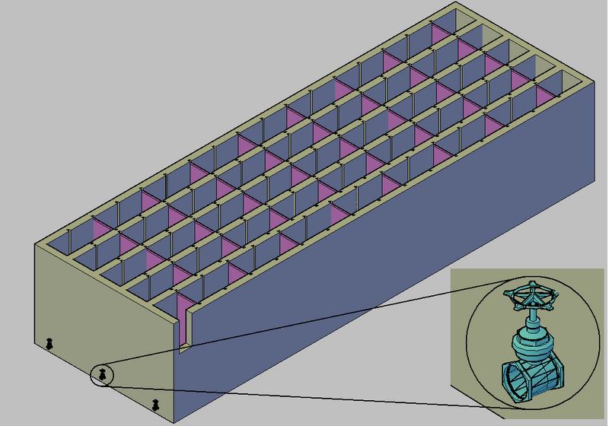
Flocculator Drain Valve
Notes:
Block that is inserted

Slide 31
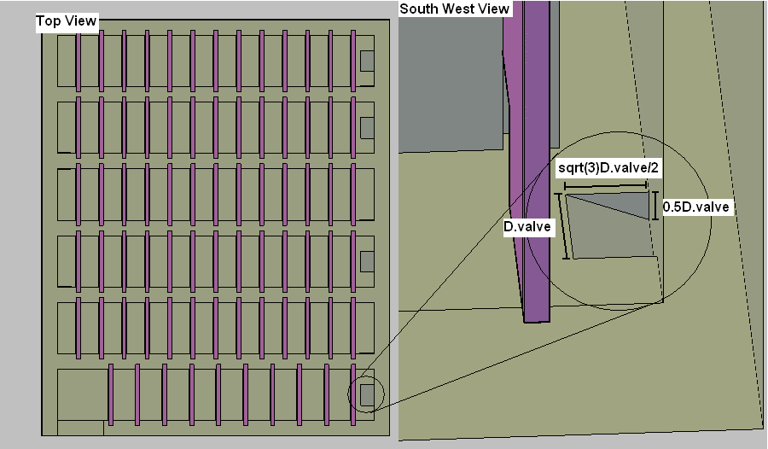
Flocculator Drain Slope
Notes:
Slope length may change depending on the space between baffles

Slide 32
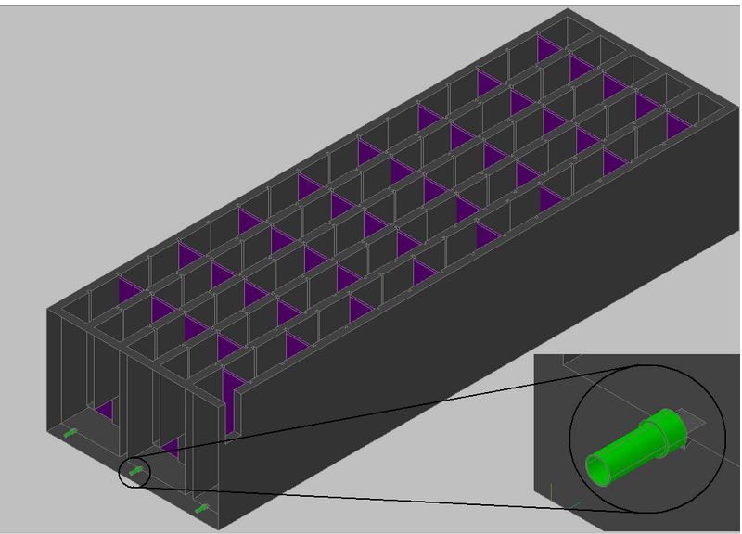
Flocculator Drain Adapter
Notes:
Adapter script takes a layer as an argument from which to subtract the adapter

Slide 33
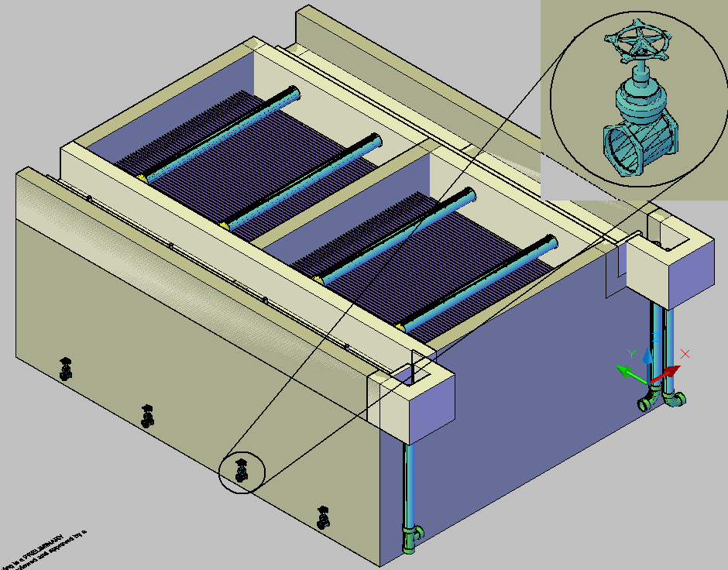
Sedimentation Drain Valves
Notes:
The valve size is limited by sludge drain channel width

Slide 34
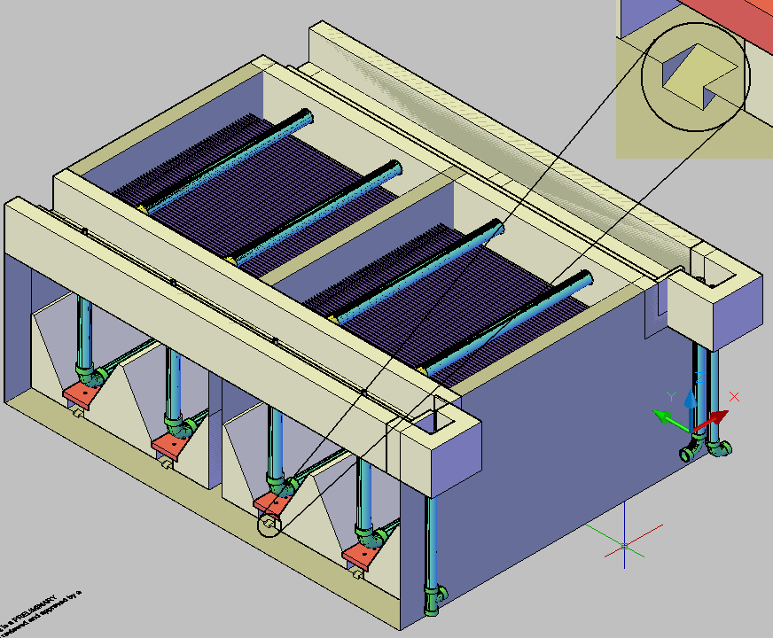
Sedimentation Drain Slopes

Slide 35
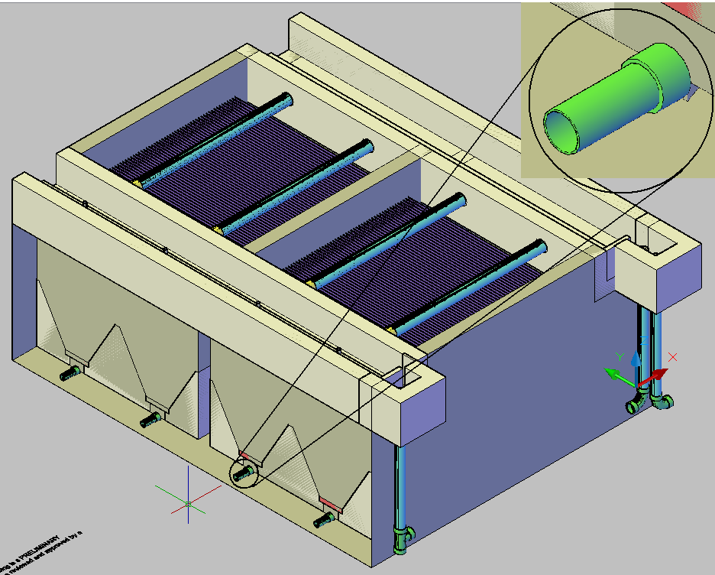
Sedimentation Drain Adapters

Slide 36
Launders
Nanditha Ramachandran,
Massielle Begazo

Slide 37
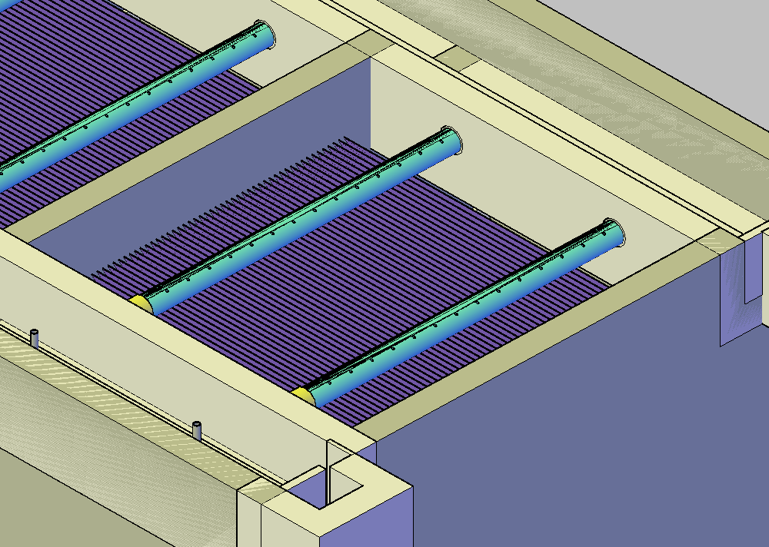
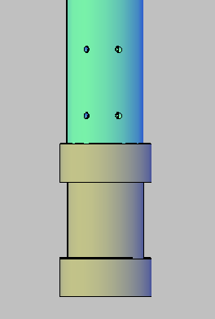
Coupling Corrections and Placement

Slide 38
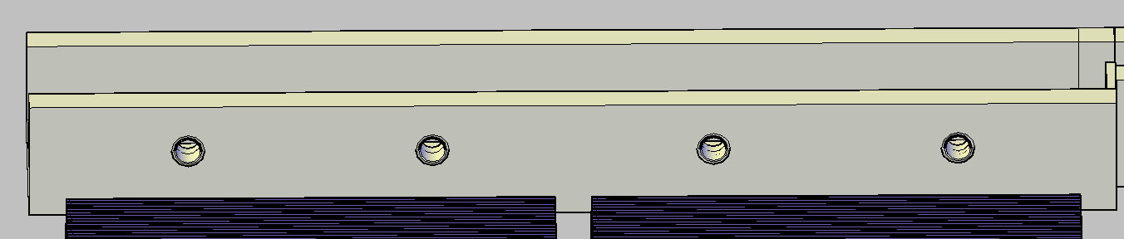
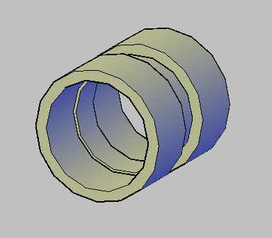
Coupling subtract
Coupling EXPLODE!

Slide 39
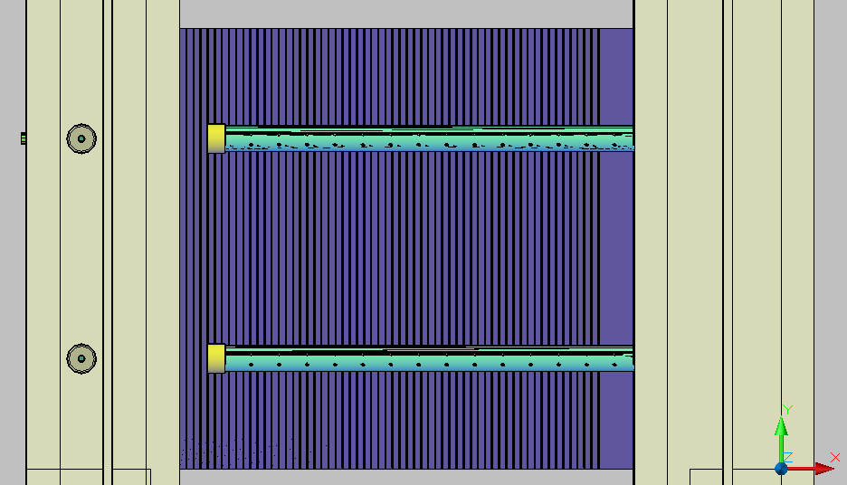
Removing the Launder

Slide 40
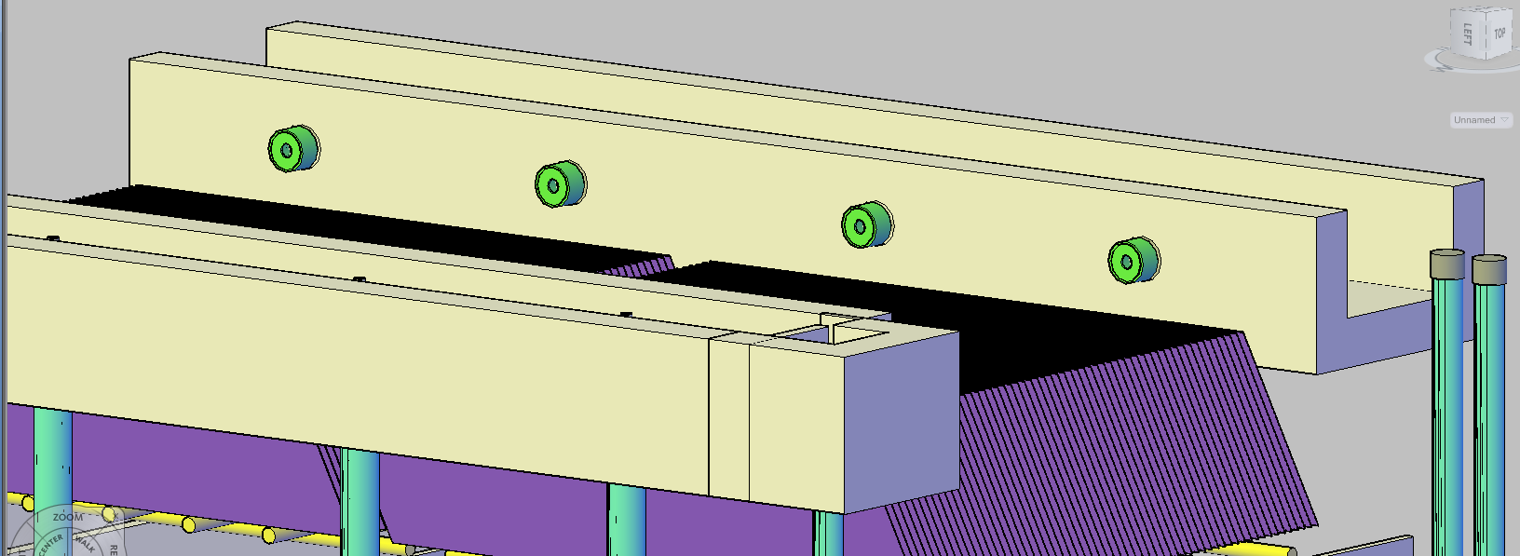
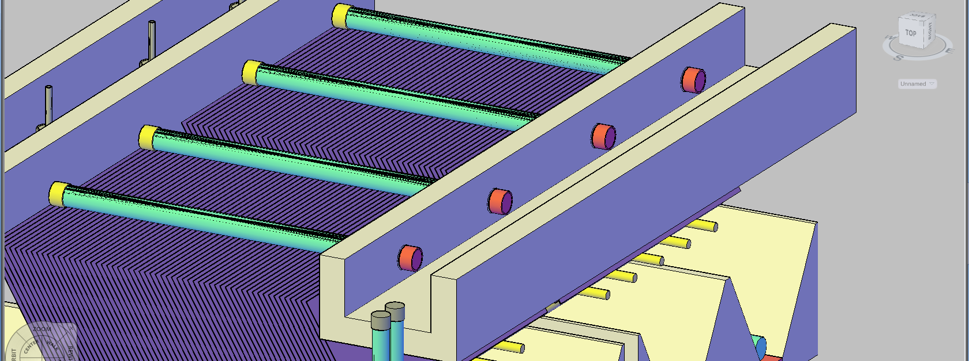
Launder Control Pieces

Slide 41
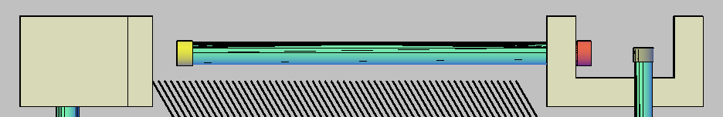
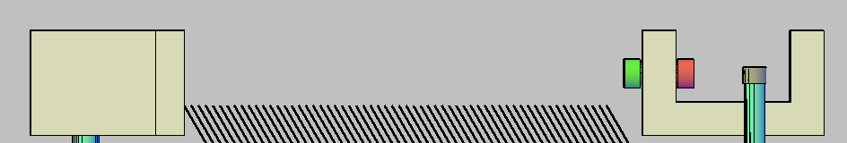
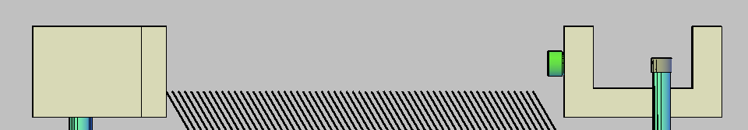
Launder Removal

Slide 42
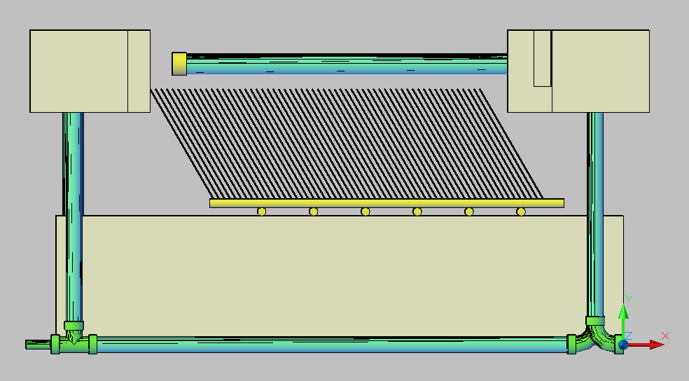
Extra Space and the Launder Support
Proposed support
Space for launder support

Slide 43
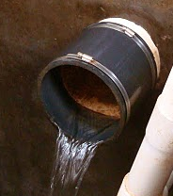
Upcoming Changes
Launder joint at exit channel end will be flexible joint →Launder can extend the length of the sed tank
Ledge will be used for launder support on inlet channel side – needs to be coded

Slide 44
Further updates
Update coupling code so draws to pre-specified lengths
Coupling subtract and coupling are separate codes → perhaps update all couplings to coupling subtract?

Slide 45
Plate Settler Support Frame
Trang Pham,
Mike Liu

Slide 46
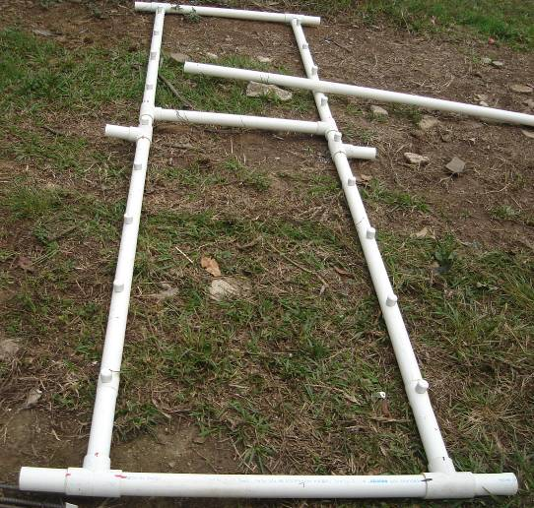
Plate Settler Support Frame
Made from PVC pipes
Provide support for the plate settlers

Slide 47
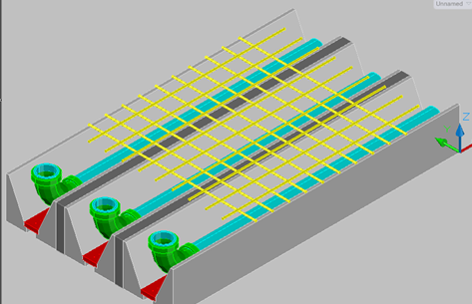
Original Design
Simple grid of pipes
Good for Sedimentation Tank with one bay
Need new design to simplify maintenance when more bays are added

Slide 48
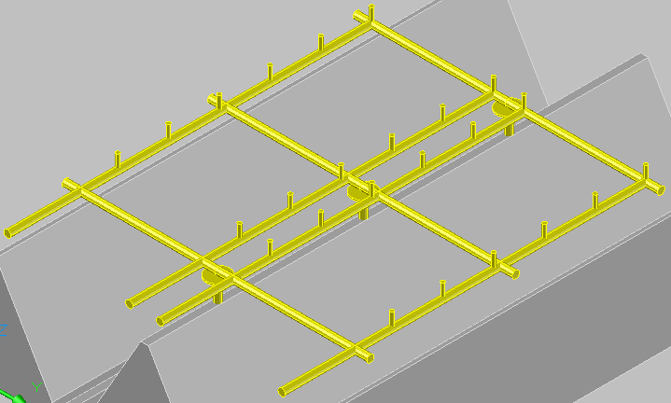
New Design
3 main components:
  Main frame
  Stubs support
  Frame support
Based on Agalteca design
Covers one bay at a time
Uses less materials and adds stability

Slide 49
Main Frame
2 Vertical pipes extend to the end wall of the sedimentation tank
(prevent sliding)
3 Horizontal pipes connect with the vertical pipes using Tees.

Slide 50
Stub Support
½ in. PVC pipes
3 in. in length, capped on the upper side of the frame
Inserted along the vertical pipes
Distance between each stub was determined by the width of one unit of plate settlers.

Slide 51
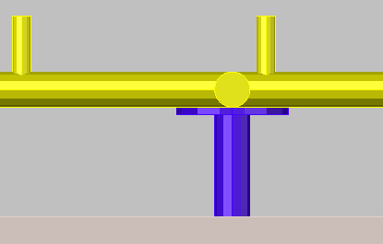
Frame Support
Necessary due to new Sedimentation tank design
In between bay, the support consists of a galvanized flange and a support pipe
On the sedimentation tank sidewall, the support will be a concrete ledge

Slide 52
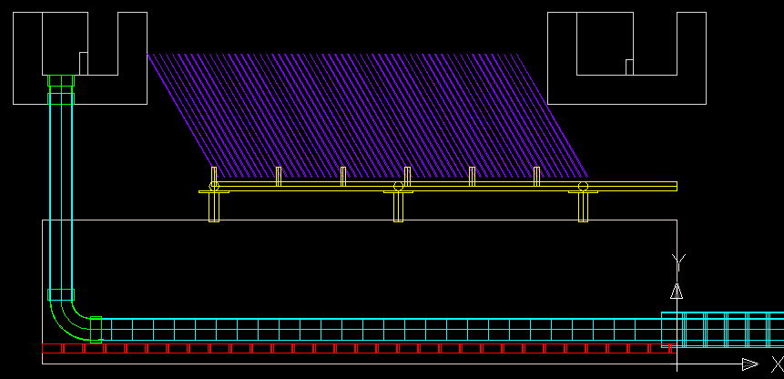
Plate Settlers: Side View

Slide 53
Future Challenges
Stub arrangements and stub dimensions need to be coordinated with the plate settler module design
Concrete ledges to support the edges of the frame must be drawn
Flange dimensions need to be figured out

Slide 54
Weir Tank Design
Andrew Sargent,
Andrew Hirshfield

Slide 55
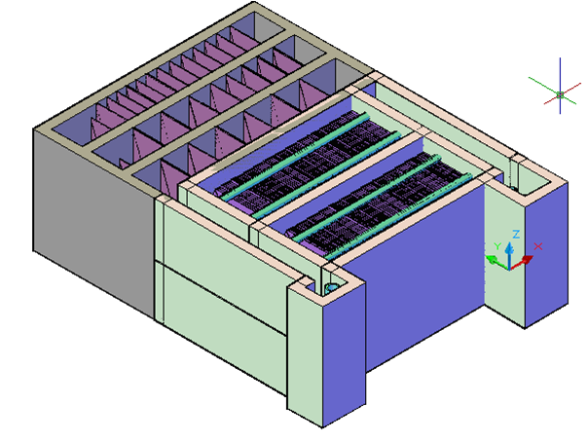
Weir Tank Design
Old Design
  Wasted Materials
  New Drain System

Slide 56
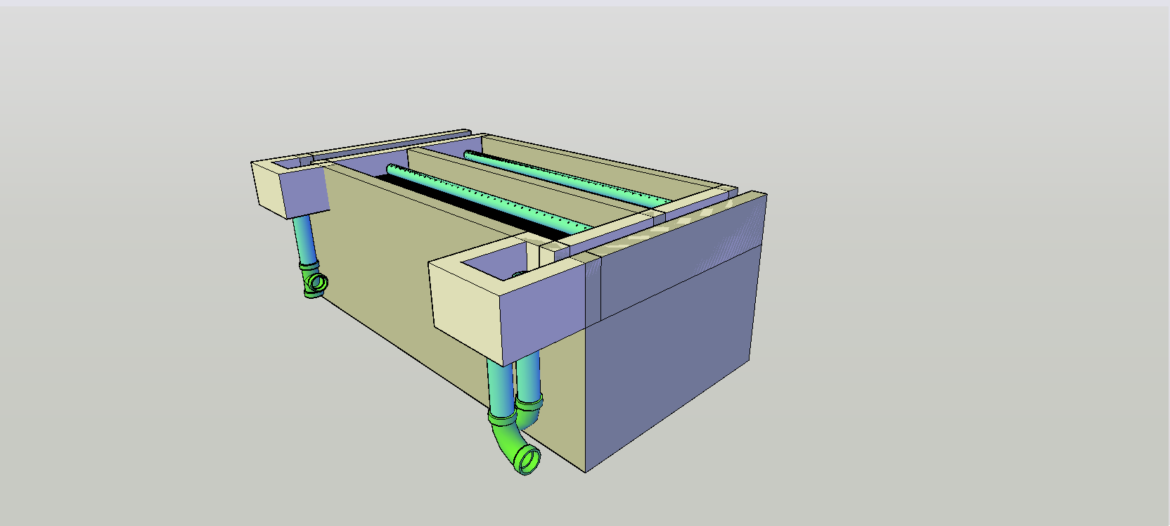
Last Semester
Waste of material
  Tank heights
  Repositioning
To allow for new drainage system
  Weir elbows
  Weir tee
Changes still needed
  Rotated Tee
  Connecting Pipe
  Weir Elevation

Slide 57
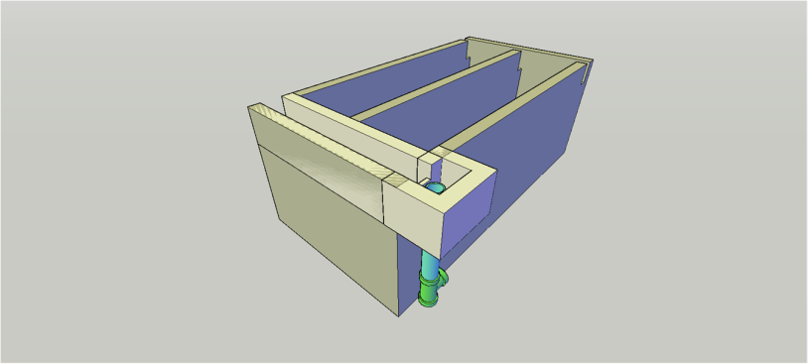
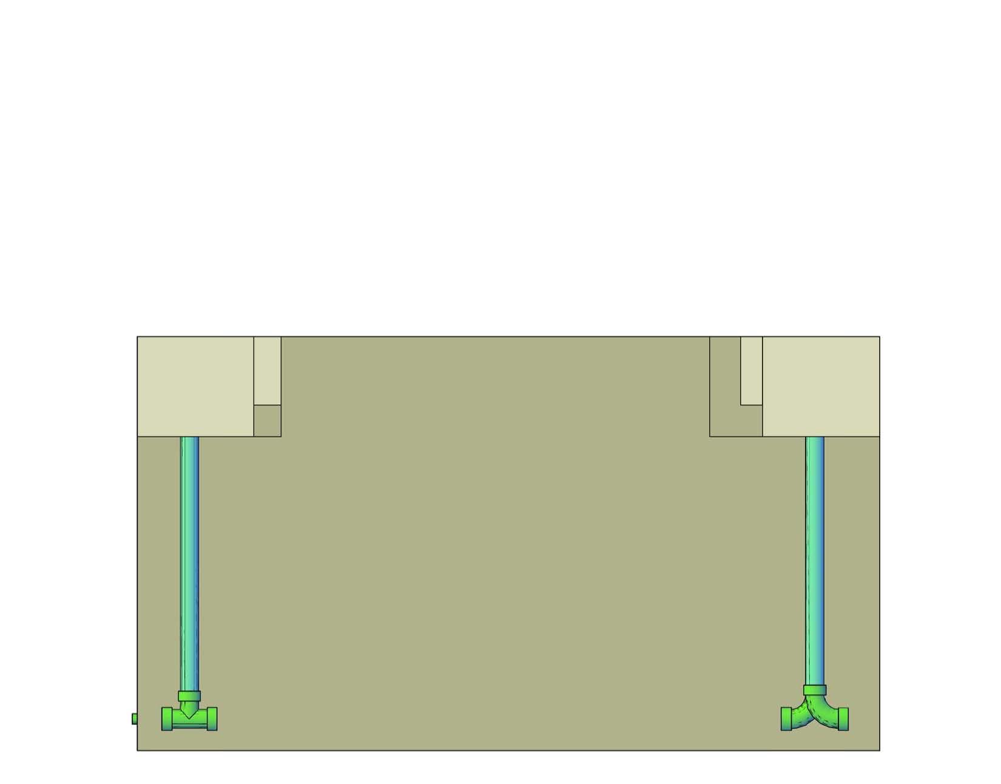
Rotated Tee

Slide 58
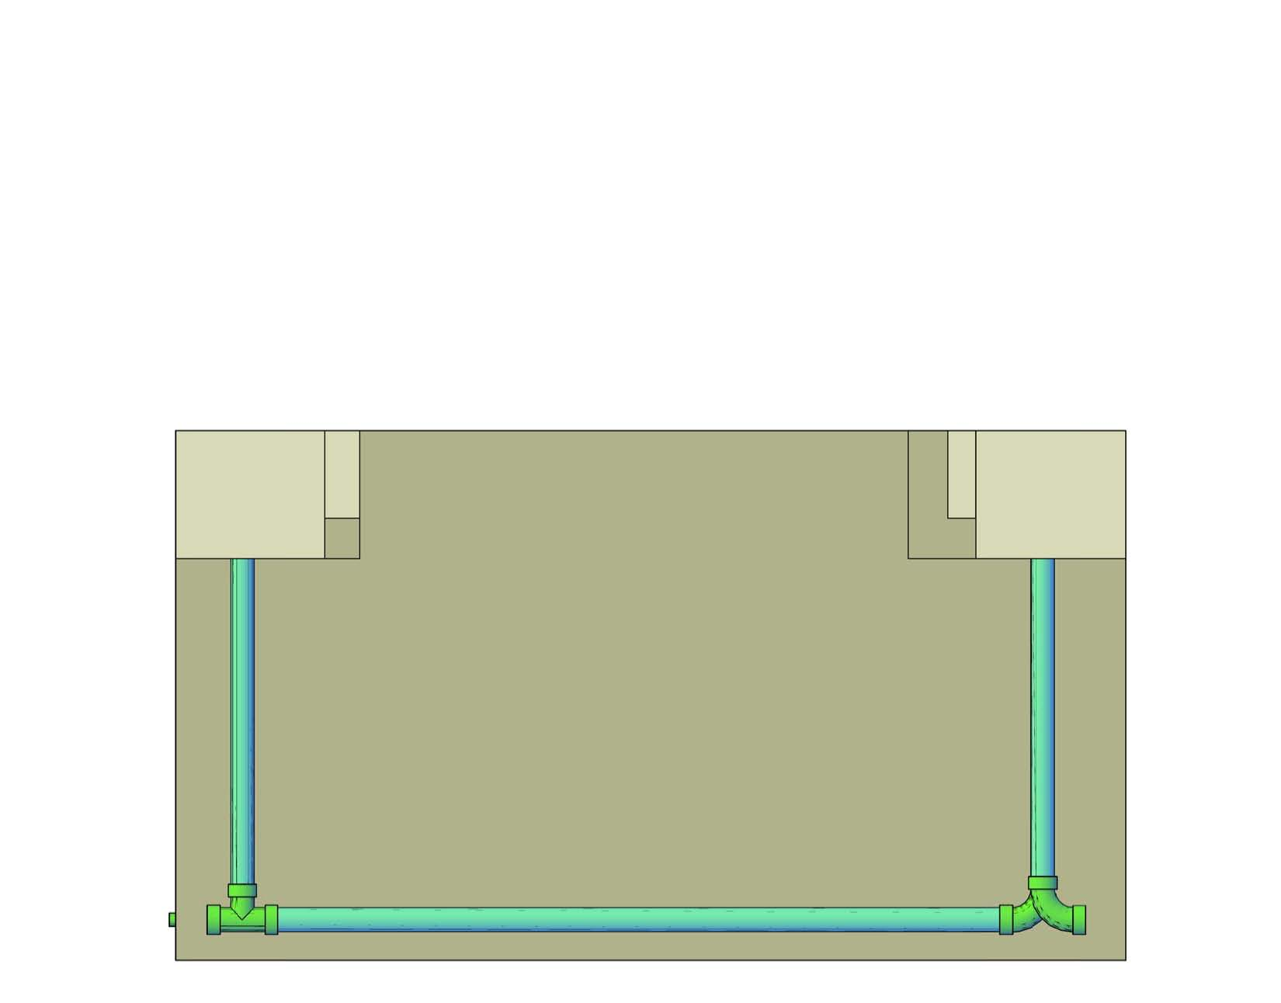
Connecting Pipe
Elevation adjustment

Slide 59

New Design
Future Changes
  Weir Tanks as extensions of channels
  Drainage Channel

Slide 60

Drain Channel
Inlet Channel side
Drains sedimentation tank valves
Rotated elbow attachment
  45 degrees

Slide 61



Debugging
Test plants with various design inputs
  ADT
  Beta Server
Check for and correct errors
  Inlet Channel Plugs
  Lamina Circles

Slide 62
Documentation
Josiah Pothen,
Andrew Smith

Slide 63
Existential Questions
Who
What
Where
When
Why
How
What?
How?
Notes:
What? Explain what documentation is.
Who
-Topic of contention
-Non-technical people? Engineers? Construction managers?
-Several meetings later, we finally decided that it was municipal engineers with some technical knowledge. It may serve other purposes, but the MEs would be the target audience.

Slide 64
What We Did
Documentation
Process Drawing
Goofing off
Notes:
Explain what the documentation is,
What the process drawing is supposed to be

Slide 65

Pdf file
It works!
Notes:
It’s time to talk about documentation. When you get emailed a design from the server, a pdf is delivered along with the other drawings, lists, and text files.

Slide 66

This slide will have a picture of the pdf
Notes:
Fields
Equations
Images
LabView
Variables

Slide 67

Process Drawing - Mark I
Notes:
Created for Arts Quad
Quick overview of the AC process geared toward non-technical audience
Used this as a basis for a new version to be used by Monroe (and others) for 4550, info for potential members, other presentations

Slide 68


Process Drawings – Mark II
Notes:
Created a low-text version for use as a presentation (left)
and high-text version for use as a downloadable file (right)

Slide 69

Siempre en la lucha…
…contra galletas
Complete documentation content
Field codes not fully functional
Process drawings - final tweaks

Slide 70
Documentation Drawing
Taisuk Kim

Slide 71


Automated Plotting
Goals: Provide the plots of AutoCAD drawings for the user manual.

Slide 72
Background Information
Model Space:
- The drawing space in AutoCAD.
- For modeling and designing objects.
Paper Space:
Layout
Environment for plotting & printing
Can specify the type/size of sheet; add a title block; display multiple viewports; create dimensions and notes for drawings.
MtoATranslator:
Translate Mathcad scripts to AutoCAD commands

Slide 73

What Do We Need?
Keyboard commands:
Work in AutoCAD by using Keyboard.
No Mouse!
New MtoATranslator:
Add plot-related commands:

Slide 74
Spring 2010 Achievements
Identified the plot-related commands.
Found the keyboard commands.
Added some of the commands to the MtoATranslator.
Created a Mathcad file that can be used for debugging.
Debugging.

Slide 75
The Plot-related Commands
layout
viewport
zoom
view
layer
vplayer
dimension
plot
mtext
shademode
ms, ps

Slide 76

Obstacles
View port
Can we move from one view port to another?
Text position
Can we insert text/dimensions in desired locations?

Slide 77
Future Challenges
Continue updating the new MtoATranslator.
Update the Mathcad design scripts with the new commands in the MtoATranslator.
Figure out how to put dimensions/texts in the paper space.
Find a way to create and edit multiple view ports in one layout.
REMEMBER:

Slide 78
Questions?

