Slide 1
Design Teach In
October 20, 2009

Slide 2
Agenda
Walk through the plant
  Entrance Tank & Rapid Mixer
  Flocculator
  Inlet and Exit Channels
  Sedimentation Tank
Our work

Slide 3
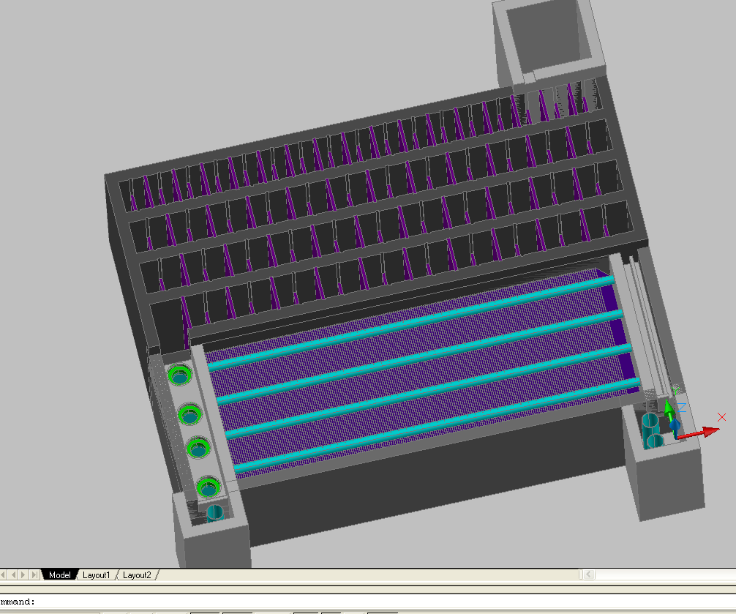

Slide 4
What Do We Do?
Calculate
Automate
Communicate

Slide 5
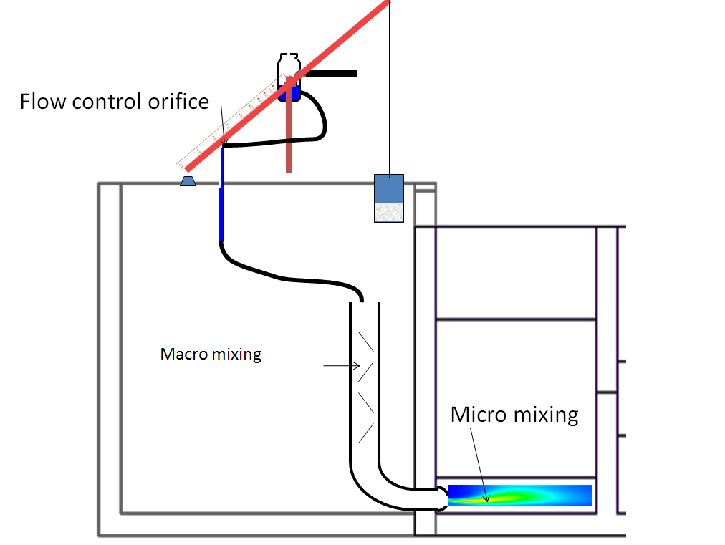
Entrance Tank and Rapid Mix

Slide 6
Rapid Mix
Necessary for flocculation which is necessary for sedimentation
Stick particles together

Slide 7
Coagulants
- -
- -
- -
+
- -
- -
- -
Negatively charged particles
Positive ions to neutralize the charge
Lower the energy barrier that prevents particles from sticking together
Coagulant of choice here is alum
- -
- -
- -
+
- -
+
- -
- -
- -
- -
- -
- -
- -
+
- -
- -
- -
- -
Lower energy barrier
High energy barrier

Slide 8
Alum
Precipitating molecules collide with particles
Al₂(SO₄)₃ + 6H₂O→2Al(OH)₃ + 6H⁺ + 3SO₄⁻²
AlOH⁺², Al(OH)₂⁺, and Al₇(OH)₁₇⁺⁴
Positive ions that lower the energy barrier

Slide 9
Rapid Mix
High intensity mixing
Disperse the coagulant
Turbulence: Mechanical to Kinetic

Slide 10

Turbulence
Higher velocity means higher energy dissipation
Q_{in}
Q_{out}
Q = AV

Slide 11
Rapid Mix
Macro Mixing
  Less energy dissipation
  Mixes to scale where micro mixing begins
  Two or more orifices
Micro Mixing
  More energy dissipation
  Goes to the scale of molecular diffusion
Scales
Diffusion
10⁻⁹ m²/s

Slide 12
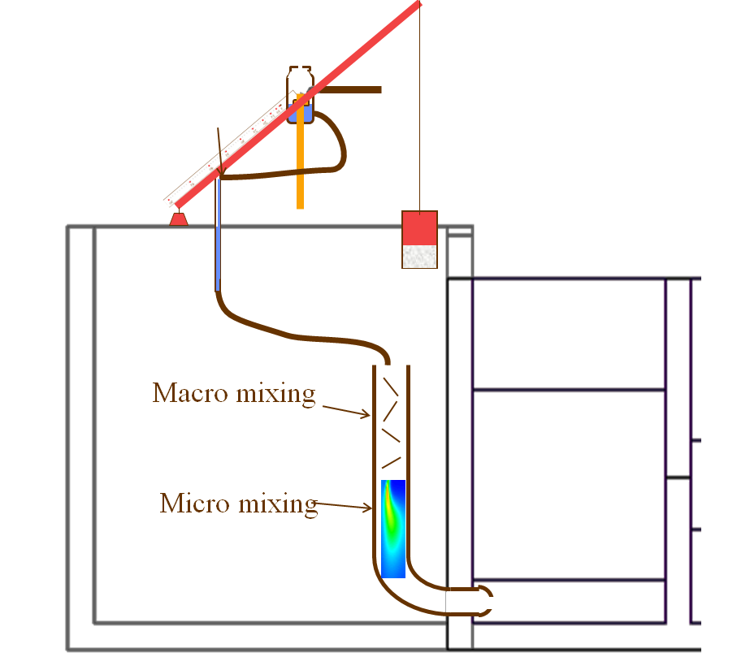
Current Rapid Mix Project
Moving the micro mixing orifices upward for ease of removal in cases of clogging
Screen placed near entrance to prevent large objects from creating blockages
Currently sizing the orifices for a variety of flow-rates and developing code to create AutoCADD images

Slide 13
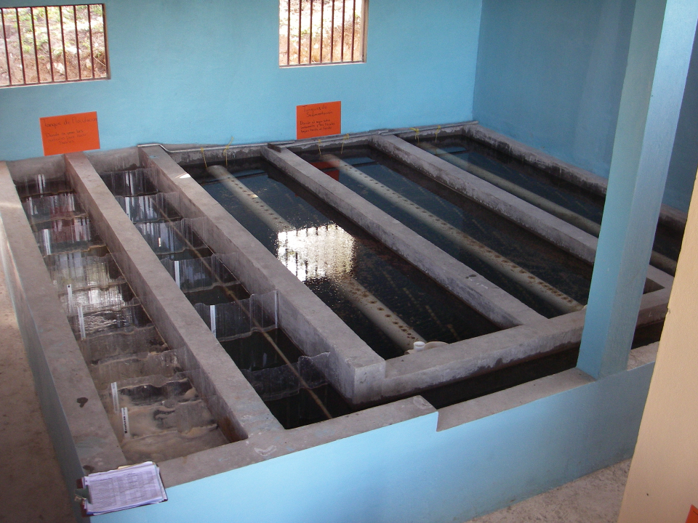
Flocculation

Slide 14
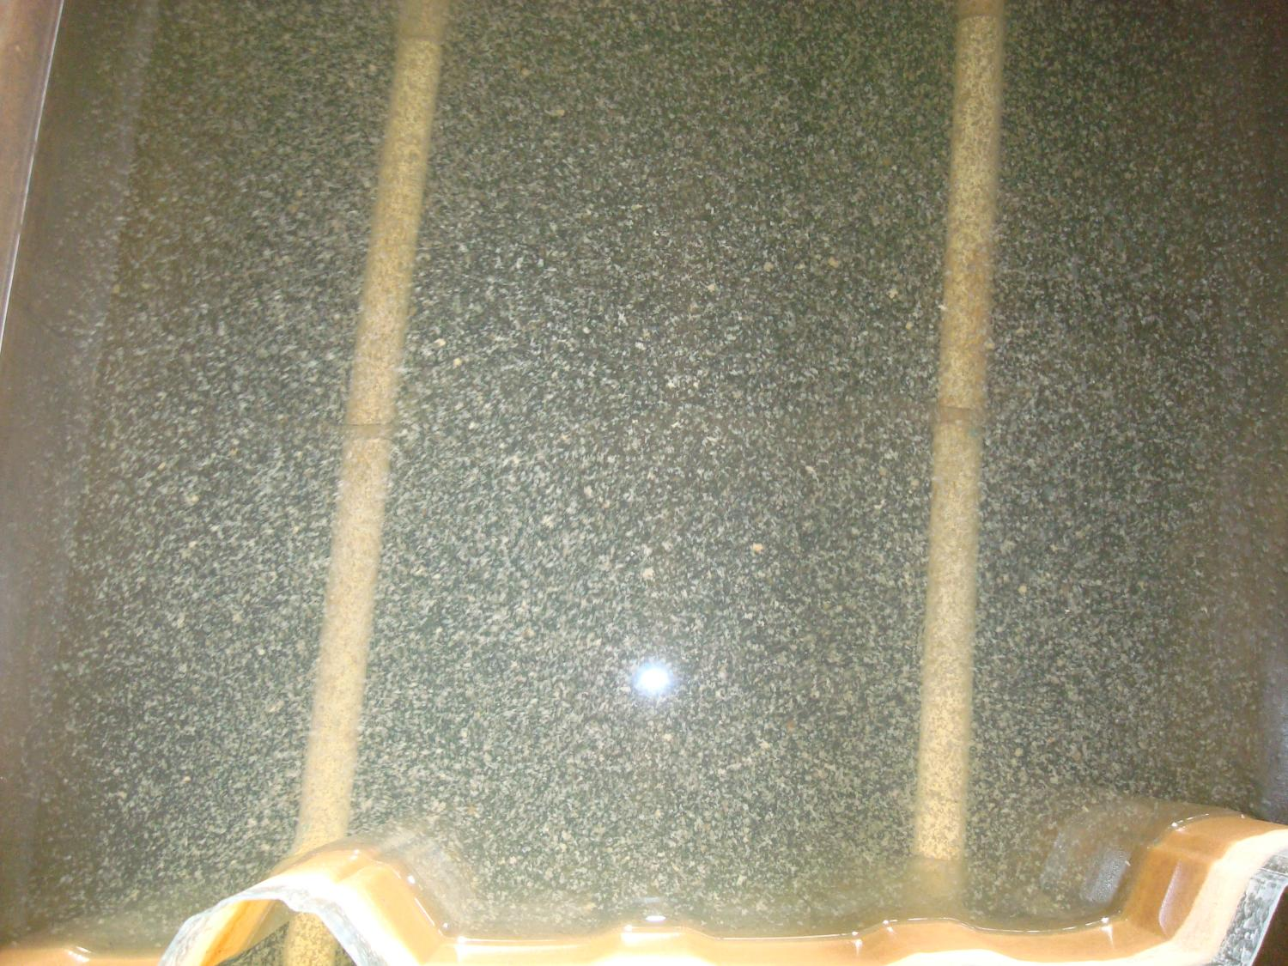

Slide 15
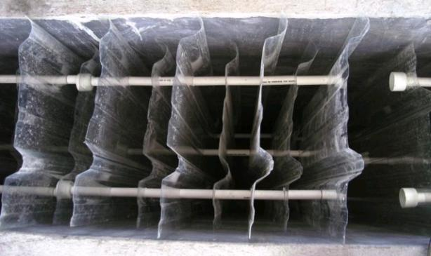
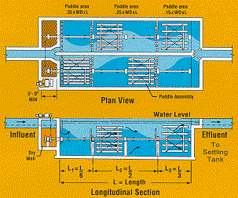
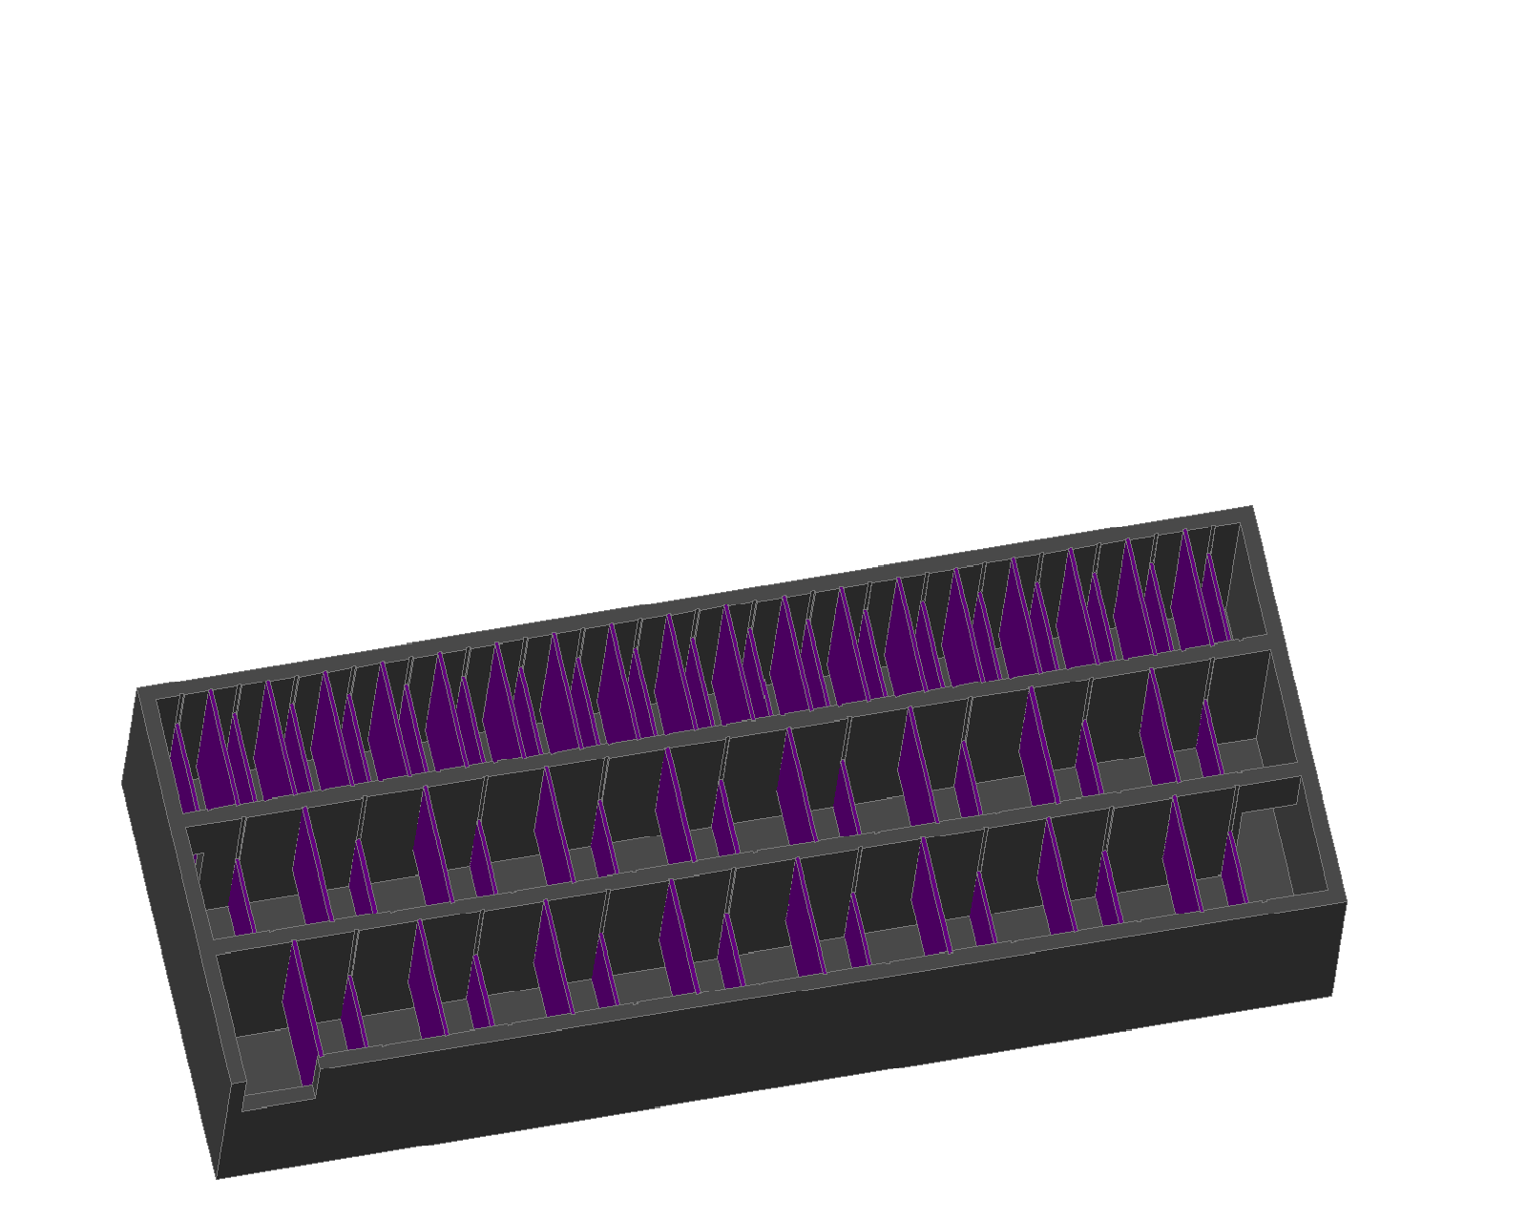
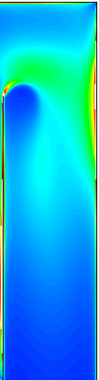
Overview
How Flocculation Works
Types of flocculators
Flocculation Theory
Design Optimization

Slide 16
What are flocs?
A process that transforms tiny particles into big particles!

Slide 17
Flocculation
Requires
  Sticky particles
  Collisions between particles
Increased size is needed for particles to settle by gravity and to filter them
  The bigger the particle, the settling velocity is higher so sedimentation is faster
  It is easier to catch a bigger particle in a filter than a smaller one
Notes:
Alum makes them sticky
Mixing makes them collide

Slide 18
Mechanical Flocculation
Turbulence created by gentle stirring provides:
  Collisions to grow flocs
  Prevention of large flocs from settling so they can grow
Presumed advantage is that collision rate is independent of flow rate (not true for AguaClara plants)

Slide 19
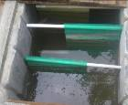
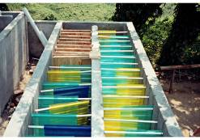
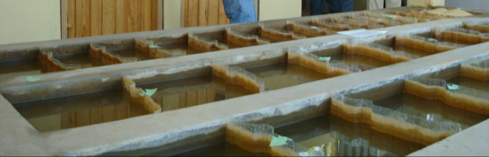
Hydraulic Flocculation
Collisions created by baffles
The advantage is that there is no need for power

Slide 20
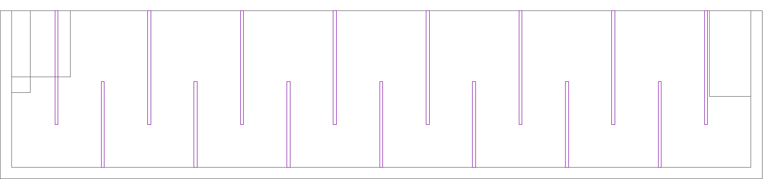
Side View
Upper baffles
Lower baffles
Notes:
planta de 50 Lps con 2 cámaras de sedimentación

Slide 21
Flocculator Geometry
Rapid mix orifice (not yet drawn)
Channels
Ports between channels
Upper Baffles
Lower Baffles
Exit to sedimentation tank entrance channel

Slide 22
Using Hydraulic Flocculators
Mechanical flocculators are presumed to have more operation flexibility (variable speed motor driving a slow mixing unit)
Poor documentation of design approach for hydraulic flocculators
Prior to AguaClara we didn’t have a design algorithm based on the fundamental physics
If the model doesn’t capture the physics, then it won’t scale correctly
Notes:
Poor documentation leads to the need to design from scratch
Need to use the fundamental physics so that our models work

Slide 23
Flocculation Theory
Flocs are transported to collide with each other by Brownian motion, viscous shear, and turbulent eddies.
Flocs grow in size with each collision
Larger flocs are more vulnerable to breakage due to the fluid forces of drag and shear
Turbulence results when the water changes direction as it flows around each baffle

Slide 24

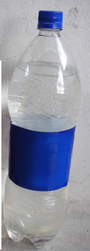
Flocculation Capacity: Collision Potential
The capacity of a flocculator is based on its ability to make collisions between flocs
This design system is the result of years of investigation by the AguaClara team
It is much easier to flocculate high turbidity suspensions than it is to flocculate low turbidity suspensions
Notes:
How well a flocculator works is determined by how many collisions happen
Higher turbidity suspensions result in larger flocs so they collide much easier

Slide 25
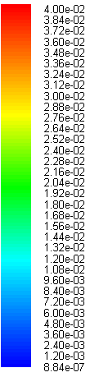

How do we quantify turbulence?
The energy dissipation rate, ε, is a measure of the turbulence
It is in the regions of maximum ε where the flocs are most likely to break, but also collide
mW/kg
Notes:
We want the highest energy disspation possible so that the flocs will settle later and not break up

Slide 26
The Importance of ε_{max}
The value of ε_{max} determines the maximum size of the flocs
A high level of ε_{max} in the beginning of the flocculator may help produce more compact (and dense) flocs. But it isn’t even known if this is a goal
We suspect that the actual value of ε_{max} at Cuatro Comunidades (0.06 mW/kg at 3.8 L/s) is too low because the flocs grow so large that they settle out before getting to the sedimentation tank

Slide 27
An interesting design
No this wasn’t AguaClara…

Slide 28

A few Reflections
The energy dissipation rate suggests that the break up of flocs is the most important constraint
It is also possible that average energy dissipation rate or maintaining the flocs in suspension is more important

Slide 29
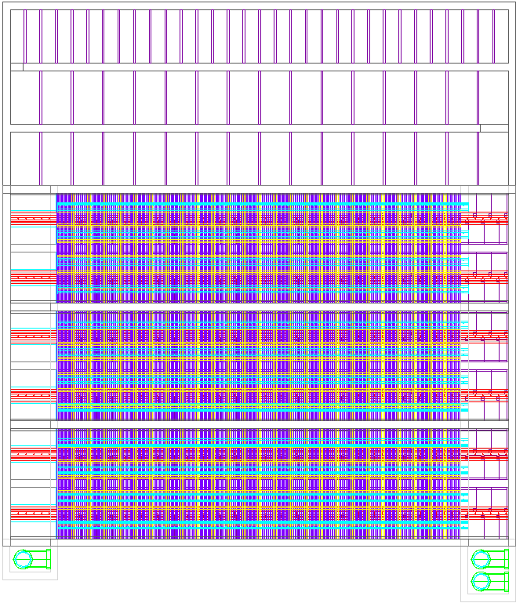
Design Optimization
The length of the flocculator channels matches the length of the sedimentation tank
The depth of the water at the end of the flocculator is equal to the depth of water in the sedimentation tank
Width of the flocculation channel?
  Minimum?
  Material limitations (polycarbonate sheets)
  Vary to optimize flocculation efficiency
Flocculation
Sedimentation
Top View
Notes:
We try to optimize our designs as much as possible. One example is making the flocculation tanks as long as the sedimentation tanks to maximize the amount of shared wall space. Another is ensuring that the depth of the water at the end of the flocculator is the same as in the entrance tank to the sedimentation tank so that there is no unnecessary head loss. We ensure that there is a minimum width of the flocculation channel so that humans can fit in it for maintenance. The materials we use must also be able to withstand the forces on them. We have considered varying the width of the channels for greater efficiency as well.

Slide 30
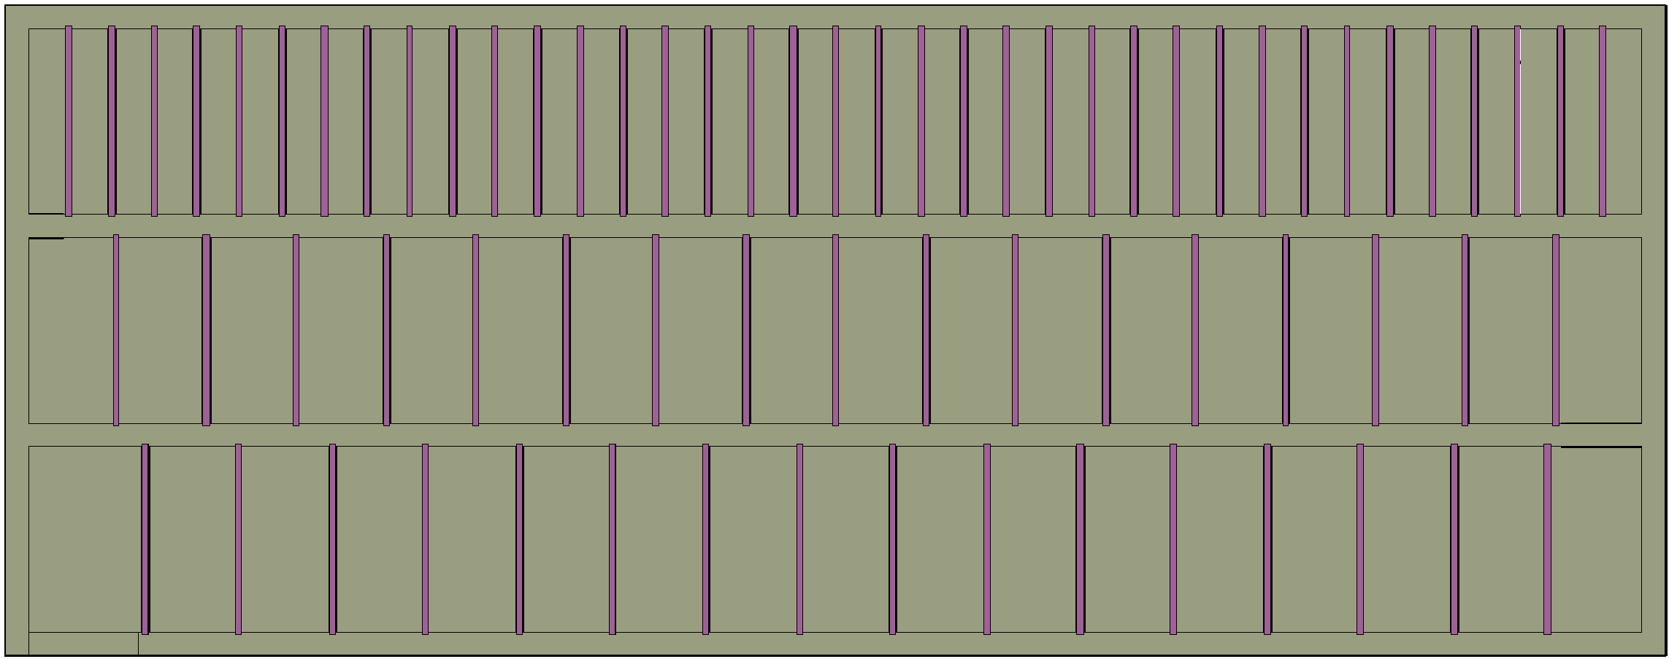
Tapered Flocculation
The idea behind tapered flocculation is that collision potential should be constant throughout
S
W
L
Notes:
Here you can see a draing of tapered flocculation, where there are differnt baffle spacings in each channel. Since the particles are much smaller at the beginning, more baffles will help them grow quicker. Once they are larger, they do not need as many baffles to keep growing. The benefits of tapering are still being analyzed, however, so we do not know if tapering is optimal.

Slide 31
Pro Tapered Flocculation
Achieve shorter residence time
Maybe small flocs are more dense if formed under conditions of higher shear
Notes:
Some arguments in favor of tapering are that there will be shorter residence times in the flocculator so the process will take less time and the flocs might be compacted more tightly with closer baffle spacing, so they will less likely fall apart.

Slide 32
Pro Uniform Flocculation
Most energy efficient (less head loss)
Unlikely that the higher shear levels would result in significant changes in floc density or strength
Easier to construct
There may be a diffusion limited stage at the beginning of flocculation where high energy dissipation doesn’t help
Notes:
Some arguments for not tapering, i.e. uniform flocculation, are that it is more energy efficient because there is less head loss and it is unlikely that the higher shear from tapered baffling actually makes a significant change in the floc density and strength. Uniform flocculators are also much easier to construct and they may not actually help with high energy dissipation at the beginning.

Slide 33
The Need for Non-Optimal Designs
For small plants the width of the channel will be determined by the need to construct the channel using humans (45 cm)
The space between baffles will be determined by the flow rate, but the height is determined by sedimentation
Small plants will need longer residence time and more baffles to achieve adequate flocculation
Notes:
While we do try to design as optimally as possible, sometimes we can’t. For instance, as I mentioned, the width must accomodate a human. Also, the space between the baffles is determined by flow rate, whereas the height is determined by the level of water in the entrance tank for the sedimentation tank. Also, small plants will need a longer residence time and more baffles to make flocculation work.

Slide 34
Conclusions on Flocculator Design
The collision potential depends primarily on the flocculator geometry
We can design a flocculator for the maximum flow rate and be fairly confident that the flocculator will also work for lower flow rates.
We also need to use the constraint that we not break the flocs
Notes:
The main conclusions from the flocculator design are that the collision depends a lot on the layout of the flocculator, we can design a flocculator for the maximum flowrate and be fairly confident that it will also work for lower flow rates, and we need to use a constraint that we are not breaking up the flocs.

Slide 35
Horizontal vs. Vertical Water Flow in the Flocculators
Upper baffle
Vertical Flocculator: Side View
Lower baffle
Left baffle
Horizontal Flocculator: Top View
Right baffle
Reference: Dr. Monroe Weber-Shirk
Notes:
Now I will talk about the difference between horizontal and vertical flocculators. The top view shows the flocculator we have been discussing, a vertical flocculator. The bottom shows a new flocculator that we are designing, the horizontal flocculator. They are essentially the same but rotated. For the vertical flocculator this is the side view. The baffles are placed up and down. For the horizontal flocculator, on the other hand, the same view is from the top. The baffles are placed on the left and right. (Do hand demonstration). Does everyone understand this?

Slide 36
Flocculation Tank Height
Flocculation Tank
Sedimentation Tank
In our current plants, the flocculation tanks are as deep as the sedimentation tank.
The important constraint is that the water level at the end of the flocculator is the same as the water height in the inlet channel of the sedimentation tank so that there is no head loss.
Notes:
One of the challenges we deal with is the height of the flocculation tank. The most important constraint is ensuring that the height of the water at the end of the flocculator is the same as the height in the entrance tank to the sedimentation tank. The easiest way to do this is to make the flocculation tank and sedimentation tank the same height.

Slide 37
Flocculation Tank Height:
Small Plant Flow Rates
Horizontal Flocculators:
Shallow and thus need to be elevated so the water level in the flocculator matches the sedimentation tank
Flocculation Tank
Sedimentation Tank
Platform for elevation=more construction materials=higher cost=bad!
Vertical flow flocculators=Winner for low flow rates!
They take up less space since they are deeper
Notes:
For small flow rates though, the flocculation tank would be shorter than the sedimentation tank. It would thus need to be raised on a platform, which would cost money because of the construction materials. So, for low flow rates, vertical flocculators are better.

Slide 38
Flocculation Tank Height:
Large Plant Flow Rates
Horizontal Flocculators:
Can be made as deep as the sedimentation tank
Preferred because easier to drain
Flocculation Tank
Sedimentation Tank
Horizontal flow flocculators=Winner for high flow rates!
Disclaimer: There might be more factors that would change this analysis
Notes:
For large flow rates though, the flocculation tank would be as deep as the sedimentation tank. Horizontal flocculators would then be preferred because they are much easier to drain. This is a very simple analysis and we have not written the algorithm to decide between the two types, so there may be other factors we have not considered yet.

Slide 39
Minimum Flow Rate for Horizontal Flocculators
The minimum flow rate given current AguaClara sedimentation tank depths is about 100 L/s
If we added an option for shallower flocculators then we could design horizontal flocculators for lower flow rates
Notes:
Right now, the minimum flow rate for horizontal flocculators is about 100 L/s. If we add the option to make shallower flocculators to our design tool, we could design them for lower flow rates.

Slide 40

My tasks
Task 1: Create the code for the horizontal flocculator in Mathcad
  Similar to code for vertical flocculator
  Think of each space as rotated 90°
Notes:
The first task I have is to create the design code for the horizontal flocculator in MathCAD. This involves manipulating the code for the vertical flocculator and essentially rotating it 90 degrees.

Slide 41
Task 1: Create the horizontal flocculator code in mathcad
Upper baffle
Vertical Flocculator: Side View
Width (into page)
Height
Lower baffle
Left baffle
Horizontal Flocculator: Top View
Height (into page)
Width
Right baffle
Reference: Dr. Monroe Weber-Shirk
Notes:
To show an example of this rotation, here you can see that the width in the vertical flocculator becomes the height and vice versa.

Slide 42
My tasks
Task 2: Create the Autocad code to draw the Horizontal Flocculator
Example of an AutoCad Drawing of Vertical Flocculator
Notes:
The second task is to convert the MathCAD code into an AutoCAD drawing. This is an AutoCAD drawing for the vertical flocculator, so I have to make something similar for the horizontal flocculator. Again, this will involve modifying existing code.

Slide 43

My tasks
Task 3: Create algorithm for automated design tool for when to choose horizontal vs. vertical flocculation
Hillary Clinton deciding when to use vertical vs. horizontal flocculation
Notes:
Once the horizontal flocculator has been designed, we need to create an algorithm for the automated design tool that will choose between the two designs. Here you can see Hillary Clinton deciding which flocculator would be better to use. Thank you to Monroe for letting us use some of his slides.

Slide 44
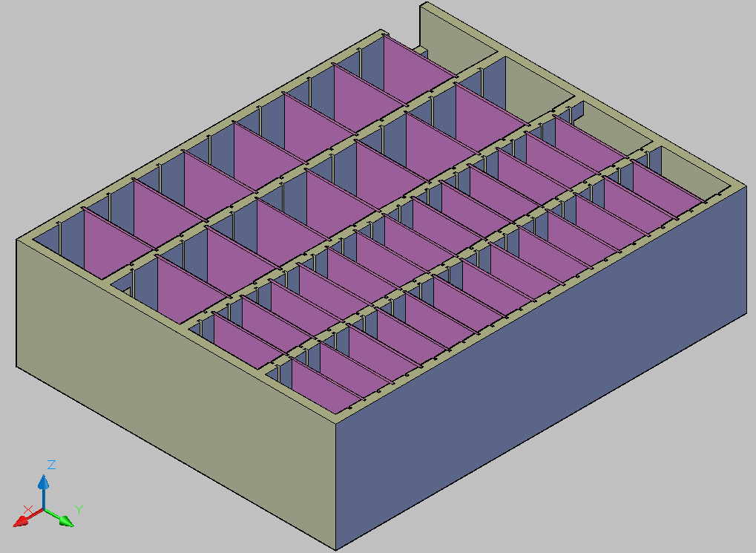
Vertical Flocculator
Notes:
Valve will be on the outside of the tank
Ports will be on alternating sides of the lower baffles

Slide 45
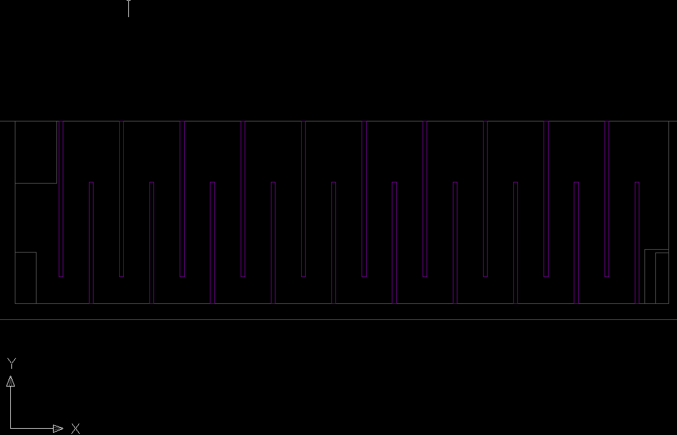
Trapped Water!

Slide 46
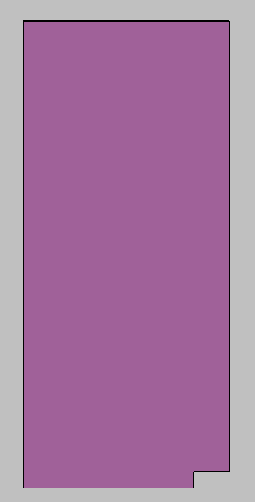
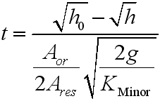
Sizing a Port
port
Notes:
Governing equation

Slide 47
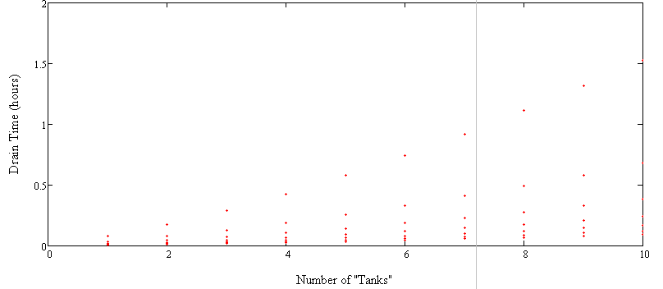
PortSize(desiredT):= function that iterates through 7 possible valve sizes and calculates the drain time for each (using the t_{master} function). It then selects the size that gives a drain time that is closest to but no greater than 110% of the desired drain time (desiredT).
Notes:
Calculates a drain time given a port size;All inputs other than valve size are known
Drain time is linear if valve is rate limiting (i.e. has an area less than or equal to that of the ports)
7 possible port sizes: smallest port sizes on top, largest port sizes on the bottom
PortSize(desiredT) was coded assuming the valve was rate-limiting
Assumptions
Flocculator may be modeled as a single straight channel
Each “tank” has the same volume
The port size is equal to the valve size
Effect of the slot on “tank” volume is negligible
Currently:
Need to make code more efficient
Debugging AutoCAD code that draws ports

Slide 48
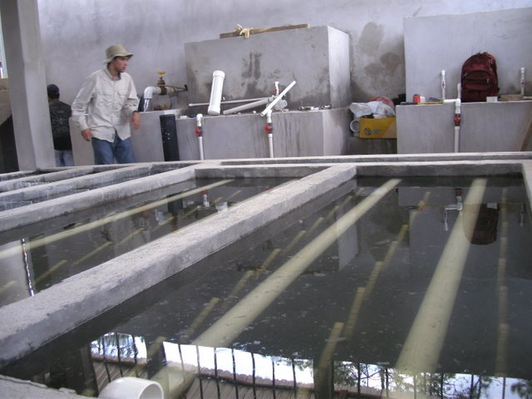
Sedimentation Tank
Adapted from lecture notes – Monroe Weber-Shirk

Slide 49
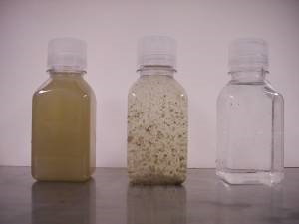
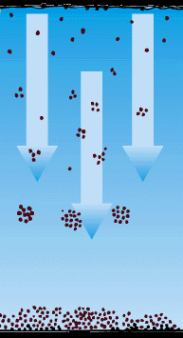
What is Sedimentation?
http://www.soil.ncsu.edu/swetc/sediment2/2008/poly2/poly.htm
F_{Drag}
F_{Buoyant}
http://www.dwi.gov.uk/children/childrens/images/illustrations/sedimentation.gif
IF F_{Gravity} > F_{Drag} + F_{Buoyant}
the particle will SETTLE
F_{Gravity}

Slide 50
Ideal Horizontal Sedimentation Tank
A_{S}
W
V_{h} = Horizontal Velocity
H
V_{v} = Vertical Velocity
Q
V_{h}
How far does the particle drop
(Worst Case)?
V_{v}
H
L
What design parameter affect
Critical velocity?
V_{critical}
Adapted from lecture notes – Monroe Weber-Shirk

Slide 51
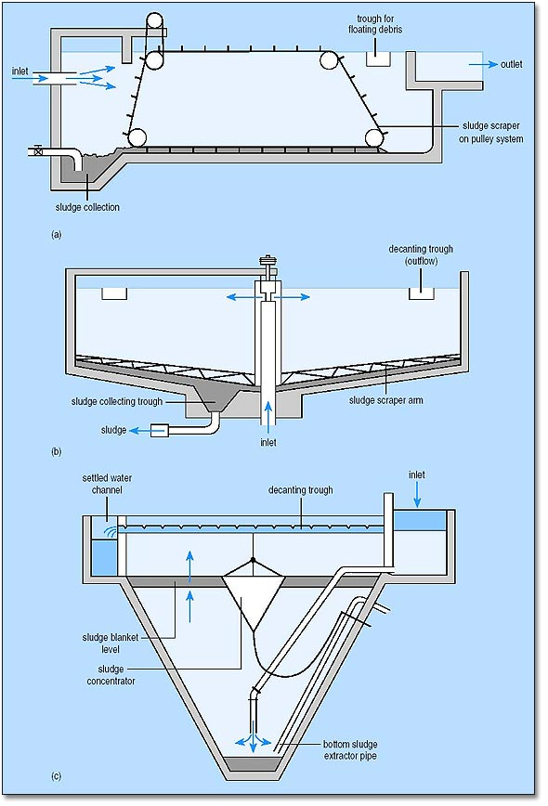
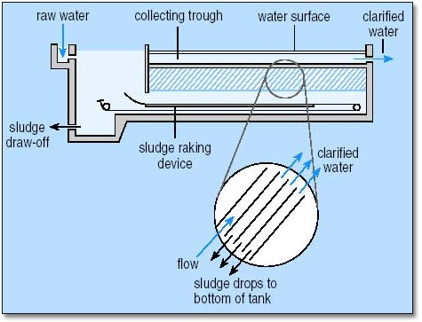
Different sedimentation tanks
Rectangular Horizontal Flow
Circular Radial Flow Tank
Sedimentation Tank with Plate Settlers

Slide 52
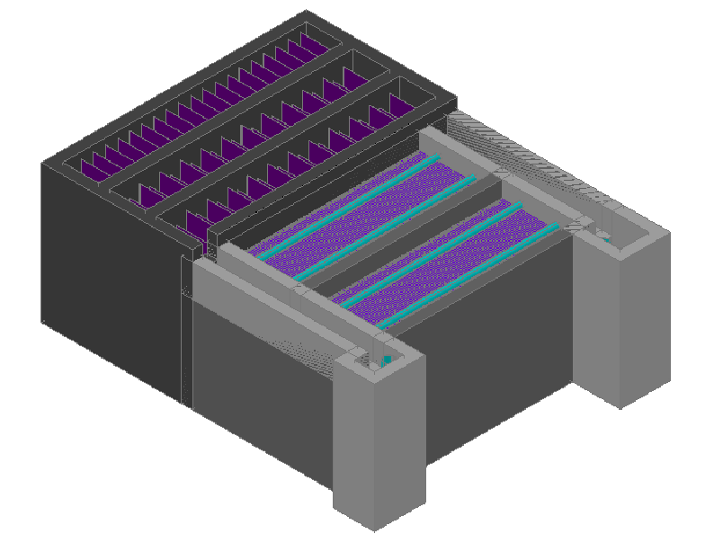
Overall view of the plant
Flocculation channels
Sedimentation Tanks

Slide 53
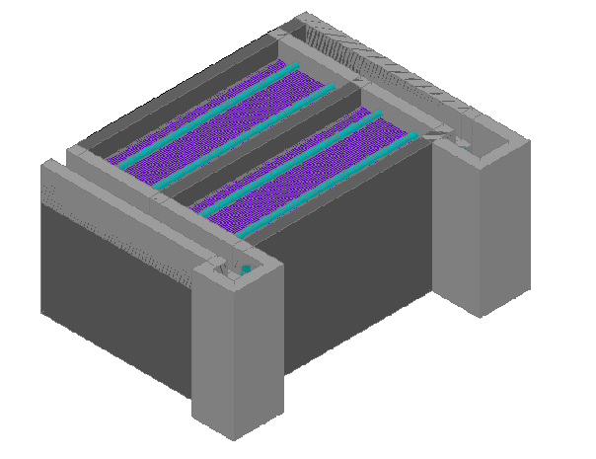
Sedimentation tanks
General view
Main components of the
Sedimentation tanks
How do we build them?
Effluent Channel
Inlet Channel

Slide 54
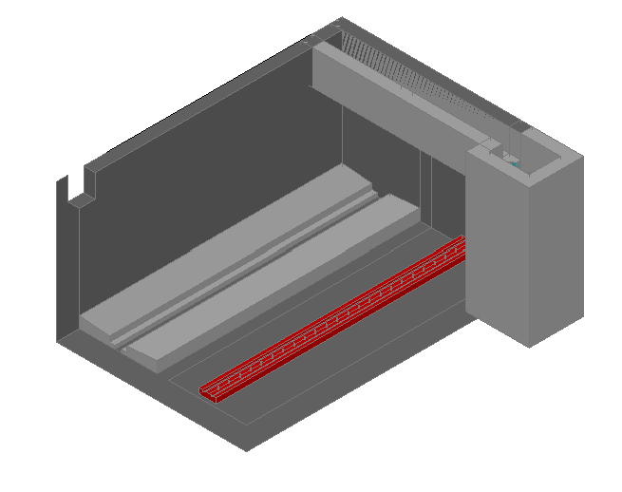
Sedimentation tanks structure
Effluent channel
Entrance to inlet channel
Sludge drain
channel
Slightly sloped distribution channel bottom
Perforated support for slope plates

Slide 55
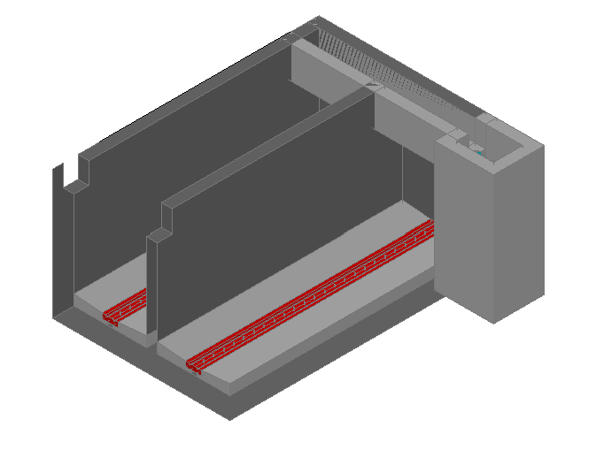
Sedimentation tanks structure
Effluent channel
Entrance to inlet channel
Sludge drain
Channel (below)
Slightly sloped distribution channel bottom
Drain cover and support for slope plates

Slide 56
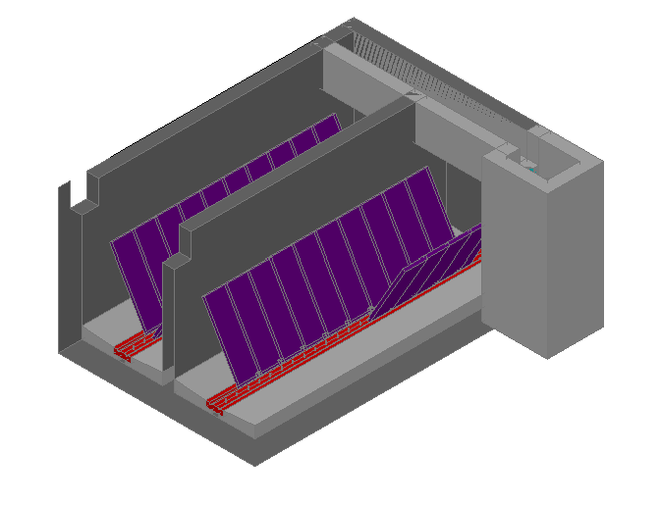
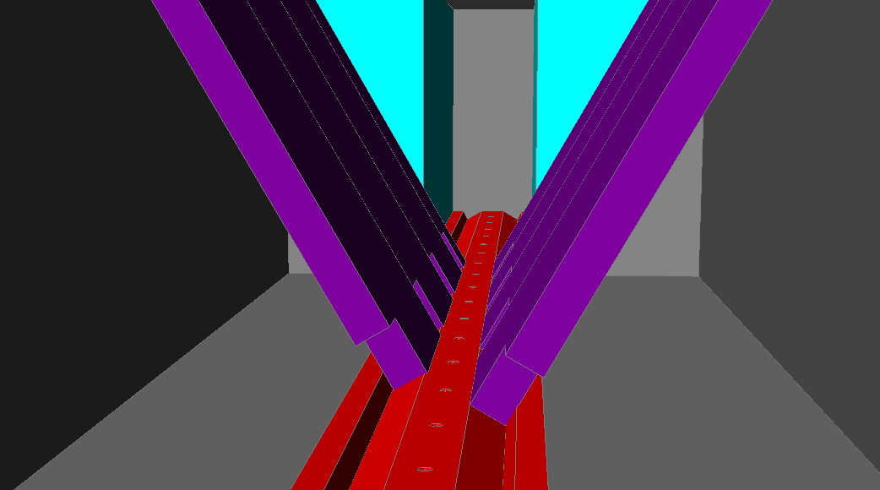
Slope plates and distribution ports
Distribution channel
Distribution ports

Slide 57
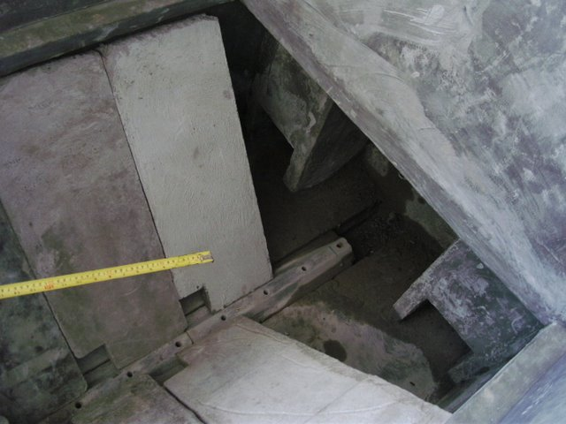
Distribution ports and drain cover
Distribution channel
Distribution ports
Drain channel
Drain cover

Slide 58
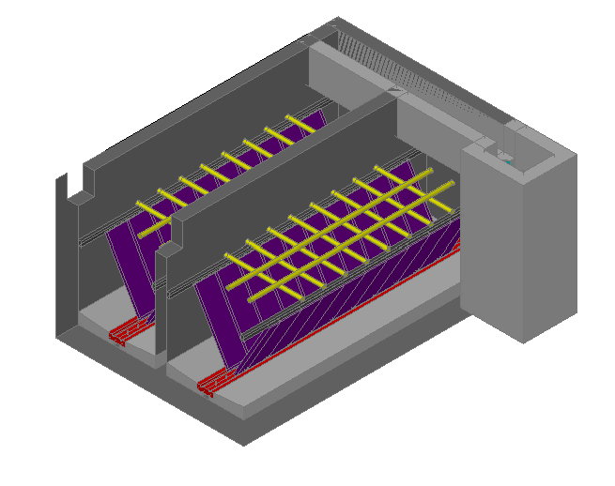
Plate settlers support rack
No hydraulic or process use
Provides support for the plate settlers
Built with PVC pipes
Plate settlers support rack

Slide 59
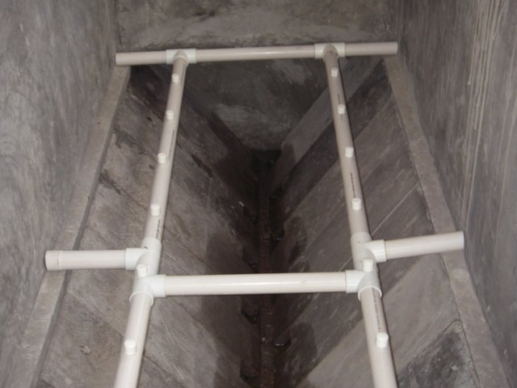
Plate Settlers Support Rack

Slide 60
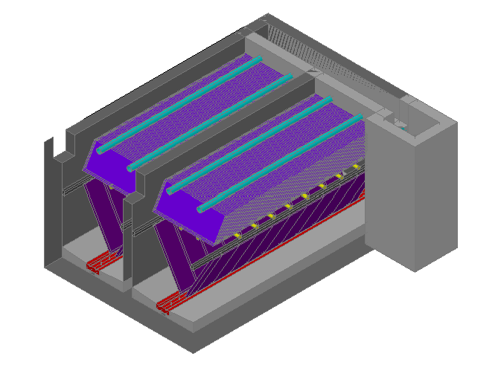
Launders and Plate Settlers
Launders
Plate Settlers

Slide 61
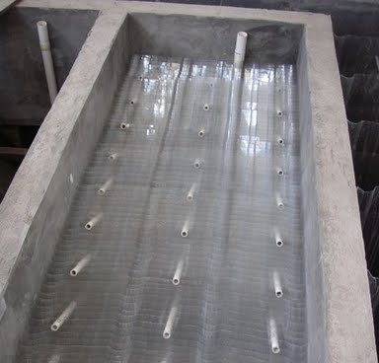
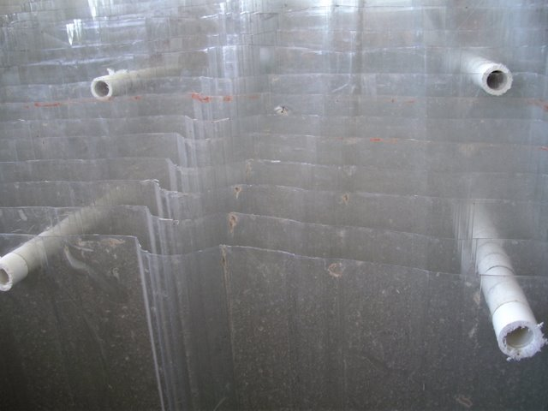
Plate settlers
Same footprint
MORE SURAFACE AREA!!!
L
h
S
α
Adapted from lecture notes – Monroe Weber-Shirk

Slide 62
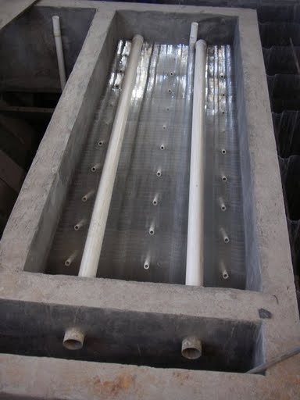
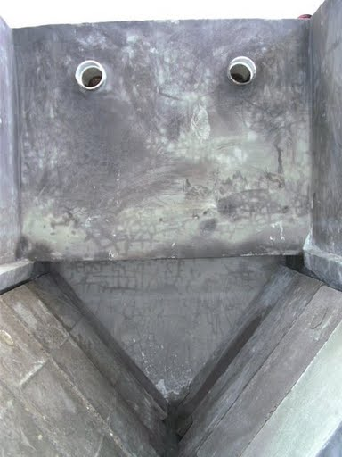
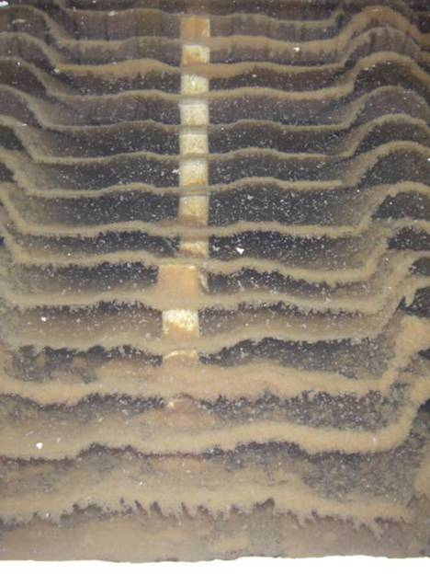
Launders and Plate Settlers
Plate Settlers
Launder pipes
Launders

Slide 63
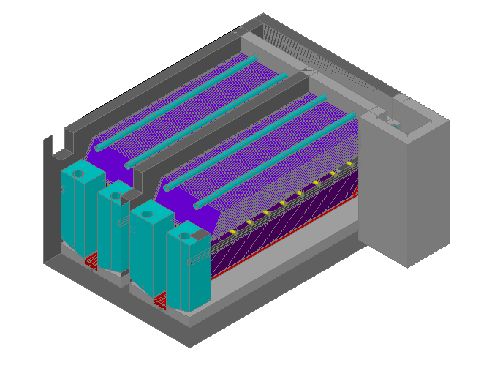
Sedimentation Tank
Sedimentation Tank with all its components
Chimneys

Slide 64
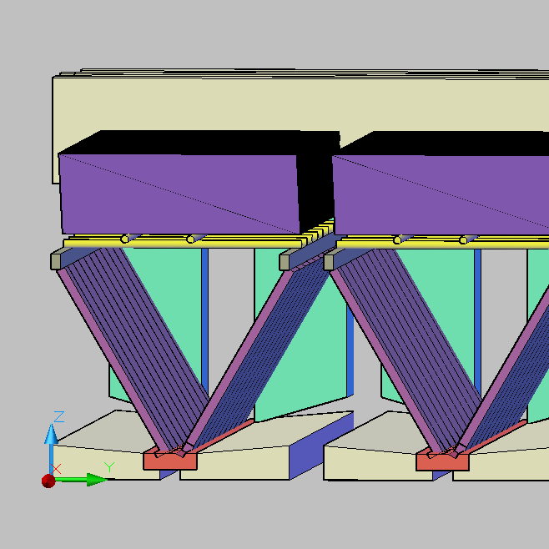
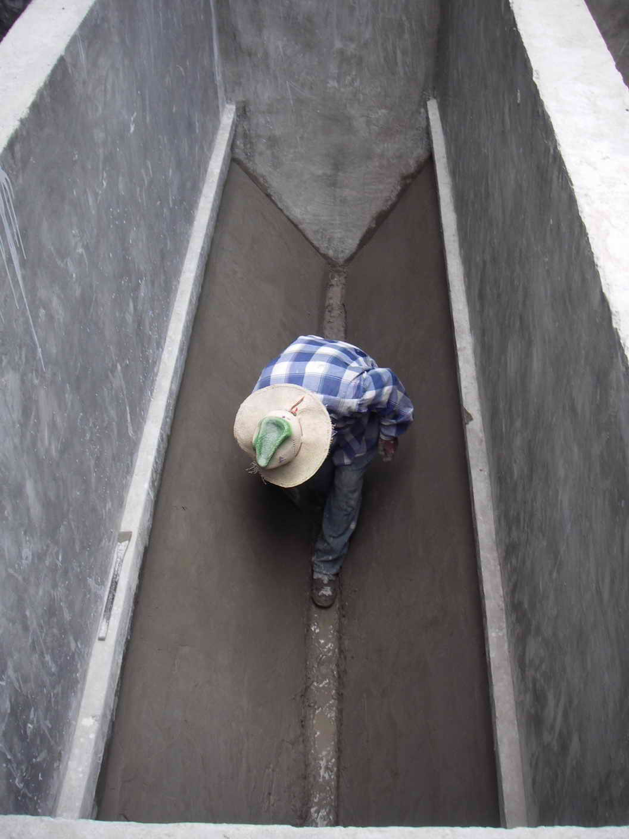
Design Challenge
Sedimentation Tank
Drainage Cleaning System
Agalteca Plant Design
AguaClara Picture Gallery

Slide 65
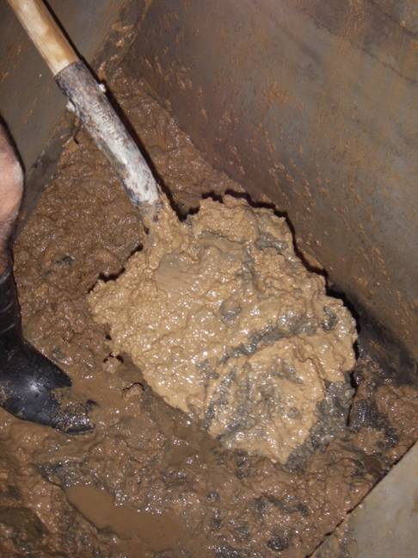
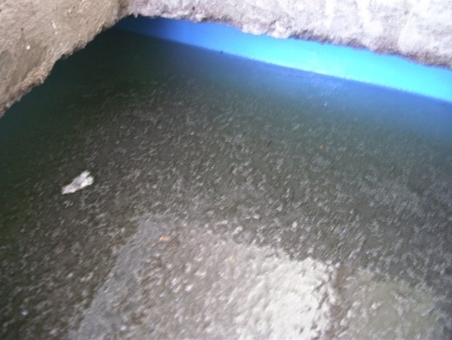
Current Problems with Design
Sedimentation Tank Cleaning requires a lot of work
  Complete Sedimentation Module has to be removed for cleaning (Plate Settlers, Slopes, Pipeframework)
  Sludge is removed manually with a shovel
  It is time consuming. (Cuatro Comunidades Cleaning activity takes 6 hours)
AguaClara Picture Gallery
  Ports and Drains Cover get clogged with sludge
    Floc removal drops
AguaClara Picture Gallery

Slide 66
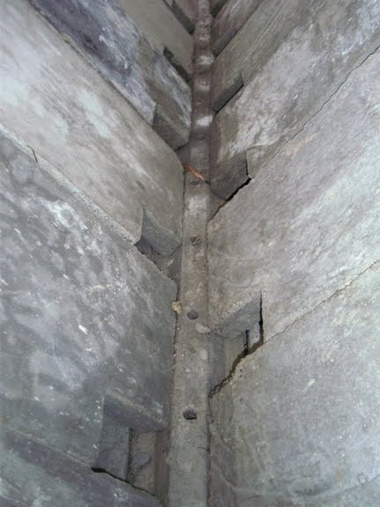
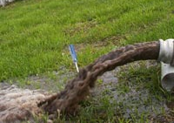
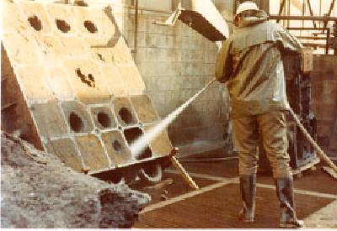
Ideas
Remove Drain Covers
Liquefy Sludge
http://www.watertankcleaning.com.au/OurClients
AguaClara Picture Gallery
Use a Water Pressure System to clean tank
WITHOUT ELECTRICITY
http://www.ptcitaliana.com/en_applications.htm

Slide 67


Sed Inlet Chimneys
Floc Tank
Inlet Channel
Sedimentation Tank
Carries water from the flocculation tank to the sedimentation tank

Slide 68



Plugging the inlet channel
D.SedChimneyPipe
Pipe to let air out
Cap to cover pipe
Pipe fits into coupling in sed inlet chimney

Slide 69

Launder Caps
Draw caps for launder pipe to stop water flowing back in from exit channel
Calculate elevation of hole in cap using Orifice equation

Slide 70

Procedure to drain and re-fill the Sedimentation Tank

Slide 71
Automated Design Tool
Materials List
JoshnCaspar

Slide 72


Automated Design Tool
What it’s used for
How it works
Why it’s important
Notes:
Allows users to enter limited data, so they can input their unique specifications.
EX: large vs. small water treatment plant, more vs. less flow…
So Honduran engineers enter their parameters and receive a design in just a few minutes.
We hope this’ll make it easier for different people around the world to get water treatment plant designs
Here you can see the user interface of the design tool. Users enter the parameters above in accordance with their plant specifications. There are default values for all parameters as guidance. I will show you two different designs in which we vary the plant flow rate, number of sedimentation tanks, and bays per sedimentation tank. In this design, we used a plant flow rate of 3 Liters/second, and 3 sedimentation tanks with 1 bay per sedimentation tank.

Slide 73


Materials List in MathCAD
Equations to calculate relevant physical quantities
Purpose
Feedback we’ve gotten from Honduran engineers
Notes:
In MathCAD, the Materials list consists of a series of equations for the volumes, areas, and other component specifications
Purpose: (1) to give Hondurans physical quantities they’ll need to know how much cement, bricks, and other resources to use
(2) to give them an idea of which supplies they’ll need, such as PVC pipes, connectors, etc.
Feedback: they requested more physical data than we provided before, such as the surface areas of the floor, the walls, and other components
they also requested suggestions on which types and sizes of PVC pipes, PVC adapters, and gate valves to use

