Slide 1

Design Team
Amanda Rodriguez, Andrew Smith, Annie Newcomb, Heidi Rausch, Joseph Fallurin, Julia Morris, Nick Parisi, and Tori Klug

Slide 2

Automated Design Tool
User Inputs
Plant
Design
LabVIEW
AutoCAD
Mathcad
Calculations
MS Word
Mathcad
Drawing Files

Slide 3
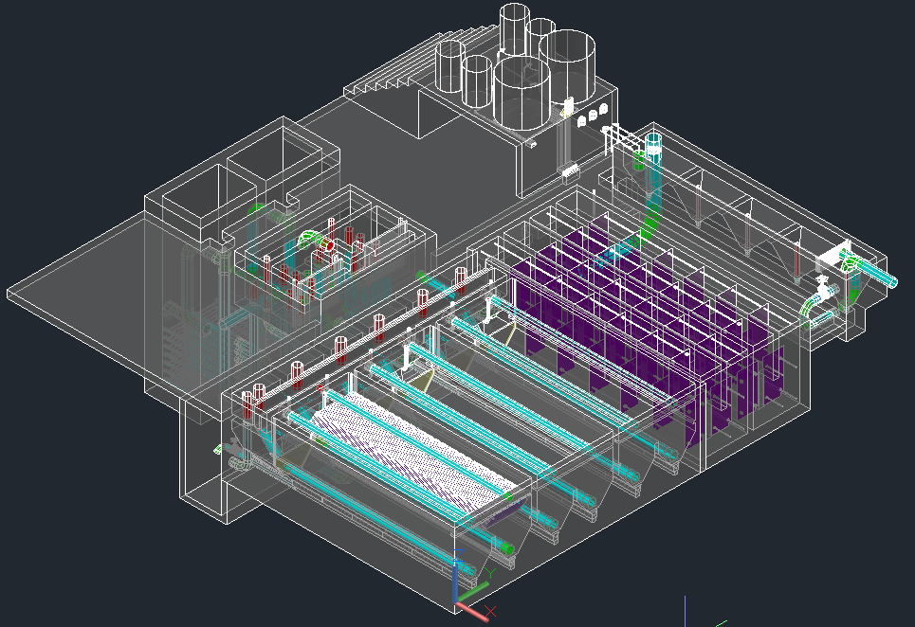
The Design

Slide 4
Continuing Design Tasks
  Incorporating new research progress into the design
  Making the code more robust—being able to design plants for a greater range of flow rates
  Making our designs more easily understood
  Communicating with the team in Honduras to receive feedback and address concerns

Slide 5
Plumbing Functions
Heidi Rausch

Slide 6
Plumbing Functions
In the Final Designs folder there in a file called PlumbingF
This file contains code to draw all of the plumbing elements of the plant, such as pipes, tees, elbows, etc.

Slide 7
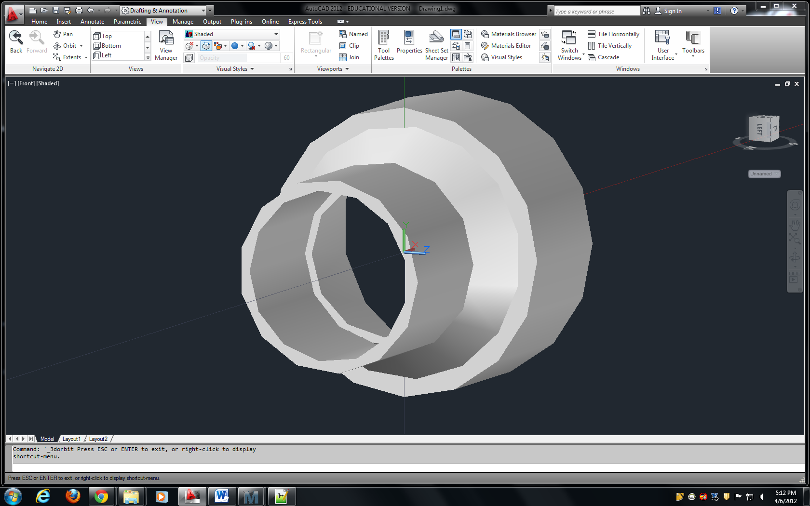
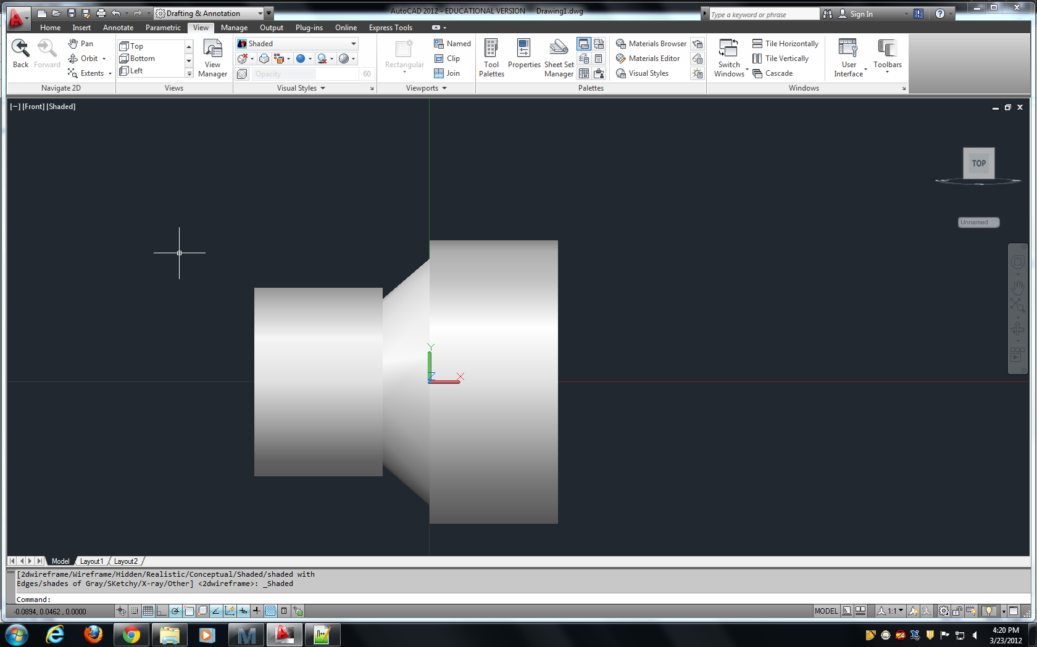
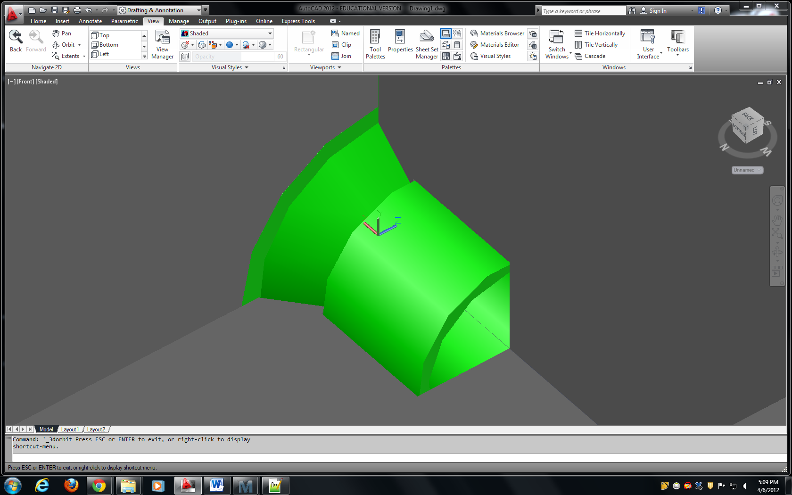
Reducer functions
Used for the siphon valve and and the backwash pipe in the filter
Incorporated into PlumbingF file
New dimension of ReducerLength specified in the pipedatabase

Slide 8
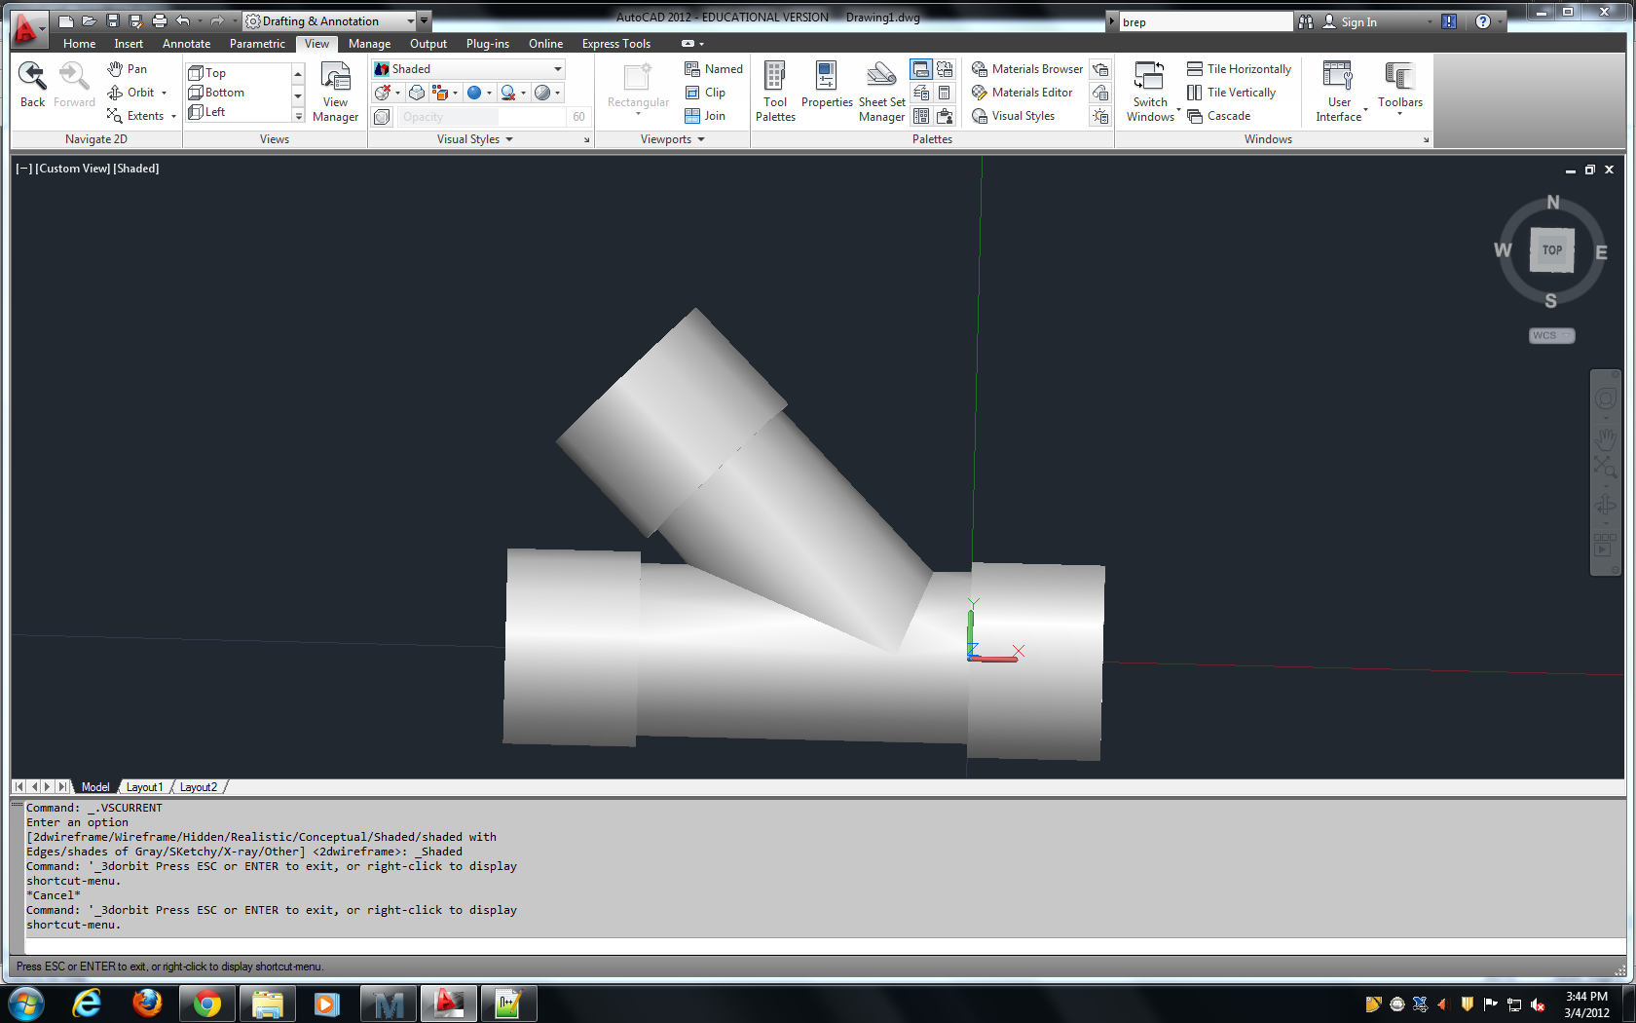
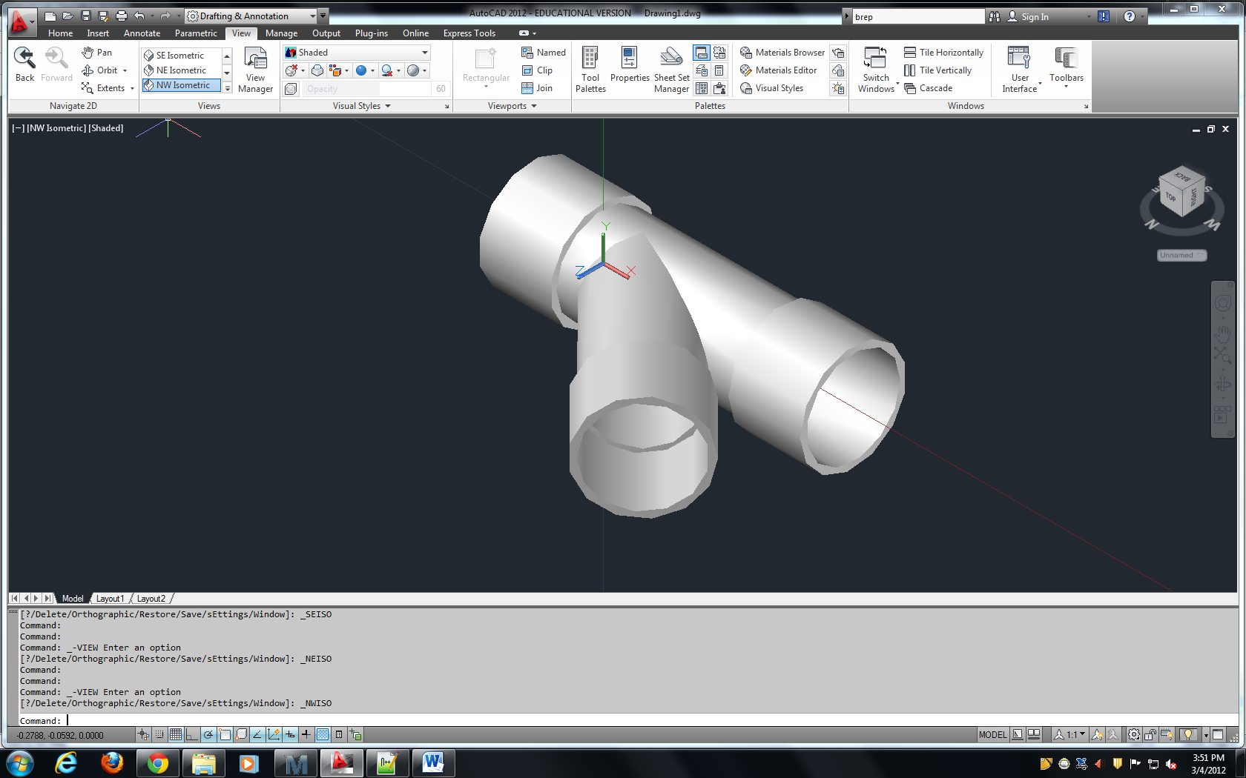
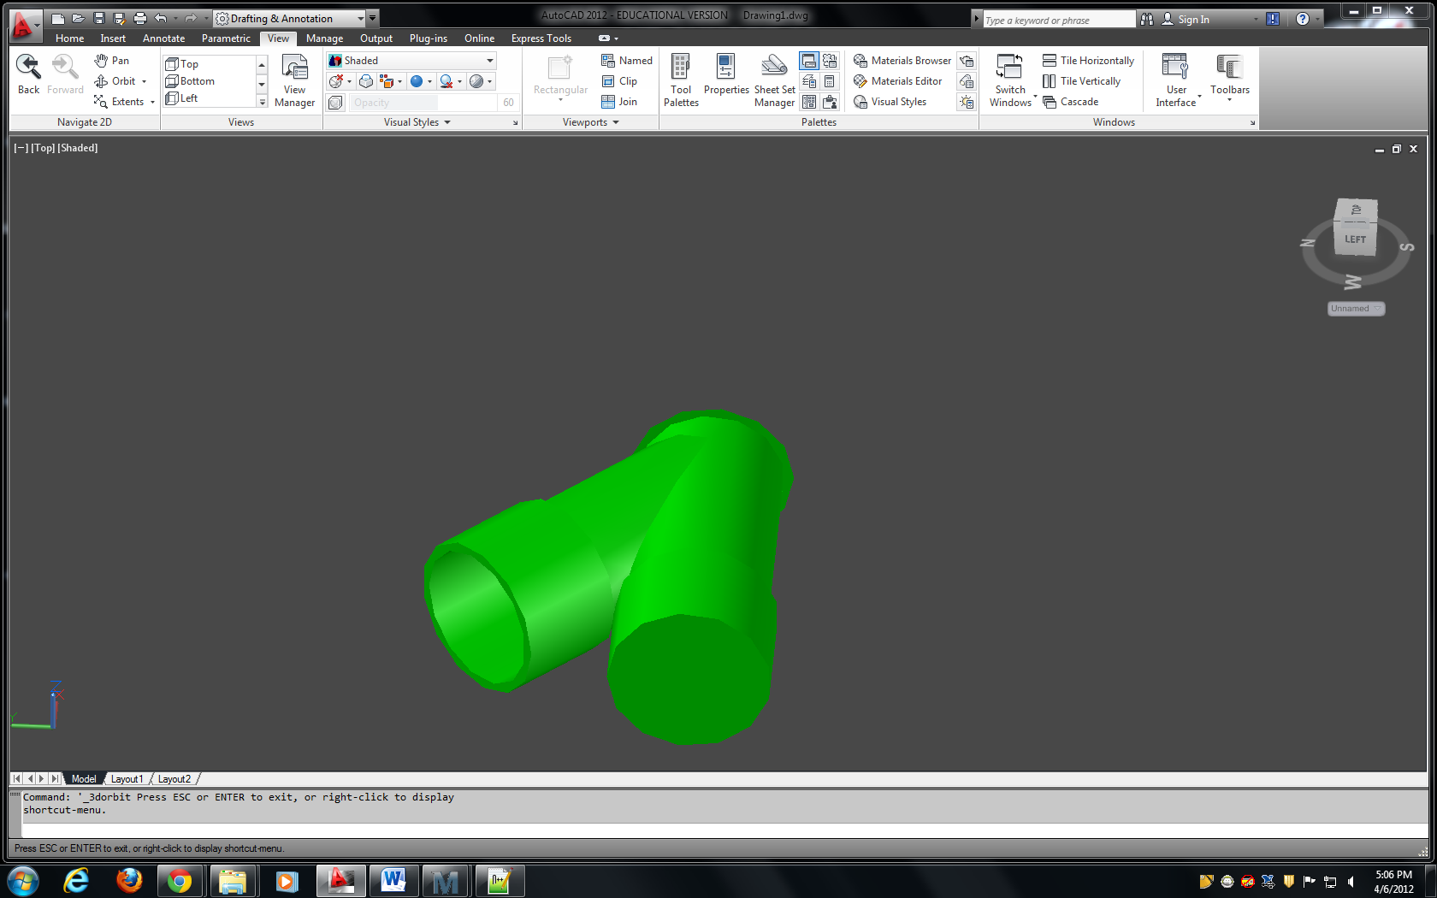
Wye Functions
Used in the Sand Rapid Sand filter’s sand drain
Incorporated into PlumbingF file
New dimensions DiagWyeLength, ShortWyeLength, and LongWyeLength specified in the pipedatabase

Slide 9
LFOM Code Redesign
Andrew Smith
Notes:
I assume that this cover page will be removed when you compile the presentation…

Slide 10
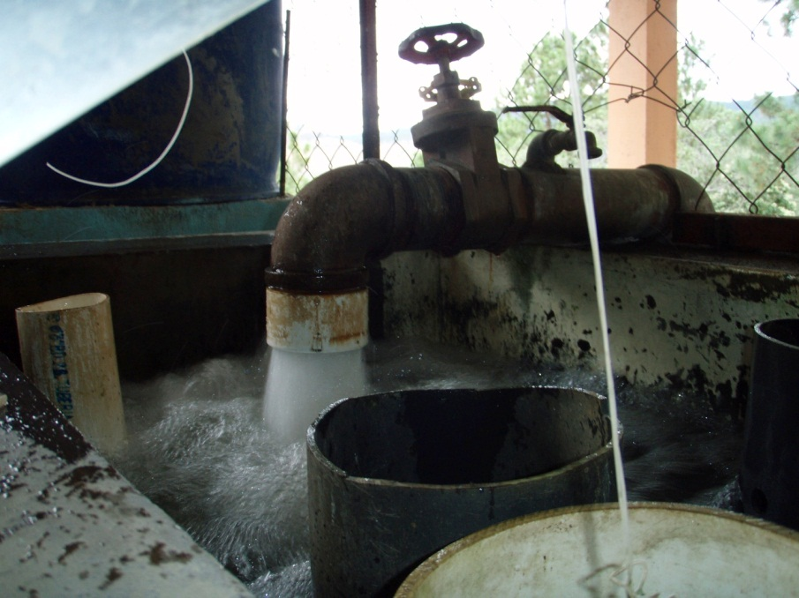
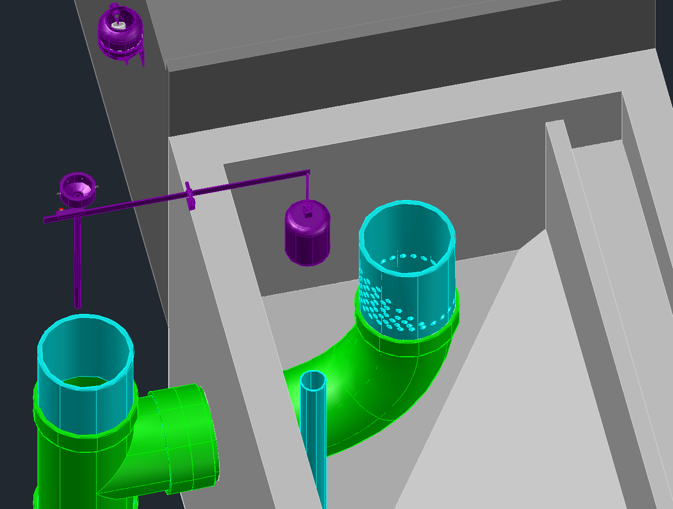
Introduction: LFOM
Produces a linear relationship between water height in the entrance tank and plant flow rate
Used in conjunction with dose controller to automatically dose proper amount of coagulant

Slide 11
LFOM Design Algorithm (pre-spring 2012)
Find flow through a single orifice (horizontal orifice equation)
Use equation for perfectly linear weir to determine how much water should be flowing from a certain row of orifices
Divide by flow through a single orifice, round up/down to produce trial solutions
Iterate with trial solutions for each row in series, rerun algorithm until solution with least possible error is produced
Notes:
Use the equation for flow through a horizontal orifice to determine flow through a single LFOM orifice
Use the theoretical stout weir equation to determine how much water should be flowing out of the orifices on a given LFOM level
Divide this flow by flow through a single orifice, round up/down to produce trial solutions

Slide 12
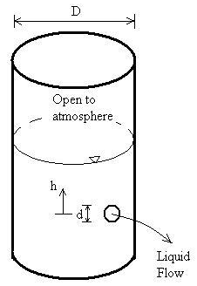
So what’s the problem????
Equation for flow through a horizontal orifice assumes distance from surface to all points in the orifice is the same:
Q=A*Pi.VenaContractaOrifice*sqrt(2gh)
Notes:
The “h” value in this equation is assumed constant

Slide 13

So what’s the problem????
If there is sufficient head available above the orifice, there is no problem.
If there is little to no head available above the top of the orifice, the horizontal equation will overestimate flow through the orifice
Notes:
Why? Very little head difference between the free surface and the top of the orifice, so little flow.
Larger head difference between free surface and middle/bottom of orifice, so more flow there.
Result: less flow through orifice than calculated by horizontal equation

Slide 14

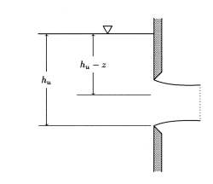
How do we fix this?
USGS equation for flow through a (vertical) partially filled orifice:
This equation accounts for difference in available head over the vertical extent of the orifice
Notes:
Create a new function in fluids functions which allows the user to input orifice orientation
If orifice orientation is actually horizontal (this could be the case in future plant components), use the horizontal orifice equation, as was done before
If orifice orientation is vertical (as is the case in the LFOM) apply new, USGS equation

Slide 15

Future Work
Test new function extensively to see if a new LFOM orientation results
Integrate new LFOM file into the automated design tool

Slide 16
Flocculator
Major unit process in original and current designs – It’s the reactor!
Provides collision potential to form large enough flocs for the sedimentation tank
Optimized to mid-sized plants, but fails at very high (>70 L/s) and very low (<5 L/s) flow plants
Not well understood → coding and cost inefficiencies

Slide 17
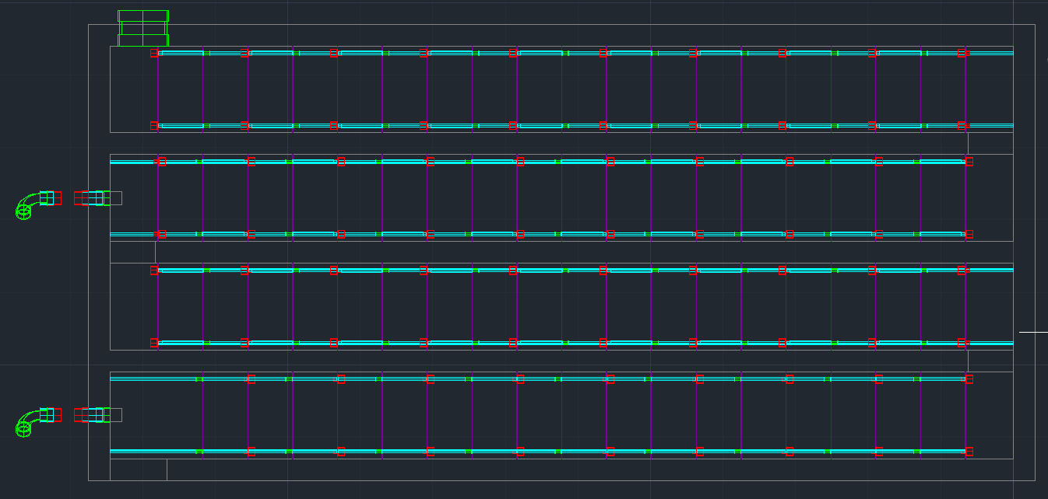
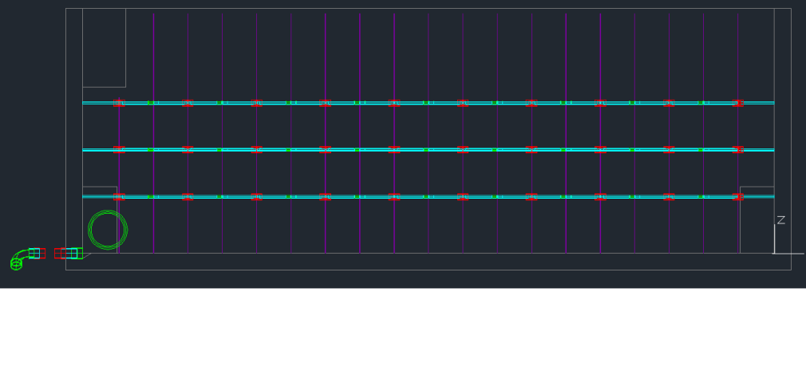
Final Goal

Slide 18
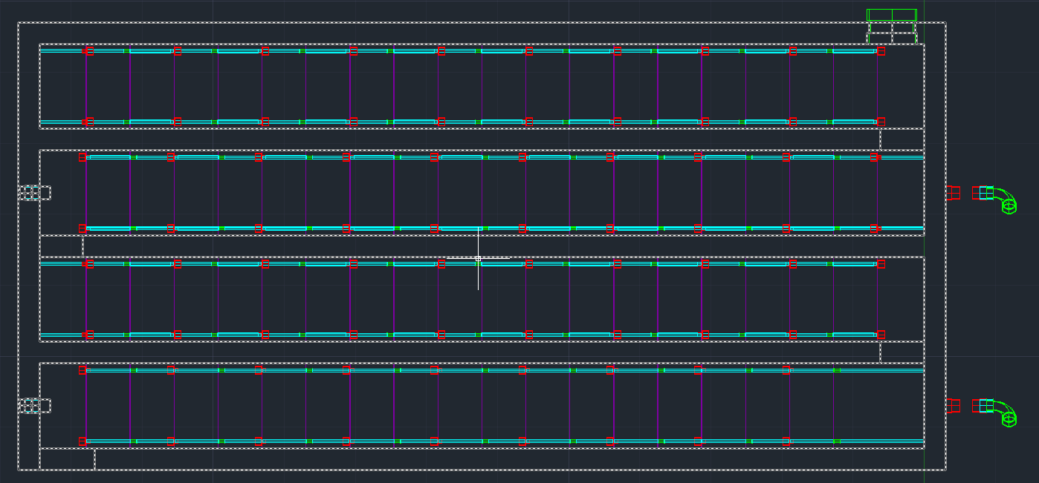
Update 1

Slide 19
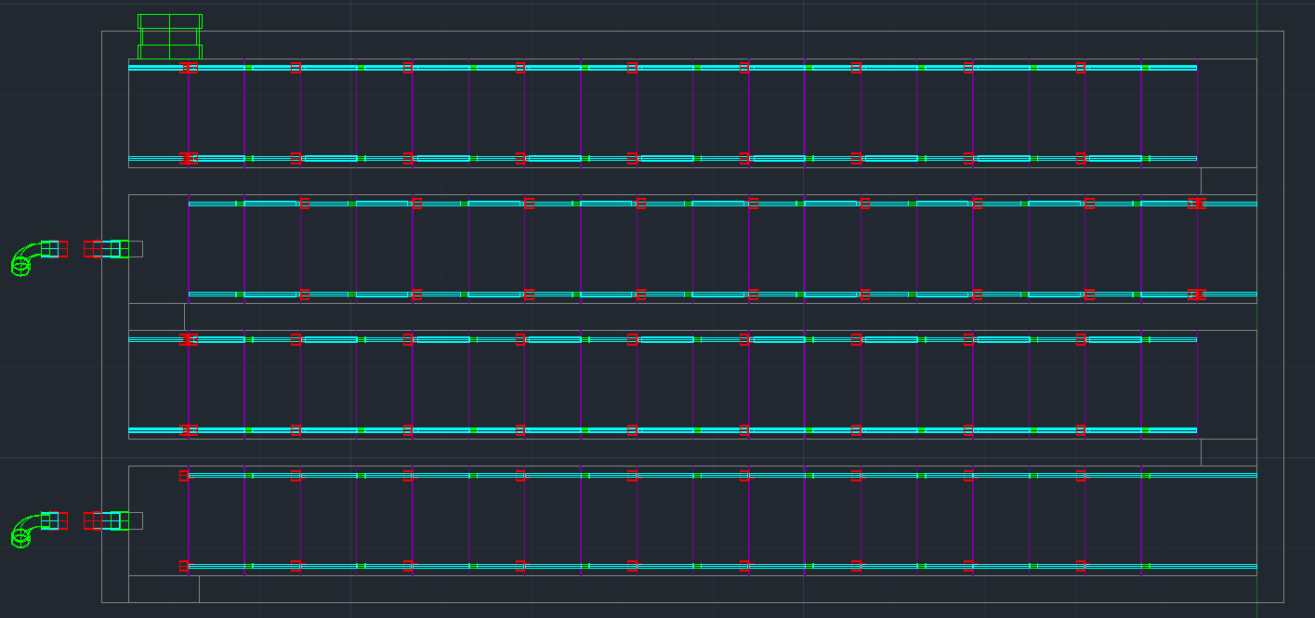
Update 2

Slide 20
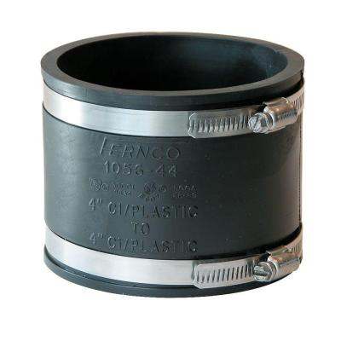
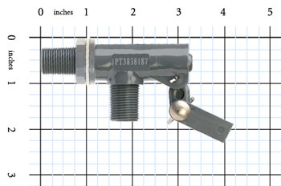
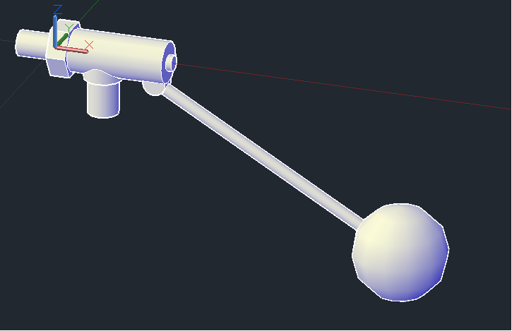
Mini Projects
Ferno Fittings (SRSF & Future Use)
Large Float Valve (>70 L/s Plants)

Slide 21
Sedimentation Tank Economics
Julia Morris

Slide 22
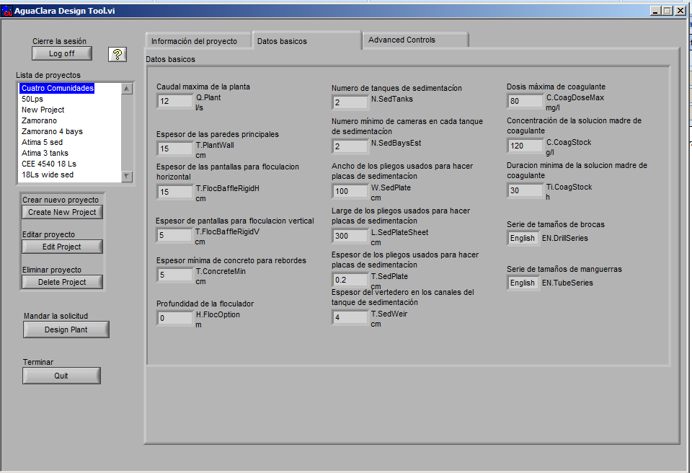
Introduction
Picture/Graph/Table

Slide 23
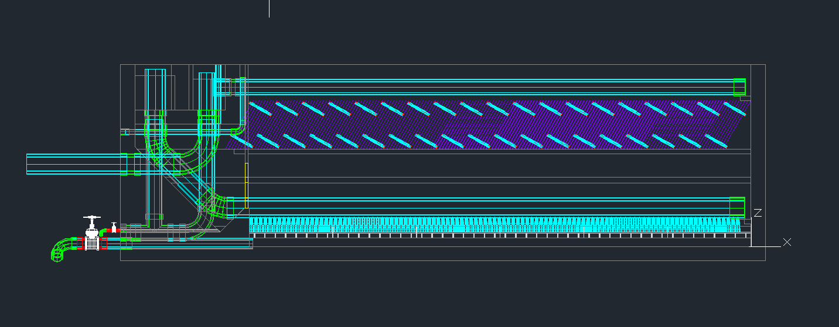
Introduction
Inlet Channel
Exit Channel
Launder
Caps
Coupling
Elbows
Inlet Manifold
Diffusers

Slide 24
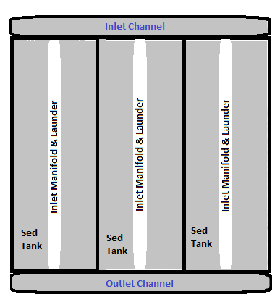
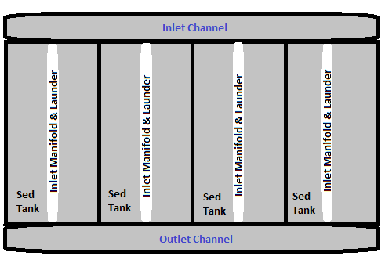
Plan of Attack
Key Parameters
  Number of Sed Tanks
  Number of Sed Bays
  Nominal Diameter of Inlet Manifold

Slide 25
Plan of Attack

Slide 26
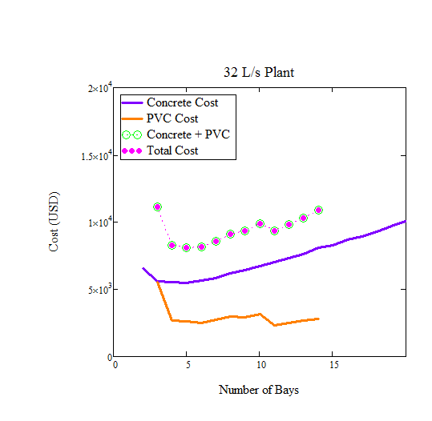
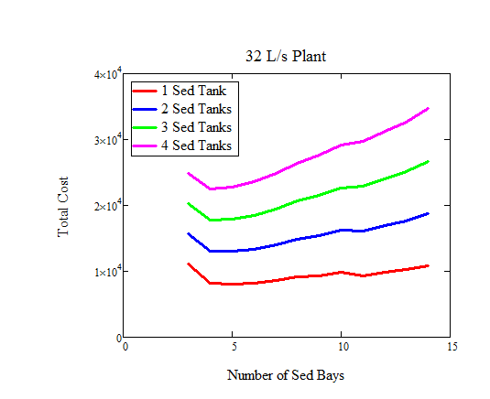
Results of Cost Functions

Slide 27
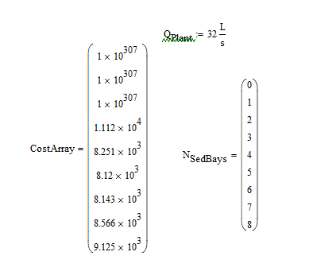
Algorithm
Step 1) Find the Optimal Number of Sed Bays
Make cost vector by cycling through a range of number of bays
Find minimum cost in that vector and number of bays associated with that cost

Slide 28
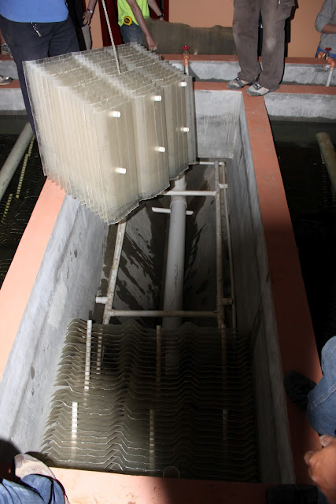
Algorithm
Step 2) Find the Optimal Number of Sed Tanks
Ease of Maintenance and Operation
  Need at least 2 tanks
  No more than 2 bays per tank

Slide 29
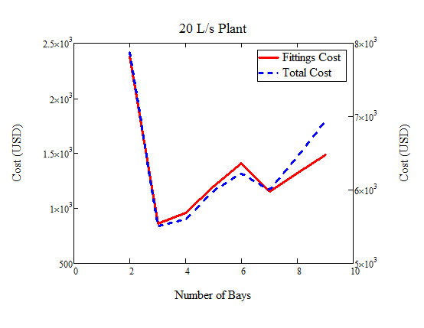
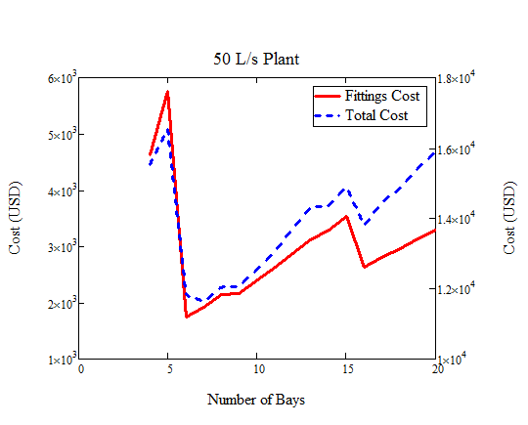
Simpler Algorithm?

Slide 30
Chemical Dosage System
Amanda Rodriguez and Nicholas Parisi

Slide 31
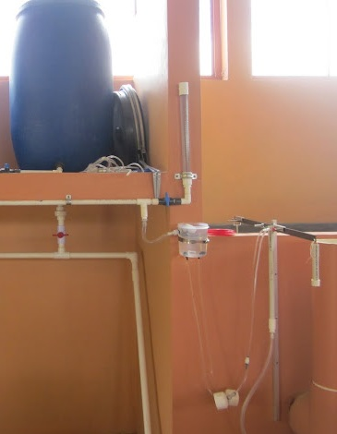
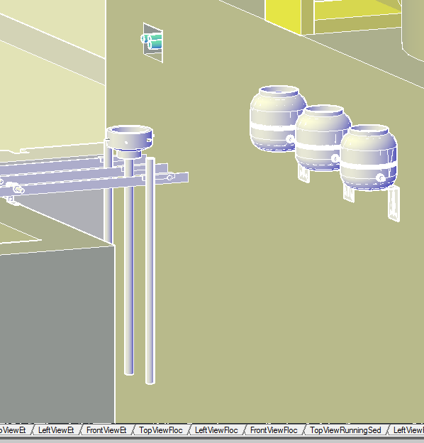
Where We Are Working

Slide 32
Task and Purpose
Task: replace inserted drawings of Chemical Dose Controller with simpler components
Have these components directly from the command line
Purpose: Simplify code and make objects scalable for various inputs

Slide 33
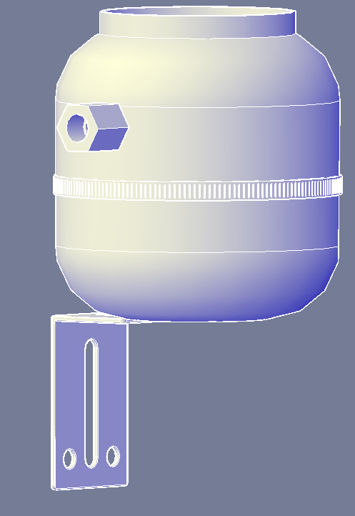
Current Drawing
many different parts:
  float valve
  drop tubes
  lever arms
  L-brackets for the lever arms and the constant head tank
  constant head tank(s) with barbed fittings extending from the sides.

Slide 34
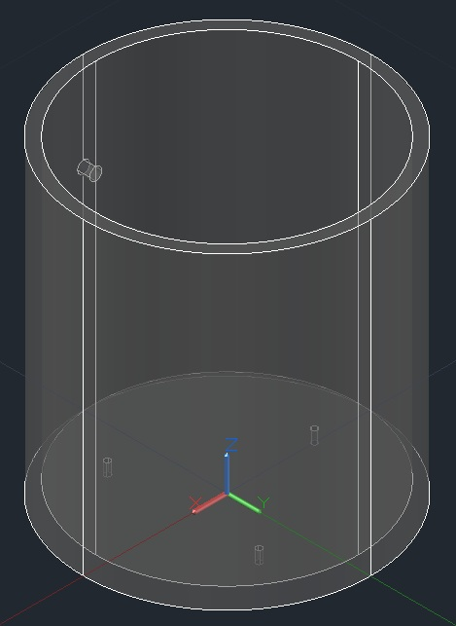
Inserted vs. Command Line Drawing

Slide 35
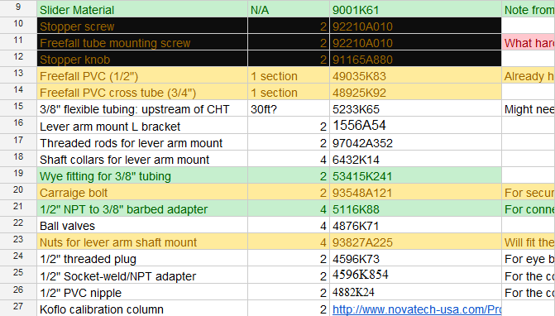
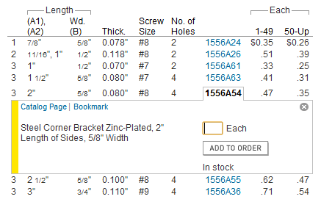
General Process

Slide 36
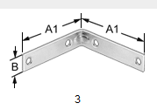
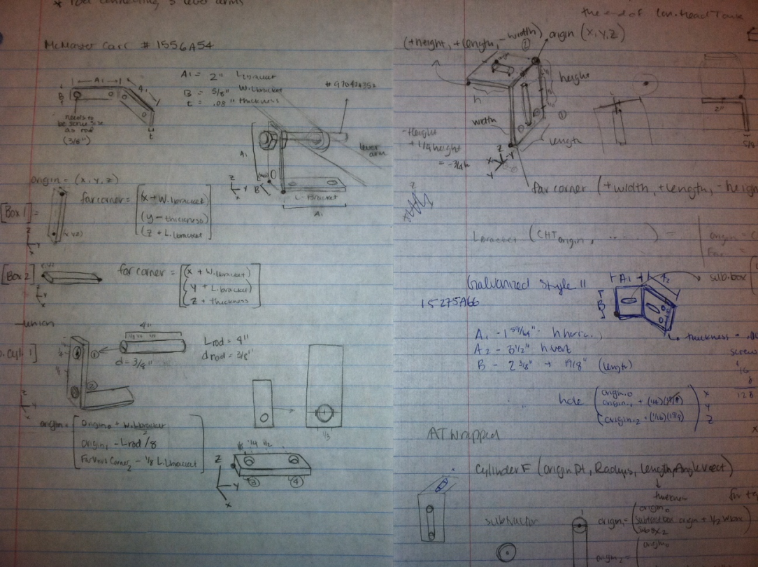
General Process

Slide 37
Constant Head Tank Coding:
Draw a basic cylindrical container with a cap, a hole on the side for the float valve, and barbed fittings extending from the bottom.
float valve = inserted drawing
Barbed fittings drawn incorrectly
  Should be on bottom rather than sides
  Dependant on number of tubes required
Notes:
(As of right now, the float valve will remain as an inserted drawing.)
(Also, things we need to fix)
(incorrectly (barbed fittings allow flexible tubing to connect the constant head tank to lever arms and the reducer)

Slide 38
Inputs
origin point dependent on position of Entrance tank
outer radius and height determined by numbers listed in the specifications given by McMaster
Some inputs already defined: height between the attachment of the float and the water level (dependent on the size of the float valve)
Define water depth and thickness of tank myself
An angle vector of rotation
Notes:
(this is calculated – check mathcad code)
outlined in ChemStorageTanks: height between the attachment of the float and the water level dependent on the size of the float valve; define water depth myself
Rotation – in case we rearrange plant layout

Slide 39
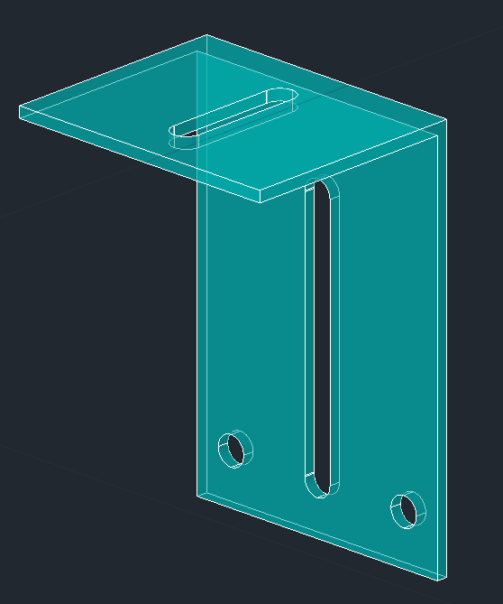
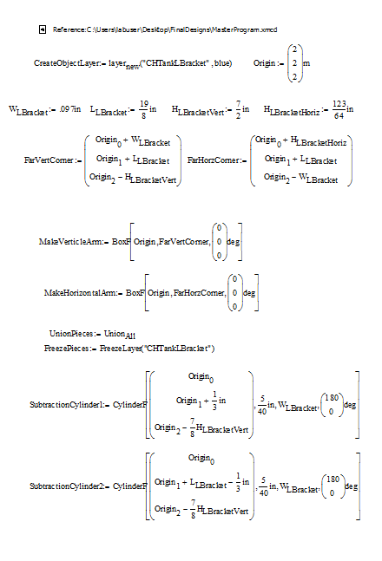
L-Bracket
L - Bracket Design
Finished Product

Slide 40
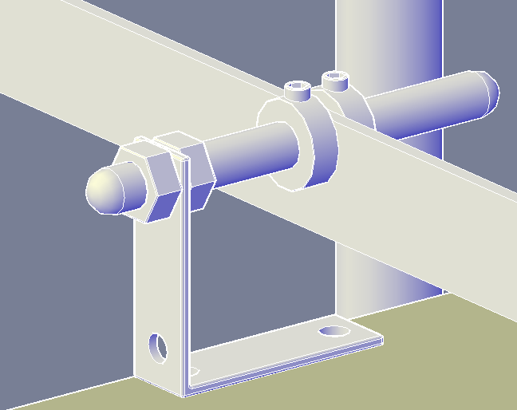
Lever Arm and L-Bracket

Slide 41
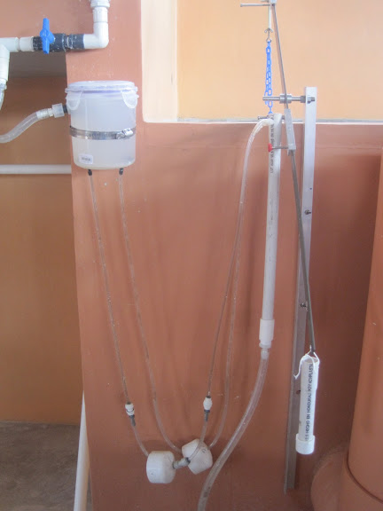
Flexible Tubing
Find the start and endpoints for each tube
Transform function: require a point array that only consists of the start and endpoints
Based on the mathematical function for a catenary, which describes how a general chain or tube drapes.
Notes:
(should be fairly straightforward and based solely on the arrangement of the other items we are currently working on.)
(this will be a little trickier)

Slide 42
Concept Paper
Annie Newcomb

Slide 43
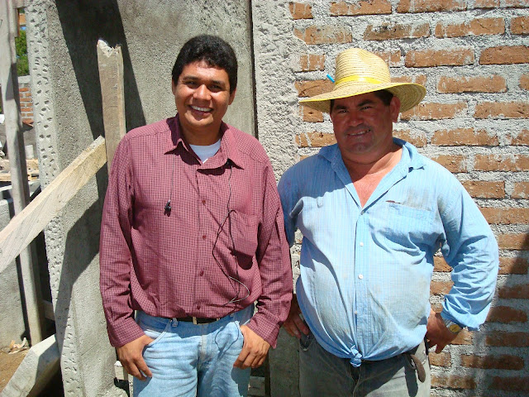
Objectives
AguaClara abstract
  8-10 pages
  Spanish / English version
Extended concept paper
  20-30 pages
  Detailed plant components
  Spanish / English version

Slide 44
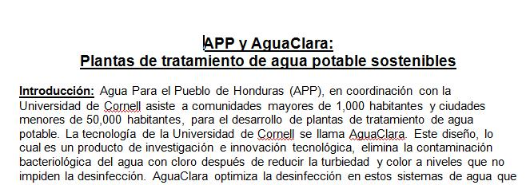
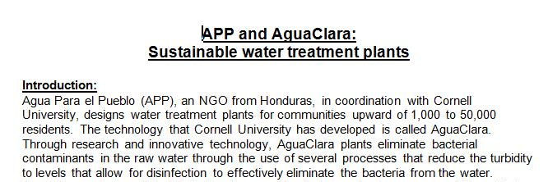
Purpose / Future Work
Audience
Technical language
Scalability
Moving beyond Honduras?
Future Work:
Finalize abstracts in English and Spanish
Extended concept paper
Design

Slide 45
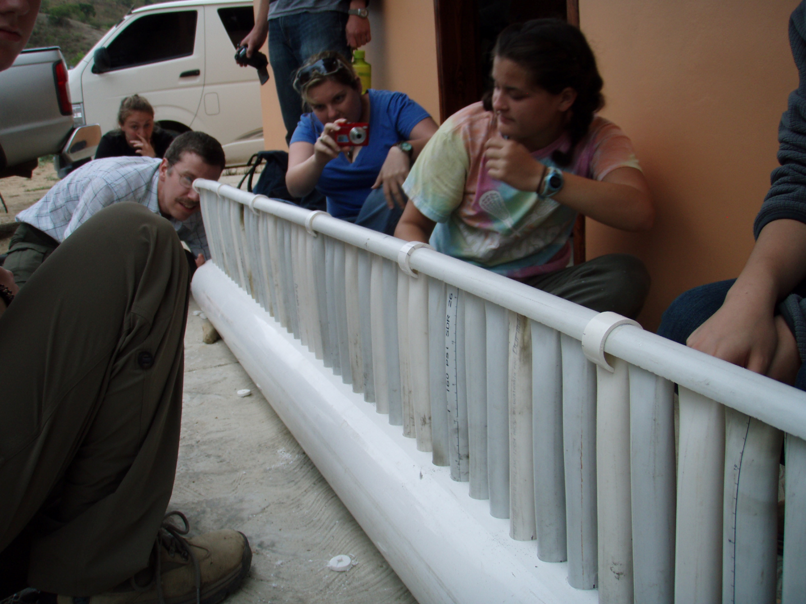
Questions????

