Slide 1
Design Team
Spring 2015

Slide 2
Goal
Update the Design Tool
What is the Design Tool?
AutoCAD Drawing
Report of Plant
Materials List
Section Cuts
User Input:
Plant Flow Rate

Slide 3
Server
Interface
Data and design flow rate input
Mathcad
General functions and inputs
User Email
Delivery of design materials
Mathcad
Design algorithms
LabVIEW
Program execution and communication between components
Mathcad
AutoCAD drawing algorithms
Microsoft Word
Design documentation
AutoCAD
3D plant model

Slide 4
Challenges
Sedimentation Tank Updates: Dave
Materials List: Stephanie and Ewa
Chemical Dose Controller: Michelle

Slide 5
Sedimentation Tank
Updates
David Gold

Slide 6
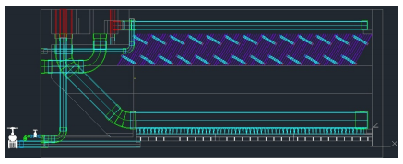
Code Organization
Design code has been incrementally updated over the past several years
Pieces of outdated code still exist in the current code

Slide 7
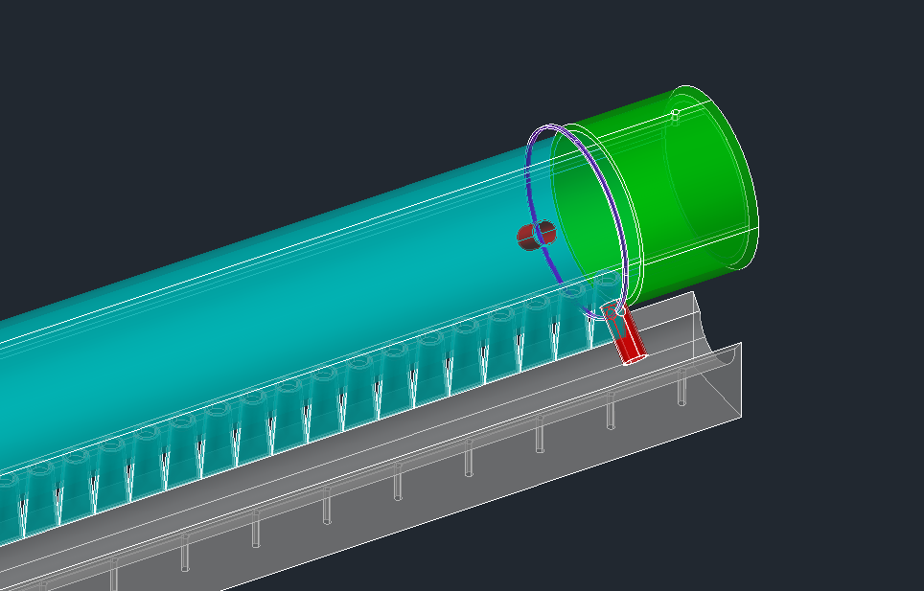
Manifold Air Vent

Slide 8
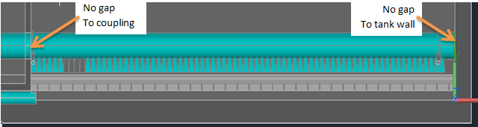
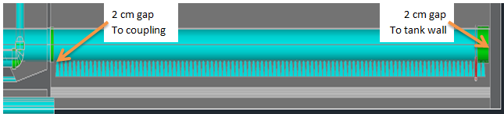
Diffuser Position
Existing Diffuser Layout
Updated Diffuser Layout

Slide 9
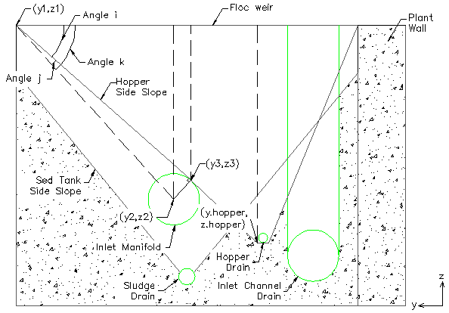
Floc Hopper Adjustment

Slide 10
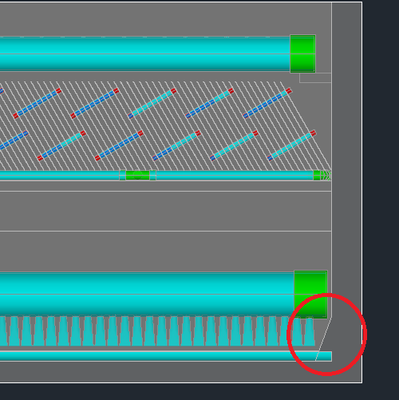
Bottom Wedge

Slide 11
Sedimentation Tank
Questions?

Slide 12
Materials List
Stephanie Sun
& Ewa Przybylko

Slide 13
Materials List
Goals for Spring 2015:
  Create MathCAD code to draw plant pipes and accessories as blocks in AutoCAD
  Extract a materials list from AutoCAD that counts the instances of each block in the drawing
Purpose:
  Make it easier for engineers in Honduras to extract hydraulic materials lists from the AutoCAD drawings

Slide 14
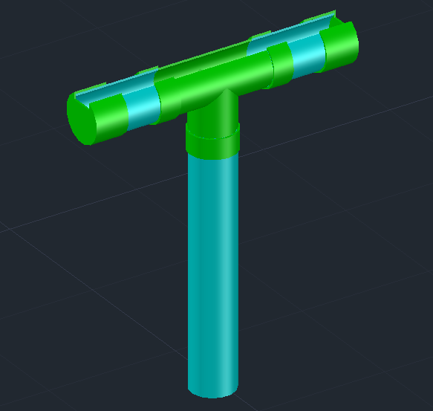
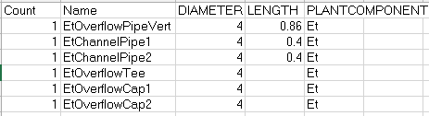
Materials List
Overflow Drain Grit Excel Output
Entrance Tank Overflow Drain Grit AutoCAD Output

Slide 15
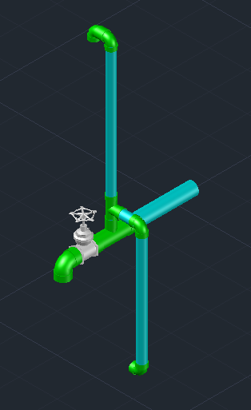

Materials List
Entrance Tank Pipe Flow Control (left)
Entrance Tank Hopper Drains (bottom)

Slide 16
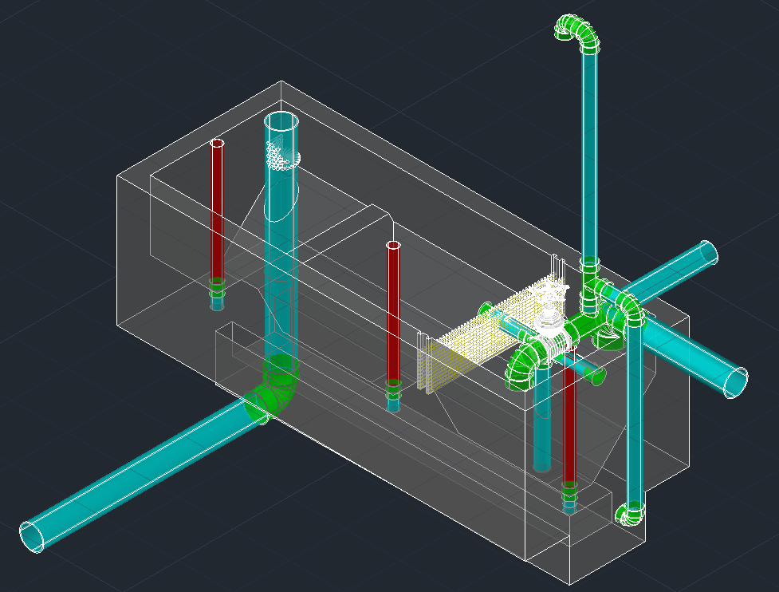
Materials List
Entrance Tank
Hopper Drains

Slide 17
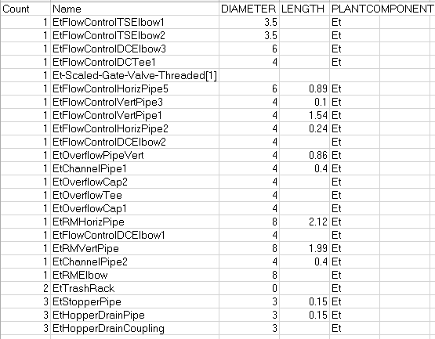
Materials List
Entrance Tank Materials List (Excel file)

Slide 18
Materials List
Questions?

Slide 19
Chemical Dose Controller
Michelle Lee

Slide 20
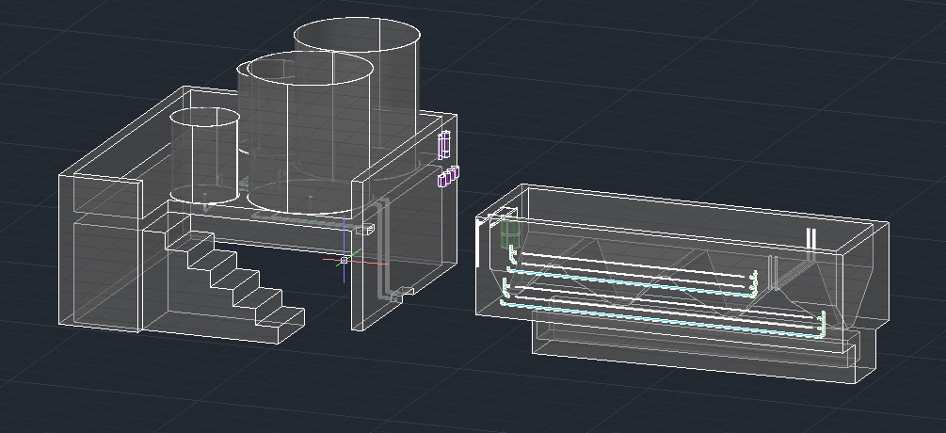
CDC
➢Objective
To update the design drawing of the CDC such it reflects to our clients of how the CDC is incorporated in the plant

Slide 21
CDC
➢Tasks
❖Update Chemical Storage Tanks Platform Drawing functions
❖Update Constant Head Tanks and Calibration Columns drawing functions
❖Update Lever Arm Drawing functions

Slide 22
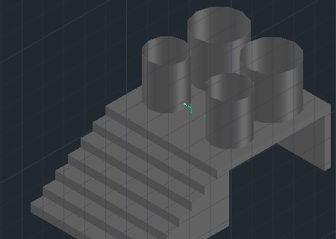
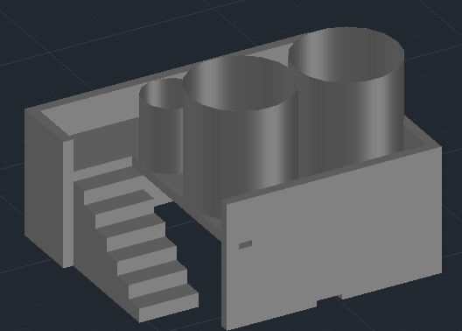
CDC
➢Achievements
❖Modified the platform design in the plant drawing to improve its aesthetic appeal
Before
After

Slide 23
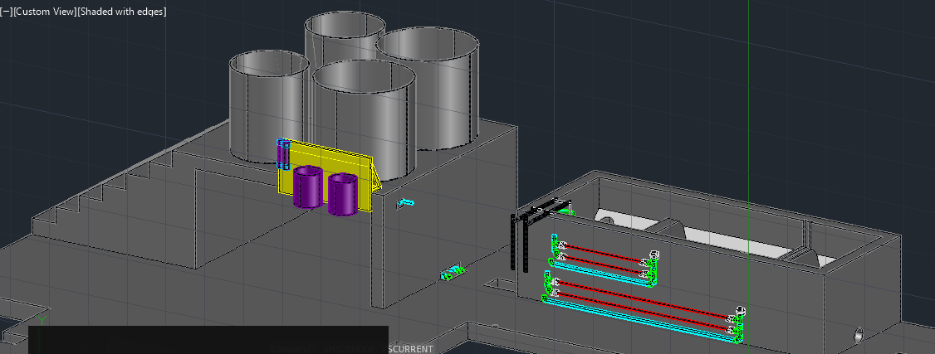
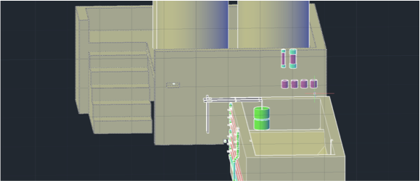
CDC
❖Two Constant Head Tanks were added
❖CHT and Calibration Columns were repositioned
Before
After

Slide 24
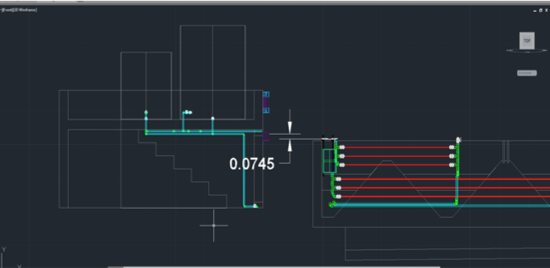
CDC
❖Elevation of the CHT was modified

Slide 25
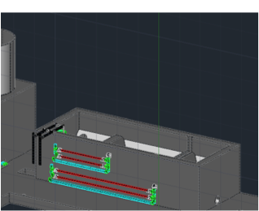
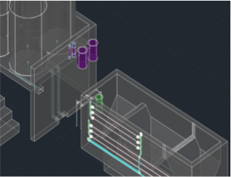
CDC
Future Plan
❖Finalize the drawing functions for the lever arm
❖Implement codes that draw the pipes that connect the entrance tanks and chemical storage tanks.

Slide 26
CDC
Questions?

