Slide 1
Design Team

Slide 2


Automated Design Tool (ADT)
Access to customized plant designs
  User inputs
Key to continuing scalability
Open Source Engineering
AguaClara Design Philosophy
Notes:
Online interface that provides access to customized plant designs, invent scalable, reproducible tools that can be combined to form a complete water treatment plant.

Slide 3
Automated Design Tool
User Inputs
Plant
Design
LabVIEW
AutoCAD
Mathcad
Calculations
MS Word
Mathcad
Drawing Files
Notes:
User places inputs, design tool sends a request to the AguaClara server to produce a spreadsheet of all variables relevant to the plant design, and the values assigned to each of them. These include pipe diameters, wall dimensions, and baffle dimensions and placement. The ADT uses these variables to scale plant components in AutoCAD to create a complete, three dimensional design of the entire plant and its components.

Slide 4
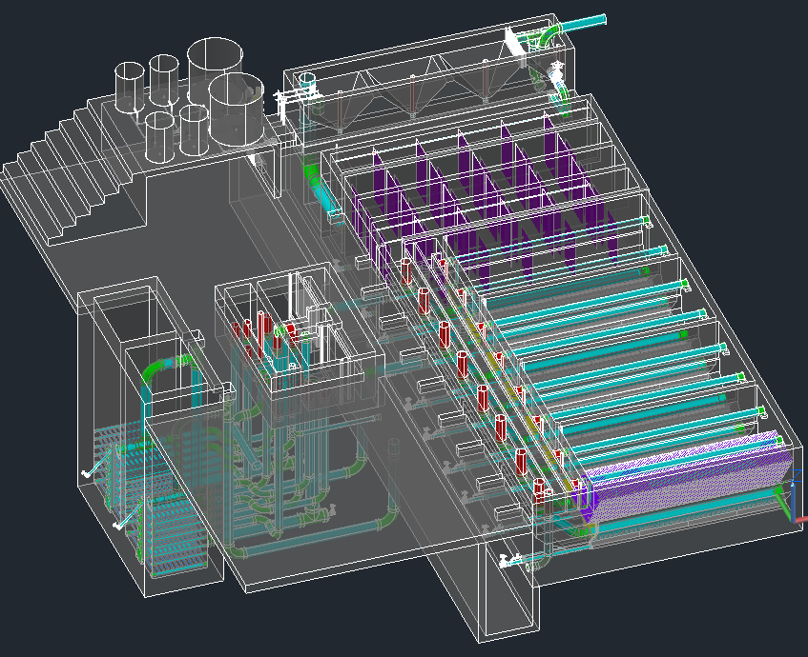
The Drawing

Slide 5
Overall Design Tasks
  Incorporating new research progress into the design
  Designing plants for a greater range of flow rates
  Making our designs more easily understood
  Communicating with the team in Honduras and with new implementation partners to address concerns
Notes:
Design or constructability concerns

Slide 6
Modifications to Filter Inlet Channel
Paul Larios & Runpeng Yu

Slide 7
Problem Statement
Agua Clara Stacked Rapid Sand Filters (SRSF) are designed such that the filtration flow rate is equal to the backwash flow rate
When plants are operating at flow rates less than the design flow rate, the backwash flow rate is too low and the desired bed expansion in the sand filter is not achieved.
As a result, filter performance is worsened.
Notes:
Current Design/San Nicolas Plant: desired bed expansion is not achieved.
END: this results in worse filter performance

Slide 8
Approach
Objective: Devise a means to increase flow rate through a filter during backwash
Ideal solution:
  Allow for flow rate to be increased during backwash mode
  Allow plant operator to easily adjust flow rate
  Work for a wide range of flow rates
  Be low-cost and easy to construct
Notes:
Tenets of Agua Clara: simple, elegant solutions
Cheap, easy to operate and construct

Slide 9
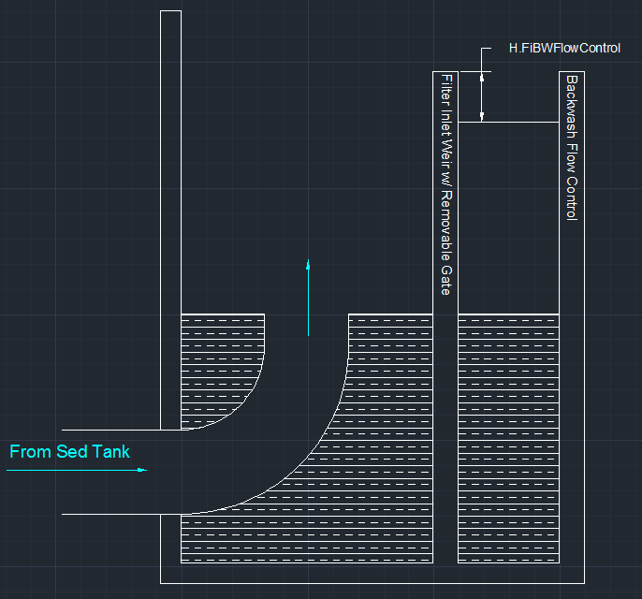
Proposed Design
Notes:
Change for inlet from sed tank-too deep for human to reach down.

Slide 10
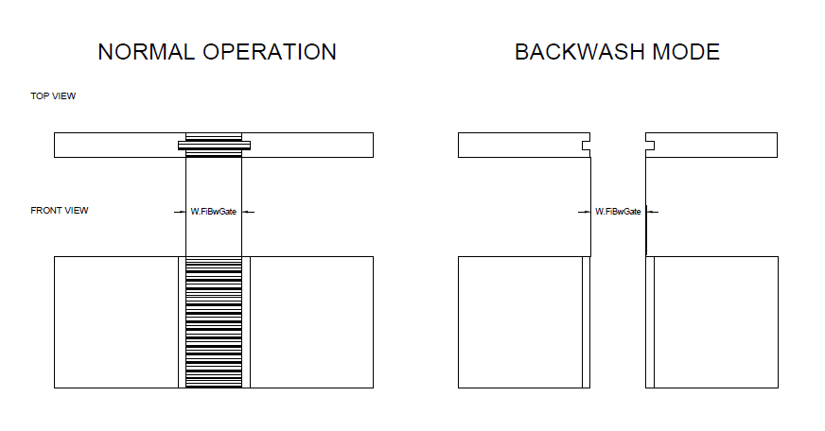
Filter Inlet Weir with
Removable Gate
Notes:
Filled-in piece==gate to be pulled out of slot for BW

Slide 11
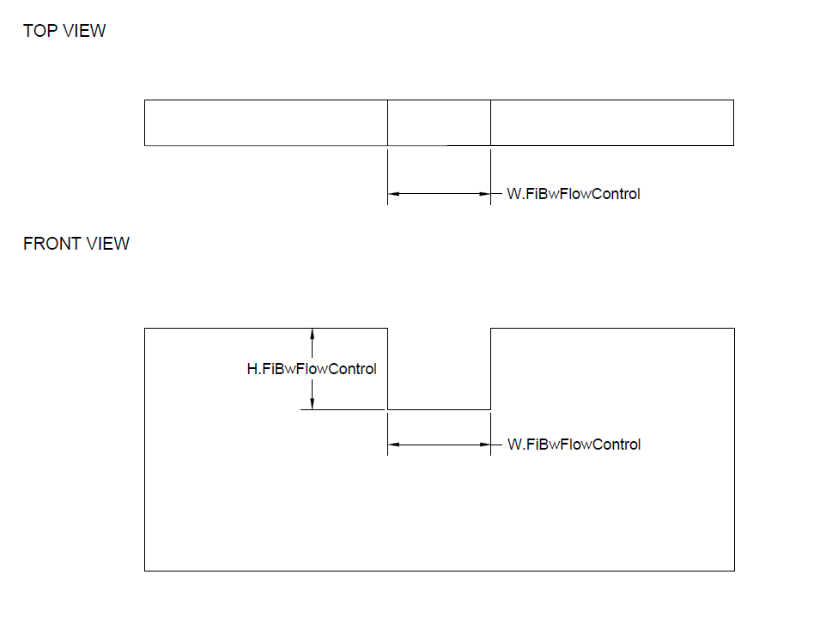
Backwash Flow Control Restriction
Notes:
HL thru this set based on MAX WL in Fi Inlet Box to avoid backwater influencing hydraulics.
Delivers target Q
“STOP LOGS”-ADJUST Q at startup.

Slide 12
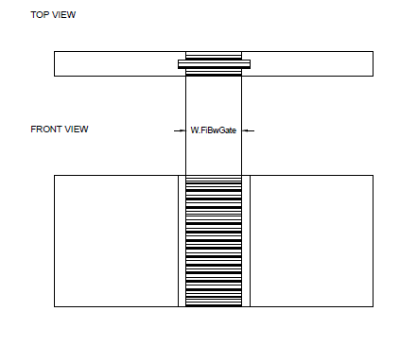
Backwash Gate Design
Expert Inputs:
  HL.FiBwGate= 0.5 cm, H.FiBwGate= 30 cm
Modeled gate as submerged orifice:
Notes:
Explain basis for expert inputs
-why submerged orifice
Area/Ht for width—FEASIBLE? must be some fraction of weir and corresponding dimension of filter inlet channel

Slide 13
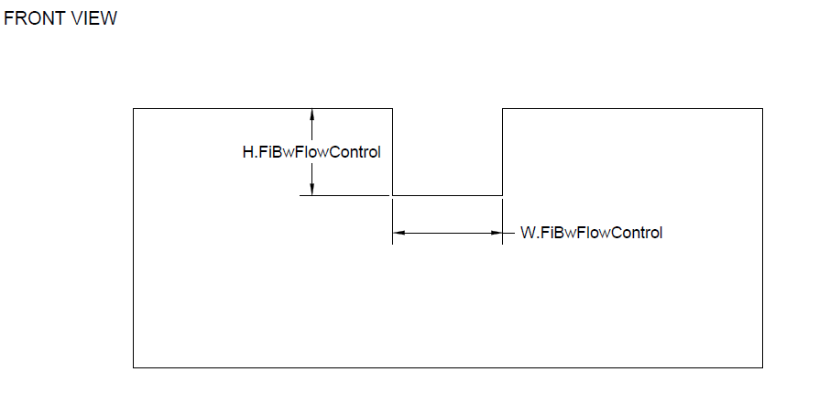
Flow Control Restriction
Expert Inputs:
  H.FiBwFlowControl = 10 cm
  .
  .
Modeled as rectangular weir:
  H.FiBwFlowControl = 9.5 cm
Notes:
10 cm. kept small cuz this is how much the filter box must be increased---COSTS $$
This restriction must be some ht above max WL in filter box so free fall occurs
What does piQ indicate
Model as weir:
-9.5 cm: Difference hl and ht is HL from gate (free fall)
Use result to calculate W. (Q is factor of Q and Pi-designed for max increase)
STOP LOGS-place at bottom-alter Q from max increase to plant Q

Slide 14
Analysis
Q.Plant=25 L/s
To achieve 50% expansion in BW Flow Rate:
  W.FiBwGate=42.2 cm
  W.FiBwFlowControl=68.8 cm
  Inlet channel: 30 cm wider than current
  Filter box: 10 cm deeper than current
Notes:
25 L/s=max size of filter (or MIN???)
Analyze results
Comment on ease of operation and effectiveness of such simple design

Slide 15
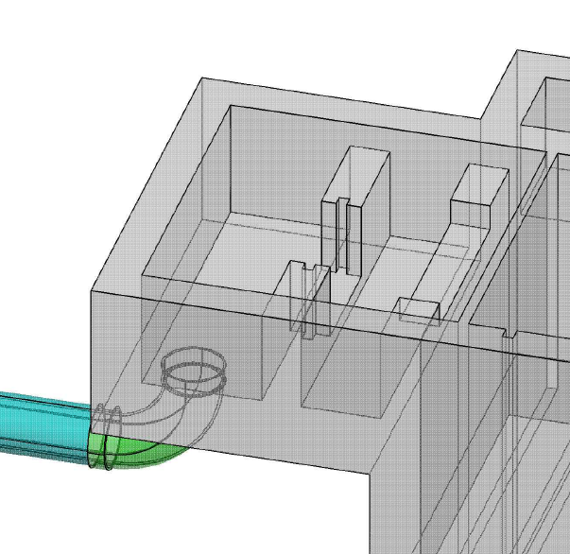
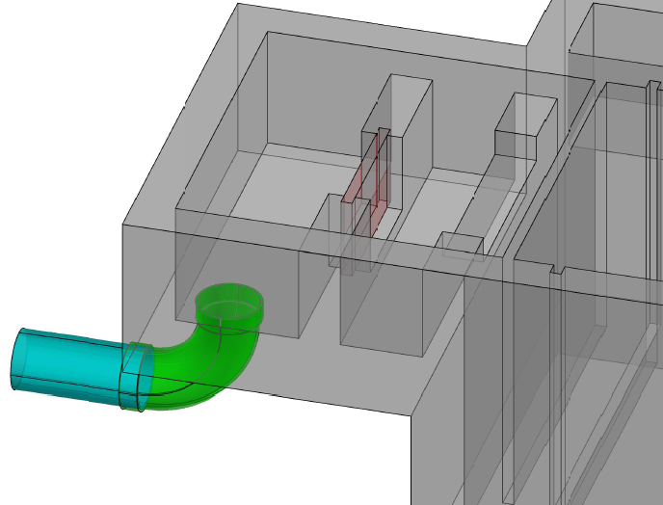
Modified Drawing
Normal Operation Mode
Backwash Mode

Slide 16
Future Work
Problem arises when drawing the whole filter using stack command
Draw water level to show more clearly how the new design works
New design testing and field implementation

Slide 17
Sedimentation Tank Design Details
Kristie Guo and Paroma Chakravarty

Slide 18
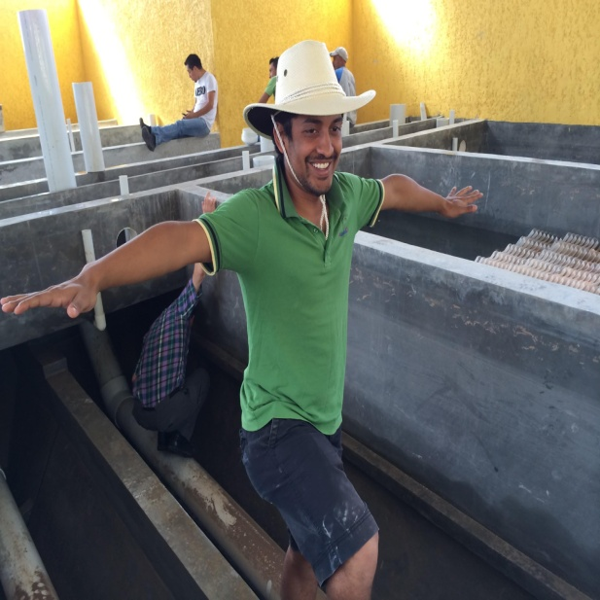
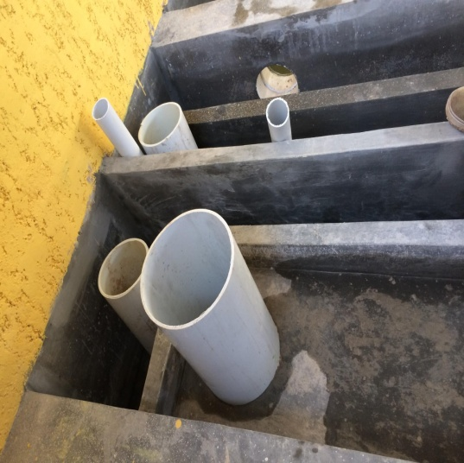
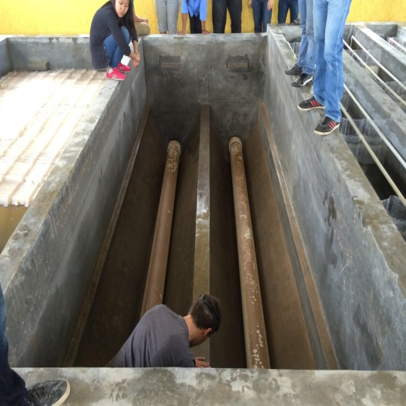
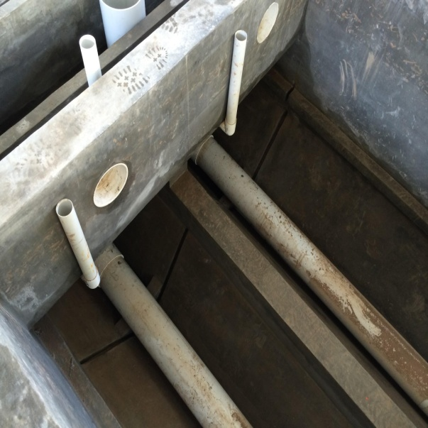
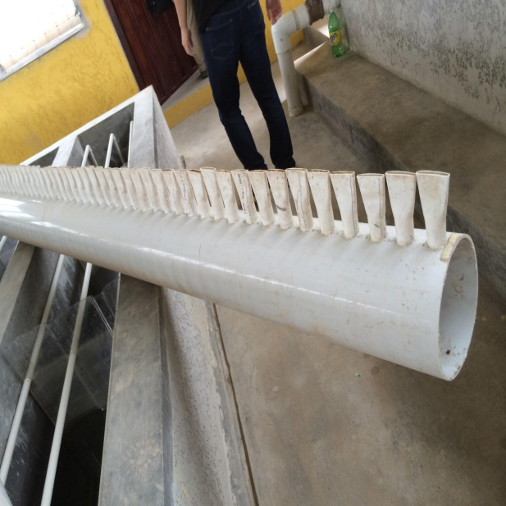
Honduras!

Slide 19
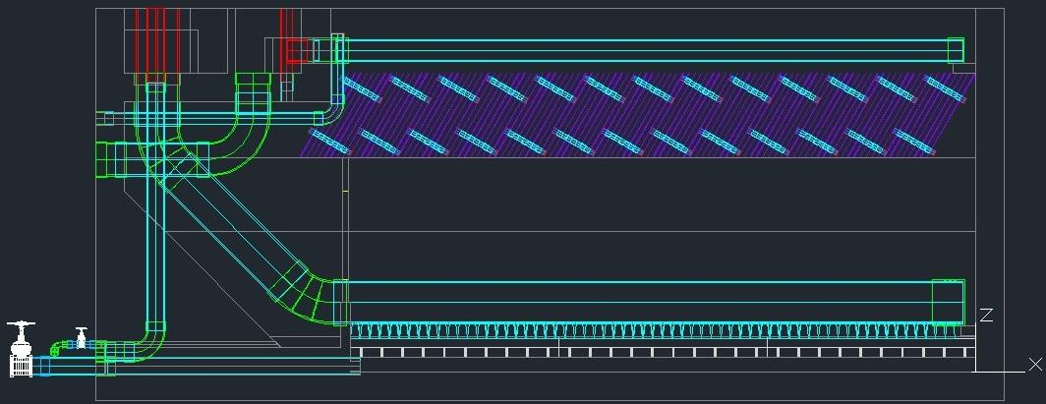
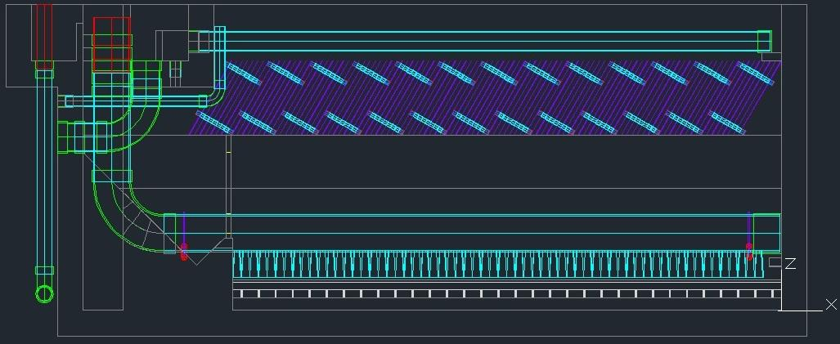
Merging the Codes
Current Sedimentation Tank
May’s version of the Sedimentation Tank
Notes:
- inlet pipe angle
- length of manifold
- feet
- inlet/ exit channels different
- no drainage pipe
- Floc hopper

Slide 20
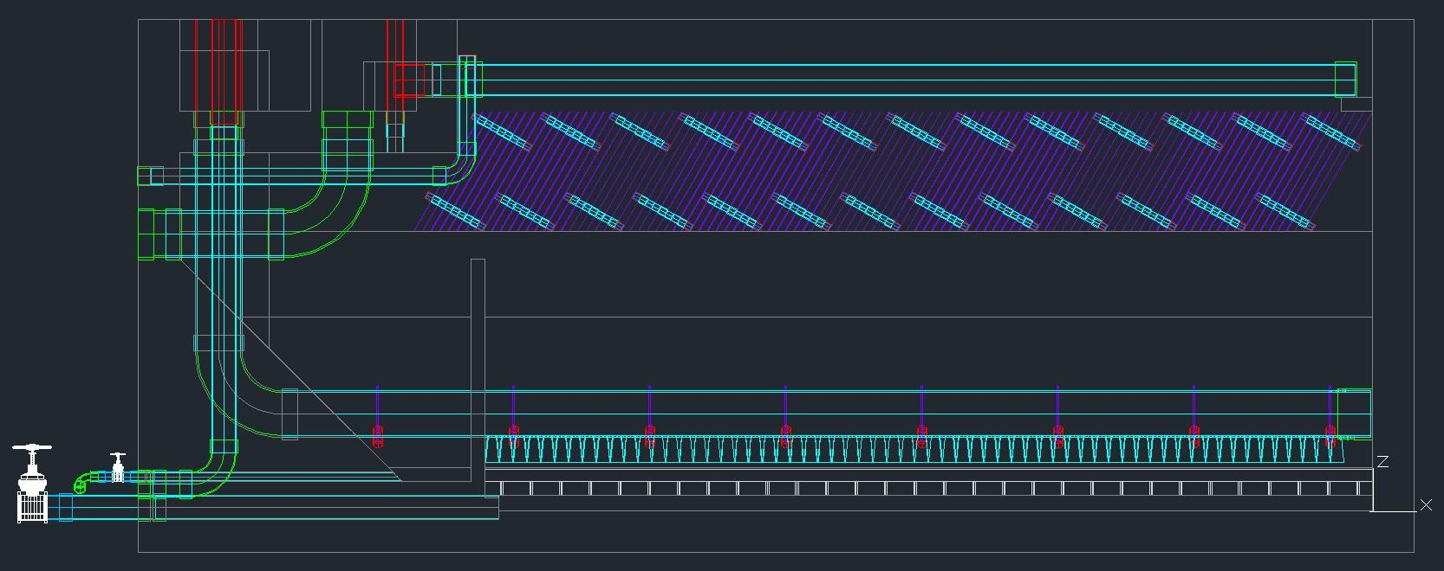
The Merged Code
Notes:
- code includes our changes
- inlet angle- now 90, got rid of an elbow, corrected inlet manifold length
- Feet were arrayed along length of the inlet manifold
- Space between the floc weir and bottom of the inlet channel
- Diffuser length is fixed
- Inlet manifold support platform was eliminated

Slide 21
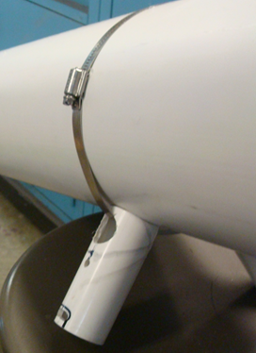
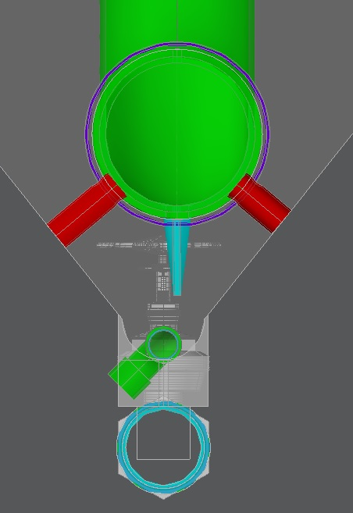
Current Feet
Current Manifold and Feet
Notes:
- Feet are on the manifold, our methods didn’t work. Its length needs to be measured based on the slope angles, our code just shows where the feet should be.

Slide 22
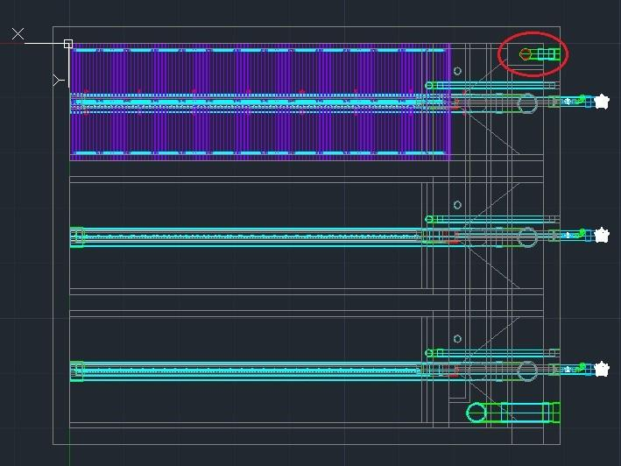
Bury the Emergency Drainage Pipe
Top 2-D View
Notes:
- Attached to the plant wall (same width as the channel)

Slide 23
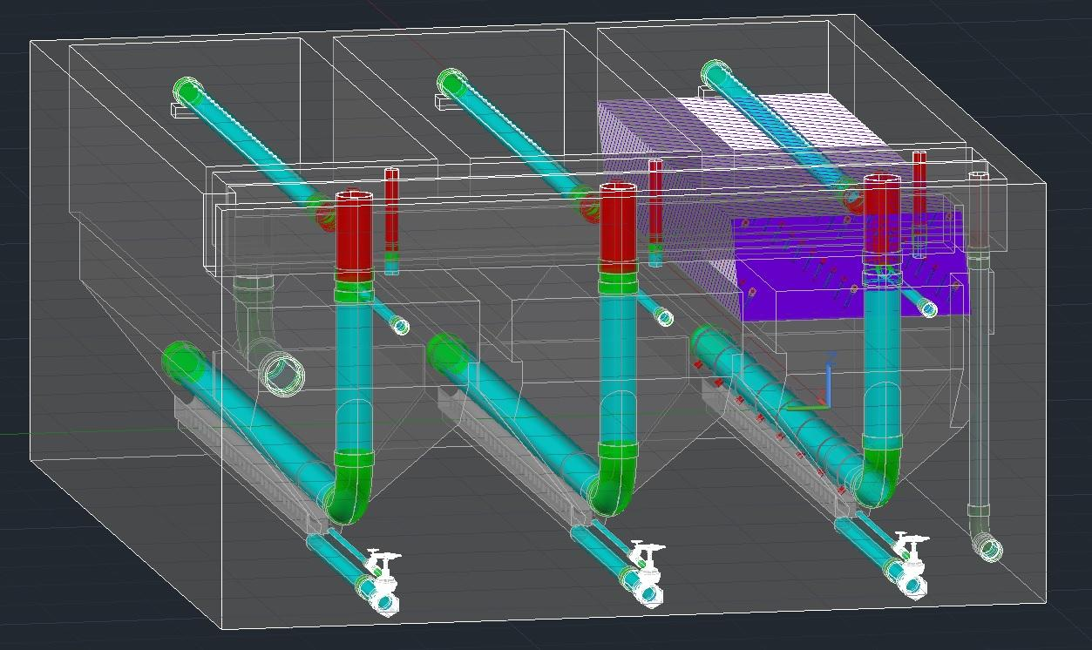
Bury the Emergency Drainage Pipe
X-Ray View

Slide 24
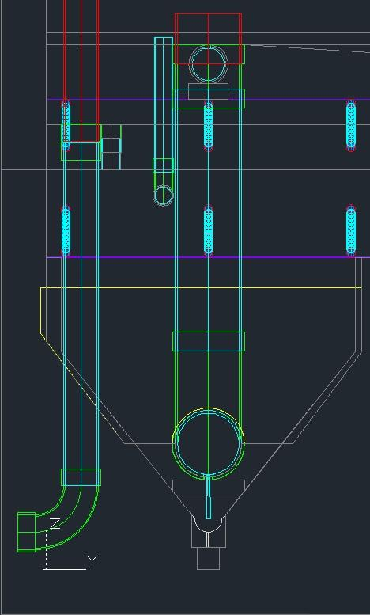
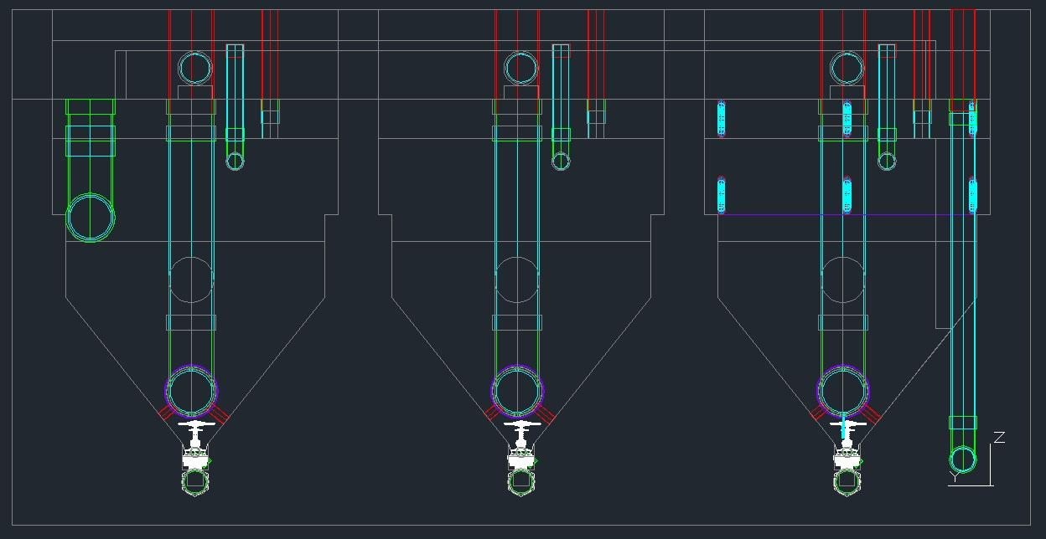
Floc Weir Concrete
Original Floc Weir
Current Floc Weir Concrete
Notes:
- made the floc weir out of concrete
- measured the distance between the concrete floc weir and the bottom of the channels (about 38 cm, enough?)

Slide 25

Future Work
Taper the inlet channel to prevent flocs settling at the end of it where the velocity is low.
Add in additional changes as the sed tank evolves

Slide 26
ERROR CHECKING CODE
GUNEET SANDHU
TOUN SALAWU

Slide 27
Introduction
Open Source
Multiple User Interface
Flexible
(Power to User)
Research Based updates
Feedback From Field
Design Code
Notes:
In context of the design team:
AguaClara is an open source technology that allows multiple user interface. Due to the flexibility of the design tool, which allows users to modify certain parameters for special design requirements the integrity of the code can be compromised in this process.
Unwanted Consequences:
Redundant Functions
Incorrect function definition
Outdated or modified expert inputs
Committing modified code
Inconsistent Designs
Incorrect head loss estimation - design issues like flooding

Slide 28
Objectives
Independent code to test the integrity and reliability of design code
Identification of potential sources of error
The agreement of overall plant hydraulics and individual components
  Review the current design code and identify discrepancies
  Incorporating changes based on the feedback of other teams
Notes:
A feature needed to test the integrity of the designs produced by the AguaClara design tool is an independent error checking code. The objective of having such a code is primarily to identify potential sources of error that could lead to serious design issues or failures.
Having an independent error checking code will act as a validation mechanism to bolster the reliability of each final plant design through various check points within the error checking code.
It will act as a warning system to the user hence the purpose would be to alert the user of the discrepancy.

Slide 29
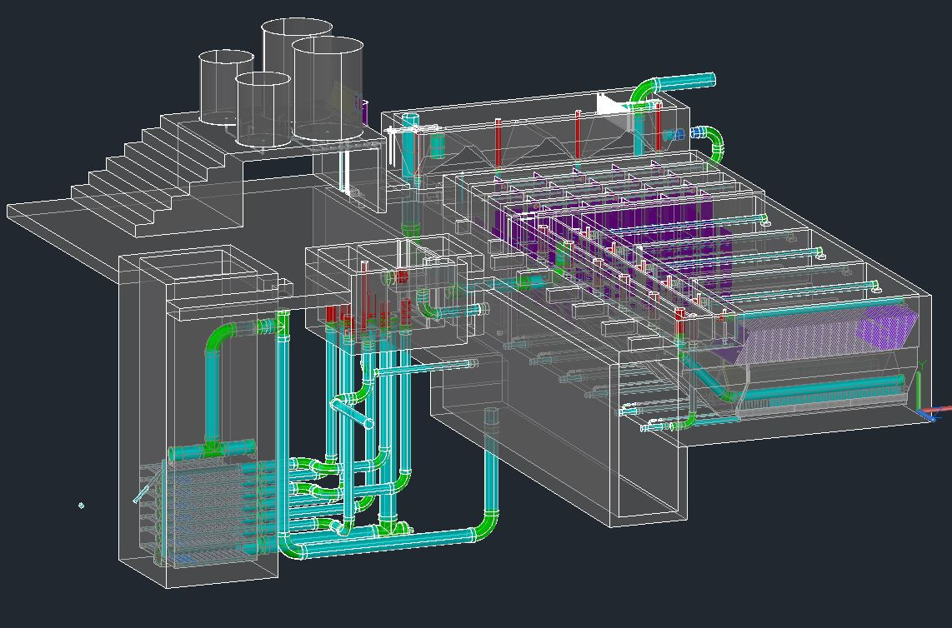
Solution Approach
Error Checking Code – Mapping hydraulic gradient
Expert Inputs Comparison Code
Notes:
Error Checking Code
Importing all relevant functions for head loss estimation
Identifying all sources of head loss
Identifying critical dimensional constraints
Hydraulic head estimation for each unit
Overall plant hydraulic gradient
Expert Inputs Comparison Code
Approved Expert Inputs list
Modifying name of the parameters
Comparison with Design Tool Expert Inputs

Slide 30
Design Philosophy
Mapping Hydraulic Gradient
  Selection of datum and head estimation
  He_{Unit} = HW_{Unit} + Z_{unit}
Constraint to prevent flooding
  HW_{Unit} < H_{unit}
Overall Plant Hydraulic Gradient
  HL_{PlantTotal} = Z_{EtTop} – H_{PlantFreeboard} – Z_{FiEntranceBottom}
  HL_{PlantTotalCalc} = He_{EntranceTank} - He_{FiDistPipe}

Slide 31
Challenges
Correcting unit elevations for units below plant origin
Ongoing changes in the design
Some constraints were violated for certain flow rates
Independent code needs to be updated separately

Slide 32
Accomplishments
  Calculation of head loss across each of the units
  Accounted for head loss not originally included in the main design code
  Developed hydraulic grade line for the entire plant
  Compared approved “Expert Inputs” to the values used in the design code
  Incorporated feedback from LFSRSF team
  List of discrepancies and resolution
Notes:
Calculation of head loss across each of the units and checking for consistency with CEE 4540
Accounting for head loss not originally included in the main design code
Developing hydraulic grade line for the entire plant considering the dimensional constraints of each component
Comparing approved “Expert Inputs” to the values used in the design code
Incorporating feedback from LFSRSF team
List of discrepancies and resolution

Slide 33
Future Work
Code is currently consistent and fully inclusive
Updating the code for changes in the design code
Implementation of resolved discrepancies
Changes pertaining to feedback from field or other teams
Notes:
The error checking code as of now is consistent and fully inclusive however, in order to maintain the integrity of the code an ongoing task will be to update the Error Checking Code and Expert Inputs Comparison Code for any changes that take place in the design tool as the individual codes are independent and do not reference any file. The importance of this task was highlighted during the course of the semester when changes in the design code were not carried over into the error checking code leading to discrepancies in the computation and comparison of key parameters. Any open comments that were highlighted in the discrepancies list, if resolved need to be implemented in the codes also. In order to make the error checking code more comprehensive, it will be beneficial to incorporate changes made to the design code based on feedback received from other teams.

Slide 34
Materials List
Annie Ding and Meghan Furton

Slide 35
Purpose
Calculate the amount and cost of materials needed to build a design requested from the server.
Useful for cities looking into getting a plant and construction teams.

Slide 36
Materials
Hydraulic design materials:
Pipes
Pipe ﬁttings
Sheets for ﬂocculator baﬄes
Sedimentation plate settlers
Chemical dose controller pieces
Structural design materials include but are not limited to:
Brick
Rebar
Cement for plant walls
River rock for entrance tank hoppers

Slide 37
The Pipe Matrix
What is it?
  The information about all pipes drawn in the plant
How do we get it from the code?
  Every time a pipe is added to a stack for drawing, pull out its row “address” in for the Pipe Matrix
N
L ND EN ?
R x 4 matrix
Pipe Matrix =

Slide 38
Extracting the Pipe Matrix
Each pipe is assigned a row address when a Pipe drawing function is called
cell array
Drawing Script
Row Address
PipeF or PipeSUBF
}
Access cell 1 for stacking drawing script
Access cell2 to add to the pipe matrix
These two things always happen together
NOTE: N values are modified when new rows are added to the growing pipe matrix

Slide 39
Implementation
Plant components modified:
SRSF | Entrance Tank
Initiates a pipe matrix | References the SRSF pipe matrix and helper functions
Mirrors and Arrays: These pipes need to be added multiple times | If statements: The format is copied when increasing pipe matrix values
Pipes with changing lengths: The format is copied when increasing pipe matrix values | Unused Pipes: The pipe matrix is not added to until the end of the code

Slide 40
Optimizing Pipes
Overall outputs:
  Matrix with the number of lances (6.1m lengths of pipes sold in Honduras) of each pipe specification and nominal diameter needed to build plant.
  Matrix with the lengths we can cut out of individual lances
  Overall cost of pipes used in the design called

Slide 41
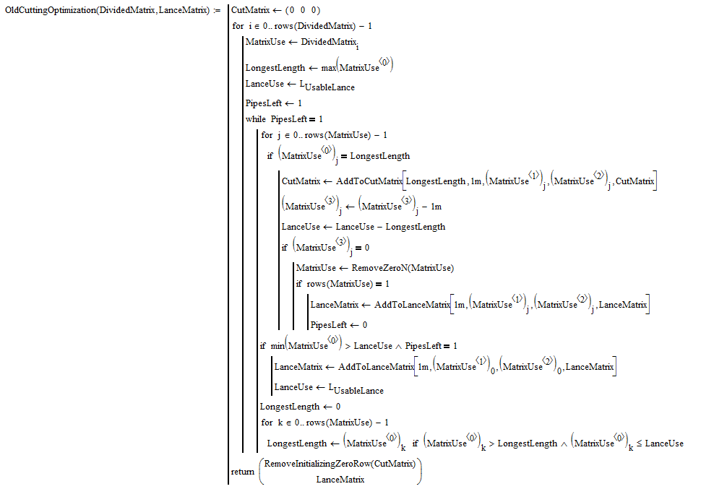
Original Algorithm
Too Complicated! MathCAD can’t handle the calculations.

Slide 42
Revised Algorithm
Assumes only two sections are cut out of each lance
Can do large batches of sections at once, reducing the need to calculate for each n for each specific section
Uses less calculations
Less accurate but actually outputs approximate results

Slide 43
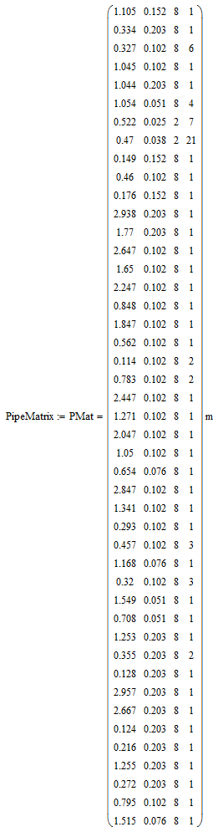
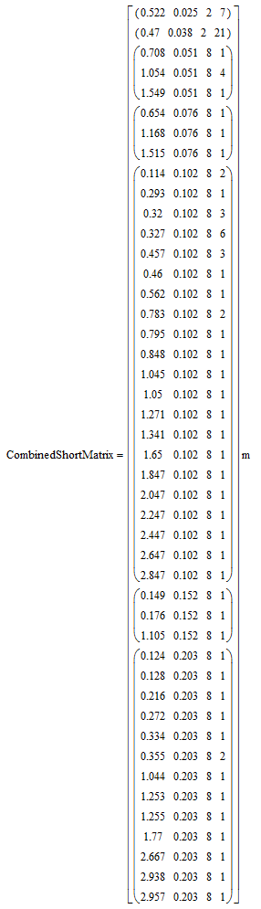
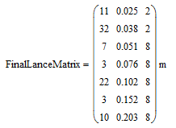


12 L/s SRSF Example

Slide 44
Future Work
…For Pipe Matrix Extraction
Add to pipe matrix from all plant components
…For Cutting Optimization
Determine current pipe costs
Improve optimization code

Slide 45
Section Cuts &
Sedimentation Tank Updates
Songlin Guo

Slide 46
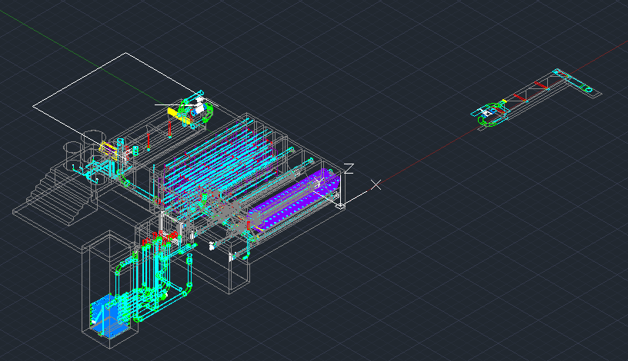
Left over problems
Mirror Image

Slide 47
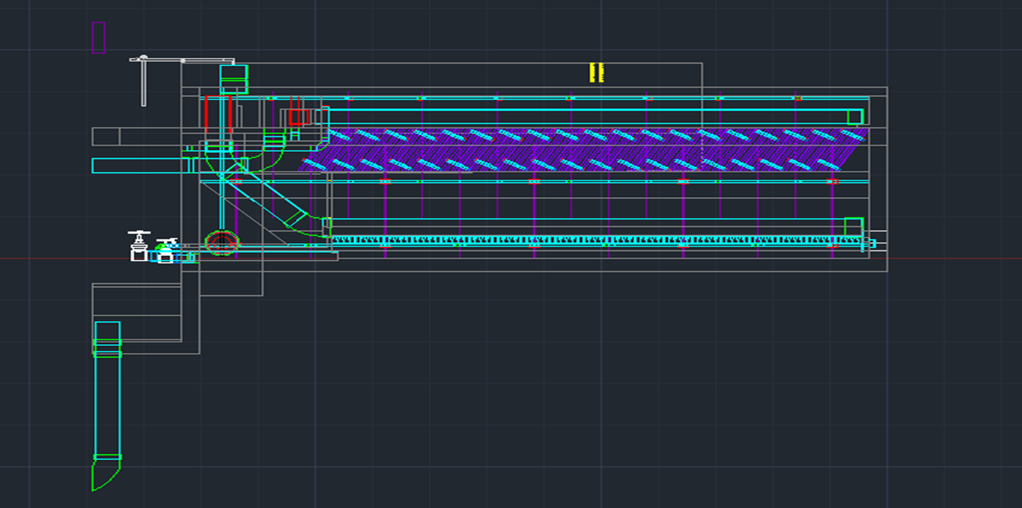
Left over problems
Misleading Information

Slide 48
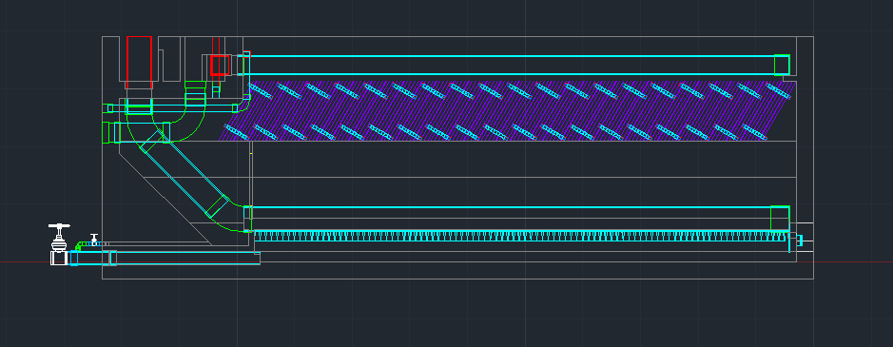
Left over problems
Desire Cut

Slide 49
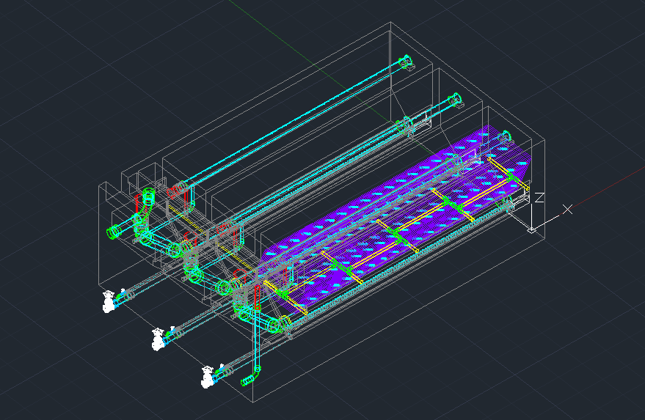
Plates support pipes

Slide 50
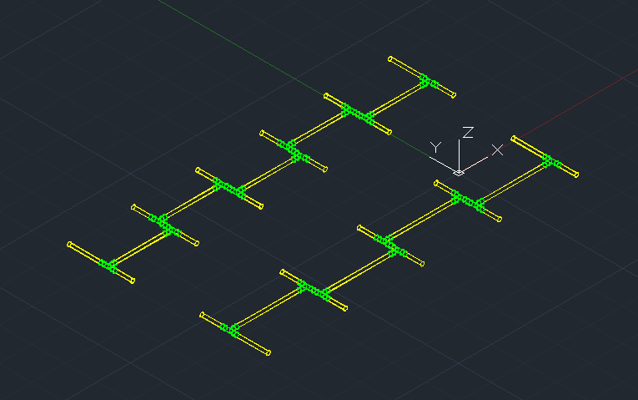
Plates support pipes

Slide 51
Chemical Dose Controller Modifications
Zeyu Yao and Chenxi Wen

Slide 52
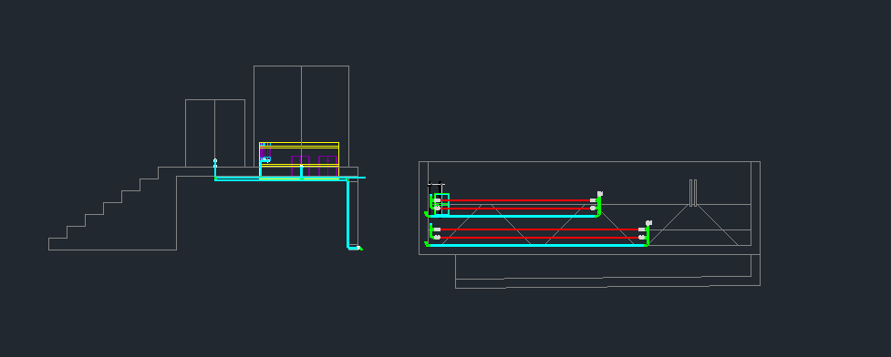
CDC Drawing

Slide 53
Tasks
Dosing components redundancy and entrance tank height adjustment
Flexible tubing
Lever arm
Chlorine viscosity equation
Stock tank equation

Slide 54
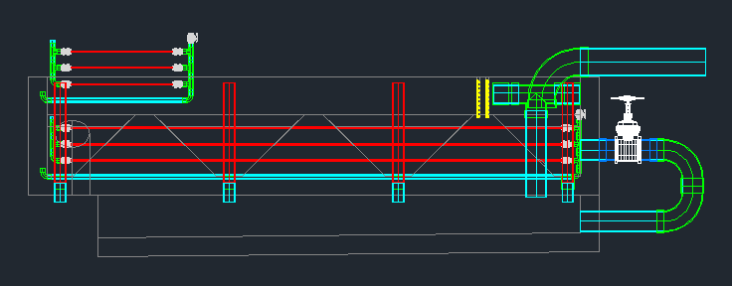
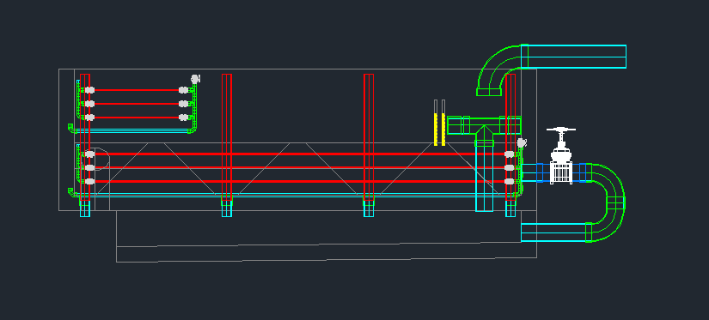
Dosing components redundancy, wall height, air removal
Before
After
Notes:
Added one more dosing tube under all circumstances
Changed chlorine manifold origin points so it won’t exceed the entrance tank wall length, and two manifolds are aligned
Added height (0.4 m) to entrance tank if plant flow rate is lower than 35 L/s so the manifolds can fit onto the wall (tested below which flow rate would the manifolds be taller than the wall)

Slide 55
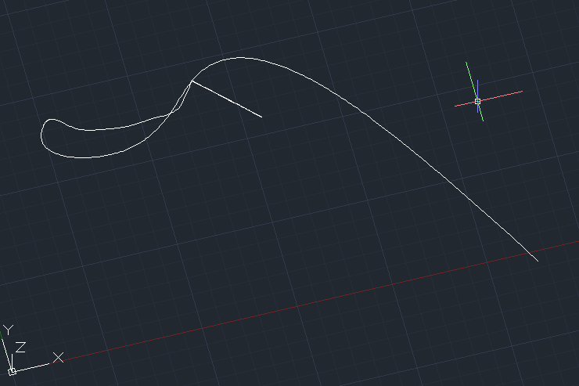

Flexible tubing function
1. Naming problem
Using AguaClara conventional names: CoagCHTtoManifold.Inlet and CoagCHTtoManifold.Outlet
Or CoagCtoM.Inlet
Using simple names: Inlet1, Outlet 1
Notes:
Also the same for tubing connecting manifold to drop tube

Slide 56
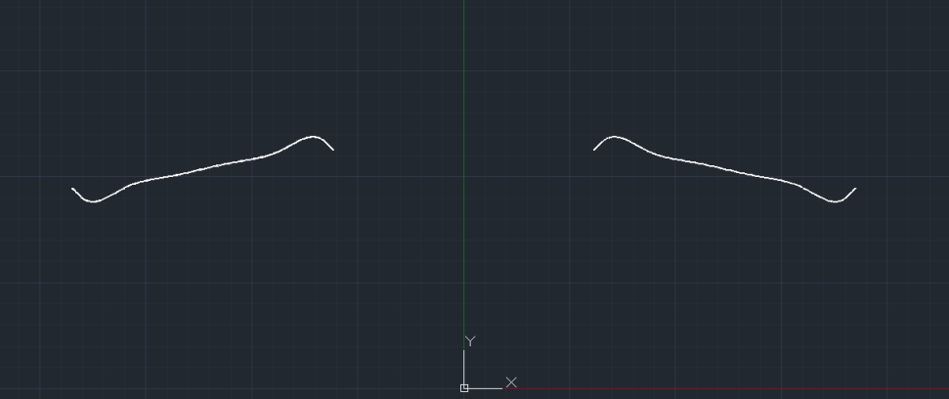
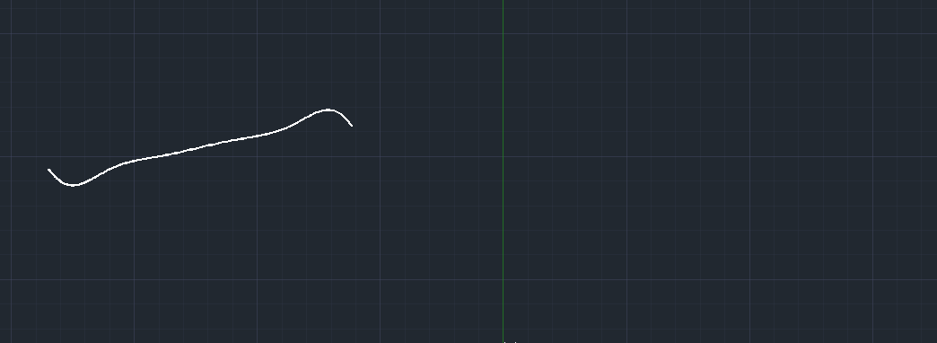
Flexible tubing function
2. Mirror problem
Only the inner tube is mirrored
Both inner and outer tubes are mirrored. Left out the subtractInner command.

Slide 57

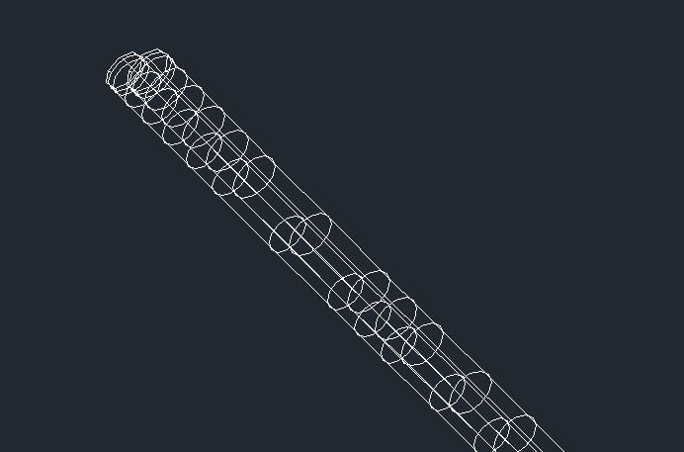
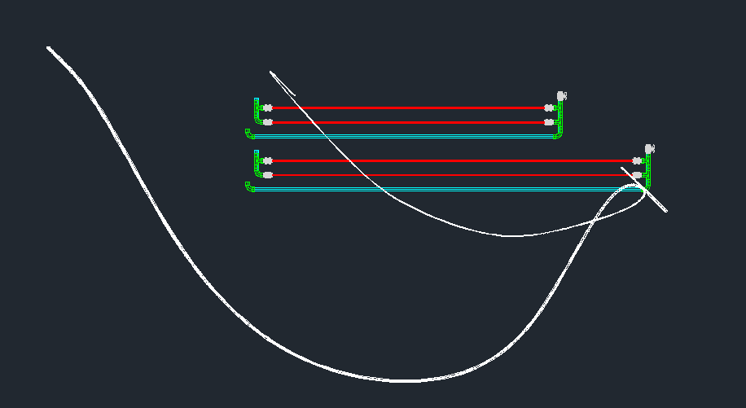
Flexible tubing function
3. Inner, outer tubes mismatch
4. Stacking problem

Slide 58
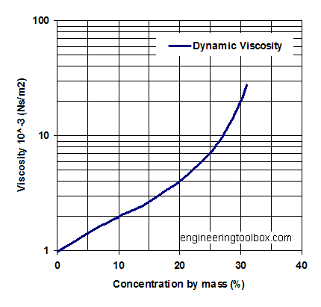

Chlorine viscosity
Currently assumed to be the same as water
Our approach
Using article “Modeling Viscosity of Multicomponent Electrolyte Solutions”.

Slide 59
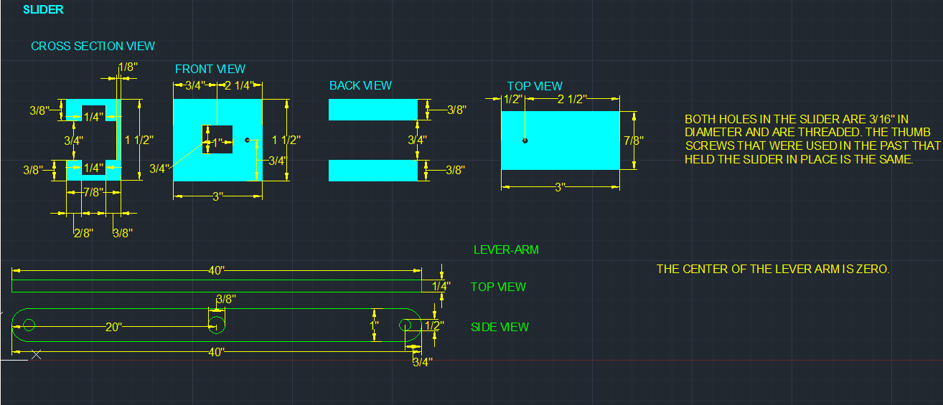
Lever Arm Design
Design provided by CDC team

Slide 60
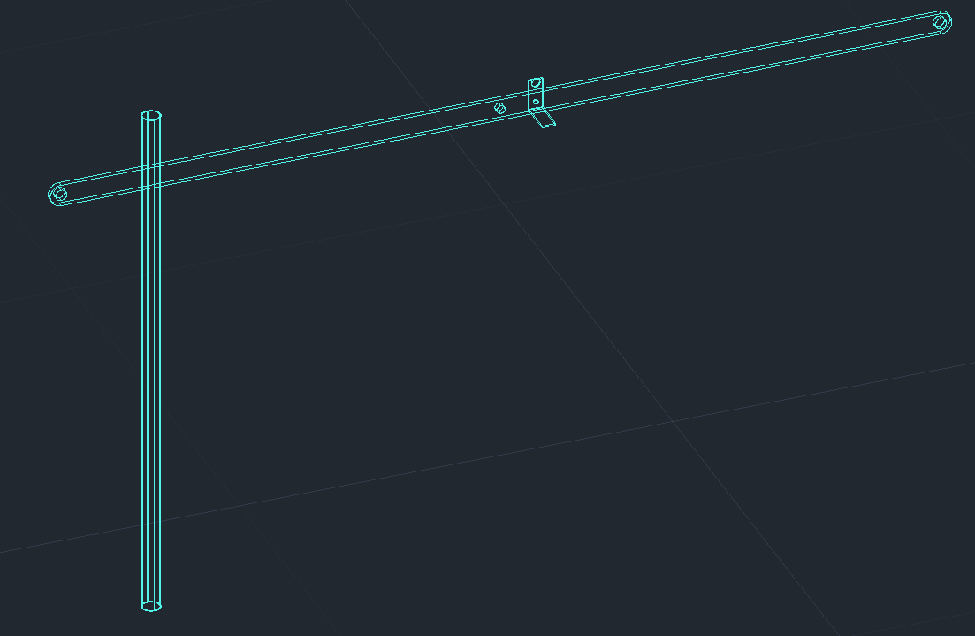
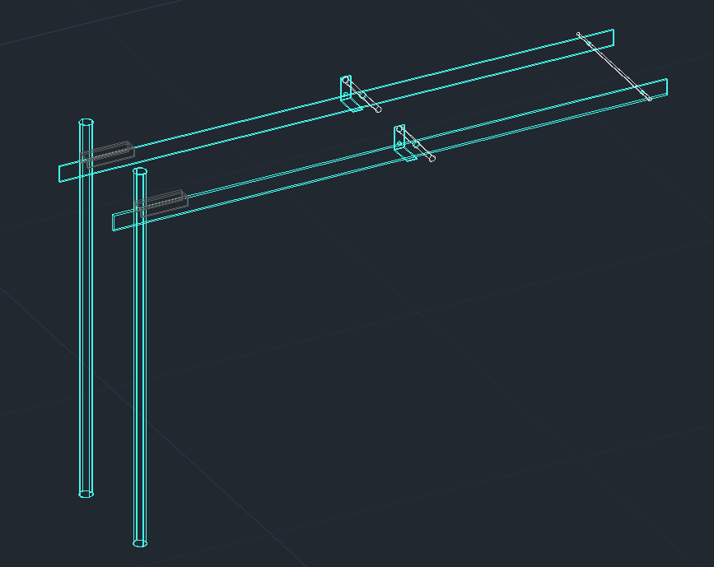
Lever Arm Design
Single Lever Arm
Double Lever Arms

Slide 61
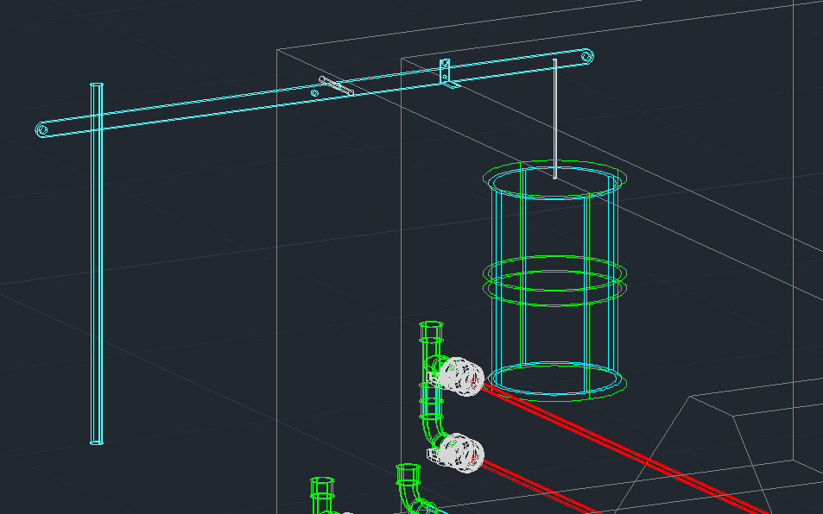
Lever Arm Design

Slide 62
Conclusion and Future Work
We accomplished:
Stock tank function
Dosing component redundancy
Lever arm
Flexible tubing
Chlorine viscosity equation
Future work:
Entrance tank components modification
Flexible tubing function
  Tangent points
  Mirror and stacking issues
  Naming problem*
  Use FlexCylinderF
Keep updating the drawing
Determine Cl viscosity as a function of concentration

Slide 63

Questions, Comments, or Suggestions?

