Slide 1

Design Team
Annie Ding, Anthony Andrews, Bonnie Schiffman, Brooke Pian, Julia Morris, and Kelly Huang

Slide 2

Automated Design Tool (ADT)
Access to customized plant designs
  User inputs
Key to continuing scalability
Open Source Engineering
AguaClara Design Philosophy
Notes:
Online interface that provides access to customized plant designs, invent scalable, reproducible tools that can be combined to form a complete water treatment plant.

Slide 3
Automated Design Tool
User Inputs
Plant
Design
LabVIEW
AutoCAD
Mathcad
Calculations
MS Word
Mathcad
Drawing Files
Notes:
User places inputs, design tool sends a request to the AguaClara server to produce a spreadsheet of all variables relevant to the plant design, and the values assigned to each of them. These include pipe diameters, wall dimensions, and baffle dimensions and placement. The ADT uses these variables to scale plant components in AutoCAD to create a complete, three dimensional design of the entire plant and its components.

Slide 4
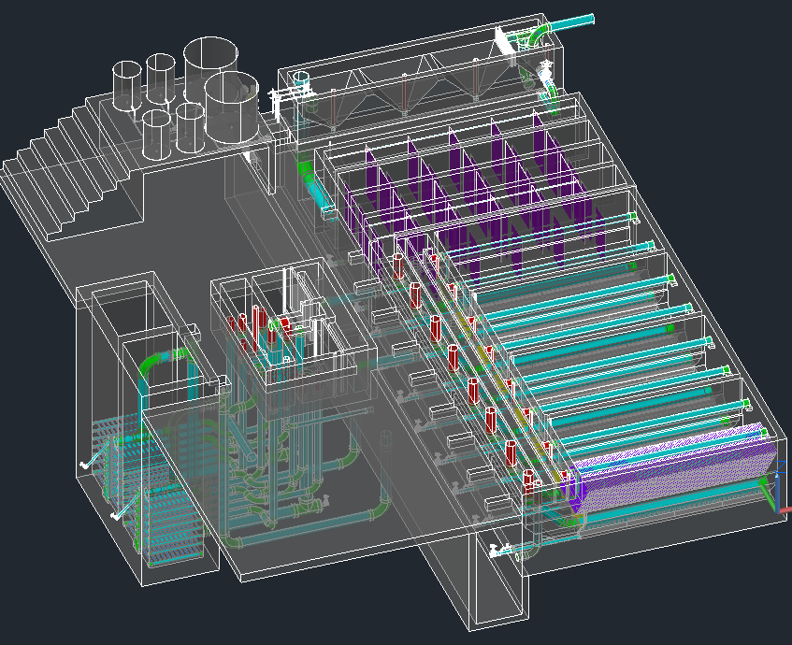
The Drawing

Slide 5
Overall Design Tasks
  Incorporating new research progress into the design
  Designing plants for a greater range of flow rates
  Making our designs more easily understood
  Communicating with the team in Honduras and with new implementation partners to address concerns
Notes:
Design or constructability concerns

Slide 6
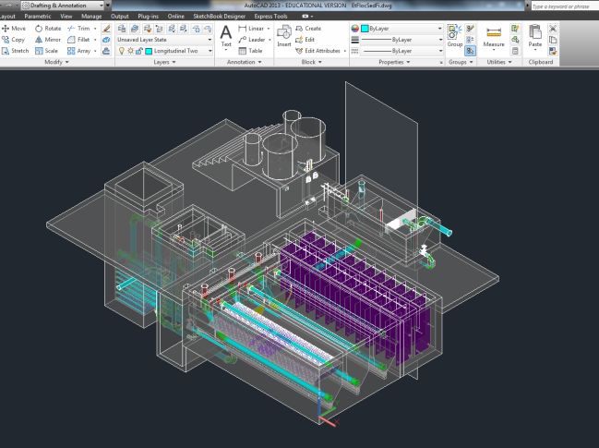
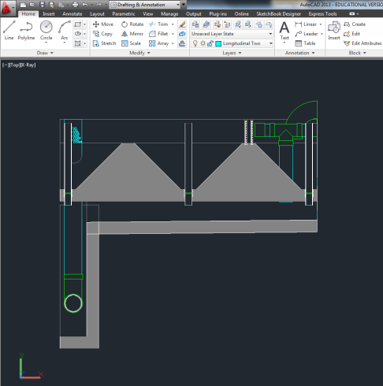
Automated Section Cuts
  Contact with AutoDesk Engineer
  Customized AutoCAD module
    Loadable (ex: Add-on), no use of dialog box
    Consistent layer colors from source
Section plane shown in 3D view
Finished section cut

Slide 7
High Flow Modifications:
Rapid Mix
Bonnie Schiffman and Brooke Pian
Spring 2013

Slide 8
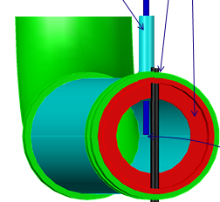
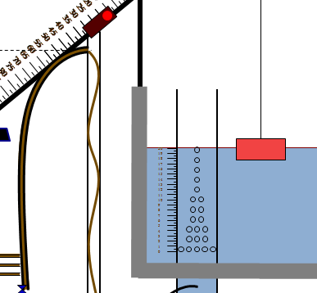
Introduction
For high flow plants, the current LFOM design is not ideal.
A new flow metering system and coagulant rapid mix design is necessary for AguaClara to be able to serve larger communities.

Slide 9
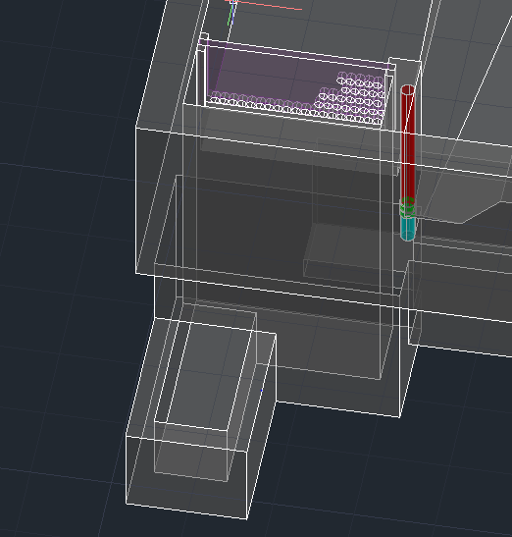
Previous Design
Tori Klug, 2012
Notes:
Previous work on high flow plant designs resulted in the design of an LFOM mica sheet, which would have water flow from the entrance tank into a rapid mix channel rather than a PVC pipe.

Slide 10
Initial Schematic
LFOM sheet
Macro-mixing and Coagulant Dosing
Micro-mixing
Notes:
Our task is to continue with the rapid mix channel design to provide rapid mixing of coagulant for high flow plant designs. We need to determine the geometry of the channel that will flow from the entrance tank to the bottom of the flocculator and design for macro- and micro-mixing; thus, we need to understand which constraints are most important. We need to consider where coagulant dosing will occur and include dosing into the design. We need to determine at which point the transition from LFOM pipe to LFOM channel will occur by evaluating hydraulics, construction and cost of materials needed, and include this switch into the design.

Slide 11
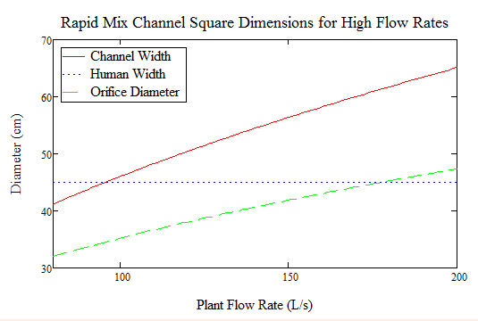
Channel Size and Macro-Mix Orifice
We assumed for now that macro-mixing would be achieved by designing one large orifice using the current rapid mix orifice design but with a lower energy dissipation rate of 700 mW/kg
To find channel size we assume total head loss is 5cm and minor losses rein: inflow, around a bend, through an orifice sheet (2), and outflow

Slide 12
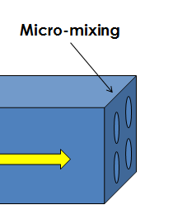
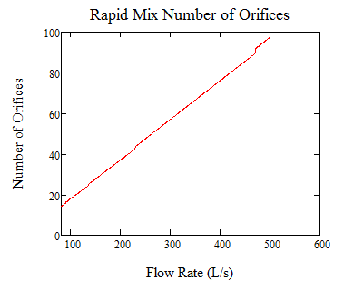
Micro-Mix Orifice Sheet
We started with the LFOM orifice diameters and worked our way up until the diameter would allow for at least 5 mm of spacing between orifices.
For all flow rates, D ~ 4 in.
Head loss ~ 2.3 cm
K ~ 2
Porosity ~ 44%

Slide 13
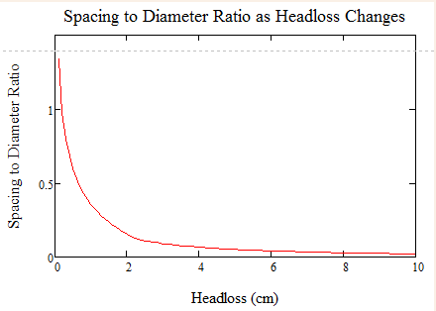
Spacing Issues…
Spacing is very small relative to orifice diameter.
80 L/s plant D = 4 in, S = 0.05 in.
To increase S:D, we would need to lower our initial head loss assumption

Slide 14
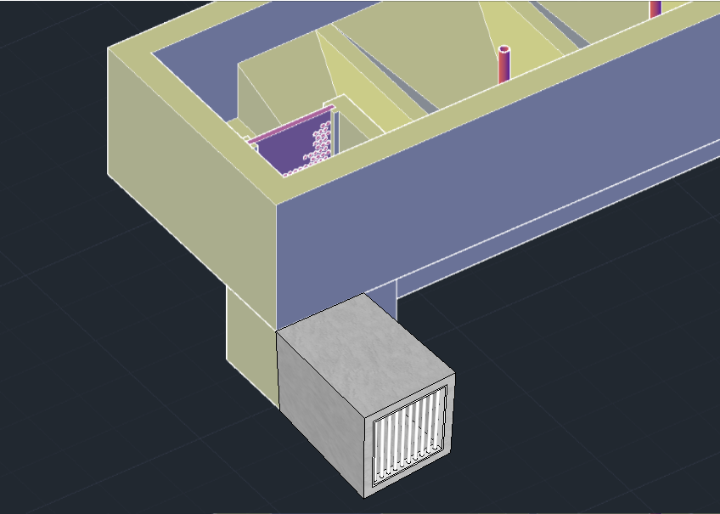
New Idea: Micro-Mix Gate

Slide 15
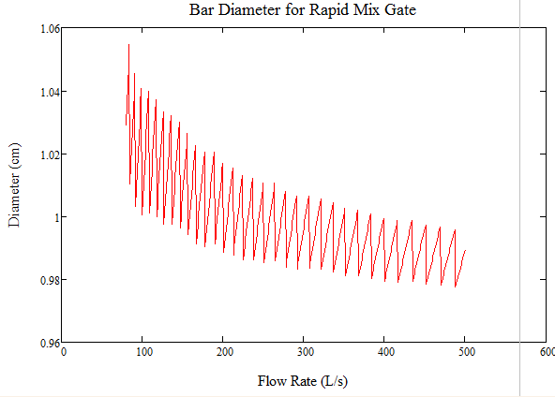
Micro-Mix Gate
PVC or steel
Porosity = 50%
HL = 1.1 cm
Minor Losses = 1
No vena contracta
Calculate spacing needed to achieve 1000 mW/kg
Calculate diameter given geometry constraints
D ~ 1 cm
Notes:
Because of the spacing issue, we analyzed a different option: creating a “micro-mix gate” with either PVC pipes or rebar to create slots through which micro-mixing would be achieved. Assuming a porosity of 0.5, Ain:Aout is 0.5 and Vin:Vout is 2, so the minor loss coefficient through the gate is effectively 1 and the headloss through the gate is about half the headloss through the orifice sheet. The lower minor losses through the plant would lower the size of the channel, assuming the same 5 cm headloss.

Slide 16
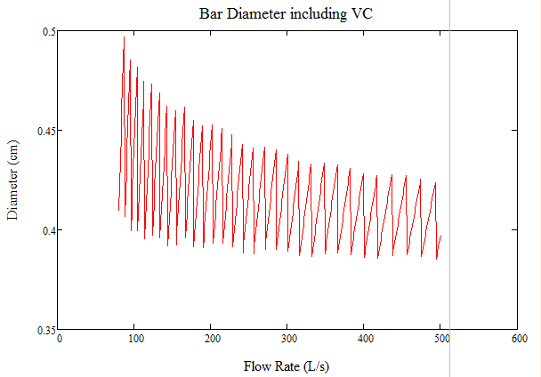
Aluminum Rapid Mix Gate
Including vena contracta for rectangular bars
More expensive
Less material
D ~ 0.45 cm

Slide 17
Future Work
Micro-mix: Orifice sheet or gate?
Micro-mix Gate: PVC, steel, aluminum?
Macro-mix design needs further investigation
Hopper design constraints may need reevaluation
LFOM sheet to sutro weir cut out possibility

Slide 18
Low Flow Plant
Julia Morris

Slide 19
Intro
Current design range = 6 L/s – 70 L/s
Want to be able to serve small communities
Need new design for entrance tank, flocculator, sedimentation tank, and filter
Need new layout

Slide 20
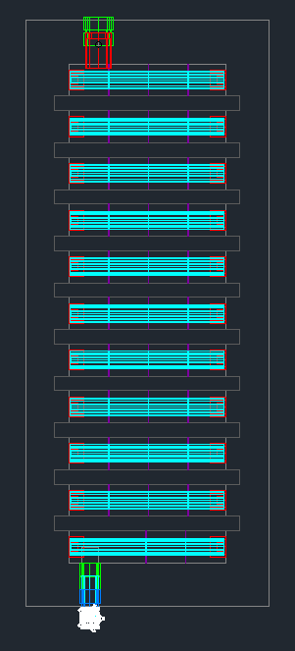
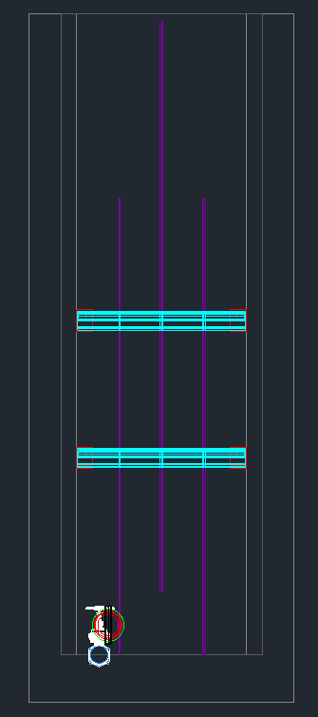
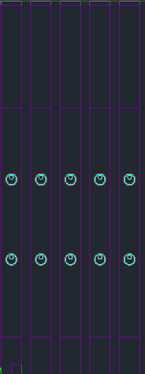
Pipe Spacer – Takes up 60% of Upflow Area
Plastic Baffle
Ferrocement Baffles
Notes:
H/S ratio is too high still…so add pipe obstacles to create more collision potential

Slide 21
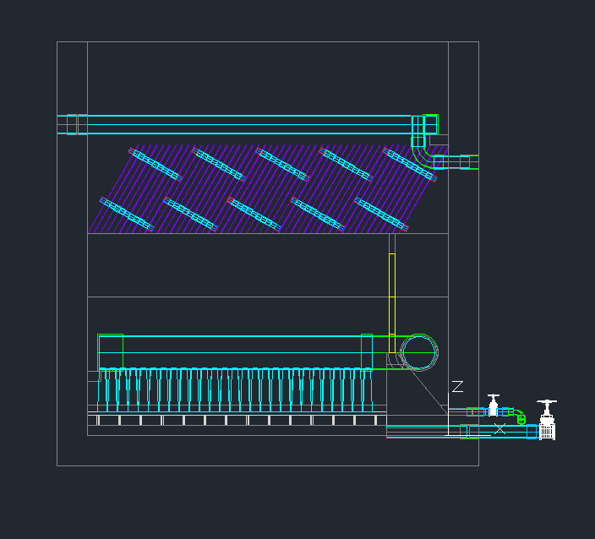
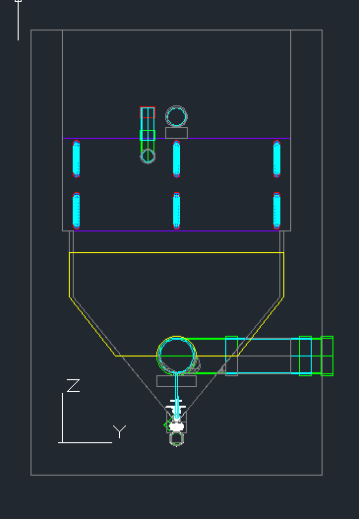
Low Flow Sed Tank

Slide 22
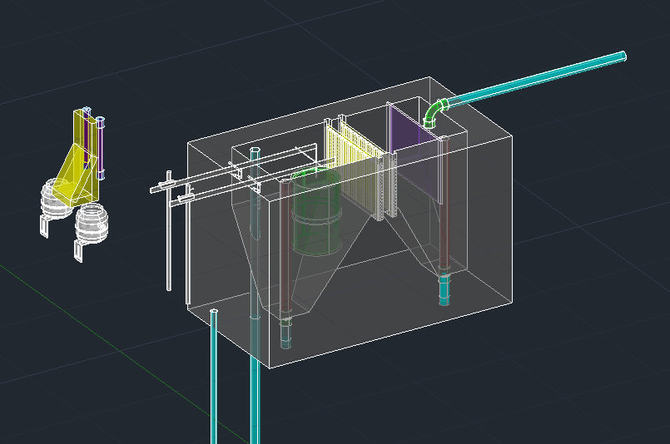
Entrance Tank
Wider Last Channel

Slide 23
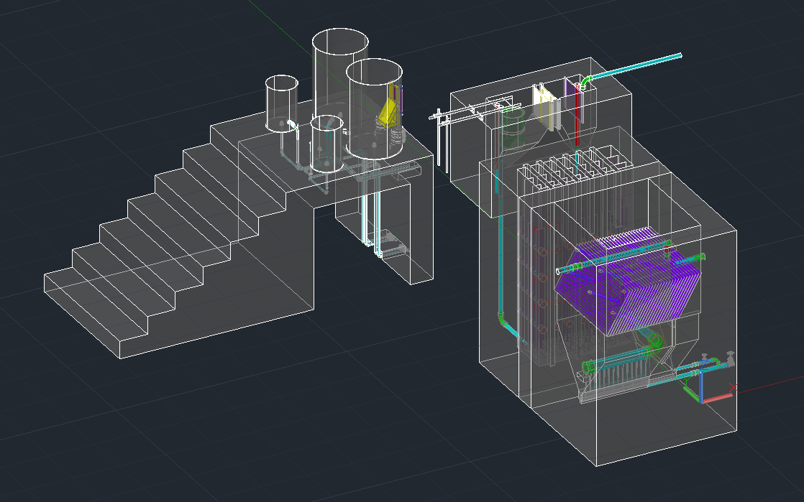

Slide 24
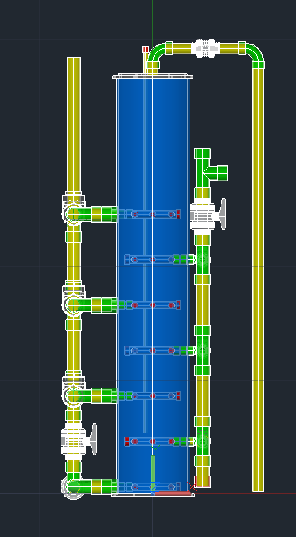
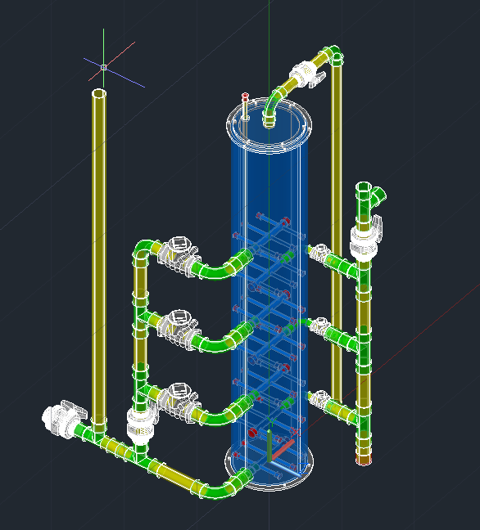
LFSRSF
Backwash
Inlet
Outlet

Slide 25
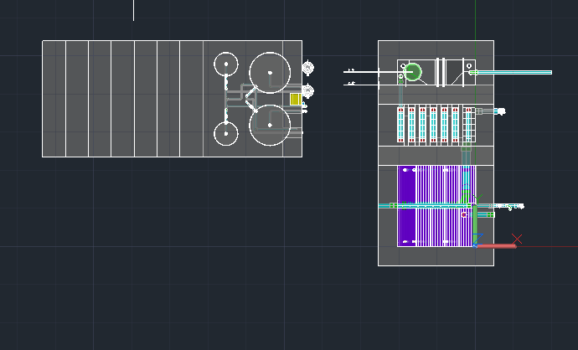
Future Work
Finish up details on filter
Placement of filters
System to carry water from sed tank to filter

Slide 26
Flocculator Design Detail
Kelly Huang

Slide 27
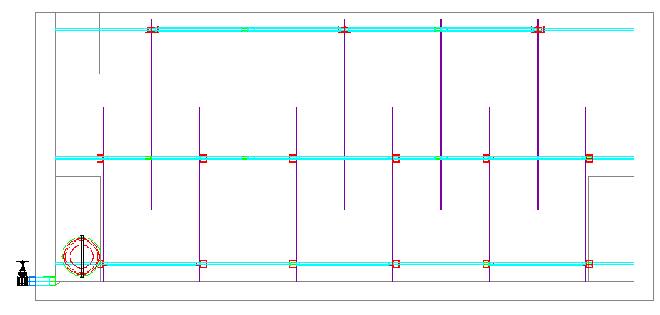
Flocculation Tank

Slide 28
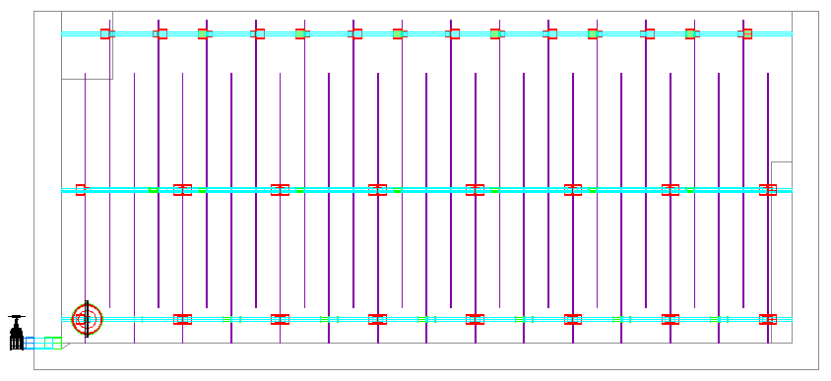
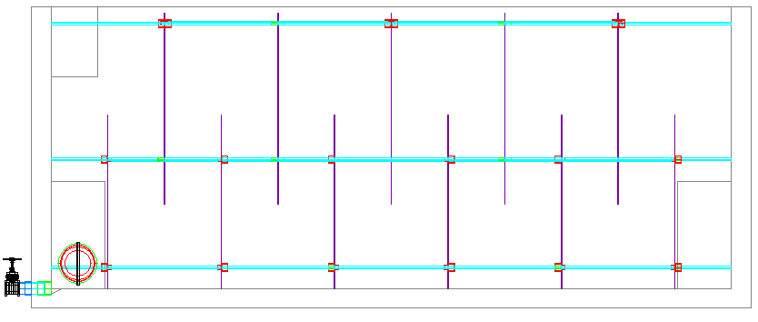
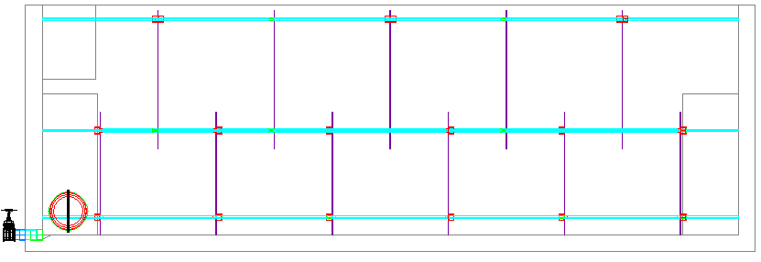
Side Views of Flocculation Tanks
6 Lps
25Lps
50Lps
Notes:
- Not neccesary at lower flowrates, but adding it to al of designs

Slide 29
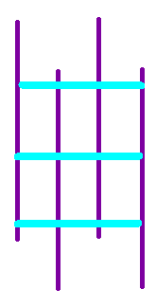
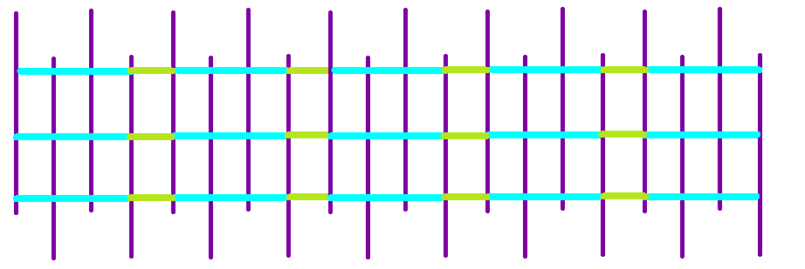
Modules
Modules
Array of Modules in a channel

Slide 30
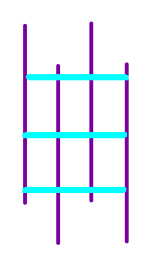
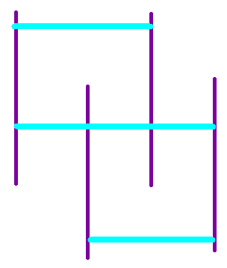
Two Types of Modules
  Overlapping modules Non-Overlapping modules
Notes:
Define modules
Two cases
Currently all use Non-Overlapping modules so only N-O was modified

Slide 31
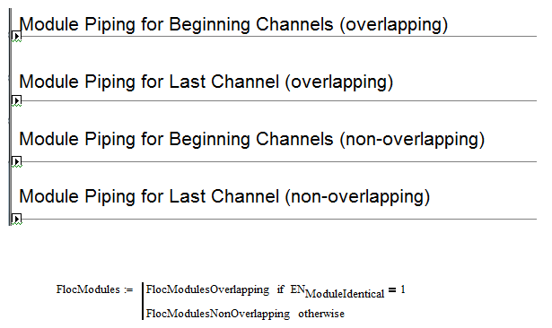
AC Flocculator Code

Slide 32
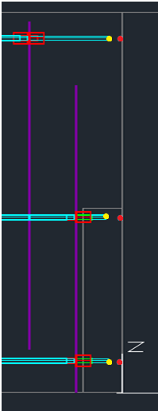
modified existing origin
shortened length of pipe
(elbow radius/tee length + 2*ND)

Slide 33
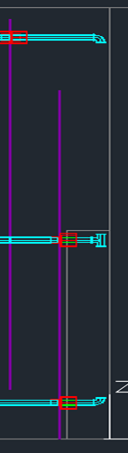
tees and elbows were drawn using the same origin as the respective pipes

Slide 34
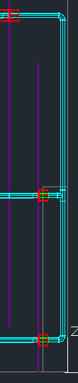
Draw vertical pipes
(difference between z-coordinates)
- (elbow radius)
- (half of tee length)
________________________________
vertical pipe length

Slide 35
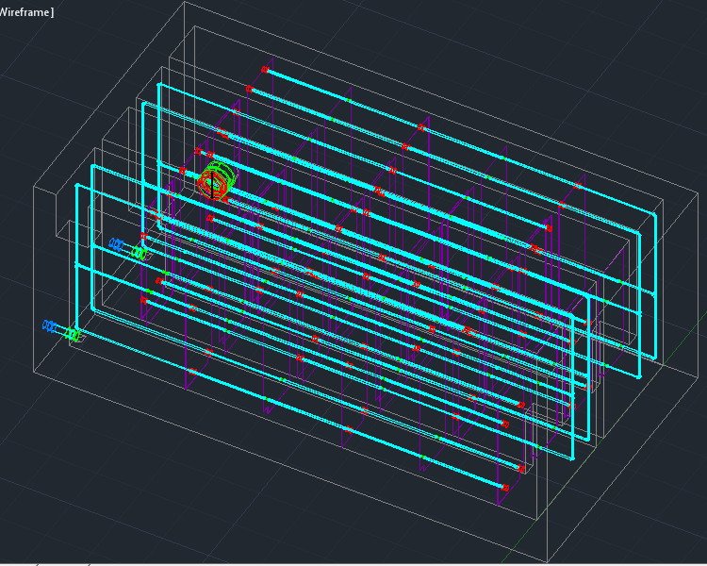
Result (25 Lps)

Slide 36
Future Work
Overlapping Case

Slide 37
Materials List
Annie Ding
05/11/13

Slide 38
Purpose
Calculate the amount and cost of materials needed to build a design requested from the server.
Useful for cities looking into getting a plant and construction teams.

Slide 39
Materials
Hydraulic design materials:
Pipes
Pipe ﬁttings
Sheets for ﬂocculator baﬄes
Sedimentation plate settlers
Chemical dose controller pieces
Structural design materials include but are not limited to:
Brick
Rebar
Cement for plant walls
River rock for entrance tank hoppers

Slide 40
Optimizing Pipes
Overall outputs:
  Matrix with the number of lances (6.1m lengths of pipes sold in Honduras) of each pipe specification and nominal diameter needed to build plant.
  Matrix with the lengths we can cut out of individual lances

Slide 41
Accomplishments
Separated entire PipeMatrix into smaller matrices by nominal diameter (ND) and pipe schedule (EN)
Started code on cutting optimization

Slide 42
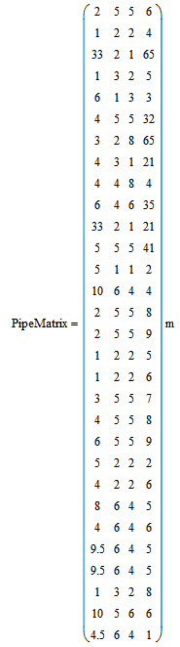
Pipe Matrix Separation
Original pipe matrix
  Length
  Nominal Diameter (ND)
  Pipe schedule (EN)
  Number of times arrayed (N)

Slide 43
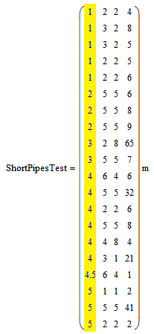
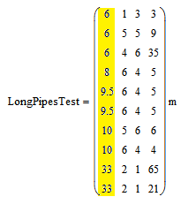
Pipe Matrix Separation
PipeMatrix separated into Long and Short

Slide 44
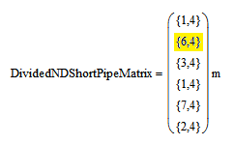
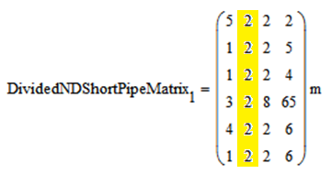
Pipe Matrix Separation
PipeMatrix separated by ND

Slide 45
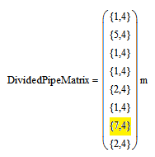
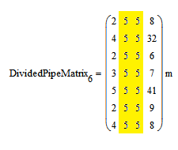
Pipe Matrix Separation
Matrices now separated by ND and EN

Slide 46
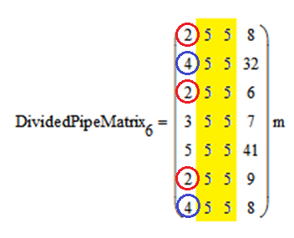
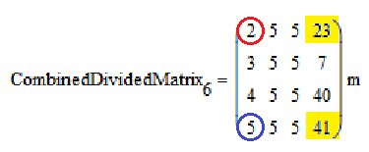
Pipe Matrix Separation
Combine rows with the same length

Slide 47
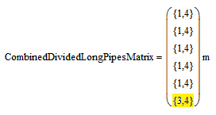

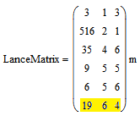
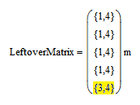

Pipe Matrix Separation
Separate the matrix with Long pipes into LanceMatrix and LeftoverMatrix

Slide 48
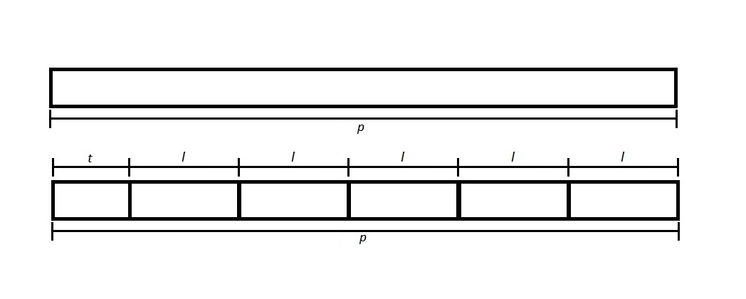
For Pipes Longer than a Lance

Slide 49
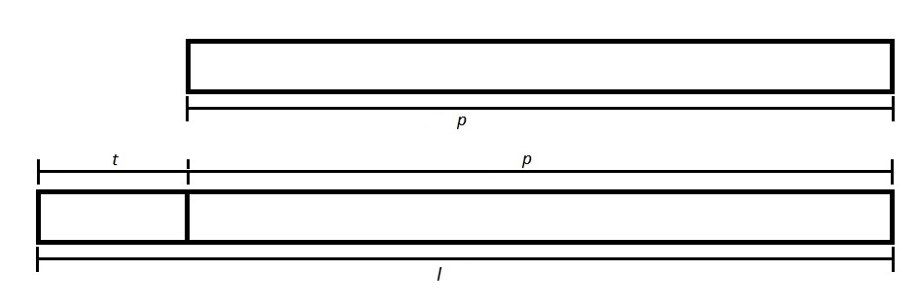
For Pipes Shorter than a Lance

Slide 50

Getting as much out of a lance as possible (cutting stock problem)

Slide 51
Future Work
Finish cutting optimization code
Edit pipe drawing code to output PipeMatrix
Test code to see if the numbers match up with numbers of pipes used in actual plants

