Slide 1

Design Team
Amanda Rodriguez, Andrew Smith, Annie Newcomb, Heidi Rausch, Joseph Fallurin, Julia Morris, Nick Parisi, and Tori Klug

Slide 2
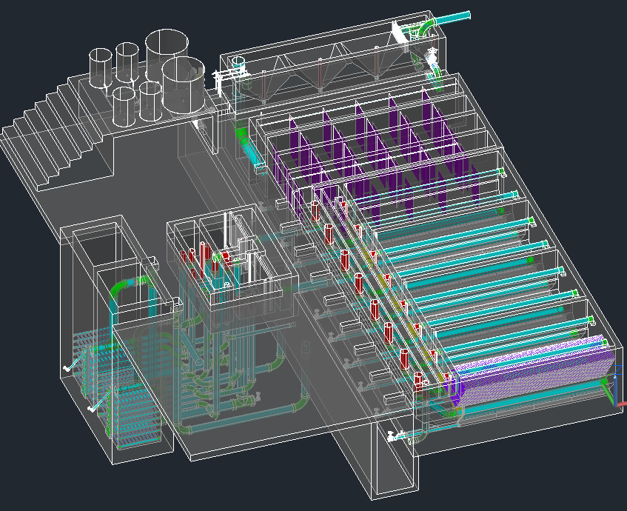

The Drawing

Slide 3
Automated Design Tool
User Inputs
Plant
Design
LabVIEW
AutoCAD
Mathcad
Calculations
MS Word
Mathcad
Drawing Files

Slide 4
Continuing Design Tasks
  Incorporating new research progress into the design
  Making the code more robust—being able to design plants for a greater range of flow rates
  Making our designs more easily understood
  Communicating with the team in Honduras to address concerns

Slide 5
Expanding Our Design Services?
  Possible new implementation partners aren’t as familiar with AguaClara technology as APP
  Need for additional or improved documentation for new partners:
    Updated design specifications
    Materials list
    Budget????
    Structural aspects????

Slide 6
Sedimentation Tank Economics
Julia Morris

Slide 7
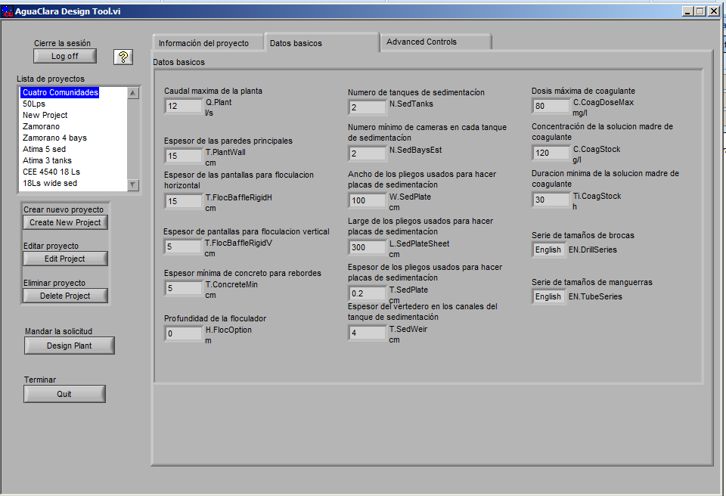
Why?
Picture/Graph/Table

Slide 8
Review
Created an algorithm that finds the optimal number of sed bays from a minimum cost
Finds optimal number of sed tanks based on operation and maintenance constraints
  No more than 2 bays per tank
  At least 2 tanks

Slide 9
Simple Algorithm
Not include any costs
Be based only on plant flow rate and energy dissipation rate
Use original algorithm as a guide

Slide 10
How It Works

Slide 11
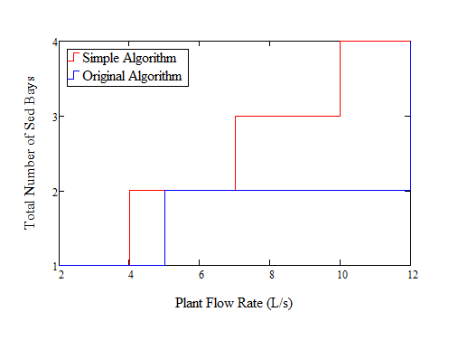
How It Works
If Q.Plant ≤ 12 L/s
  Assume ND of Manifold is 6 in
Notes:
For ease of construction and maintenance

Slide 12
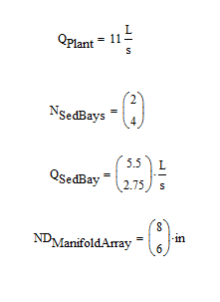
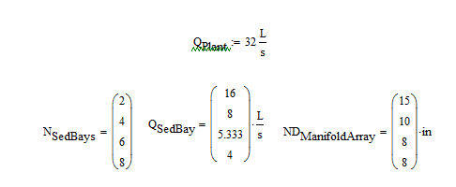
How It Works
If Q.Plant > 12 L/s
  From analysis
    Always have an even number of bays
    Usually use Max ND Manifold
    N.SedTanks = N.SedBays/2
Q.Plant = 32 L/s
N.SedBays | Q.SedBays (L/s) | ND.Manifold (in)
2 | 16 | 15
4 | 8 | 10
6 | 5.333 | 8
8 | 4 | 8
Notes:
Always have an even number of bays = Algorithm divides plant flow rate by even multiples of sed bays until the flow rate in each bay drops below 3 L/s

Slide 13
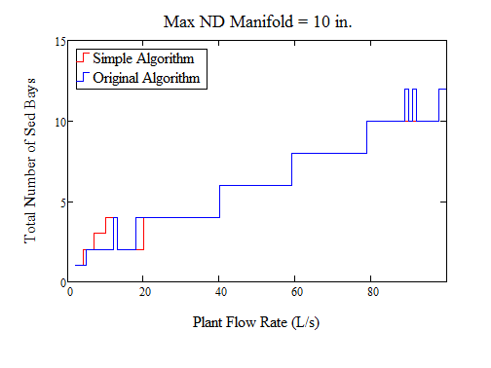
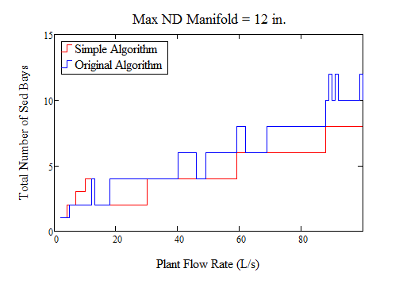
Simple vs. Complex
Notes:
Works better if the maximum possible nominal diameter of the manifold is 10. Doesn’t work as well for ND manifold of 12 probably because there is a substantial price jump between 10 and 12 inch piping which makes the cost analysis not as uniform.

Slide 14
Future Work
Confirm results with AguaClara engineers
Confirm the maximum possible nominal diameter of the manifold
Implement into the Design Code

Slide 15
Low Flow Sedimentation Tank
Joey Fallurin
Julia Morris

Slide 16
Making Low Flow a Go
Current Operating Range: 5 L/s < Q.Plant < 70 L/s
Want to serve smaller communities
Need to solve technical issues at low flow rates to keep up with increased demand!

Slide 17
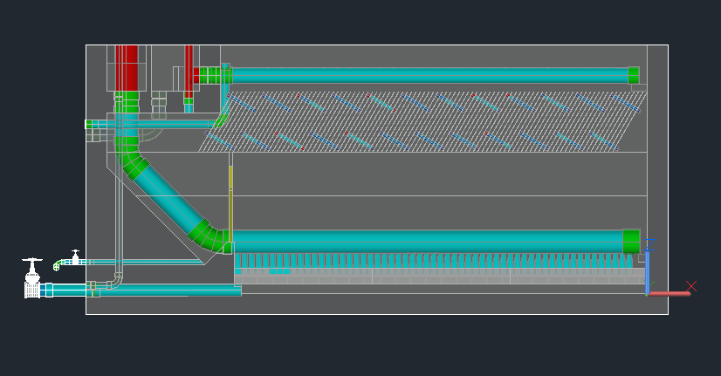
Current Design

Slide 18
Design Goal
Exit Channel
Weir
Launder
Pipe to filter
Floc weir
Floc hopper
Inlet manifold and diffusers

Slide 19
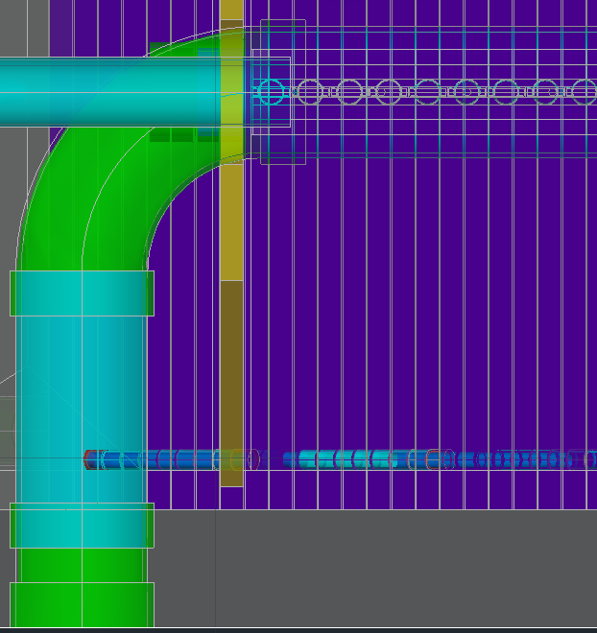
Inlet Piping Changes
Inlet Manifold now fed directly from the side of the tank.
No more 45° Elbows, just 1 Elbow, 1 Coupling & 1 Short Pipe
Saves materials & space

Slide 20
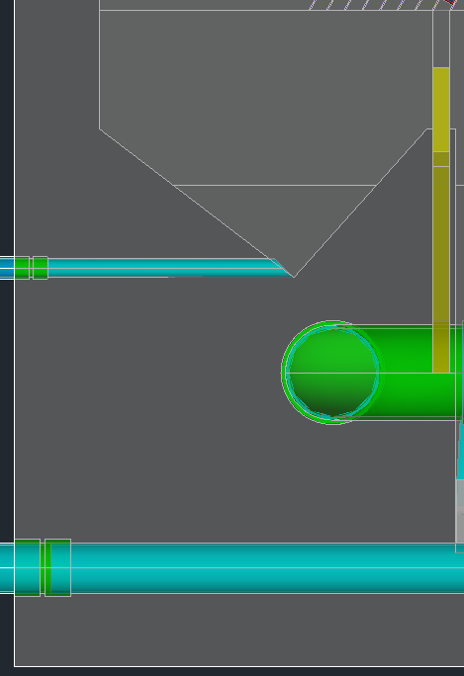
Hopper Changes
Hopper length altered to use space savings
Created overlap between Hopper Drain & Inlet Manifold piping
Fixed by raising Hopper trough

Slide 21
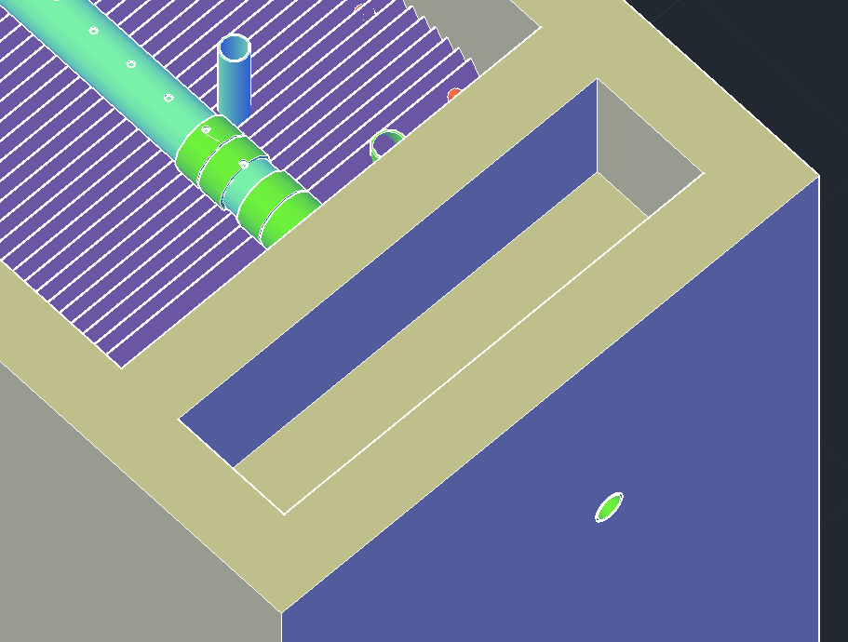
Inlet/Exit Channel Changes
Inlet Channel, Channel Dividers & Channel Weirs removed
Exit Channel repositioned & enclosed by concrete on all sides (except top)

Slide 22
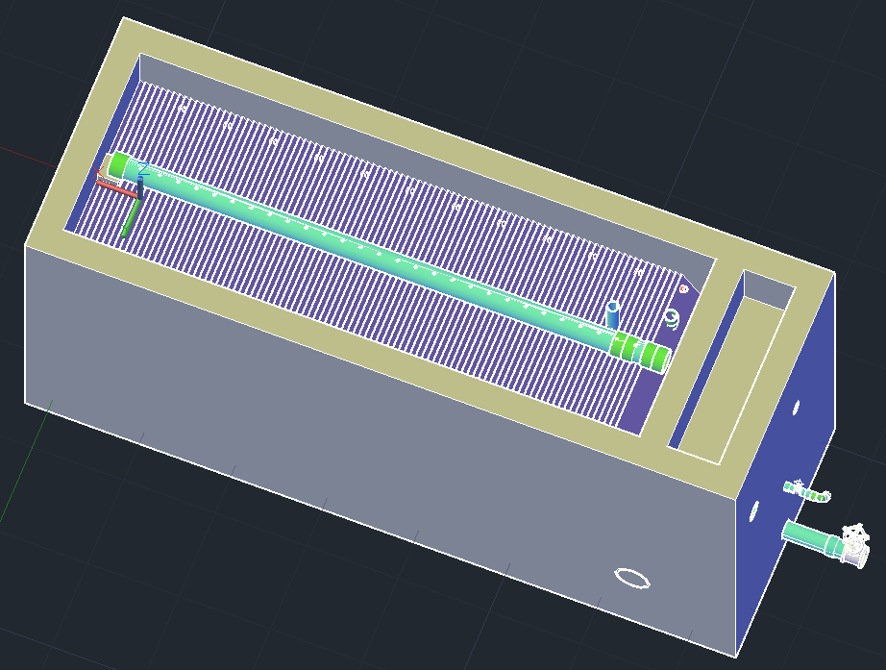
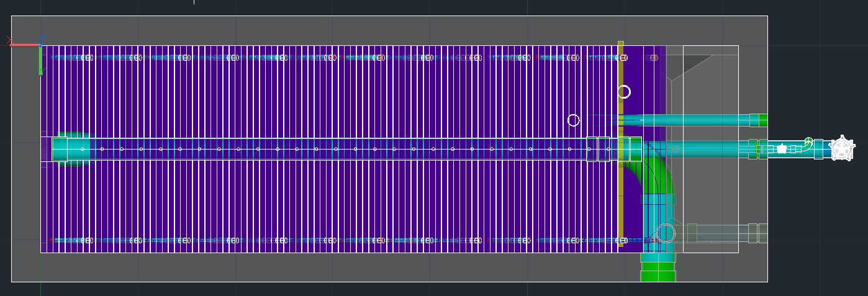
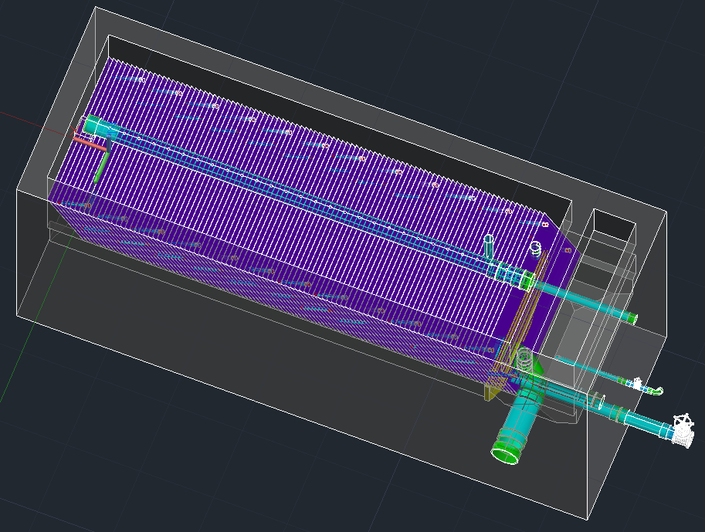
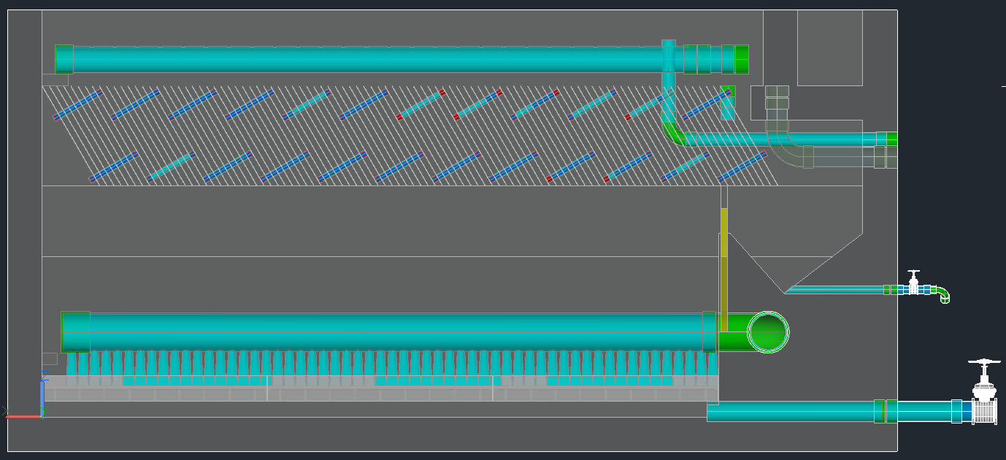
Current Progress

Slide 23
Future Work
Finish connections to Exit Channel (Launder, Piping to Filter)
Reposition Floc Skimmer to avoid Plate Settlers
Flip Plate Settlers?
Integrate Low Flow Sedimentation Tank changes directly into current files using If statements

Slide 24
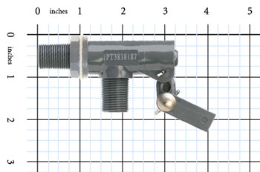
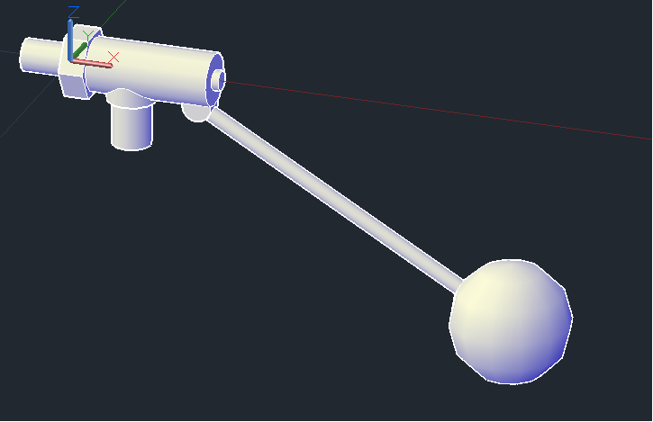
Large Float Valve – Inserted Drawing

Slide 25
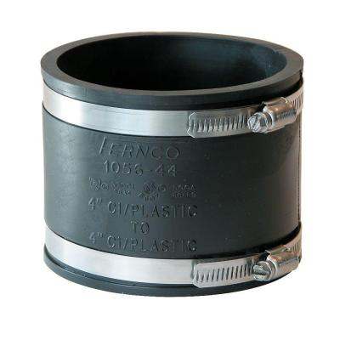
Fernco Fittings
ND (in) | ID (in) | OD (in) | Uncut Length (in)
1 | 1.32 | 1.72 | 2.38
1.5 | 1.94 | 2.43 | 3.43
2 | 2.41 | 2.9 | 3.45
3 | 3.46 | 4.25 | 3.98
4 | 4.58 | 5.22 | 4.02
5 | 5.52 | 6.16 | 3.97
6 | 6.6 | 7.32 | 5.74
8 | 8.64 | 9.03 | 6.04
10 | 10.63 | 11.77 | 5.89
12 | 12.52 | 13.54 | 6.32
15 | 15.4 | 16.49 | 10

Slide 26
LFOM Code Redesign
Andrew Smith
Notes:
I assume that this cover page will be removed when you compile the presentation…

Slide 27
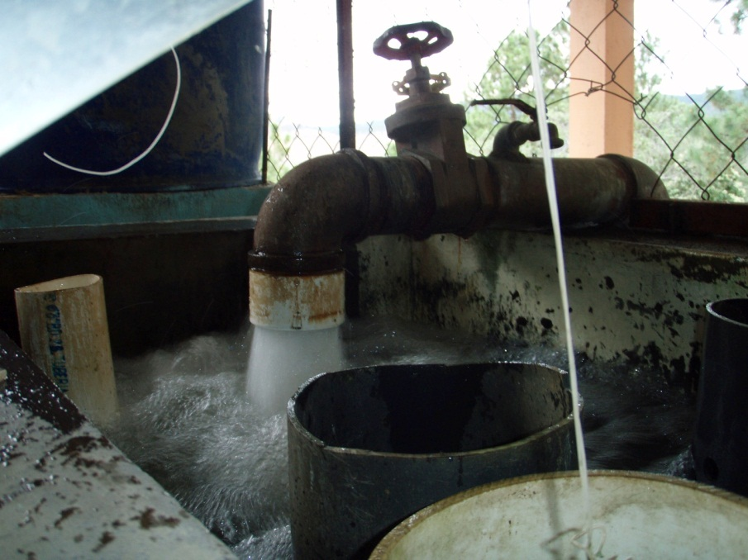
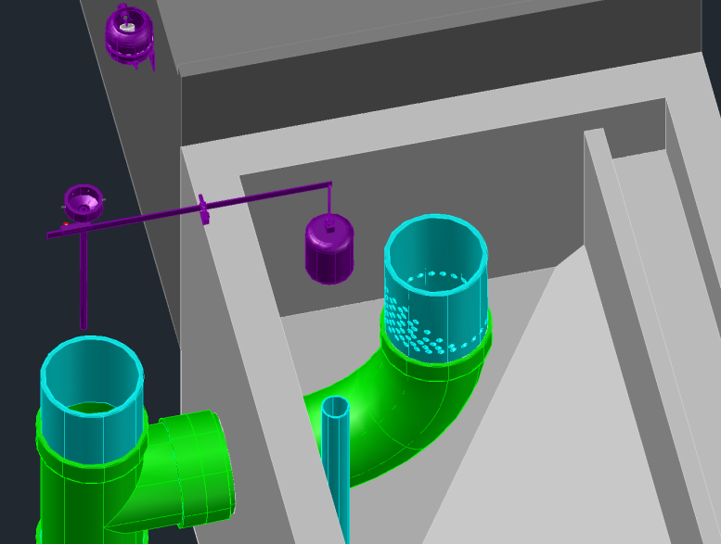
Introduction: LFOM
Produces a linear relationship between water height in the entrance tank and plant flow rate
Used in conjunction with dose controller to automatically dose proper amount of coagulant

Slide 28
LFOM Design Algorithm (pre-spring 2012)
Find flow through a single orifice (horizontal orifice equation)
Use equation for perfectly linear weir to determine how much water should be flowing from a certain row of orifices
Divide by flow through a single orifice, round up/down to produce trial solutions
Iterate with trial solutions for each row in series, rerun algorithm until solution with least possible error is produced
Notes:
Use the equation for flow through a horizontal orifice to determine flow through a single LFOM orifice
Use the theoretical stout weir equation to determine how much water should be flowing out of the orifices on a given LFOM level
Divide this flow by flow through a single orifice, round up/down to produce trial solutions

Slide 29
So what’s the problem????
Equation for flow through a horizontal orifice assumes distance from surface to all points in the orifice is the same:
Q=A*Pi.VenaContractaOrifice*sqrt(2gh)
Notes:
The “h” value in this equation is assumed constant

Slide 30
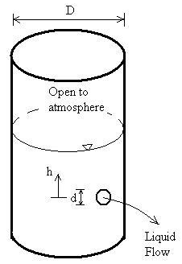
So what’s the problem????
If there is sufficient head available above the orifice, there is no problem.
If there is little to no head available above the top of the orifice, the horizontal equation will not properly measure flow through the orifice
Notes:
Why? Very little head difference between the free surface and the top of the orifice, so little flow.
Larger head difference between free surface and middle/bottom of orifice, so more flow there.
Result: less flow through orifice than calculated by horizontal equation

Slide 31

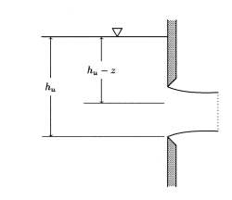
How do we fix this?
USGS equation for flow through a (vertical) partially filled orifice:
This equation accounts for difference in available head over the vertical extent of the orifice
Notes:
Create a new function in fluids functions which allows the user to input orifice orientation
If orifice orientation is actually horizontal (this could be the case in future plant components), use the horizontal orifice equation, as was done before
If orifice orientation is vertical (as is the case in the LFOM) apply new, USGS equation

Slide 32
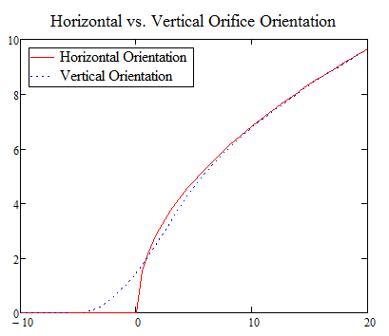
Does it really work?
Reported flow through orifice (L/s)
Location of water surface above center of orifice (cm)
Notes:
Talk through this graph with the audience. Major points:
When the water level is below the center of the orifice, the horizontal equation grossly underestimates flow (reports no flow at all)
When the water level is above the center of the orifice but below the top of the orifice, the horizontal equation overestimates flow
When the water level is above the top of the orifice, the two equations report identical flow

Slide 33
New orifice equation in FluidsFunctions
Because vertical orifice equation is more accurate, it was programmed into fluids functions and is now called in the LFOM code
Notes:
People probably will not be able to see this
Walk them through it step-by-step and explain that it is just the equation shown on previous slides
Explain Orientation.Orifices
Explain that horizontal equation was retained for HFOM, etc

Slide 34
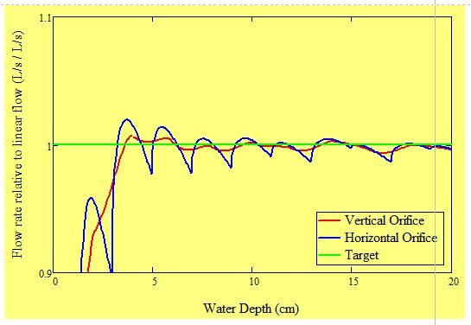
Performance of new algorithm
Both equations bracket target (linear) flow, but algorithm w/ vertical orifice equation shows less deviation

Slide 35
High-Flow Entrance Tank
Andrew Smith
Notes:
I assume that this cover page will be removed when you compile the presentation…

Slide 36
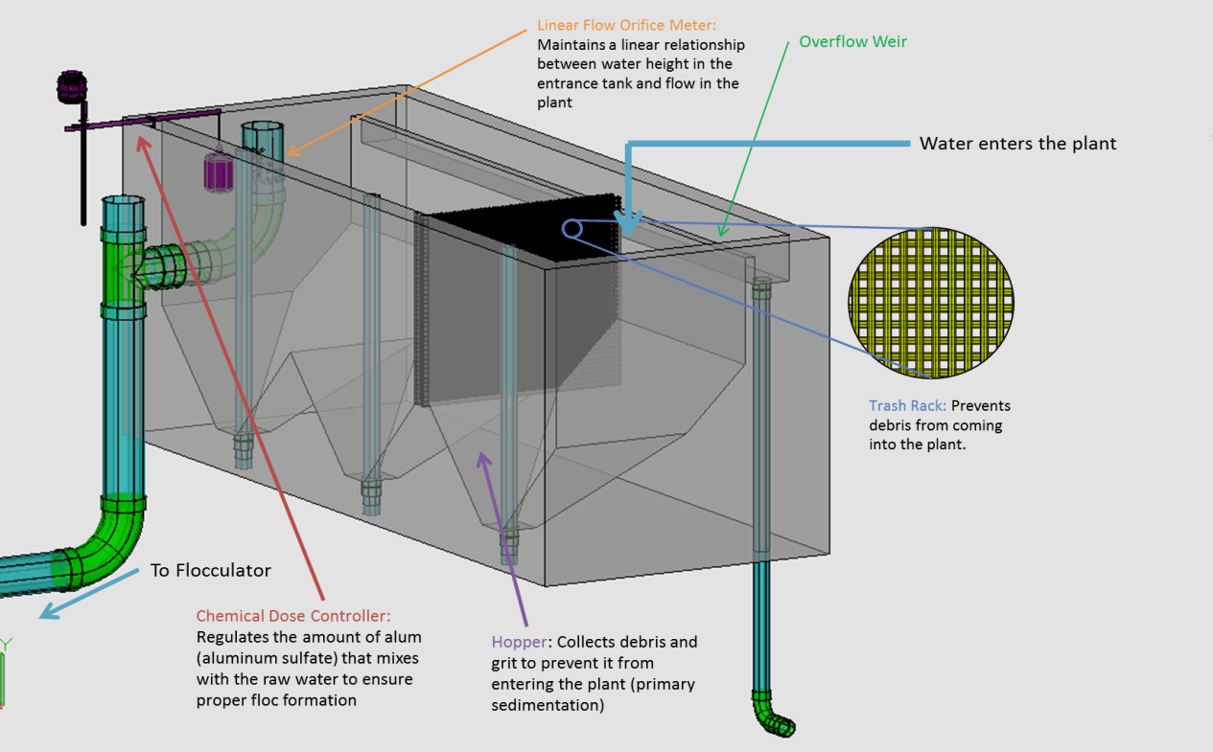
Introduction: Entrance Tank
Serves as a grit chamber (a type of primary sedimentation), prevents large debris from entering the plant and damaging it
Measures influent flow rate and ensures that the proper amount of water is flowing through the plant at all times
Notes:
Explain that overflow weir/pipe channels returns excess water to source if flow rate is too high (after a storm event, etc)

Slide 37
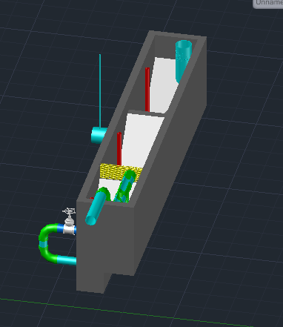
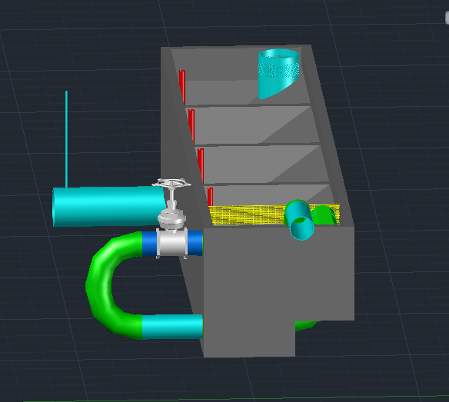
Issues at high flow rates (>~70 L/s)
Length of entrance tank must equal length of sedimentation tank
In order to have enough plan view area to meet capture velocity requirements, tank gets very wide at high flow rates

Slide 38
Issues at high flow rates (>~70 L/s)
LFOM cannot provide a linear relationship between height of water in the entrance tank and plant flow rate above ~70 L/s
New flow orifice meter design needed
LFOM Performance when Q.Plant = 150 L/s
Notes:
Show graph from LFOM file (do this in Carpenter)

Slide 39
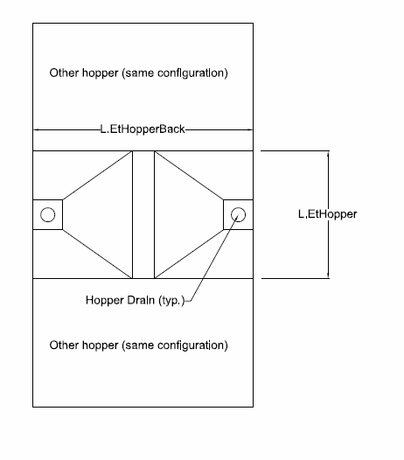
Proposed Fix #1 – Double Hoppers
Split each hopper into two hoppers which come to a peak in the middle of the entrance tank
Cut peak off and create middle ledge
Notes:
Why middle ledge?
Easier constructability
If peak was too high up, water would not be able to pass between hoppers and insufficient capture velocity would be provided

Slide 40
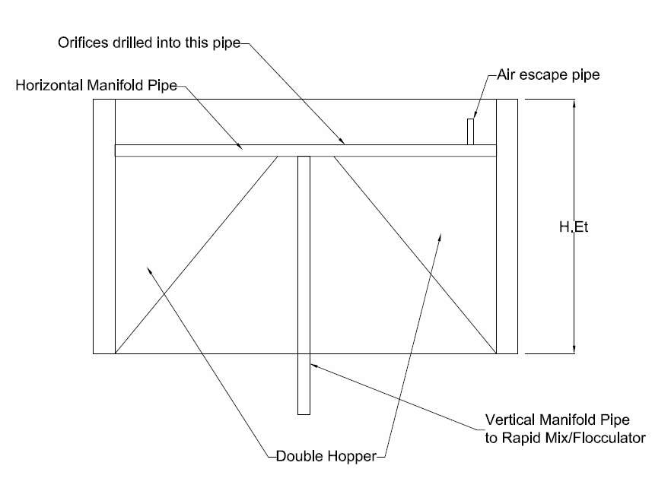
Proposed Fix #2 – Horizontal “FOM”
Lay horizontal manifold pipe across far hopper
Drill 1-2 rows of orifices in pipe
Can use horizontal orifice equation, multiplied by number of orifices in manifold, to determine overall plant flow rate
Notes:
Why middle ledge?
Easier constructability
If peak was too high up, water would not be able to pass between hoppers and insufficient capture velocity would be provided

Slide 41

Documented Progress/Future Work
Preliminary code created which designs double hoppers and horizontal flow orifice meter
Need to test performance of this code and modify entrance tank drawing files to reflect new geometries

Slide 42
Plumbing Functions and
Chemical Stock Tanks Updates
Heidi Rausch

Slide 43
Plumbing Functions
In the Final Designs folder there is a file called PlumbingF.
This file contains code to draw all of the plumbing elements of the plant, such as pipes, tees, elbows, etc.
Two functions, a wye and a reducer have been drawn. Another bushing type reducer will have to been drawn in the future.

Slide 44
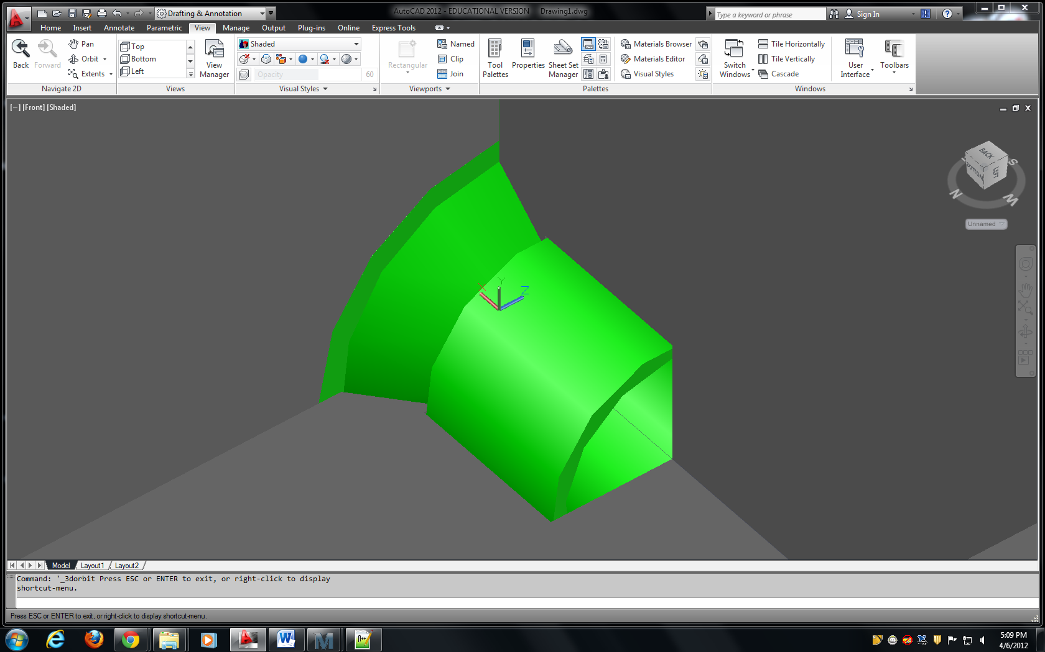

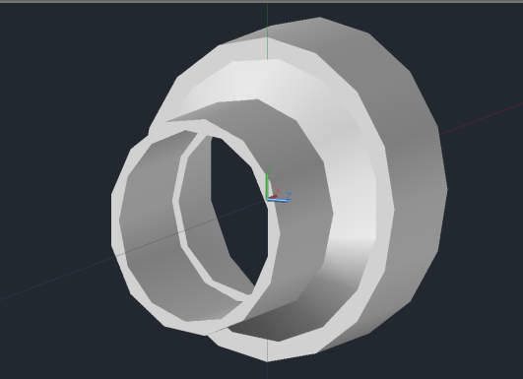
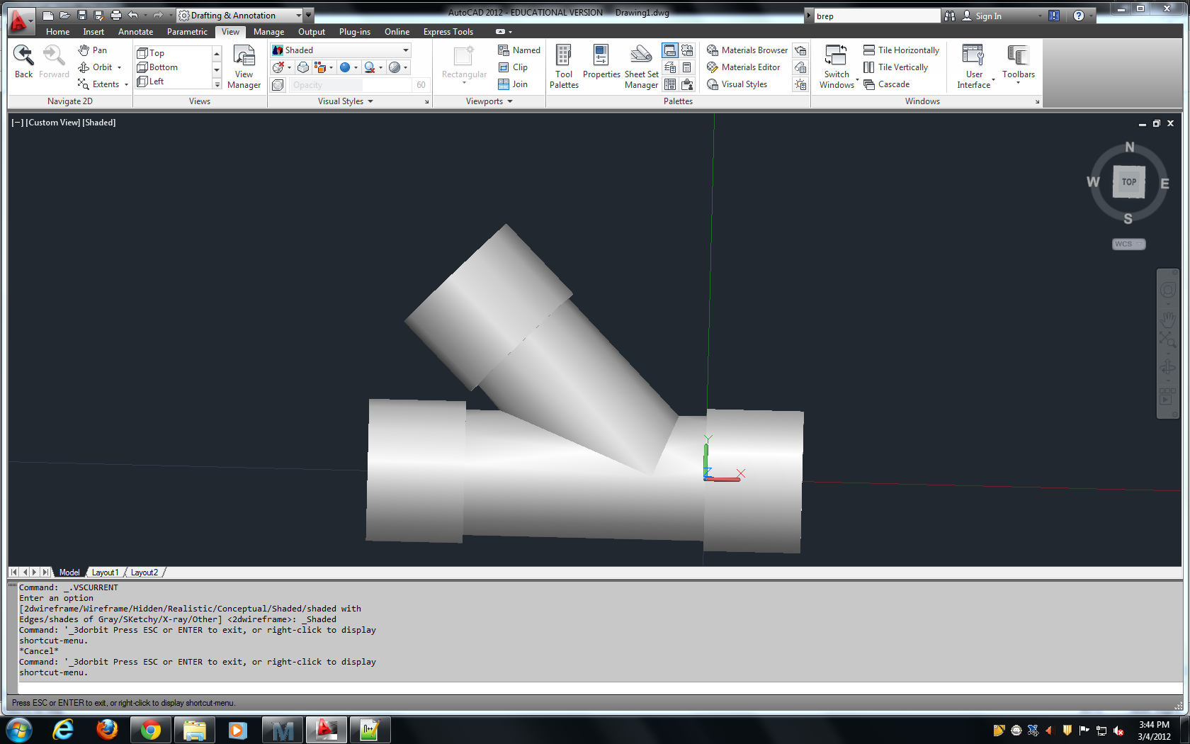
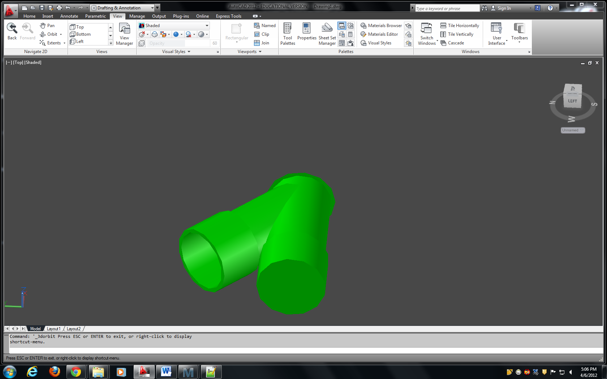
Updates to PlumbingF

Slide 45
Updates to ChemStockTanksAC
Would like to have the option of not having filter coagulant in our future plant designs.
Best way to do this was to rearrange the current layout of the Chemical Stock Tanks.
Involves incorporation of a new variable, FilterCoag, into Expert Inputs.

Slide 46
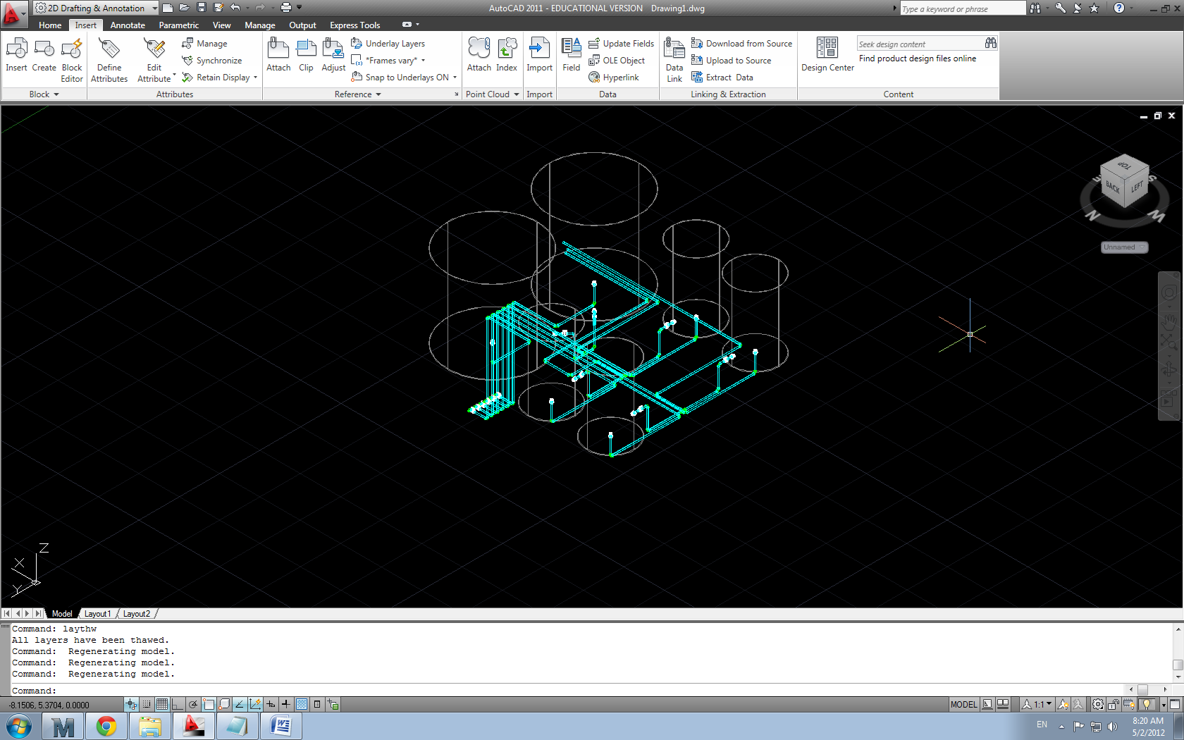
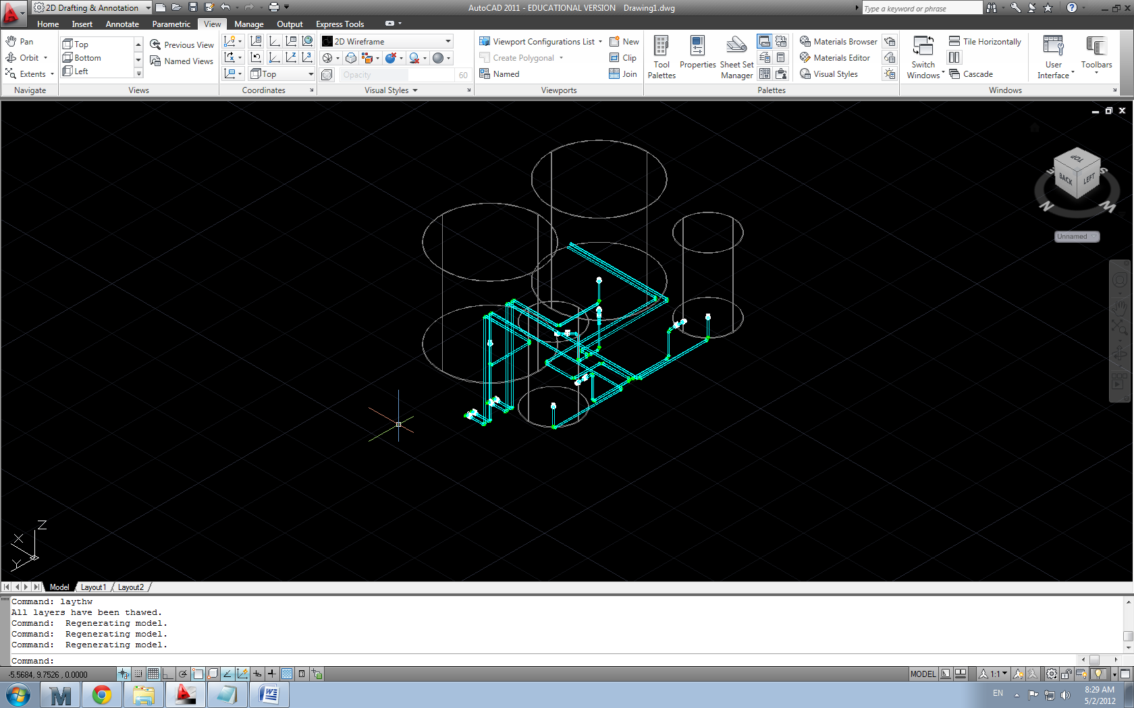
ChemStockTanksAC

Slide 47
Future Work
Fix small problem of overlapping pipes that I am currently having
Incorporate FilterCoag into expert inputs and make small changes to CdcAC and ChemStorageTanks design file
Question of moving the valves on the drainage pipes from where they currently are to immediately under the chemical stock tanks

Slide 48
Chemical Dosage System Update
Nicholas Parisi & Amanda Rodriguez

Slide 49
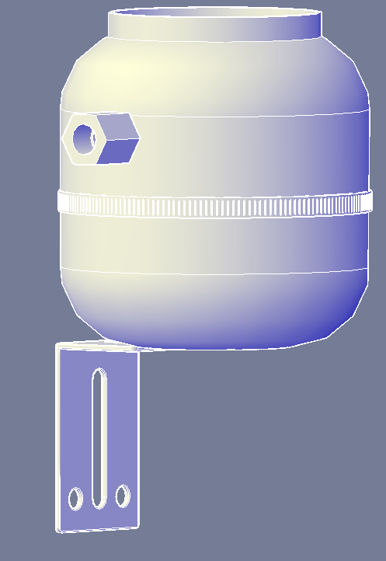
Task Review
Task: replace inserted drawings of Chemical Dose Controller with simpler components
Have these components directly from the command line
Purpose: Simplify code and make objects scalable for various inputs

Slide 50
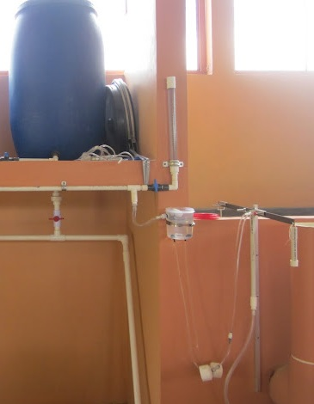
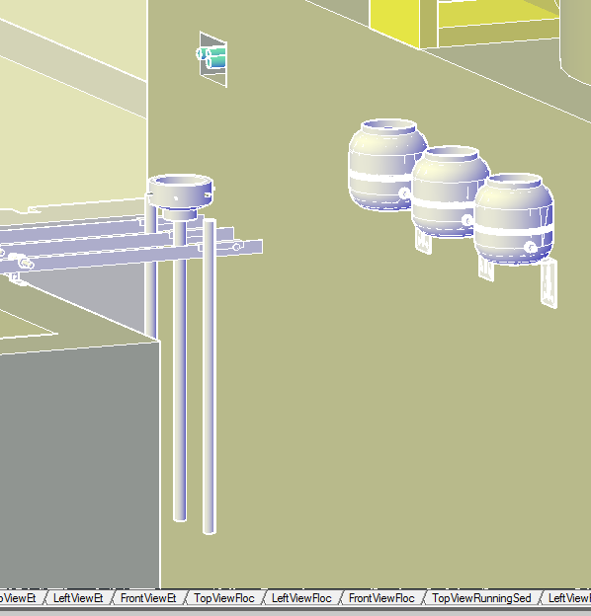
Where We Are Working

Slide 51
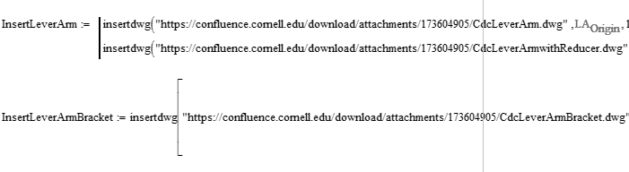
Progress to Date
Successfully wrote out code which replaces the previously inserted drawing in CDC Script
Draws the components of the Chemical Dosage system: Lever Arm, Drop Tube, L-Bracket and connecting bar

Slide 52
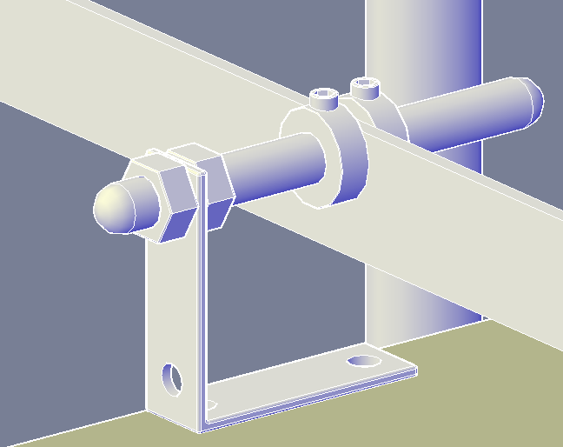
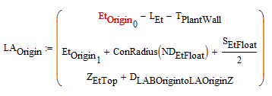
Progress to Date
Calculated new origin point based on previously defined LA.Origin
Previous origin point merely placed inserted drawing into AutoCAD plant drawing

Slide 53
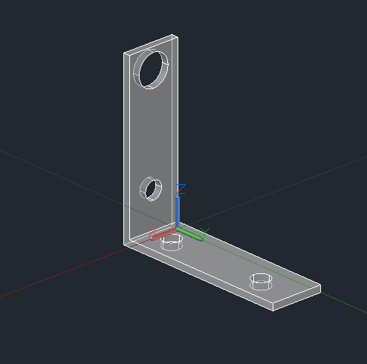
Progress to Date
Successfully completed function LBracket2F which is a function of an origin point.
This function was added to PlumbingF and is called in the CDC Script to replace the previously inserted drawing

Slide 54
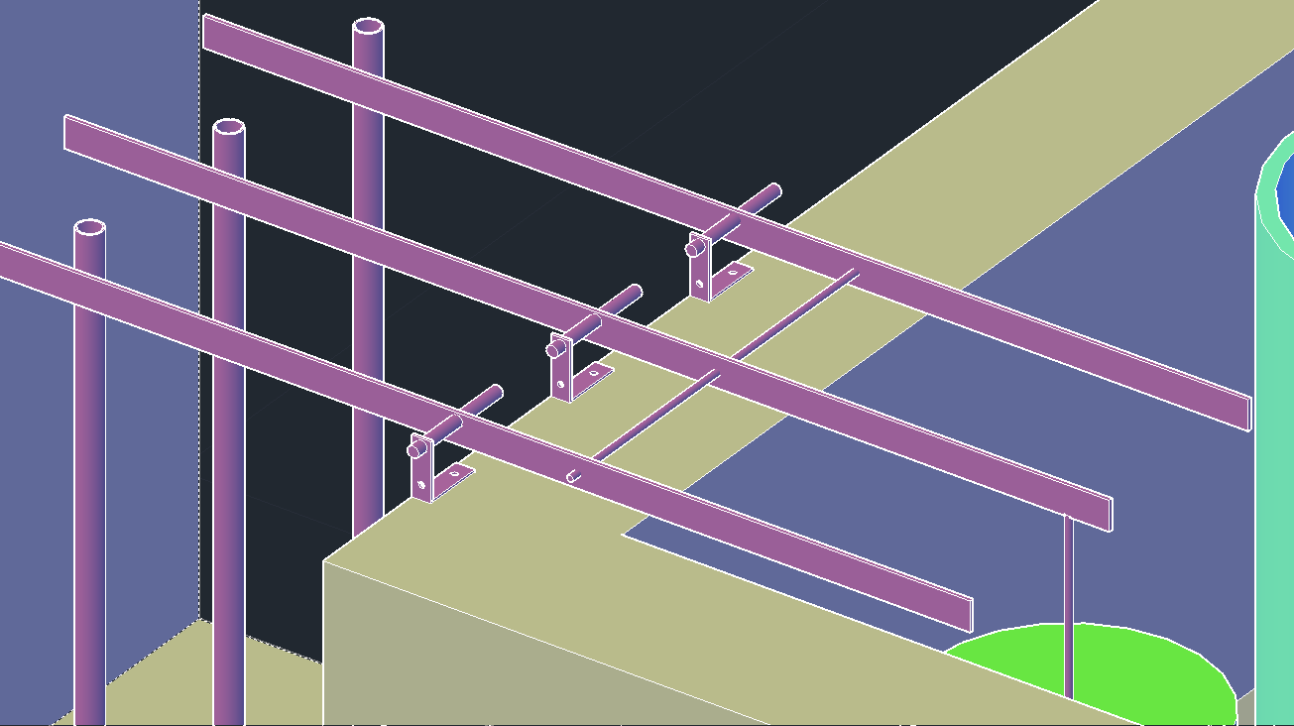
Implemented Plant Design

Slide 55
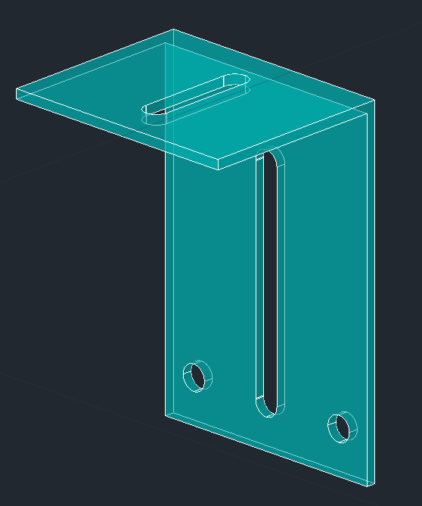
Progress to Date
Successfully created code to draw the Constant Head Tank to be embedded in CDC Script along with CHT tank.

Slide 56
Constant Head Tank Function
ConstantHeadTankF
Committed - Located in PlumbingF
float valve = inserted drawing
Barbed fittings previously drawn incorrectly
  Should be on bottom rather than sides
  Dependent on number of tubes required
    Varies as a function of plant size
Notes:
(As of right now, the float valve will remain as an inserted drawing.)
(Also, things we need to fix)
(incorrectly (barbed fittings allow flexible tubing to connect the constant head tank to lever arms and the reducer)

Slide 57
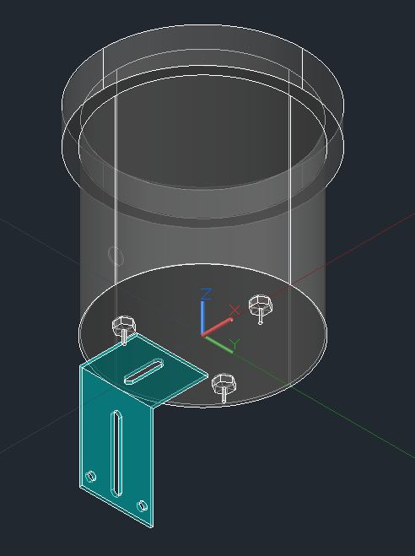
Updates
Given dimensions for McMaster part 42955T2 → tank radius and height
Holes for these inserted drawings
  Float valve location defined in ChemStorageTanks
  thickness of the tank based on inserted drawings.
Working on combining ConstantHeadTankF and inserted drawings with supporting bracket
Notes:
(this is calculated – check mathcad code)
outlined in ChemStorageTanks: height between the attachment of the float and the water level dependent on the size of the float valve; define water depth myself
Rotation – in case we rearrange plant layout

Slide 58
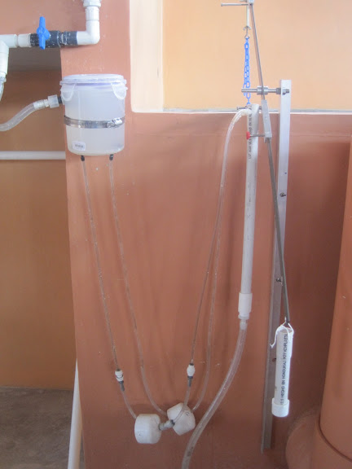
Future work
Incorporate code into Design Tool – summer design team?
  CHT, supporting bracket, float valves and barbed fittings
  lever arm sliders and connecting bolts
Incorporate Reducer, if number of tubes is 3 or more
Flexible tubing - tank to drop tubes and lever arms
  Will a catenary function properly model flexible tubing?

Slide 59
AguaClara
Abstract
Annie Newcomb

Slide 60
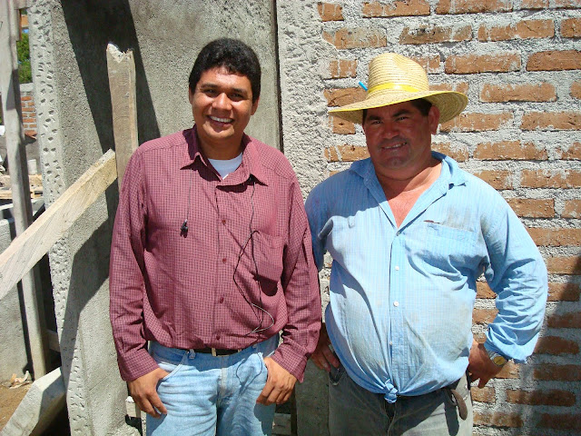
Objectives
Replace outdated concept papers
8-10 pages
  Technical aspects
  Community impact
Audience

Slide 61

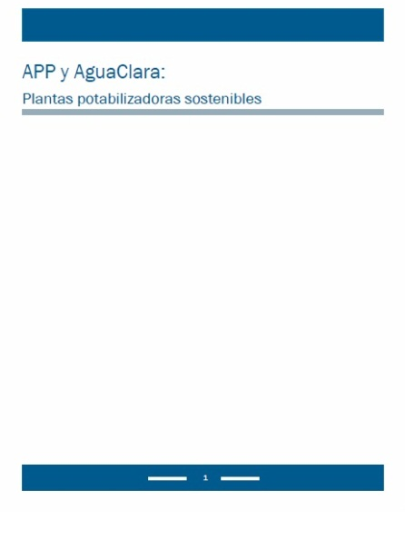
Final Abstract

Slide 62
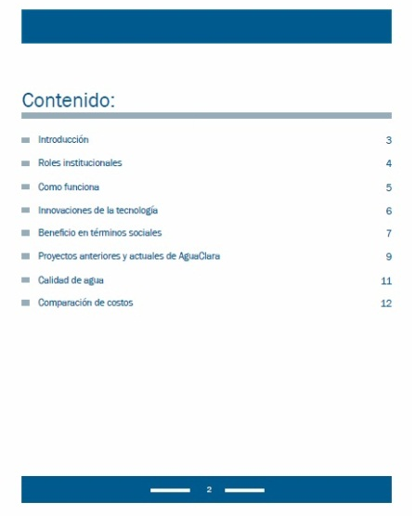
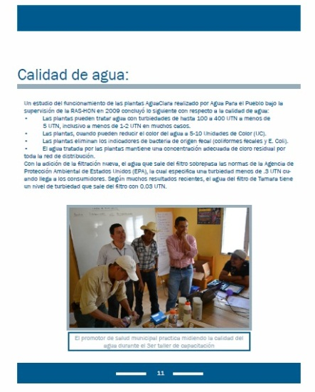
Abstract Design

Slide 63


Future Work
English Abstract
  More general
  AguaClara focused
Extended concept paper
  30 pages
  Highlight technical aspects
  Spanish
  English

Slide 64

Questions???

