Slide 1

Design Team

Slide 2

Automated Design Tool (ADT)
Access to customized plant designs
  User inputs
Key to continuing scalability
Open Source Engineering
AguaClara Design Philosophy
Notes:
Online interface that provides access to customized plant designs, invent scalable, reproducible tools that can be combined to form a complete water treatment plant.

Slide 3
Automated Design Tool
User Inputs
Plant
Design
LabVIEW
AutoCAD
Mathcad
Calculations
MS Word
Mathcad
Drawing Files
Notes:
User places inputs, design tool sends a request to the AguaClara server to produce a spreadsheet of all variables relevant to the plant design, and the values assigned to each of them. These include pipe diameters, wall dimensions, and baffle dimensions and placement. The ADT uses these variables to scale plant components in AutoCAD to create a complete, three dimensional design of the entire plant and its components.

Slide 4
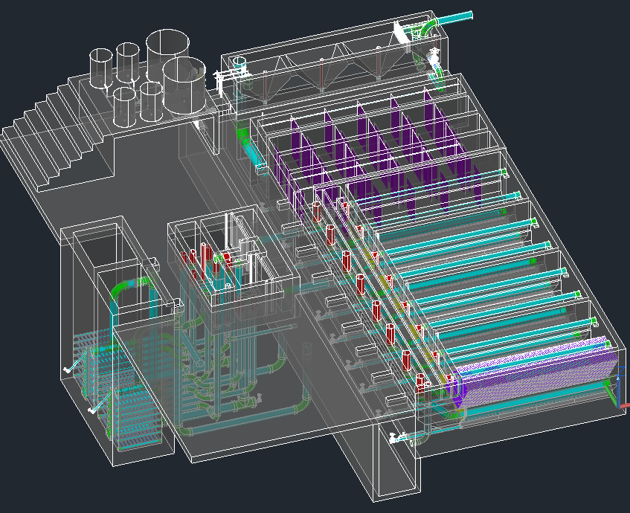
The Drawing

Slide 5
Overall Design Tasks
  Incorporating new research progress into the design
  Designing plants for a greater range of flow rates
  Making our designs more easily understood
  Communicating with the team in Honduras and with new implementation partners to address concerns
Notes:
Design or constructability concerns

Slide 6
Low Flow Plant
Julia Morris

Slide 7
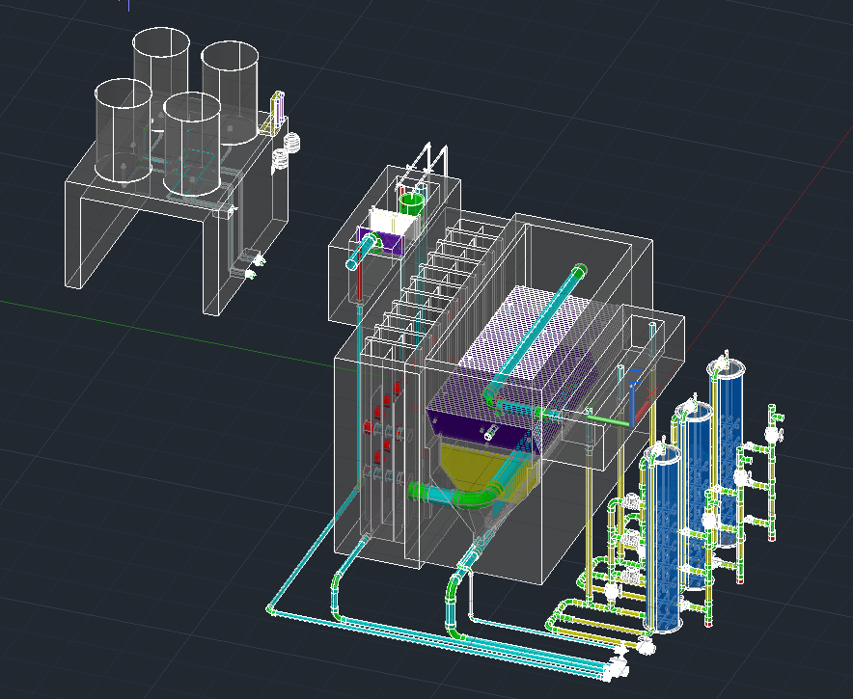
2.4 L/s Plant
32 L/s Plant

Slide 8
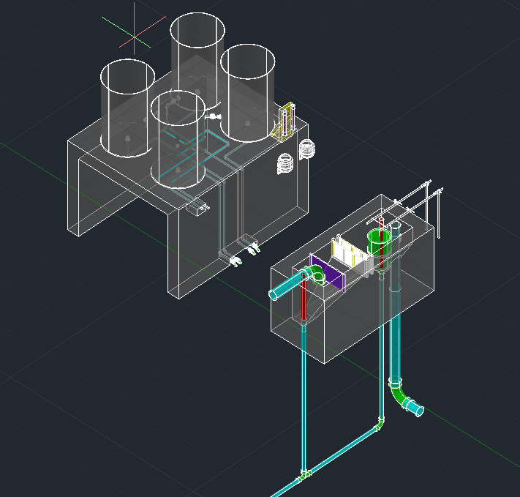

Slide 9
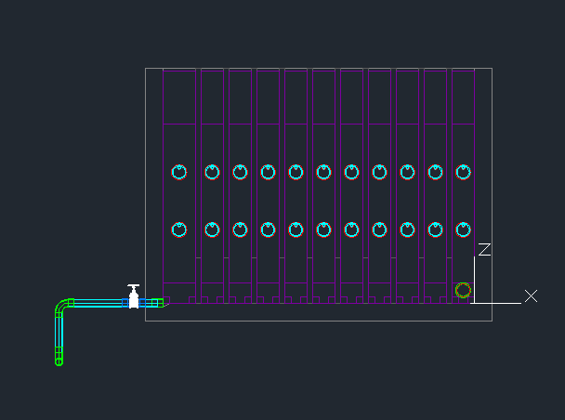
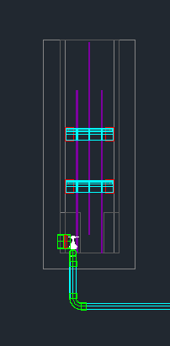
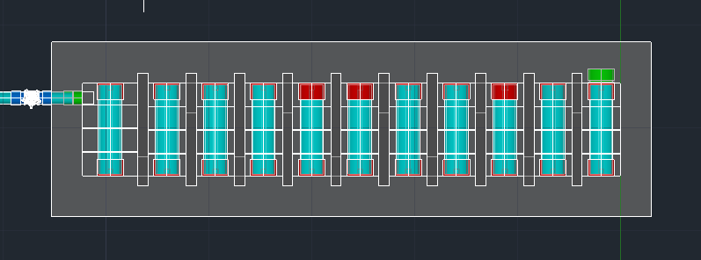
Side View
Front View
Top View

Slide 10
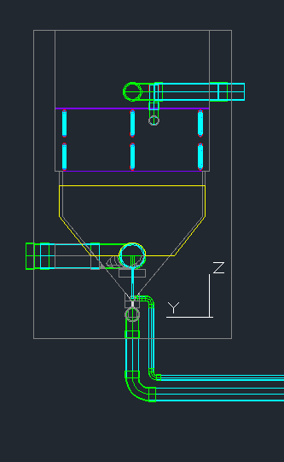
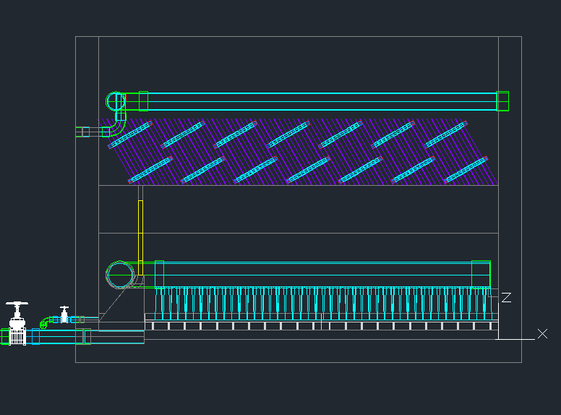

Slide 11
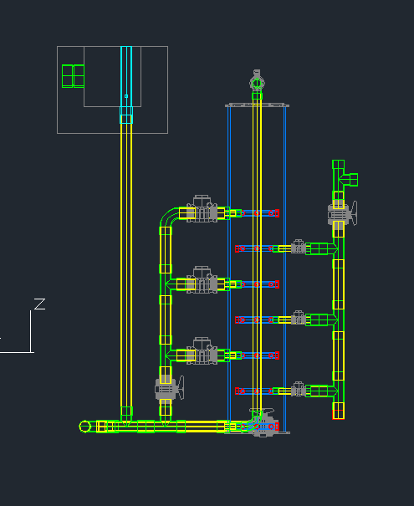
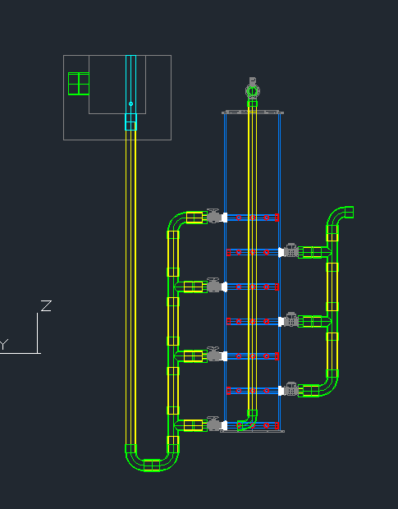

Slide 12
Future Work
Finish Drain Plumbing for Filter
Add Operator Access

Slide 13
Sedimentation Tank Design Details
Kristie Guo and Paroma Chakravarty

Slide 14
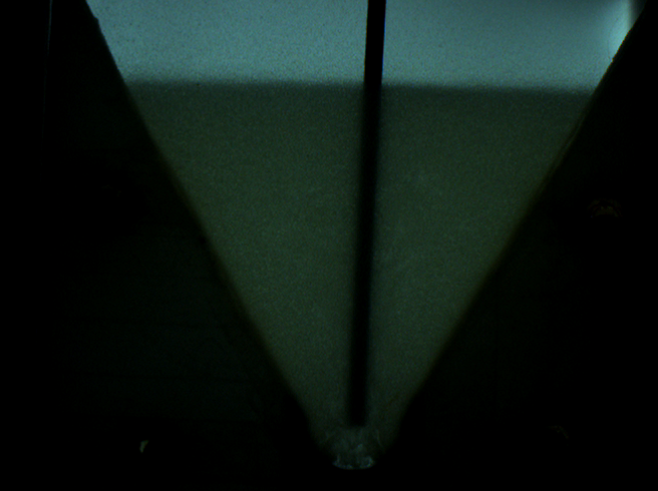
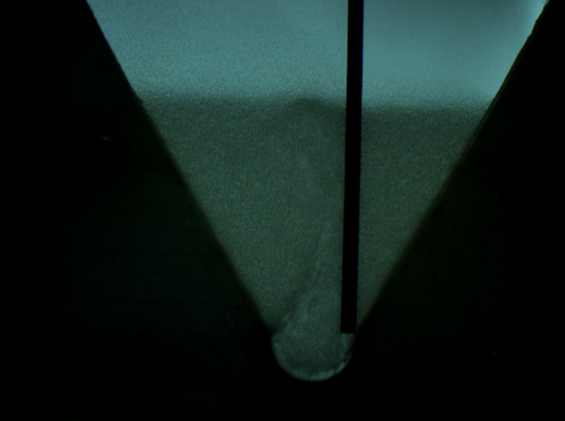
Task 1: Asymmetrical Inlet Jet

Slide 15
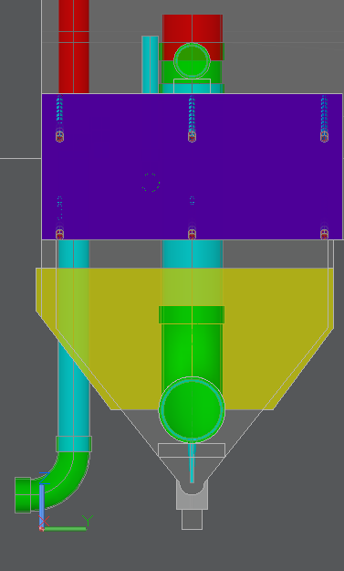
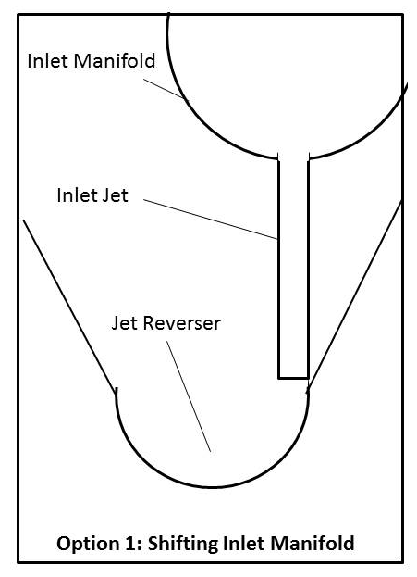
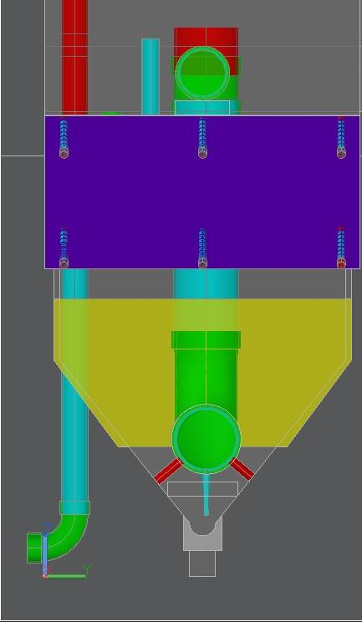
The Shift in the Code

Slide 16
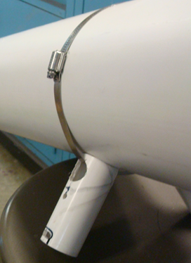
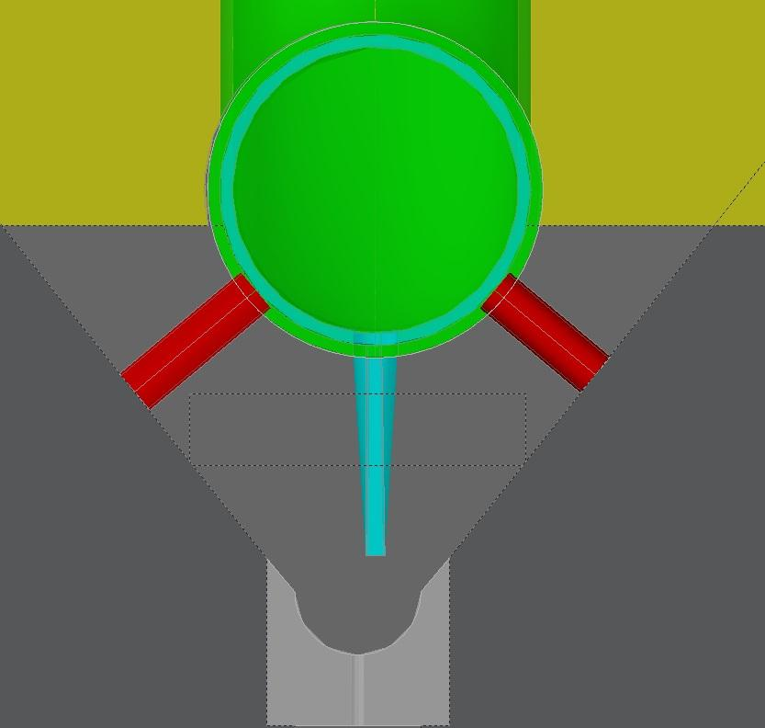
Task 2: Manifold Feet

Slide 17
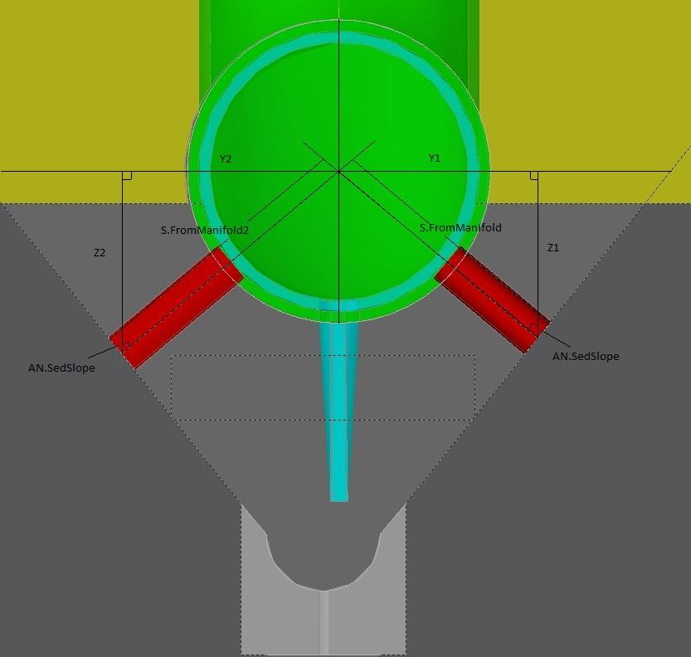
Origin Point Calculation of Feet

Slide 18
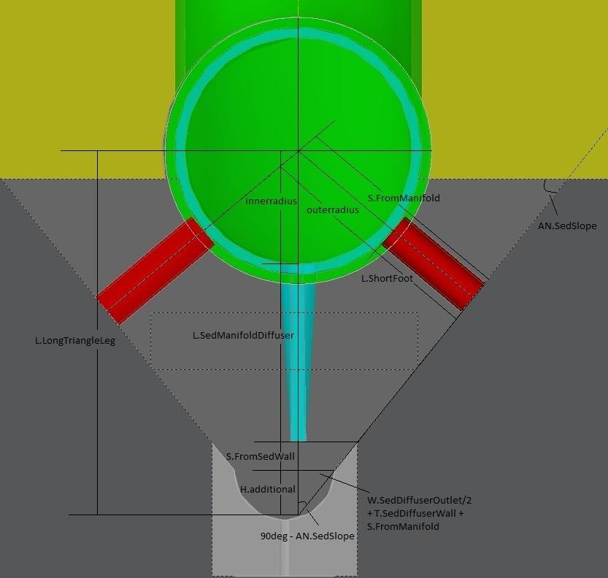
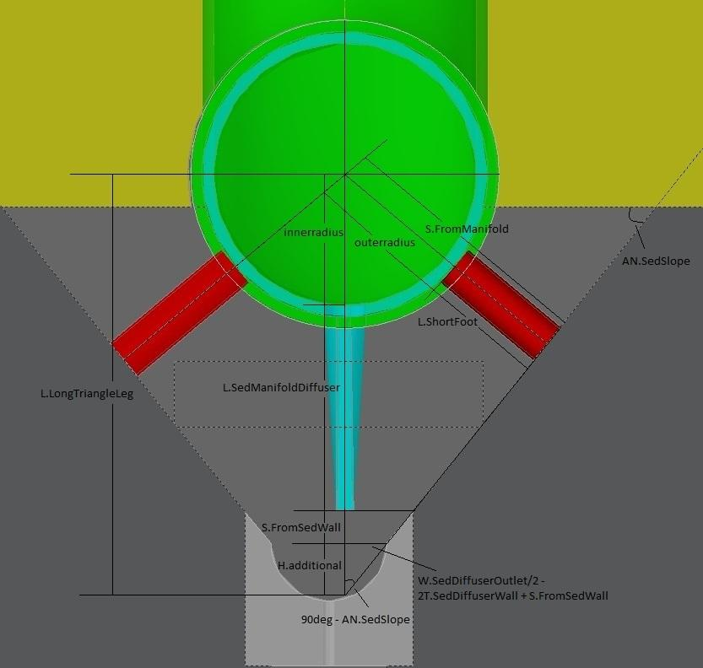
Calculation of Feet Length
Theoretical Calculation
Real Calculation

Slide 19
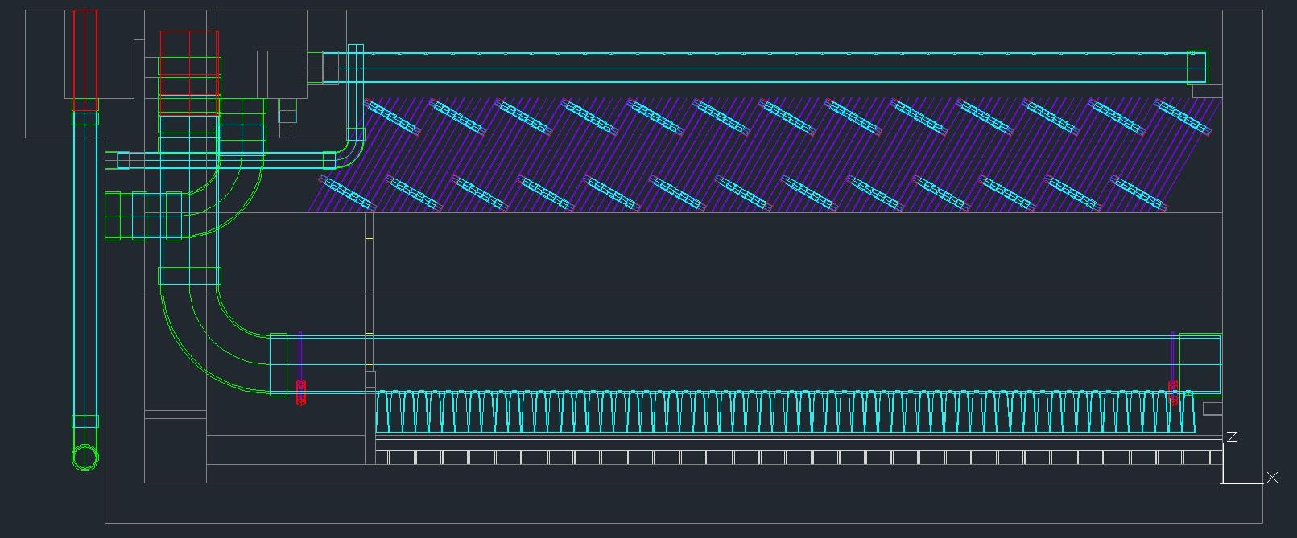
Feet Placement On Manifold

Slide 20
Future Work
Finding definite values for the arbitrary distances we have set
Analyze the code to identify why the methods we used to make the feet fit worked

Slide 21
Design Case Study
Derrick Yee

Slide 22
Design Case Study
Created design document to improve the clarity of all of the files on the AguaClara server, and increase collaboration between people working with the same files and code.
Noticed “poor” coding habits and focused on mainstreaming a process for visible coding

Slide 23
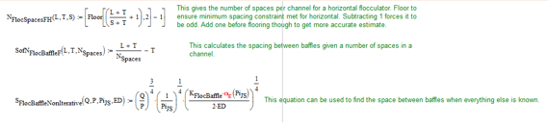
Design Case Study
Section Guidelines:
  File Name.
  References.
  Input Values.
  Variables/Functions.
Photo example on the design document documenting variables/functions.

Slide 24
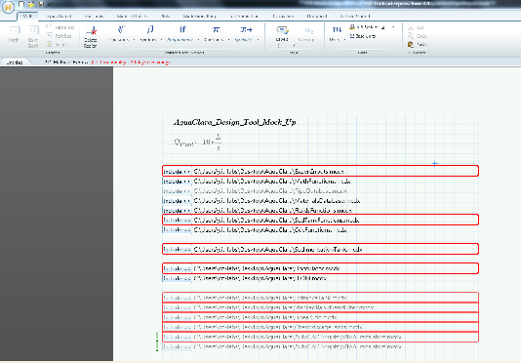
Design Case Study
Investigated options of upgrading from MathCAD 15.0 to MathCAD Prime 3.0 for more functionalities
  -Solve EtFlocSedFi disorganization issue
Figure: Error page of converting MathCAD 15.0 files to MathCAD 3.0. The files have synatax errors that disable the program from operating similar to that of MathCAD 15.0.

Slide 25
Plant Cost Calculator
The purpose of the plant cost calculator is to share the cost information from the website and to make this information more visible.
The user will be providing the input (community size and location) to get a cost estimate to make an informed decision.

Slide 26
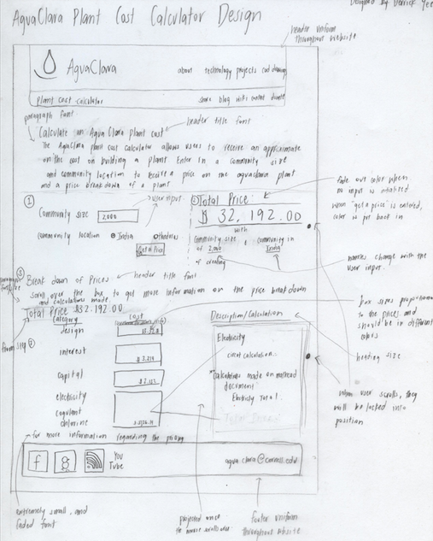
Cost Calculator Initial Design
Process:
  1. Analyze the user needs.
  2. Determining how the data will be stored.
  3. Creating the design and implementation
  4. Verifying calculations are correct

Slide 27
Future Work
Create a running prototype of the calculator and implement the calculator into the website
Researching MathCAD Prime 3.0 and continue to test whether the files on the AguaClara server work
  Simplifying code on EtFlocSedFi Files

Slide 28
Future Challenges
Plant Cost Calculator: calculating the most accurate calculations and documenting the process.
MathCAD Prime 3.0: having all design drawings run “normally”

Slide 29
Chemical Dose Controller Drawing Updates
Tori Klug

Slide 30
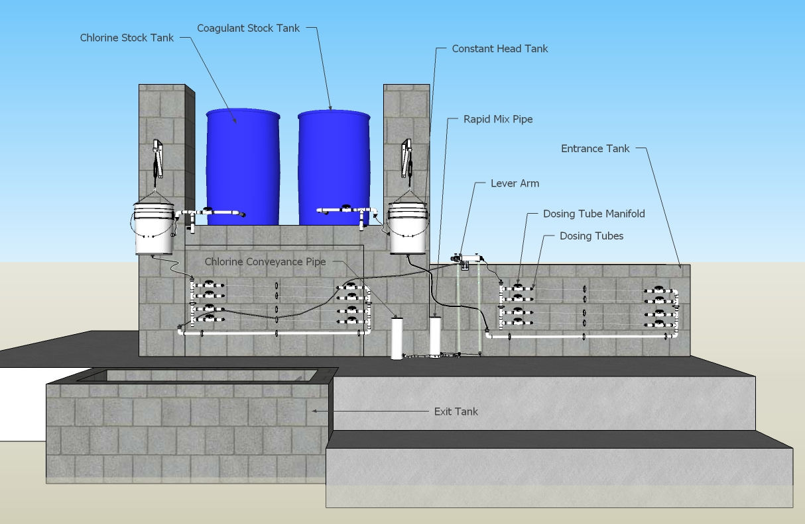
CDC Drawing Updates
Goal: accurately represent flow of coagulant and chlorine from stock tank to dosing site
Notes:
Main goal
Chemicals flow from stock tank, to constant head tank (and calibration column), to manifold, through manifold, to dosing lever arm drop tube, and finally to their dosing site
Actual CDC updates
CDC design has changed significantly over the past few semesters
Updated design has yet to be fully integrated into the design tool
Main steps
Manifold
Consists of several flexible tubes running length-wise along the entrance tank that allow for major losses to dominate the system
Flexible tubing
Connects the stock tanks to the constant head tanks, the constant head tanks to the manifold system, the manifold system to the top of the drop tubes on the lever arm, and the bottom of the drop tubes to the rapid mix pipe (for coagulant) and to the chloring dosing site at the effluent to the filter.
Calibration column and constant head tanks
Complete the drawing as it would appear in the plant
Lever arm system
Fix dimensions
Stock tank concentrations
Should be calculated so that an integer number of bags of chemical has to be mixed into the tank

Slide 31
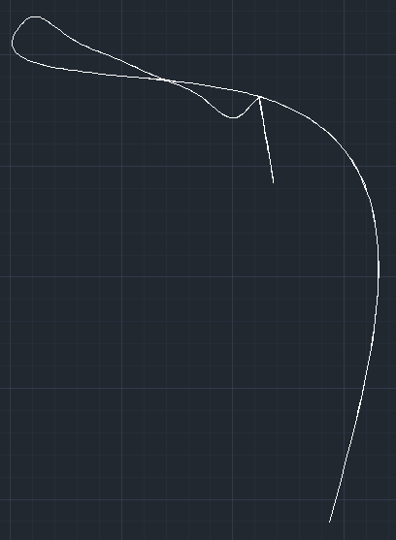
Flexible Tubing Difficulties
Errors in drawing
  Function to create flexible tubing very complex
Modified function to take proper inputs
Decided to do other updates first
Need to fix for future semesters

Slide 32
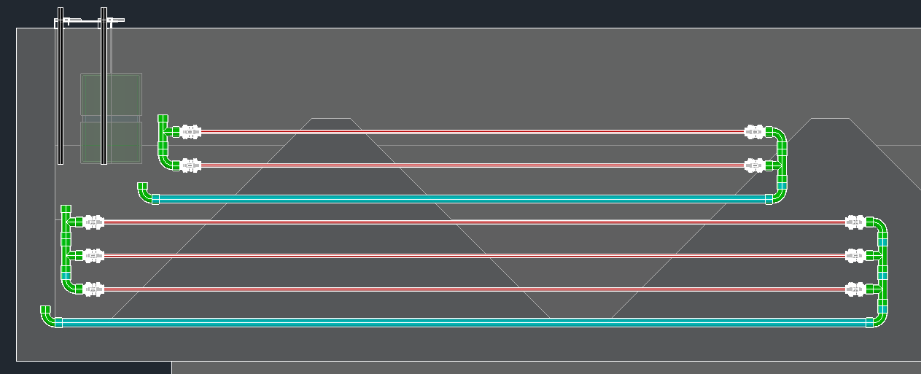
Updated Drawing
Manifold completed
Location of manifold changed
Coded so that changes reverberate properly

Slide 33
Future Work
Ensure that manifold fits on entrance tank wall for all flow rates
Finish fixing flexible tubing function and use to draw connections
Fix dimensions of lever arm system
Revise stock tank concentrations
Complete the drawing of the CDC in the design tool for the first time ever!

Slide 34
Section Cuts
Presented by Runpeng, Songlin

Slide 35
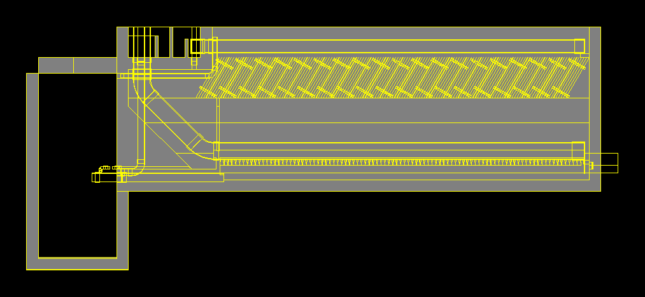
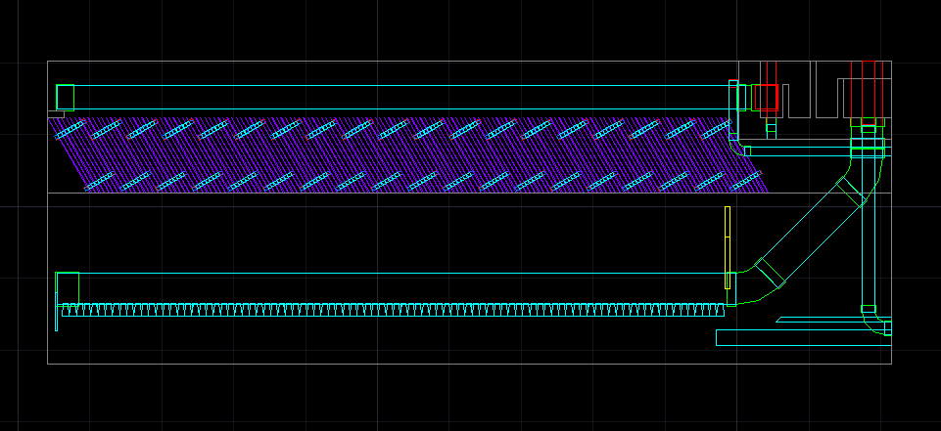
Brief Introduction
Previous Section Cut
Desire Section Cut

Slide 36
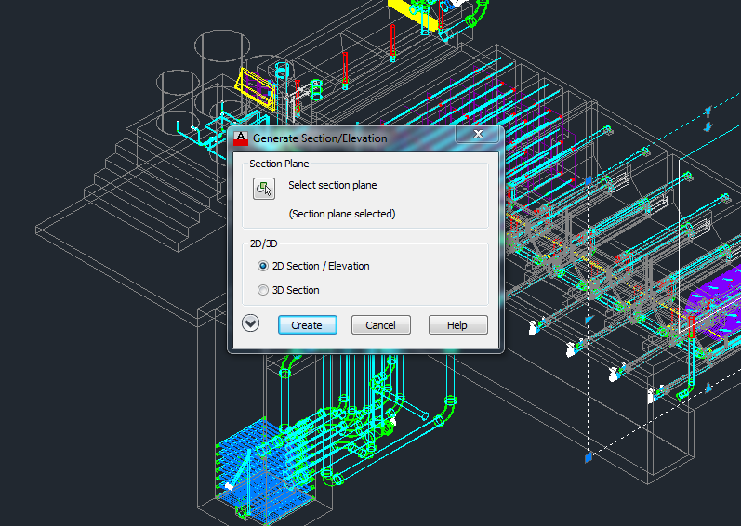
Problems Encountered
Automation

Slide 37
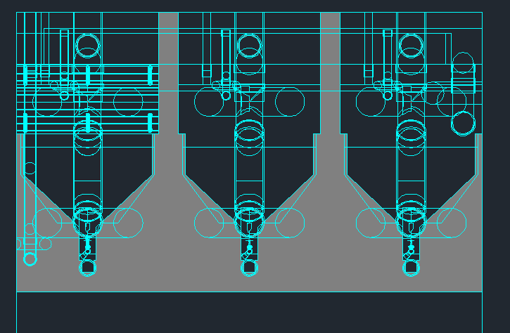
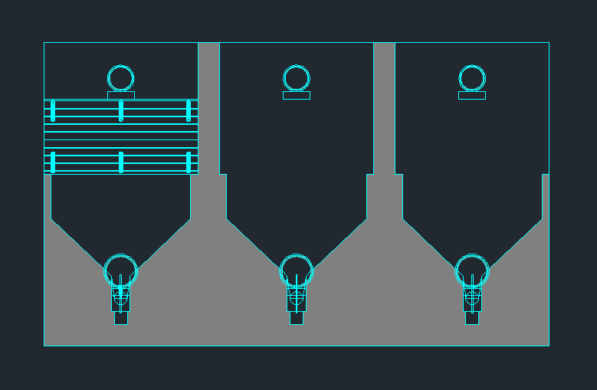
Problems Encountered
Redundant Stuff

Slide 38
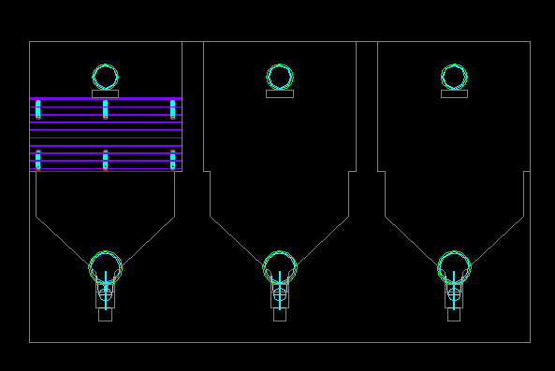
Problems Encountered
Colored by layer

Slide 39
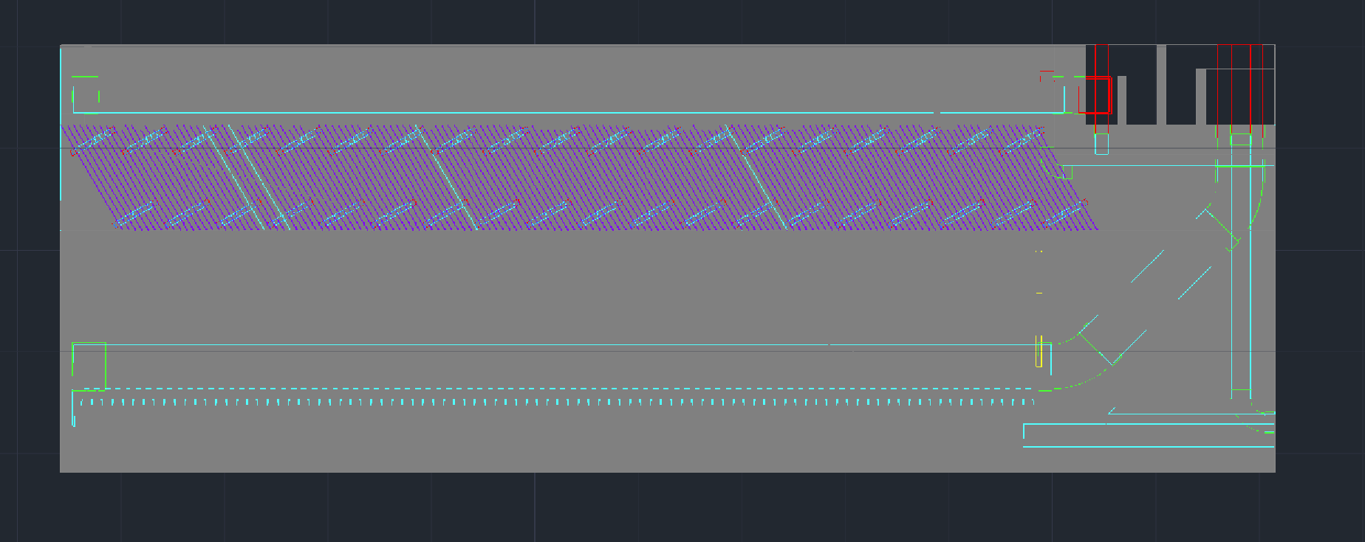
Problems Encountered
Unexpected Solid Background

Slide 40
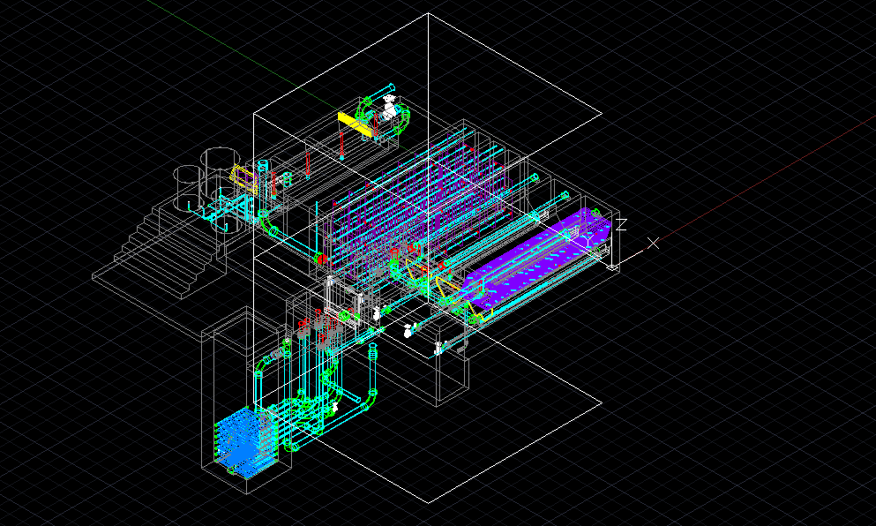
Accomplishment
Modified code

Slide 41
Accomplishment
Solved Encountered Problems

Slide 42
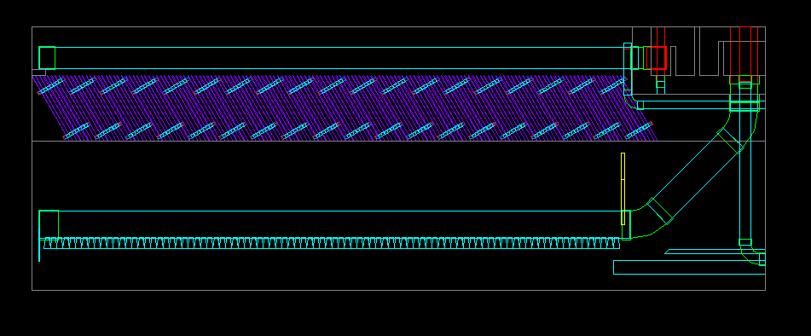
Accomplishment
Solved Encountered Problems

Slide 43
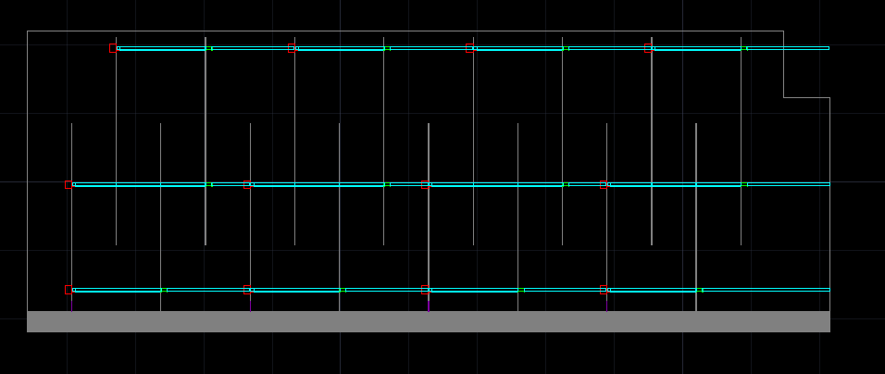
Accomplishment
Built New Section Cuts
Transverse view of flocculator

Slide 44
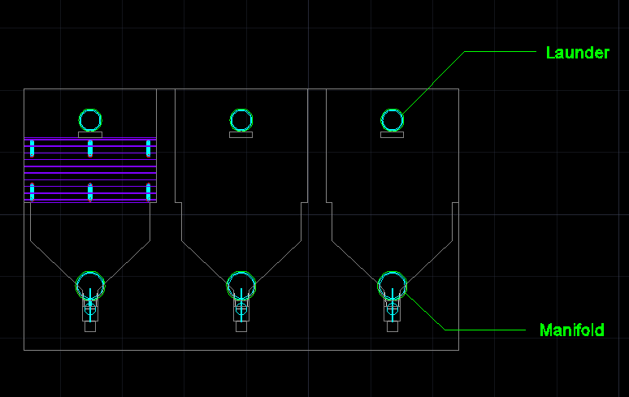
Future Work
Labeling

Slide 45
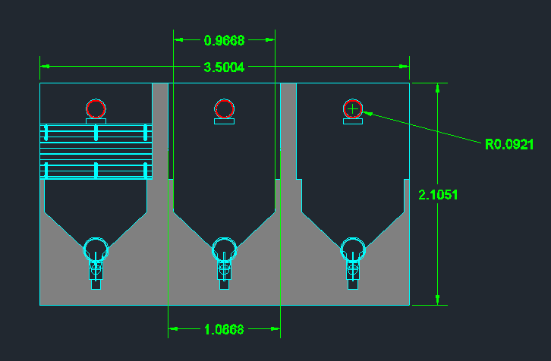
Future Work
Dimension

Slide 46
Entrance Tank Flow Control
Paul Larios

Slide 47
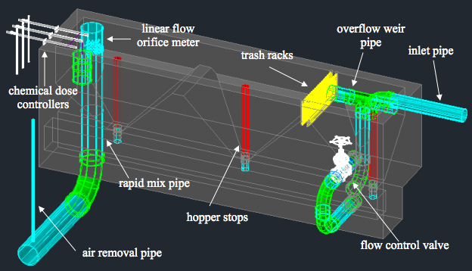
Current Design
Notes:
Point out valve. Purpose of flow control.

Slide 48
Current Design
Problem:
Price of bronze gate valve becomes overly expensive as the plant flow rate increases.
Challenge:
Design a cost-effective flow control solution that allows the operator to adjust flow coming into plant.

Slide 49
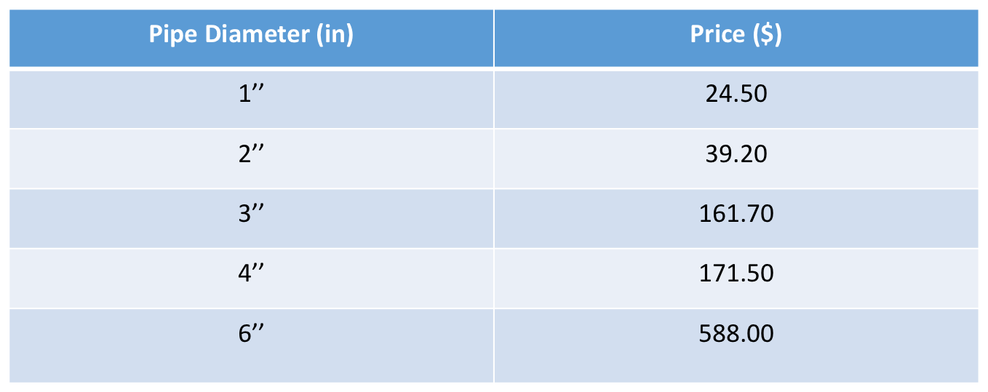
Current Design
Typical Pricing on Bronze Gate Valve:
Notes:
From Drew Sharp in Honduras. Highly variable pricing. Notice price jumps at 3’’, 6’’. No pricing above 6’’-Specialty item. Limits high flow analysis.

Slide 50
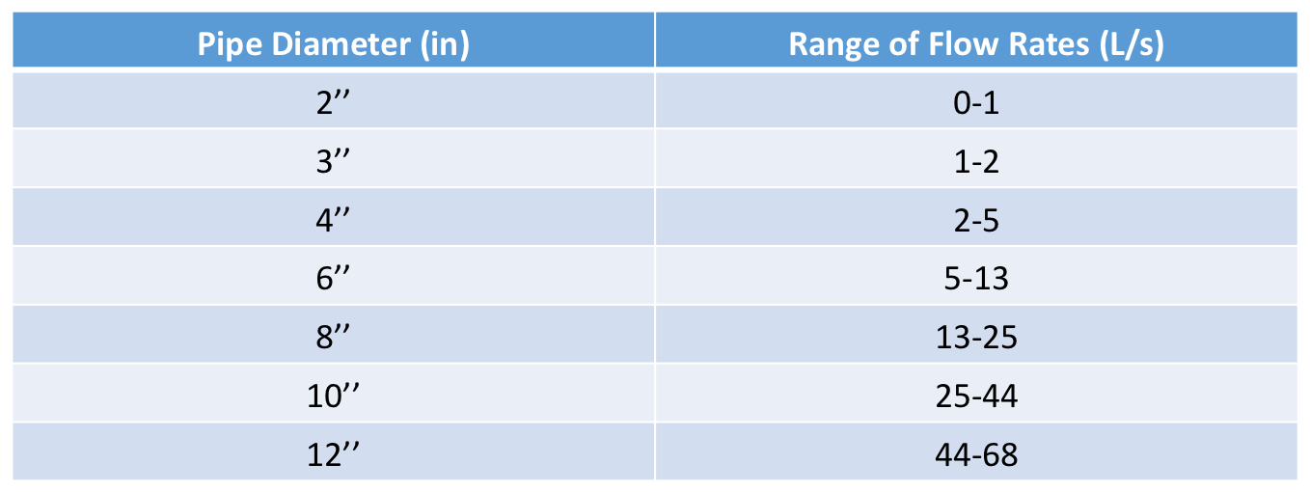
Current Design
Range of Flow Rates for each valve size:

Slide 51
Alternative Designs
Approach:
Generate alternative designs. Compare with current design based on estimated cost and operator’s “adjustability” for each flow rate.
Alternatives Considered:
  The use of different valve types
  The use of multiple, smaller-size valves in parallel
  The use of Fernco flexible couplings on top end of drain stopper pipes
Notes:
PVC Gate, PVC Butterfly, DI Butterfly. Common manifold for parallel, better than current? Limited by cost info on valves. Focus on Fernco “Adjustable weir”.

Slide 52
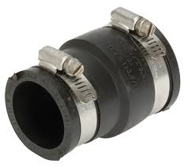
Alternative Design-Fernco Coupling
Prices for Fernco Flexible Reducing Couplings:
Coupling Size | Cost ($)
3’’ x 3’’ | 13.63
3’’ x 4’’ | 18.37
3’’ x 5’’ | 37.93
3’’ x 6’’ | 51.85
6’’ x 8’’ | 67.76
4’’ x 8’’ | 92.75
Notes:
Much cheaper than any valves. So how will this work?

Slide 53
Alternative Design-Fernco Coupling
Recall the current entrance tank design:
Notes:
Point out stoppers, their usual function. From 3 to 4 stoppers at 14 L/s. 1 drain considered off limits b/c LFOM.

Slide 54
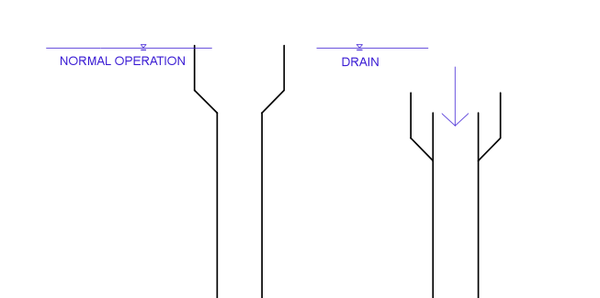
Alternative Design-Fernco Coupling
Notes:
Mechanism. Stoppers fixed at 3’’. Arbitrary? Limits max flow to 13.4 L/s each.

Slide 55
Alternative Design-Fernco Coupling
Drainable Flow Rate for each:
Size | Flow (L/s)
3’’ x 3’’ Coupling | 1.8
3’’ x 4’’ Coupling | 3.7
3’’ x 5’’ Coupling | 6.5
3’’ x 6’’ Coupling | 10.2
8’’ Top Coupling | 20.9
3’’ Stopper Pipe | 13.4
4’’ Stopper Pipe | 24.3
Notes:
Less than 6’’? Limited by 3’’ stopper pipe. 2 or 3 couplings total. compared all competitive combinations (cost, max drainable flow, #/level of draining increments)

Slide 56
Comparison of Coupling Uses
Example: Choosing optimal usage for 14 L/s
Coupling Use | Maximum Drainable Flow (L/s) | Cost ($) | Drainable Flow Increments
1 3’’ x 3’’, 1 3’’ x 4’’, 1 3’’ x 5’’ | 12.0 | 69.83 | 7 (1.8, 3.7, 5.5, 6.5, 8.3, 10.2, 12)
2 3’’ x 5’’ | 13.0 | 75.86 | 2 (6.5, 13)
2 3’’ x 4’’, 1 3’’ x 5’’ | 13.9 | 74.67 | 5 (3.7,6.5, 7.4, 10.2, 13.9)
Notes:
Top chosen b/c more effective increments. No need to dump entire flow. Done for each flow rate.

Slide 57
Recommended Designs
Range of Flow Rates (L/s) | Recommended Design | Estimated Cost ($)
4-5 | 2 3’’ x 3’’ Fernco | 27.26
6-8 | 1 3’’ x 3’’, 1 3’’ x 4’’ Fernco | 32.00
9-13 | 1 3’’ x 3’’, 1 3’’ x 5’’ Fernco | 51.56
14-15 | 1 3’’ x 3’’, 1 3’’ x 4’’, 1 3’’ x 5’’ Fernco | 69.83
16-17 | 2 3’’ x 4’’, 1 3’’ x 5’’ Fernco | 74.67
18-20 | 2 3’’ x 4’’, 1 3’’ x 6’’ Fernco | 88.59
21-27 | 1 3’’ x 4’’, 1 3’’ x 5’’, 1 3’’ x 6’’ Fernco | 108.15
28-30 | 1 3’’ x 5’’, 2 3’’ x 6’’ Fernco | 141.63
31-41 | 3 3’’ x 6’’ Fernco | 155.55
42-62 | 2 4’’ x 8’’ Fernco* | 185.50
62> | 3 4’’ x 8’’ Fernco* | 278.25
Notes:
After comparing all. Mention future work/code changes.

