Slide 1

Design Team
Amy Boncelet, Annie Newcomb, Anthony Andrews, Heidi Rausch, Jen Gass, Julia Morris, Kira Gidron, Michael Walsh, and Tori Klug

Slide 2

Automated Design Tool
User Inputs
Plant
Design
LabVIEW
AutoCAD
Mathcad
Calculations
MS Word
Mathcad
Drawing Files

Slide 3
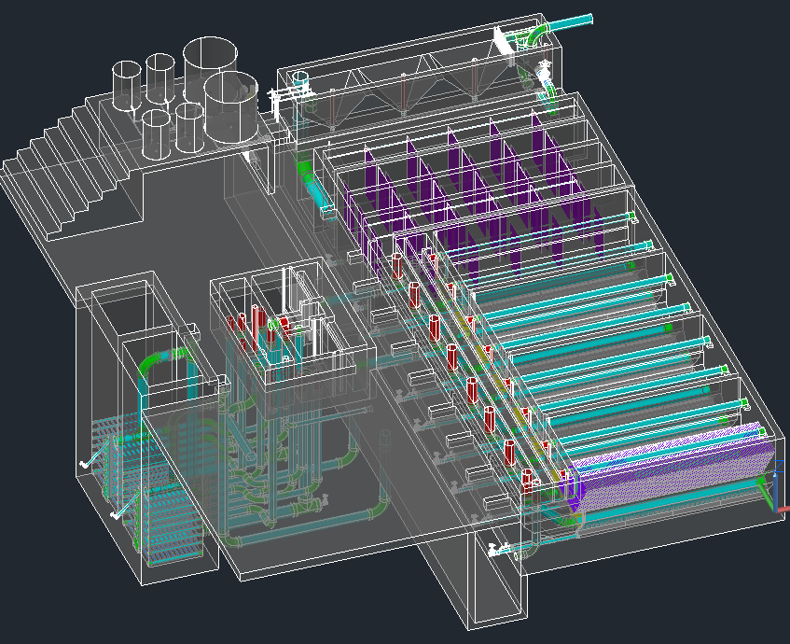
The Drawing

Slide 4
Overall Design Tasks
  Incorporating new research progress into the design
  Designing plants for a greater range of flow rates
  Making our designs more easily understood
  Communicating with the team in Honduras and with new implementation partners to address concerns

Slide 5
Flexible Tubing
Function
Jennifer Gass

Slide 6
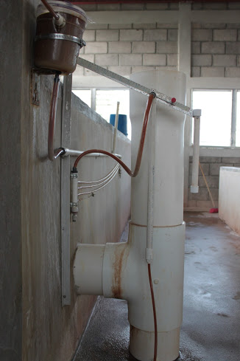
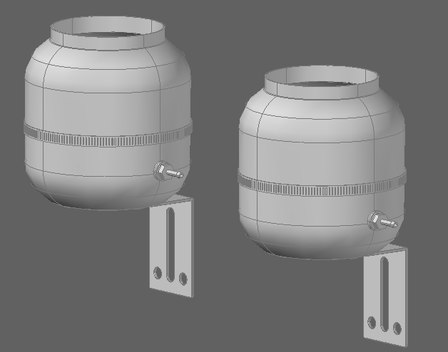
New CDC set-up

Slide 7
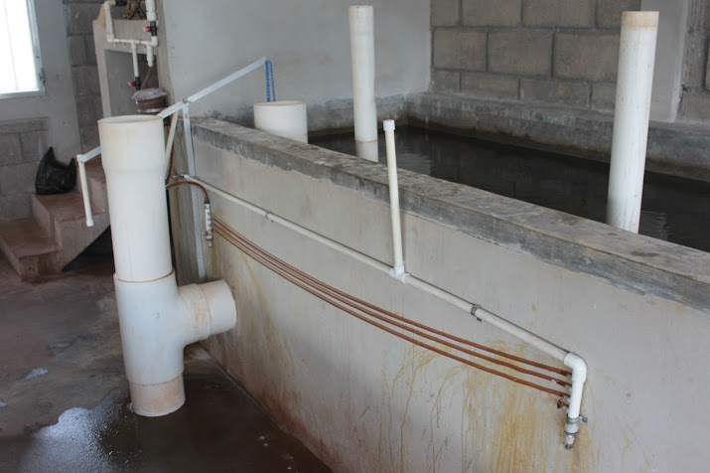

Slide 8
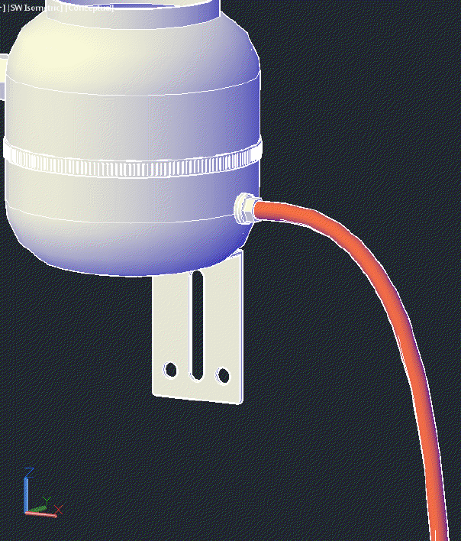
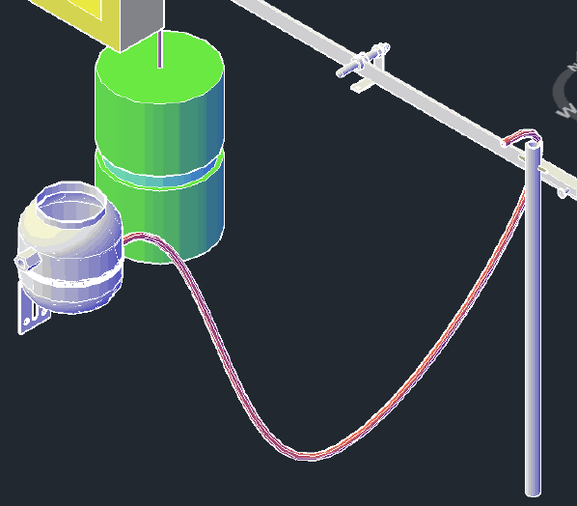
Design Tool

Slide 9
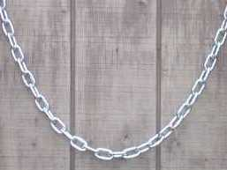
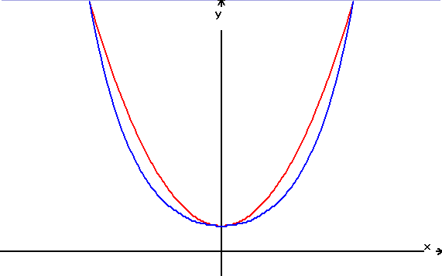
Flexible Tubing Automation
Previous Work:
Manually drawn / non-customizable
Uses spline to estimate shape based on a few parameters
Goals:
Automated with simple inputs
Uses a parabola with spline for easier automation

Slide 10
User Inputs
Inlet and outlet coordinates
Length
Inlet and outlet orientations
Inner and outer pipe diameters

Slide 11
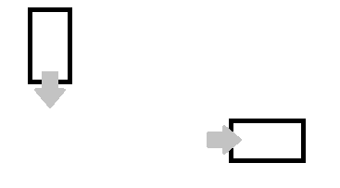


3 Cases

Slide 12
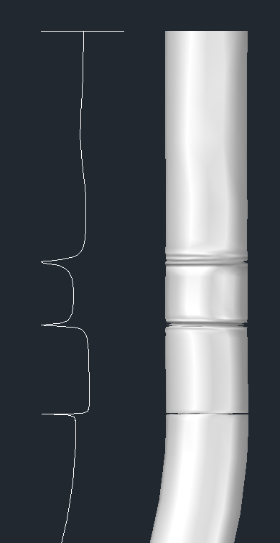
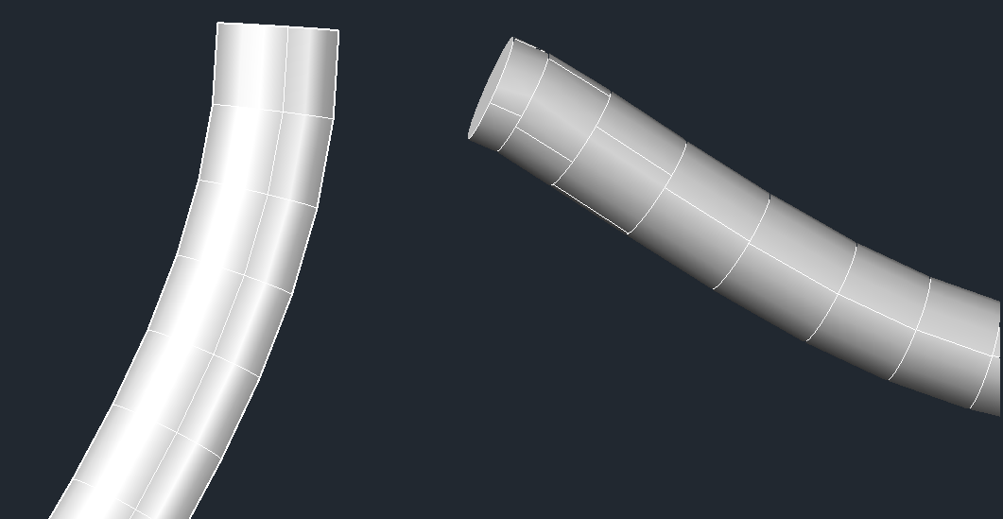
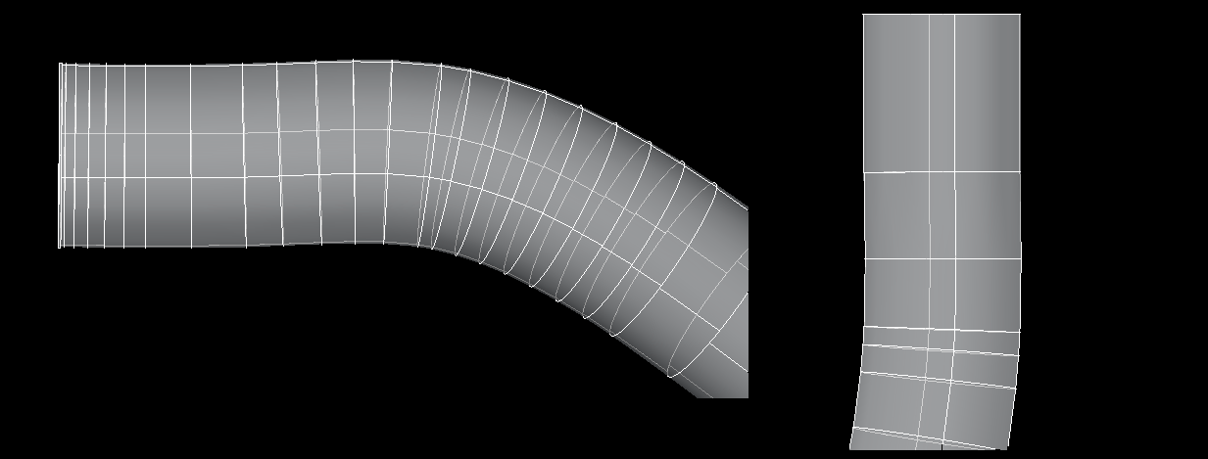
Pipe End Tangency
2
1
3

Slide 13
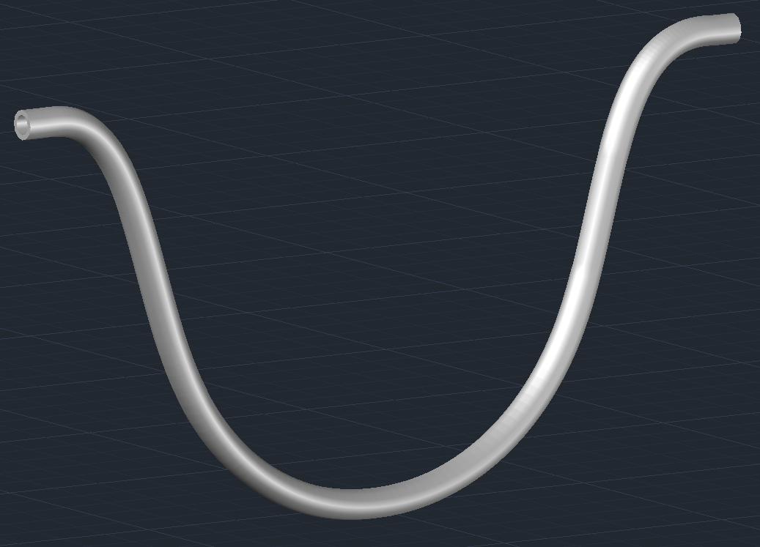
Final Output

Slide 14
Entrance Tank
Amy Boncelet Michael Walsh

Slide 15

Purpose

Slide 16
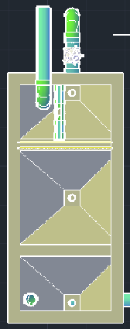
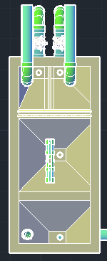
Full Layout
Original Design
New Design

Slide 17
Overview of Modifications
Two of each
  Inlet Pipes (Half original Size)
  Drains
  Flow Control Valves (Half original Size)
  Initial Hoppers (Half original Size)
Additional
  Removable Wall
  Wall Supports
Modified
  Location of Overflow Weir
  Sloping wall in Hoppers

Slide 18
Full Layout
Original Design
New Design

Slide 19
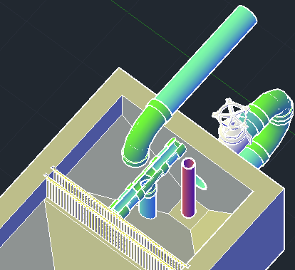
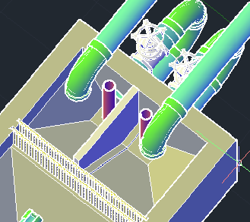
First Hopper
Original Design
New Design

Slide 20
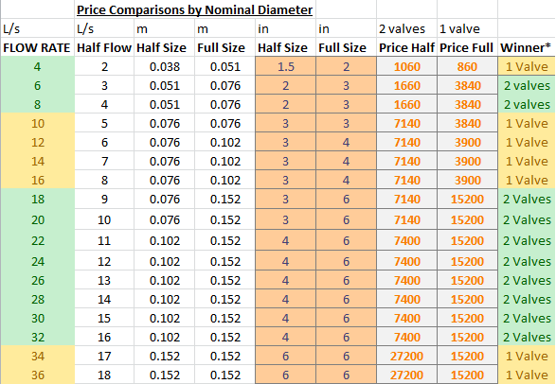
Price Comparison
Wanted to look at the feasibility of 1 flow control valve rather than 2
Shows evaluation of cost for each design through the range of flow rates

Slide 21
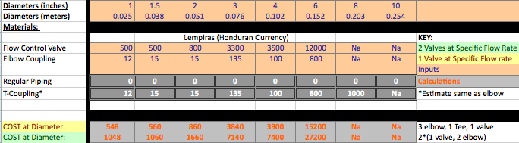
Pricing of Design by Diameter

Slide 22
Mathcad
Most of work in EntranceTankAC
  Modifies AutoCAD (AC) output file
Some work in EntranceTank, ExpertInputs
  Sets variables Thickness of Removable Wall
  Change width of entrance tank

Slide 23
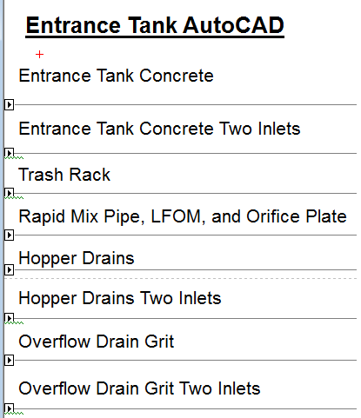
EntranceTankAC
Second section for 2 Inlets!
Each section produce
“Stack” command to
input commands to AutoCAD
“If” Clause later enables either
design

Slide 24
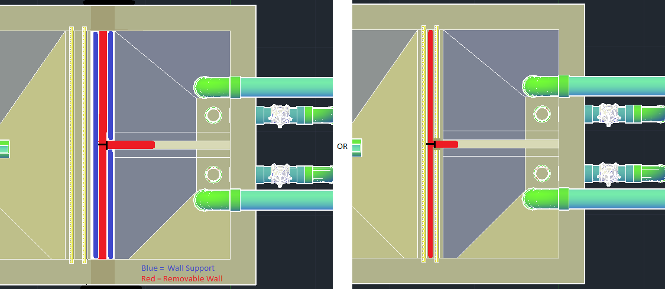
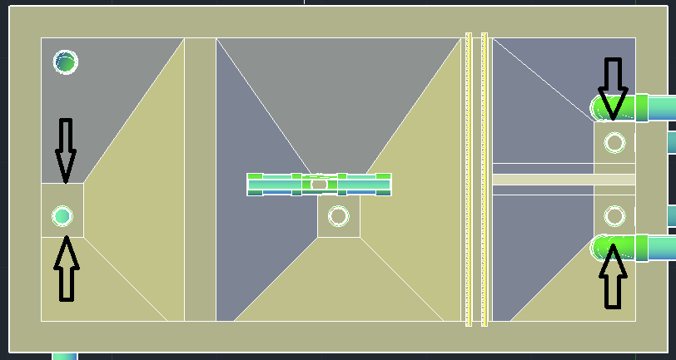
Future Work
1. Second Removable Wall
Two Designs Choices!!
In Trash Rack
In front of Trash Rack
2. Material of Wall??
3. Back Wall Modification
Wedge function
Vary for different hoppers

Slide 25
Low Flow Plant
Julia Morris

Slide 26
Intro
Current design range = 6 L/s – 70 L/s
Want to be able to serve small communities
Need new design for entrance tank, flocculator, sedimentation tank, and filter
Need new layout

Slide 27
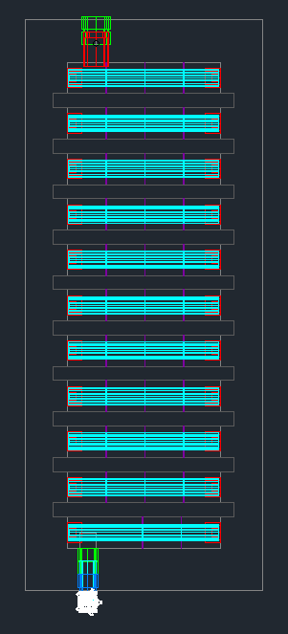
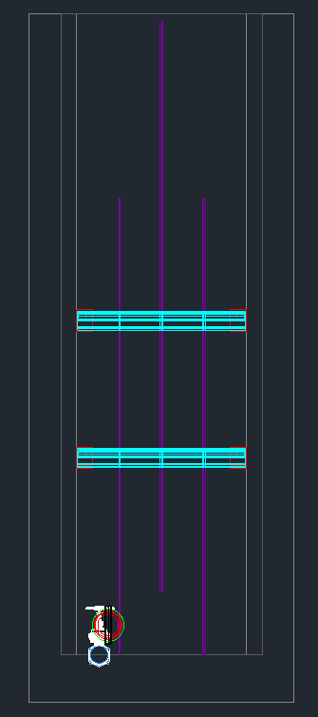
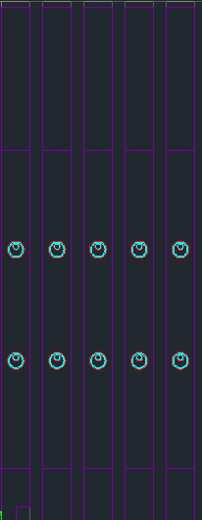
Top View
Front View
Side View
Pipe Spacer – Takes up 60% of Upflow Area
Plastic Baffle
Ferrocement Baffles
Notes:
H/S ratio is too high still…so add pipe obstacles to create more collision potential

Slide 28
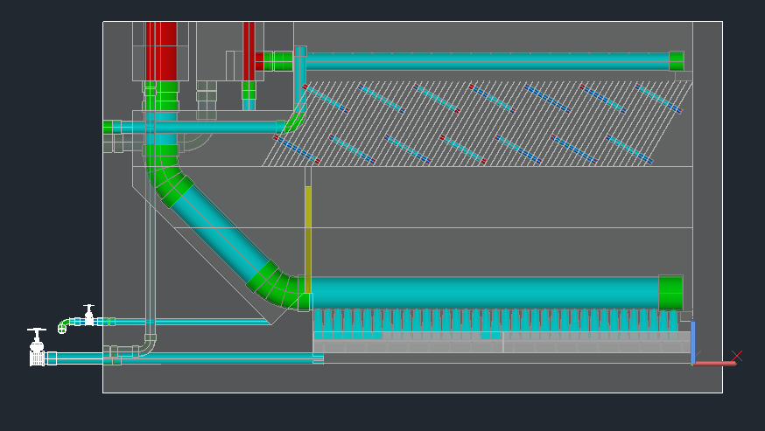
Current Sed Tank Design
Single Sed Tank
Channels are unnecessary

Slide 29
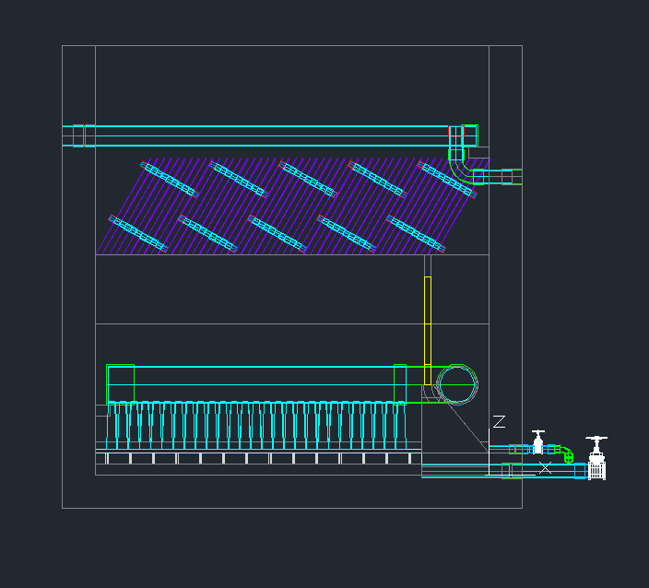
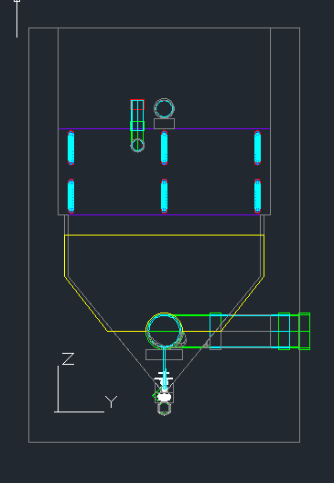
Low Flow Sed Tank
Side View
Front View

Slide 30
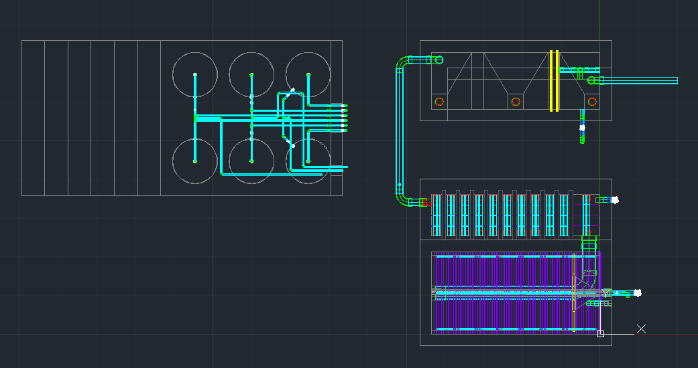
Low Flow Layout
Change in Rapid Mix Pipe Connection
L.Floc = L.Sed
Notes:
Worked on layout
Changed flocculator so that it is the same size as the sed tank

Slide 31
Entrance Tank Proposal
Trash Rack
LFOM
Ferrocement Baffle
Length needed for grit removal
Drain Pipe

Slide 32
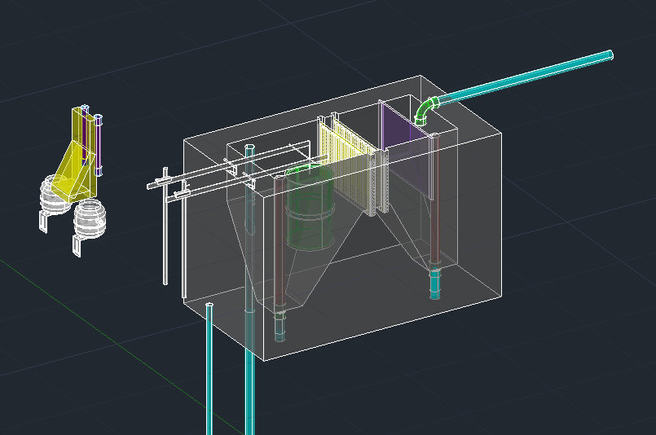
Entrance Tank
Wider Last Channel

Slide 33
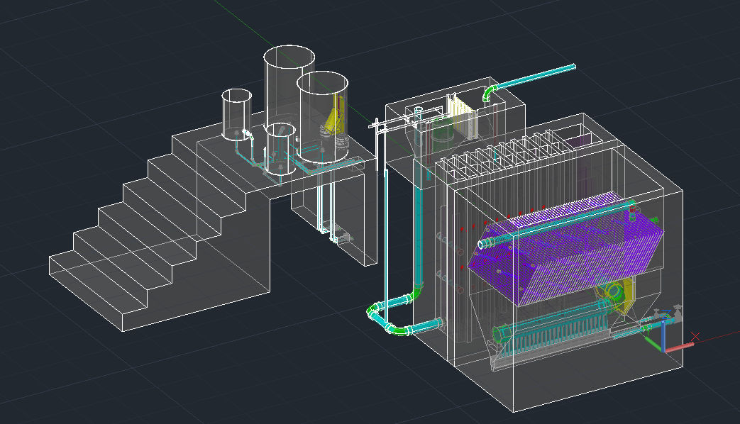

Slide 34
Future Work
Add low flow filter to the plant drawing
Finalize Plant Layout
BUILD!!!

Slide 35
Materials List
Kira Gidron

Slide 36
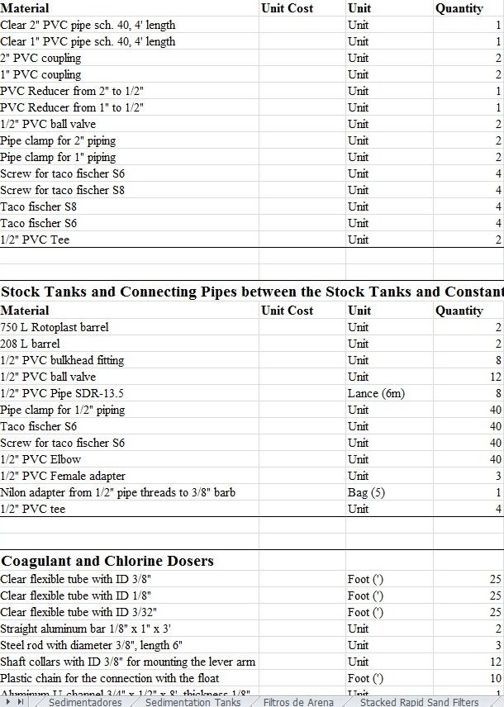
Purpose and Parts
Purpose
  Tell us the materials we need to buy
  Help us reduce costs
Parts
  Hydraulic Materials
  Structural Materials
  Prices
  Translation

Slide 37
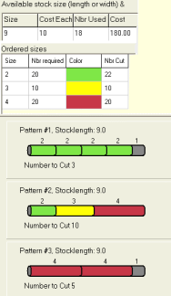
Lances Calculation
What are lances?
How many lances do we need?
Reducing waste
Cut list

Slide 38
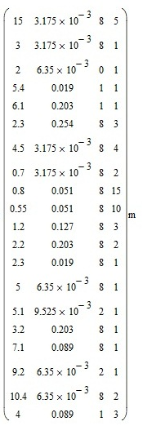

Pipe Length Matrix
4 columns
  Pipe length
  Nominal diameter
  Pipe specification
  Number of pipes

Slide 39
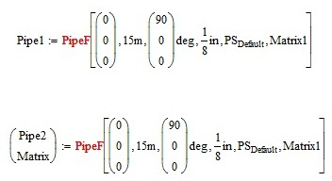
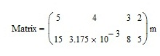
Code to Build the Matrix
PipeF: function that draws out a pipe
Add code to PipeF
Change the call to PipeF

Slide 40

Perfecting the Matrix
Get rid of pipes that are too long
Divide the matrix
  Sort the matrix by pipe specification
  Divide by pipe specification
  Divide by nominal diameter

Slide 41
Lances Calculation Code
1. ﬁnd the longest length in the array
2. calculated the unused length of the lance t
3. ﬁnd the next longest length that is under t
  (a) loop through all the lengths
  (b) ﬁnd all the lengths that are under t
  (c) ﬁnd the maximum of these lengths
4. repeat until lance is finished or no lengths are under t
5. add new lance
6. repeat until all pipes are accounted for

Slide 42

Next Steps
Implement the code that builds the matrix
Finish the lances calculation code
Output cut list
Add other hydraulic materials
Add structural materials
Add prices
Translate to Spanish

Slide 43
Section Cuts
Anthony Andrews
Annie Newcomb

Slide 44
Semester Outline
Create a function to draw section cuts through the 3D plant
  Incorporate into Automated Design Tool
  Streamline information to new implementation partners
Arrange the section cuts in the model space
Dimensions and scales
Improve drawing layout

Slide 45
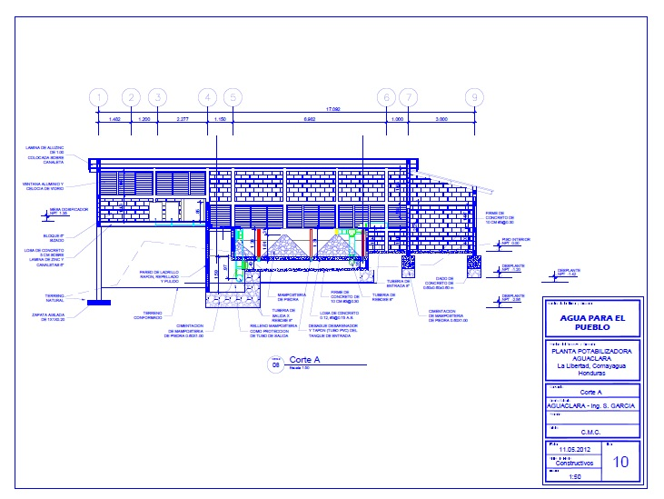
Section Plane Example

Slide 46
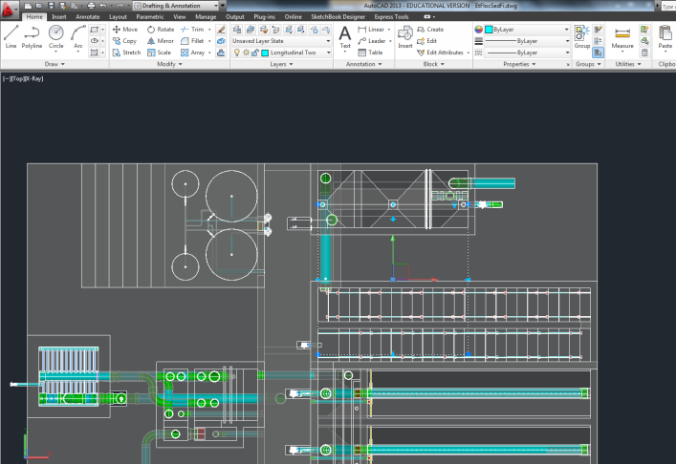
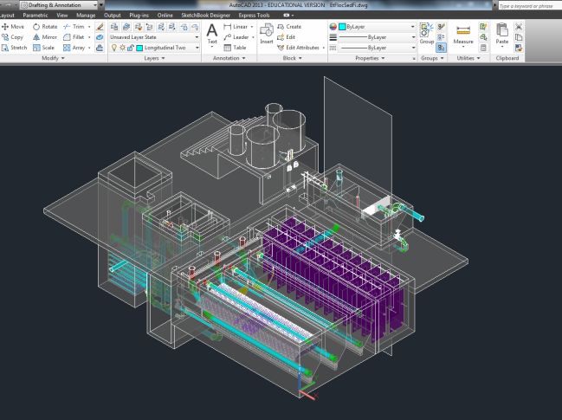
AutoCAD - Sectionplane
Section plane shown in 3D view
Section plane defined in model space

Slide 47
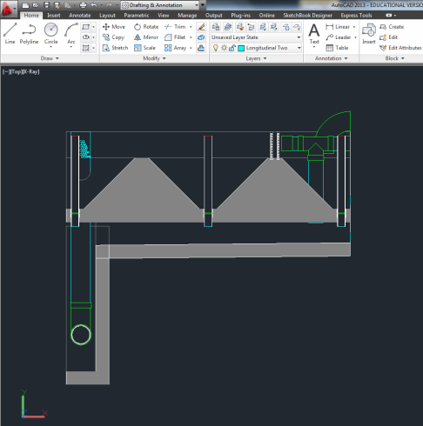
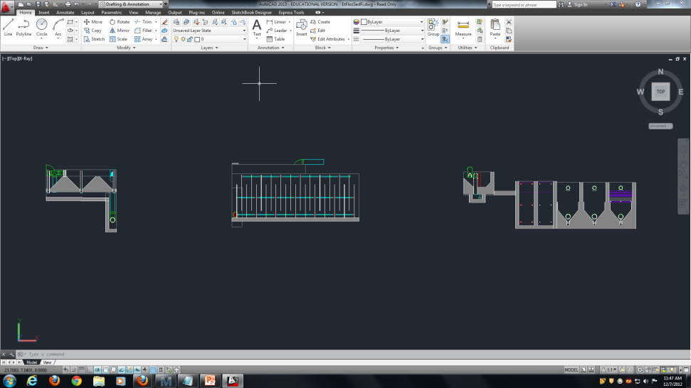
AutoCAD - Sectionplanetoblock
Section cuts arrayed in model space
Finished section cut

Slide 48
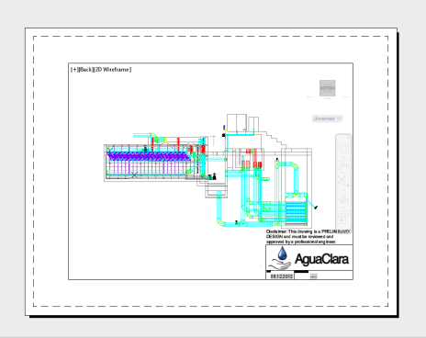
AutoCAD – View Ports
Views outside of the plant
Specified to scale
Maintains the layers from the 3D model
Back view of the plant

Slide 49
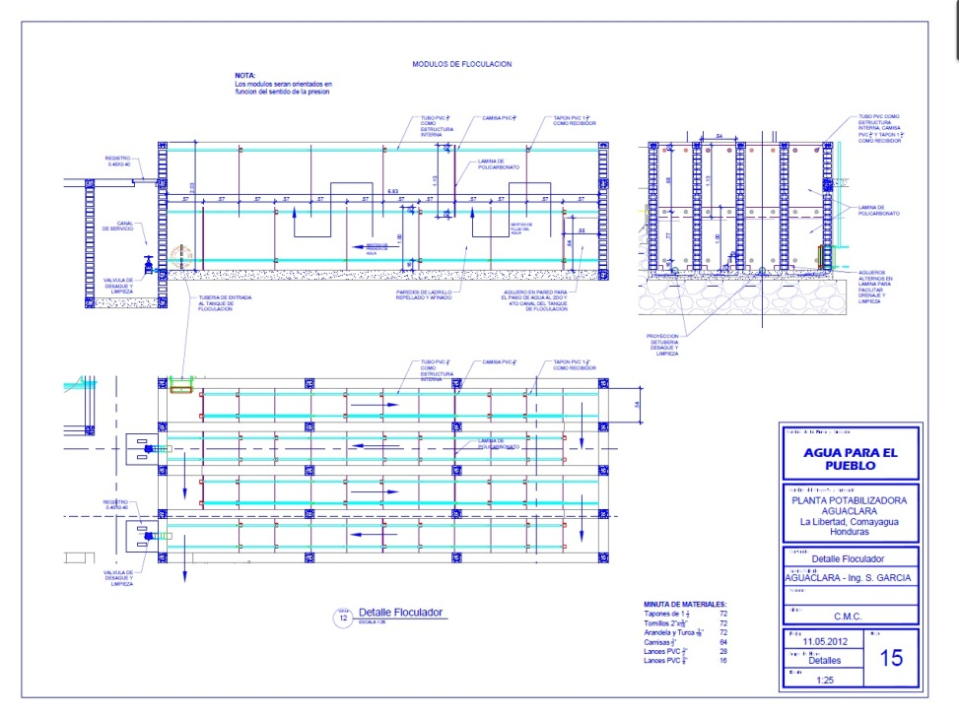
Future Work
Layout pages
Effectively communicate the SRSF design
Component details
  Modify inputs

Slide 50
Modular Designs
Heidi Rausch

Slide 51
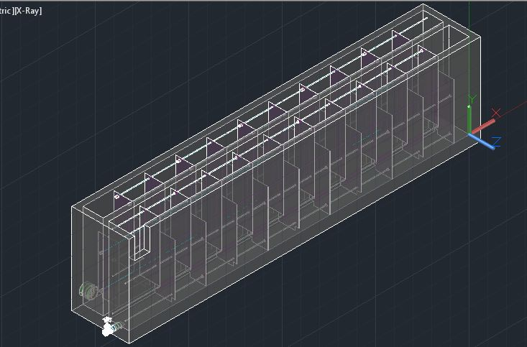
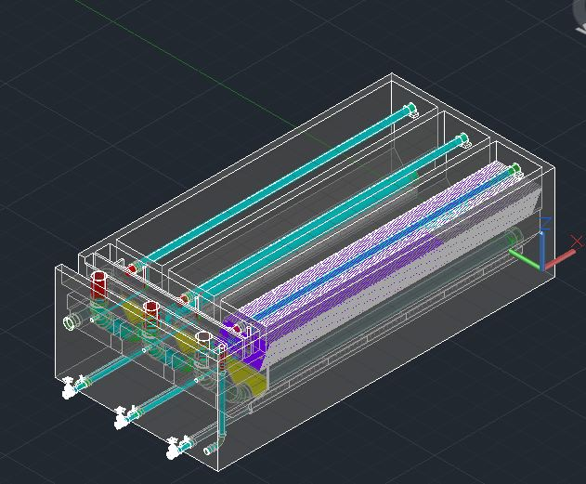
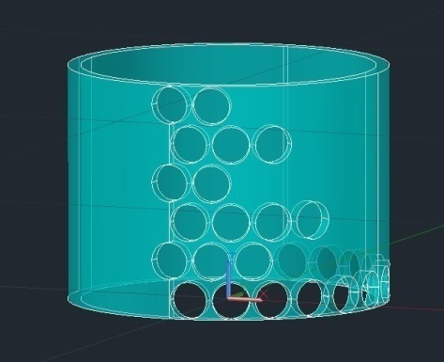
Modular Designs
Modular designs folders have been created for the LFOM, SRSF, Sed Tank, Floc tank, Entrance tank, Cdc, and for a low flow plant.
Fun New Website!

Slide 52

Questions?

