Slide 1
Tapered Manifold Design Challenge
Sarah Clement, Lauren Nielsen, Abby Sterle, Nigel Watt

Slide 2
Introduction
Untapered inlet manifolds (pipes with constant cross sectional area) experience a decrease in flow rate.
We would like uniform flow →performance of sed tanks is consistent.
Tapered inlet manifold is a possible solution for achieving optimal flow distribution.
  Decreasing area causes velocity to increase and counteract the decrease in flow due to friction.
Our project compares a new tapered design with the traditional pipe manifold.

Slide 3
The Problem
Using a series of standard pipe sizes is possible, but minor losses are prevalent and transitioning with a level base is difficult.
Our idea: Cut pipes at an angle Θ to easily create a tapered pipe
Θ
10 cm

Slide 4
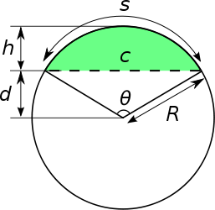
Geometry of New Tapering Design
Used to calculate the cross sectional area of the tapered manifold as a function cut angle

Slide 5
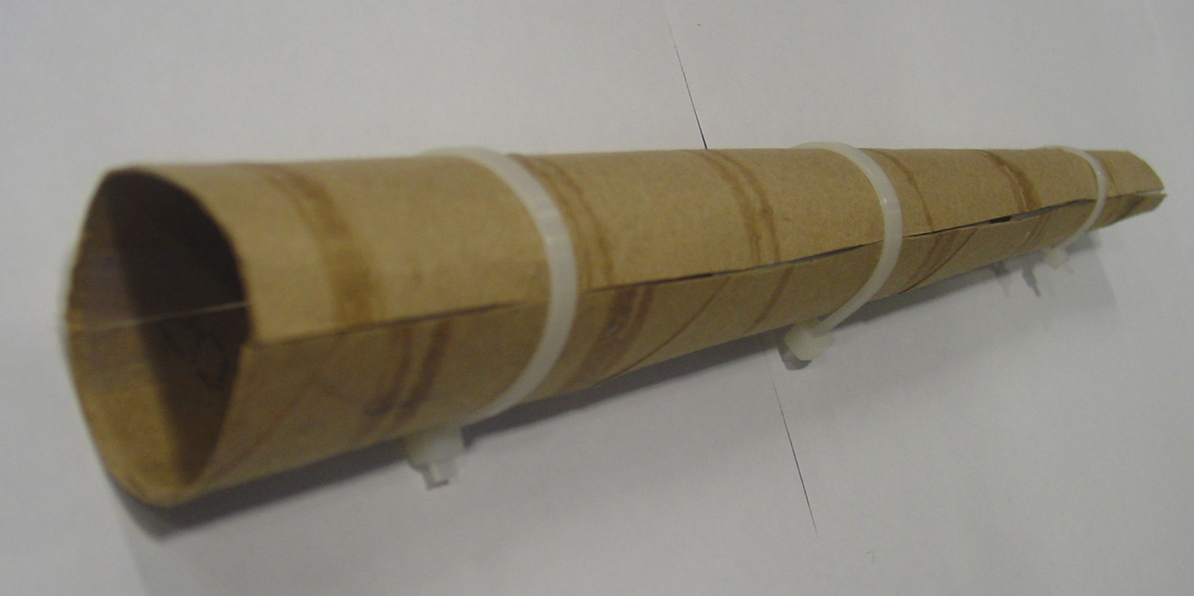
Prototype
Piece 1
Piece 2

Slide 6
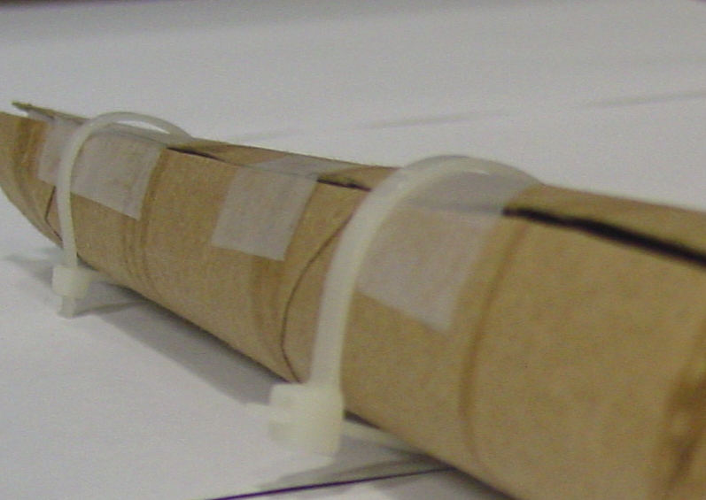
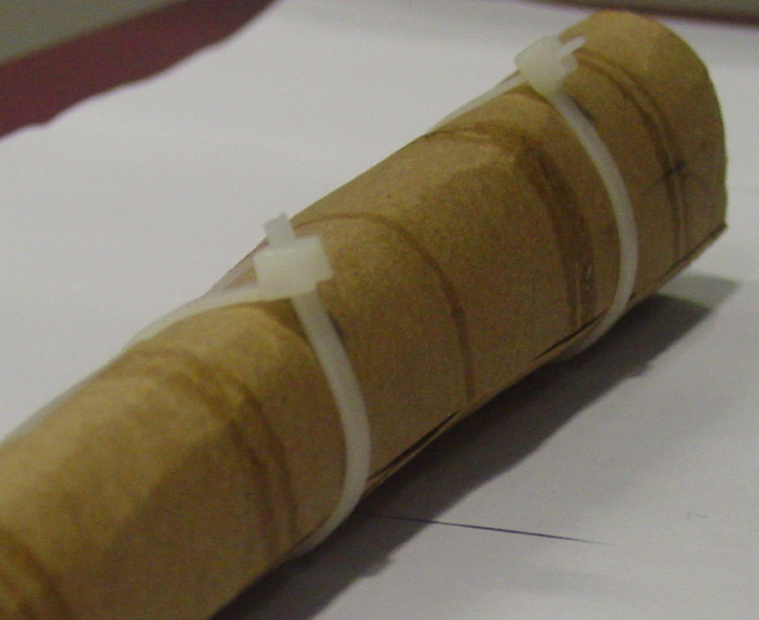
Prototype

Slide 7
Graphs used to Help Evaluate Designs
Flow rate in inlet manifold as a function of distance along the length of the manifold.
  Log scale to differentiate between lines
Velocity in the manifold as a function of distance.
  Also log scale
Energy dissipation through the ports
Flow through manifold with one diameter but varied slice angle.

Slide 8
Graphs used to Help Evaluate Designs
Flow rate in inlet manifold as a function of distance along the length of the manifold.
  Log scale to differentiate between lines
Velocity in the manifold as a function of distance.
  Also log scale
Energy dissipation through the ports
Flow through manifold with one diameter but varied slice angle.

Slide 9
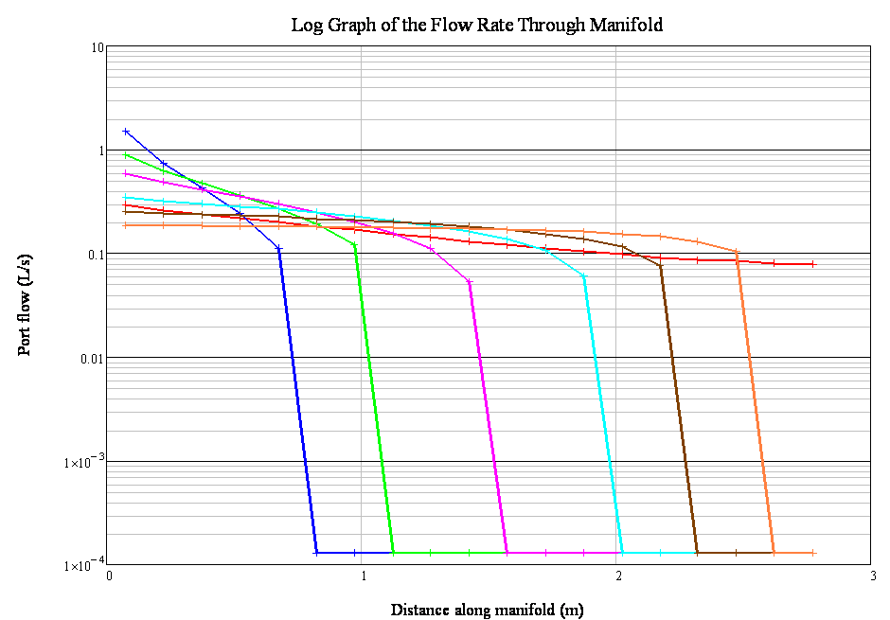
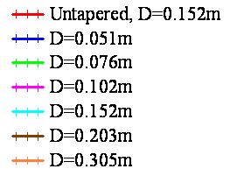
Log scale graphs of flow through ports as a function of distance along manifold for standard pipe sizes
D = Diameter of original pipe
The Untapered pipe in calculations is about average D among available pipe sizes
Notes:
Make sure the legend is clear that the diameter is the original ones of the standard pipe sizes

Slide 10
Comparison
These are two lines from the previous graph that directly compare the effect of tapering for D = 0.305

Slide 11
Graphs used to Help Evaluate Designs
Flow rate in inlet manifold as a function of distance along the length of the manifold.
  Log scale to differentiate between lines
Velocity in the manifold as a function of distance.
  Also log scale
Energy dissipation through the ports
Flow through manifold with one diameter but varied slice angle.

Slide 12
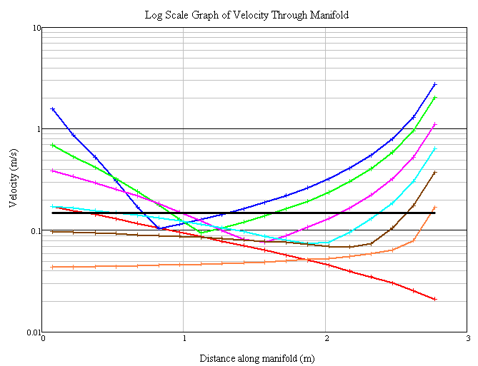
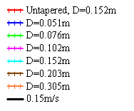
Log scale plot of velocity through manifold as a function of distance along the manifold.
Comparison with the Ten-State Standard Scour velocity
All scenarios fail to reach the scour velocity at every point along the manifold
Minimum Scour Velocity

Slide 13
Graphs used to Help Evaluate Designs
Flow rate in inlet manifold as a function of distance along the length of the manifold.
  Log scale to differentiate between lines
Velocity in the manifold as a function of distance.
  Also log scale
Energy dissipation through the ports
Flow through manifold with one diameter but varied slice angle.

Slide 14
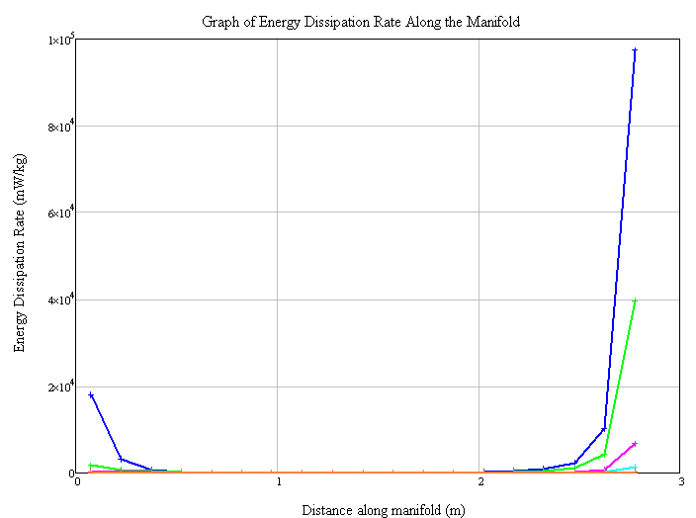
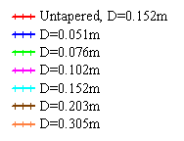
Energy Dissipation Rate through ports along the manifold

Slide 15
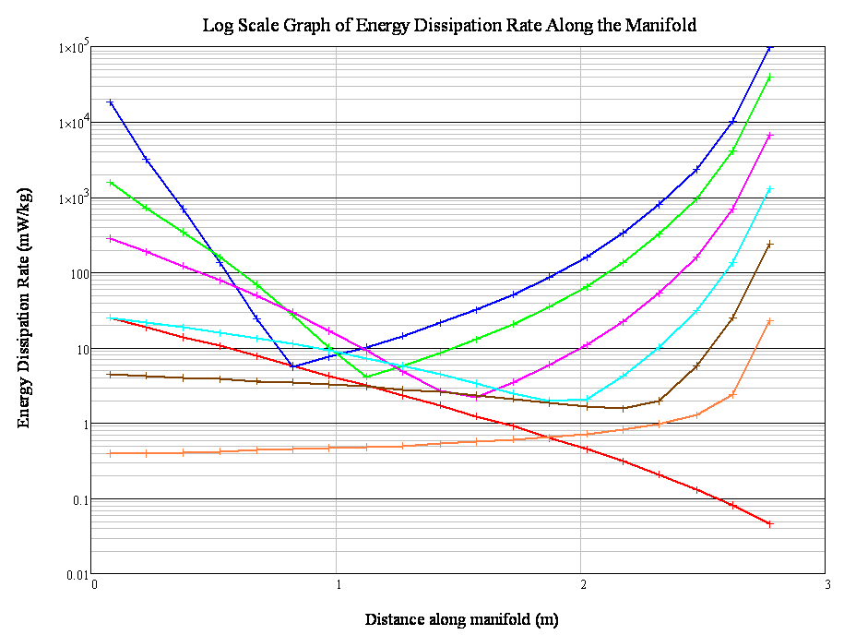
Energy Dissipation Rate through ports along the manifold
Same shape as velocity at points along manifold

Slide 16
Graphs used to Help Evaluate Designs
Flow rate in inlet manifold as a function of distance along the length of the manifold.
  Log scale to differentiate between lines
Velocity in the manifold as a function of distance.
  Also log scale
Energy dissipation through the ports
Flow through manifold with one diameter but varied slice angle.

Slide 17
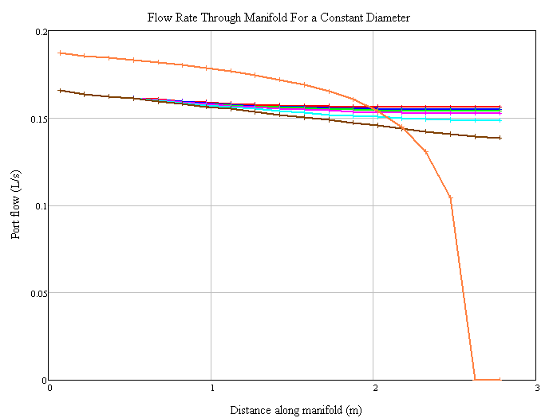
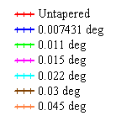
Port flow based on Slice Angle (degree of tapering)
Again demonstrates that tapering does not result in uniform flow

Slide 18
Advantages
Fairly easy to build
  Can use standard pipe size
  Need careful measurements so that pieces will fit together
Build a jig to easily reproduce
No transitions
Only two pieces to fit together for each pipe
Fairly circular flow profile
Area tapers linearly
Notes:
This was determined by graphing Hydraulic radius, area, etc.
The geometry is complicated but the area of the inlet manifold does indeed taper linearly

Slide 19
Disadvantages
Doesn’t work
Very limited possible angles
Tapering is low especially at small pipe sizes

Slide 20
Flow characteristics
Design fails for small pipe sizes
  All flow comes out of first few ports
  Velocities and energy dissipation rates are very high
Better results for larger pipe sizes
  Flow is more even out of ports
  However, velocity in pipe is below 0.15 m/s, so flocs will settle out before entering the tank

Slide 21
Recommendation
We were not able to find a workable set of parameters for this geometry
Either flow is too uneven or the velocity is too low within the pipes
For a given pipe size, an untapered manifold produced more even flow than this design

Slide 22
Possible improvements
Use this geometry with a series of different pipe sizes
  Introduces transitions
  May not be substantively different from unaltered pipes
Separate pieces by some small distance so water flow out the sides (as two slots) instead of out of ports
  More complicated than orifice flow
  Again, may not be substantively different than an unaltered pipe with a slot cut in it
Determine what exactly happens when our equations break down – can it be avoided?

Slide 23
I have not failed, I have just found 10,000 ways that won’t work.
-Thomas Edison

