Slide 1
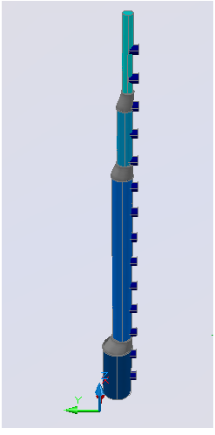
Step-Tapered Inlet Manifolds
Chris DeFeo
Akta Patel
Patrick Farnham
David Chang
Team CAP’D

Slide 2
Importance of Properly Designed Manifold
Flocs settle out if scour velocity is not maintained
  Especially important if using pipe manifold
Need equal flow distribution
  Floc blanket
  Equal loading on plate settlers
Notes:
akta

Slide 3
Simple Manifold Design
Untapered inlet pipe
15.24 cm (6 in) diameter
Uniform port size

Slide 4
Problems with Untapered Manifold
VManifold < Vscour
→ Floc breakup, settling within manifold
Notes:
akta

Slide 5
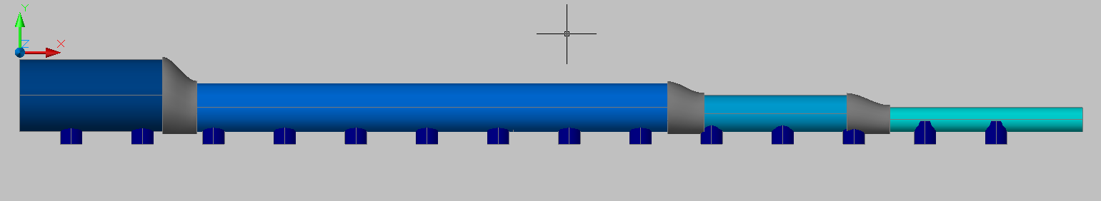
Step-Tapered Manifold Design Goals
Attempt to achieve uniform port flow while also minimizing energy dissipation rate
Keep manifold velocity greater than scour velocity
Notes:
akta

Slide 6
Step-Tapered Manifold Design
Agalteca design constants
  Plant flow rate, sedimentation tank length
Use eccentric reducers
  Keep ports eqidistant from sed tank bottom
  Maintain sludge scouring on sed tank bottom
Added pressure recovery
to piezometric head
Entrance region losses?
Notes:
dave

Slide 7
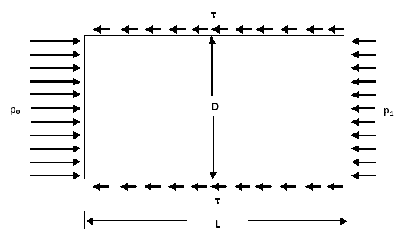
Force Balance
For a fully-developed flow condition
Notes:
dave

Slide 8
Laminar and Turbulent Conditions
Laminar Equation:
Turbulent Equation:
Notes:
Looked up for flat plate
Patrick

Slide 9
Shear vs. distance
Notes:
Shear always less than predicted by fully dev. – we used DW equation- conservation energy dissipation…less than prediction.
patrick

Slide 10
Manifold Velocity
Notes:
Added major loss and pressure recovery term.
Designed manifold so that manifold velocity is above scour velocity.
Patrick?

Slide 11
Varying port spacing
Notes:
Length of manifold given by dimension of sed tank. Ports constant diameter. Pipe diameter determined by given sizes.
How energy dissipation varied with different spacing and total port area.
Bigger port spacing….lower energy dis. But worse flow distribution…but sucks anyway
akta

Slide 12
Varying total port area
Notes:
Bigger ports- worse flow, lower energy dissipation
akta

Slide 13
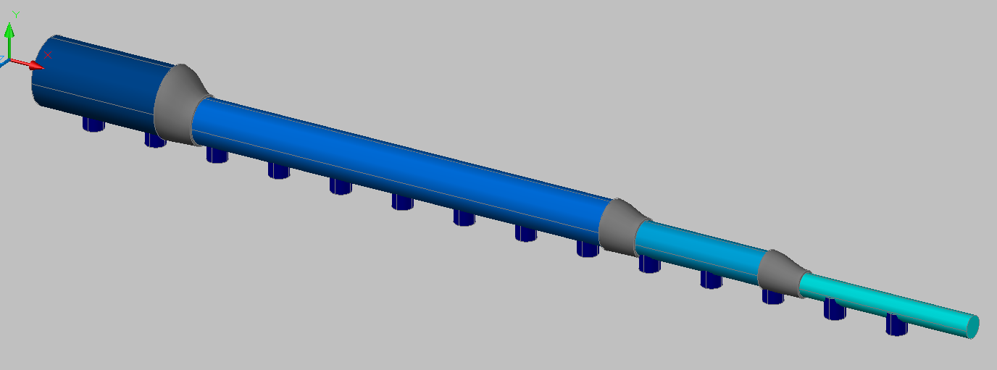
Final Design
14 ports with 15 cm spacing
Total port area of 320 cm² (0.202 m diameter ports)
Pipe Diameter |  | Pipe Length
(cm) | (in) | (m)
15.25 | 6 | 0.30
10.16 | 4 | 1
7.62 | 3 | 0.30
5.08 | 2 | 0.30
Notes:
Chris

Slide 14
Energy Dissipation Rate
Notes:
With b= 15cm and port area of 3202
chris

Slide 15
Port Flow Rate
Notes:
chris

Slide 16
Problems
Port flow not uniform
Energy dissipation higher than AguaClara recommended maximum energy dissipation rate of 6 mW/kg
Ports large compared to smallest pipe size (1.8 in. diameter port compared 2 in. pipe diameter)
Notes:
patrick

Slide 17
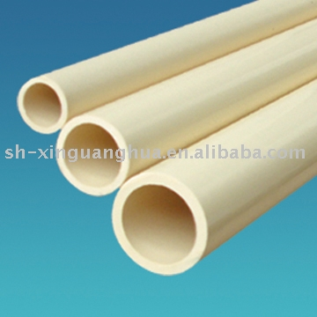
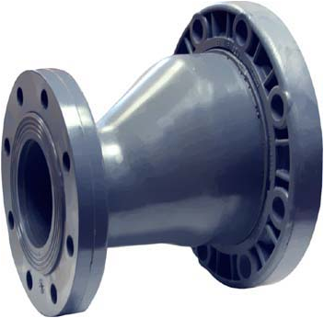
Tapered Manifold Cost Analysis
Pipe Diameter` |  | Price (USD/m) | Pipe Length (m) | Cost (USD)
(cm) | (in)
15.25 | 6 | 22.61 | 0.30 | 6.8
10.16 | 4 | 12.86 | 1 | 12.9
7.62 | 3 | 8.99 | 0.30 | 2.7
5.08 | 2 | 4.43 | 0.30 | 1.3
 |  |  | TOTAL | 23.7
Eccentric Reducer Size |  | Price (USD)
cm x cm | in x in
15.25 x 10.16 | 6 x 4 | 35.5 |  | 35.49
10.16 x 7.62 | 4 x 3 | 30.5 |  | 30.49
7.62 x 5.08 | 3 x 2 | 25.5 |  | 25.49
 |  |  | TOTAL | 91.47
 |  | PIPE + REDUCER | TOTAL | 115
2 Sedimentation Tanks |  |  |  | x 2
 |  |  | TOTAL COST | $230
Notes:
chris

Slide 18
What we learned and future explorations
Manifolds are tricky!
Continuously taper
Changing design constraints
  Maintaining scour velocity
More thorough analysis of losses within manifold
Notes:
Dave

Slide 19


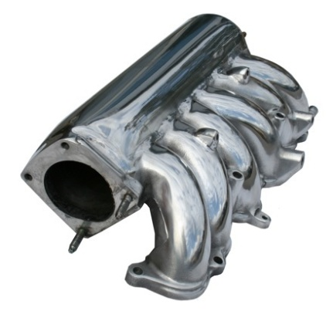
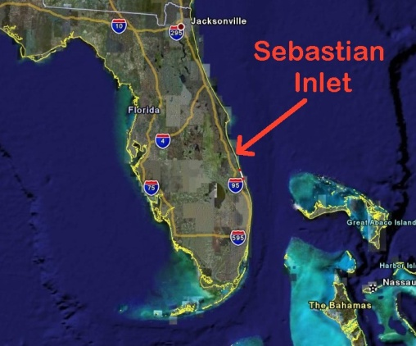
Questions?
Step
“Tapir”ed
Inlet
Manifold

Slide 20
References

