Slide 1

Foam Filtration
Jenny Guan
Monica Kuroki
Lishan Zhu

Slide 2
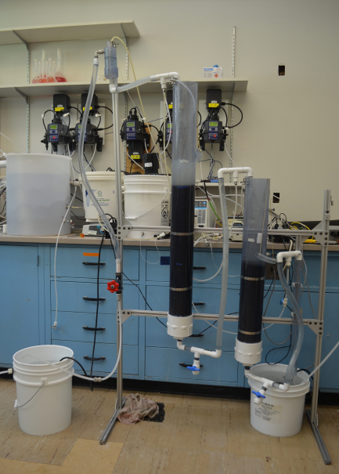
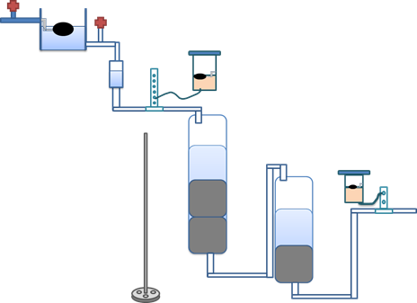
Introduction
introduction
Filter water using polyurethane foam
Designed for small communities or schools
Notes:
Had the idea of using for emergency situations, i.e. Earthquake in Haiti. But that idea was scrapped. Pretty effective, can get turbidity down to 0.1 NTU

Slide 3
PVC pipes
Two segments of 4 in Schedule 40 PVC:
Roughing filter
height 56 in (142.25 cm)
Finishing filter
height 31 in (78.75 cm)
Connected via 0.5 in schedule 40 PVC pipe

Slide 4
foam filters
Filtration system consists of:
2 roughing filters (30 ppi)
1 refining filter (90 ppi)
Cylindrical with measurements:
height: 14.75 in (37.5 cm)
diameter: 4 in (10.16 cm)
Hole drilled horizontally across filters:
diameter 0.5 in (1.27 cm)
plastic tubing inserted for reinforcement
string inserted for cleaning and measuring purposes

Slide 5
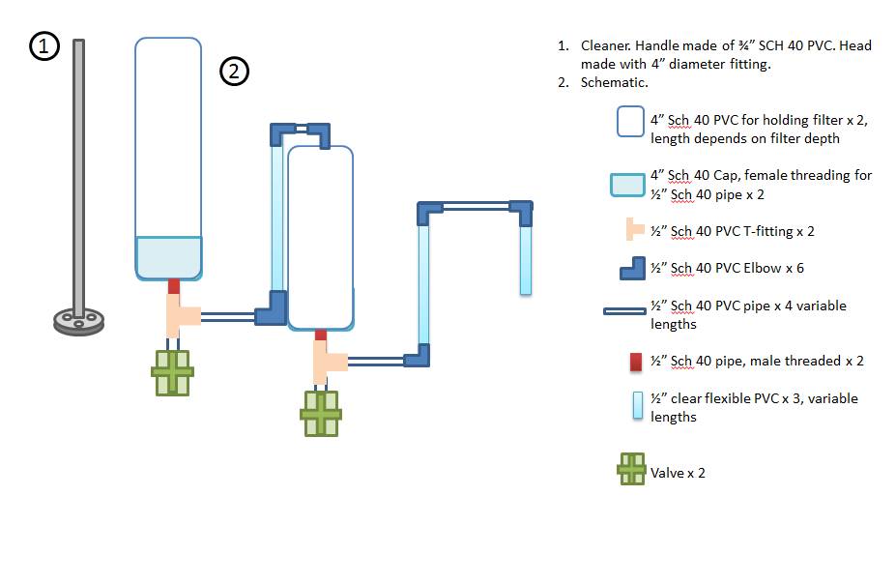
Schematic

Slide 6
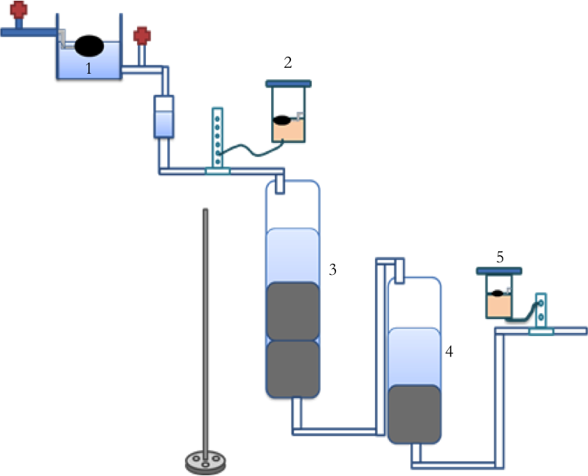
Method
Method
Water enters LFOM
Goes through Roughing Filter
Dosed with coagulant
Then Finishing Filter
Dosed with Cl

Slide 7
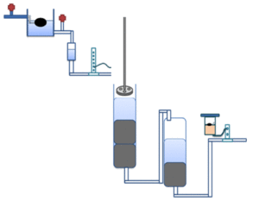

Cleaning
cleaning
When foam gets dirty, clean with plunger
Pull filter back up when done.
  Just like squeezing gunk from dirty sponge

Slide 8
Progress
Ordered piping from McMaster Carr
Cut into two segments for each filtration step
Cut available foam into 4 in diameter cylinders
Designed a method to pull the foam up to a suitable height without the use of clear PVC
In the progress of designing a new LFOM
Drawn up an idea of a wooden stand
Notes:
I figure we can explain this more in detail during the actual presentation.
Past groups have found that 4 inch diameter provided the best efficiency and life, which is why we go with 4 inches.
Need to make a new LFOM because old LFOM is glued to the holder. If you try to take it out, it will pretty much destroy it (the LFOM). *can show people the old LFOM we have).
Why wood? Because it’s readily available in Honduras.

Slide 9
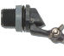
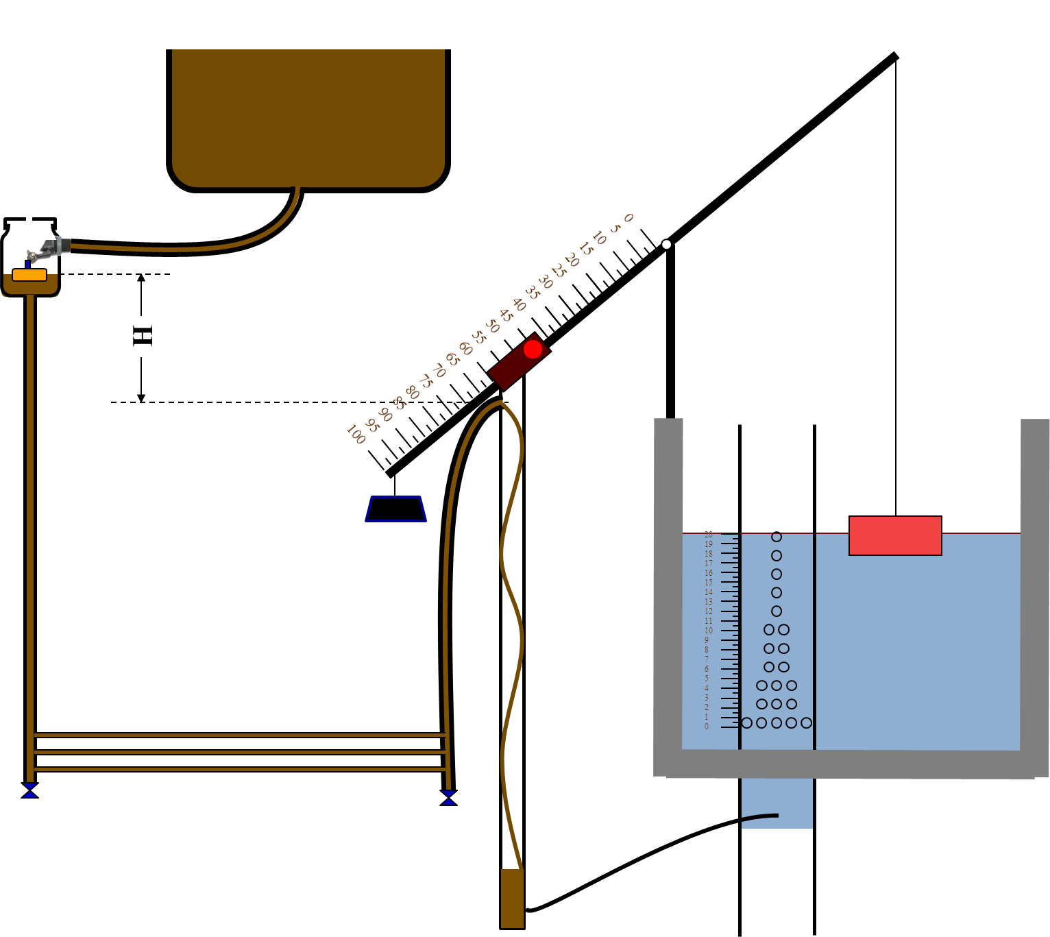
Semester Goals
goals
Next Step:
Design and construct LFOM
Construct wooden stand
Semester Goals:
Rebuild the system with items available in Honduras
Design chemical dosing system
Make new system more compact and operator friendly
Keep track of materials and tasks in order to compile fabrication guide
Notes:
-Clear PVC is not available in Honduras, plus it’s more expensive.
- Design a level-arm chemical dosing system. Dosing changes with the flow, better than changing it manually. The previous chemical dose controller is considered “almost linear”

Slide 10
Questions?

