Slide 1

Foam Filtration
Kristin Chu
Skyler Erickson
Melissa Shinbein
Jeffrey Suen
Kadambari Suri

Slide 2
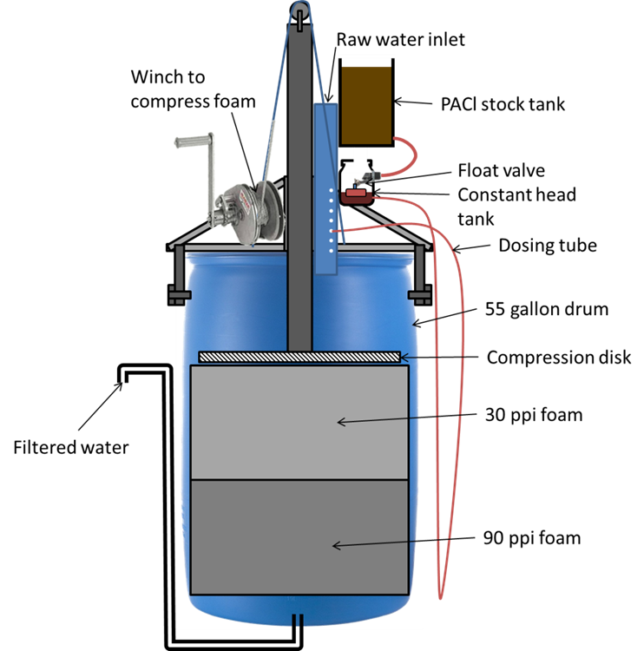
Last Semester

Slide 3
Problems → Solutions
Over-designed
Slow compression& drainage
New Materials
Side Valve
Pulley System
Turbidity Test
Notes:
Perhaps “Complicated fabrication or setup” would be more accurate than “overdesigned”

Slide 4
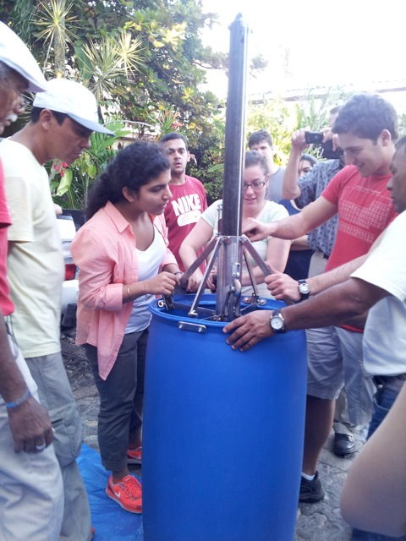
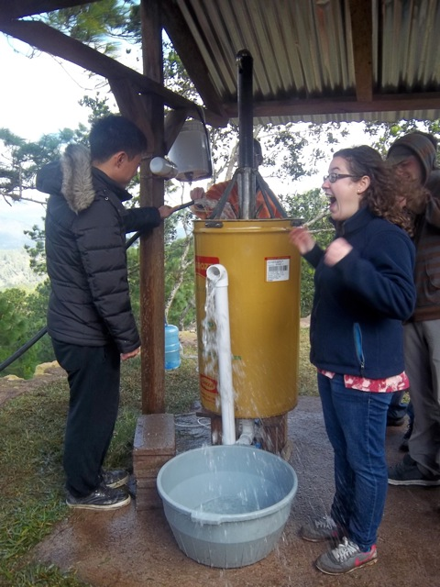
Problem: Overdesigned

Slide 5
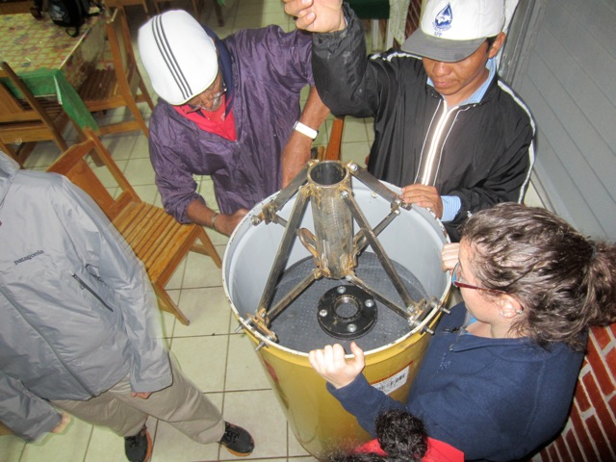
Solution: New Materials
Notes:
Melissa: plunger
SKYLER/JEFF

Slide 6
Problem: Siphon
Slow
Hard to prime
Not user friendly
Dirty Water
30 PPI
90 PPI
Waste Bucket

Slide 7
Solution: Side Valve
Spin Welding
Apparatus= constricted to the wall of the drum
Pipes can be attached.
Water-tight seal
Hole in a bucket calculations for varying flow rates
Meeting to discuss derivation (approx 2in diameter)
Notes:
Do we have any numbers for the side valve that could be compared against the siphon?

Slide 8
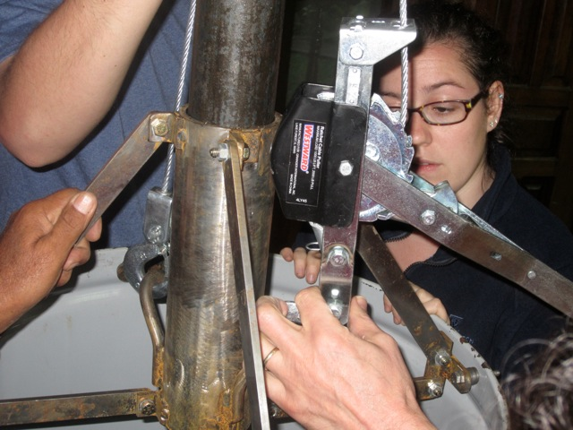
Problem: Winch
Too slow, not efficient
Extremely hard to use
Notes:
Skyler
Do we have any more details describing how hard it was too use?

Slide 9
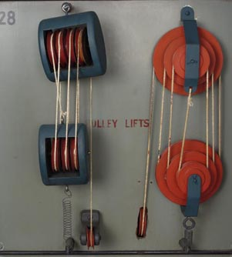
Solution: Pulleys
Force multiplier
Adjustable mechanical advantage
Potential to compress quickly with foot power or body weight
Image Source: http://kmoddl.library.cornell.edu/model.php?m=460

Slide 10
Simple Pulley Design
One continuous rope flowing between the travelling and fixed pulleys.
Tension is equal in all parts of the rope.
Each pulley increases the ideal MA by 1.
Compression distance (18.67”)
Support system height (12”)
Drum height (36.75”)
10:1 Mechanical Advantage
10:1 Mechanical Advantage
Total foam height (28”)
Drum diameter (23”)

Slide 11
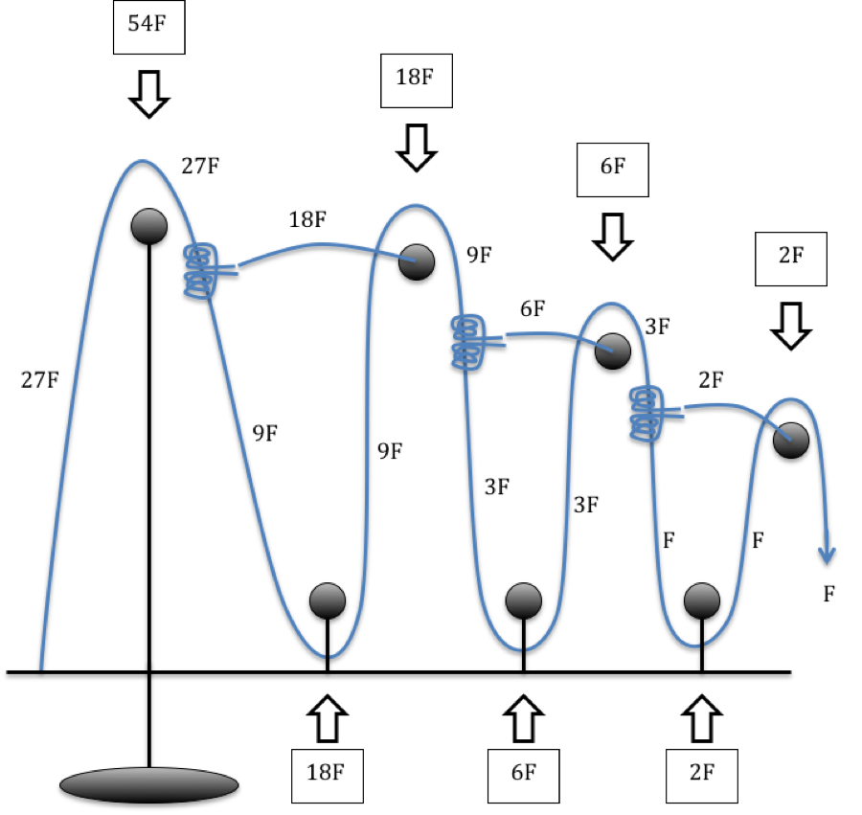
Compound Pulley Design
Defined by one simple pulley system pulling on another simple pulley system.
The tension in the rope is not equal at all parts.

Slide 12
Compound Pulley Design
The MA per pulley is an exponential relationship.
The The MA of the simple pulley systems are multiplied together to find the total MA of the compound pulley system.

Slide 13
Simple vs. Compound
10:1 Mechanical Advantage
9 Pulleys
54:1 Mechanical Advantage
7 Pulleys

Slide 14
Compression Velocity Testing
Hypothesis #1
Higher compression velocities will result in cleaner foam, and thus higher NTU in the wash water sample.
Hypothesis #2
If Hypothesis #1 is true, the relationship between the velocity and the fraction of particles remaining in the foam remains constant regardless of the % particle loaded in the foam during filtration.

Slide 15
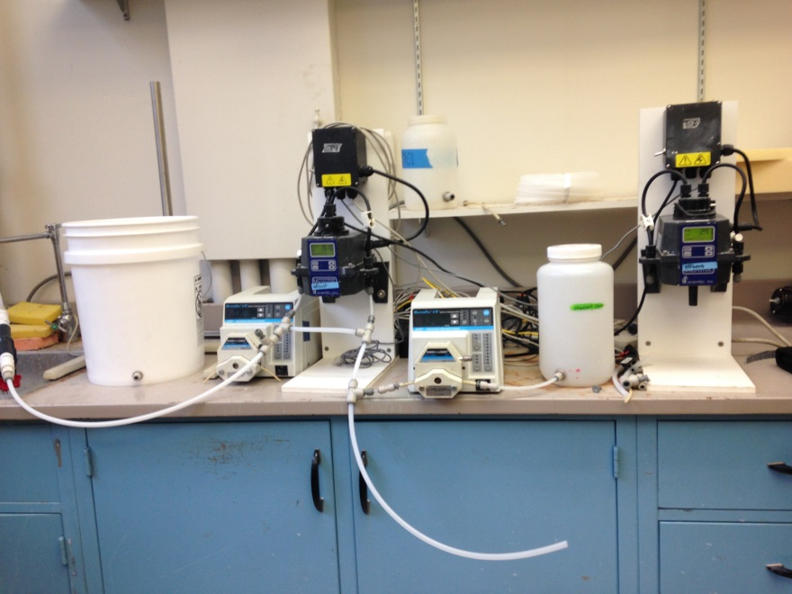
Compression Velocity Testing
So Far:
  Set up apparatus
  Learned Process Controller
Still Need:
  Cut foam to fit 4-in diameter column
  Conduct tests

Slide 16
Moving Forward
Continue brainstorming different materials, techniques
Test current solutions, materials to determine which are viable options
Designing dose controller, LFOM
Semester Goal:
To design and build a fully functioning foam filter.

Slide 17
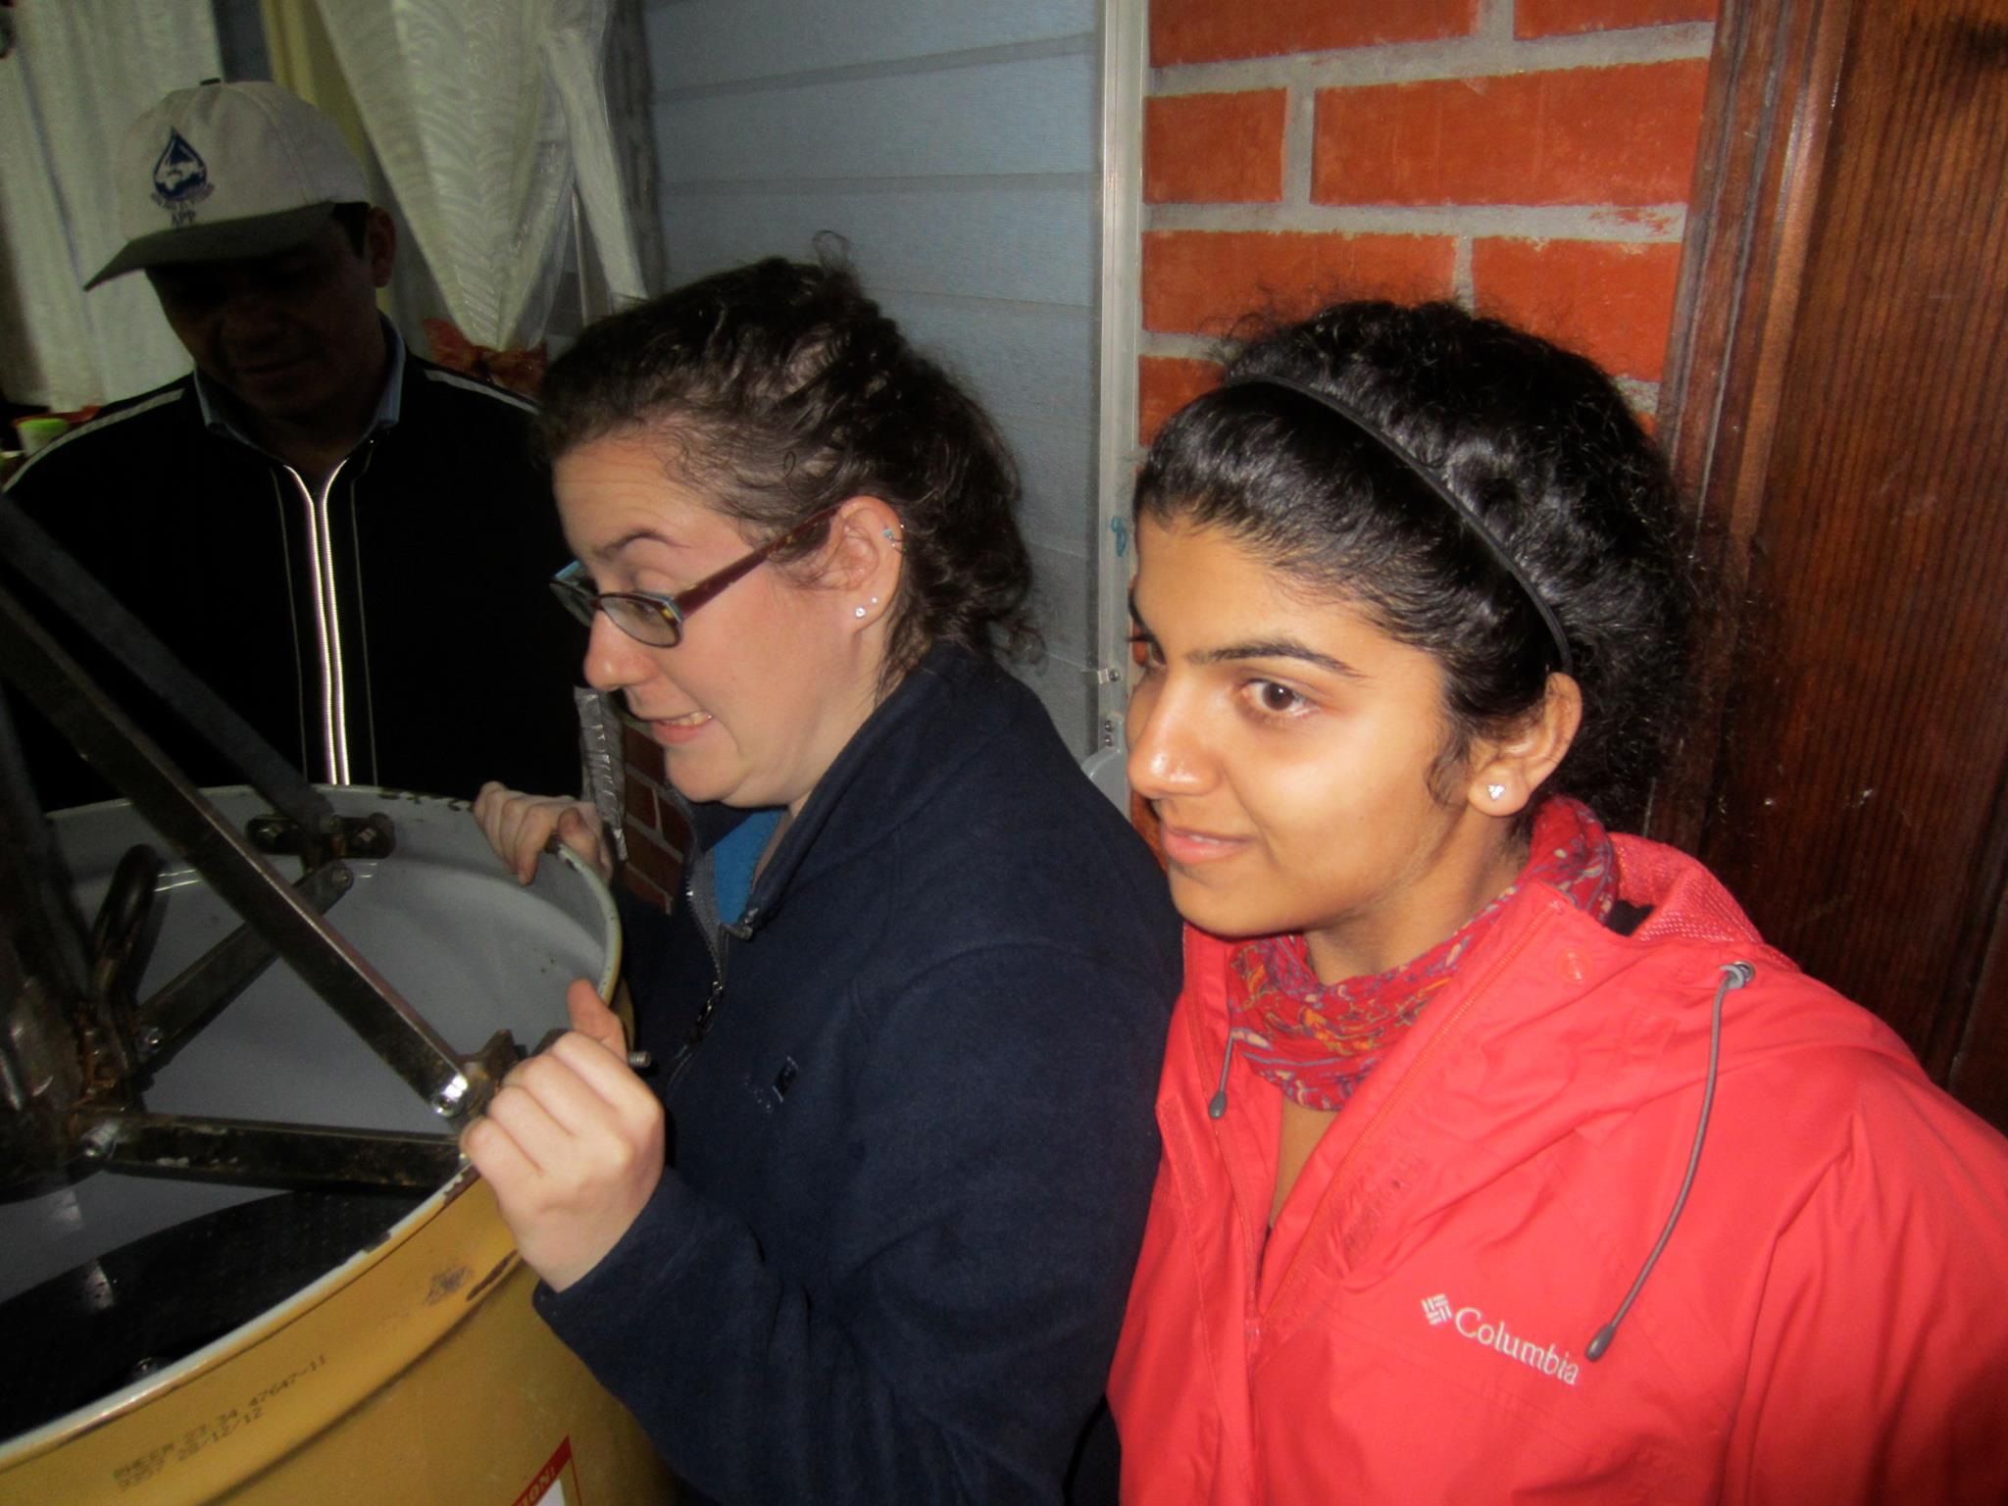
Questions?

