Slide 1
Foam Filtration
Alena Hutchinson
Marlana Hinkley
Ethan Keller
Alicia Peters
Notes:
Ali

Slide 2
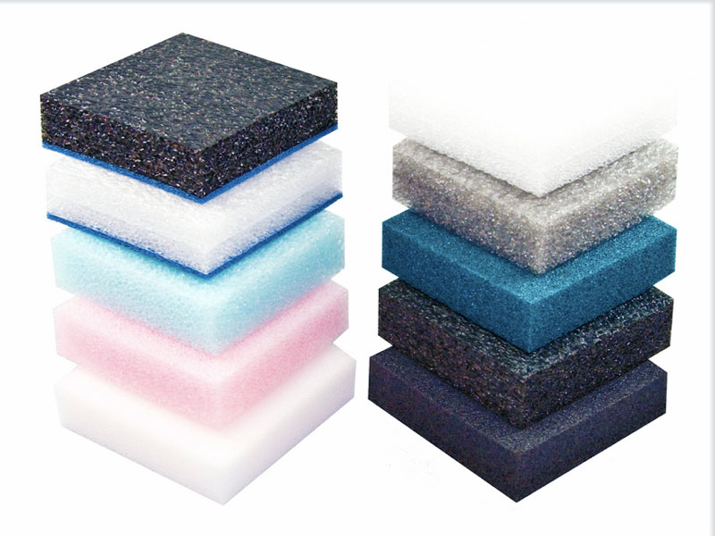
Why Foam?
Less water wasted
Less space needed
Less expensive
This would be most
beneficial for:
Smaller sized villages
Emergency situations
Temporary situations
Notes:
Ali

Slide 3
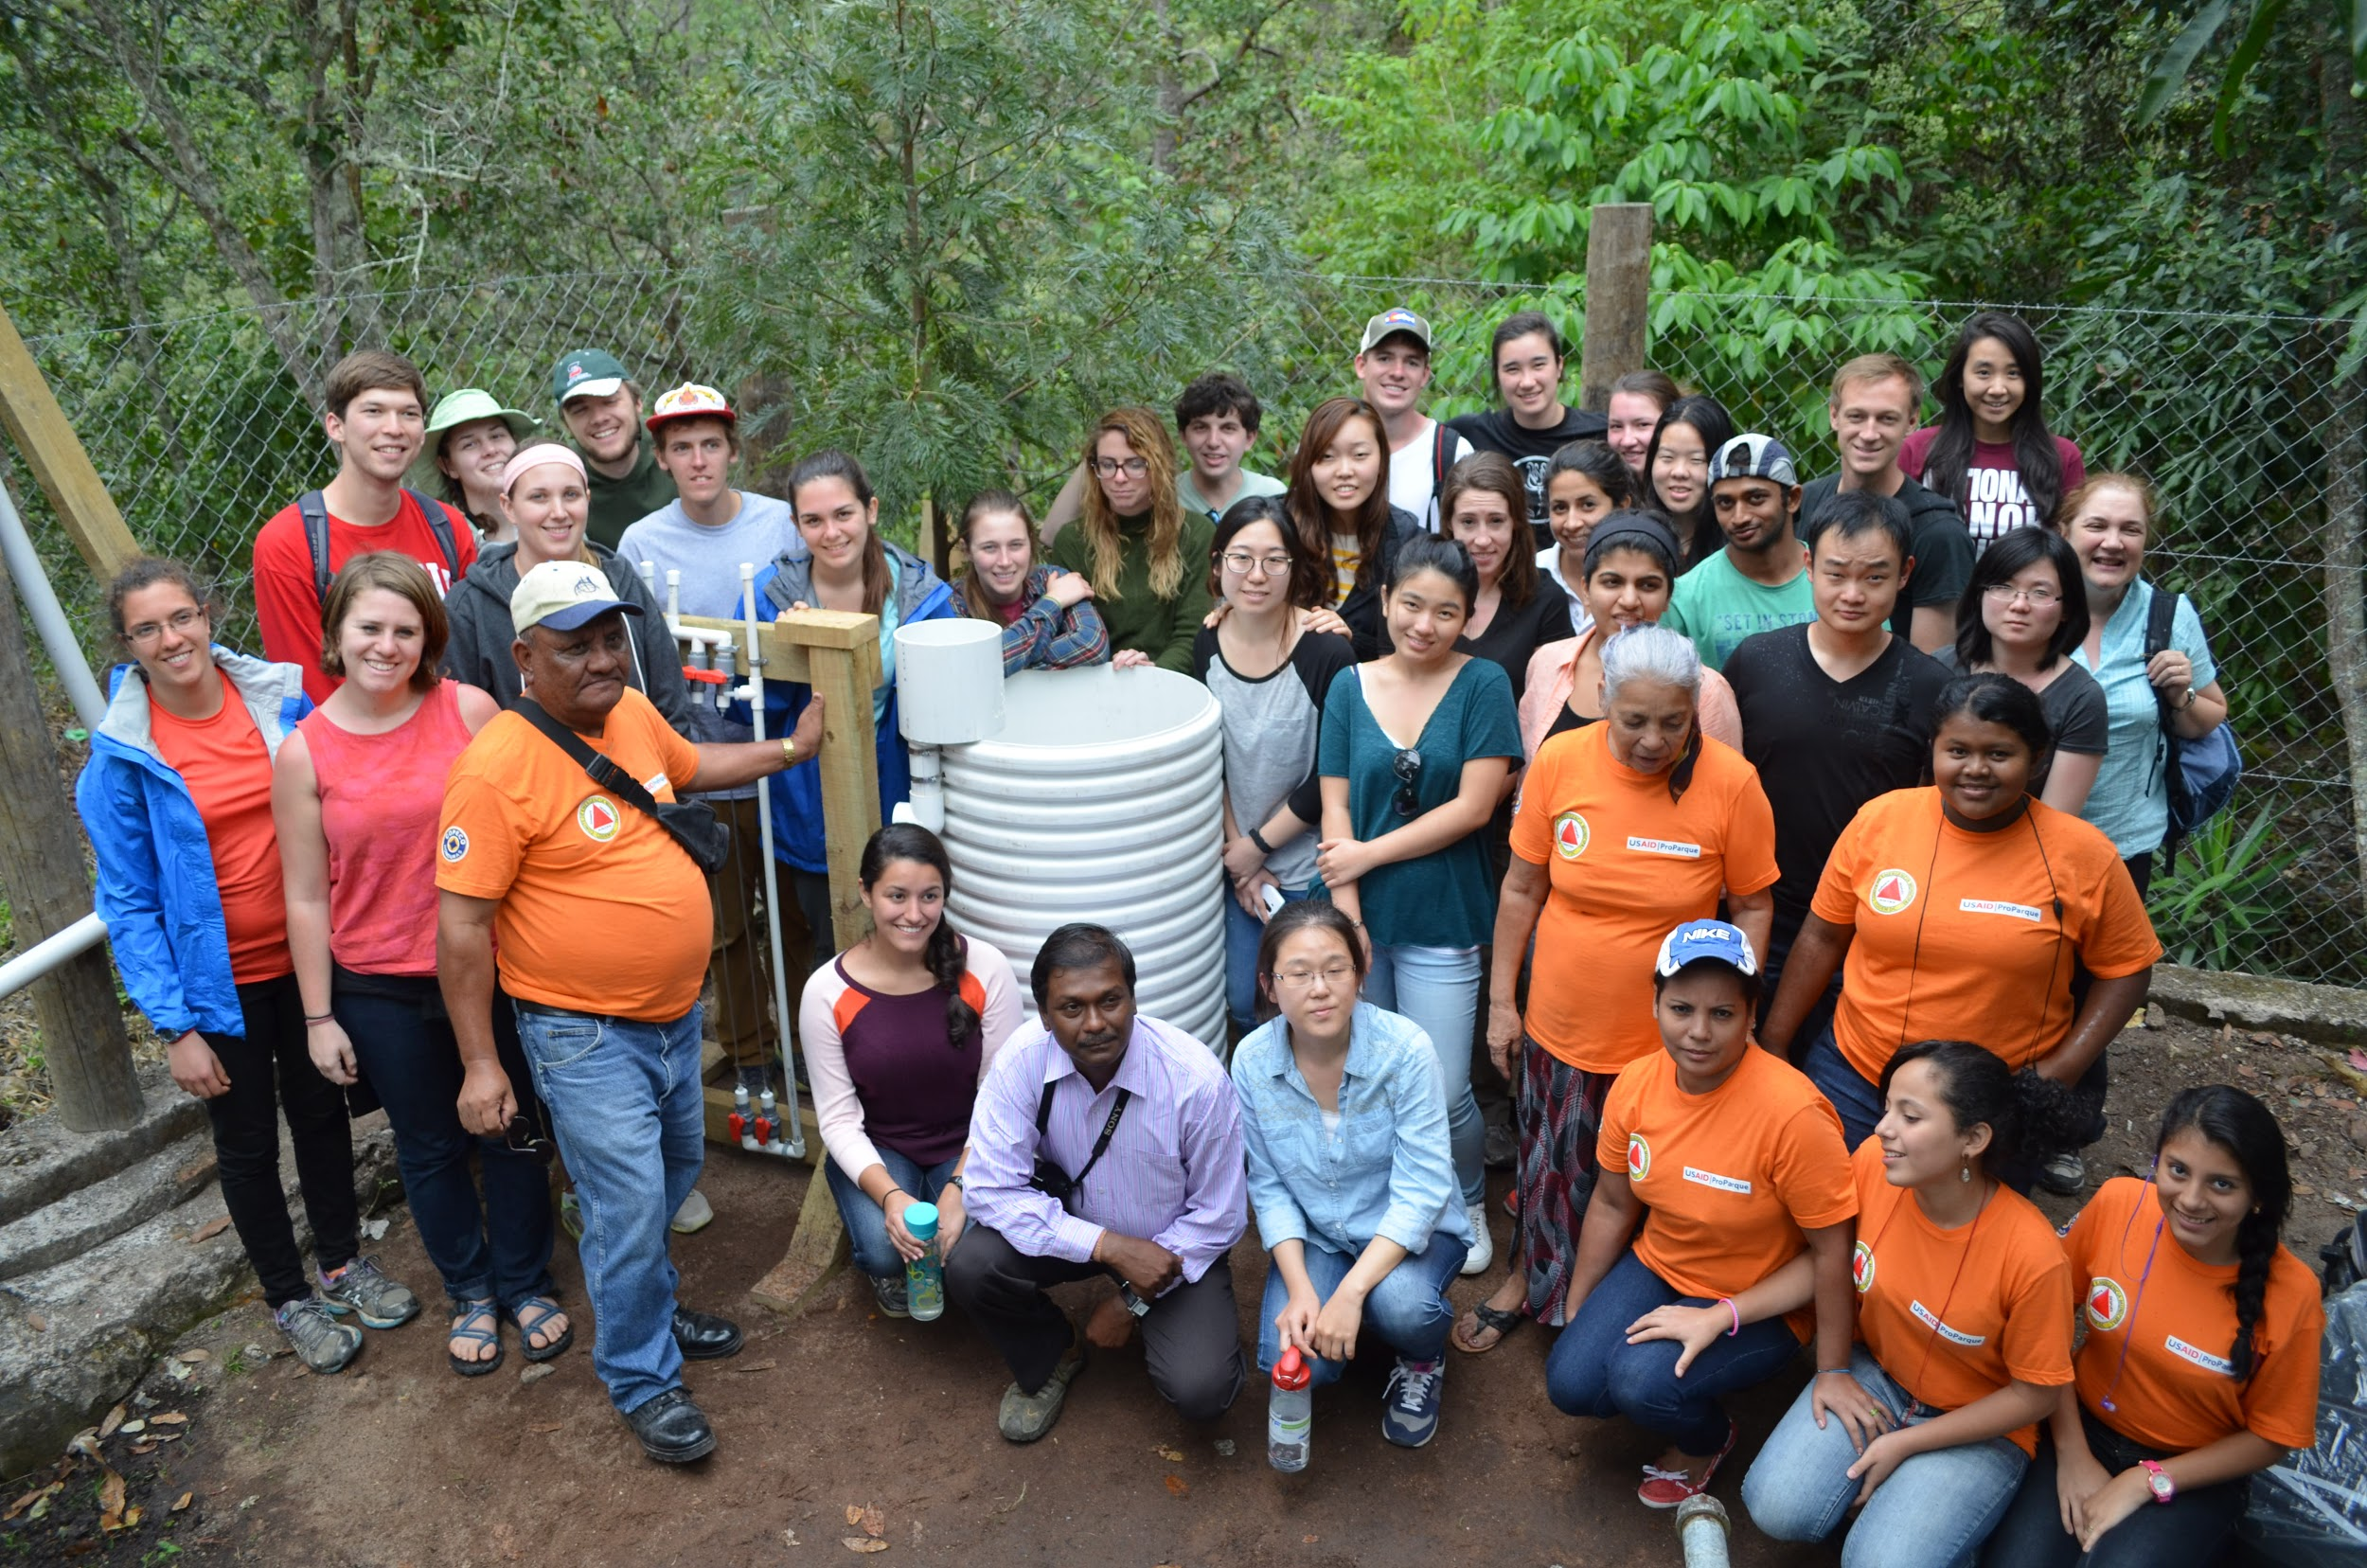
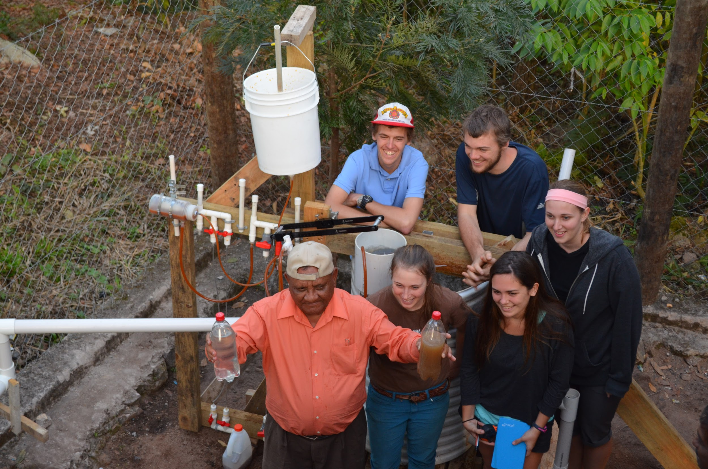
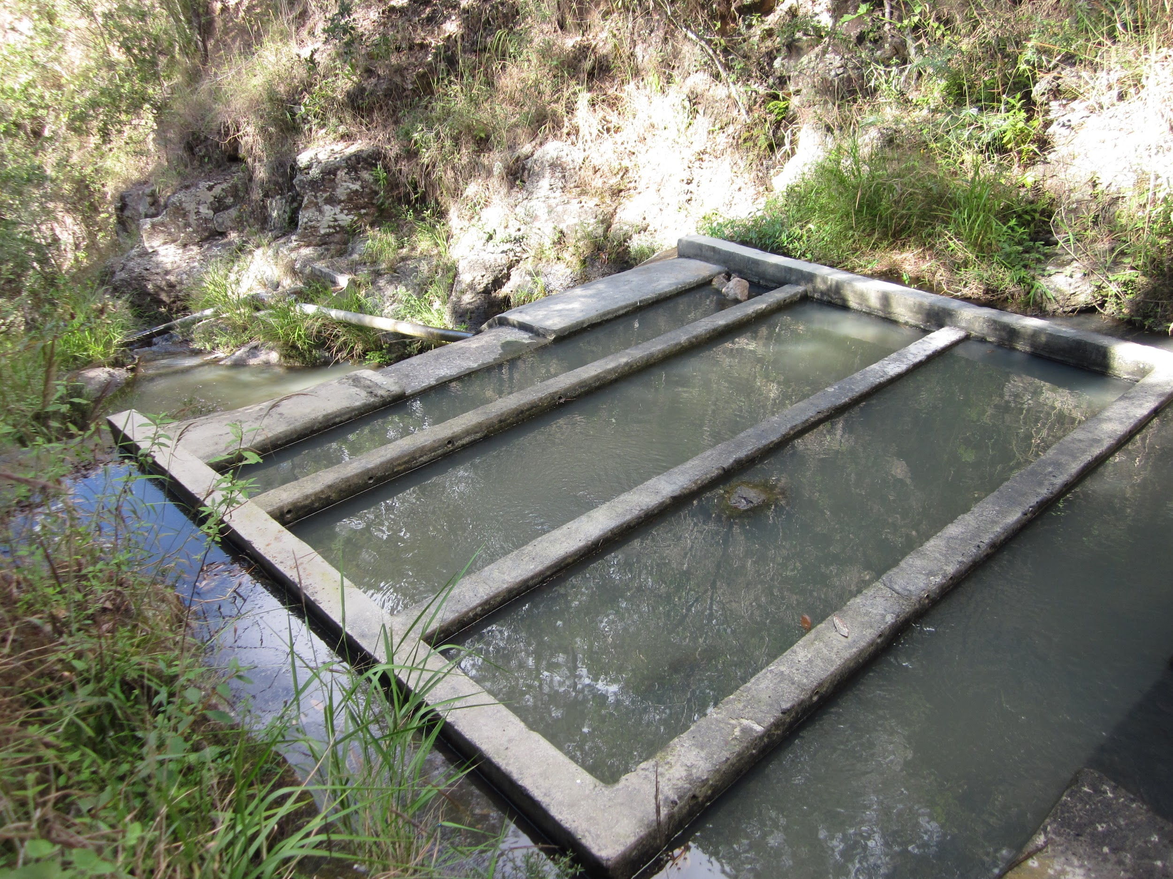
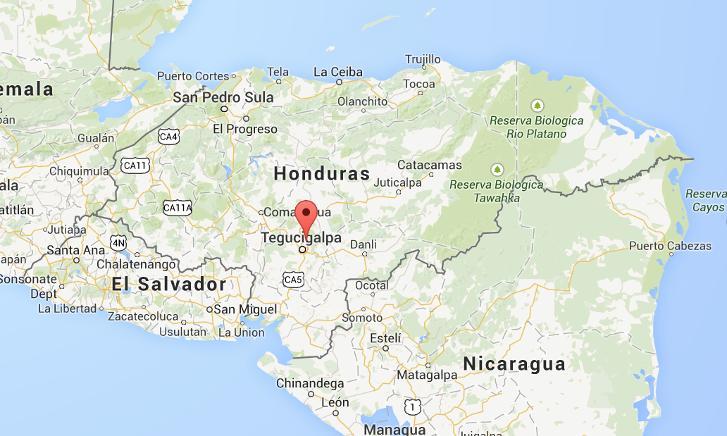
January Trip Experience
Constructed a foam filter in El Carpintero for testing purposes
Notes:
Marlana
Overview of what happened in Honduras- some cultural tid bits : )
El Carpintero currently being served by a stream, uphill from the community
In-take structure is a rudimentary grit chamber ← visited
military police officers to keep us safe
community came to visit during construction

Slide 4
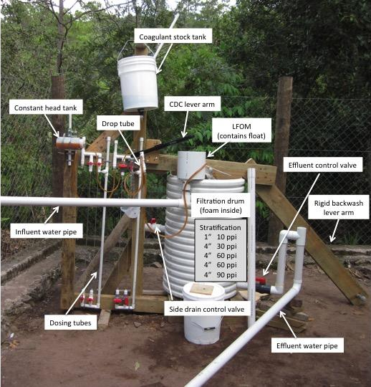
Large Filter Status
How does it work?
In El Carpintero
Working poorly:
  High PACl demand
  Low pC*
  Builds head-loss fast
Working well:
  backwash
  LFOM/CDC
Notes:
Ethan- combine CDC and this slide as an update from Honduras

Slide 5
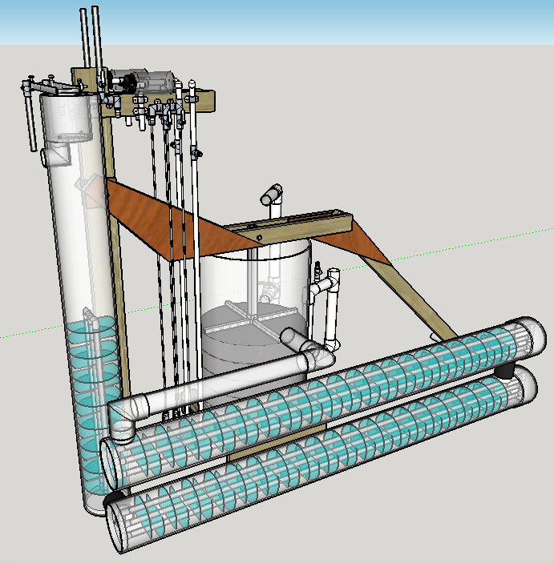
Large Filter Flocculator?
Lighter lever arm
Flocculator
  8”X6’X3
  Build headloss in the flocculator
Different backwashing techniques
Calibration Columns
Raised pivot
Notes:
Ethan- combine CDC and this slide as an update from Honduras

Slide 6
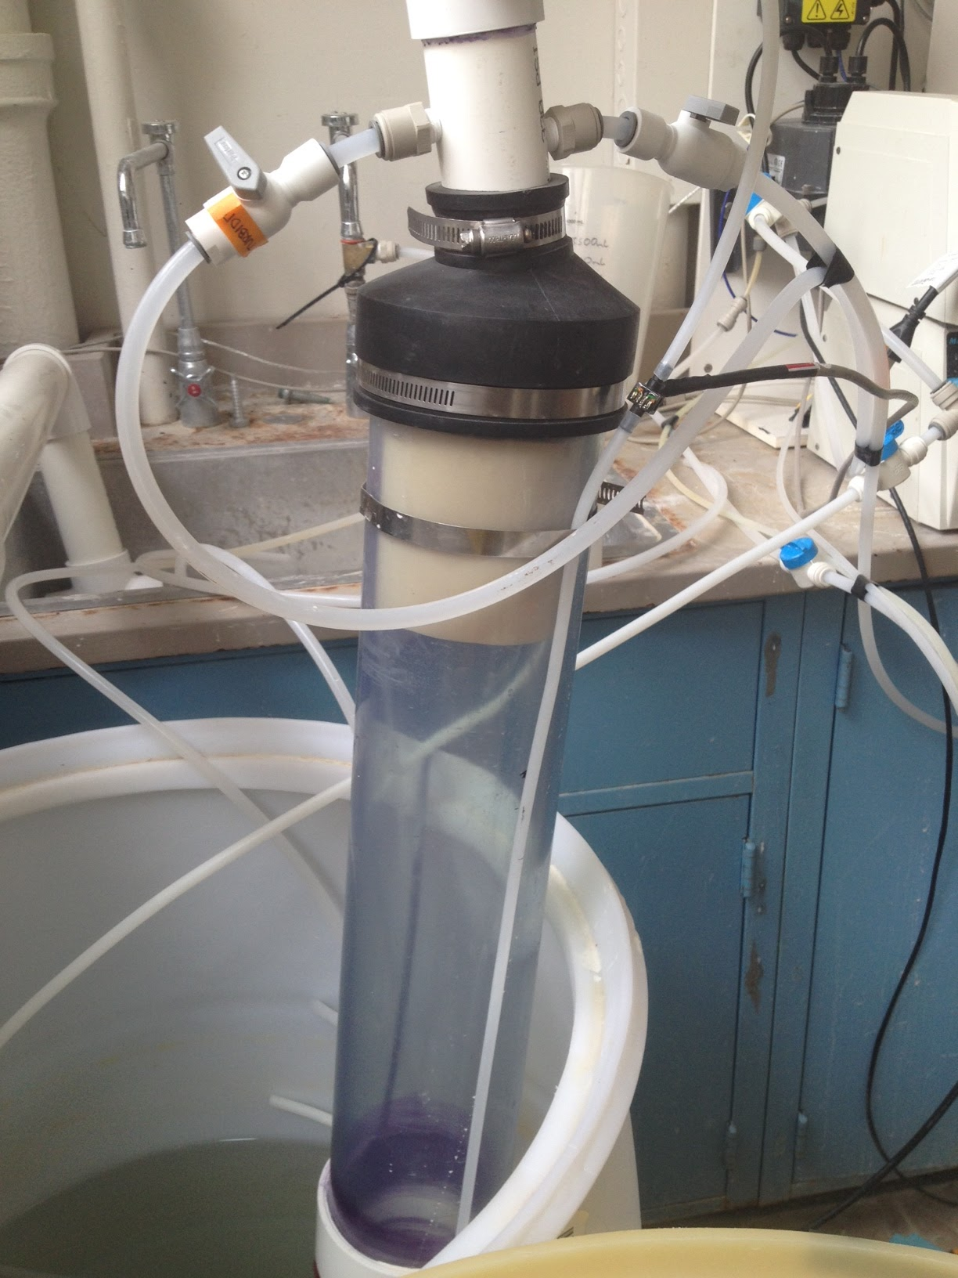
Small Filter: Why?
Objective: collect data on efficiency of backwash system
Function: replicates large scale filter
Benefit: easy to operate and SEE backwash
Notes:
Marlana
better understanding of backwash to improve performance (effect of pore velocity on cleaning efficiency)
replicates large scale filter in achieving 6 cm/s forward filtration velocity and high backwash velocities
downside: lots of valves/tubing

Slide 7
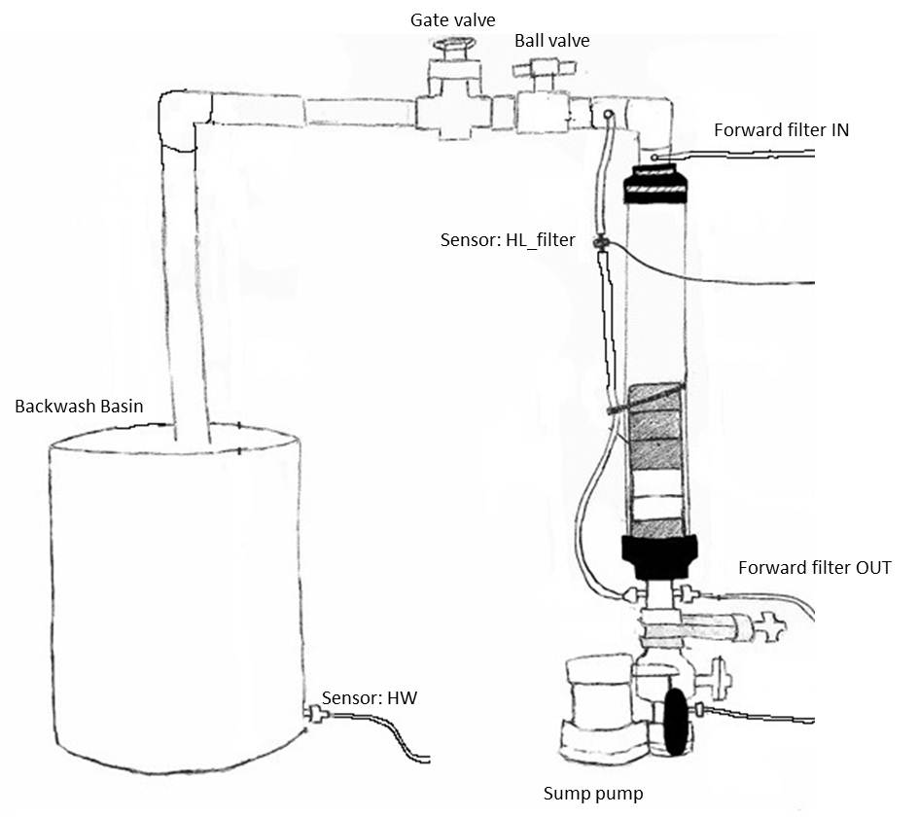
Small Filter: How?
Forward filter and backwash modes
4” diameter filter body
1.5” diameter piping
Notes:
Marlana
Sensors measure flow rate and head loss
Valves allow for change in flow rate

Slide 8
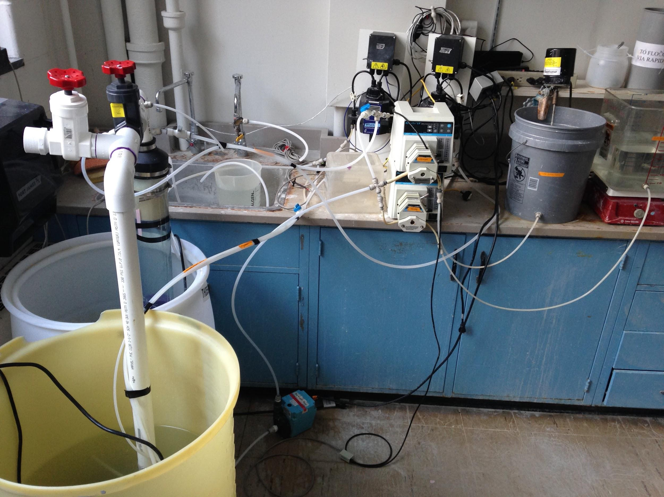
Pore Velocity vs. Cleaning Efficiency
WHY?
Objective: Determine empirical relationship between backwash pore velocity and filter cleaning efficiency
Goal: create backwash system easily operated by one person
Key to lever arm design
Notes:
Right now, 24” filter in Honduras, specs not based off of any data
Determining optimal velocity provides crucial design variable
eg. force on lever arm in certain amount of distance

Slide 9
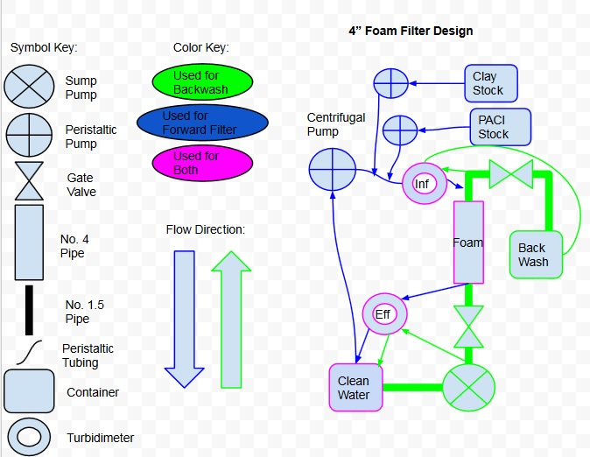
Pore Velocity vs. Cleaning Efficiency
METHODS
Clog filter with clay and PACl solution
Create pressure within chamber
Use ball valve to control pore velocity
Collect effluent turbidity data
Notes:
Alena- cleaning efficiency testing, methods

Slide 10
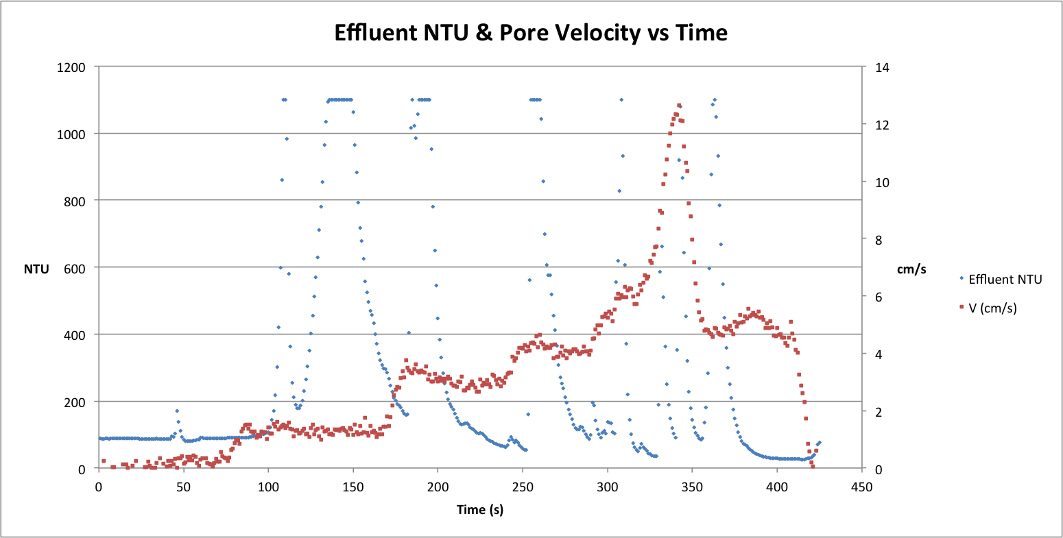
Pore Velocity vs. Cleaning Efficiency
RESULTS
Notes:
create system to backwash well with one person, with reasonable amount of energy
spikes in velocity, followed by spikes in turbidity
next step is determining how much mass is removed at each velocity, finding point of diminishing returns, same concept as NTU flattening

Slide 11
What’s Next
Data analysis (from lab and El Carpintero)
  Determine % mass removed
Continue testing
  Our foam is still dirty!
EPA Phase 2 Project Proposal
Notes:
Alena

Slide 12
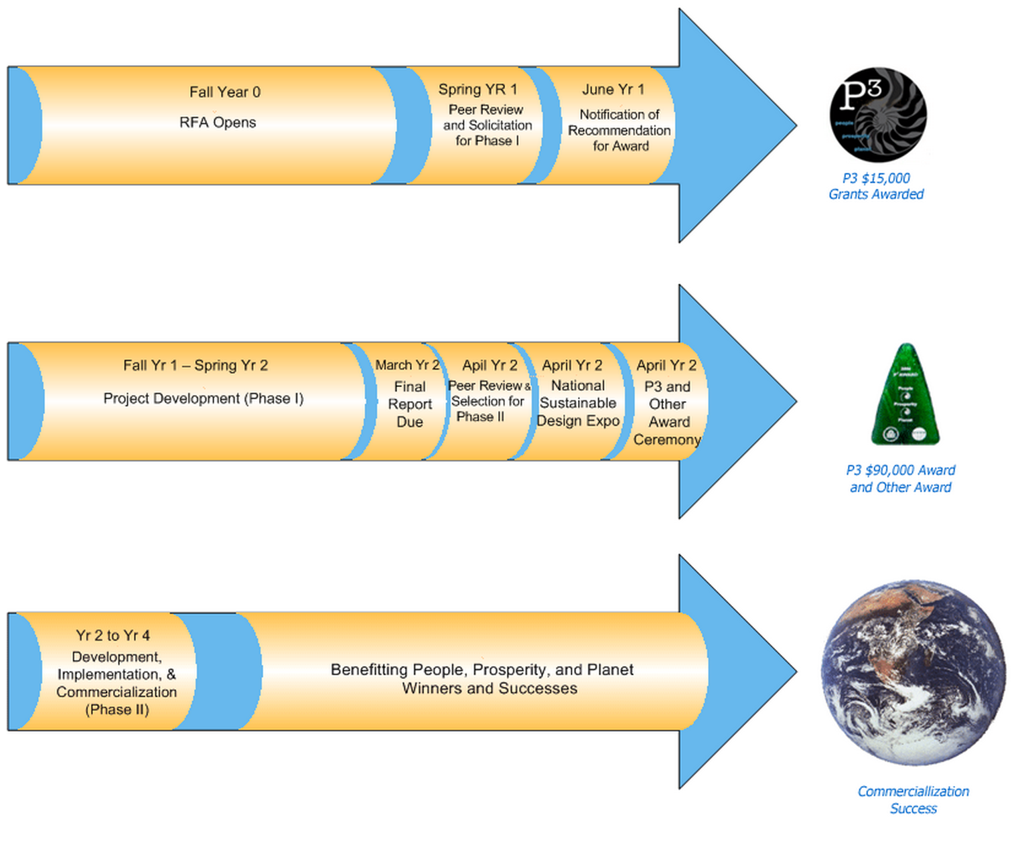
EPA P3 Award Phase 2
We’re going to D.C. to win $75,000!
Notes:
Ali -

Slide 13
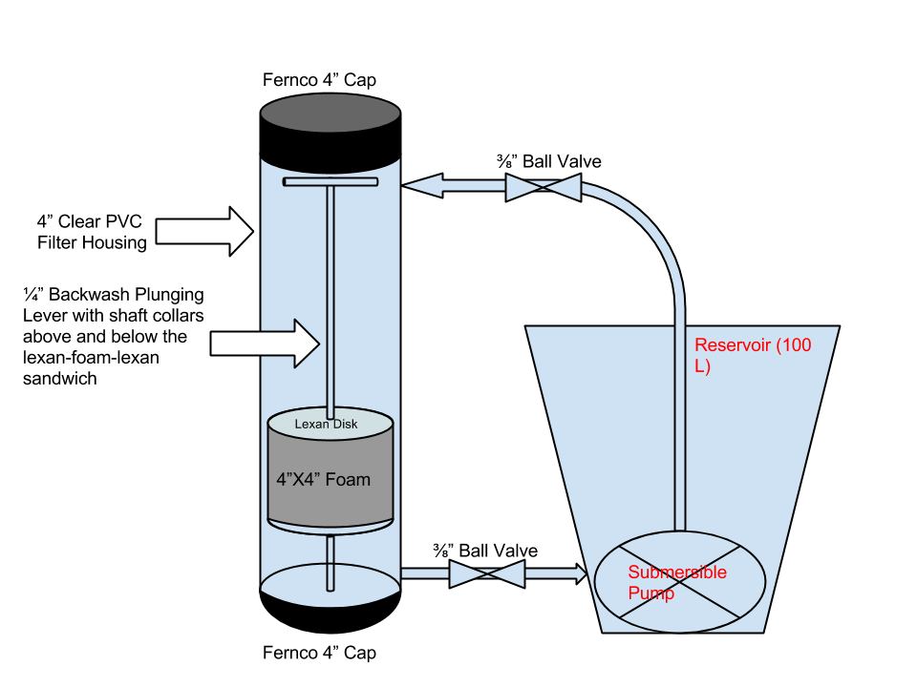

EPA P3 Award Phase 2
Notes:
The primary objective for Phase II is to sufficiently develop the foam filter technology so that it can be deployed to provide safe drinking water to small communities. The opportunities to improve the technology and prepare it for deployment include: additional flocculation to achieve more efficient filtration, enhanced cleaning techniques to achieve longer run times, the use of two or more filters with different pore sizes in series to improve cleaning and filtration efficiency, and testing for the presence of chemicals that may leach from the foam to assess the safety of the filtered water.
The goal of the small filter demo is to be a teaching aid that gives a broad audience insight into the key operations of the foam filter while potentially serving as a research apparatus.
During the previous three months, the team has attended EPA P3 training sessions held by James Rea, a specialist in technical communication.

Slide 14
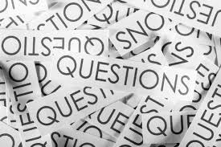
Questions???

