Slide 1
Foam Filtration
Marlana Hinkley
Alena Hutchinson
Ethan Keller
Alicia Peters
Notes:
Ali

Slide 2
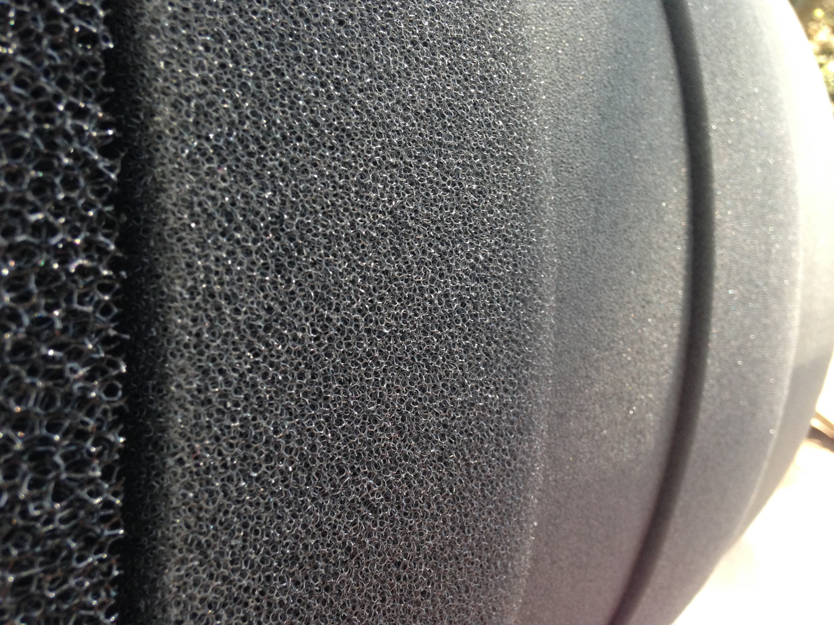
Why Foam?
Less water wasted
Less space needed
Less expensive
This would be most
beneficial for:
Smaller sized villages
Emergency situations
Temporary situations
Notes:
Ali _ bring foam in for the presentation

Slide 3
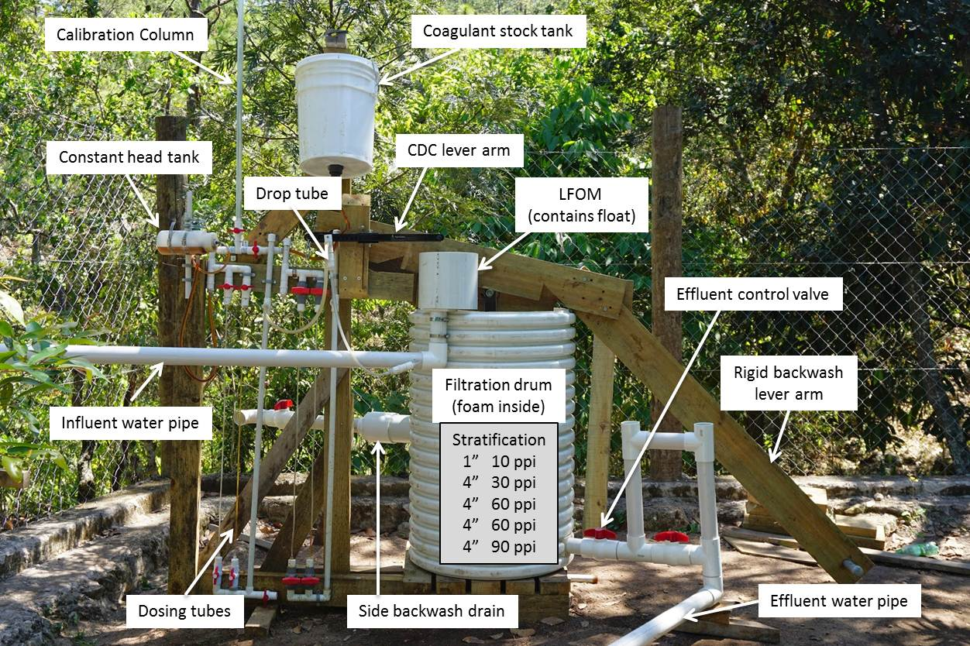
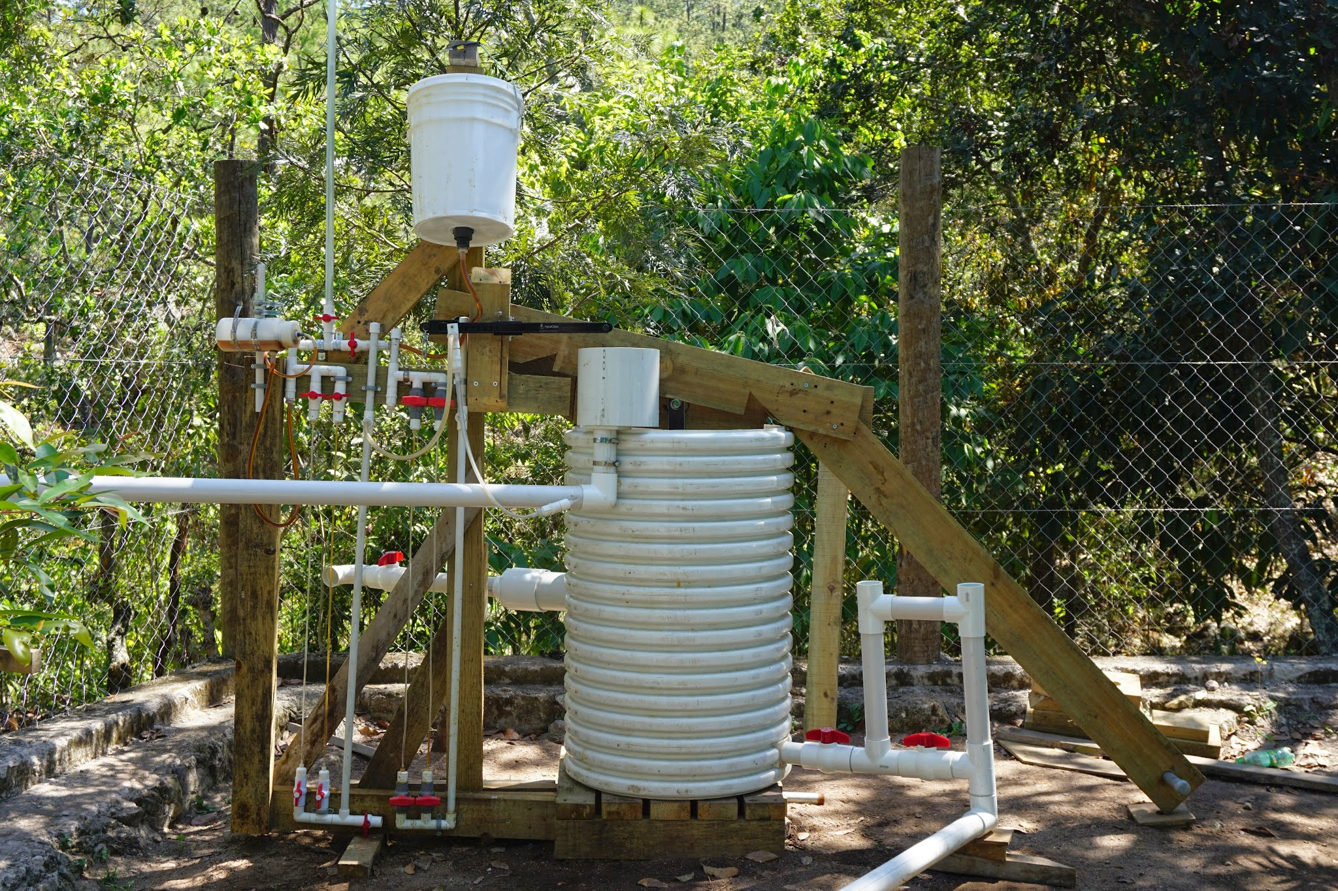
Large Filter Status
MAY IS CONSTRUCTION MONTH!
Waiting for the rains...
Backwash lever arm re-design?
  Counterweight?
  Pulley system?
Calibration column
Coagulant stock tank
Calibration column
Coagulant stock tank
Calibration column
Coagulant stock tank
Calibration column
Coagulant stock tank
Constant head tank
CDC lever arm
Constant head tank
CDC lever arm
Constant head tank
CDC lever arm
Constant head tank
Drop tube
CDC lever arm
LFOM
(contains float)
Drop tube
LFOM
(contains float)
Drop tube
LFOM
(contains float)
Drop tube
LFOM
(contains float)
Effluent control valve
Effluent control valve
Effluent control valve
Effluent control valve
Filtration drum
(foam inside)
Rigid backwash lever arm
Filtration drum
(foam inside)
Rigid backwash lever arm
Filtration drum
(foam inside)
Rigid backwash lever arm
Influent water pipe
Filtration drum
(foam inside)
Rigid backwash lever arm
Influent water pipe
Stratification
1” 10 ppi
4” 30 ppi
4” 60 ppi
4” 60 ppi
4” 90 ppi
Influent water pipe
Stratification
1” 10 ppi
4” 30 ppi
4” 60 ppi
4” 60 ppi
4” 90 ppi
Influent water pipe
Stratification
1” 10 ppi
4” 30 ppi
4” 60 ppi
4” 60 ppi
4” 90 ppi
Stratification
1” 10 ppi
4” 30 ppi
4” 60 ppi
4” 60 ppi
4” 90 ppi
Dosing tubes
Side backwash drain
Effluent water pipe
Dosing tubes
Side backwash drain
Effluent water pipe
Dosing tubes
Side backwash drain
Effluent water pipe
Dosing tubes
Side backwash drain
Effluent water pipe
Notes:
Marlana

Slide 4
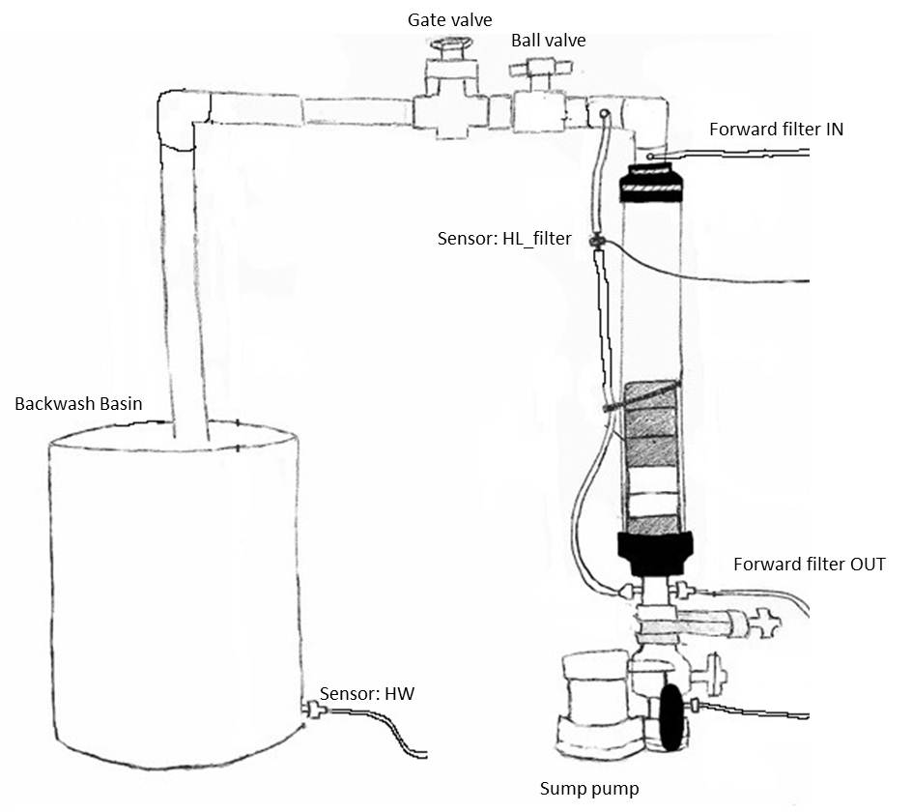
Small Filter
Objective: collect data on efficiency of backwash system
Function: replicates large scale filter
Benefit: easy to operate and SEE backwash
Notes:
Marlana
better understanding of backwash to improve performance (effect of pore velocity on cleaning efficiency)
replicates large scale filter in achieving 6 cm/s forward filtration velocity and high backwash velocities
downside: lots of valves/tubing

Slide 5
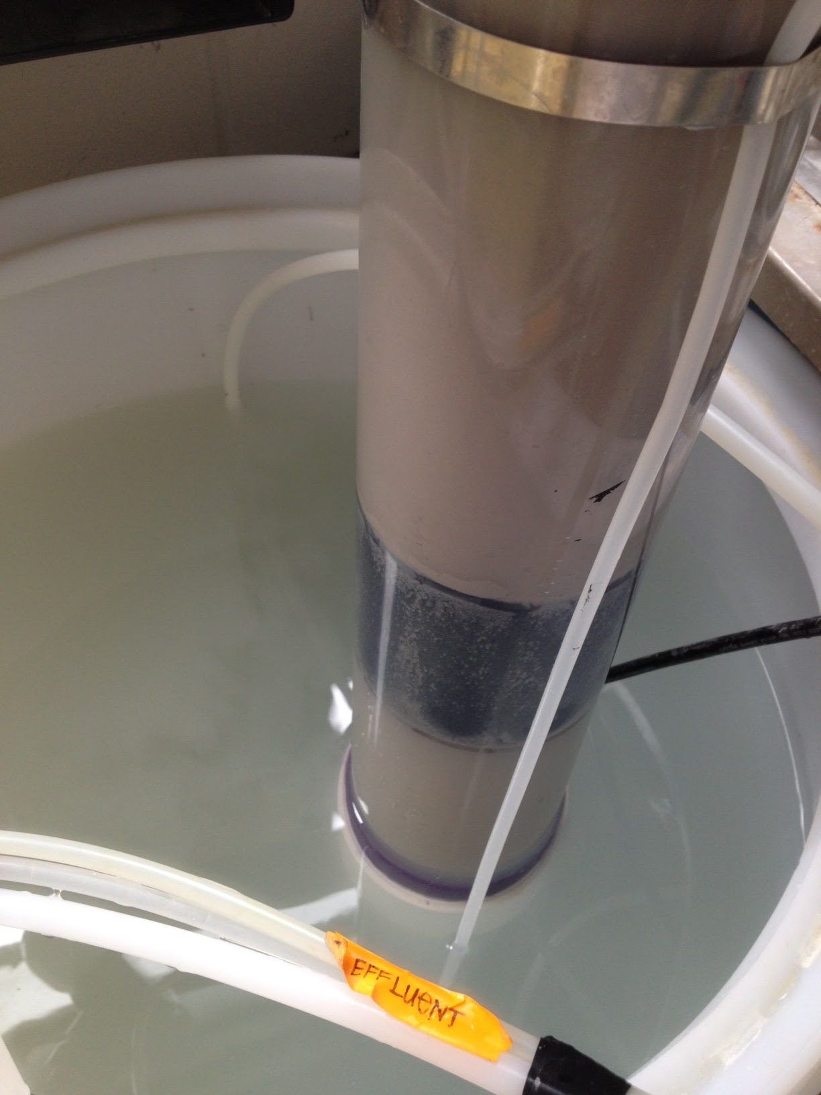
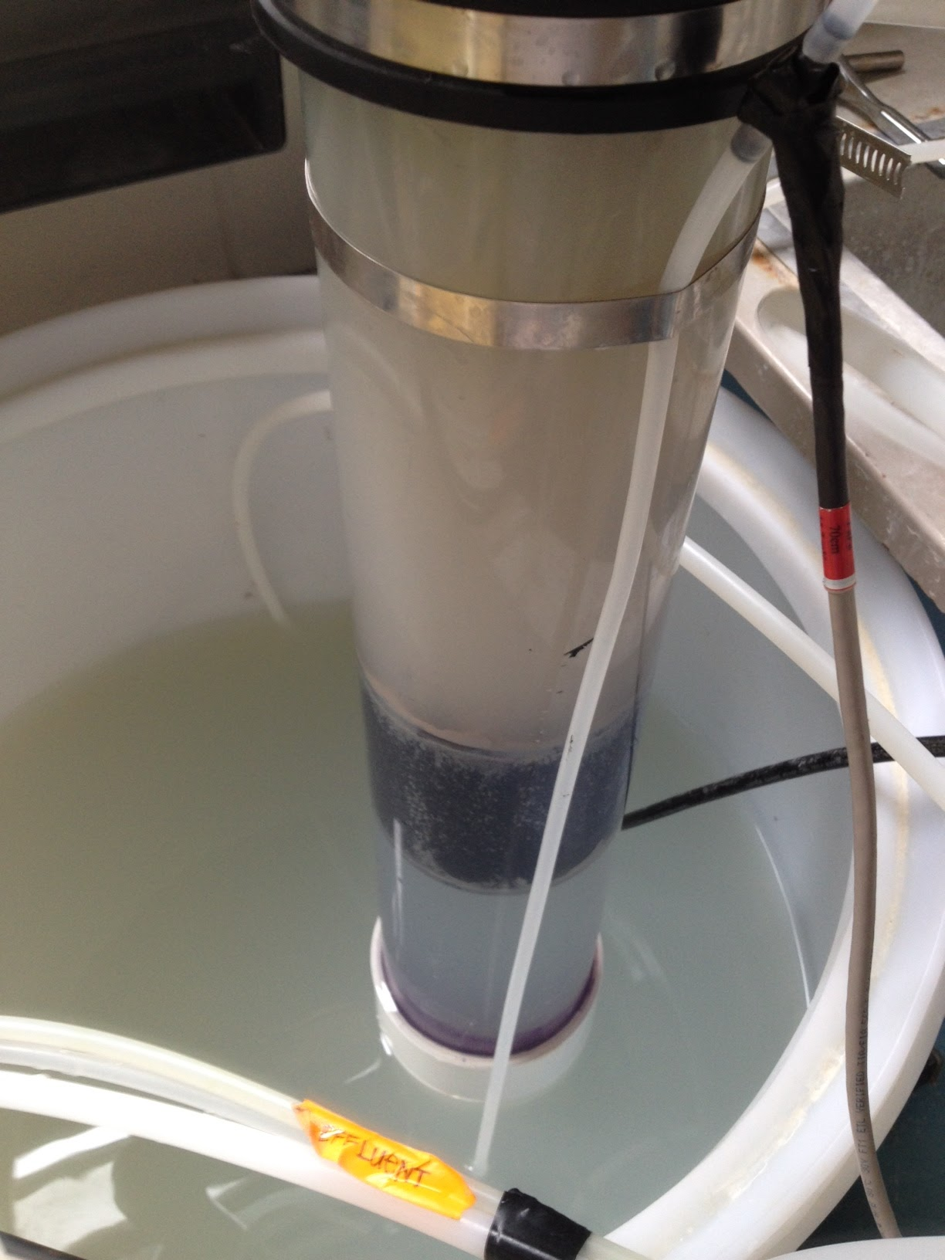
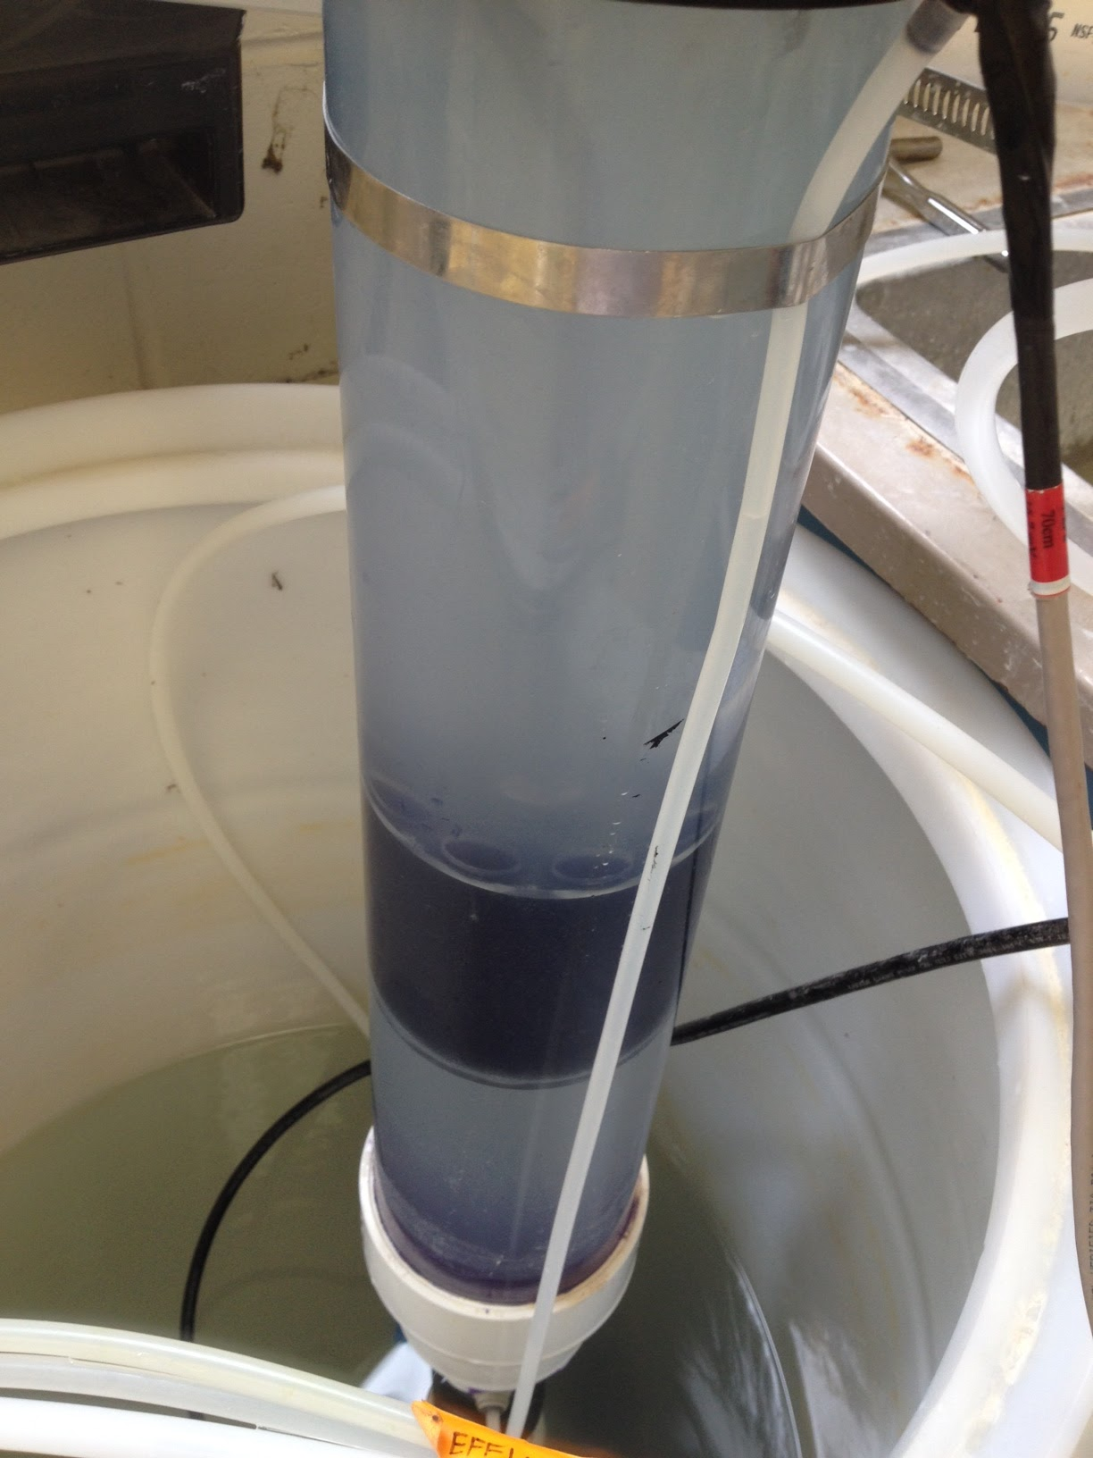
Pore Velocity vs. Cleaning Efficiency
WHY?
Objective: Determine empirical relationship between backwash pore velocity and filter cleaning efficiency
Goal: create backwash system easily operated by one person
Notes:
Marlana
Right now, 24” filter in Honduras, specs not based off of any data
Determining optimal velocity provides crucial design variable
eg. force on lever arm in certain amount of distance

Slide 6
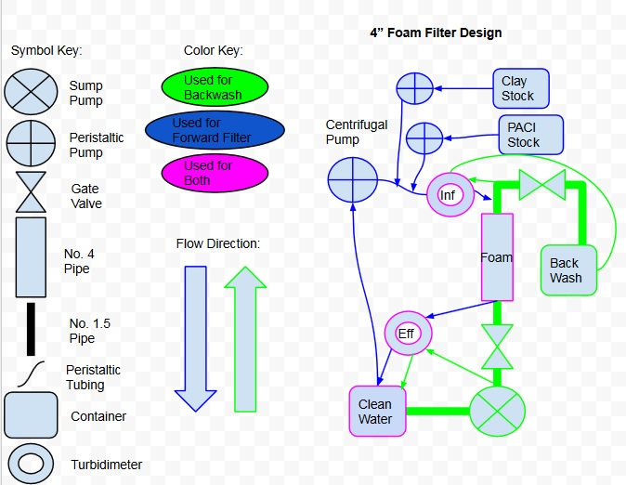
Pore Velocity vs. Cleaning Efficiency
METHODS
Forward Filtration: Clog filter with clay and PACl solution
Backwash: Use gate valve to control pore velocity
Collect effluent turbidity data
Notes:
Alena- Update, cleaning efficiency testing, methods

Slide 7
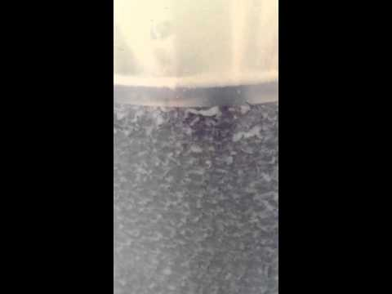
Pore Velocity vs. Cleaning Efficiency
FORWARD FILTRATION VIDEO!

Slide 8
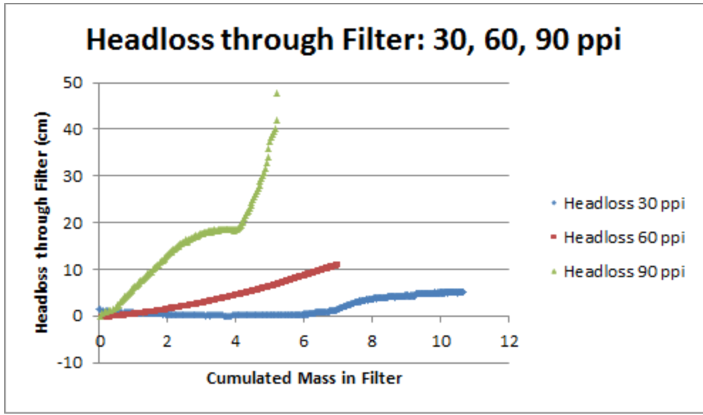
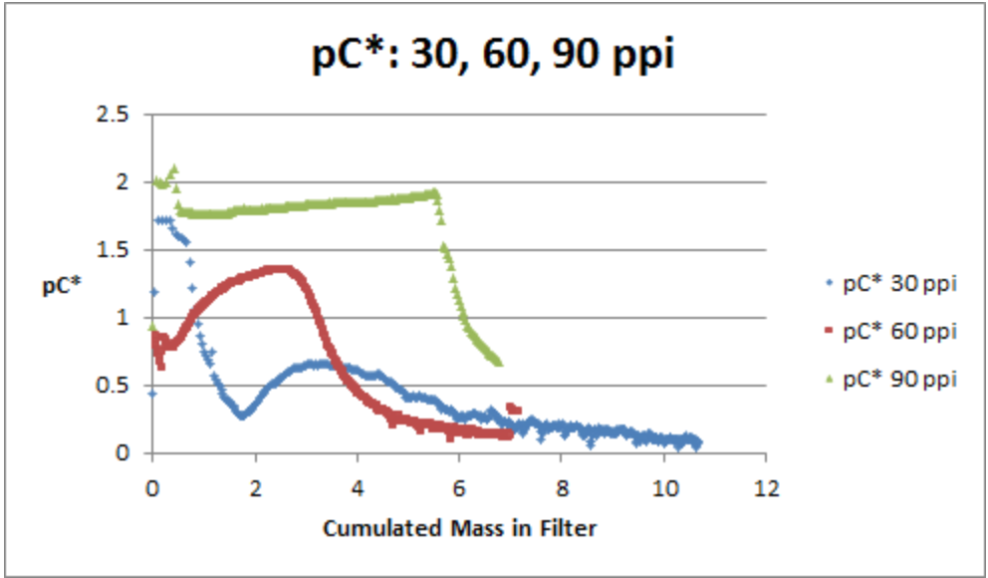
Pore Velocity vs.
Cleaning Efficiency
Forward Filtration Results

Slide 9
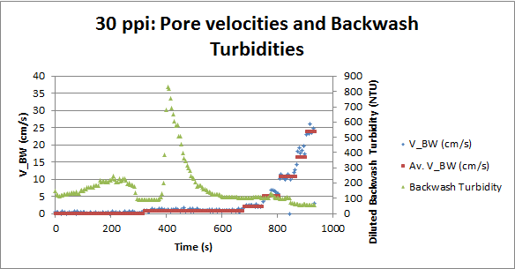
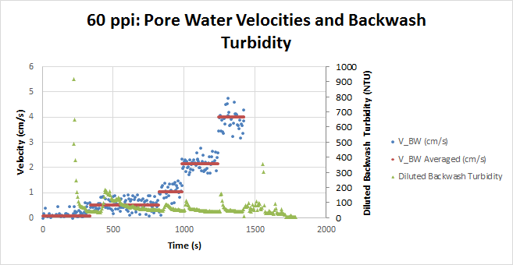
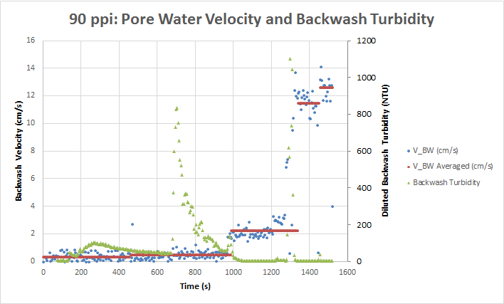
Pore Velocity vs.
Cleaning Efficiency
BACKWASH DATA ANALYSIS

Slide 10
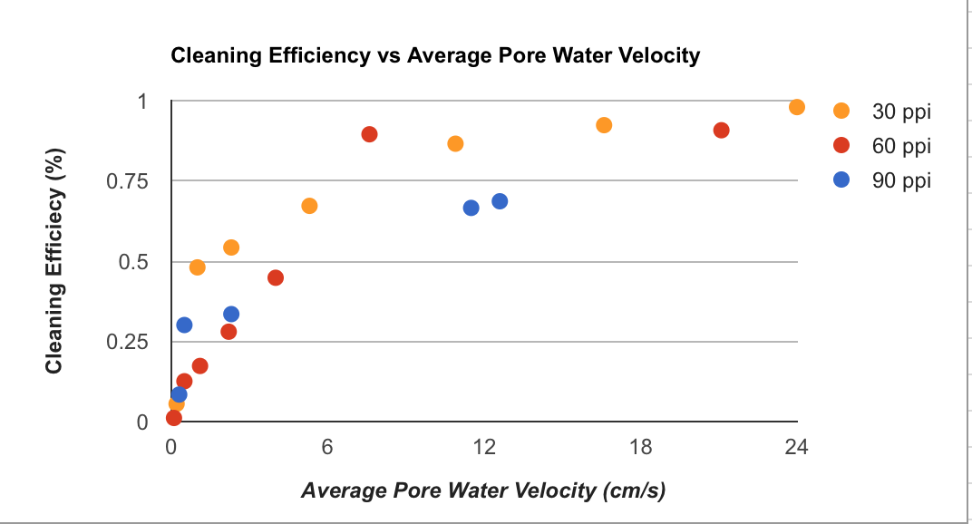
Pore Velocity vs. Cleaning Efficiency
BACKWASH RESULTS
Notes:
Alena- create system to backwash well with one person, with reasonable amount of energy
spikes in velocity, followed by spikes in turbidity
next step is determining how much mass is removed at each velocity, finding point of diminishing returns, same concept as NTU flattening

Slide 11
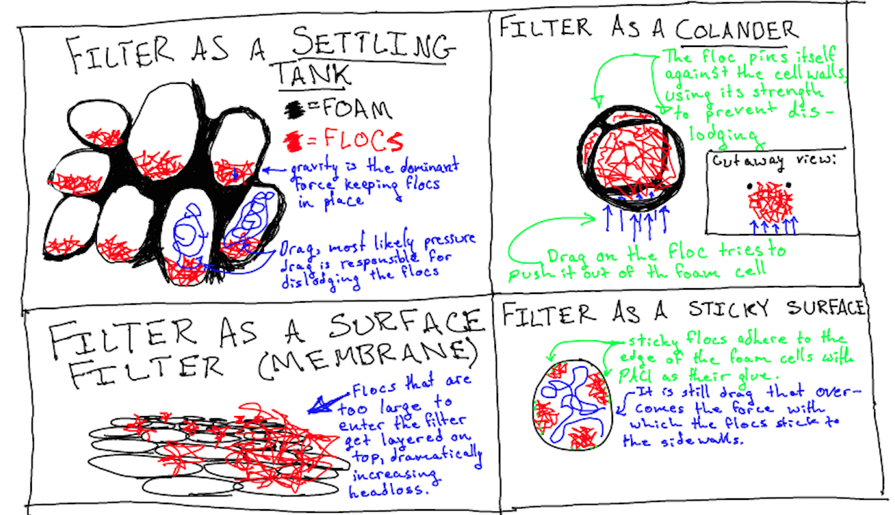
Filtration Thoughts

Slide 12
What’s Next
Continue to learn more: Develop a set of governing equations to guide the foam filter design
  Replicate experiments
  Vary PACl doses, OM concentrations
  Determine effect of stratification on filtration and cleaning efficiency
Notes:
Alena - Update with future research directions for next semester.

Slide 13

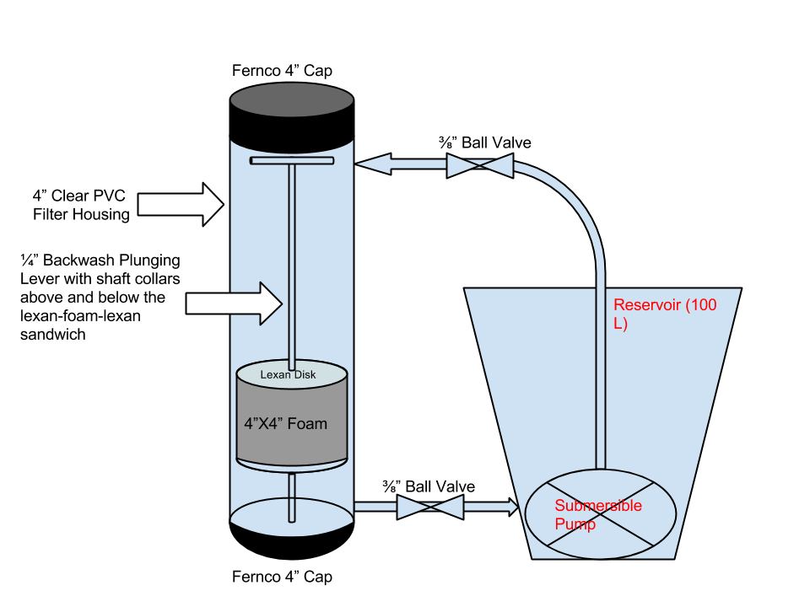
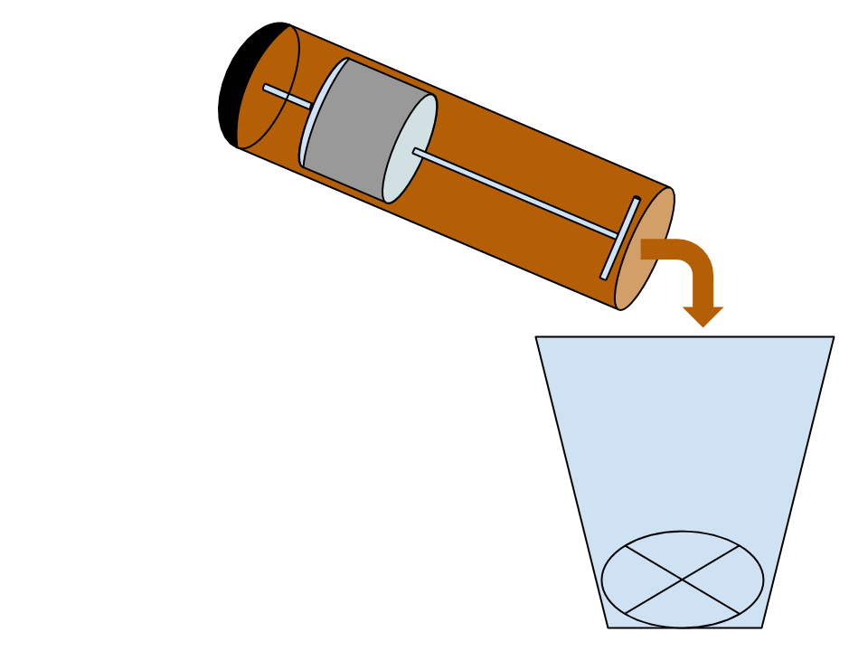
EPA P3 Phase 2 Competition
Notes:
Ali

Slide 14
EPA P3 Award Phase II
Notes:
Ali -
Talk about that we received an honorable mention, waiting on review from judges and will also add this to our report.

Slide 15

Questions???

