Slide 1


Foam Filtration
Summer 2012
Leah Meyerholtz
Michelle Gostic
Sarah Levine

Slide 2

Overview
Ultimate goal: Design a system to provide clean water in emergency situations
  Portable, small, efficient, operator-friendly, electricity-free
  Not ideal for use at municipal scale

Slide 3
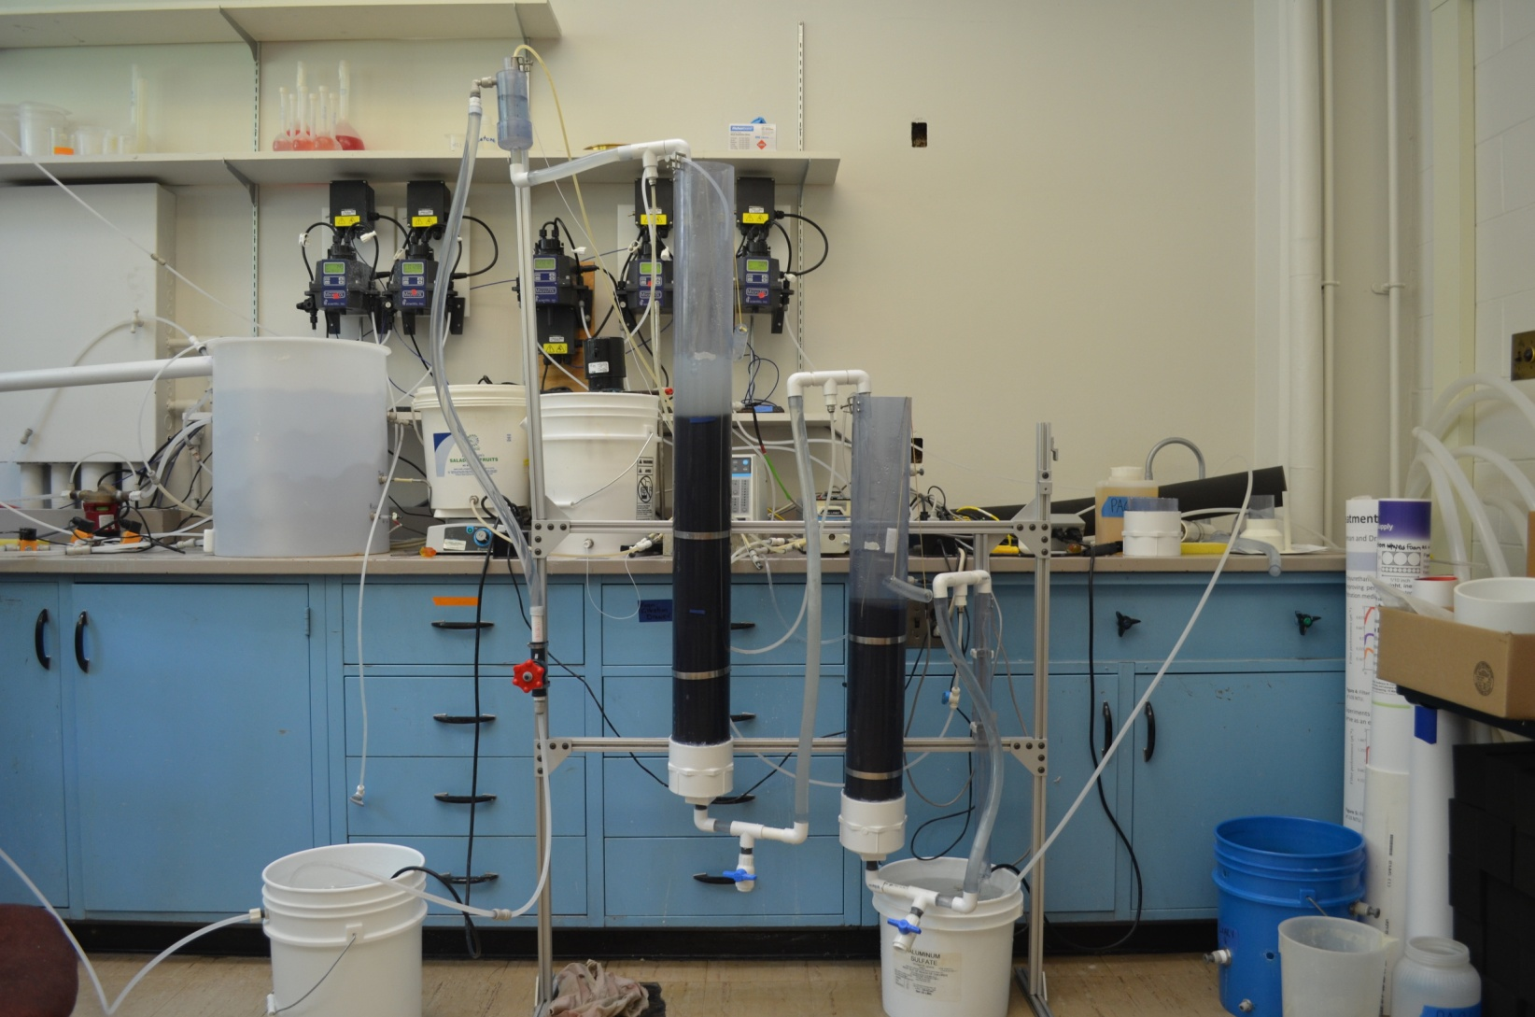
Apparatus

Slide 4
Our Goals For Summer 2012
Determine particle removal capability and longevity of filter components
Determine effectiveness of plunger cleaning method/length of filter cycle
Find a way to run the filter without use of electricity

Slide 5
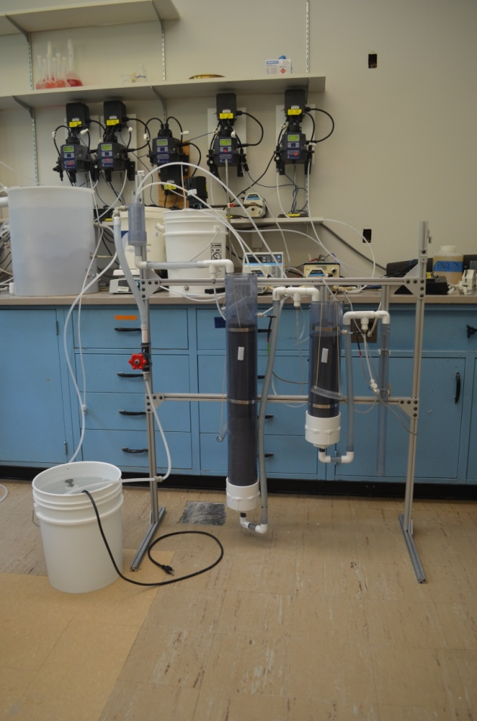
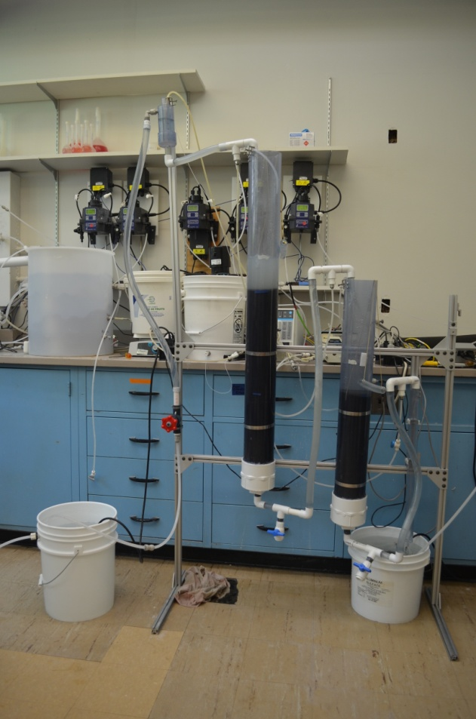
Current Progress
Original apparatus:
Modified apparatus:

Slide 6
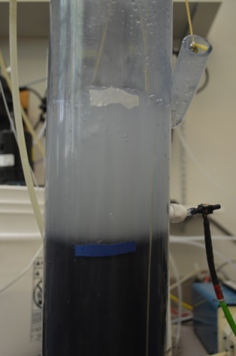
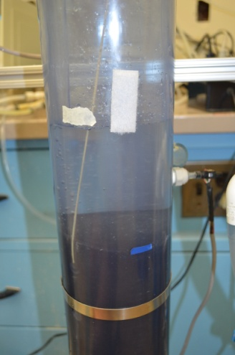
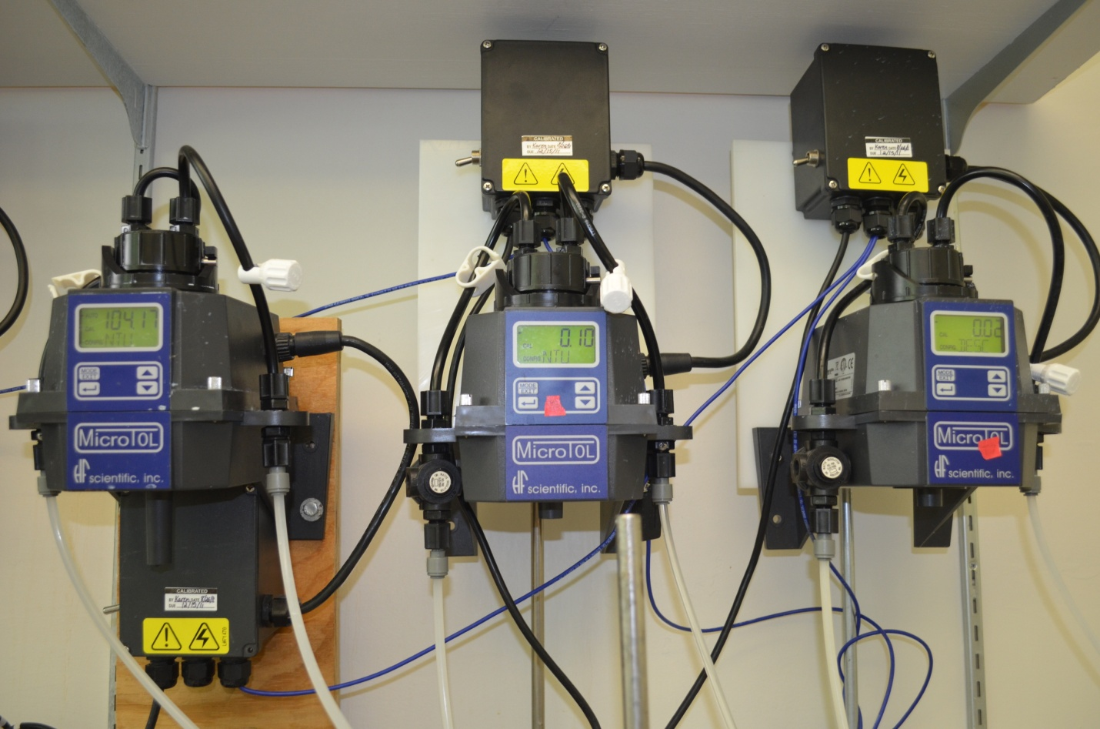
Experiment
  Run multiple day tests at 500 NTU, 200 NTU, 100 NTU and 50 NTU.
  Measure head loss and turbidity to assess performance and to determine when filter needs cleaned

Slide 7
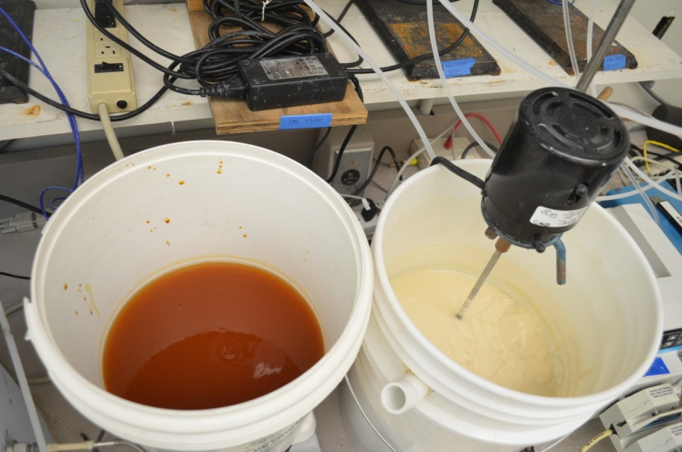
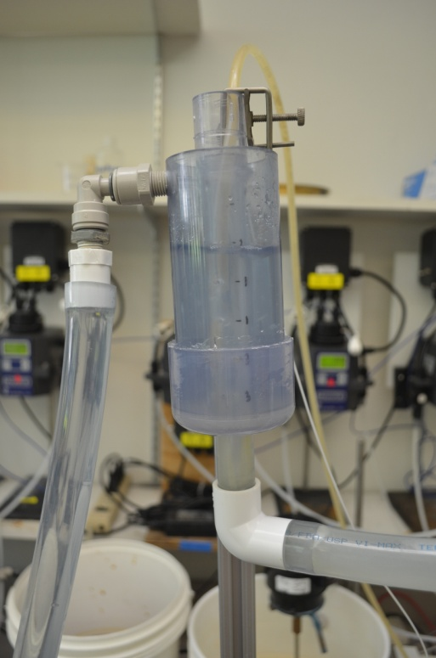
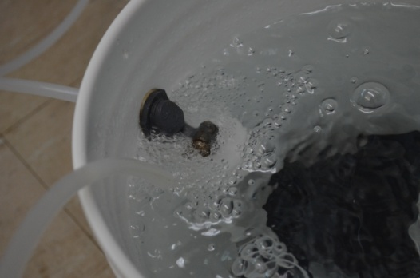
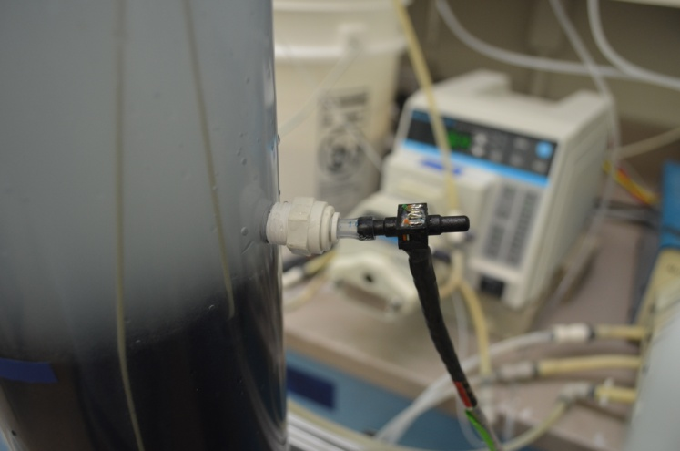
Experiment

Slide 8
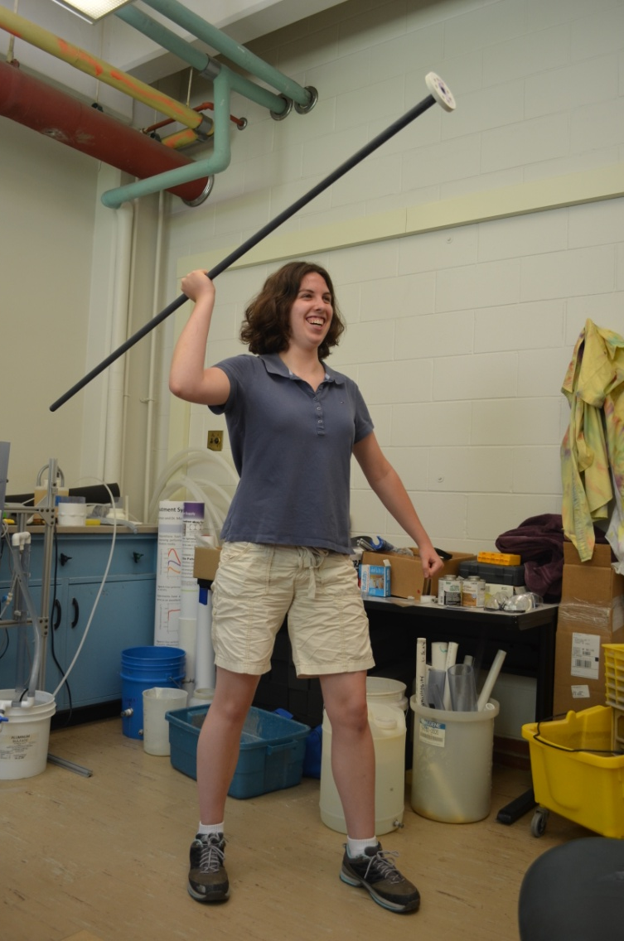
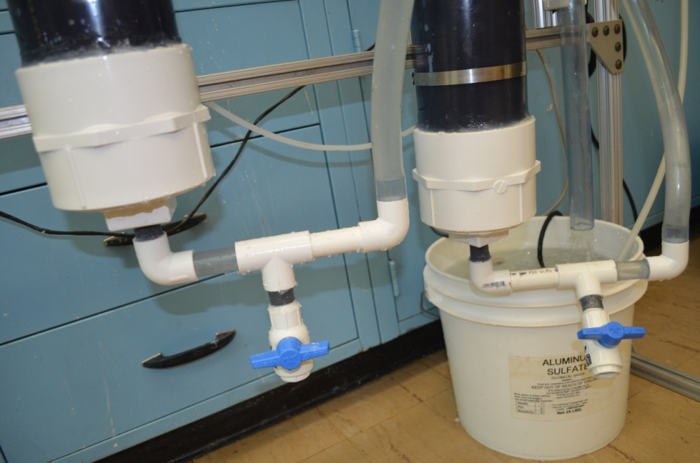
Cleaning

Slide 9
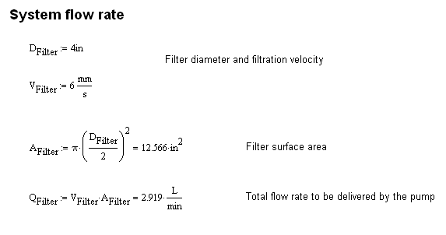
Calculations

Slide 10
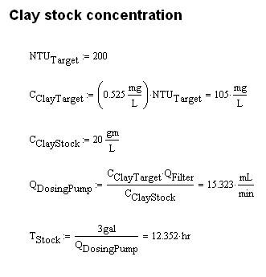
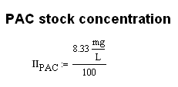

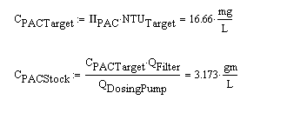
Calculations

Slide 11
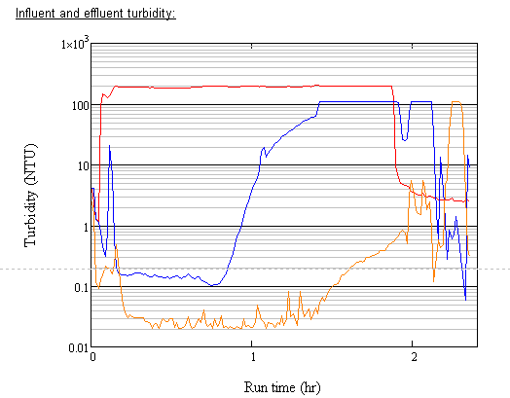
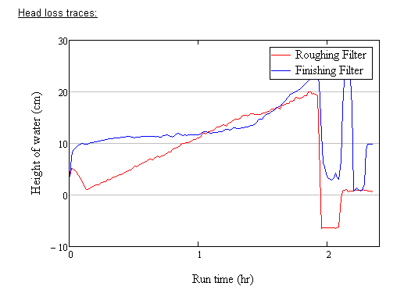

Data Analysis (200NTU)

