Slide 1

Foam Filtration Teach-In
Katie Edwards, Walker Grimshaw, Bradshaw Irish, Kelly McBride, and Nadia Shebaro

Slide 2
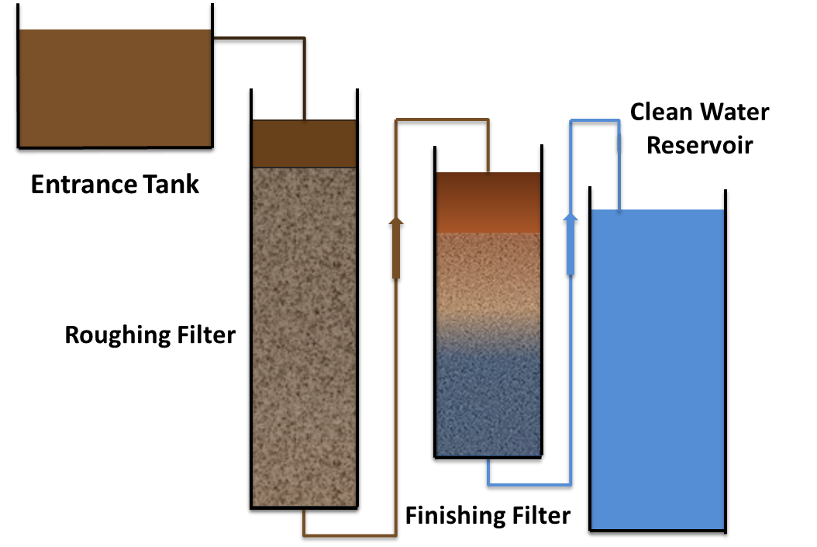
Foam Filtration
Serves smaller scale communities
Easily scalable
Readily available materials
Simple to operate and maintain
Ideal for water kiosks, emergency situations

Slide 3
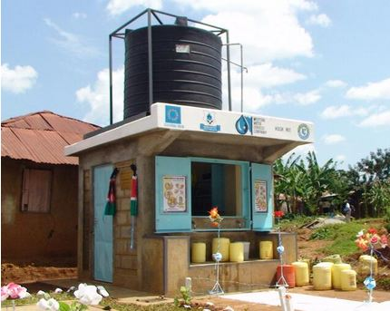
Water Kiosks
Community water supply
Serve smaller scale communities in India and Africa
Cheap but susceptible to failure
Current technologies require materials which are difficult to replace

Slide 4
Emergency Water Treatment
World Health Organization: 15 liters per person per day, turbidity < 5 NTU
Diarrheal diseases cause 40% of deaths in refugee camps, 80% in children < 2 years old
Estimated 1,220 drinking water systems affected by Katrina
Inability to clean emergency systems following South Asian earthquake in 2005

Slide 5
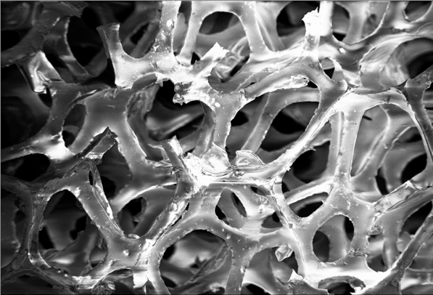
Foam as Filtration Media
Advantages:
High solids loading capacity
High porosity
Lightweight
Depth filtration vs. surface filtration
Easy cleaning mechanism
Pores per inch (ppi): the number of pores within a linear inch of foam
Higher ppi foam has more, smaller pores

Slide 6
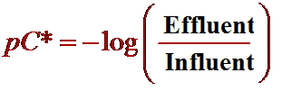
pC*
Notes:
pC* is the log removal of the system. When varying the influent turbidity, it is often more straightforward to compare effluent turbidities than compare pc* values. Theoretically, when two filters are put in series, the pC*s of the two filters should be additive for the entire system. We are hoping to achieve a pC* of approximately 1.5 - 1.6 so that we can reduce turbidity from 100 to EPA approved 3
6

Slide 7
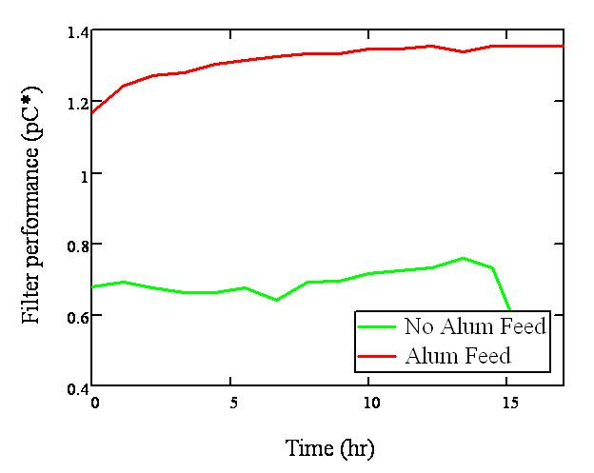

Use of Coagulant
Coagulant is necessary for adequate filtration
Thus, point of use systems would not be feasible
Focus has shifted to an emergency use or kiosk system

Slide 8
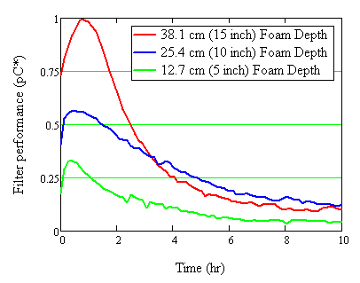
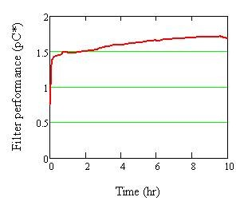
Filter Performance
30 ppi foam, varying depths
90 ppi foam, 15 inches

Slide 9


Depth Filtration in Series
Filtration Theory
  Performance of filters in series is additive
Roughing Filter
  30 ppi foam
Finishing Filter
  90 ppi foam
From
Entrance
Tank
Clean
Water
Roughing
Filter
Finishing
Filter

Slide 10
Filter Operation
From
Entrance
Tank
Clean
Water
Roughing
Filter
Finishing
Filter

Slide 11
Cleaning the Filter
Step 1
Step 2
Step 3

Slide 12
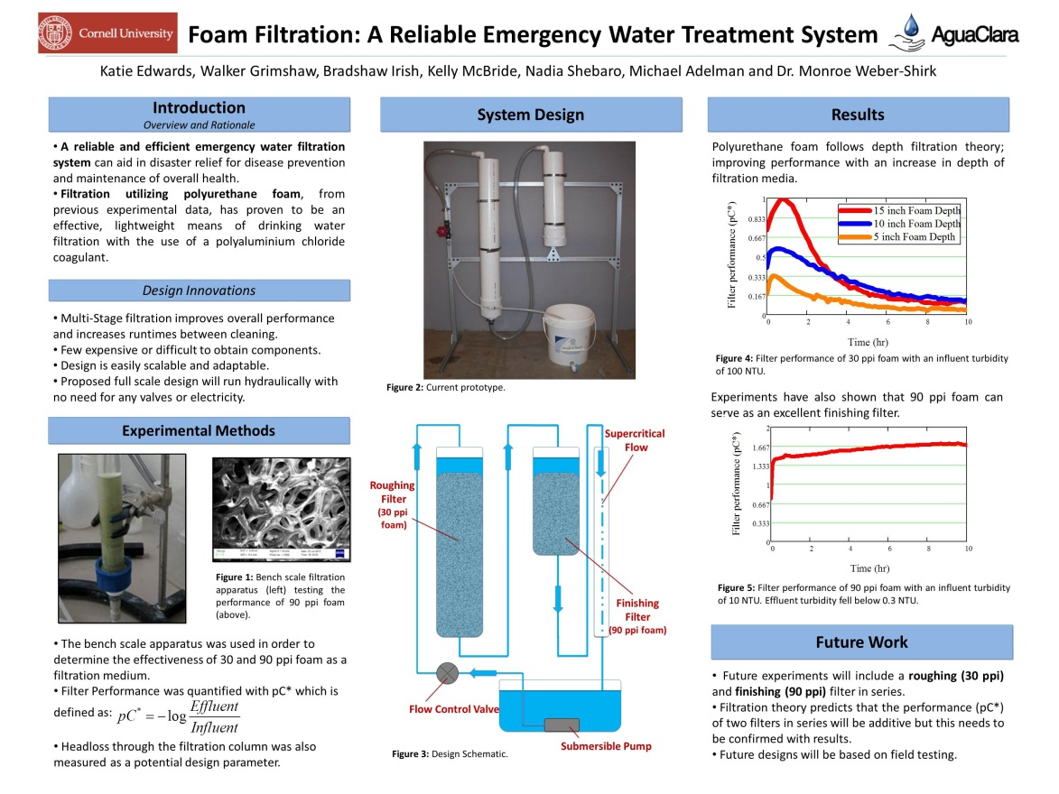
Current Work
CEE Graduate Student Research Symposium
EPA P3 Competition Phase 2 Grant Proposal

Slide 13
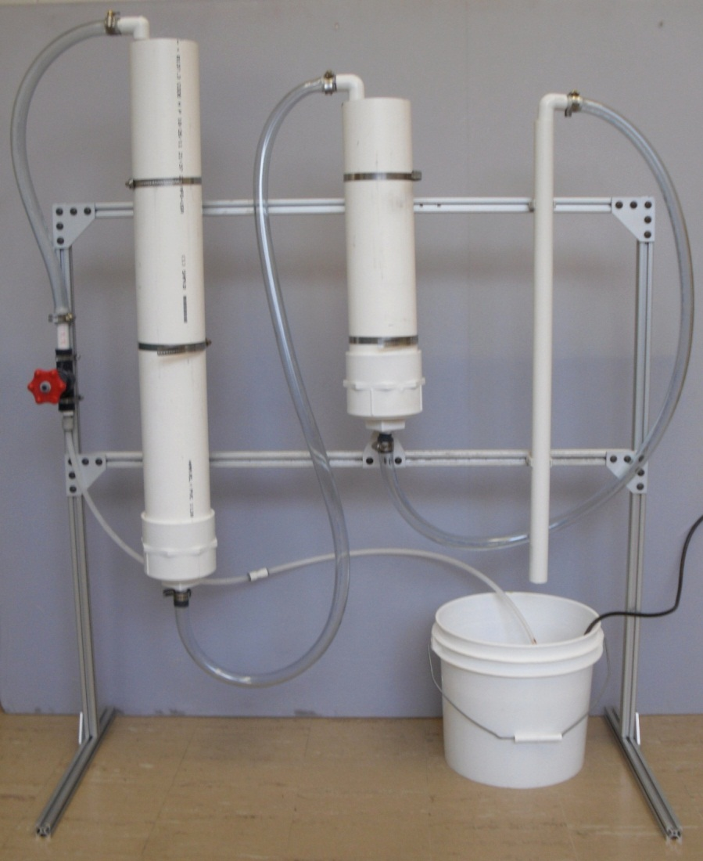
Future Work
Prototype
  Testing with foam
  Try high turbidity influent
  Test cleaning device
  Improve design

Slide 14
Future Work
EPA Competition
  Travel to Washington D.C. to present poster
  Judges evaluate our proposed Phase II research
  Win $$$!

Slide 15

Questions?

