Slide 1

Foam Filtration Teach-In
Brad Irish
Anna Lee
Rachel Philipson
October 18, 2011

Slide 2
Foam
Non-conventional filtration media
More porous
  Filtration velocities through foam can be 3x larger than sand
Surface area 3x as smaller than conventional sand filter
Lighter and easier to transport than sand
Less ripening time
No backwash required
Notes:
Be sure to note that we do still have to clean the foam!

Slide 3
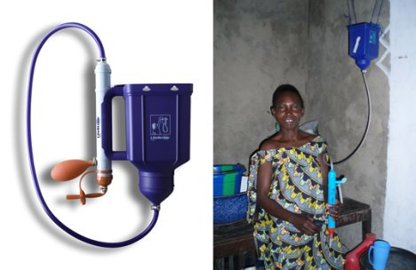
Point Of Use
Ruled out for AguaClara plants
  Operational problems
Foam can successfully filter water- want to find a use for this technology
  POU design constraints
    No moving parts
    Minimize cost
    Small size
    Ease of use

Slide 4
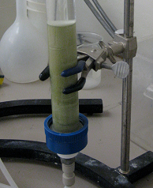
Point-of-Use Foam Filter
Finding a place in the POU filter Market
  Spring 2011 calculations proved that small size is impossible without moving parts
  Can foam filter water without the addition of coagulant?

Slide 5
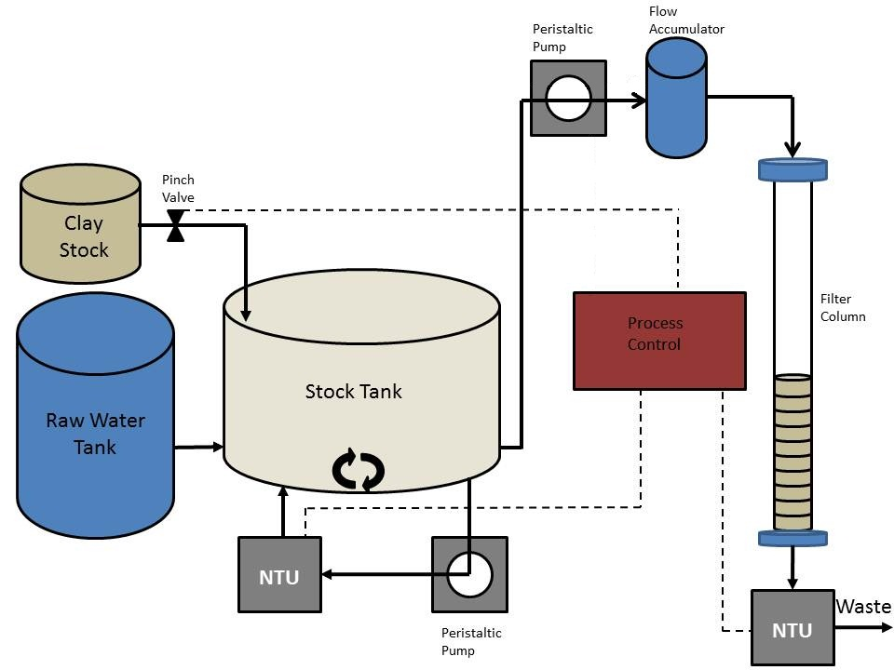
Experimental Setup

Slide 6
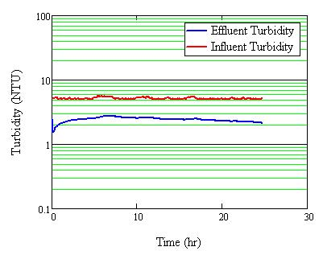
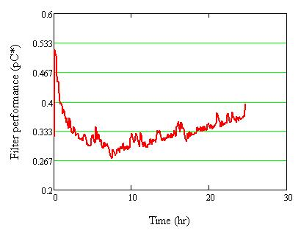
Filter Performance without Coagulant

Slide 7
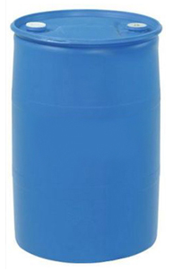
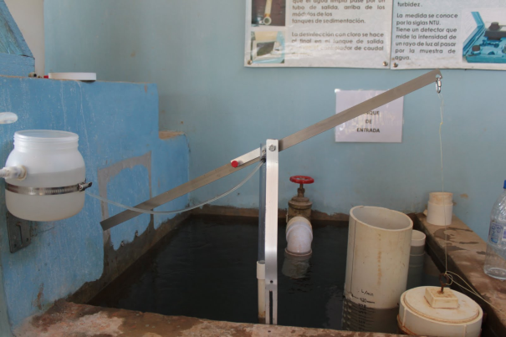
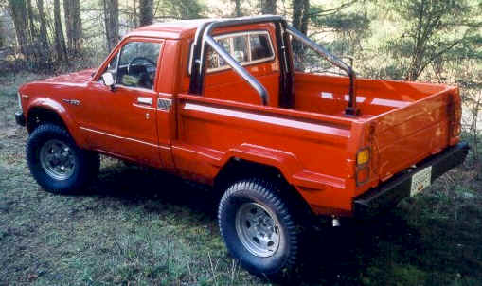
Emergency Systems
Easily portable
Larger than POU but smaller than a municipal system
Using AguaClara dose controller for PACl
Foam Emergency Filter
Lightweight
Durable
Roughing Filter and Finishing Filter
With a velocity of 6mm/s, can treat 1.7 L/s or enough water for 50 people every minute.

Slide 8

Cleaning the Filter
Normal Operation
Top valve closed, bottom valve open
Water flows through roughing filter then finishing filter
Fluid Layer
Roughing Filter
Finishing Filter

Slide 9
Cleaning the Filter
Cleaning the Filter
Lower valve closed, upper valve open
Cleaning lever compresses foam, releasing clay into water
Both valves closed and filter refilled before releasing cleaning lever and letting foam expand
Fluid Layer
Roughing Filter
Finishing Filter

Slide 10
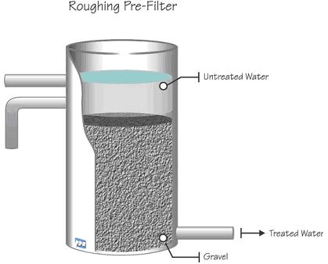
Roughing Filter
Allow deep penetration of filter media (prevents clogging)
Initially treats highly turbid water
Large pores prevent excessive head loss

Slide 11
Updated Experimental Apparatus
PACl Stock

Slide 12
30 ppi Performance Trial

Slide 13
Future Work
Quantify 30 ppi foam performance
  Varying Influent Turbidity
  Varying Depth
  Head Loss
Begin design of roughing filter
  Dimensions!
Backwash/cleaning method
  Compressor with lever
Emergency System Design
  EPA P3 Phase 2 this April

Slide 14
Questions?

