Slide 1

Foam Filtration Final Presentation
Leah Meyerholtz, Michelle Gostic, Sarah Levine

Slide 2
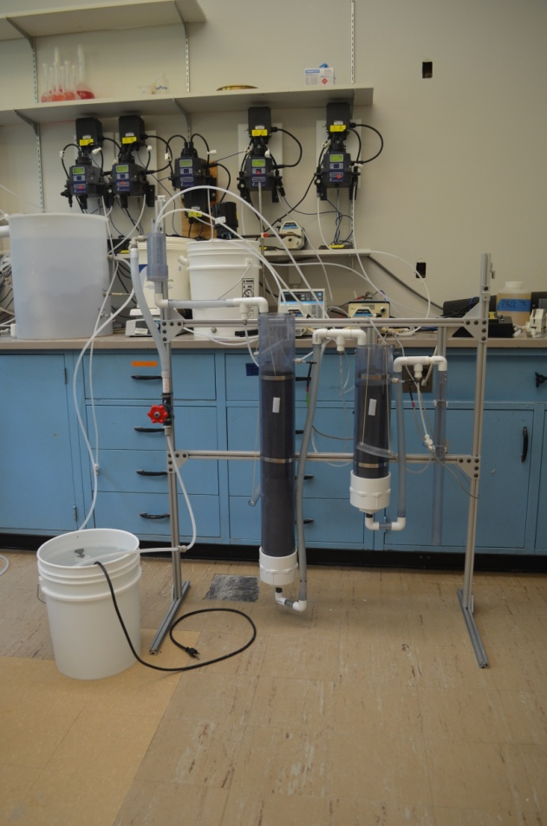
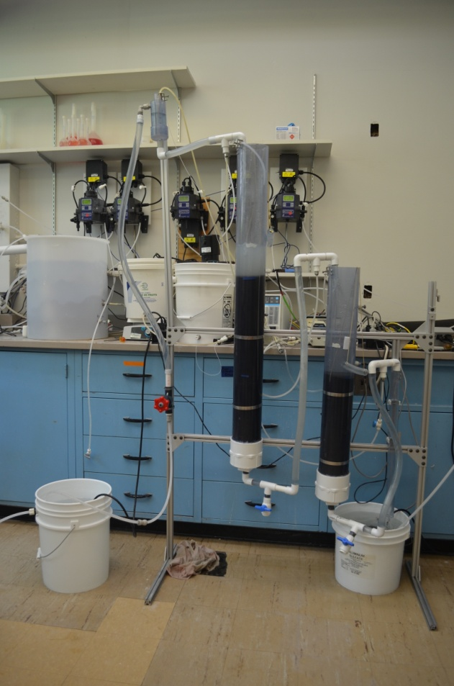

Recap
Original apparatus:
Modified apparatus:

Slide 3


Recap
Entrance Tank
Coagulant
(PACl)
Finishing Filter
(90 ppi foam)
Disinfectant
(Chlorine)
38cm
75cm
Clean Water Reservoir
Roughing Filter
(30 ppi foam)

Slide 4
Useful?
Demand for emergency filtration systems since 1994 Rwanda Crisis (85 – 90% deaths caused by diarrhea) [Toole and Waldman; Doocy and Burnham]
Providing clean water source is the best way to prevent waterborne disease and dehydration (obvi)
15 liters/day per person [UNHCR]

Slide 5
Still Recappin’
Turbidimeter
Turbidimeter
Turbidimeter
Coagulant Feed
Clay Feed
Solenoid Valve
Water Tank
Finishing Filter
Submersible Pump
Roughing Filter

Slide 6
Our Goals For Summer 2012
Determine particle removal capability and longevity of filter components
Determine effectiveness of plunger cleaning method/length of filter cycle

Slide 7
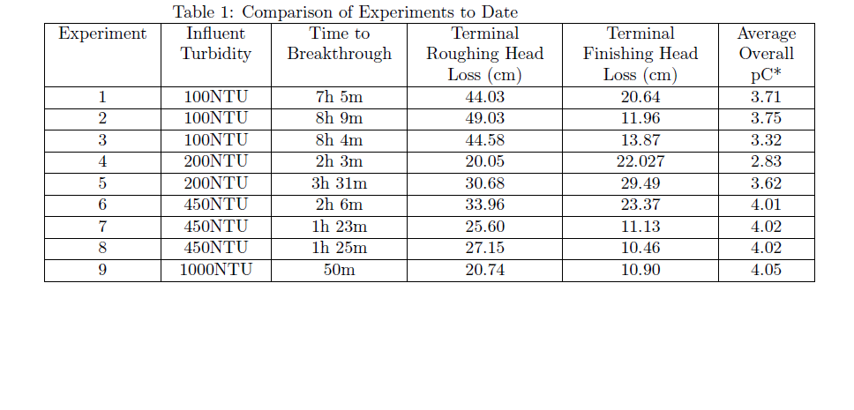
Goal 1: Determine particle removal capability and longevity of filter components

Slide 8

Goal 1: Determine particle removal capability and longevity of filter components
So basically, pC* stays way above the goal of about 1.6…
Btw, pC* = -log(effluent turbidity/influent turbidty)

Slide 9
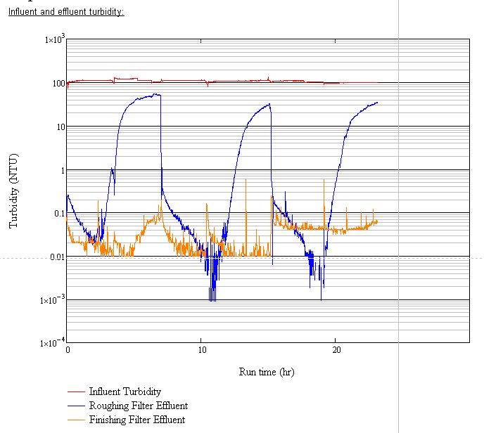
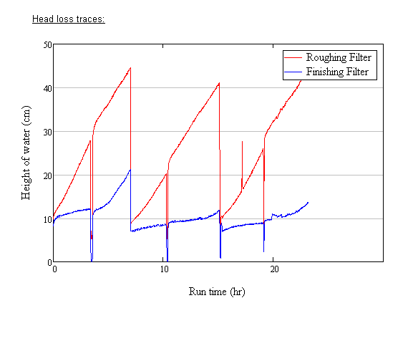
Goal 1: Determine particle removal capability and longevity of filter components
Turbidity and Head Loss data for Three 100NTU Tests

Slide 10
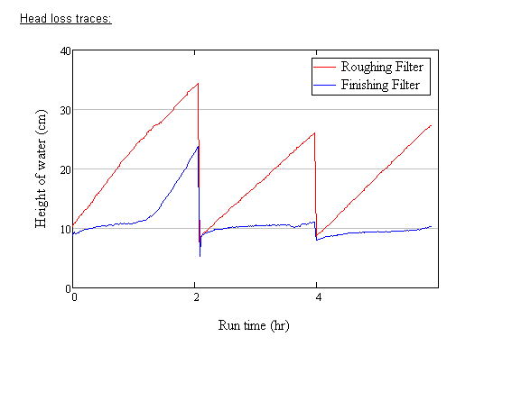
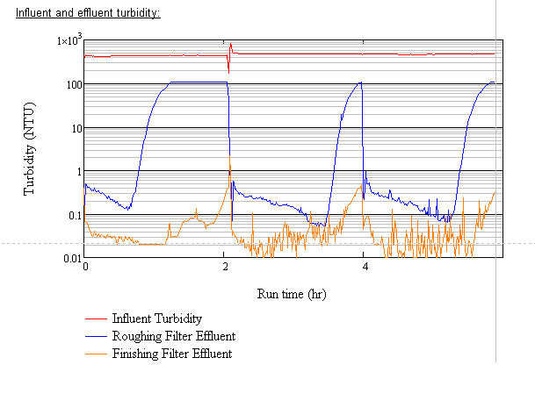
Goal 1: Determine particle removal capability and longevity of filter components
Turbidity and Head Loss data for Three 450NTU Tests

Slide 11
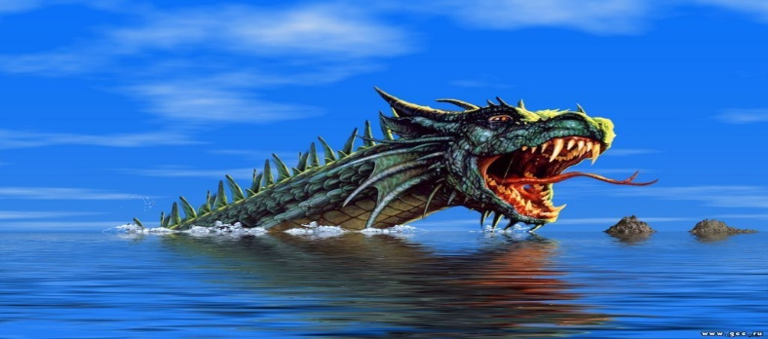
Goal 2: Determine effectiveness of plunger cleaning method/length of filter cycle
See above graphs. Head loss is different for each influent turbidity
Particle penetration is also different, so the filter columns look different at each influent turbidity
However, clean bed head loss returns to normal after cleaning, indicating that the plunger cleaning method works

Slide 12
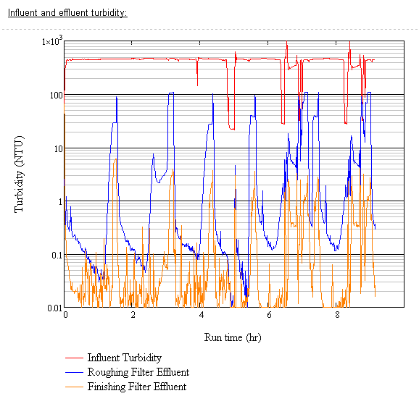
Goal 2: Determine effectiveness of plunger cleaning method/length of filter cycle
Turbidity Data for an Alternative Cleaning Method Test

Slide 13
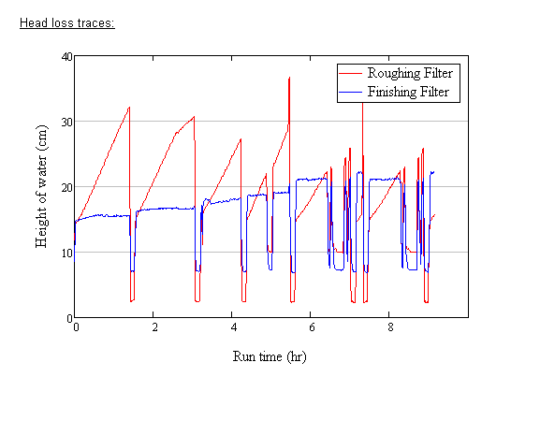
Goal 2: Determine effectiveness of plunger cleaning method/length of filter cycle
Head Loss Data for an Alternative Cleaning Method Test

Slide 14
Goal 2: Determine effectiveness of plunger cleaning method/length of filter cycle
We tried this test because minimizing plunging helps the foam retain its structure
Fewer particles get shoved into the foam’s pores, so it lasts longer
Cleaning when roughing filter effluent turbidity reaches about 5% of influent turbidity might help determine a physical indicator for cleaning (e.g., consistent head loss).

Slide 15
Conclusions!
Effective at a large range of turbidities
Plunger cleaning method appears to be effective
But we don’t know how to determine when to clean the filter without technology
Run time can be extended by cleaning roughing filter at 5% of influent turbidity

Slide 16

Future Work
Run more tests using
alternate cleaning method at
different turbidities
Identify a visual cue for the
end of a filter cycle
Determine the effectiveness of an external cleaning cycle (reuse foam!?)
Find a way to run the filter without electricity
More tests will determine the lifespan of the foam

Slide 17
References
[UNHCR] Stafford, D.M. (1992). Water manual for refugee situations. Program and Technical Support, United Nations High commissioner for Refugees (UNHCR), 1-84
[Toole and Waldman] Toole M, Waldman R. THE PUBLIC HEALTH AS- PECTS OF COMPLEX EMERGENCIES AND REFUGEE SIT- UATIONS. Annual Review Of Public Health [serial online]. April 1997;18(1):283. Available from: Academic Search Alumni Edition, Ipswich, MA. Accessed February 23, 2012.
[Doocy and Burnham] Doocy S, Burnham G. Point-of-use water treatment and diarrhoea reduction in the emergency context: an effectiveness trial in Liberia. Tropical Medicine & International Health [serial online]. October 2006;11(10):1542-1552. Available from: Academic Search Alumni Edition, Ipswich, MA. Accessed February 23, 2012.

Slide 18

¿ Preguntas?

