Slide 1

Foam Filtration
Jenny Guan
Carrie Smith

Slide 2
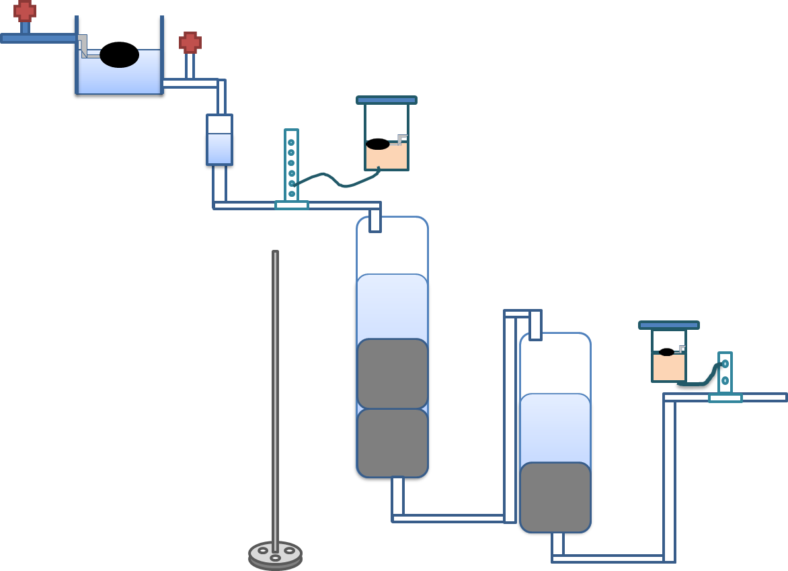

Introduction
Filter water using polyurethane foam
Designed for municipal use
Notes:
Final schematic
Originally, there was a pump that delivered water to the LFOM. Pump was removed. Now system runs without electricity.
We raised the reservoir tank, so now the water is delivered to the through gravity.
Added a cdc for coagulant and chlorine. (talk about what we added)
Point out the components of system (refresher from teach-in)

Slide 3
Methods
Run without electricity
Chemical doser
  Coagulant
  Chlorine
Visual detection
Operator’s Manual
Notes:
Here are the tasks in the order in which we completed them

Slide 4
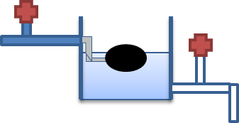
Results
Removing the pump
Notes:
Old set-up. Submersible pump delivered water to LFOM then to roughing filter.
Elevated tank so gravity delivers water to system.
LFOM had to be at a certain level to deliver constant flow to system. Valve to control flow of water to LFOM.
-Need to have LFOM to keep height of tank linear with flow rate
~30 cm (~1 foot) to raise the tank.

Slide 5


Results
CDC
  Coagulant
  Chlorine
Notes:
“Almost Linear Flow Controller”
Based on design from presented in Sustainable Drinking Water. Created by AguaClara researchers
-Need to use a straight tube so can neglect minor losses
-Wanted to minimize amount of materials so we tried to use only the materials already on the system (like the frame)
Used head loss and gravity to deliver a flow of chemical for a range of NTU’s (electricity free!). This is because certain turbidities can’t give round numbers.
Chemical is fed to dosing tank through gravity as well (not pictured). Flow to dosing tank must be larger than max dosing flow (maintain constant head).
Calibrating the system. Measure flow through maximum dose, adjust height of dosing tank according to result.

Slide 6
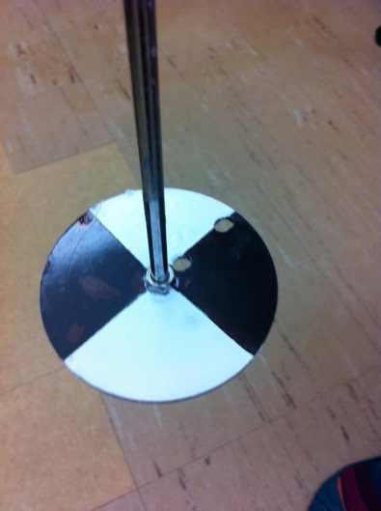
Results
Detection Methods
  Secchi Disk
Notes:
Put on top of finishing filter (effluent from roughing filter). We noticed effluent from roughing filter gets cloudy around 20 NTU.
Secchi disk used in bodies of water→attempt to apply to filter system
Theory: When the secchi disk is not visible, clean the filter.
Idea to calibration: make colors less harsh/ distinct. Use matte paint instead of glossy.

Slide 7
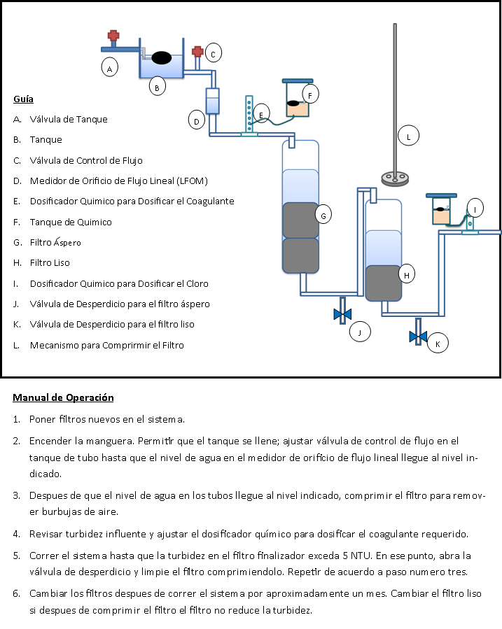
Results
Operator Manual
Notes:
Should be simple to use.
It’s in Spanish!!!
Takes the operator through the task of initializing the system (by adding the foam), running the system (maintaining a constant LFOM height), and cleaning the system.

Slide 8
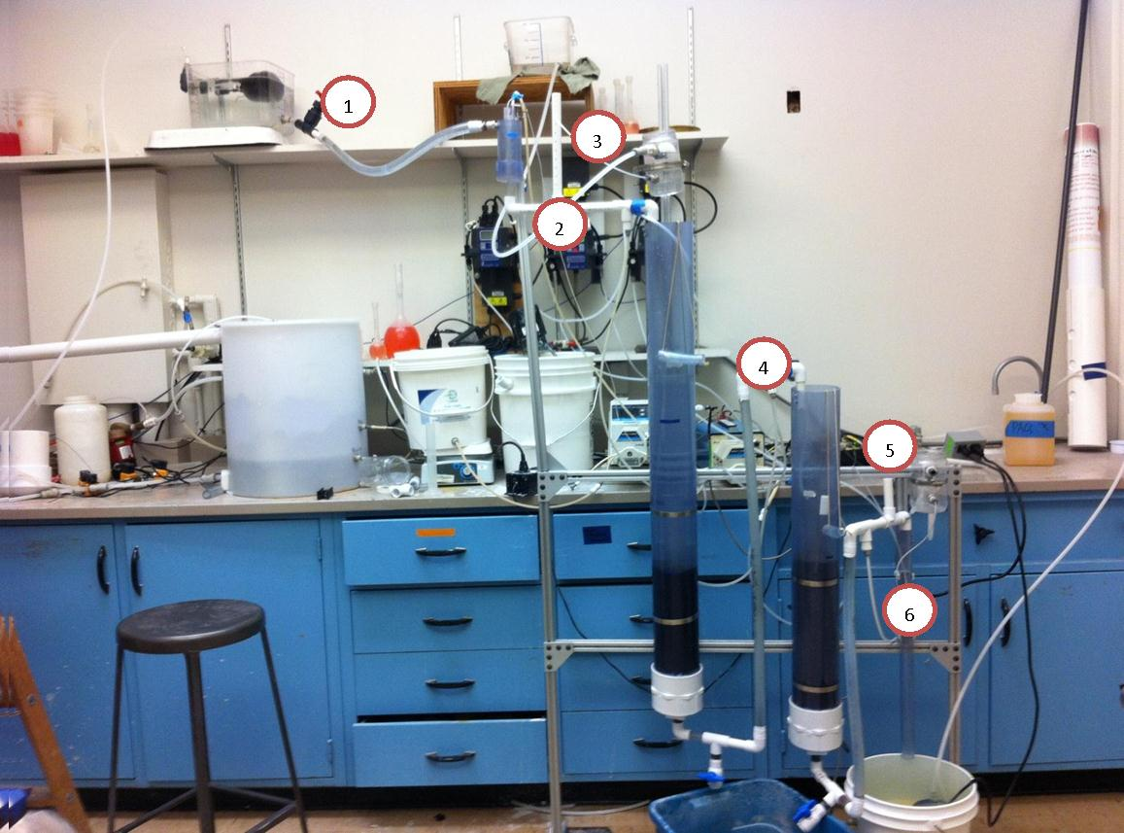
Conclusions
Ability to regulate chemicals in system
Determine when to clean system accordingly
Simple to use user manual
Notes:
This is essentially what our final system looks like…but the bend in the tank pipe isn’t there…

Slide 9

Future Work
Run more experiments with Secchi Disk
Is stacking two filters efficient?
Better visual indicators
  Other than Secchi Disk
Notes:
Run more experiments with the secchi disk. Make use duller colors and matte paint.
See if there’s a correlation between NTU’s and depth the disk disappears at.
Stacking two short filters as opposed to one long filter. The thing we noticed about the clay being visible in the top filter, but not the bottom one. Perform more experiments to see if stacking two filters is in fact more inefficient than having one long filter.
Is there a better method than the Secchi disk? For now we are going by time. Past foam filtration teams have found out that the roughing filter needs to be cleaned once every 4 hours at range of regular turbidities (highest being 120 NTU under normal conditions). The filter itself can last one month before being replaced.

Slide 10
Questions?

