Slide 1

Foam Filtration Final Presentation
December 10, 2011
Brad Irish
Anna Lee
Rachel Philipson

Slide 2
Foam
Non-conventional filtration media
More porous
  Filtration velocities through foam can be 3x larger than sand
Surface area 3x as smaller than conventional sand filter
Lighter and easier to transport than sand
Less ripening time
No backwash required
Notes:
Be sure to note that we do still have to clean the foam!

Slide 3
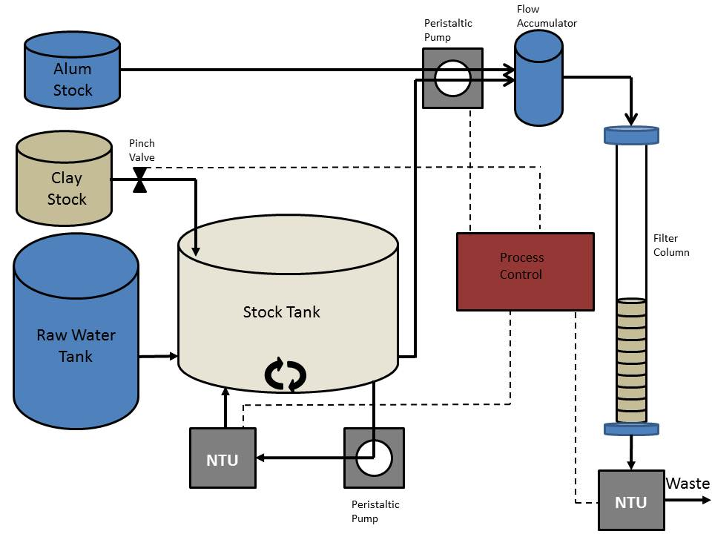

Experimental Apparatus

Slide 4
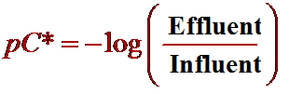
pC*
Notes:
Additionally, log removal (pC*) is also a metric for determining filter performance; however, when influent turbidities are varied, it is more straightforward to compare effluent turbidity. Log removal is defined as the negative log of effluent turbidity divided by influent turbidity.

Slide 5
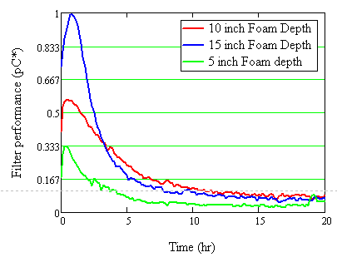
Varying Depth
Filter Performance of 30 ppi foam with an approach velocity of 6 mm/s, an alum feed, a 100 NTU influent and a 5, 10 and 15 inch filter bed depth.
Notes:
In order to continue our explore the idea of using foam with a larger pore size as a roughing filter, we decided to investigate the relationship between the depth of the foam fitler bed and its performance. The experimental apparatus is the same was previously described, however we varied the depth of foam. Bed depths of 5, 10 and 15 inches were chosen. This range will accuratlely capture the effect of filter bed depth on performance. This experimental trial will also give insight into the filter bed's capacity for capturing particles. Additionally, 30 ppi foam filtration performance was measured as a function of varying influent turbidity. The same experimental apparatus was also used for this trial, however the PACl dose was varied linearly to reflect the differences in influent turbidity.
Filter Performance of 30 ppi foam with an approach velocity of 6 mm/s, an alum feed, a 100 NTU influent and a 5, 10 and 15 inch filter bed depth.
These results prove that filtration performance is directly related to the depth of the filter. Since the 15 inch foam depth can successfully filter 100 NTU water to 10 NTU, it is assumed that a filter bed of approximately 30 inches will be able to do the same, and thus the roughing filter will be able to provide acceptable influent turbidities for the finishing filter.

Slide 6
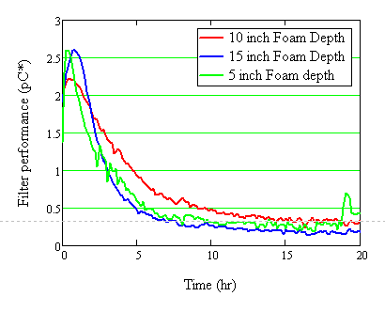
Normalized Plot
Notes:
Additionally, it should be noted that when the pC* data is normalized with the bed height, all three performance curves are the same. Thus, filtration performance varies linearly with filter bed depth, and based on the desired effluent turbidity, the bed height can be determined. This confirms our hypothesis about the linear relationship between the filter performance and the filter bed depth. From this we can conclude that we can get pc* of 2.5 per meter of filter bed depth.

Slide 7
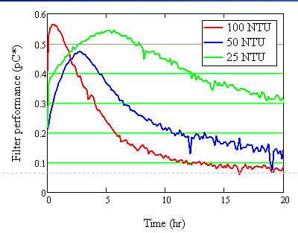
Varying NTU
Filter Performance of 30 ppi foam with an approach velocity of 6 mm/s, filter bed depth 10 inches, an alum feed of 25, 50, 100 NTU influent.
Notes:
This graph shows that pC* stays relatively constant with changing influent turbidity.
The higher the influent turbidity, the lower the ripening time. You can see that the performance gets better faster for 100 ntu compared to lower ntu’s
We hypothesized that with the lower NTU it would perform better longer which is demonstrated on the graph by its wide.

Slide 8
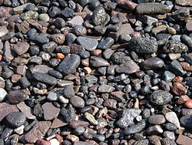
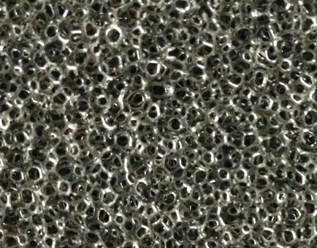
Emergency Filter Design – Roughing Filter
Conventionally composed of gravel/larger particles
Effective pre-treatment process
  Removes larger particles that would clog finishing filter
Minimal head loss

Slide 9
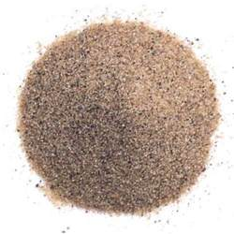

Emergency Filtration – Finishing Filter
Conventionally composed of sand/smaller particles
Lower effluent turbidities
  Meets EPA drinking water standards (0.3 NTU)
Higher head loss
  Potential for collapse

Slide 10
Emergency Filtration
Influent
A
B
Effluent
C
D
Finishing Filter 1
Finishing Filter 2
Roughing Filter
E
F
Notes:
Preliminary schematic
-filter columns are made out of PVC of varying widths depending on the quantity of water required
-will probably use 1.5 inch pvc pipes to connect the filters
-note that 2 way valves are cheaper than 3 way valves

Slide 11
Modes of Operation
Influent
A
B
Effluent
C
D
Finishing Filter 1
Finishing Filter 2
Roughing Filter
E
F
Notes:
1. Both finishing filters are in operation. Order of operation is Filter 1, Filter 2 and valves A, D and F are open.

Slide 12
Modes of Operation
Influent
A
B
Effluent
C
D
Finishing Filter 1
Finishing Filter 2
Roughing Filter
E
F
Notes:
2. Finishing filter 2 is in operation while finishing filter 1 is offline for cleaning. Valves B and F are open.

Slide 13
Modes of Operation
Influent
A
B
Effluent
C
D
Finishing Filter 1
Finishing Filter 2
Roughing Filter
E
F
Notes:
3. Both finishing filters are in operation. Order of operation is Filter 2, Filter 1 and valves B C and G are open.

Slide 14
Modes of Operation
Influent
A
B
Effluent
C
D
Finishing Filter 1
Finishing Filter 2
Roughing Filter
E
F
Notes:
4. Finishing filter 1 is in operation while finishing filter 2 is offline for cleaning. Valves A and E are open

Slide 15
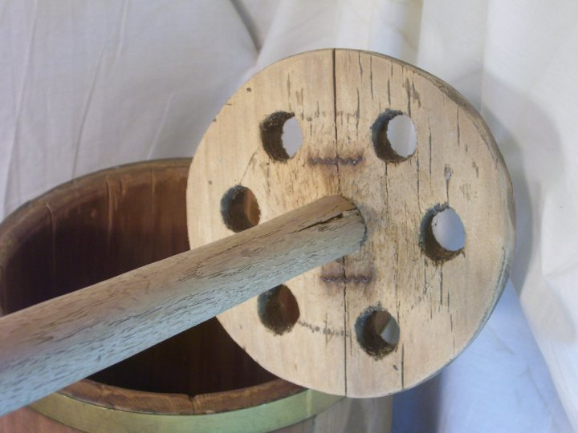
Cleaning the Filter
In order to clean the filter the foam must be compressed to release accumulated clay particles.
Because the force required to compress the foam is small, a simple plunger system was designed.
At all times the foam must be kept fully submerged to prevent air bubbles from entering the column.

Slide 16
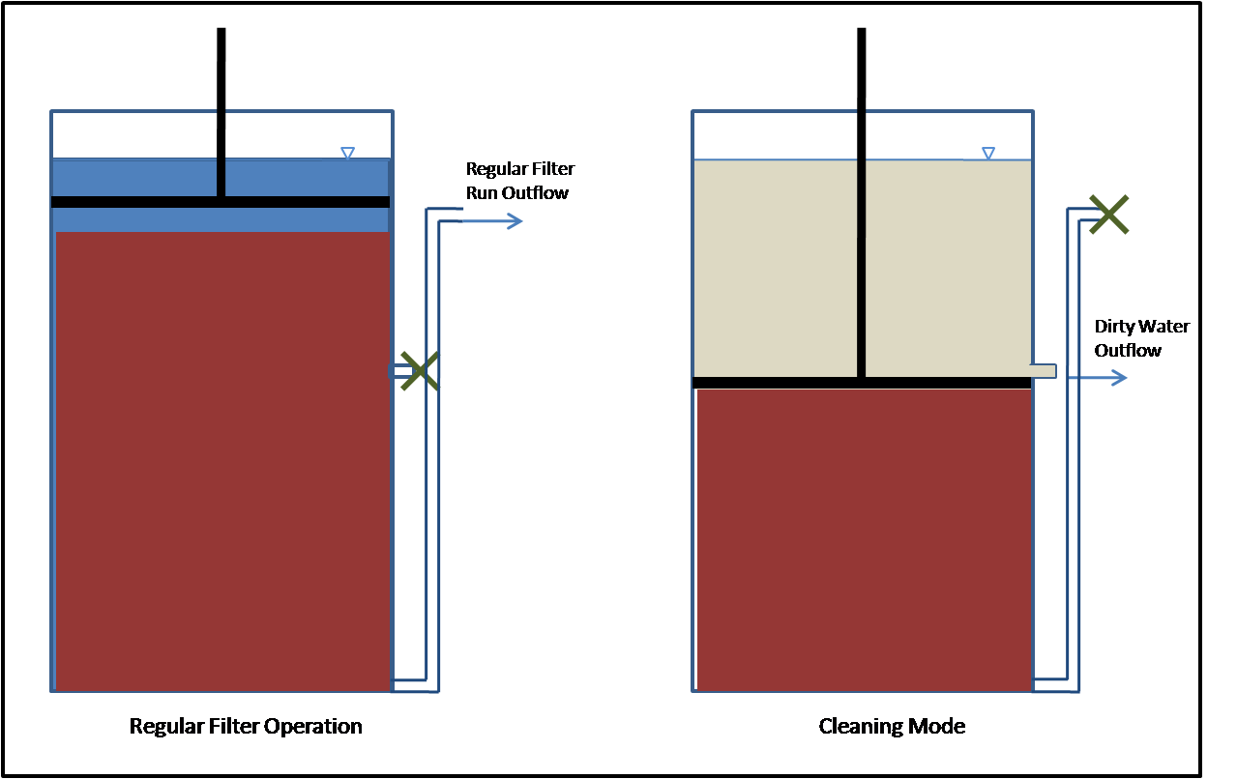
Cleaning the Filter
The plunger is designed to work in essentially the same way as a butter churn.
A long pole is attached to a circular plate with holes bored in it to allow water to flow past.
The plunger compresses the foam underwater and is pinned in place when the foam is compressed enough.
Water is then flushed through the system to remove most of the turbid waste water.

Slide 17
Cleaning the FIlter
Before the plunger is released, the lower valve is closed and the column is refilled with water, ensuring that the foam is never exposed to the air.
Once the plunger is released the foam will naturally expand to fill the column.

Slide 18
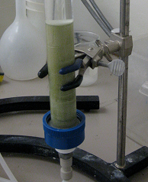
Future Work
Though we have a design for both the filtration system and the cleaning system, both designs still need to be thoroughly tested.
The plumbing and overall design of the filtration system also needs to be evaluated to minimize head loss and cost.
Perhaps most importantly, we need to find a reliable source of polyurethane foam that meets our specifications.

