Slide 1
Foam Filtration
Kristin Chu
Marlana Hinkley
Ethan Keller
Valerie Pietsch
Notes:
Val

Slide 2
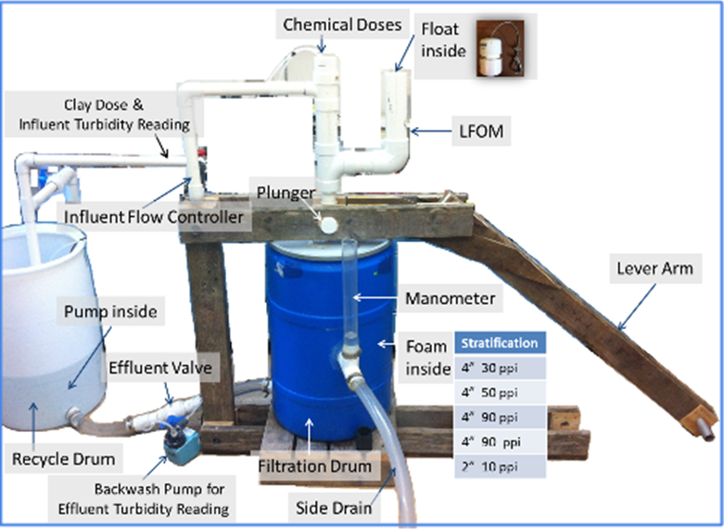
Why Foam?
Less water wasted
Less space needed
Less expensive
This would be most
beneficial for:
Medium sized villages
Emergency situations
Temporary situations
Notes:
Val

Slide 3
Goals
Easy to test
Easy to build
Easy to operate
Construct cohesive system
Communicate
Construct
Research
Design
Notes:
Val

Slide 4
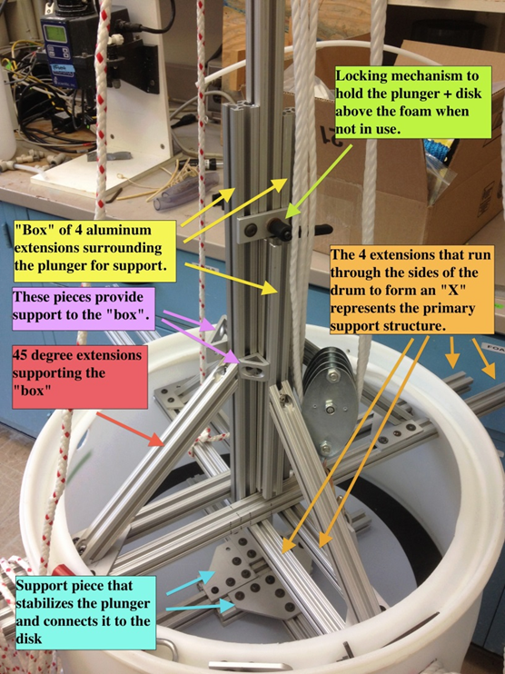
Last Semester/Summer
Used compression system to clean the foam
  Found backwash to be more efficient
Funding sources still skeptical – need more data!
Notes:
Val

Slide 5
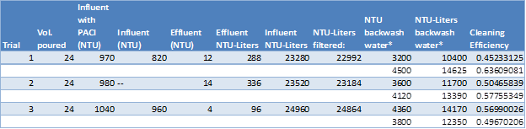

Compression/Backwash Data
4” Pipe Filter Compression Test
4” Pipe Filter Backwash Test
(NTUliters.backwashed)/(NTUliters.filtered)=Cleaning efficiency
Notes:
Marlana

Slide 6
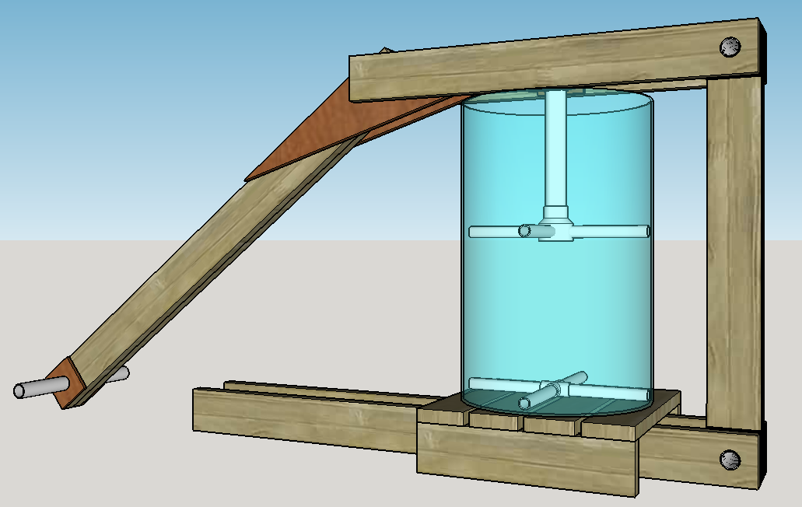
This Semester
Testing apparatus
  New plunger
  New backwash drain
  Keep electronics dry
  Design & integrate LFOM/CDC
  Lighter lever arm
  Re-design 4” Filter
Notes:
Marlana

Slide 7
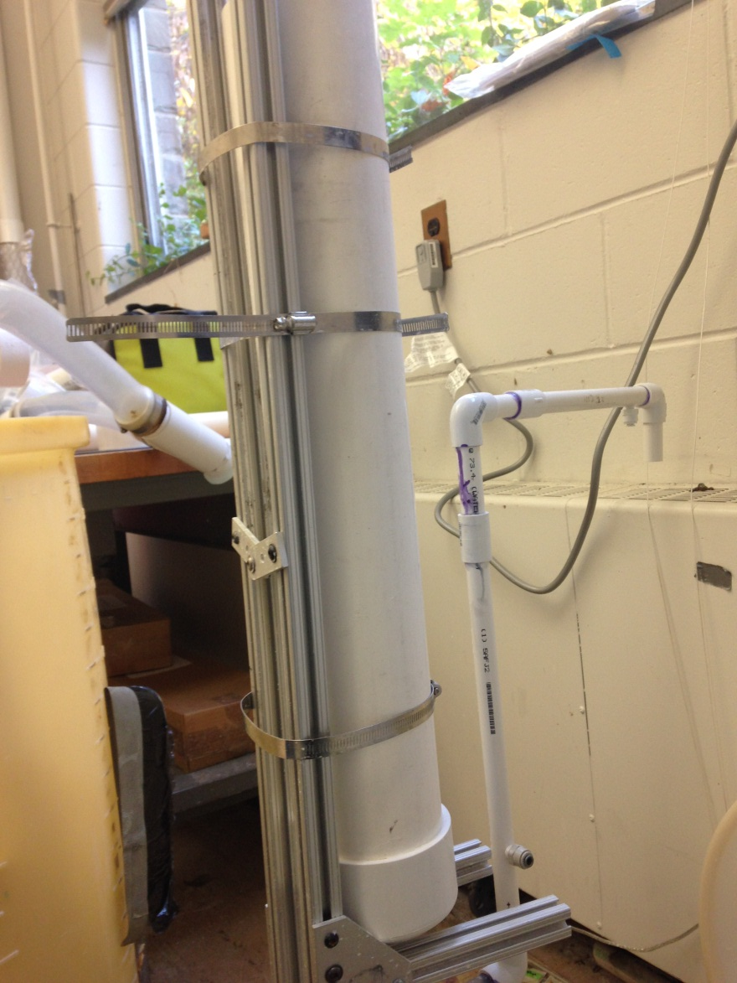
Small Filter
Re-design: clear pipe, recycle system, lever arm
Backwash system efficiency
  Empirical relationship between force used to plunge, pore velocity and cleaning efficiency
Notes:
Marlana

Slide 8
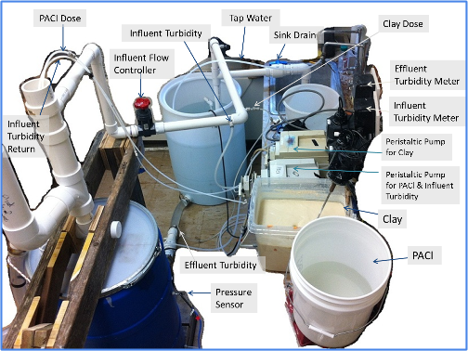
The Current System
Notes:
Ethan

Slide 9
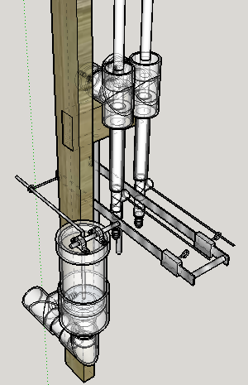
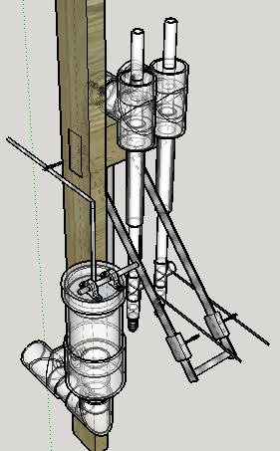
Proposed CDC System
Notes:
Ethan

Slide 10
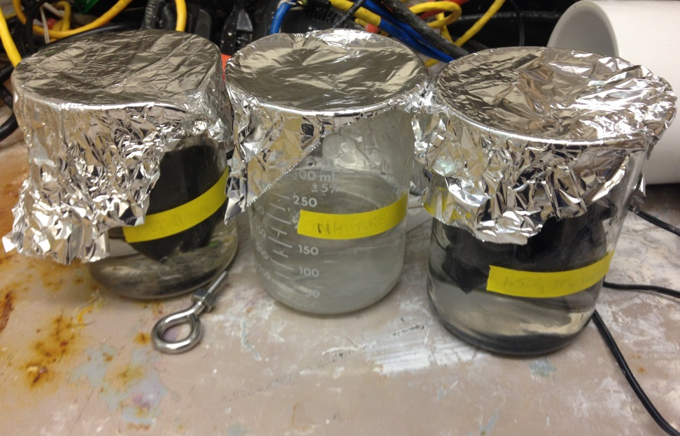
Is Foam Safe?
Ether- and ester-based reticulated polyurethane foam
Conducted an initial leaching test using mass spectrometer
THE FOAM LEACHES!!
Notes:
Kristin

Slide 11
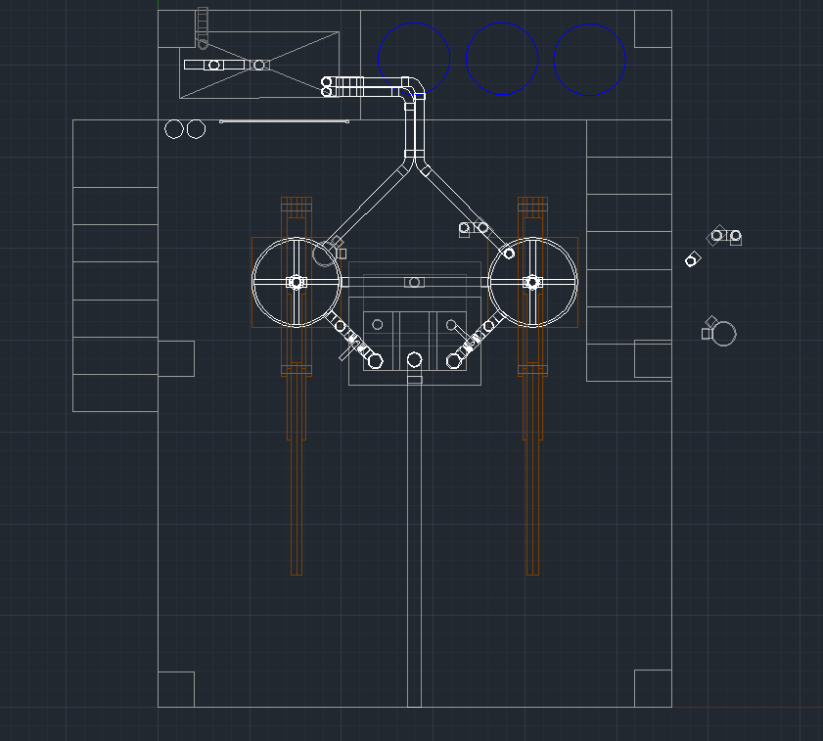
Honduras
Video calls with Jon & Walker to share research/designs
Provide data for support of system in Honduras
Current priority: integrate LFOM/CDC into a cohesive system
Trip in January
Notes:
Kristin

Slide 12
What’s Next
Continue researching what could be leaching from foam
Construct new 4” Pipe Filter & begin conducting tests
Fabricate & implement LFOM & CDC designs on large filter
EPA Phase 2 Project Proposal
Notes:
Kristin

Slide 13

Questions???

