Slide 1

Foam Filtration
Lishan Zhu
Jianying Guan
Monica Kuroki
Notes:
Lishan: Background/ Intro (include literature review on foam filters), Semester Goals, LFOM slides (include chart of hole measurement and sizes, grab the equation used in MathCad file), Add works cited for literature review
Jenny: Stand (please elaborate on the entire design process, piece choice, assembly, measurements, etc-- this will be fairly long because it was a large part of the semester that you spearheaded), Materials Sheet and Pricing (just copy and paste table)

Slide 2

Background
Filter water using polyurethane foam
Designed for small communities, schools, and emergency situations.
Flow of 3L/min

Slide 3
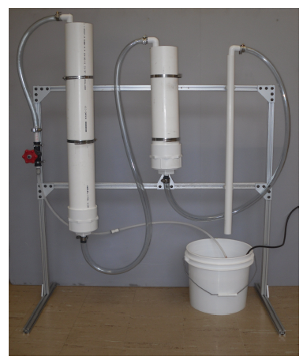
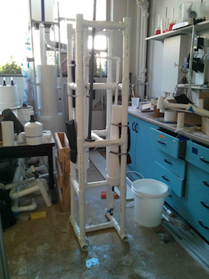
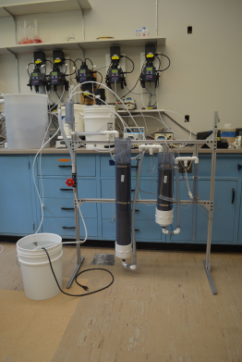
Background
Spring 2012
Spring 2013
Fall 2012

Slide 4
Semester Goals
The primary goals for this semester:
  Develop new foam filtration system (original deployed to Honduras, January 2013)
  Design system to use more in-country materials
  Design new stand
  Provide documentation guide and ordering requirements for foam filtration fabrication

Slide 5
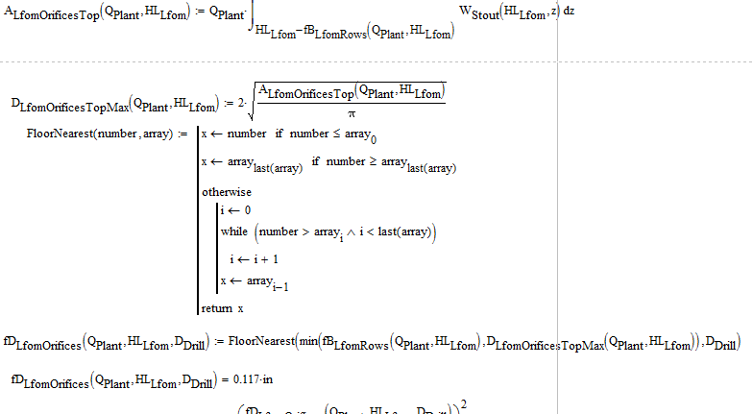
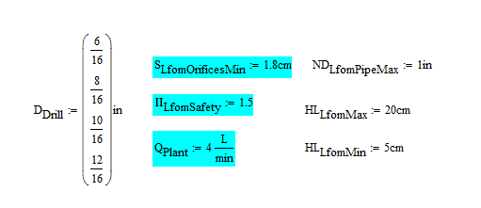
Linear Flow Orifice Meter

Slide 6
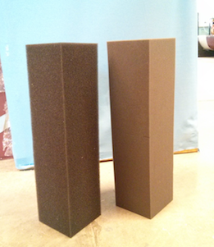
Foam Filters
Two roughing filters
  30 pores per inch (ppi)
One finishing filter
  90 ppi
Pieces ordered from New England Foam

Slide 7
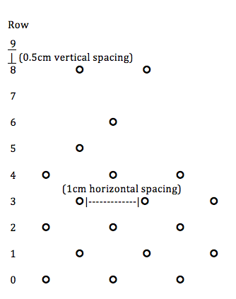
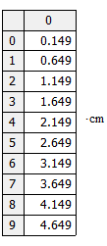
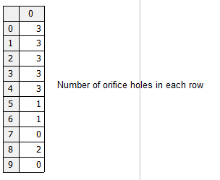
Linear Flow Orifice Meter

Slide 8
Foam Filters Measurements
Cut in a 4 inch (10.16 cm) diameter circular shape
Kept at the original height of 14.75 inches (37.5 cm)
(2) 4 inch (10.16 cm) diameter Schedule 40 PVC pipes were ordered as holders for the foam filters
  These measurements were determined by a previous team as they optimize NTU removal

Slide 9
Foam Filters Fabrication
Cut pieces as close to a 4 inch (10.16 cm) circular diameter as possible using a table saw.
  Continue to remove small segments on the edges until the piece looks round (will appear octagon shaped)
  Want diameter slightly greater than 4 inches to ensure there is not preferential flow
Insert pieces into PVC to ensure no gaps

Slide 10
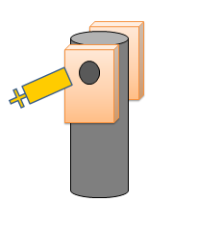
Foam Filters Fabrication
  Puncture a hole horizontally across the top of the filters using a corer
    Clamp the foam between two wood block
    With a 0.5 inch (1.27 cm) hole drilled into one wood block, puncture the foam using the corer once the foam is secure.
    Creates a 0.5 inch diameter (1.27 cm) hole.
    Hole used to thread the string through for cleaning and measuring purposes.
Insert 0.5 inch clear PVC tubing into hole to protect foam from damage during usage

Slide 11
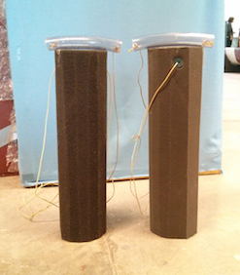
Foam Filters
Thread String with plastic handles through hole
  For foam removal during cleaning
Picture/Graph/Table

Slide 12
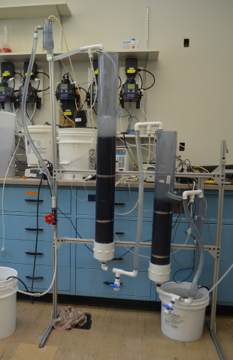
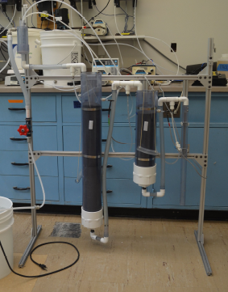
Stand
Original Design:
  For experimental purposes
  Used materials not readily available in country (i.e. 8020 steel, clear PVC, flexible clear PVC)

Slide 13
Stand
Use readily available materials in country.
Original plan: use wood
Concerns:
  Contact with water, warps
  Not the best option

Slide 14
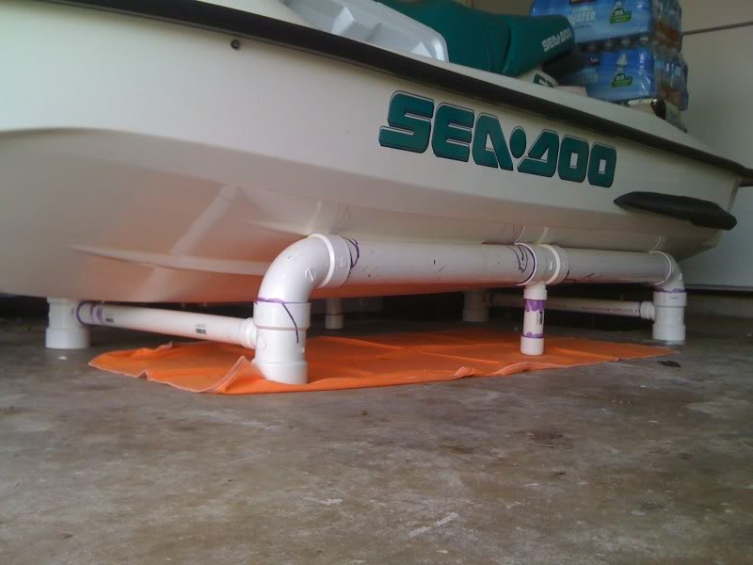
Stand
Use PVC instead
Cheaper option than wood
Readily available
Surprisingly strong

Slide 15
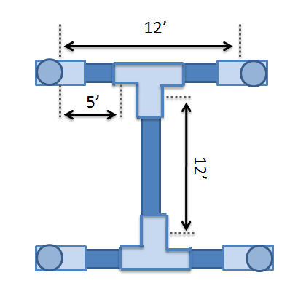
Stand
Chose 1 ½ inch diameter Sch 40 PVC piping.
Connected using 1 ½ inch Sch 40 PVC Tees.
Lengths based on filter casing sizes.
Extra foam to create more area between filter cases and stand.

Slide 16
Materials Sheet and Pricing
Item | Purpose | Quantity | Total Price
4”D x 10’L PVC Pipe | Filter Case | 1 | $40.92
4”D PVC Pipe Cap | Filter Case Seal | 2 | $11.40
3-7/8” Flange, ¾” Pipe fitting | Bottom of Cleaner | 1 | $8.66
¾” D x 5’ L PVC Pipe | Cleaner Handle | 1 | $4.75
1 ½”D x 10’L PVC Pipe | Stand Legs & Rungs | 4 | $43.16
1 ½”D Fitting, Tee | Stand Connectors | 20 | $30.20
1 ½”D Fitting, Elbow | Stand Connectors | 4 | $4.52

Slide 17
Materials Sheet and Pricing
Item | Purpose | Quantity | Total Price
1” Female Socket x NPT Male | Attach LFOM to Reservoir | 1 | $0.54
½”D PVC Fitting, Tee | Attaching Pipes Between Filters | 3 | $1.11
½”D PVC Fitting, Elbow | Attaching Pipes Between Filters | 8 | $2.40
½”D x 10’L PVC Pipe | Transport Water Between Filters | 1 | $4.13
PVC Ball Valve, ½” Female Threading | Exit for Cleaning Residue | 1 | $6.90
½” Female Socket x NPT Male | Attaching Valve | 1 | $0.27
½”D x 3”L Theaded Pipe Nipple | Attach Filter Casing | 1 | $1.56
Hose Clamps | Attach Filter Casing to Stand | 5
Total |  |  | $160.52

Slide 18
Future Work
Complete stand to hold coagulant and chemical dosers
Seal all joints to make water tight
Run trials recording head loss, turbidity removal rates
Run trials to record lifetime of foam
Develop Linear Chemical Dosing System for coagulant and chlorine

Slide 19
Conclusion
Accomplishments:
  Developed and constructed a new foam filtration system
    in-country materials
  Designed new stand
    Easily acquired materials, transportable, light-weight
  Provide documentation guide and ordering requirements for foam filtration fabrication
    Ordering lists, instructions for construction

Slide 20
We want to give a special THANK YOU to Casey who was an amazing team leader and incredibly helpful throughout this semester!
Are there any questions?

