Slide 1

Foam Filtration
Skyler Erickson
Melissa Shinbein
Kadambari Suri
Jeffrey Suen

Slide 2
One Column
Notes:
Bari

Slide 3
Two Columns
Notes:
Bari

Slide 4
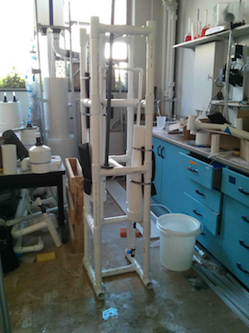
Emergency System
Notes:
Bari

Slide 5
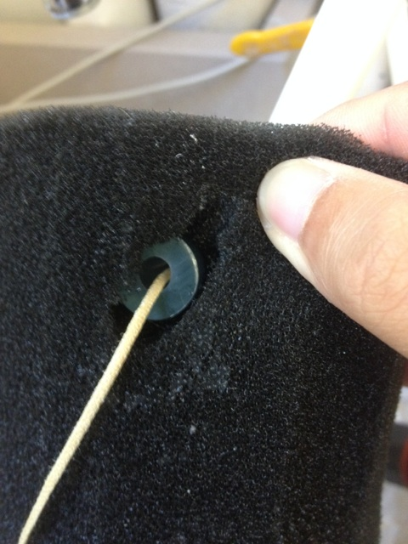
Compression Test
The current method of decompressing foam doesn’t result in tear on the foam, BUT allowing the foam to decompress naturally would:
  Simplify the cleaning process.
  Eliminate the need to install a handle in the foam.
Notes:
Jeff

Slide 6
Problems → Solutions
Stability
Cleaning Techniques
One Column
Siphon
Concrete, Compound lever, Lever-Screw, Cable-Tension, Winch-Pulley
Notes:
Melissa
So after the compression test showed the foam wouldn’t be the first thing to fail, we started investigating other issues with the apparatus such as stability and cleaning techniques. First we looked at stability and realized… we really had no reason why two columns would be better than one, so we reduced the system to one column.
Then, to more effectively clean the foam, we began looking at a bunch of different options which we will go into more detail on in future slides. The main message here is we were investigating using a siphon with one of those other mechanisms that could be used to compress the foam.

Slide 7
One-Column Simplicity
30 PPI
34”
30 PPI
24”
30 PPI
90 PPI
90 PPI
90 PPI
Notes:
Jeff

Slide 8
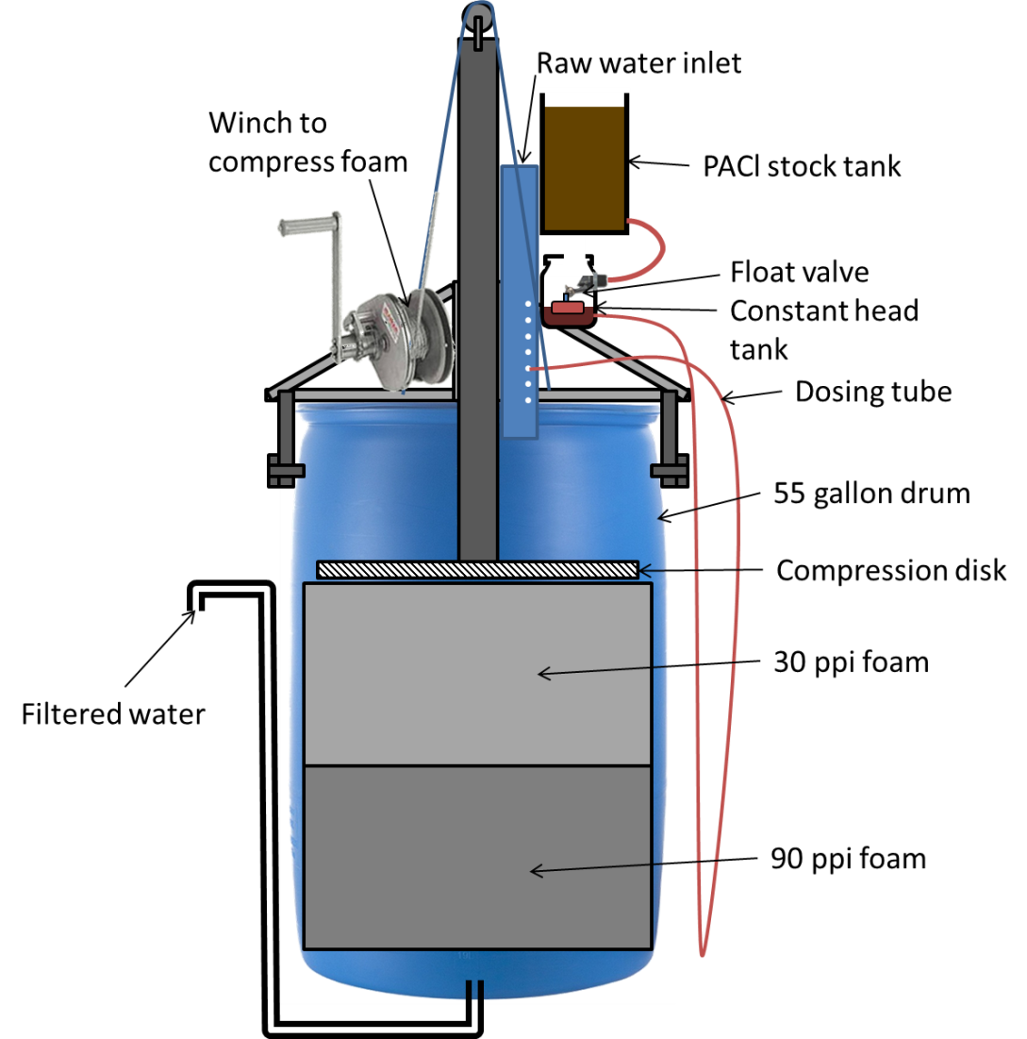
NEW SYSTEM
Siphon, CDC, LFOM
Ratchet-Lever Hoist
Pulley System
Notes:
Melissa
Mixing all these extra components together with our one-column, we came up with this system! (props to Monroe who made this for our EPA P3 proposal) the idea is, its an aguaclara system rolled into one. It doses influent water with coagulant (eventually including an LFOM to measure flow), treats the water with foam, and then lets the water out through an effluent drain which goes up to just above the level of the foam so at equilibrium, the foam is still fully submerged in water. When it is time to clean the foam, the system is compressed and dirty water goes out an exit drain… which will be shown on the next image.

Slide 9
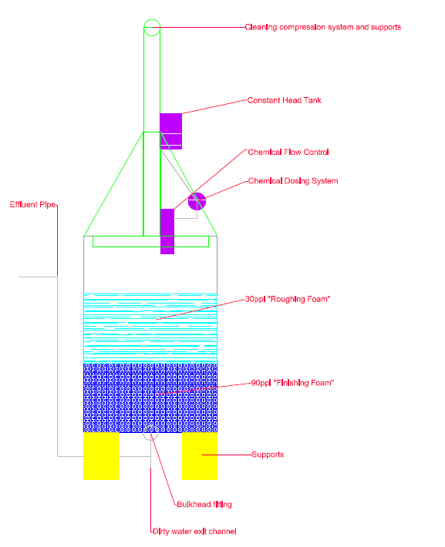
Frame
Entirely Steel, to withstand 500 lbs. of force
1 Telescoping Pipe that encompasses the smaller plunging pipe
4 Triangular braces attached to drum sides to provide stability and support
Notes:
Skyler

Slide 10
Plunging Techniques
Hoist and Cement
Cement isn’t realistic for an emergency system.
Cement will have some degree of buoyancy so we actually need closer to 1000 lbs.
Winch and Pulley System
Allows us to apply a customizable force
Compression might happen too slowly
Notes:
Skyler

Slide 11
Siphon
Remove dirty water on top of the foam displaced by plunging
Do so without cutting a hole in the drum
Dirty Water
30 PPI
90 PPI
Waste Bucket
Notes:
Skyler

Slide 12
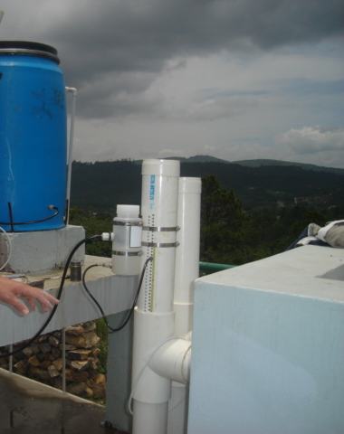
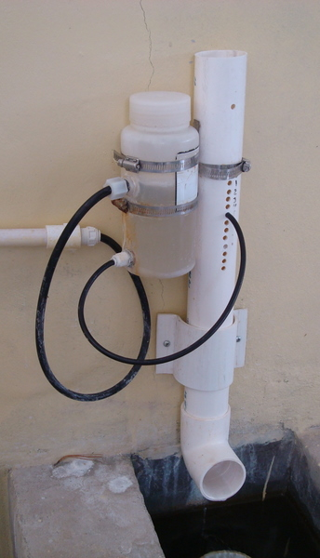

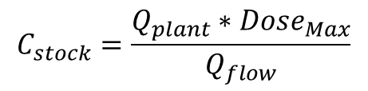
Flow Controller
Set amount of coagulant
10cm pipe
1/8th and 1/16th diameter tube
Optimize Q.flow and C.stock
$$C_{stock}=\frac{Q_{plant}∗{Dose}_{Max}}{Q_{flow}}$$
Notes:
Melissa:
Set coagulant based on influent turbidity where the topmost hole represent “equilibrium” (so, no stock coming out)
To set some constraints: plant 1L/s, dose max 20mg/L, hf, and diameter of tubing between those two.
Ran it at different possible lengths of the tubing to get a range of Q.Flows. Since Q.flow had to be linear, narrowed down scope. From this scope, calculated Cstock which (from other plants couldn’t be greater than approximately 200 or 260mg/L)

Slide 13
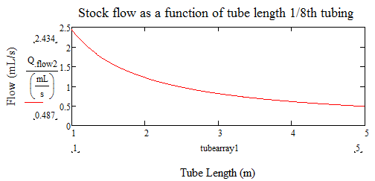
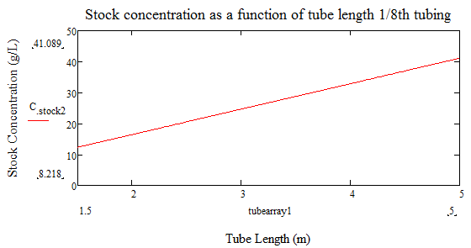
Flow Controller Analysis
Notes:
Concerned about 1/16th clogging so only showing 1/8th
Linear after 2.5m
Cstock should be greater than the max dosage (20mg/L), putting ideal tube length between 2.5 and 5m

Slide 14
EPA P3
Back to emergency system
55gallon drum with all pieces inside
  Airplane drop
SUBMITTED: December 9, 2013
Notes:
Jeff

Slide 15
Questions?
ERASER
Getting Jeff’s attention
Fun Uses for Foam! :D
The possibilities are endless!
Pillow
“Learning enforcement tool”
(aka- baseball bat)
Threaten the CDC team (BFFs) with

