Slide 1

Foam Filtration
Kristin Chu
Skyler Erickson
Melissa Shinbein
Jeffrey Suen
Kadambari Suri

Slide 2
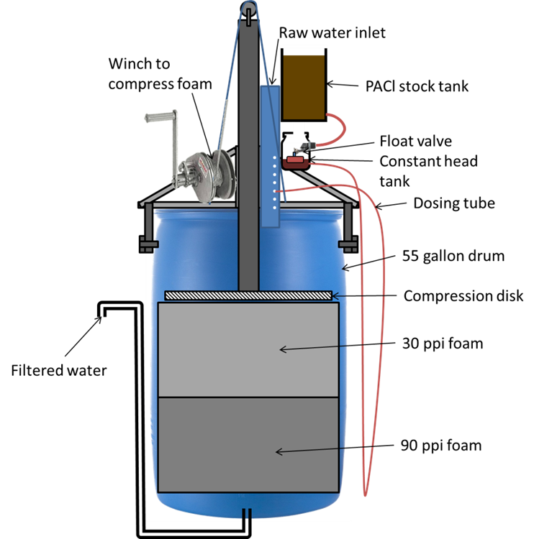
Last Semester
Notes:
JEFF

Slide 3
This Semester
GOAL: To design and build a fully functioning foam filter.
  Continue brainstorming different compression materials, techniques
  Designing dose controller

Slide 4
Pulleys

Slide 5
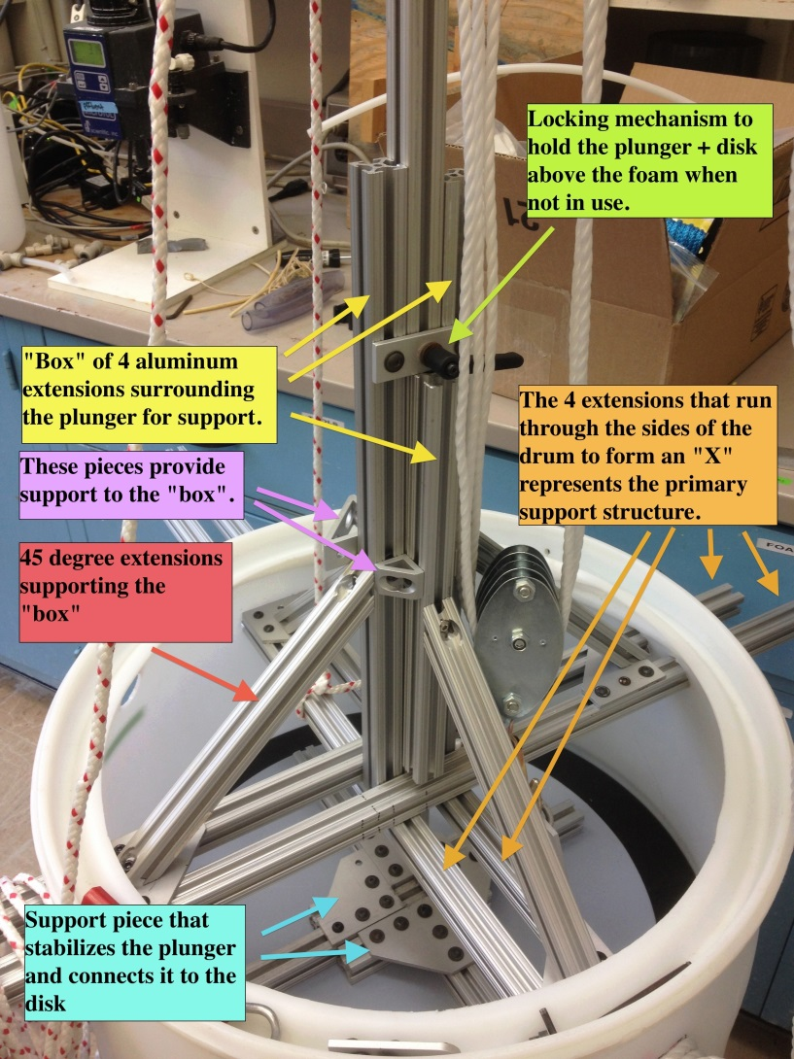
Structural Support
4 cross drum support pieces
“Box” for balance and stability
Supported by 45 degree extensions
Locking mechanism to hold plunger and disk above the foam

Slide 6
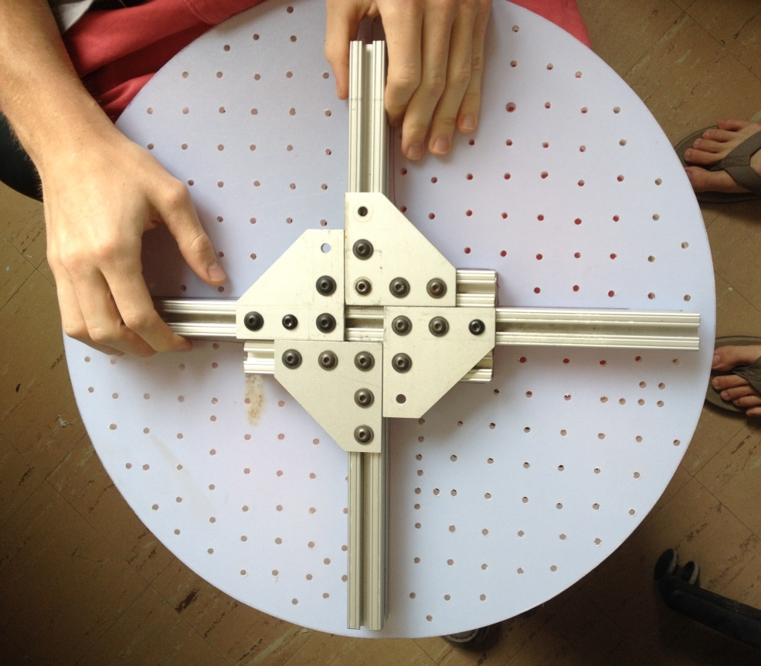
Plate Design
80/20 support system to distribute force evenly
18” diameter plate with 3/16” holes spaced 1” apart
Water to flow in natural channels of 80/20

Slide 7
Foam Decompression
Original problem in Honduras
Excess of 1” diameter
Decompresses 14 of 16” almost immediately
DEMONSTRATION

Slide 8
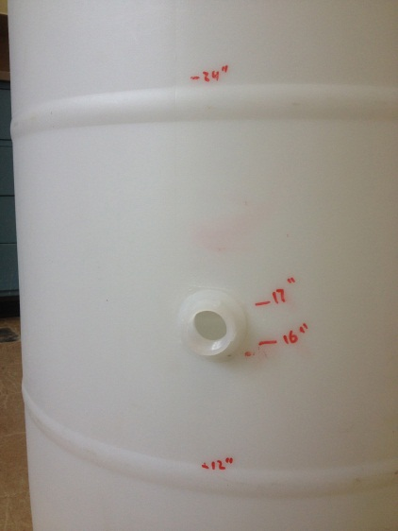
Side Drain
Problem: Dirty water that sits on top of the compressed foam needs to be removed.
Previous Solution: Siphon → Tested in Honduras.
Improved Solution:
SPIN WELDING
Dirty Water
30 PPI
90 PPI
Notes:
Skyler

Slide 9
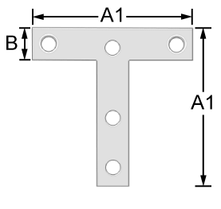
Flow Controller
Stock tank: 2.6cm above flow controller
Tubing length: 0.55m
Attaching to drum

Slide 10
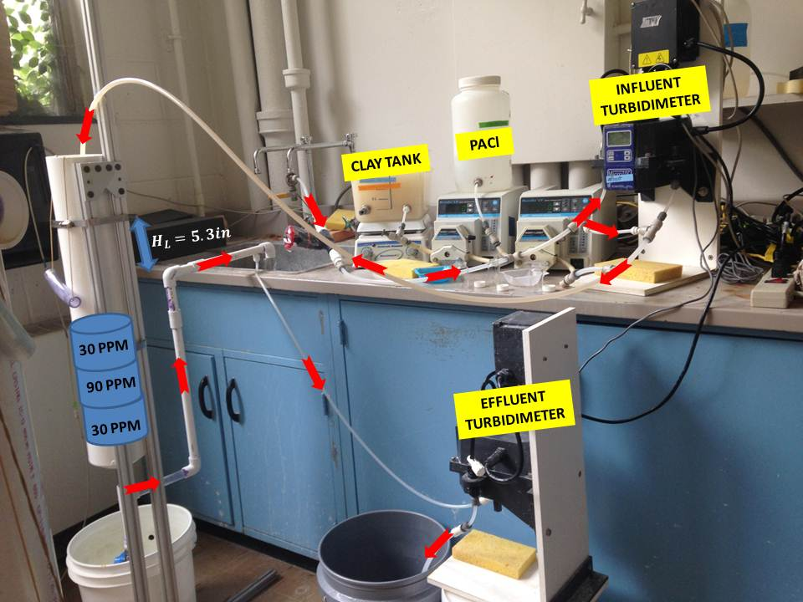
Compression Velocity Test

Slide 11
Compression Velocity Test
 | Velocity (mm/s) | Influent Turbidity (NTU) | Effluent Turbidity (NTU) | Wash Water Turbidity after Compression (NTU) | Percent Cleaned
Test 1 | 312 | 180 | 0.7 | 978.2 | 104.1%
Test 2 | 128 | 234 | 1.6 | 1029.4 | 80.0%
Test 3 | 39 | 220 | 0.67 | 250 | 3.2%

Slide 12
Moving Forward
Side exit for effluent water → using SPIN WELDING
Testing the drum (Lab and Honduras)
Packaging system
Answer fundamental questions about foam

Slide 13
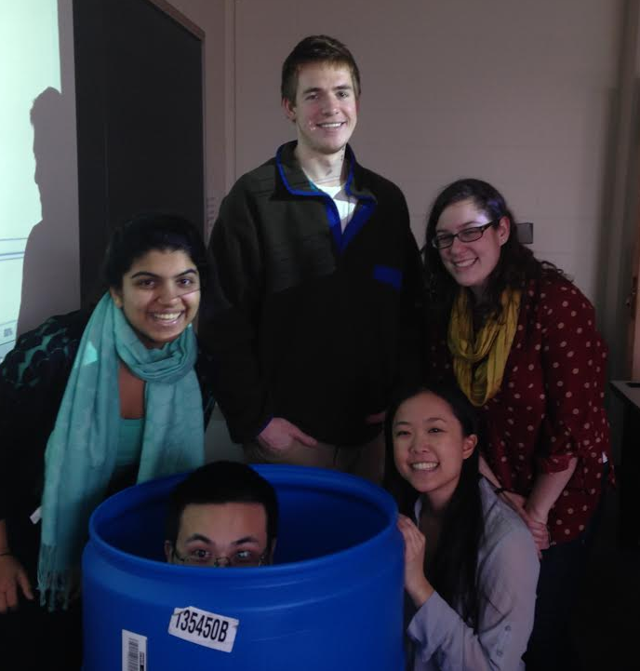
Questions?

