Slide 1

Foam Filtration
Skylar Erickson
Melissa Shinbein
Kadambari Suri
Jeffrey Suen

Slide 2
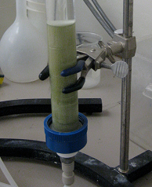
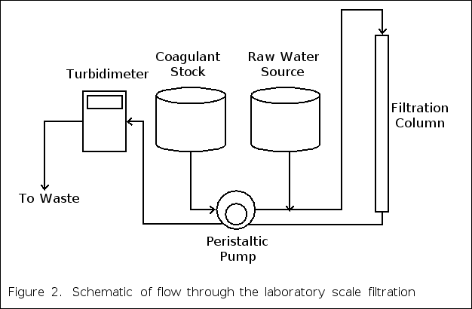

Summer 2010

Slide 3
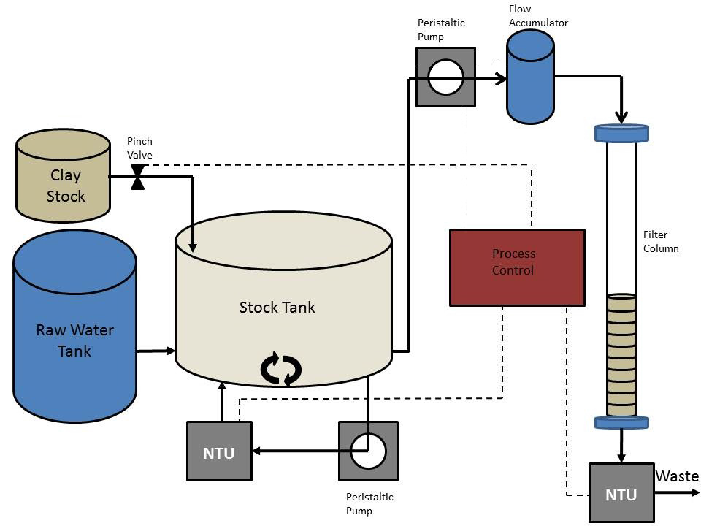
Fall 2011
Foam too inefficient
without coagulent
30 ppi foam is
efficient to reduce
highly turbid water
(100+ NTU)

Slide 4
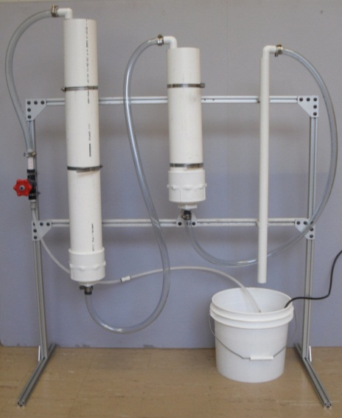
Spring 2012
Develop the plunging method
Foam expo proved the full scale system was effective

Slide 5
Fall 2012
Move towards electricity free
Implemented a coagulant and a chlorine doser
Used a secchi disk to identify cleaning time

Slide 6
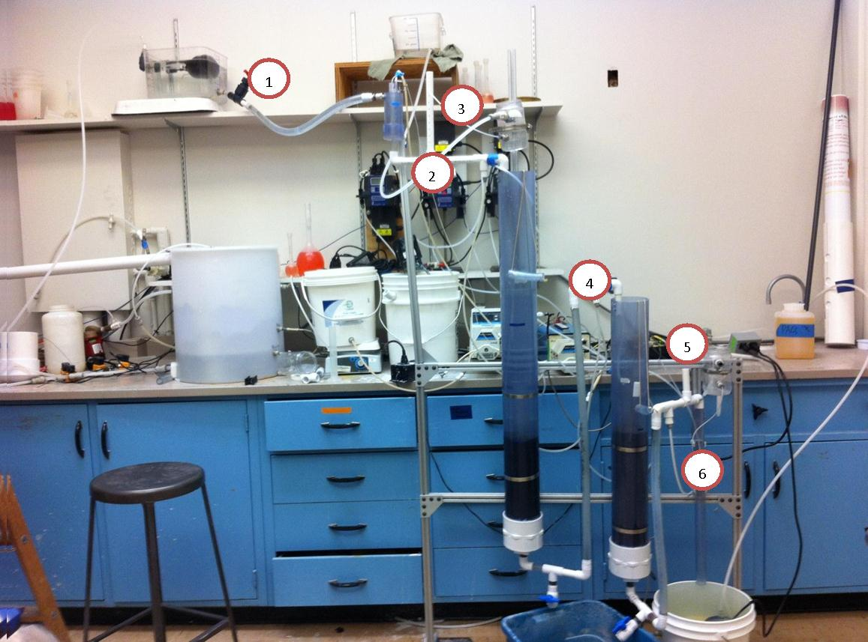
Summer 2012

Slide 7
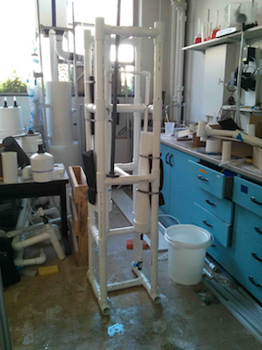
Spring 2013
Created a larger stock tank to provide enough space for linear dosing
Built unit out of pvc to withstand water and sunlight as an emergency unit

Slide 8
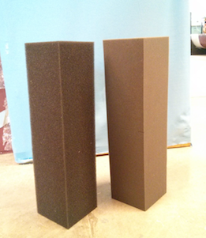
Goals for this Semester
New Design
Economic Feasibility
Chemical Doser
De-compressibility of Foam
Improved Cleaning Techniques

Slide 9
New Design (Circular in 3D)
Uncompressed
Compressed
15”
30 PPI
63”
Exit Valve
15”
30 PPI
30 PPI
Not yet determined
15”
90 PPI
90 PPI

Slide 10
Economic Feasibility
The monthly cost per household has to be affordable / economically sustainable.
Target monthly cost ≤ 20 Lempiras/month (provided by APP)
The monthly cost would cover
  replacement foam
  chemicals
  general maintenance
  operator/plumber salary

Slide 11
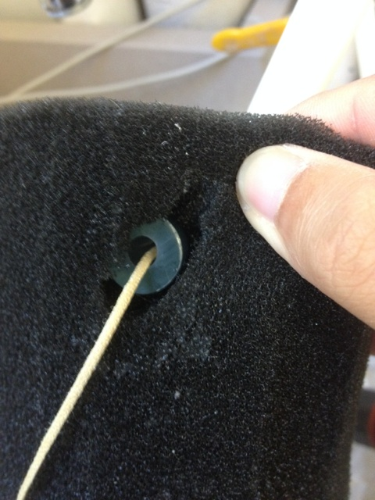
Foam Decompression
The current method of decompressing foam after compression results in tear on the foam.
Allowing the foam to decompress naturally would
  simply the cleaning process
  Eliminate the need to install a handle in the foam.

Slide 12
Questions?

