Slide 1

Sedimentation Tank Hydraulics
Yiwen Ng
Saied Khan
Jill Freeman
Mahina Wang

Slide 2
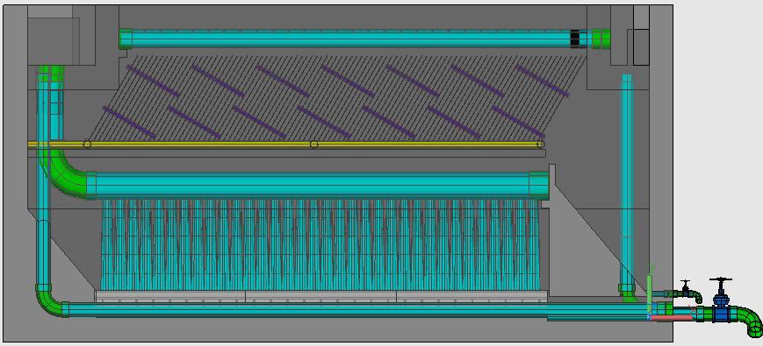

Our Goals
Create a floc blanket!
  Improve performance
  Floc recycle
  Reduce cost
Optimize sed tank geometry
Investigate effect of operating conditions
Notes:
Questions that we would like to answer:
What is the best geometry of the sed tank that will reliably create a floc blanket?
How do variables such as upflow velocity, alum dose, and influent turbidity affect floc blanket formation, growth and performance?
How beneficial will floc recycle be? Collaboration with Floc-Sed Optimization, Floc Recycle Venturi team
What are the dimensions of the floc hopper needed to maintain FB height, obtain desired sludge concentration for floc recycle? Depends on factors such as rate of floc consolidation.

Slide 3
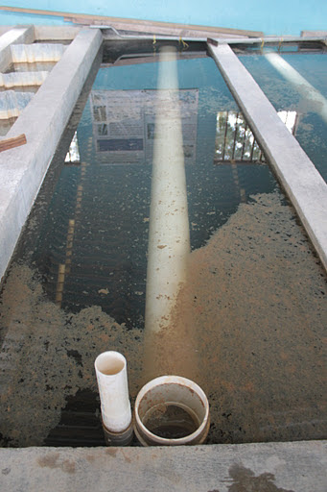
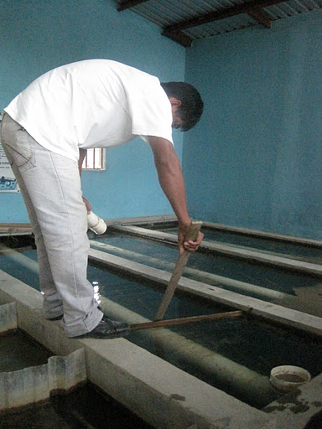
Honduras Sed Tanks
https://lh3.googleusercontent.com/-r6ejUqK9lrQ/TyMCjMaD9-I/AAAAAAAAmKg/auNbTbq0Xgc/s512/IMG_5540.JPG
Notes:
-aerated water (distilled water to which purified water is added--as opposed to carbonated water) not in photo
-raw water: average influent turbidity at 100 NTU
-Turbidimeter measures turbidity and is connected to Process Controller, which can add either raw water or clay 30g/L depending on the turbidity
-concentrated kaolinite (low shrink-swell capacity)
-Run through a tube flocculator before being expelled through a downward-pointing jet suspended 10 cm from the bottom of the sedimentation tank (half inch crosssection)
-lit LCD screen behind tank
-Images of the tank acquired with camera at fixed time intervals and recorded using the LabVIEW data acquisition software
-1s/shot for background shots (adjustments)
-0.03s/shot for dye injection shots
-5s/shot when run flocs
-Used MasterProgram (image analysis software) to make a video (30 or 10 images/frame). Hope to at some point take measurable data about floc concentration (currently outside scope of what are doing now)
-Simulate a cross-section of the sedimentation tank in such a way so that we can image solids concentration (this is how spacing was chosen)
-Mention data and how it is analyzed
-we are not quantifying anything yet
-making observation based on images and video, generating hypotheses and durther developing bottom geometries based on these

Slide 4
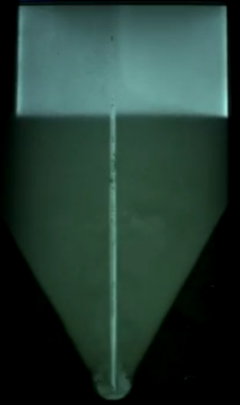
What is a Floc Blanket?
  A fluidized, highly concentrated bed of particles.
  Occurs when flocs switch from a state of differential settling to hindered settling.
Benefits of a floc blanket:
  Greatly improves the effluent turbidity by trapping small flocs.
  Reduces clean water waste from frequent draining of the sedimentation tank.
Notes:
How does it form?
Flocs switch from a state of differential to hindered settling.
differential:
-Large flocs settle faster than small flocs.
-No interactions between flocs
-This means that very small flocs can escape through the plate settlers.
hindered settling:
-the flocs interact with each other
-settle at the same rate.
The floc blanket grows in size and density as it traps more and more particles.
A floc blanket greatly improves effluent turbidity.
Previous teams have determined that a minimum angle of repose of 23 degrees is needed on sedimentation tank sides for floc blanket formation.

Slide 5
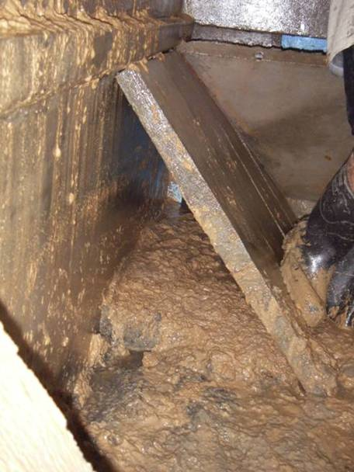
Floc Blanket Failures
http://www.youtube.com/watch?v=bf3fRxmk2VU
http://courses.cit.cornell.edu/cee4540/Sedimentation.pptx
Notes:
How does it form?
Flocs switch from a state of differential to hindered settling.
differential:
-Large flocs settle faster than small flocs.
-No interactions between flocs
-This means that very small flocs can escape through the plate settlers.
hindered settling:
-the flocs interact with each other
-settle at the same rate.
The floc blanket grows in size and density as it traps more and more particles.
A floc blanket greatly improves effluent turbidity.
Previous teams have determined that a minimum angle of repose of 23 degrees is needed on sedimentation tank sides for floc blanket formation.

Slide 6
Conditions for Floc Blanket Formation
  Inclines to direct settling flocs towards inlet jet
  Adequate floc re-suspension by inlet jet
  No increase in energy dissipation rate after flocculator
http://www.youtube.com/watch?v=bQgMdkO0qUA&feature=related
Notes:
-Previously, the minimum angle required to form a blanket was determined to be 23 degrees. Otherwise, sludge will build up on the slope until this angle is formed. This can be see in later experiments.
Explain how floc blanket forms. Jet resuspends flocs, and the flocs settle down to again be resuspended by jet.
First picture is differential settling. Jet resuspends flocs to full tank height.
Second picture: jet starts to resuspend flocs to a fraction of the tanks height.
3rd picture: floc blanket fully formed after about an hour. Note floc/water interface. Water above is significantly less turbid.

Slide 7

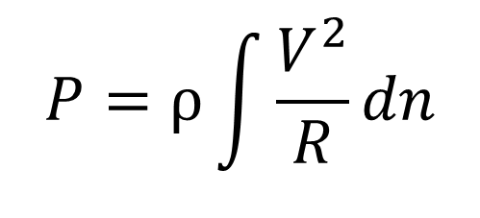

Hydrostatic vs. Hydrodynamic Pressure
Hydrodynamic Pressure:
$$P=ρ\int{\frac{V^{2}}{R}dn}$$
Hydrostatic
Pressure
Hydrostatic Pressure:
h
Returning Solids
R
$$P=ρgh_{solids}$$
v
Hydrodynamic
Pressure
Notes:
Visual for hydrostatic vs. dynamic pressure.

Slide 8
Stages of Settling
  Discrete Settling
  Differential (Flocculated) Settling
  Hindered Settling
  Compression Settling
Notes:
Understanding the 4 different stages of settling is also crucial to our understanding of floc blankets and floc blanket formation.
Discrete Settling: Particles settle independently of each other. We will not focus on this type of settling because it is not usually observed in the sedimentation tank due to the higher concentration of particles and the tendancy of these particles to form flocs.
We will focus on the last 3 stages because these are the types of settling that occur in the sedimentation tank.

Slide 9
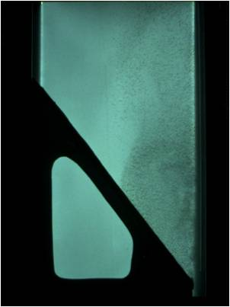
Stages of Settling
  2. Differential (Flocculated) Settling
Notes:
Differential settling: the concentration of particles is high enough so that flocs are present. Flocs collide and grow during flocculent sedimentation. If the terminal settling velocity is less than the upflow velocity of the tank, the particle will enter the plate settlers at the top of the tank.

Slide 10
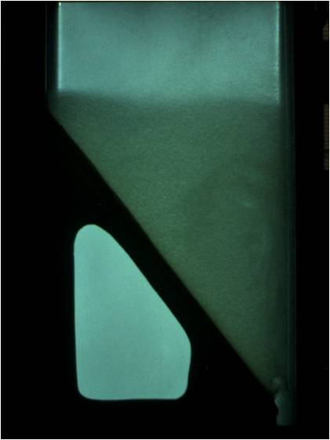
Stages of Settling
  3. Hindered Settling
Notes:
Hindered settling:
interactions between particles dominate.
The concentration of particles in the suspension is much greater, and the particles are therefore more affected by water displacement.
Because of the close proximity of the particles, water displacement slows down the settling speed of surrounding particles.
**Floc blanket formation occurs when particles transition from flocculated settling to hindered settling.
Once particles transition to hindered sedimentation, a floc-water interface can be clearly observed.

Slide 11
Stages of Settling
  4. Compression Settling
Notes:
Compression settling:
flocs are highly concentrated.
flocs are in contact with other flocs in the sedimentation tank and solids are compressed underneath solids above them. The weight of the solids above gradually squeeze out water from the floc matrix, resulting in sludge thickening.
This type of settling typically occurs at the bottom of the sedimentation tank or on the sedimentation tank inclines in the form of sludge build-up or debris flow.
Examining compression settling will help us understand:
floc blanket failure mechanisms--compression settling occurs in the tank during floc blanket failure
floc hopper design parameters—we want the sludge to settle in the floc hopper and we will drain the settled sludge. Understanding compression settling will help us to determine the amount of time we should allow solids to settle in the hopper and the rate at which we should waste sludge from the hopper.
Total Solids Test performed has indicated that the concentration of compressed solids (after 3 days of compression) is about 29.4 g/L. For our purposes, however, this value will be less because the sludge will not be settling for a period of 3 days. Most of the settling, however, occurs within the first few hours. ????

Slide 12
Design Objectives for Floc Blanket Formation
No increase of energy dissipation rate after flocculation
Minimal complexity of inlet design
Resuspension of all returning solids
Tolerance of asymmetry
Minimal floc blanket formation time
Ease of operation and maintenance
***Maintain good performance with different upflow velocities

Slide 13
Current Sedimentation Tank
60 degree angle, flat bottom geometry
Notes:
UPDATE WITH NEW DESIGN TEAM DRAWINGS
Sed tank from side and front view.
Show where floc blanket forms
Explain how we model the tank (1/2 inch cross section)
How spacing was chosen: Simulate a cross-section of the sedimentation tank in such a way so that we can image solids concentration

Slide 14
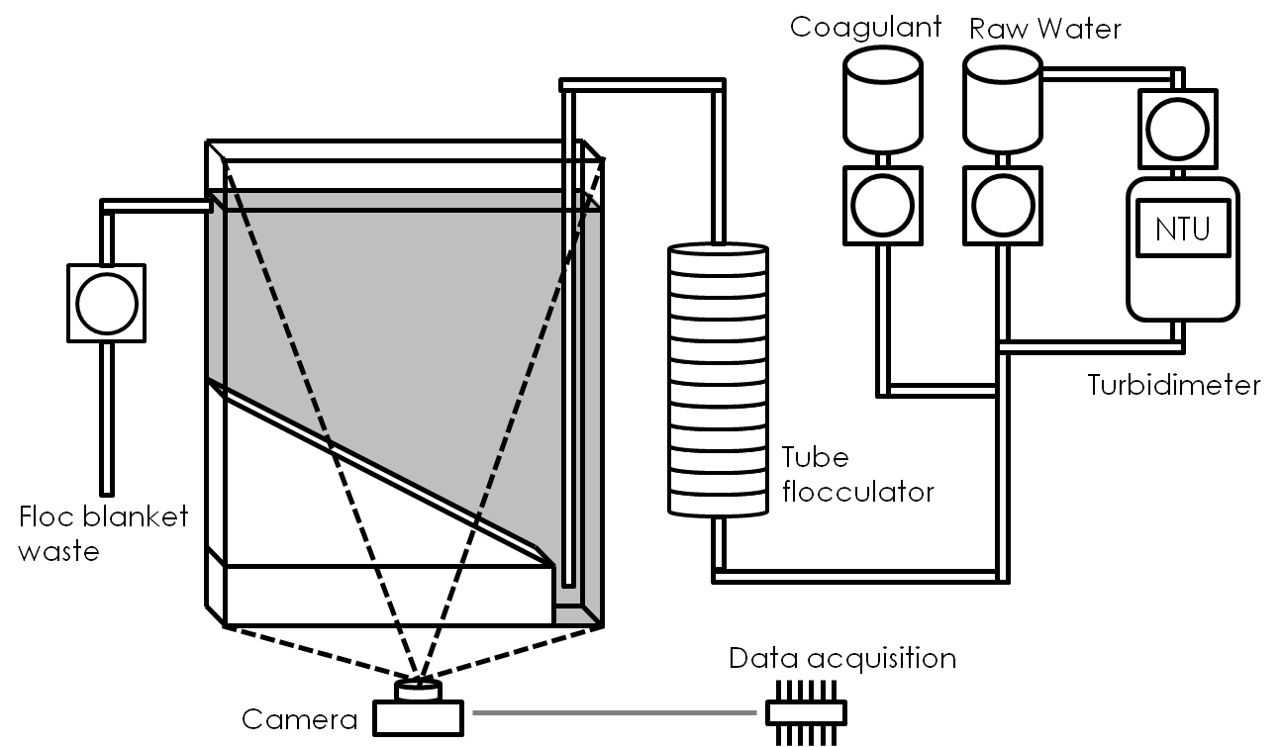
Methods: Our Experimental Setup
Notes:
-raw water: average influent turbidity at 100 NTU
-Turbidimeter measures turbidity and is connected to Process Controller, which can add either raw water or clay 30g/L depending on the turbidity
-aerated water (distilled water to which purified water is added--as opposed to carbonated water) not in photo
-concentrated kaolinite (low shrink-swell capacity)
-Run through a tube flocculator before being expelled through a downward-pointing jet suspended at a distance from the bottom of the sedimentation tank

Slide 15
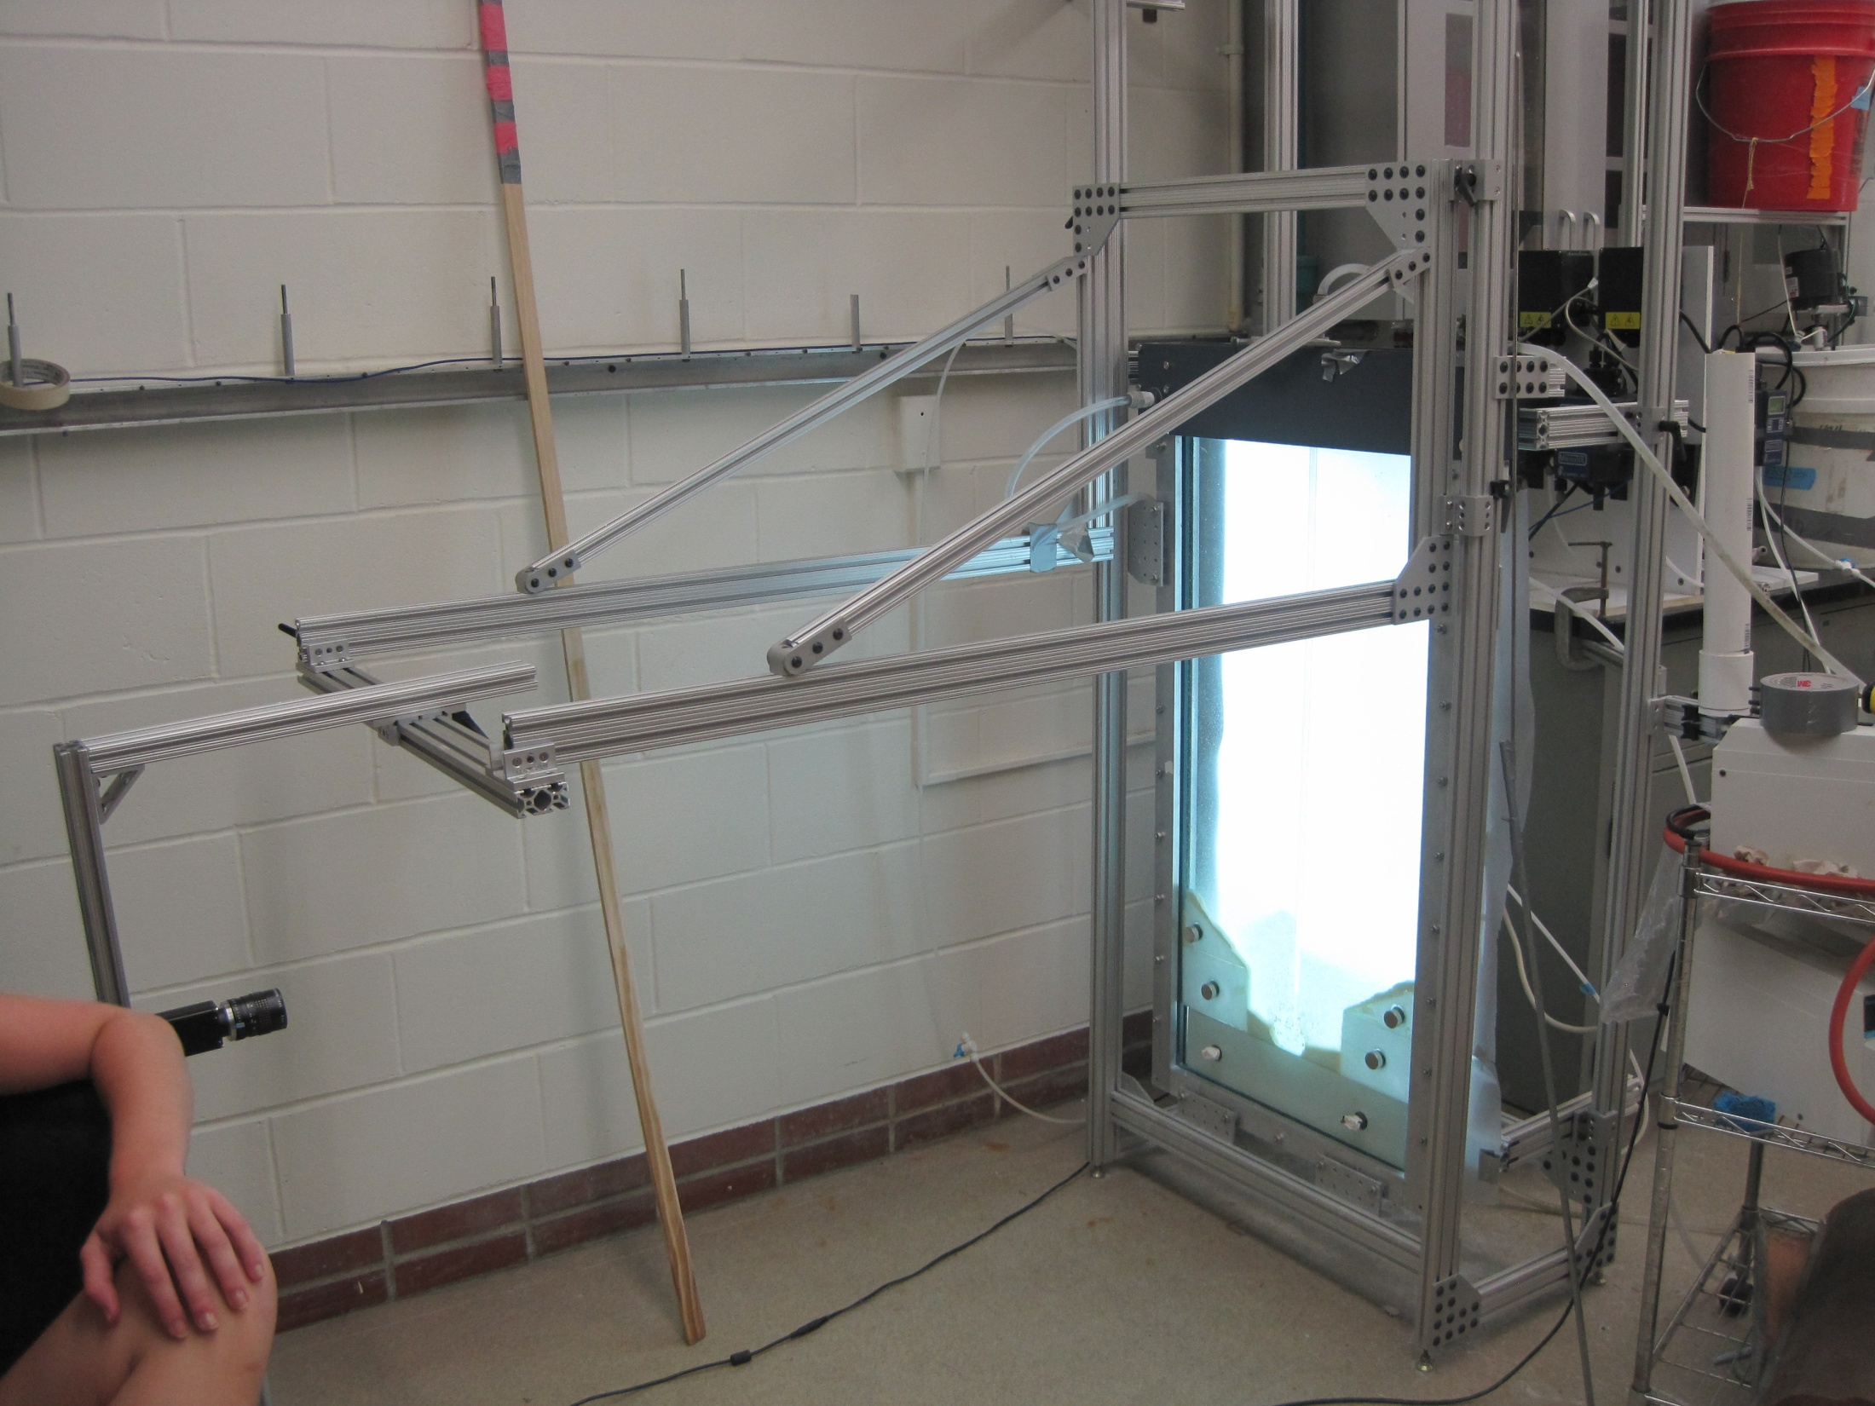
Notes:
-floc blanket waste to drain
-lit LCD screen behind tank
-Images of the tank acquired with camera at fixed time intervals and recorded using the LabVIEW *data acquisition software*
-1s/shot for background shots (adjustments)
-0.03s/shot for dye injection shots
-5s/shot when run flocs
-Used MasterProgram (*image analysis software*) to make a video (30 or 10 images/frame). Hope to at some point take measurable data about floc concentration (currently outside scope of what are doing now)
-Mention data and how it is analyzed
-we are not quantifying anything yet but
-making observation based on images and video, generating hypotheses and further developing bottom geometries based on these

Slide 16
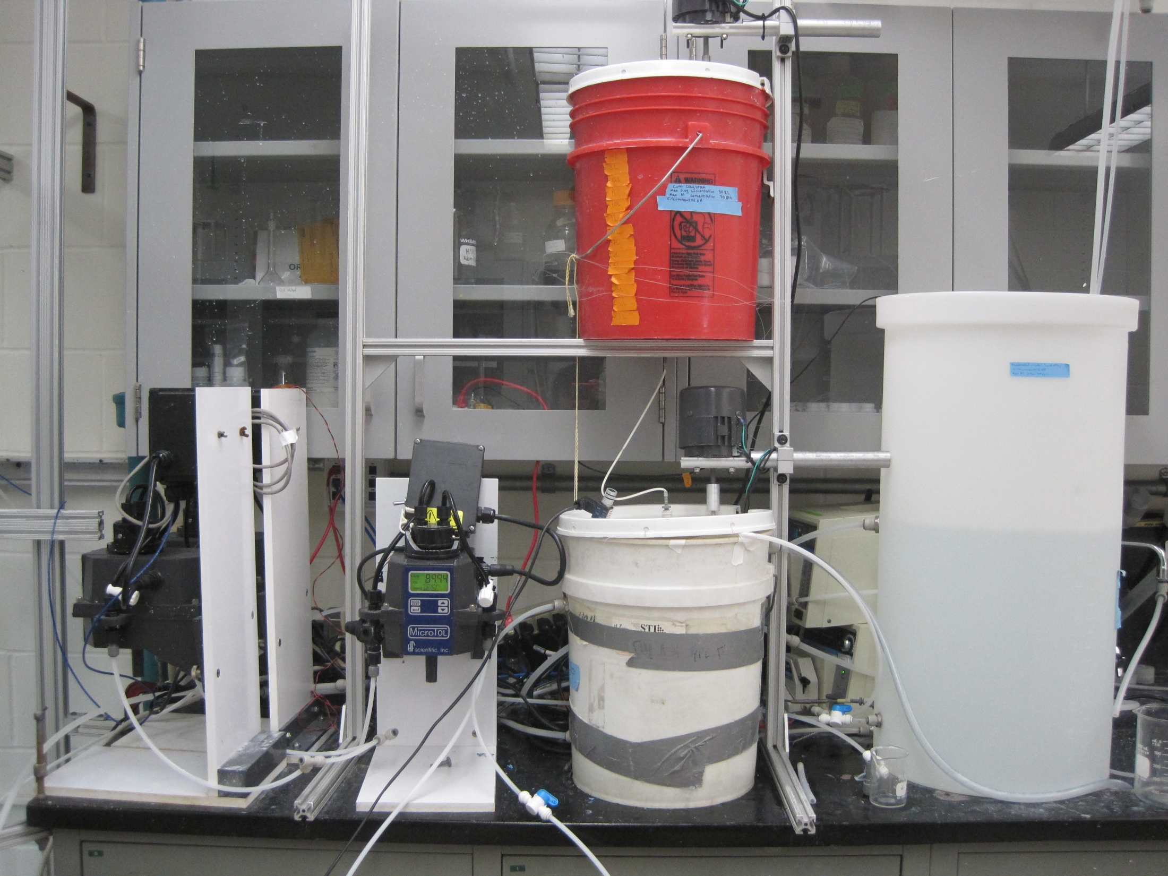

Slide 17
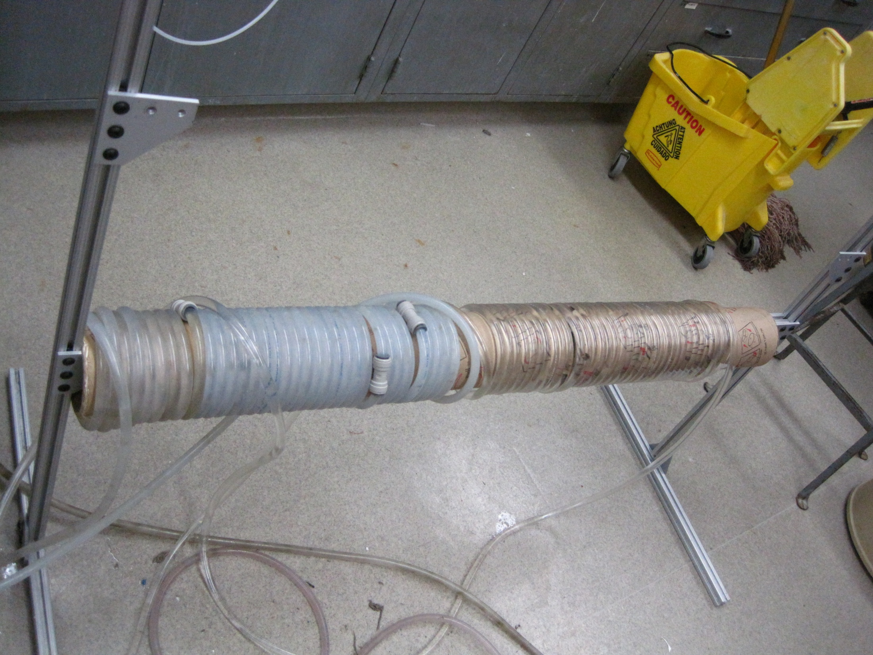

Slide 18
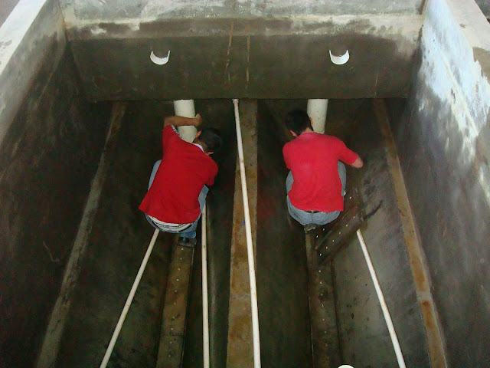
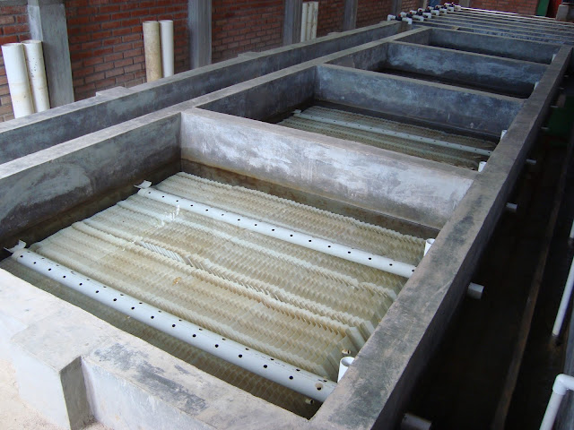
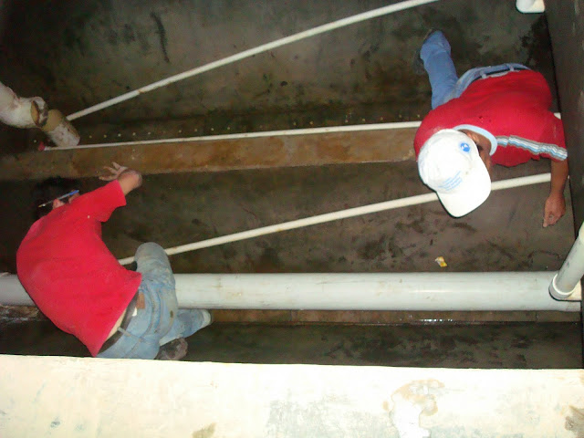
Marcala Tanks
Notes:
2 bays

Slide 19
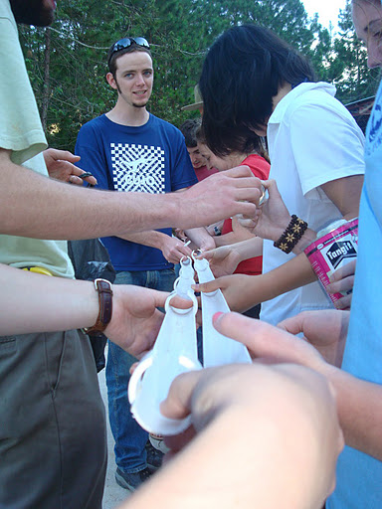
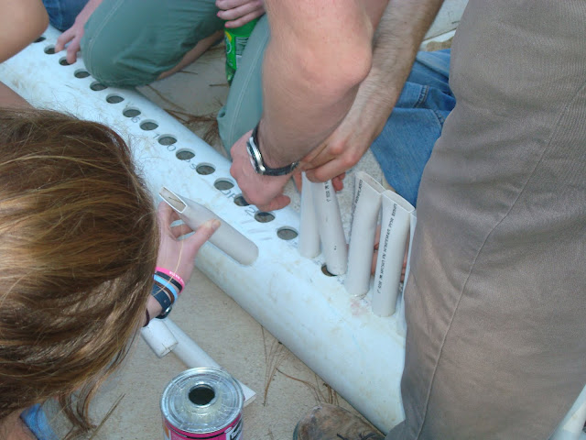
Fabrication: Manifold, Diffusers, Couplings

Slide 20
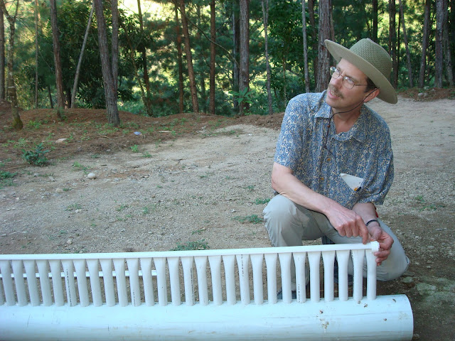
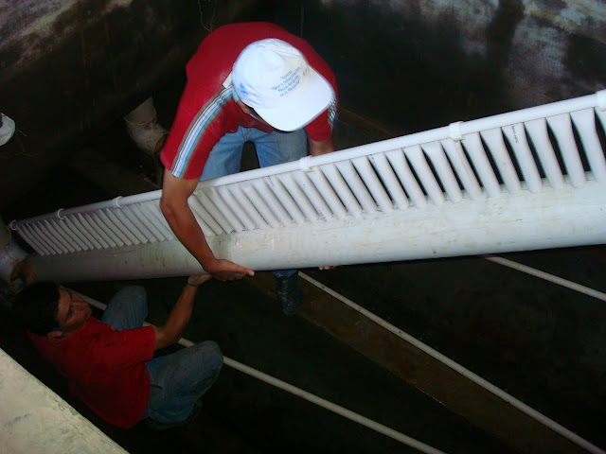
Improved Inlet Manifold for Sed Tank #4

Slide 21
Marcala Retrofit Experiment
First 4 hours: 100 NTU
Turbidity (gradually) decreased to 10 NTU
  Alum dosing unchanged
http://www.youtube.com/watch?v=o_-e36HdSGg&feature=relmfu
Notes:
Fluffier flocs break up more easily, more susceptible to shear stresses and escape from floc blanket

Slide 22
Marcala Sed Tank 4 today..
Fred Stottlemyer directed the Marcala plant operators to continue to clean Tanks 1, 2, and 3 but NOT 4
After 30 hours, Tank 4’s turbidity shot up:

Slide 23
What happened?
Floc blanket?

Slide 24
5 NTU Experiment
5 NTU: similar to Marcala’s influent turbidity
No flocs visible in the tube flocculator or jet influent
Potential Problems:
  Not enough collision potential
Notes:
We need floc recycle to increase collision potential

Slide 25


Theories of Hindered Settling
Theory 1
Theory 2
Consider floc blanket as an aggregate whole
Consider individual particles in floc blanket
The porosity (ϕ) of the floc blanket matters!
V.UpInterface
V.UpParticle
V.Hindered
V.Hindered
Notes:
Theory 1
For floc blanket to remain stationary, settling velocity is balanced by fluid velocity above the FWI (ie. The upflow velocity)
If upflow velocity increases, floc blanket grows. And vice versa.
Theory 2
- For each particle to remain stationary, the settling velocity of the particle is balanced by the average upward velocity it experiences

Slide 26
Hindered Settling Experiment
  Which theory best describes the floc blanket?
  Form a floc blanket at different V.up,
  then shut off pump for 20 seconds
  to measure initial settling velocity
  Inconclusive results
or
V.Up
V.Hindered

Slide 27
Future Work
Ideas for Future Experiments:
Improvements to Hindered Settling Experiments
Marcala Failure Mode
Determining Optimal Upflow Velocity
Designing a floc weir
Measuring Hydrostatic vs. Hydrodynamic Pressure

Slide 28
Questions?

