Slide 1

Sedimentation Tank Hydraulics
Mahina Wang
Jill Freeman
Elana Liskovich
Yiwen Ng

Slide 2
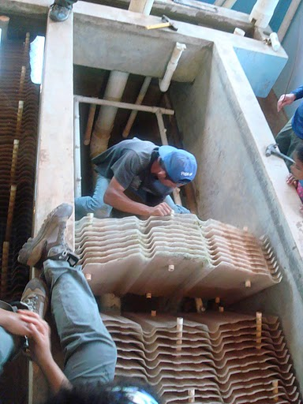

Objectives
  Find the optimal sedimentation tank bottom geometry for floc blanket formation
  Determine the optimal floc blanket height and design a floc weir to keep the floc blanket at this height

Slide 3
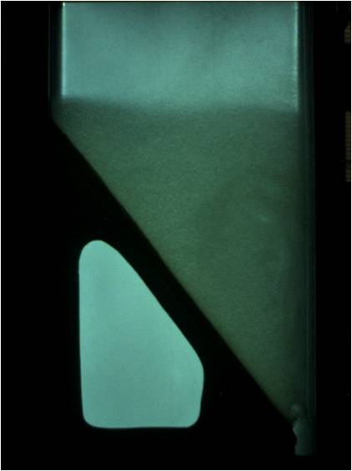
What is a floc blanket?
  A fluidized, highly concentrated bed of particles.
  Occurs when flocs switch from a state of differential settling to hindered settling.
Benefits of a floc blanket:
  Greatly improves the effluentturbidity by trapping small flocs.
  Reduces clean water waste from frequent draining of the sedimentation tank.
Notes:
How does it form?
Flocs switch from a state of differential to hindered settling.
differential:
-Large flocs settle faster than small flocs.
-No interactions between flocs
-This means that very small flocs can escape through the plate settlers.
hindered settling:
-the flocs interact with each other
-settle at the same rate.
The floc blanket grows in size and density as it traps more and more particles.
A floc blanket greatly improves effluent turbidity.
Previous teams have determined that a minimum angle of repose of 23 degrees is needed on sedimentation tank sides for floc blanket formation.

Slide 4
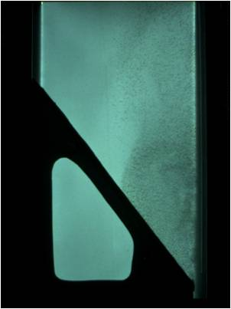
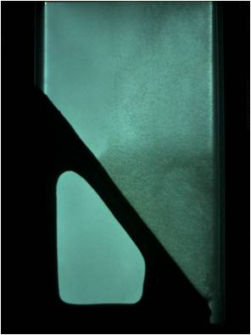
Conditions for floc blanket formation
  Adequate floc re-suspension by inlet jet
  Inclines to direct settling flocs towards inlet jet
Notes:
-Previously, the minimum angle required to form a blanket was determined to be 23 degrees. Otherwise, sludge will build up on the slope until this angle is formed. This can be see in later experiments.
Explain how floc blanket forms. Jet resuspends flocs, and the flocs settle down to again be resuspended by jet.
First picture is differential settling. Jet resuspends flocs to full tank height.
Second picture: jet starts to resuspend flocs to a fraction of the tanks height.
3rd picture: floc blanket fully formed after about an hour. Note floc/water interface. Water above is significantly less turbid.

Slide 5
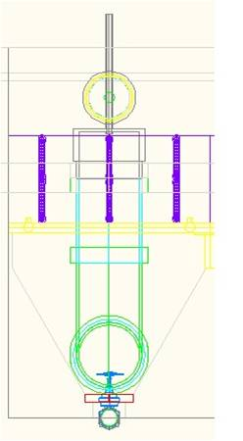
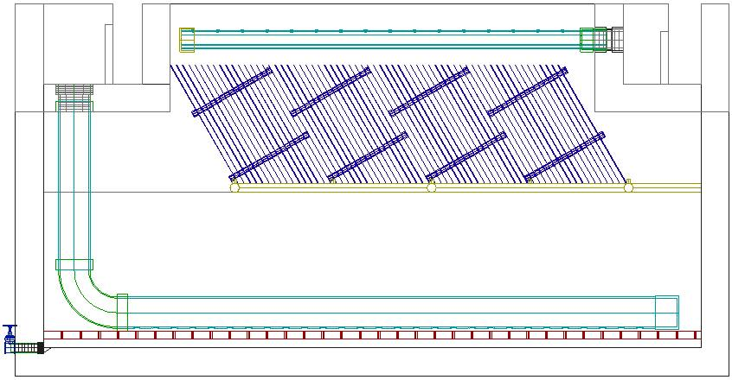
Current Sedimentation Tank
60 degree angle, flat bottom
geometry
Notes:
Sed tank from side and front view. Explain how we model the tank.
-show where floc blanket forms

Slide 6
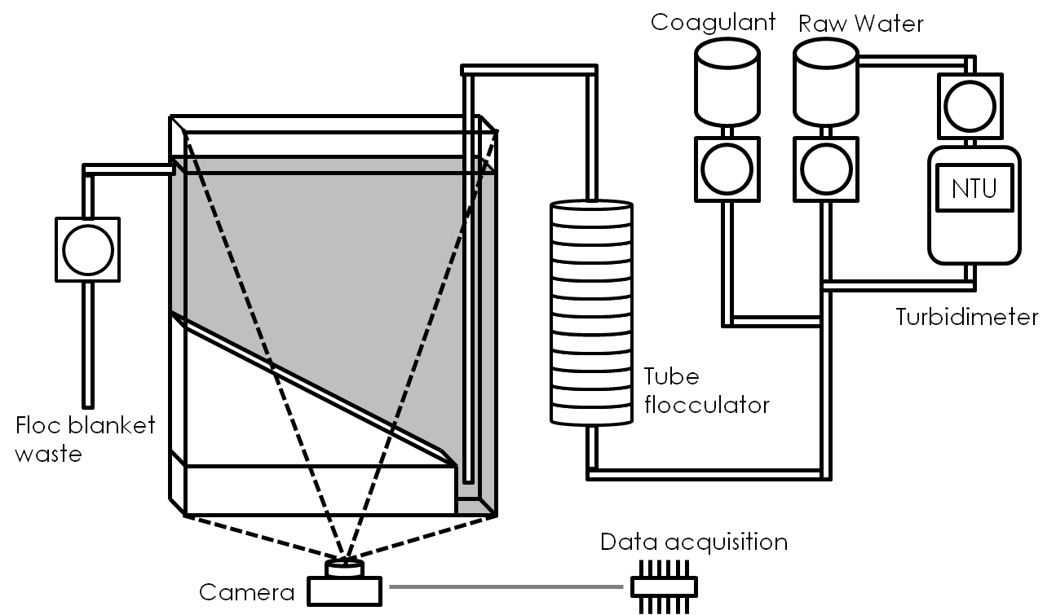
Our Experimental Setup
Experimental Setup
Notes:
-aerated water (distilled water to which purified water is added--as opposed to carbonated water) not in photo
-raw water: average influent turbidity at 100 NTU
-Turbidimeter measures turbidity and is connected to Process Controller, which can add either raw water or clay 30g/L depending on the turbitdty
-concentrated kaolinite (low shrink-swell capacity)
-Run through a tube flocculator before being expelled through a downward-pointing jet suspended 10 cm from the bottom of the sedimentation tank (half inch crosssection)
-lit LCD screen behind tank
-Images of the tank acquired with camera at fixed time intervals and recorded using the LabVIEW data acquisition software
-30s/shot for run til failure experiment
-5s/shot for all others
-Used MasterProgram to make a video (30 images/frame)

Slide 7
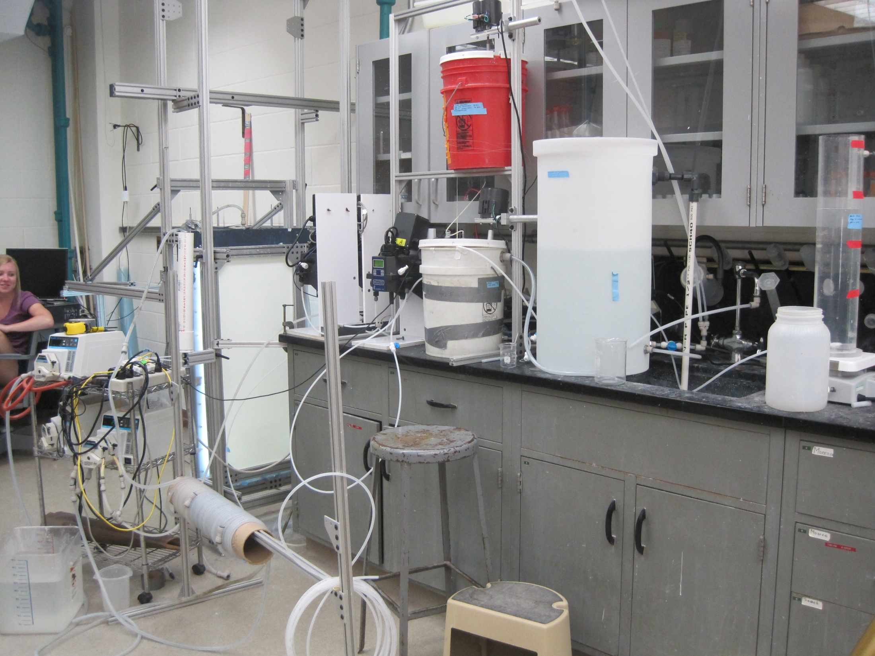
Our Model

Slide 8
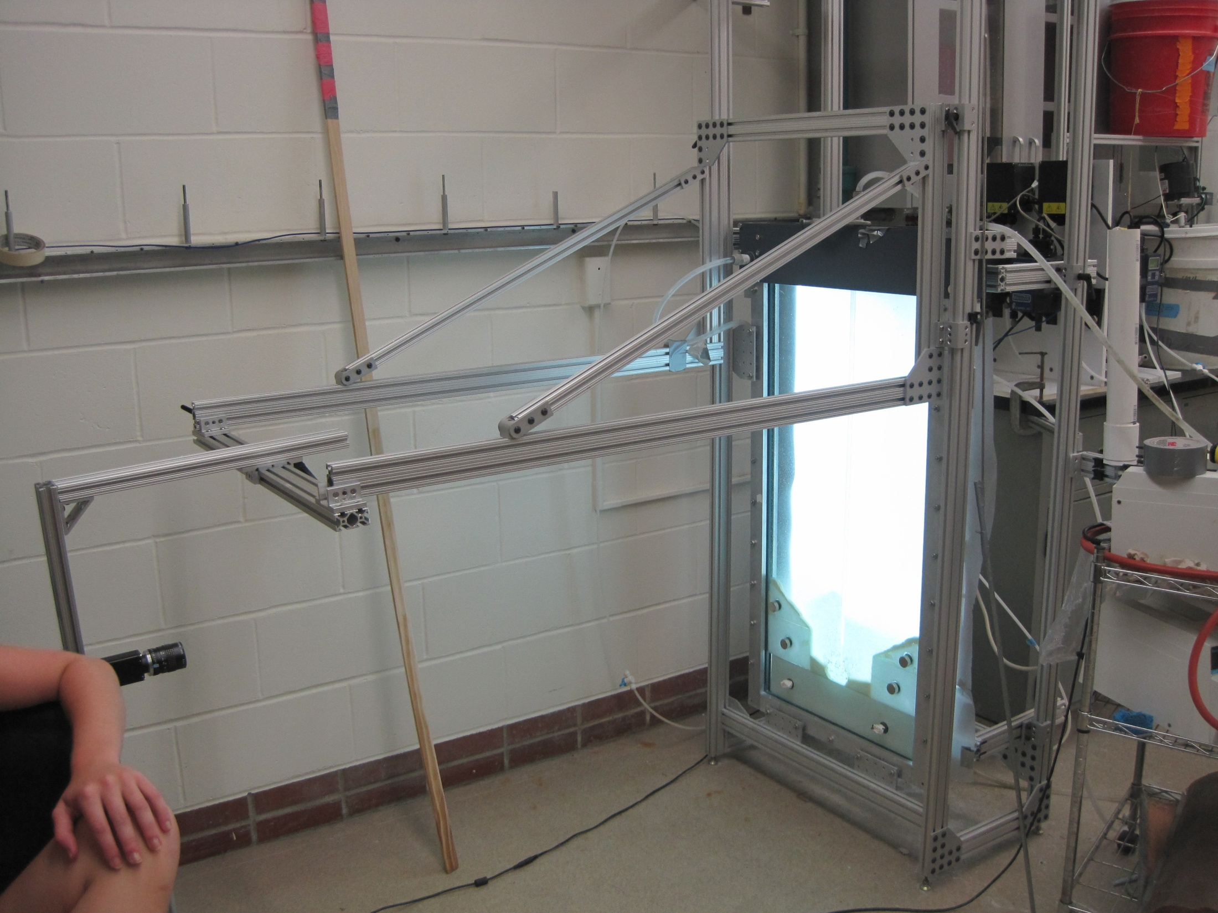

Slide 9
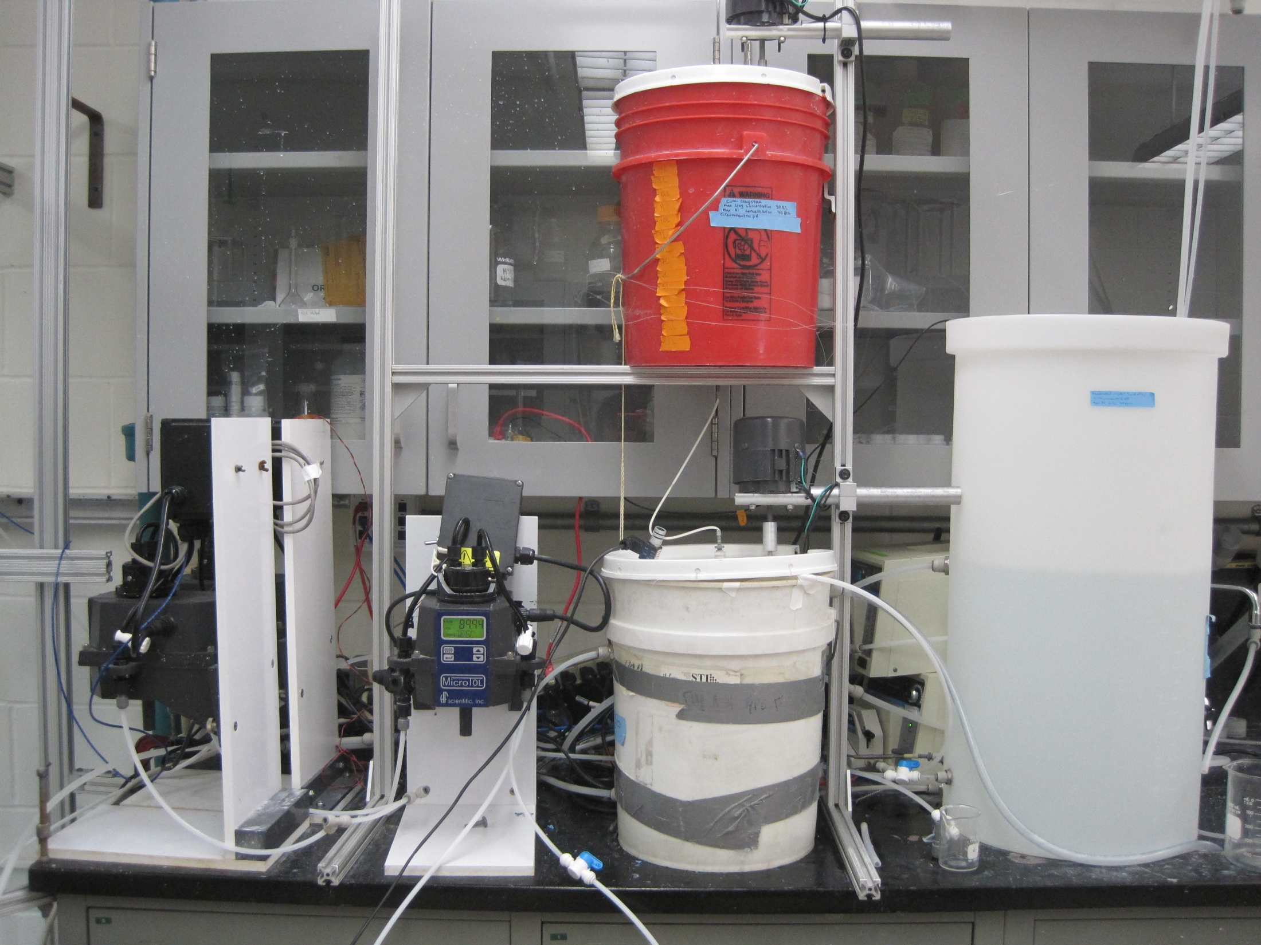

Slide 10
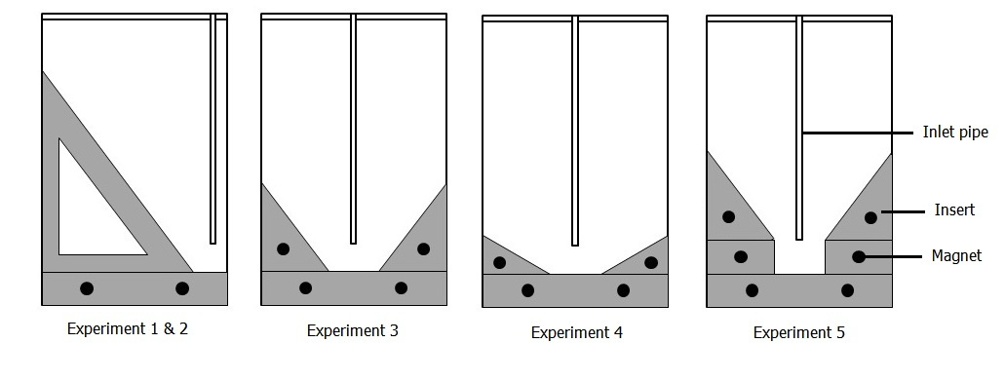
Experiments
Notes:
1. 60 degree insert
2. 60 degree run til failure
3. 2 60 degree inserts w/out trench
4. 2 30 degree inserts w/out trench
5. 2 60 degree inserts w/ trench

Slide 11
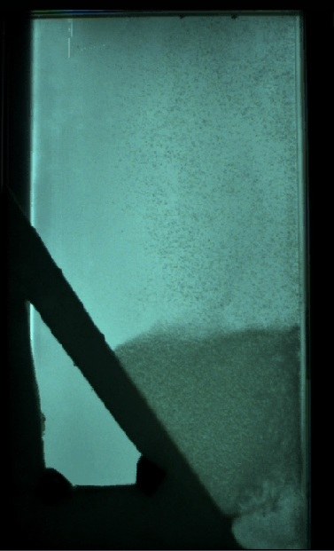
60 degree insert
Experiment 1

Slide 12
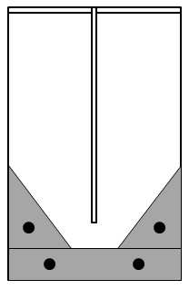
60 degree, symmetric, flat bottom geometry
We designed an experiment to model the current sedimentation tank geometry:
60 degree double inserts
Notes:
A floc blanket currently does not form in the tank. The main goal of this experiment was to observe why.
-middle third of tank
-20 cm middle, 40 cm side
Note: The floc blanket forms easily with a model of just the left half of the tank, instead of the middle half. It does not form in the actual tank and did not form easily in this experiment. This may be due to experimental error: simplification and wall effects.

Slide 13
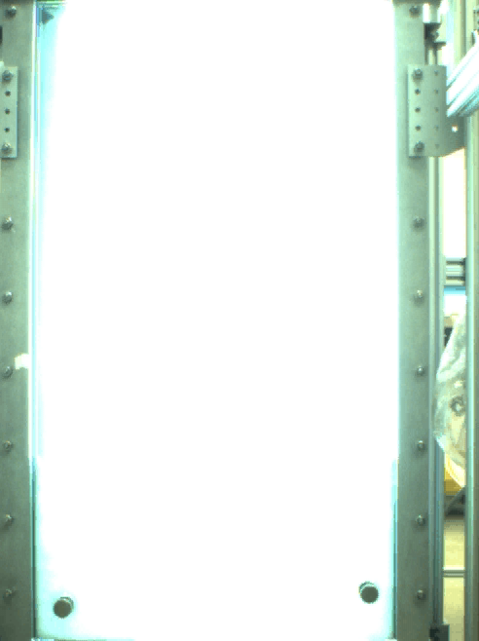
60 degree, symmetric, flat bottom geometry
60 degree double inserts
Notes:
A floc blanket currently does not form in the tank. The main goal of this experiment was to observe why.
Note: The floc blanket forms easily with a model of just the left half of the tank, instead of the middle half. It does not form in the actual tank and did not form easily in this experiment. This may be due to experimental error: simplification and wall effects.

Slide 14
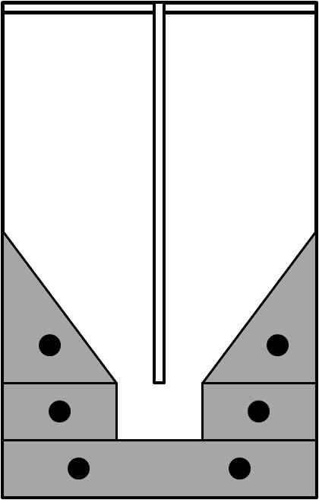
60 degree, symmetric, trench bottom geometry
The trench bottom allows for better resuspension of flocs and less floc break-up.
Notes:
The trench bottom allows for better resuspension of flocs. The jet water
-show video
-mention we also did 30 degree with and without trench

Slide 15
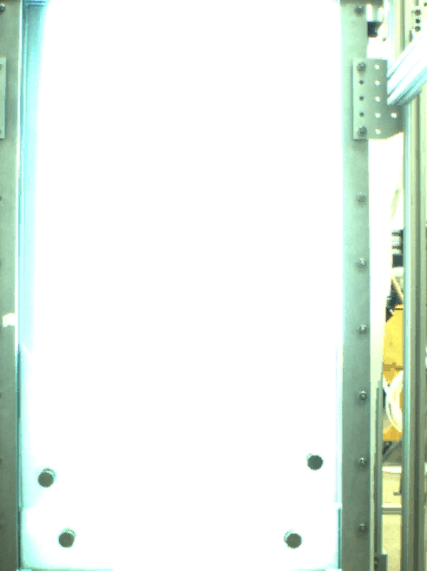
60 degree, symmetric, trench bottom geometry
Notes:
The trench bottom allows for better resuspension of flocs. The jet water
-show video
-mention we also did 30 degree with and without trench

Slide 16
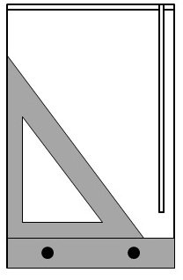
60 degree run until failure
Notes:
-Define ‘failure’
-floc blanket breaking: head loss too great, too much energy for water to get through
-floc blanket escaping through top

Slide 17
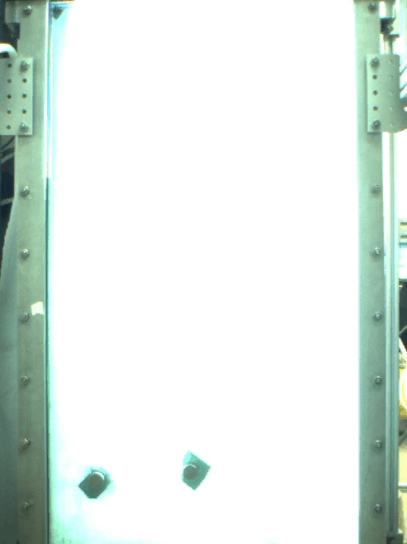
60 degree run until failure
Experiment 2
Notes:
-point out sludge creeping down

Slide 18
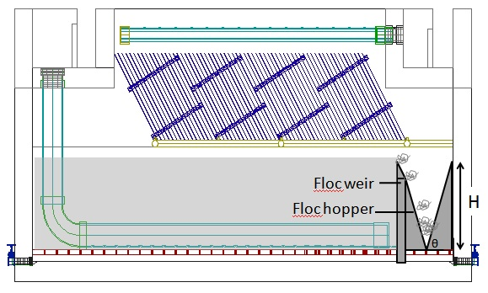
Floc Weir Design
Purpose, proposed designs, how we will model these designs
Proposed floc hopper design for current actual sedimentation tank
Notes:
-purpose of a floc weir is to maintain height of floc blanket
-under plate settlers in order to keep them working (otherwise poor effluent quality)
-current design: sharp crested weir placed at far end of the sedimentation tank with an adjacent V-shaped floc hopper to collect excess flocs
-a weir is something that stuff flows over
-ex. Pitcher of water
-cant model actual tank because crosssection half inch thick

Slide 19
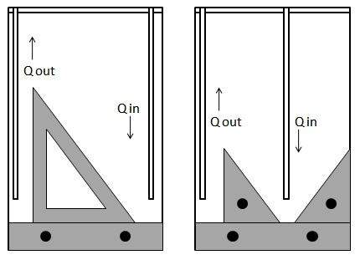
Floc Weir Design
Question: appropriate height of floc weir?
Notes:
-when height of the floc blanket exceeds the height of the weir, excess flocs will be collected in the hopper
-accumulated sludge can be removed by opening the sludge drain
To determine appropriate height of floc weir:
-consider a simple mass balance model where at steady state, the rate of mass added to the floc blanket should be equal to the rate of mass removed from the floc blanket via the floc weir
-discharge coefficient, concentration of flocs in the influent, concentration of flocs in floc blanket at steady state (can be obtained)
-run til failure experiment showed weir good
-show how weir works with diagram

Slide 20
Future Work
Goals for future experiments:
  Continue to determine ideal tank bottom geometry, floc weir design
  Determine height of floc hopper
  Determine ideal jet height/location
Notes:
-Narrower trench, modify rectangular trench bottom by adding curved trench bottom (currently 90 degree corners)
-Change size of inlet pipe to more accurately reflect the diameter of the actual drop tube, and so that flocs are able to easily pass from one side of the tank to the other
-Determine the ideal height of the jet above the sed tank bottom (jet height affects the resuspension of floc and thus the creation of the floc blanket)
-Determine height of floc hopper necessary to effectively maintain the floc blanket at a constant height (previously explained)

