Slide 1

Sedimentation Tank Hydraulics Team
Yiwen Ng
Tiffany Tsai
Anna Lee

Slide 2
Objective
To find an optimal design of the bottom of the sedimentation tank to form Floc Blanket.

Slide 3
Since last teach in…
We have been working to find the exact geometry of the insert on the bottom of the sedimentation that enables floc blanket formation using 2-D model
Notes:
Another slide for

Slide 4

Quick Recap: Floc Blanket is…
A fluidized and highly concentrated bed of particles
Improves effluent performance by significantly enhancing particle removal
Reduce clean water waste from frequent draining of sed tank
Floc re-suspension
  Sufficient jet velocity to scour settled flocs
  Settled flocs are directed towards upward jets
Notes:
Floc blanket is a thick concentrated layer of particles that grows in size and density as it traps more and more particles.
Previous research has shown that the floc blanket can significantly enhance particle removal, thereby improving effluent performance. Picture shows floc-water interface with relatively less turbid water above the floc blanket. We want to create a floc blanket in the sed tank such that this interface is below the plate settlers.
The sed tank does not need to be drained out as often to clean out the sludge, because we want to build up the floc blanket. Can save clean water.

Slide 5
Current AguaClara Plant
Inadequate floc resuspension
Tank geometry creates in dead zones and sludge formation
Circulation may disrupt the floc-water interface (without diffusers)
Notes:
Jets exiting the manifold are not strong enough to scour the flocs on the tank bottom
Geometry is such that dead zones form at the front and back ends of the tank. Dead zones are areas where settled flocs are not redirected towards jets that can resuspend them. This causes settled flocs to collect and form sludge at the corners. Dead zones are less likely to form in the middle portion of the tank because of the 60’ inclines which can direct flocs to the middle where the jets are located.
Circulation caused by the horizontal velocity component of the jets exiting the manifold can cause excessive turbulence at some parts of the floc blanket, diminish ability of blanket to catch flocs.

Slide 6
Experiments
Objective: Find the minimum angle of repose that results in floc blanket formation
Hypothesis: When the angle of repose is too small, flocs accumulate on the incline and are not returned to the jet, resulting in no floc blanket formation
  Previous Experiment: 60 degree incline
  Experiment 1 & 2: 30 degree incline
  Experiment 3: 15 degree incline

Slide 7
Experimental Set Up
Create a floc blanket in tank
Coagulant
Raw Water
NTU
Turbidimeter
Tube flocculator
Floc blanket waste
Produce flocculated water
Data acquisition
Camera images tank every 30 seconds
Data sent to LabVIEW program for analysis
Camera
Notes:
Tubidity maintained at 100 NTU, tube flocculator
Tank contains insert at either 30 or 15 degrees. Flocculated water pumped in.
Camera takes pictures, including background image at start of experiment
Sent to computer for analysis: compile into movie, ability to determine conc of flocs based of brightness of pixels in image

Slide 8
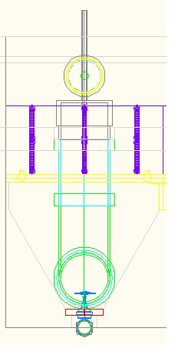
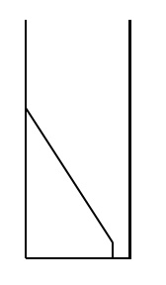
A Closer Look at Our Tank
Cross sectional view (from front)
A 2-D representation of half a full size sedimentation tank
Rotate
Our tank!
Thin slice of the sedimentation tank
Take half the cross section

Slide 9
Tank and Insert
Tank
  ½ inch thick, 0.5m x 1m cross sectional area
  LED backlight
Insert
  Foam board laminated with tape
  30 and 15 degree incline
  Anchored with magnets
'
4125
4125
Drain
Light Panel
Sedimentation
Tank Section
PVC Frame
Aluminum Frame
Foam Insert
4128
Notes:
get dimensions of tank
Backlight to clearly view and image flocs
Bring foam insert

Slide 10
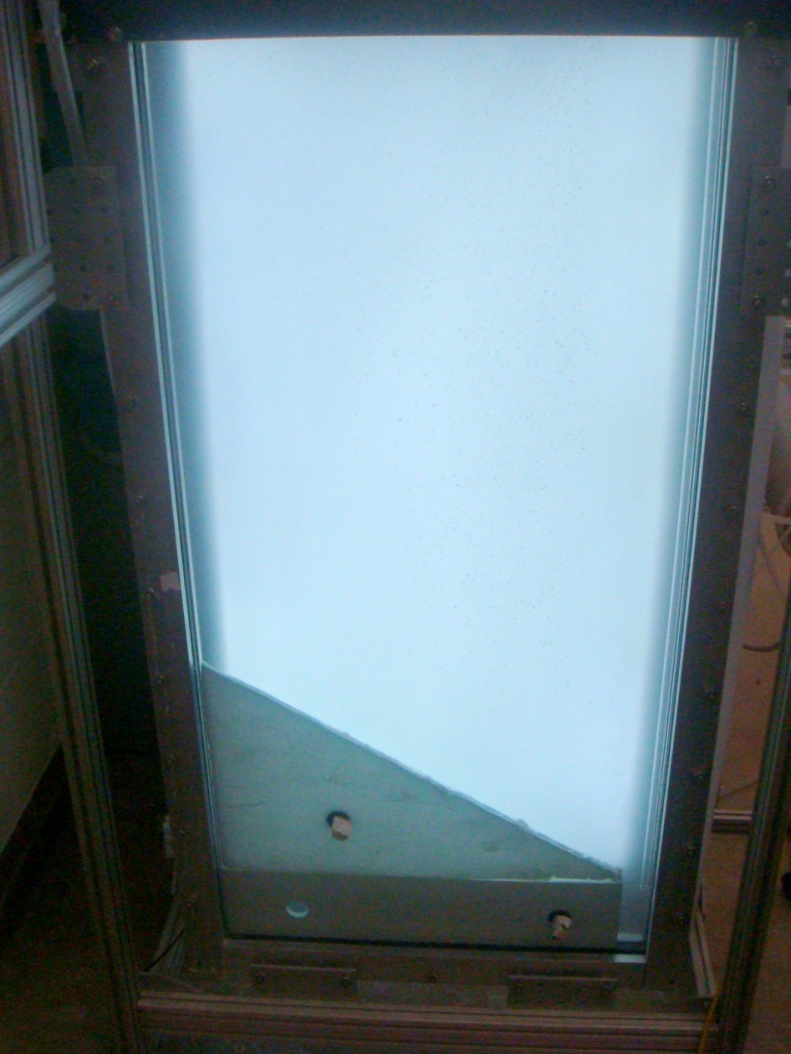
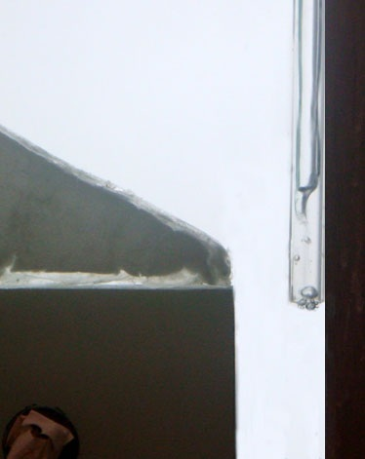
Photographs of Apparatus
Sedimentation tank with insert
Close up view of inlet pipe
Notes:
Pipe is 10cm above the tank bottom explain why (light panel is too short) basically for imaging issue
Rectangular base to simulate bottom of actual sed tank
Draw the flow arrow

Slide 11
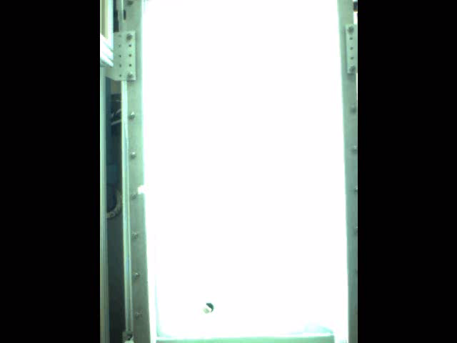

Results
30 Degree Angle of Repose
15 Degree Angle of Repose
Notes:
Quatlitative
-the flocs rolling down
-sludge accumulation
-flocculated to hindered settling
-we don’t exactly know how the transition occurs
-point out that the 15 degree takes longer
*Hindered settling-concentration high that as particles that are settling, they are pushing up water and the neighboring particles feel that and slows down. Overall, settle velocity slows down
*flocculant sedimentation-increasing the mass of the flocs, they settle faster. As larger flocs settle they hit and stick with smaller flocs

Slide 12






Simplified Mass Flux Processes
Θ < Min angle of repose
Θ ≥ Min angle of repose
θ
θ
Flocs build up on insert until min angle of repose is formed
All flocs returned to jet
Notes:
Before: rate of return is less than rate of settling → flocs build up. Not enough flocs being resuspended → no floc blanket formation yet
After: floc build up until min angle of repose is attained → because of gravity, flocs able to overcome friction → all settling flocs are returned to the jet → lots of floc resuspension → promote formation of floc blanket

Slide 13
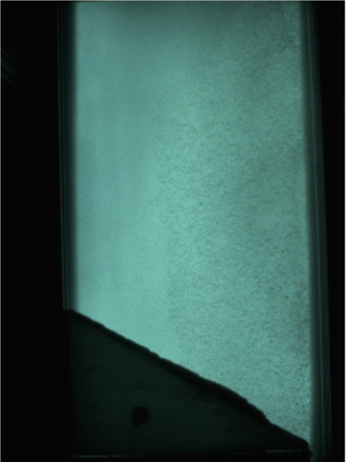
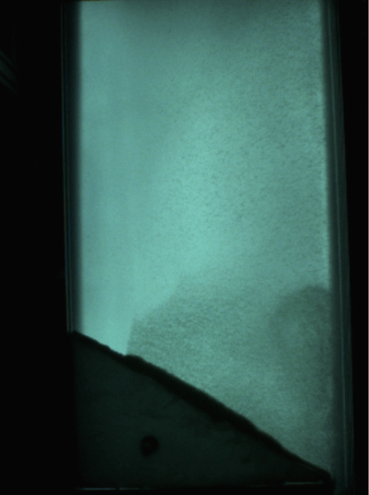
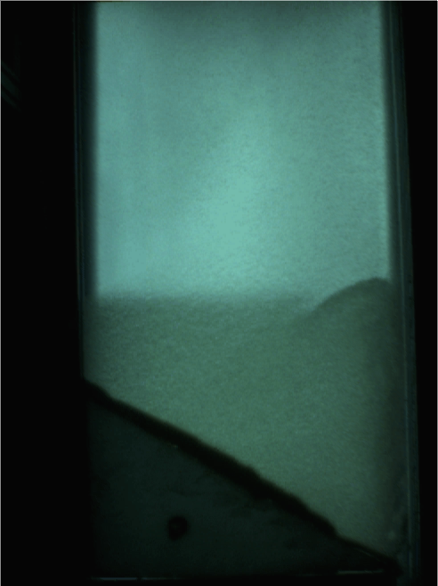
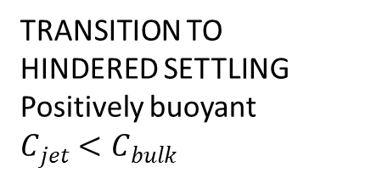
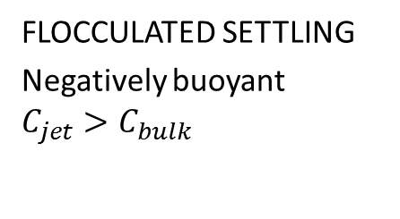
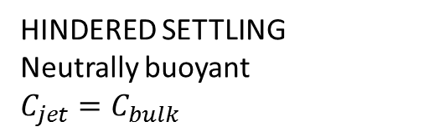
Discussion
FLOCCULATED SETTLING
Negatively buoyant
$$C_{jet}>C_{bulk}$$
TRANSITION TO HINDERED SETTLING
Positively buoyant
$$C_{jet}<C_{bulk}$$
HINDERED SETTLING
Neutrally buoyant
$$C_{jet}=C_{bulk}$$

Slide 14
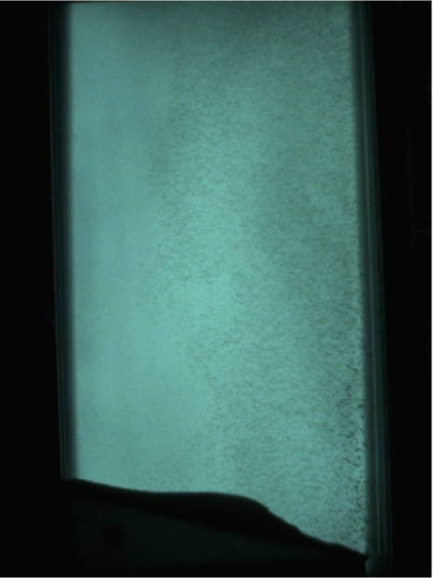
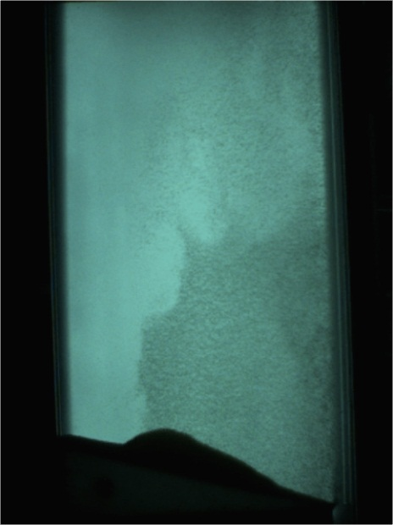
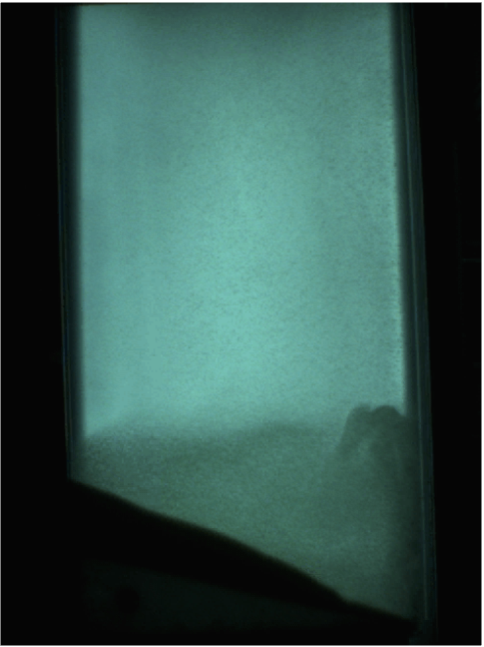
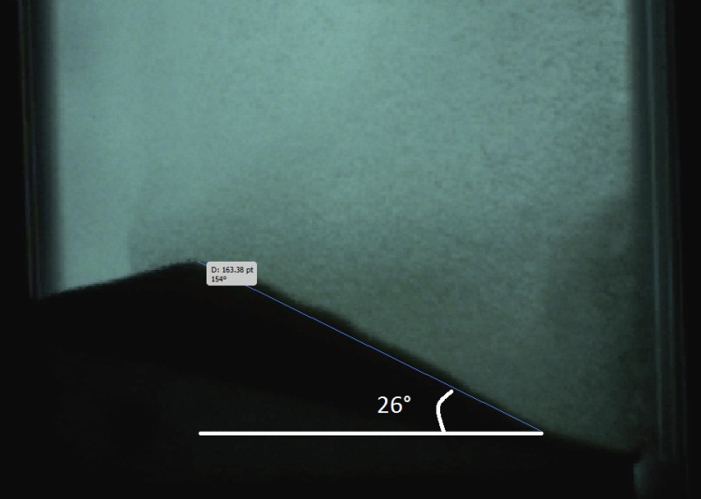
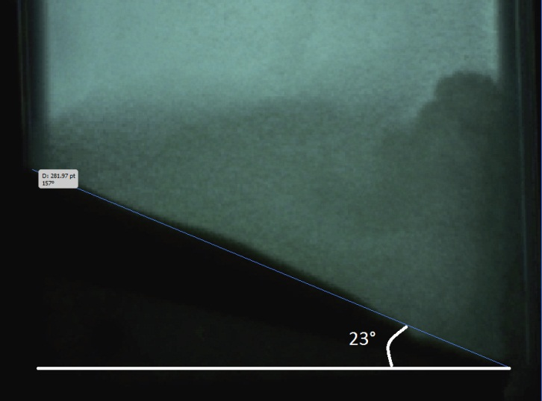
Discussion

Slide 15
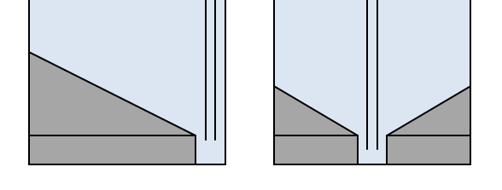
Future Work
Effluent turbidity
Investigate effect of other parameters on floc blanket formation
  Alum concentration
  Jet height above tank bottom
Centralized jet position
Current geometry
New geometry
Notes:
Alum affects stickiness of particles. May be more difficult for sticky particles to be returned to the jet.
Jet height above tank affects ease of floc resuspension.
(better entrainment of bulk fluid vs. adequate resuspension)

Slide 16
Questions?

