Slide 1
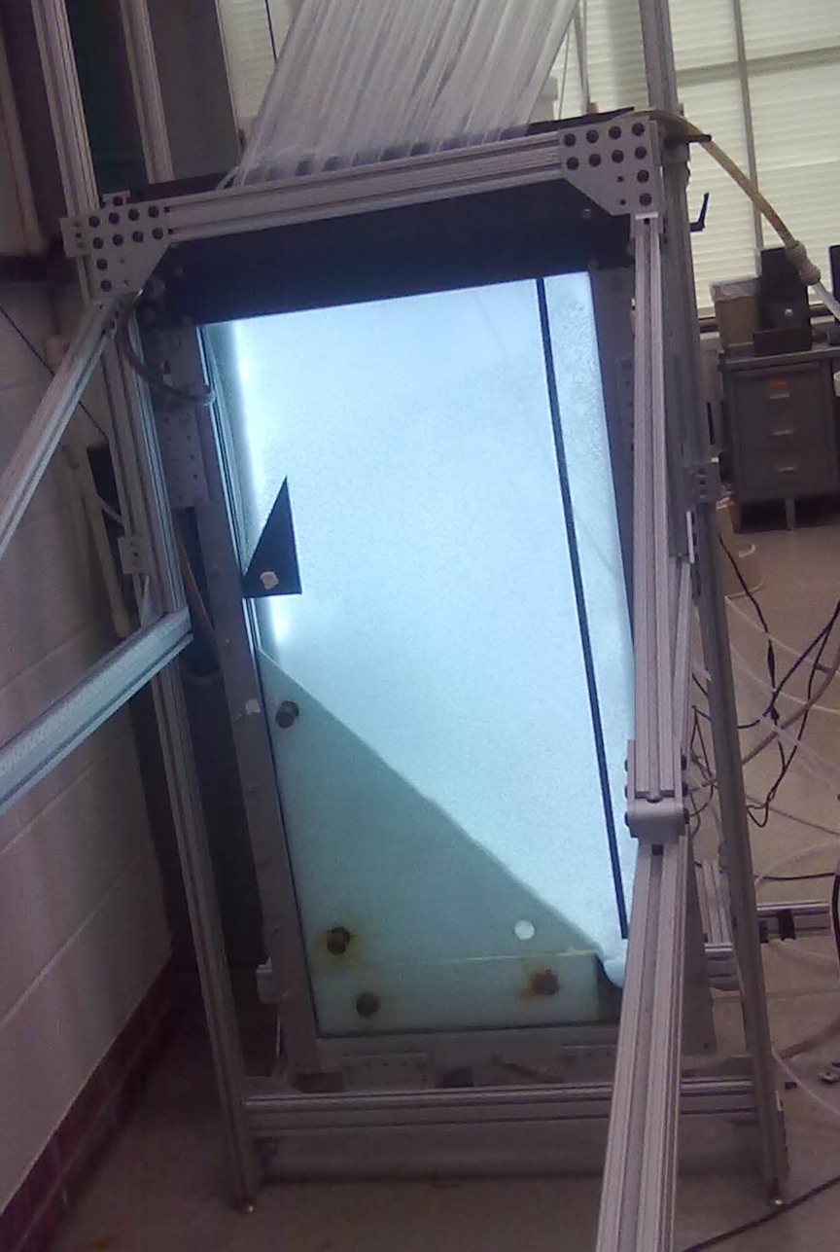
Sedimentation Tank Hydraulics
The Team
  Hongyi Guo
  Ethan Yen
  Frances Ciolino

Slide 2

Importance
Floc Suspension
  Prohibits sludge buildup
  Traps small flocs
Hopper Optimization
  Less water wasted
  Prohibit failure
Tube settlers in floc blanket failure

Slide 3
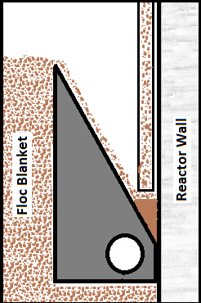
Goals
Optimize floc hopper geometry
Failure Conditions and detections
Floc blanket Stabilty

Slide 4
Vertical Sedimentation Velocity
Sed Velocity @ 0 Upflow
Upflow Velocity

Slide 5
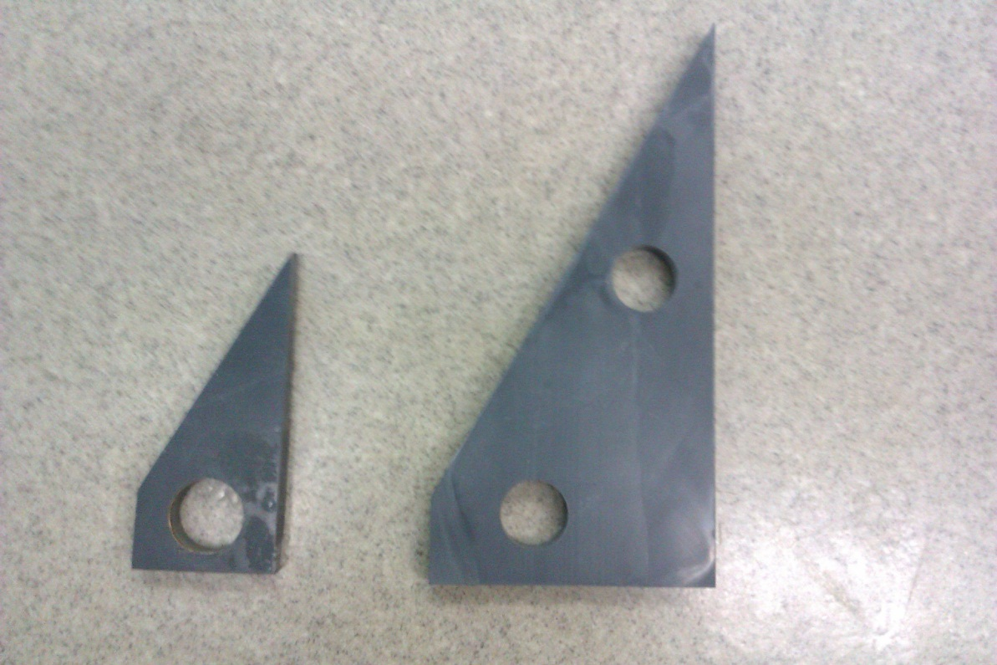
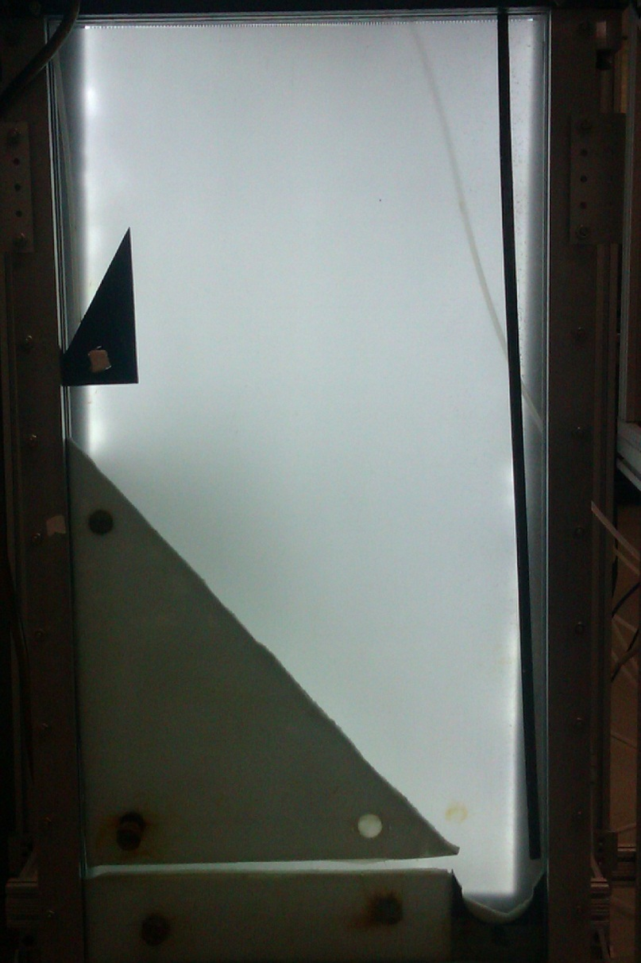
Floc Hopper Geometry

Slide 6
Future Work
Flop Blanket
  Try other upflow rate
  Explore failure condition
  Write a guide for plant operator
Floc Hopper Geometry
  Try other wasting rate
  Try different plan view area

