Slide 1

Sedimentation Tank Hydraulics
Frances Ciolino
Andrea Fortman
Marlana Hinkley
Marlon Passos

Slide 2
Experimental Set-Up

Slide 3
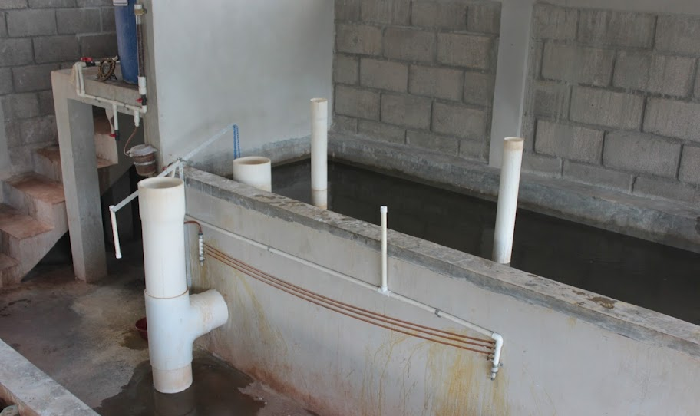
The Set-Up: a Real AguaClara Plant
Coagulant Stock Tank
Flow calibration column
Lever
Constant Head Tank
Linear Flow Orifice Meter
Dosing Tubes

Slide 4
Experimental Set-Up
Includes the same components
  Raw Water Source
    Aerated tap water
    Addition of clay
    Turbidity measured
  Coagulant stock tank
  Dosing tubes = pump
    Rate adjusted based on raw water turbidity
Flocculator

Slide 5
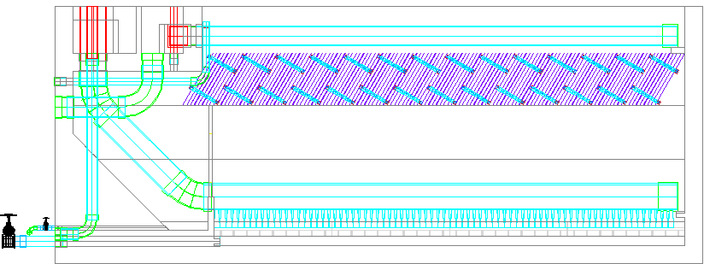
AguaClara Sedimentation Tank Design
Entrance Channel
Dump poorly flocculated water channel
Exit Channel
Exit Weir that controls water levels all the way back to the next free fall (LFOM!)
Launder
Plate Settlers
Floc Weir
Floc Hopper
Inlet Manifold
Diffusers
Floc Hopper Drain (to remove sludge)
Sed Tank Drain

Slide 6
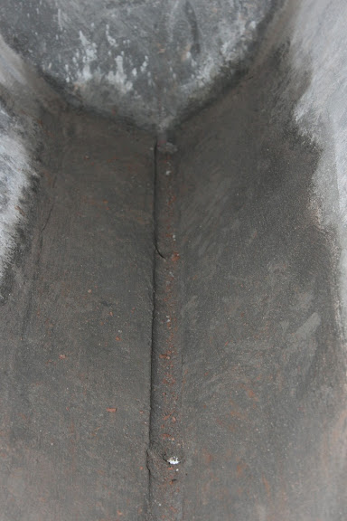
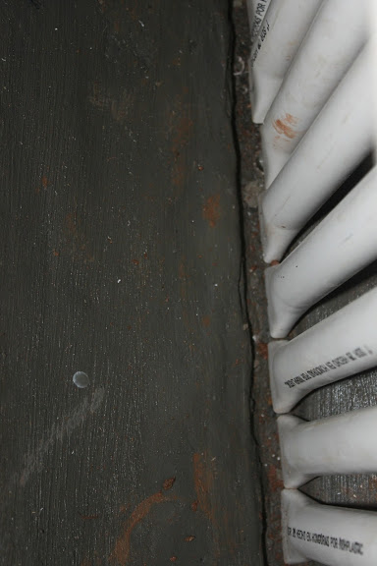
Tank Geometry in a Real Plant

Slide 7
Experimental Set-Up
Diffusers = Jet reverser
Same bottom geometry
  Weir and floc hopper
  Sludge turbidity measured
Plate settlers = tube settlers
  Effluent turbidity measured
Camera to visually monitor floc blanket

Slide 8
Goals: What and Why?

Slide 9
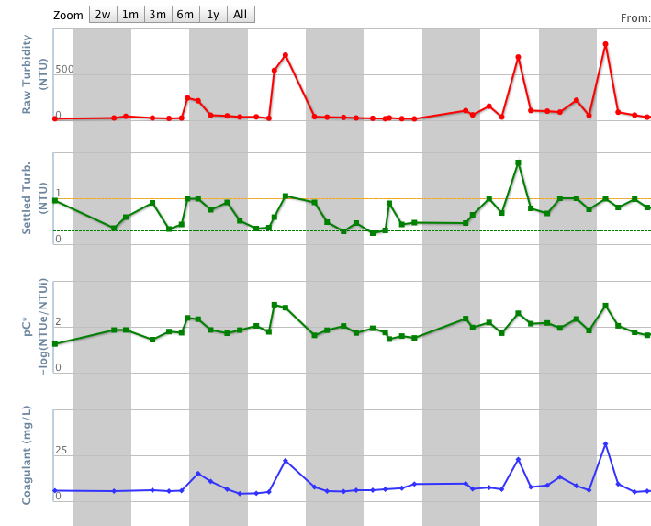
Goals for the semester
Alum dosage
  Do not waste
  coagulant
  Based on Atima numbers
Energy dissipation
  Particle size effect
  Floc blanket effect
Atima Data

Slide 10
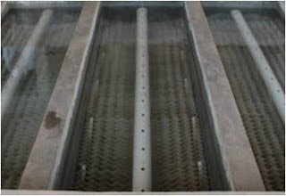
More Goals
Floc hopper depth
  Effect on the sludge
Time till formation
  Relationship between NTU and floc blanket formation
  Help operators
See into floc blanket and hopper
Atima Sedimentation Tank

Slide 11
Accomplishments

Slide 12
Research and General Set-Up
Conducted background research
Consolidated the apparatus
Lengthened the flocculator to increase residence time
Altered tank geometry

Slide 13
Background Research:
“Parameters affecting steady-state floc blanket performance”
Gained insight on parameters affecting floc blanket performance
  (1) Energy dissipation, (2) upflow velocity, (3) height and solids concentration in floc blanket, and (4) coagulant dosage
This semester, we plan to test the effects of (1), (3), and (4) on floc blanket formation

Slide 14
Consolidating the apparatus
Moved to left side of sink
Replaced tubing to decrease head loss through connections
Note: Switched to using PACl
  PACl dosage levels based on those at Atima

Slide 15
Lengthening the flocculator
Quadrupled the amount of tubing and used a figure-eight pattern rather than the tight coils
  This will increase collisions and more accurately model baffles in AguaClara flocculators
Want to test effect of increased residence time and energy dissipation on blanket formation

Slide 16
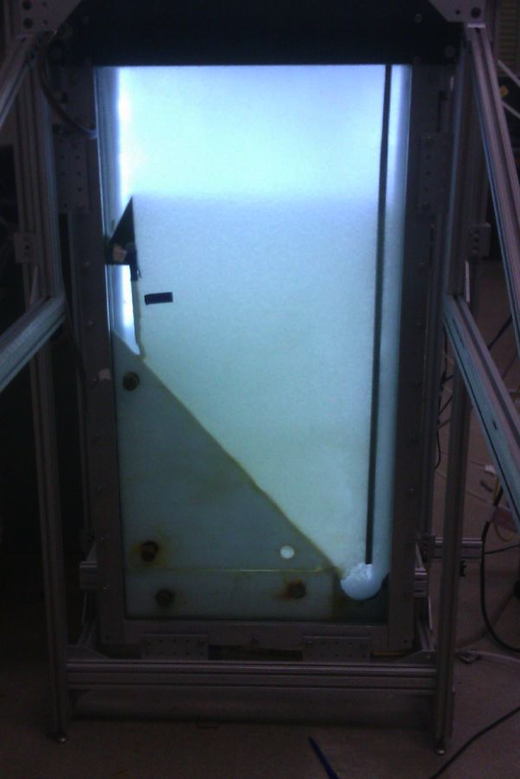
Old Sed. Tank Geometry

Slide 17
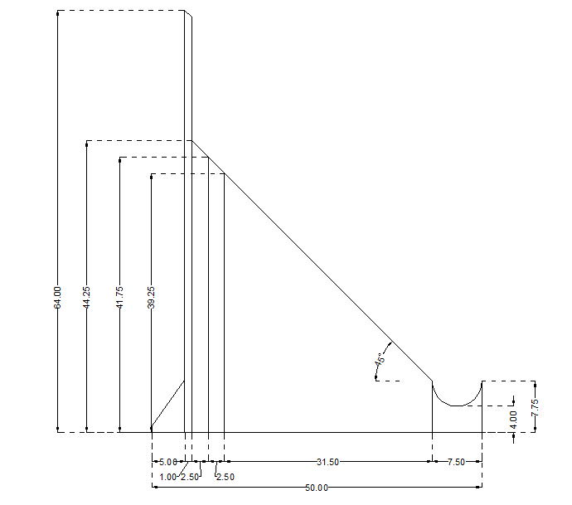
Altered Tank Geometry
New PVC inserts
  More durable, aesthetically pleasing
New Geometry
  Adjustable floc hopper area
Pieces removable with metal rod

Slide 18
Future Work

Slide 19
Future Work
Coagulant Dose
  Switch to PAC
  Test three dosages
Pipe Ending Diameters
  Energy Dissipation and Turbidity relationship
  Find the Optimal Point

Slide 20
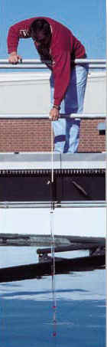
More Future Work
Floc hopper depth
  Heights based on piece sets
  Optical imaging analisys of sludge
  Geometric ratio
Floc blanket formation
  Time and turbidity relationship
Implement contact chamber
Operator management
Notes:
Contact chamber and camera capabilities (via Monroe)

Slide 21
Questions?
Comments?

