Slide 1

Sedimentation Tank Hydraulics
Frances Ciolino, Andrea Fortman, Marlana Hinkley, Marlon Passos

Slide 2
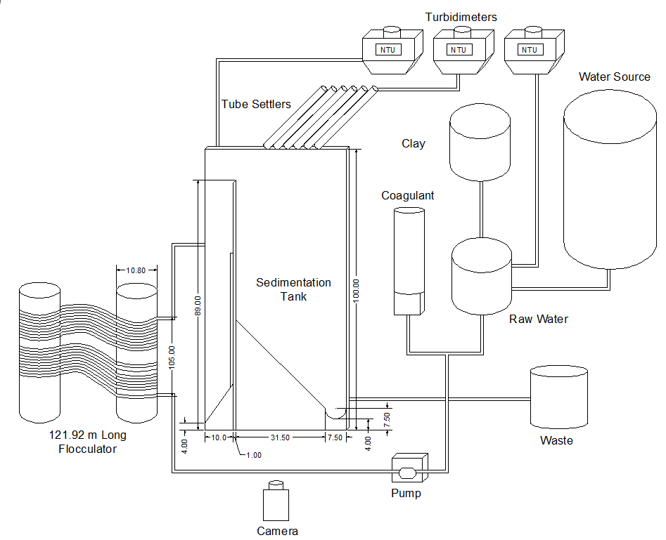

Set Up
Bottom geometry
  18% (7.5/39)
Plant flow rate
  365.7 mL/min
  Upflow velocity 1.2 mm/sec
Rubber seal
Floccualator length
  Increase residence time to 23.7 minutes
  Increase collisions

Slide 3
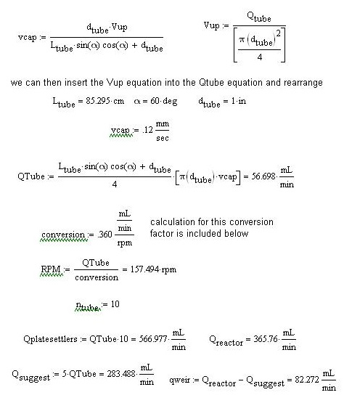
Plate Settlers
Capture velocity
  0.12 mm/sec
Conversion factor
  0.36mL/min/RPM
5 tube settlers each at 56.7 mL/min

Slide 4
Sludge Removal
Camera Configure
  Detects sludge water interface
  Numerical derivative of each row of pixels
  Converts image data to physical height data
Use On/Off controller
  Needs a on, off, min and max height, and flow rate
  Flip on and off because emptying not filling

Slide 5
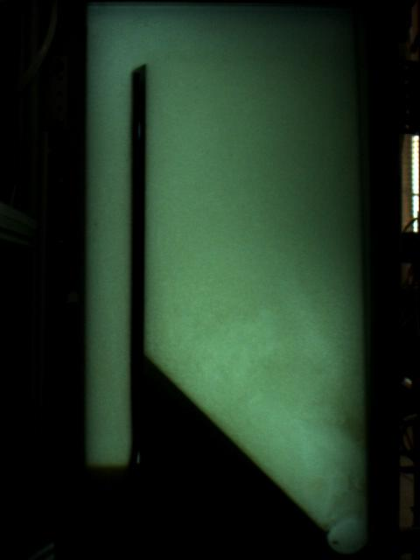
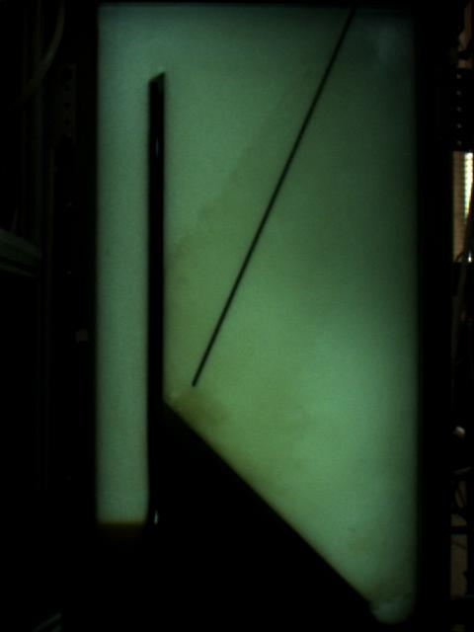
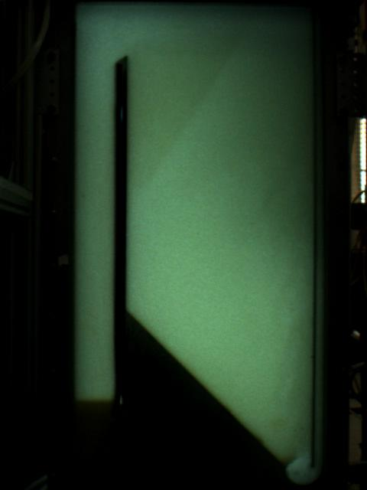
PACl Findings
Very sticky so more frequent cleaning
No concentration graphs

Slide 6
Varying Coagulant Dose

Slide 7
Analysis
5, 10 and 15 mg/L
Other parameters constant
Floc Blanket Failure at 5 mg/L
Coagulant Dose | Effluent Turbidity
15 mg/L | 0.73 NTU
10 mg/L | 0.68 NTU
5 mg/L | 0.68 NTU

Slide 8
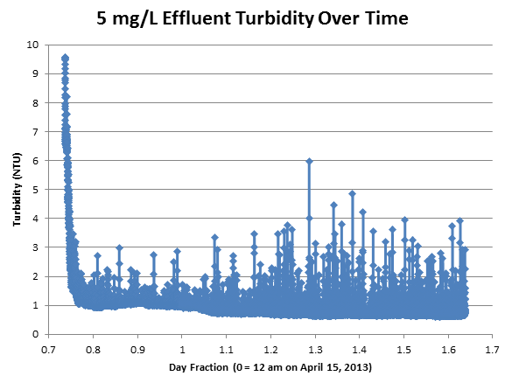
Conclusions
Best performance: 5 and 10 mg/L
Momentum and energy dissipation rate are important

Slide 9
Dye Test

Slide 10
Analysis and Conclusions
Pulse of red dye at 800 and 100 NTU
Complete mix and plug flow behavior
Different flow paths

Slide 11
Energy Dissipation Rate Experiments

Slide 12
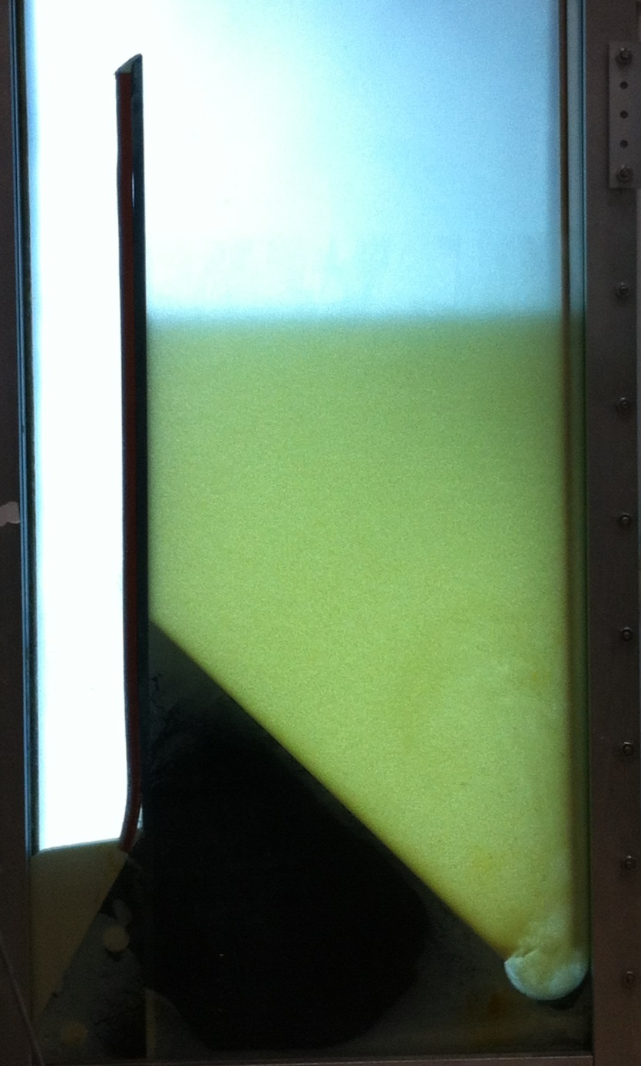
What?
Test range of energy dissipation rates to failure (1 – 100 mW/kg)
Hypothesis: Higher small floc production rate as a result of high energy dissipation rates increases blanket performance
Notes:
Floc break-up occurs after flocs settle and are resuspended by the jet

Slide 13
Why?
Find ways to improve floc blanket performance
Surface shear too great in large flocs for colloids to attach
smaller flocs = less surface shear = lower effluent turbidity!

Slide 14
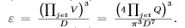
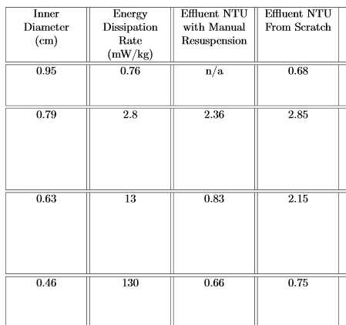
Energy Dissipation Rate (EDR):

Slide 15
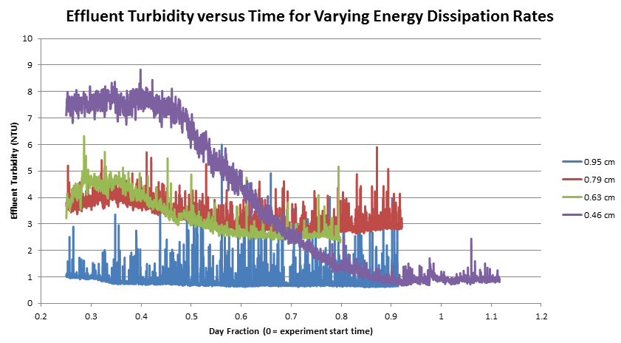
Effluent Turbidity vs. Time

Slide 16

Failure
Floc blanket collapse at 0.76 mW/kg (0.95 cm ID jet)
Avg. effluent turbidity before failure: 0.68 NTU
The jet diffuser velocity could not create enough momentum

Slide 17
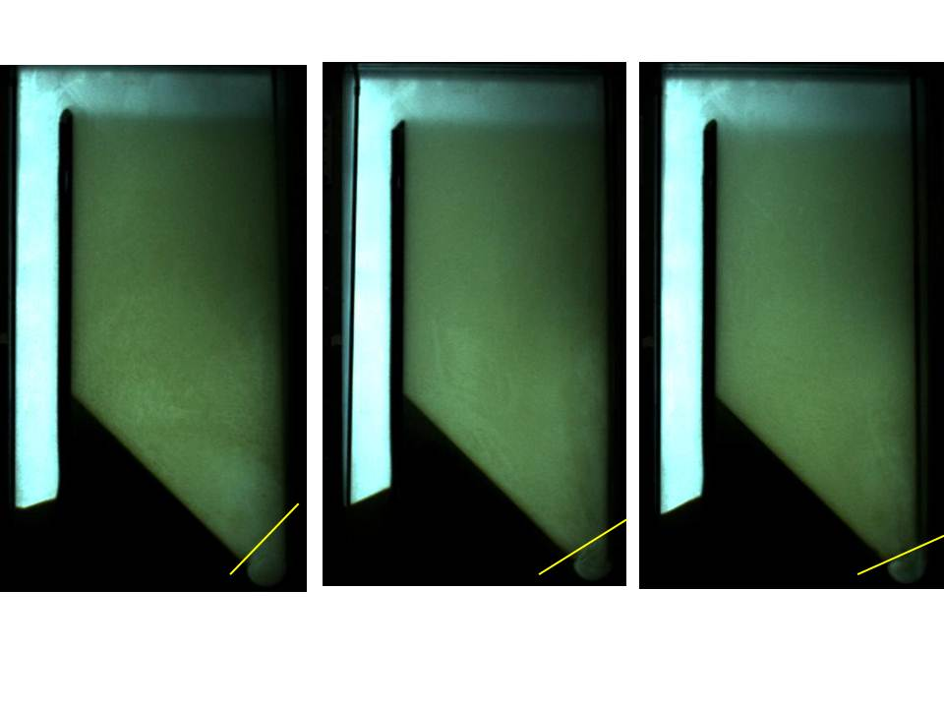
Jet and Debris Interaction
As p of the jet decreases, the angle at which the jet flow leaves the semi-circular bottom geometry decreases. From L to R : 130, 13, 2.8 mW/kg

Slide 18
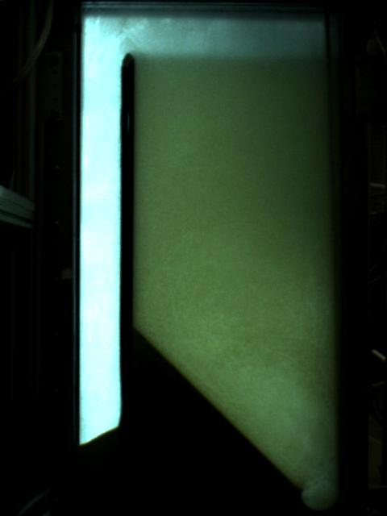
Success
130 mW/kg, 0.46 cm ID jet
Manual re-suspension: 0.66 NTU
“From Scratch”: 0.75 NTU
0.46 cm ID jet EDR Experiment
Notes:
Start video at 1 minute in

Slide 19
Significance
Application in full-scale sed. tanks: better floc blanket with smaller diffusers!
Reduces material costs while increasing performance!
Win, win!
Notes:
This finding also dispelled the concern that the energy dissipation rate in the transition from the
flocculator to the sedimentation tank needs to be the same as in the flocculator to avoid floc breakup.

Slide 20
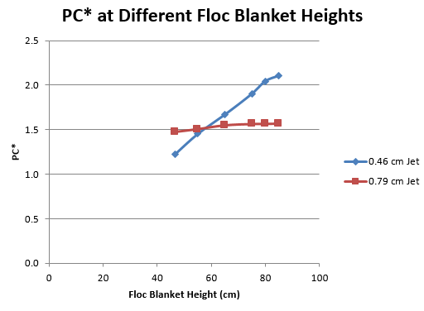

Turbidity versus Floc Blanket Height
Notes:
In previous years, the geometry of the sed tank resulted in a floc blanket that was 60 cm tall at steady-state, whereas this year, our blankets have been 85 cm tall. To test the effects of floc blanket height on performance, we tracked the height of the floc blanket during it’s formation and compared effluent turbidity at each of these heights for two different experiments – the 0.79 and 0.46 cm jet reversers from scratch. This graph is of PC* versus height for these two experiments. A higher PC* is better, so you can see that the smaller jet (larger energy dissipation rate) performs better as the floc blanket grows past 60 cm, but a smaller energy dissipation rate performs better at lower floc blanket heights.

Slide 21
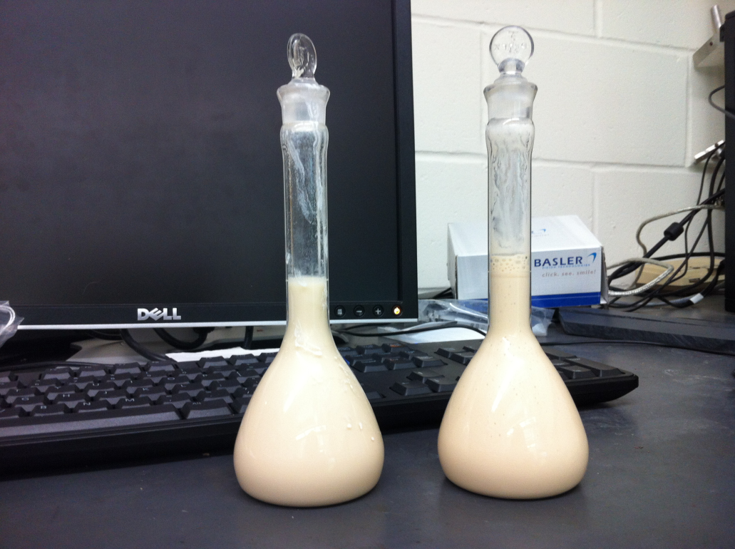

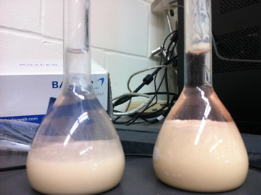
Sludge Concentration versus Depth
Collected sludge from two different depths
Visually compared settling after 48 hours
Compared oven-dry sludge mass
Taller floc hopper→ larger mass of sludge

Slide 22
Coagulant Failure
What happens when the coagulant runs out?
https://www.youtube.com/watch?v=EDLoDvZPlyw&list=UUXq9V81yyUOTQYokfp5wXfw
  0.46 cm jet reverser
No coagulant → less-dense clay particles → blanket collapse

Slide 23
Future Work
Vary floc hopper geometry
Adapt camera configure to record floc blanket height
Test the sludge judge or other device for operators to measure floc blanket growth
Time to formation experiments at lower turbidities

