Slide 1

Sedimentation Tank Hydraulics
Mahina Wang
Jill Freeman
Elana Liskovich
Yiwen Ng

Slide 2
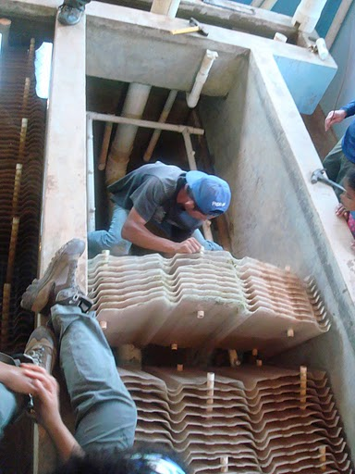

Objectives
  Find the optimal sedimentation tank bottom geometry for floc blanket formation
  Determine the optimal floc blanket height and design a floc weir to keep the floc blanket at this height

Slide 3
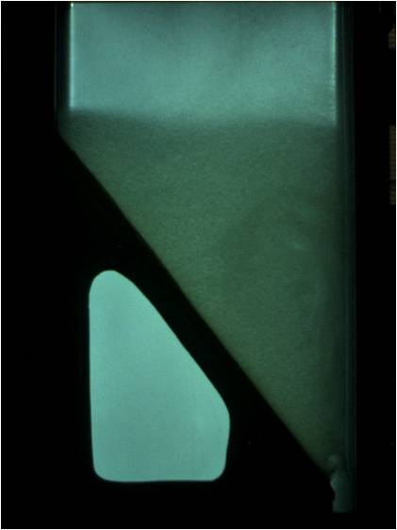
Recap: What is a Floc Blanket?
  A fluidized, highly concentrated bed of particles.
  Occurs when flocs are continuously being resuspended by the jet.
Benefits of a floc blanket:
  Greatly improves the effluent turbidity by trapping small flocs.
  Reduces clean water waste from frequent draining of the sedimentation tank.
Notes:
How does it form?
Talk about conditions for resuspension.
-continuous resuspension
-particles directed toward jet
Flocs switch from a state of differential to hindered settling.
differential:
-Large flocs settle faster than small flocs.
-No interactions between flocs
-This means that very small flocs can escape through the plate settlers.
hindered settling:
-the flocs interact with eachother
-settle at the same rate.
The floc blanket grows in size and density as it traps more and more particles. Better floc blankets are more dense.
A floc blanket greatly improves effluent turbidity.
-floc weir will reduce water waste.
Previous teams have determined that a minimum angle of repose of 23 degrees is needed on sedimentation tank sides for floc blanket formation.

Slide 4
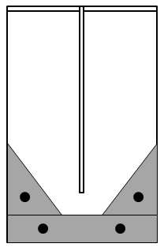
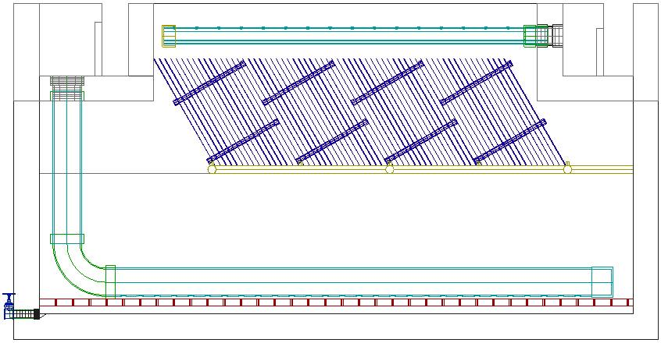
Recap: Our Tank
Sedimentation tank (side view)
Experimental set-up
(front view)
Notes:
Sed tank from side and front view. Explain how we model the tank.

Slide 5
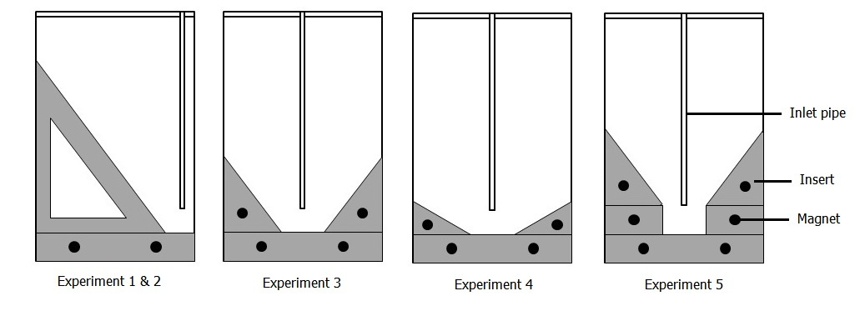
Recap: Experiments Prior to Teach-in
Notes:
-discuss how teams prior did not do double inserts and did not focus on trenches
-this slide should show the progression of our thought process in deciding which experiments to run
-we started out using one insert (also discuss run til failure experiment), then we moved to double inserts and played with the angles, then decided to experiment with a trench
-since the double inserts reflect more accurately the actual tank and since the trench positively affects floc blanket formation, we decided to make all of our experiments have a trench

Slide 6
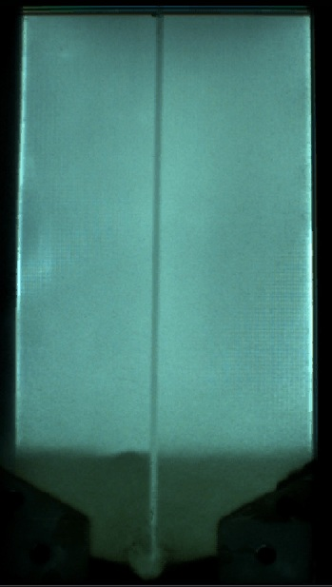
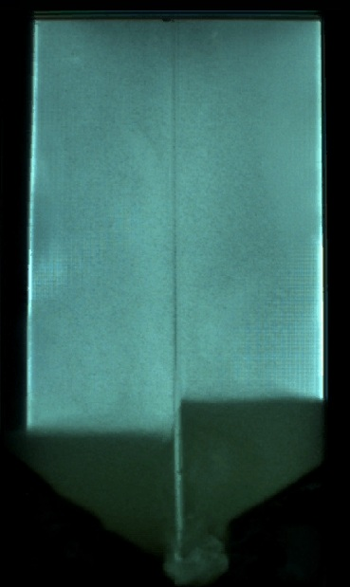
30 Degree Inserts, 20cm Rectangular Trench
Notes:
-sludge forming a narrower trench, also in semicircular shape
-height of floc blanket never passed top of insert
-Observed 30 degree floc blanket forms slower and takes longer to grow than 60 degree.

Slide 7
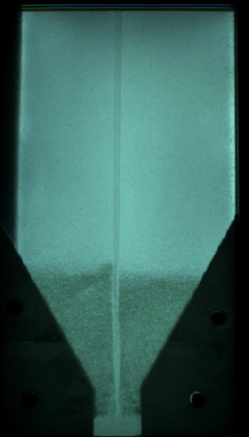
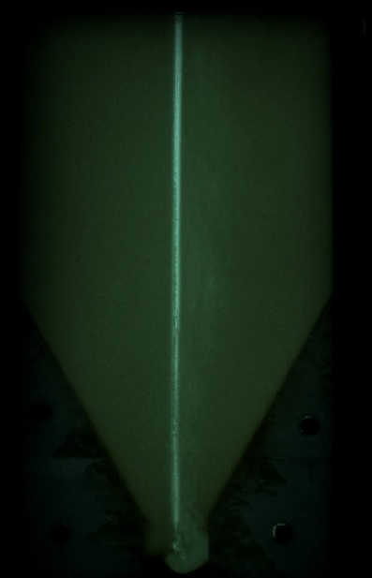
60 Degree Inserts, 10cm Rectangular Trench
The narrower trench results in less sludge build-up in the trench and floc blanket formation in approximately 40 minutes.
Notes:
image 1: 40 mins into experiment.
image 2: 5 hours into experiment. thick floc blanket. Note sludge buildup on bottom.
compare to 20 cm trench experiment talked about in previous teach-in.
-narrower trench bottom allows for better floc blanket formation because more flocs are resuspended and less end up settling on the tank bottom

Slide 8
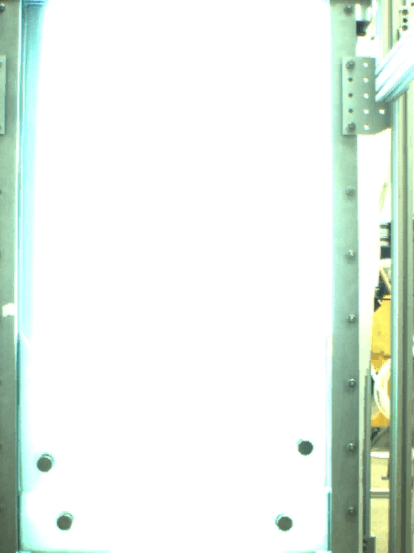
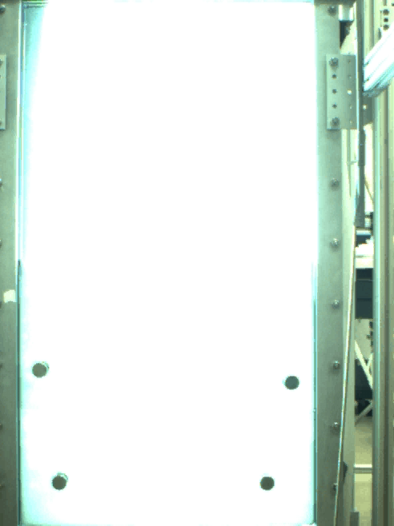
Comparing 20cm and 10cm Rectangular Trench
20 cm rectangular
10 cm rectangular

Slide 9
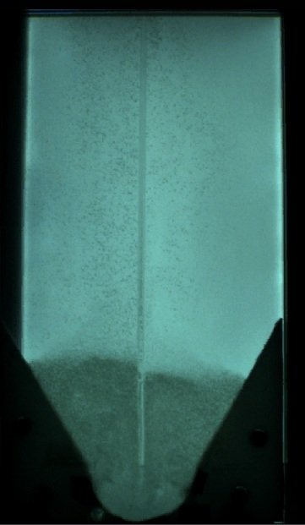
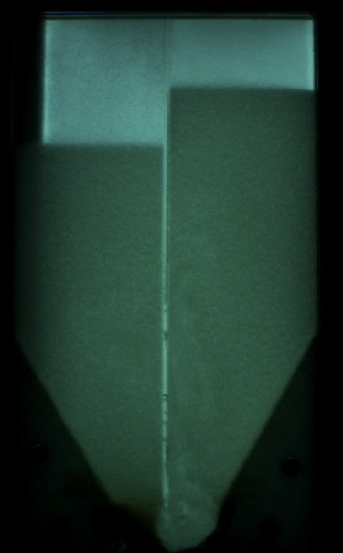
60 Degree Inserts, 20cm Rounded Trench
The curved bottom geometry results in less sludge build-up in the corners of the trench.
Notes:
We expected a semi-circular trench to result in better floc resuspension and floc blanket formation because less energy is lost by the jet water as it changes direction.
Image 1: About 50 mins into the experiment, when floc blanket forms.
Image 2: significant sludge build up on the left side of the jet, narrowing the trench to approximately 10 cm. This suggests that the 20cm is too wide for the trench bottom.
-jet occasionally diverted to the right (rather than stay in the center)
-suggests current width of tank is too wide for jet diameter and velocity

Slide 10
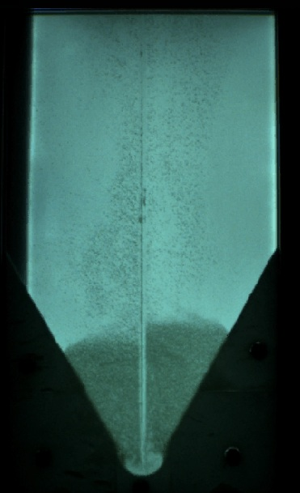
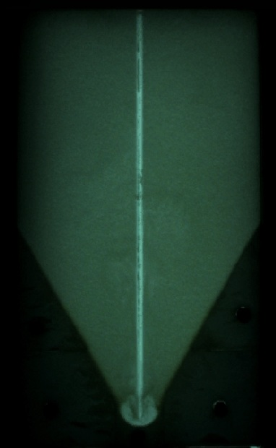
60 Degree Inserts, 10cm Rounded Trench
Notes:
Image 1: 40 mins into experiment. Floc blanket has formed.
Image 2: 5 hours into the experiment. Still very little sludge buildup in the trench bottom.
This appears to be the best bottom geometry so far.

Slide 11
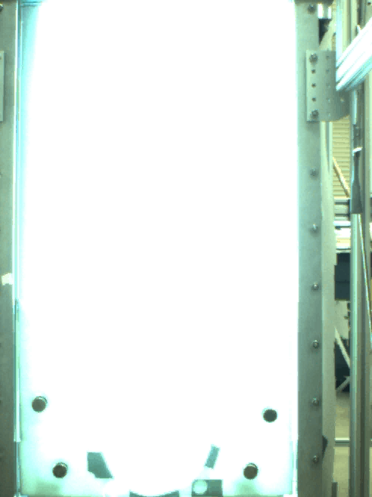
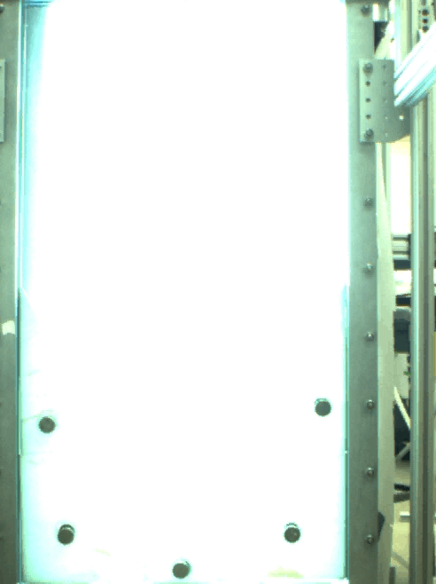
Comparing the 20cm and 10cm Rounded Trench
20 cm rounded
10 cm rounded

Slide 12
Comparing Trench Bottoms
10 cm rectangular
10 cm rounded
Notes:
Note the time it takes to form blanket, height of blanket, darkness of blanket/density of flocs, and sludge buildup on the bottom.

Slide 13
Conclusion
A narrow (10 cm) rounded trench allows for the best floc blanket formation and resuspension of flocs.
Notes:
Can we make it narrower?

Slide 14
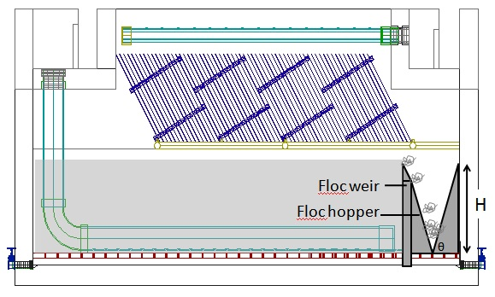
Floc Weir Design
Proposed floc hopper design for current actual sedimentation tank
Notes:
-purpose of a floc weir is to maintain height of floc blanket
-under plate settlers in order to keep them working (otherwise poor effluent quality)
-current design: sharp crested weir placed at far end of the sedimentation tank with an adjacent V-shaped floc hopper to collect excess flocs
-when height of the floc blanket exceeds the height of the weir, excess flocs will be collected in the hopper
-accumulated sludge can be removed by opening the sludge drain
To determine appropriate height of floc weir:
-consider a simple mass balance model where at steady state, the rate of mass added to the floc blanket should be equal to the rate of mass removed from the floc blanket via the floc weir

Slide 15
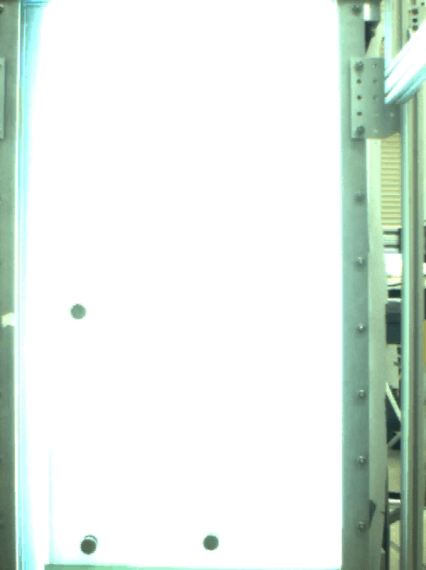
Floc Weir Experiment
Notes:
60 degree insert. Notice flocs collecting inside the insert. This would be a source of error because it takes

Slide 16
Future Work
Goals for future experiments:
  Determine ideal tank bottom geometry by further reducing the width of the trench. Determine a relationship between the diameter of the jet and the diameter of the trench.
  Determine the ideal jet height.
  Determine the rate at which sludge should be removed from the hopper.
Notes:
-Determine height of floc hopper necessary to effectively maintain the floc blanket at a constant depth
-jet height affects resuspension of floc and thus creation of the floc blanket
• Determine the effects of further reducing the diameter of the semicircular trench on sludge accumulation and floc blanket formation.
• Change the size of the inlet pipe to more accurately reflect the diameter of the actual drop tube, and so that flocs are able to easily pass from one side of the tank to the other.
• Come up with an empirical relationship between the ideal diameter of the semicircular trench to the diamter of the inlet pipe. This will help us determine the ideal trench width for the aguaClara plant.
• Determine the flow rate needed to drain sludge from the floc hopper in order to keep the system running at steady state without any sludge accumulation on the tank bottom.

