Slide 1

AguaClara Summer Program 2013

Slide 2
Welcome!
Introductions
What is AguaClara?
Teams and Assignments
Lab visit!

Slide 3
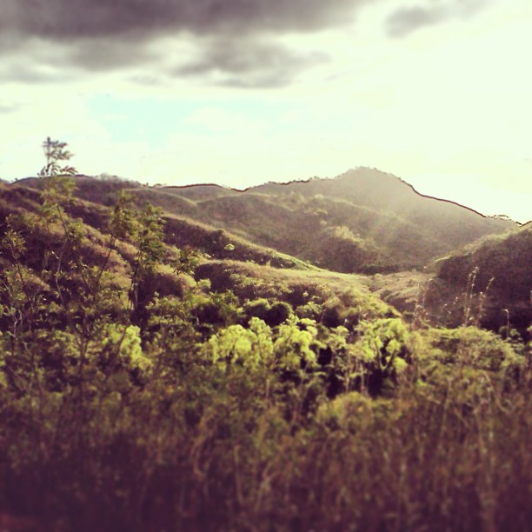
Introductions
Name
Major
Something you’re doing this summer

Slide 4
What is AguaClara?

Slide 5
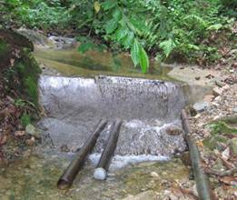
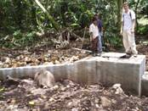
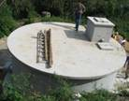
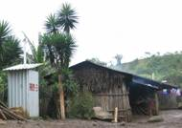
Gravity Water Supply
Drip Chlorinator
Distribution Tank
Spring box or dam

Slide 6

Stages of colloid removal
Coagulation
Flocculation
Floc Blanket
Sedimentation
Filtration
Nanoglob deposition
Collisions
More Collisions
Gravity!
Last chance!
What is a colloid?
Notes:
Here are the five stages of colloid or particle removal in hydraulic drinking water treatment plants. The first stage, coagulation, involves the addition of a chemical coagulant to destabilize a suspension of particles. The coagulant precipitates and attaches to the particle surface. Then in flocculation, velocity gradients in the water cause the particles (now coated in precipitated coagulant) to collide and stick to one another forming aggregates. In floc blankets there are many more opportunities for collisions. In sedimentation, fluid flow is very slow and the aggregates settle to the bottom of the tank. Filtration is often used to remove any remaining particles but is not included in the bench-scale setup.

Slide 7
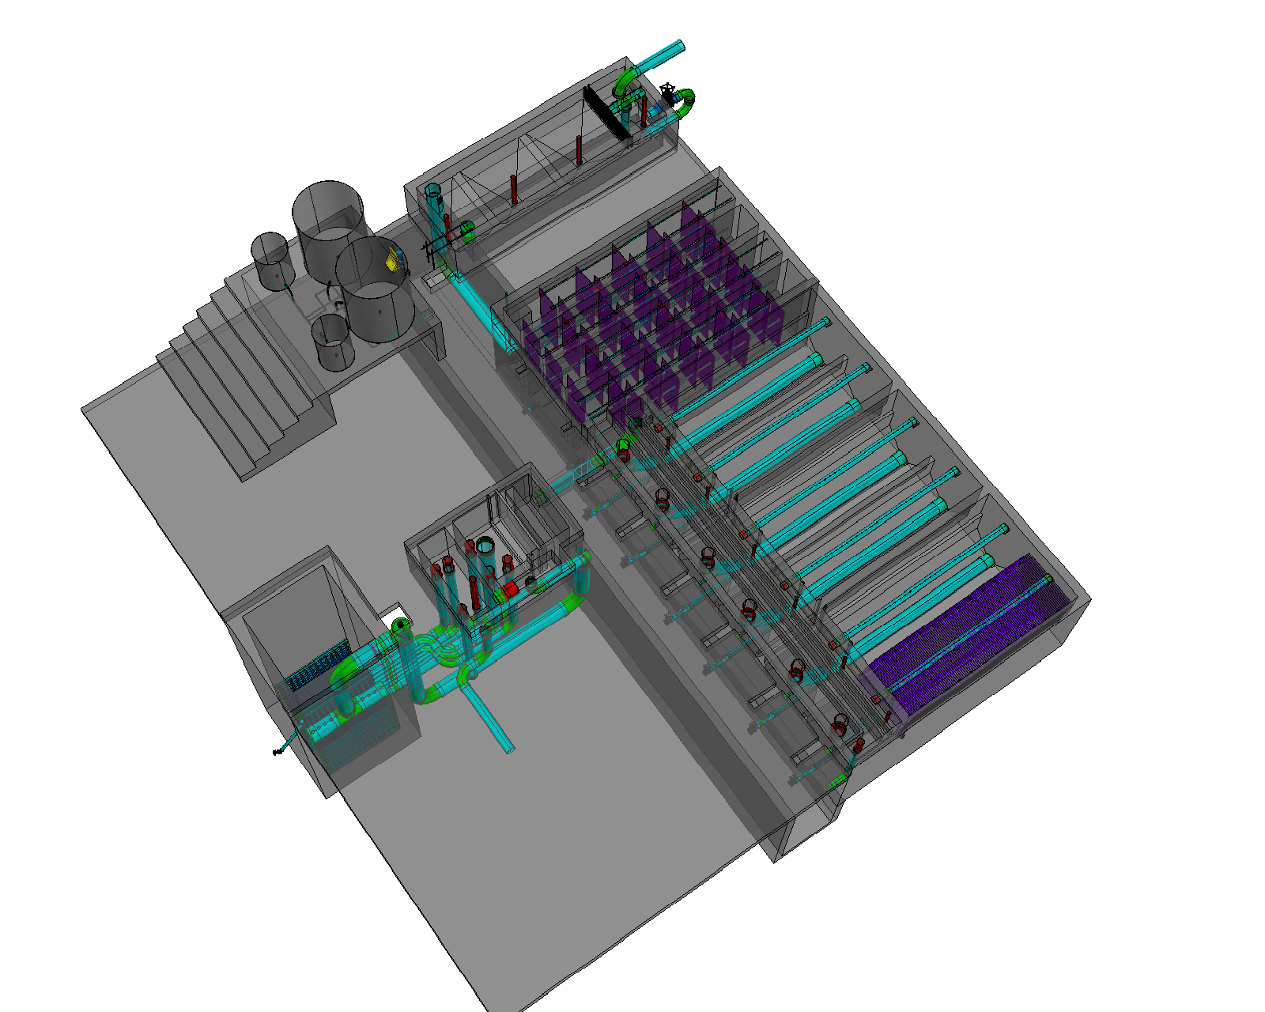
Entrance Tank
Flocculator
Sedimentation
Tanks (3 tanks with 2 bays each)
Stacked Rapid Sand Filter

Slide 8
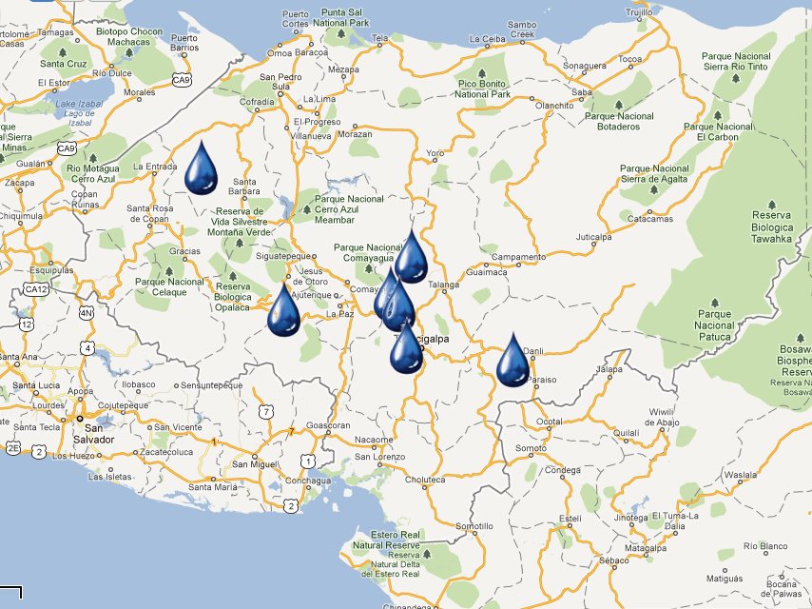



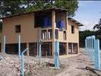



Since 2005:
AguaClara in Honduras
“Cuatro Comunidades” 2009
Atima 2012
Agalteca 2010
Tamara 2008
Marcala 2008/2011
Alauca 2011
Ojojona 2007

Slide 9
AguaClara Network
Investigation, innovation, education, and design
Cornell U
AguaClara R&D
AguaClara LLC
Supervision, quality assurance, consulting services, and technical assistance for the implementation partners.
Implementation Partners
Design/Build/Operate/Train/Transfer
Provide ongoing technical assistance for Water Boards
Water boards
Own, operate, maintain their water system. Monitor and upload performance data.
Community Members
Conserve water, drink safe water, and pay the tariff
Notes:
AguaClara Program at Cornell – R&D, new design and technology development. Note that Agua Clara plans to make their designs open source so cost for their proprietary designs is not an impediment to their adoption.
AguaClara Inc. – Proposed commercial entity which recruits and vets engineering and construction firms local to target communities (Implementation Partners, below), provides oversight and QA services, acts as a “face” to regional/local communities and as a go between with the AguaClara program as needed, and provides feedback to Cornell related to lessons learned and downstream technical requirements. In short, the “glue” between all entities.
Implementation Partners – Engineering and Construction firms in the target regions who will develop bids, sell services and build and deploy the plant and transfer support to local water boards.
Local Water Boards – Municipal entities who will “purchase” the build/deploy services from the Implementation Partner, and get funding from municipal/region/national sources for deployment of the plants.

Slide 10
Sharing understanding, feedback, and innovation
Cornell U
AguaClara R&D
AguaClara LLC
Implementation Partners
Water Boards
Community Members

Slide 11

AguaClara at Cornell
Lecture/Project Based Course
ENGRI 1131: Water Treatment Design
Research, Design, & Admin
Graduate Research
Fundamental physical chemical processes for enhanced drinking water treatment
Capstone Design Course
CEE 4540: Sustainable Municipal Drinking Water Treatment
Project Based Courses
AguaClara: Sustainable Water Supply Project*
Summer Internships at Cornell
Engineering in Context
2 week trip to Honduras during January intersession
Service
Learning
The “service learning” is reversed in this model!
Notes:
This is the “skeleton” of the AC program at Cornell, but not the human story – how this program provides a unique gateway for students into a world of high-stakes tech development an implementation appropriate to the challenges facing the Global South. High stakes because children are dying by the tens millions due to polluted drinking water– and because careful water management is rapidly ascending to the top of the list of critical global development necessities.
As you note, all the way through this Ppt, I am thinking about both the actual details (and organization) of the tasks you represent on the charts (how you would explain them to someone who has no prior knowledge of AC), and the human story that animates them all. We have to be very well prepared to talk about both to serious prospective donors.
---Gail

Slide 12
How Water Flows Through the Plant

Slide 13
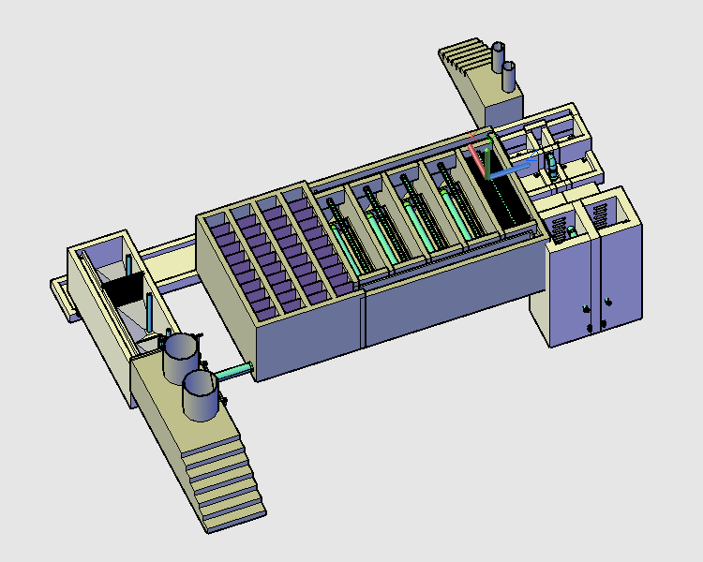
Stacked Rapid Sand Filters
Flocculator
Sedimentation
Tanks
Entrance Tank

Slide 14
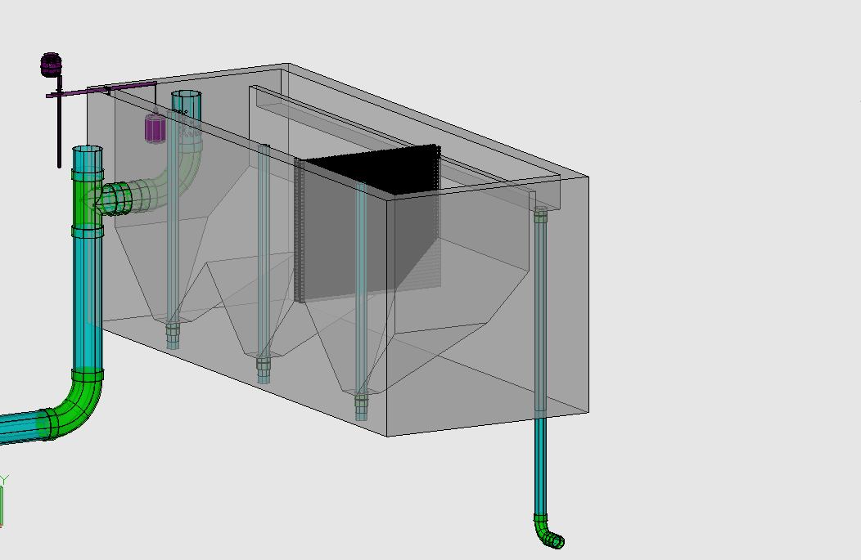

Chemical Dose Controller
Entrance Tank
Overflow Weir
LFOM
Trash Rack
Hopper
Primary Sludge Drain

Slide 15
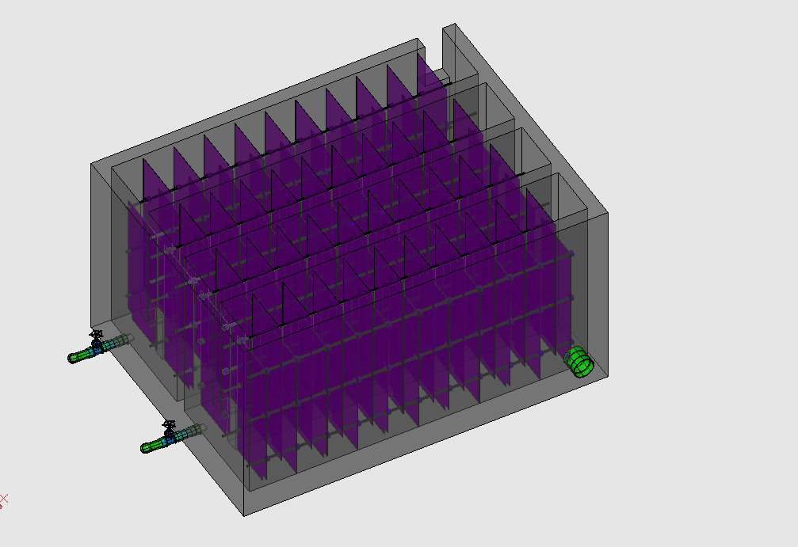
Flocculator
Rapid Mix Pipe

Slide 16
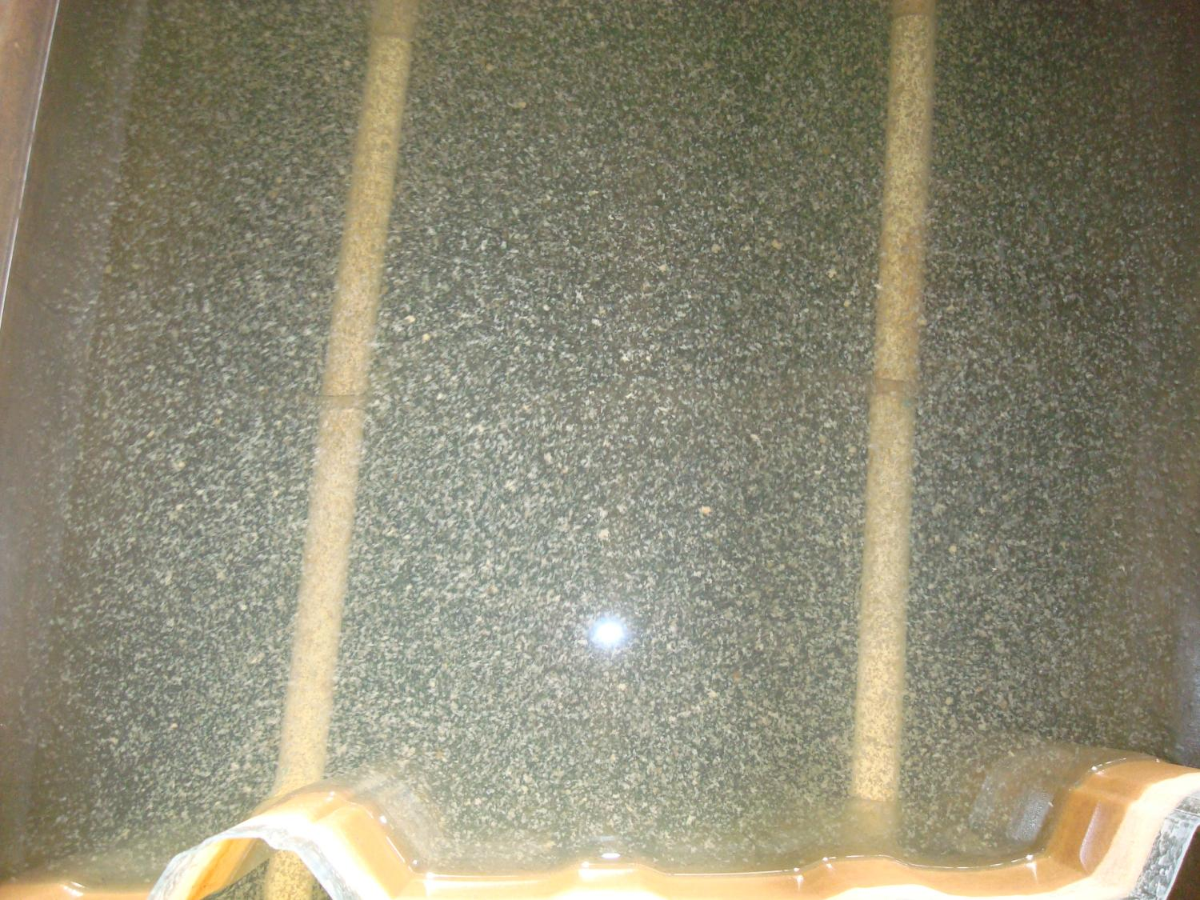

Slide 17
Stacked Rapid Sand Filters
Flocculator
Sedimentation
Tanks
Entrance Tank

Slide 18
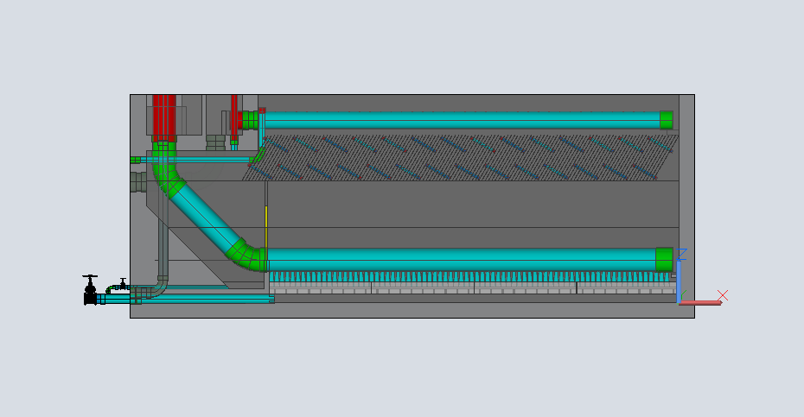
Entrance Channel
Exit Channel
Launder
Plate Settlers
Floc Weir
Inlet Manifold
Diffusers
Sludge Drain
http://www.youtube.com/watch?v=bQgMdkO0qUA

Slide 19
Stacked Rapid Sand Filters
Flocculator
Entrance Tank
Sedimentation
Tanks

Slide 20
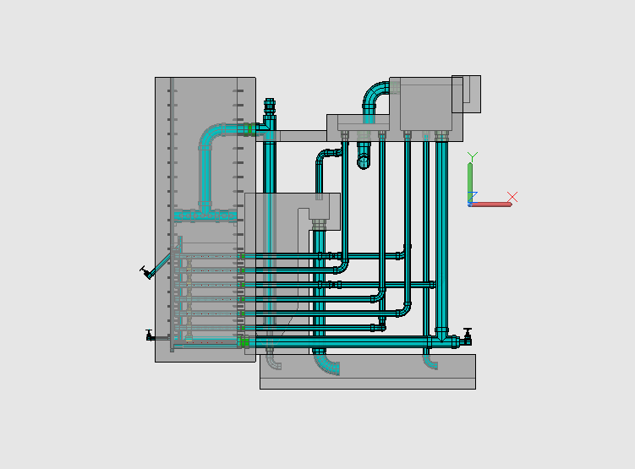
Stacked Rapid Sand Filtration
Filtration Entrance Tank (from Sedimentation Tank)
Exit Tank

Slide 21
Introduction to Teams

Slide 22

Design Team
Heidi Rausch, Julia Morris, Paroma Chakravarty

Slide 23

Automated Design Tool
User Inputs
Plant
Design
LabVIEW
AutoCAD
Mathcad
Calculations
MS Word
Mathcad
Drawing Files

Slide 24
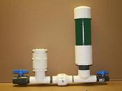
Ram Pump
Christine Vernon, Alex Balog, Madeline Haas
Team Leader: Casey
Purpose?
Create a simple, easily repaired pump that can provide water for chemical stock tanks and for the plant bathroom

Slide 25
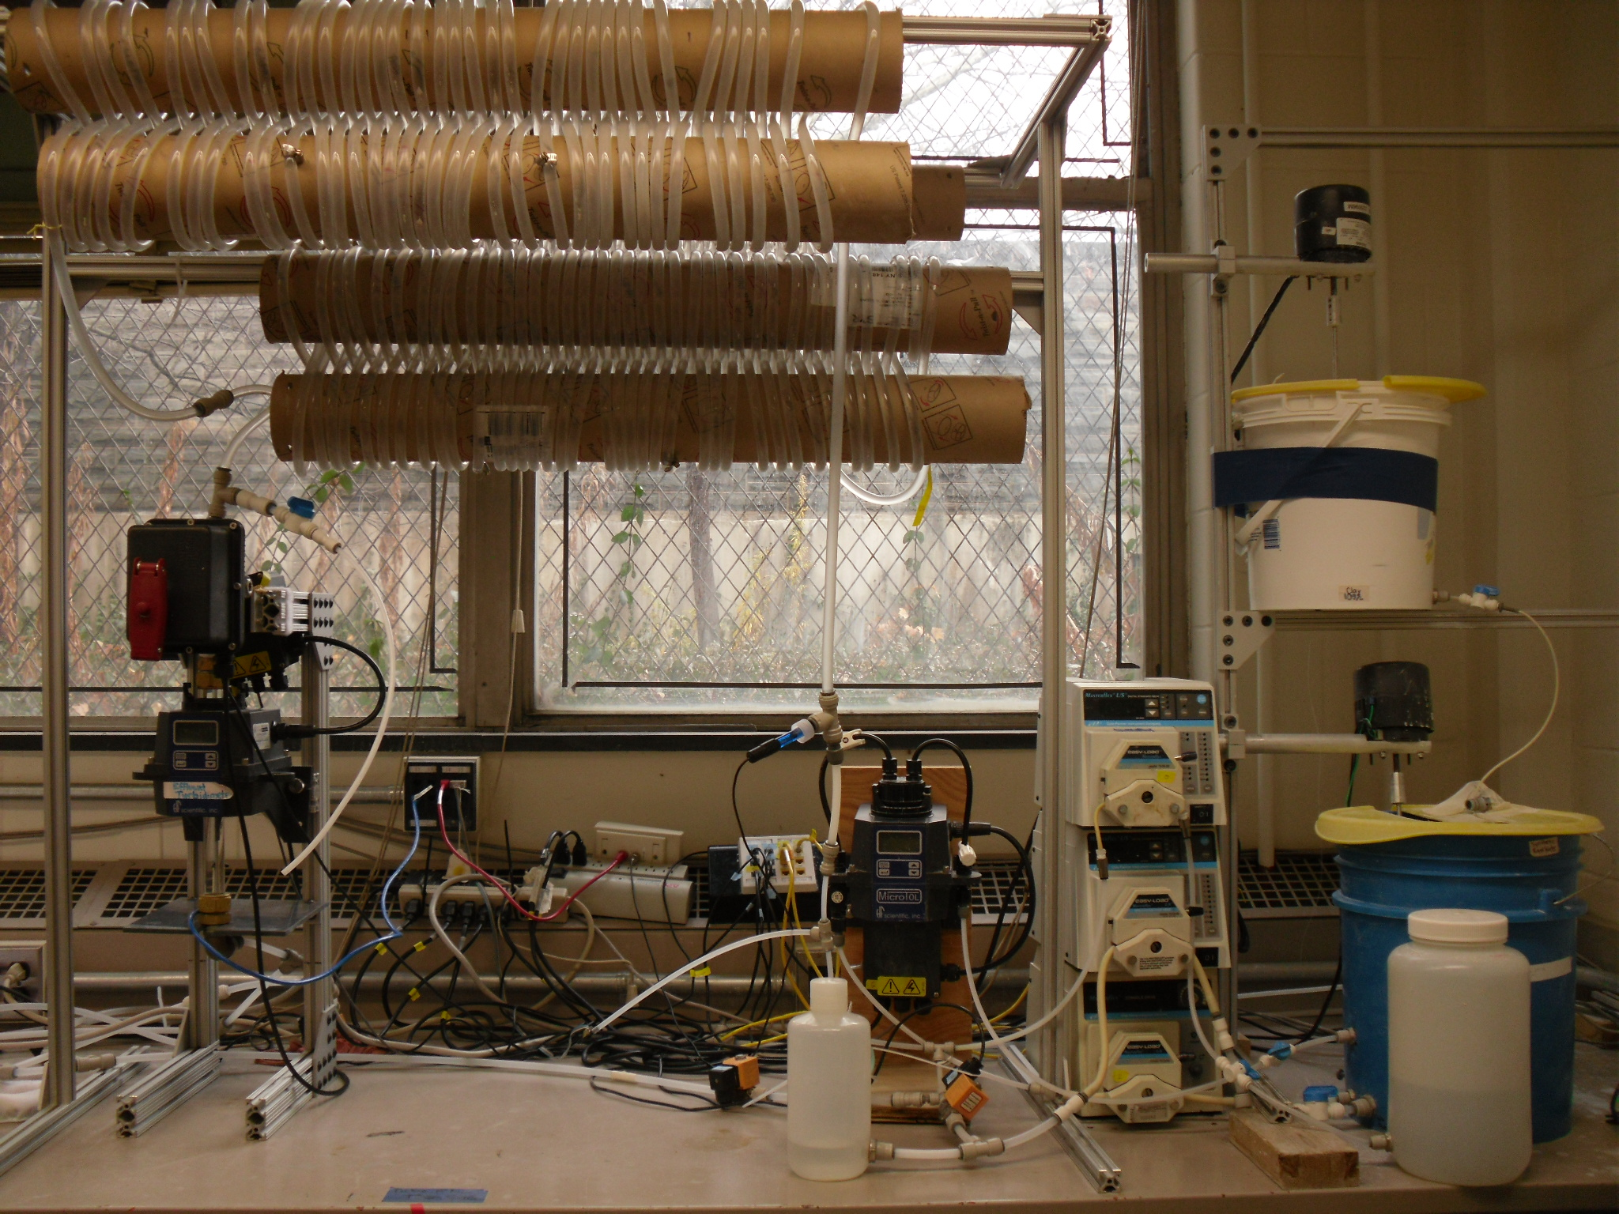
Tube Flocculator
William Pennock, Rivu Dey, Allan Brooks
Team Leader: Casey
Purpose?
To better understand the process of flocculation to improve plant design and performance

Slide 26
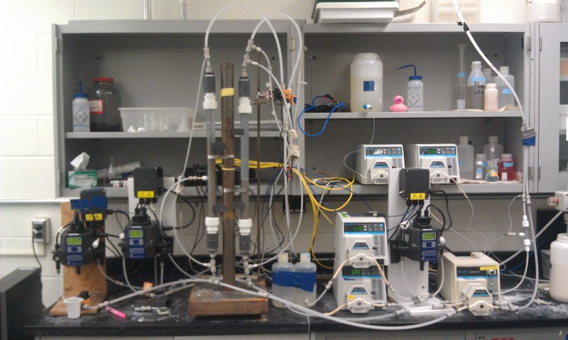
Surface vs Subsurface Filtration
Kelly Huang, Theresa Chu, Vikram Kejariwal, Tanya Peifer
Team Leader: Casey
Purpose?
Determine how subsurface injected sand filters behave differently than surface injected

Slide 27
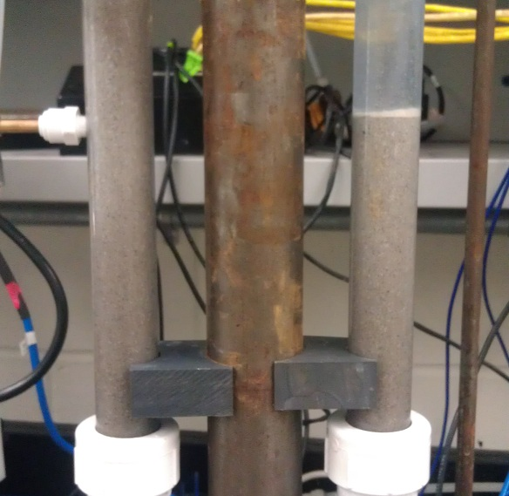
Low Flow Chemical Doser
Danielle Feng, Kwabena Nimo, Kaylyn Bacha
Team Leader: Heidi
Purpose?
Expand the design of the chemical doser that can feed coagulant and chlorine to the water

Slide 28
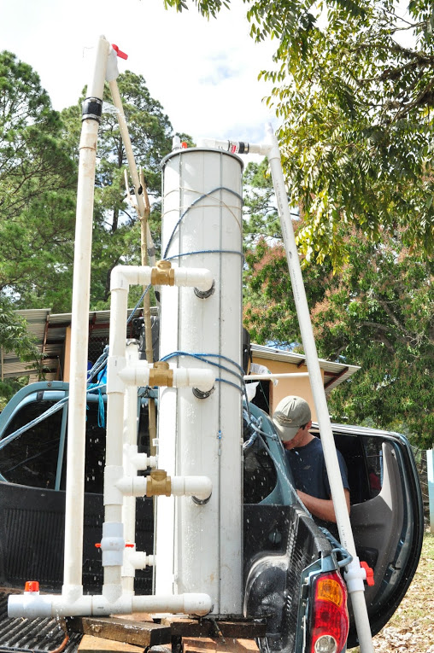
Low Flow Stacked Rapid Sand Filter
Sam Taube, Rachael Brooks, Deanna Steers, Rishika Ghosh
Team Leader: Casey/Heidi
Purpose?
Scale down the current stacked rapid sand filter for lower plant flows

Slide 29
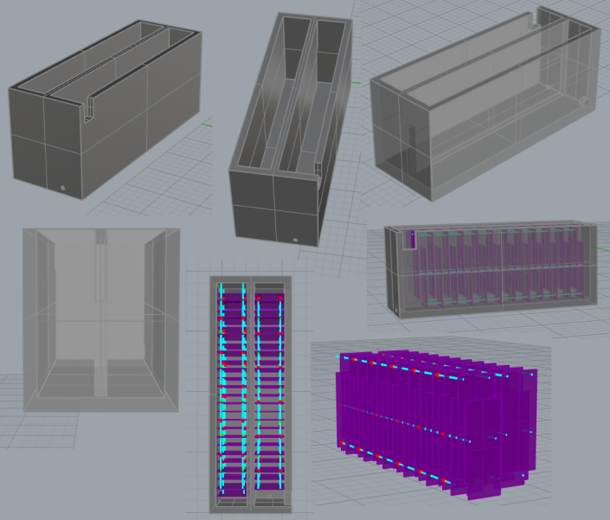
Small Scale Plant Model
Amanda Rodriguez, Sean Coholan, Molly Tierney
Team Leader: Heidi
Purpose?
Design and construct a briefcase sized plant for demonstrations and education

Slide 30
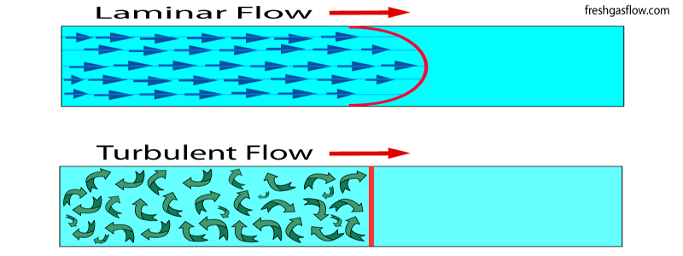
Turbulent Flocculator
Greta Schneider-Herr, Felice Chan, Brooke Pian, Amanda Rodriguez
Team Leader: Heidi
Purpose?
Design and construct a lab scale turbulent tube flocculator to better understand and design flocculators

Slide 31
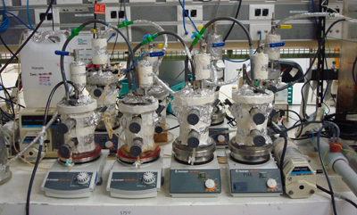
Upflow Activated Sludge Blanket
Walker Grimshaw, Fanny Okaikue, Sushil Shanbhag,
Team Leaders: Cristina Fernandez-Baca, Xian Zhang
Purpose?
Design and test systems to treat wastewater

Slide 32
Things to do
https://confluence.cornell.edu/display/AGUACLARA/Syllabi
Complete lab safety training
Volunteer form - sign and return
Meet with your team!

Slide 33
First Tasks
Detailed task list
  Outline of tasks to complete this summer with a tentative timeline of completing the tasks
Literature Review
  Discuss previous research on your topic including reviewing what previous teams have researched

Slide 34
Teams Review
UASB: Walker Grimshaw, Fanny Okaikue, Sushil Shanbhag, Cristina, Sam
Low Flow Chemical Doser: Danielle Feng, Kwabena Nimo, Kaylyn Bacha
Surface/Subsurface: Kelly Huang, Theresa Chu, Vikram Kejariwal, Tanya Peifer
Low Flow SRSF: Sam Taube, Rachael Brooks, Deanna Steers, Rishika Ghosh
Tube Floc: William Pennock, Rivu Dey, Allen Brooks
Small Scale Model: Amanda Rodriguez, Sean Coholan, Molly Tierney
Ram Pump: Christine Vernon, Alex Balog, Madeline Haas
Turbulent Flocculator: Greta Schneider-Herr, Felice Chan, Brooke Pian, Amanda Rodriguez
Design Team: Julia Morris, Heidi Rausch, Paroma Chakravarty

Slide 35
Team Meeting
  Sign-up for Process Controller and Lyx training
    Process Controller
      6/10 (today) or 6/11 (Tuesday) at 1 pm in HLS 150
    Lyx
      6/10 (today) at 2pm or 6/11 (Tuesday) at 11 am in HLS 366
  Determine a time to meet with your team leader
  Discuss expectations, schedules, look over first tasks (Detailed task list, literature review)

