Slide 1

Sedimentation Tank Hydraulics
Yiwen Ng
Saied Khan
Jill Freeman
Mahina Wang

Slide 2
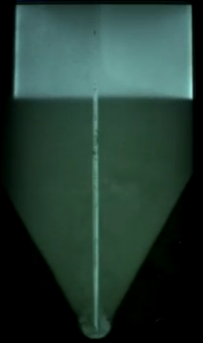

Outline
  Introduction
  Tube Settler Failure
  5 NTU Influent
  Floc Hopper Model
    Continuous vs. Pulsed Wasting
  Sludge Growth Rate
  Varying Alum Dose
  Future Work

Slide 3
What is a Floc Blanket?
    A Floc blanket is a fluidized, highly concentrated bed of particles.
Benefits of a floc blanket:
(Why is the STHT important?)
    Greatly improves the effluent turbidity by trapping small flocs.
    Reduces clean water waste from less frequent draining of the sedimentation tank.
Notes:
A floc blanket is a dense, fluidized bed of particles that forms in the sedimentation tank when flocs switch from a state of differential to hindered settling. It helps to reduce effluent turbidity by acting like a filter to trap small flocs and reduce clean water waste through less frequent draining of the sedimentation tank.
Floc resuspension is necessary for floc blanket formation so that flocs are recirculated through the tank instead of settling on the tank bottom as sludge.

Slide 4
Our Team’s Goals
Effect of upflow velocity, alum dose, influent turbidity
Floc recycle
Floc hopper design
Improve performance, reduce costs
Notes:
Our team: improve performance, reduce costs
Questions that we would like to answer:
1. What is the best geometry of the sed tank that will reliably create a floc blanket?
2. How do variables such as upflow velocity, alum dose, and influent turbidity affect floc blanket formation, growth and performance?
3. How beneficial will floc recycle be? Collaboration with Floc-Sed Optimization, Floc Recycle Venturi team
4. What are the dimensions of the floc hopper needed to maintain FB height, obtain desired sludge concentration for floc recycle? Depends on factors such as rate of floc consolidation.

Slide 5
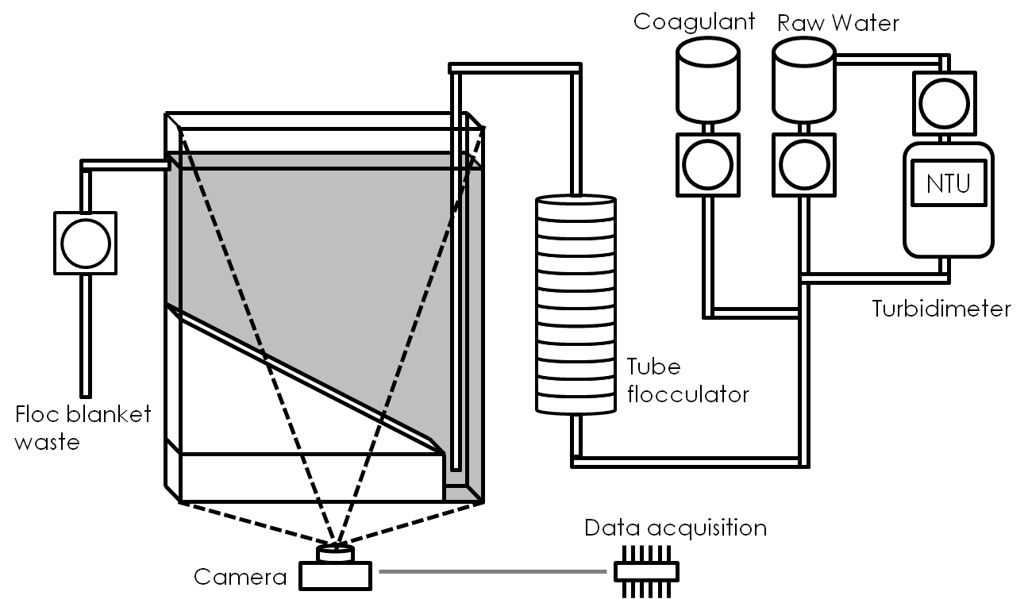
Methods: Our Experimental Setup

Slide 6
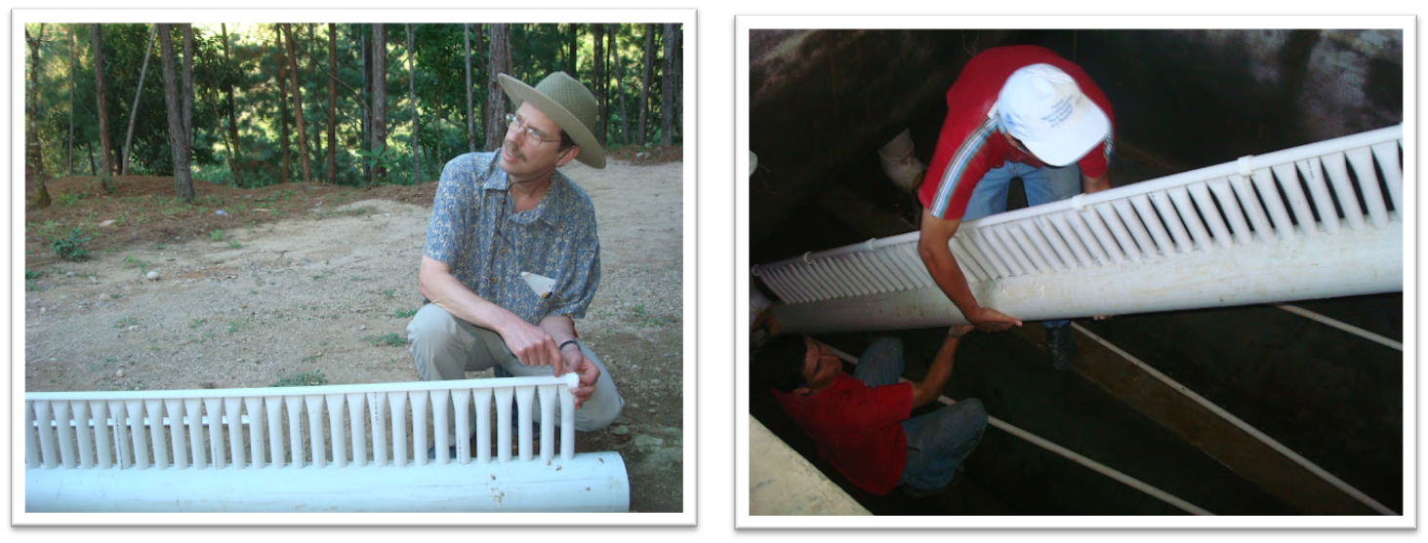
Remember
Marcala Diffuser Retrofit
January 2012

Slide 7
Tube Settler Failure
Time | Tank 1 (NTU) | Tank 2 (NTU) |  | Tank 3 (NTU) |  | Retrofit (NTU)
10 AM | All Tanks Flushed
4 PM | 0.09 |  | 0.06 |  | 0.29 |  | 0.2
8 PM | 0.18 |  | 0.34 |  | 0.45 |  | 0.32
6 AM | 0.21 |  | 0.24 |  | 0.34 |  | 0.16
12 PM | 0.39 |  | 1.52 |  | 0.1 |  | 0.35
4 PM | 0.35 |  | 0.4 |  | 0.1 |  | 1.7
8 PM | 0.1 |  | 0.12 |  | 0.1 |  | 1.45
6 AM | 0.09 |  | 0.05 |  | 0.2 |  | 0.95
12 PM | 0.34 |  | 0.48 |  | 0.35 |  | 7.35
How did this happen?

Slide 8
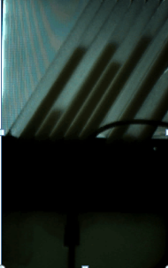
Tube Settler Failure
Floc blanket grew through
the tube settlers
No sludge wasting = Failure

Slide 9
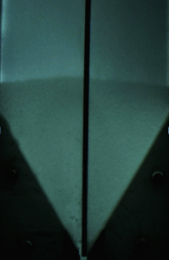
5 NTU Experiment
Difficult to form floc blanket
at various alum doses.
Adjusted tube settler upflow
velocity
Witnessed accidental seeding

Slide 10
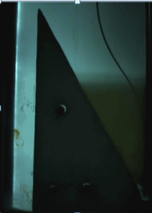
Seeding
Goal:
Decrease floc
blanket formation time
Reasons for Failure:
Too much mass
Small particle size
  Pump/Tubing
  Compression
Potential for Recycle

Slide 11
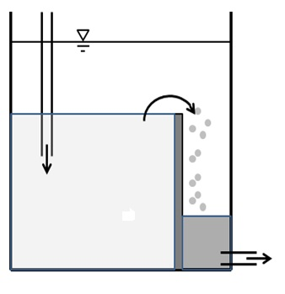
Floc Weir & Hopper
Weir: Keeps the height of the floc blanket constant
Hopper: Collects excess flocs, allows for floc consolidation
Overflowing
flocs
Floc weir
Floc hopper
Flow in
Consolidating
Sludge
Floc blanket
Waste

Slide 12
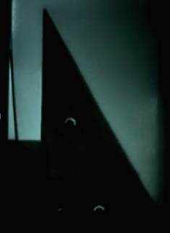
Floc Hopper Growth Video

Slide 13
Floc Hopper Model
Conservation of Mass at Steady State
How quickly should we waste sludge?
Notes:
How quickly to drain sludge?
Quick enough so that hopper doesn’t fill up
Slow enough so that flocs have time to consolidate, minimize wasted water

Slide 14

Continuous Wasting
Sludge is wasted at constant rate
Variable residence time
Amount of water wasted depends on concentration of wasted sludge
Ease of operation
Notes:
For most recent sed tank design, for a 70 L/s plant with 14 sed tanks, volume of hopper is about 0.56 m^3, Qin = 5 L/s.
Qwaste (flocs) = 65,000 L/day
Qwaste (sludge) = 4000 L/day

Slide 15

Pulsed Wasting
Hopper drained only when it is full
Longer residence time = more consolidation
Less water wasted
Requires regular operator attendance
Notes:
Time for hopper to fill with sludge given 100 NTU influent = 3.5 hours
Assuming hopper is completely drained to flush out the sludge, Qwaste = 4000 L/day

Slide 16
A Comparison for 5L/s Sed Tank
 | Pulsed | Continuous (waste flocs) | Continuous (waste sludge)
Residence time | 3.5 h | 12min | 3.4 h
Water wasted | 4,000 L/day | 65,000 L/day | 4,000 L/day
Operator involvement | every 3.5h | Minimal | Minimal
* Calculations based on most recent AguaClara sed tank design, flow rate of 5 L/s and 100 NTU influent
Notes:
Continuous System:
Drain flocs: low residence time, high water wastage
Drain sludge: high residence time, low water wastage

Slide 17
Floc Hopper Parameters
Factors affecting floc consolidation rate
  Residence time
  Hopper geometry
  Alum dose
Factors affecting ease of draining sludge
  Alum dose
  Hopper geometry
Notes:
From our analysis, we can identify some important parameters that will affect the design of the floc hopper.

Slide 18



Sludge Growth Rate
  Vary the width of the floc hopper.
Width (cm) | 5.0 | 7.5 | 10.0
Growth (cm³/min) | 0.713 | 0.415 | 0.609
Image
Notes:
Yiwen mentioned several parameters of a floc hopper for which we want to determine the effects they have on the sludge inside the hopper. Ultimately we want to minimize the size of the hopper and minimize the wasting rate.
trade-off between floc hopper size and wasting rate.. The larger the floc hopper, the longer residence time flocs can have in the hopper and the more consolidated the sludge will be, resulting in a slower wasting rate.
In this experiment we are varying the with of the hopper and determining the effect on growth rate of sludge in the hopper.
We hypothesize that a floc hopper with narrower width will have a lower growth rate of flocs, because the flocs will bhild up more vertically, so the flocs on the bottom will compress more.
Residence times??

Slide 19

Varying Alum Dose
  Alum affects the ‘stickiness’ and ‘fluffiness’ of flocs.
  Gradually decrease the alum dose and observe effects on floc blanket and sludge.
Notes:
**Picture of clumped sludge in the hopper-the ‘stickiness’ of sludge may be causing clumping and preventing it from being wasted through the tube.
We believe that lowering the alum dose may allow for better wasting. But how low can we go without negatively impacting floc blanket performance?
-We did not measure effluent turbidity because without the tube settlers we were getting a clear floc-water interface, which we wanted to observe.
We began with our normal alum dose of 45 mg/L and gradually turned it down.
Images: Floc hopper 4 -> Experimental Images -> 2985 (show flocs in clarified effluent),
Floc hopper 3 -> Experimental Images -> 2811

Slide 20
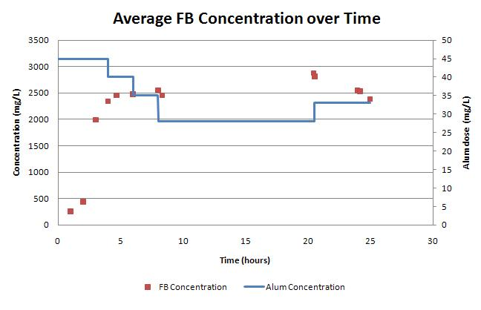
Varying Alum Dose
Floc blanket can be maintained at an alum dose of 28 mg/L
Increasing alum dose results in a decrease in blanket concentration
Notes:
Appears that an alum dose of 27.8 mg/L is sufficient for maintaining a floc blanket at 100NTU influent turbidity.
As can be seen in the graph, floc blanket concentration increases with decreasing alum dose. The initial sharp increase in concentration occurs during floc blanket formation. At t=5hrs, the concentration levels off, suggesting that the blanket has reached a steady state. Once the alum dose is decreased the floc blanket concentration increases, and when the alum dose is increased again the concentration decreases.
At low alum doses we observed smaller flocs in the tank, and at larger alum doses we observed larger, more fluffy flocs. At an alum dose of 30 mg/L, the lowest alum dose tested, no clear floc-water interface was observed and there were many small flocs in the clarified water.
Once the alum dose was increased again at t=20hours, the floc-water interface could be clearly observed after _____ hours.
The increase in concentration may be due to the fact that the flocs are less fluffy and more dense, or the fact that the larger flocs have captured the smaller flocs (since we began with a higher alum dose).
There was also noticably less clumping of sludge in the hopper with the lower alum dose of about 33 mg/L.
We hope to run further experiments to determine if a floc blanet can be formed at this alum dose, since we know it can be maintained.

Slide 21
Future Work
Ideas for Future Experiments:
Seeding
  Two standpoints
More floc hopper experiments
Further examination of alum dose
  Form a blanket for each alum concentration
Notes:
SEEDING:
Seeding is an excellent idea and is a commonly used idea to increase collision potential in flocculators but has not been an idea put forward in literature for floc blankets. I think you should approach this from two standpoints.
You could do the method that you suggested of simply pouring solids into the floc blanket.
You could also recycle the sludge back to the flocculator from the floc weir.
-seeding is important because it allows us to more reliably and more quickly form a floc blanket, esp at low influent turbidity
This could be equally interesting to compare these methods. I suspect that recycling to the flocculator would result in quicker formation of the floc blanket because you would be producing larger and more settleable flocs. I suggest testing both and comparing!
FLOC HOPPER:
-rerun FH Width Experiment with an additional vertical strip to gain more data points. Sludge should be completely wasted from the hopper before removing a strip to avoid errors due to sludge consolidation in the bottom of the hopper and should be allowed to settle for a longer period of time.
ALUM DOSE:
Vary alum dose and visually observe the effects on the floc blanket (size of flocs formed). Analytically observe formation time, fb concentration.
We can also change the alum dose while the floc blanket is formed and observe the immediate effects on fb concentration (to determine a minimum alum dose below which the floc blanket fails)

Slide 22

Questions..?
Questions?

