Slide 1
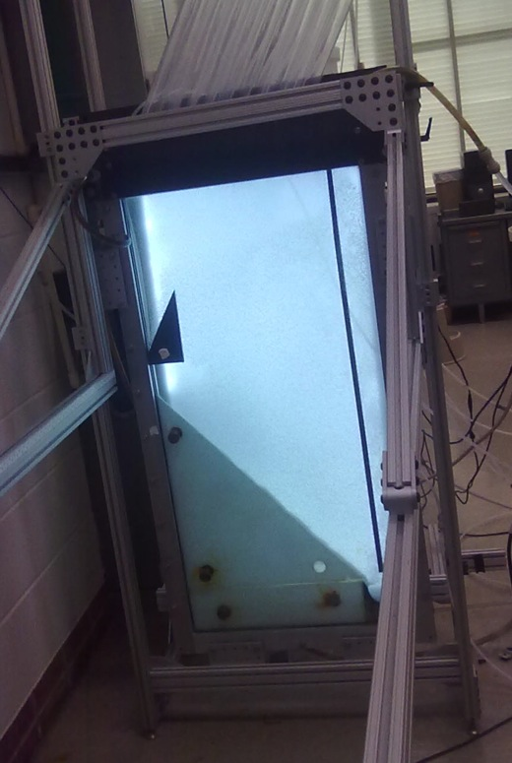
Sedimentation Tank Hydraulics
The Team
  Hongyi Guo
  Ethan Yen
  Frances Ciolino

Slide 2
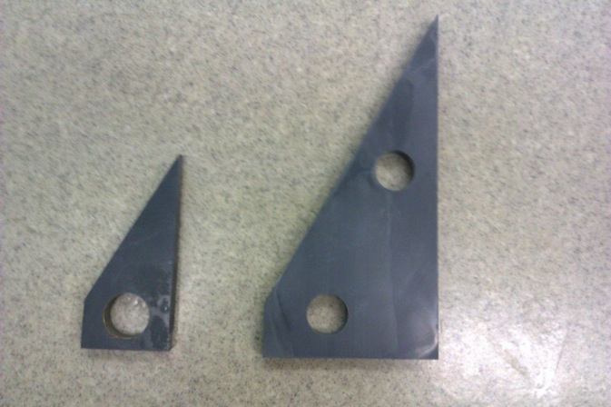
Team Goals
Optimize floc hopper geometry
Continuous wasting
Floc Blanket Stability

Slide 3
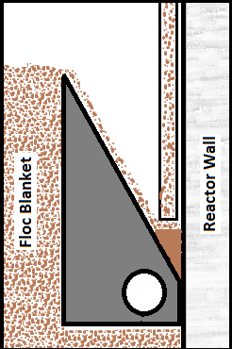
Continuous wasting
Concentrated waste
Less wasted water
No valves

Slide 4
Hindered Sedimentation Velocity
Repeat of Spring ‘12 Team
Sed Velocity @ 0 Upflow
Upflow Velocity

Slide 5
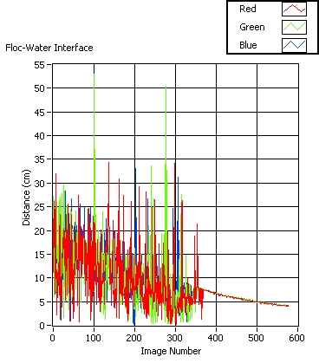
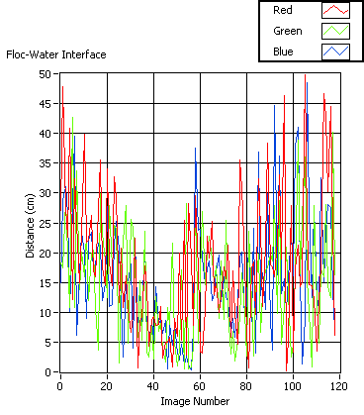
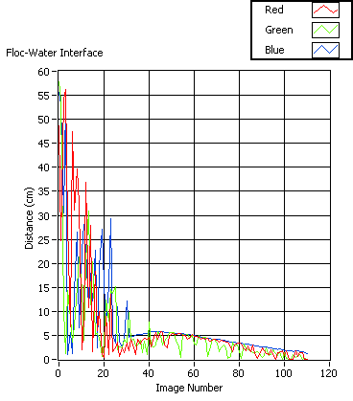
Hindered Sedimentation Velocity
Results
0.6 mm/s 1.2 mm/s 1.6 mm/s
Why so erratic?

Slide 6
Hindered Sedimentation Velocity
Results
Upflow
0.6 mm/s 1.2 mm/s 1.6 mm/s
SedVel 0.086mm 0.15mm/s 0.47mm/s

Slide 7
Hindered Sedimentation Velocity
Upflow Velocity | 0.6 mm/s | 1.2 mm/s | 1.6 mm/s
Sed Vel | 0.086 mm/s | 0.15 mm/s | 0.47 mm/s
Spring ‘12 | 0.522 mm/s | 1.02 mm/s | 1.10 mm/s
Velocity Ratios | 0.6 mm/s / 1.2mm/s | 1.2 mm/s / 1.6mm/s
Sed Vel | 0.57333 | 0.319149
Spring ‘12 | 0.51176 | 0.927273

Slide 8
Floc blanket formation
10% Plan View Area, Alum Dose 15 mg/L
Video recording floc blanket formation
30fps
Made from pictures captured by Labview, 5s/shot
Video: http://www.youtube.com/watch?v=Ho5HMh39fLc&list=UUXq9V81yyUOTQYokfp5wXfw&index=1

Slide 9
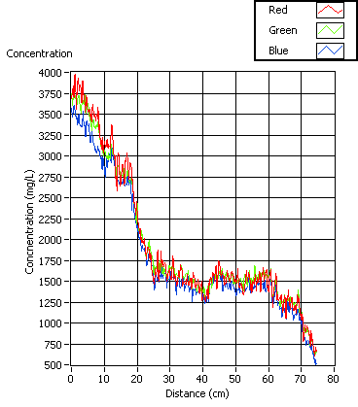
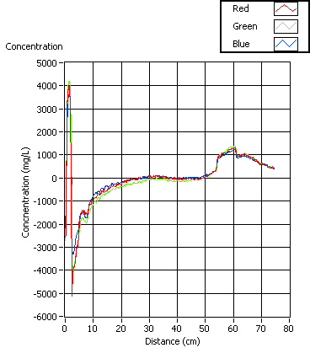
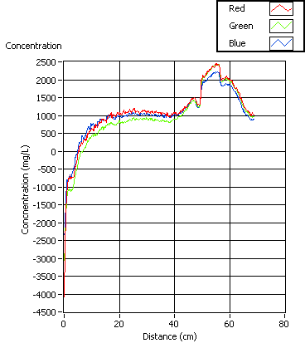
Conc.of Flocs in 15%PVA Floc Hopper
Wasting Rate
15ml/min 25ml/min 30ml/min

Slide 10
15%PVA Conclusions
What may affect the concentration
  Eddies
  Brightness of camera

Slide 11
20% Plan View Area
Dense Concentration on bottom
Floc Blanket consistently lower than hopper
Why?
Wasting Tube Sucking Flocs through gaps in Hopper?

Slide 12
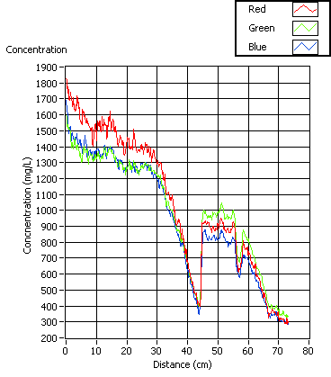
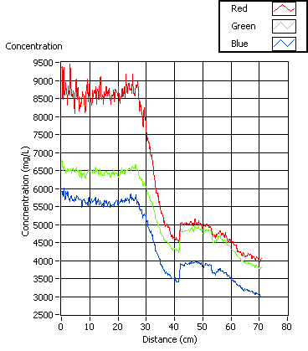
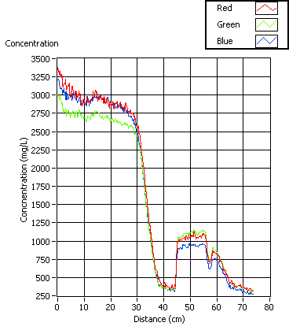
20% Plan View Area
15 mL/min 25 mL/min 30 mL/min

Slide 13
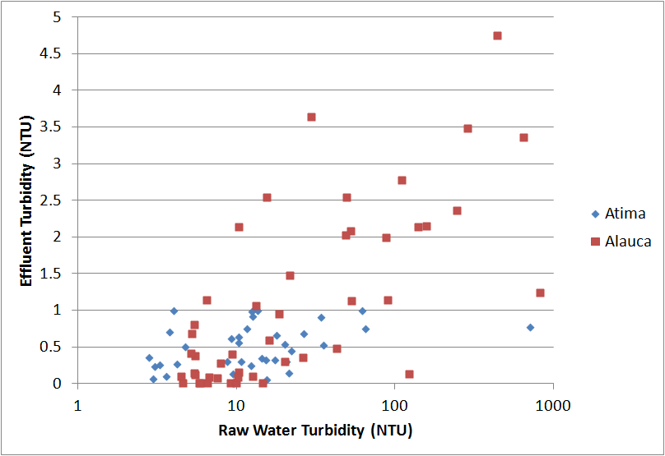
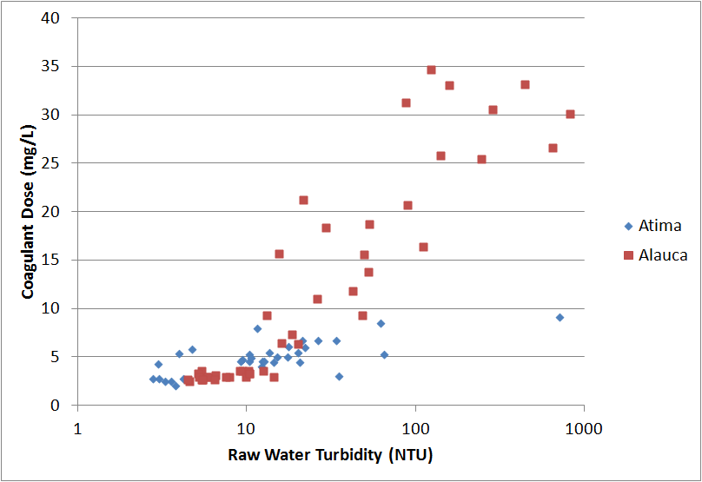
20% Plan View Area
Conclusions
  Lower Alum Dosage (From 45 mg/L to 15 mg/L)
    Less large flocs (more dense and less susceptible to flows)

Slide 14
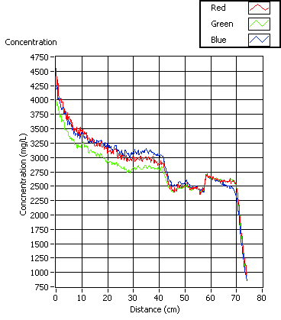
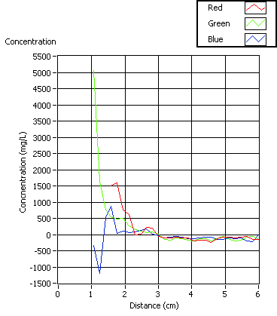
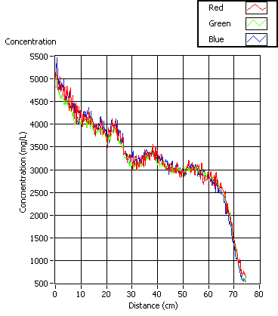
10% Plan View Area
15 mL/min 25 mL/min 30 mL/min
Video of Turbulence: http://www.youtube.com/watch?v=p8mweFDICtQ&list=UUXq9V81yyUOTQYokfp5wXfw&index=2

Slide 15
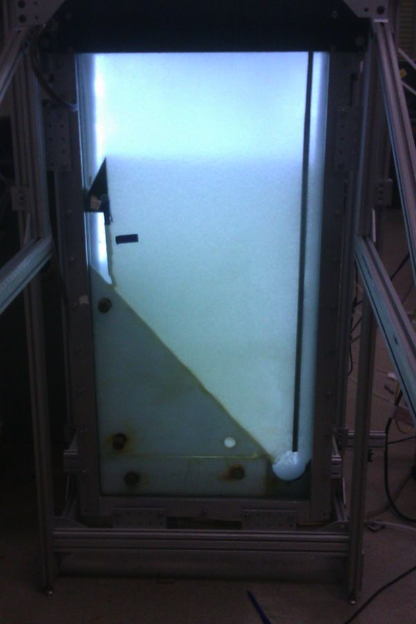
10% Plan View Area
Conclusions
  Floc blanket height
  Eddies affect results for 25%
  Lower doses

Slide 16
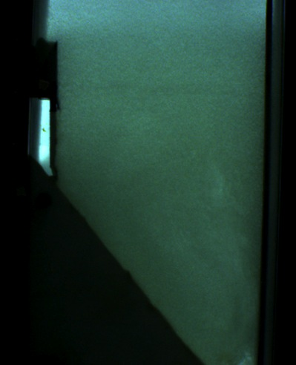
Last Continuous Wasting
Slowly turned up wasting rate
2ml/min too fast
Turbidimeter maximum
Long time to reach turbidimeter

Slide 17
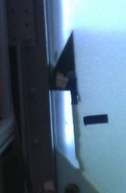
Summary
Block Added
Coagulant Dose
Lower Wasting Rate
Smallest Plan View Area

Slide 18
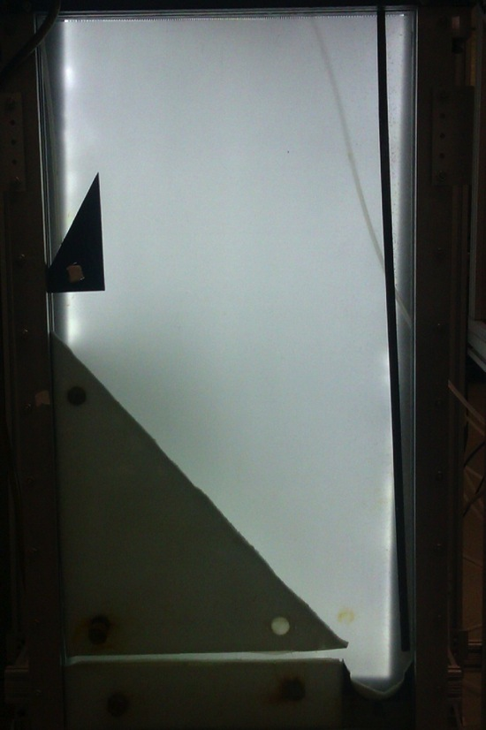
Future Work
Plan View Area
Wasting Rate
Particle size
  Effect on concentration
  Coagulant dose
Floc Blanket Failure

Slide 19
Questions?

