Slide 1
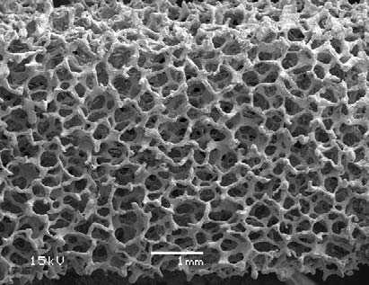
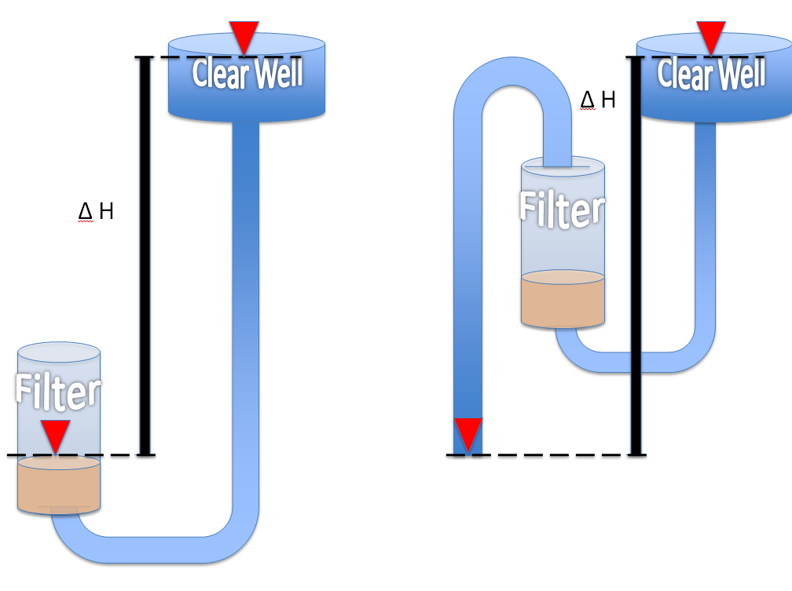
The Spring 2010
Filtration Team
Final Presentation
Carolyn Evans
Colin Hollister
Dylan Guelig
Kara Malhotra
Rachel Philipson
Sarah Stodter
Sonya Burns
Yoon Choi
May 21, 2010
Foam Filtration
Stacked Filtration
Clear Well
Siphon-Aided Backwash

Slide 2
Agenda
Introduction and Tenets of Filtration Research
II. Clear Well
Foam Filtration
Stacked Filtration
Summary
Questions

Slide 3
Comparison of Conventional Filtration Technologies to AguaClara's Proposed System
Filtration: part of the water treatment process in which colloidal and suspended material are removed from water by passing through layers of porous media.
Backwashing: Sending clean water backwards through the filter medium to dislodge particles.

Slide 4
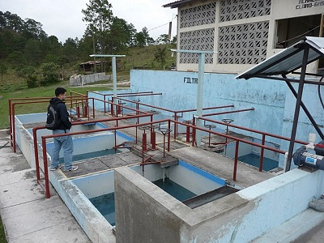
Conventional Filtration
Santa Rosa Water Filtration Plant

Slide 5
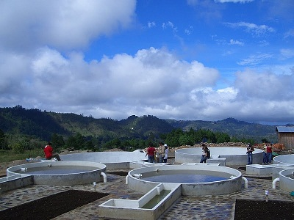
Multistage Filtration
San Pedro de Tutule FIME (multistage) Plant

Slide 6
Multistage Filtration
Multistage filtration is the "other" low-tech option
for communities using surface waters. Some
features of multistage filtration are:
Usually no coagulants
Gravel roughing filters
Polished with slow sand filters
Large capital costs for construction
No chemical costs
Labor intensive operation

Slide 7
Why do we want filtration for AguaClara?
Turbidity (NTU) = Cloudiness/Dirtiness of water caused by suspended particles in the water
1000s NTU
Surface Water Range
Cleaner Water
10 NTU
WHO Standards
5 NTU
AguaClara sedimentation tank
performance range
1 NTU
EPA Standards
0.3 NTU
Filtration technology

Slide 8
The Filtration Research Team Checklist
Do not use electricity.
Achieve effluent standard of 1 NTU or lower.
Make minimal use of specialized components
that would be difficult to acquire in remote
communities.
Make the system open to the atmosphere.
Make it easy for an operator to operate and
maintain.
Costs less than the costs of
sedimentation tank and flocculation tank.
Minimize use of water.

Slide 9
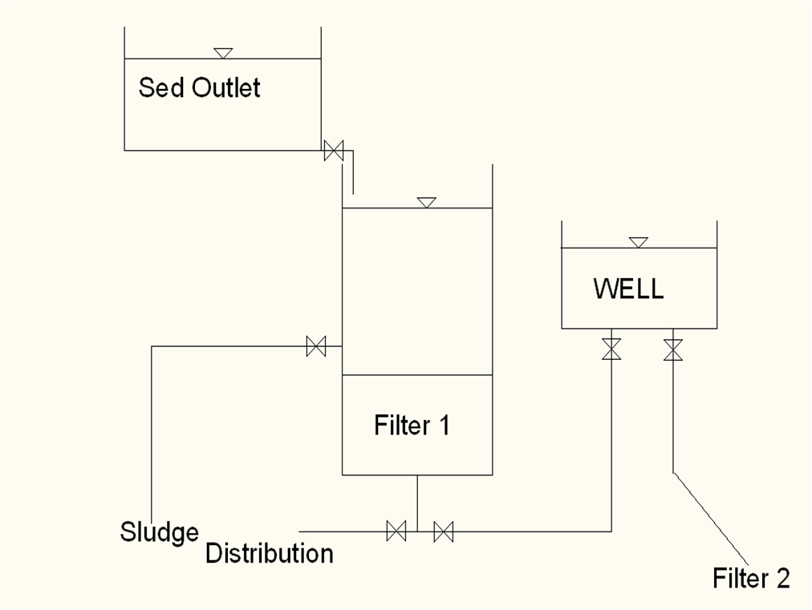
Clear Well Filter Design

Slide 10
Design Steps: Input
Plant Flow Rate of 6.3 L/S
2 Filters Bed System
Backwash Time 5-10 minutes: 10 minutes
Backwash Expansion 10-50%: 30%
Filtration Velocity 0.7-2.8 mm/s: 1.4 mm/s
Typical Rapid Sand Filter: No Anthracite, 45 cm Sand,
25 cm Gravel
10 Inch PVC Pipe minimum headloss of 5mm.
6 Inch Gate Valve(Orifice) for Flow Control

Slide 11
Design Approach
Backwash Velocity = 10 x Filtration Velocity = 14 mm/s
VERSUS
Using Below Empirical Equations for a lower Backwash Velocity
Backwash Velocity = 10.25 mm/s

Slide 12
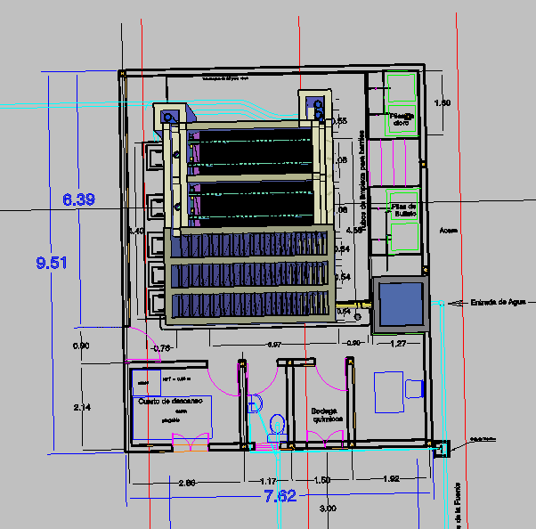
Agalteca Plant Plan View

Slide 13
MathCad Results
Plant flow of 6.3L/s: Empirical vs. Conservative
 | Conservative | Empirical
Filter Square Side | 1.5m | 1.5m
Filter Height | 3.95m | 2.56m
Clear Well Diameter | 6m | 6m
Clear Well Height | 1.37m | 1.23m

Slide 14
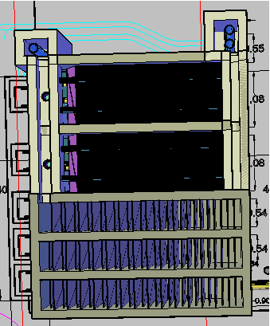
Agalteca + Filter and Clear Well Plan View
1.5m
Clear Well
1.5m
Filter 1
Filter 2
5.46m
6m
4m

Slide 15
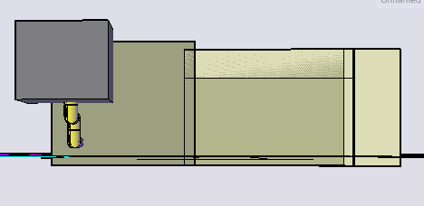
Agalteca + Filter and Clear Well Side View
1.5m
6m
1.96m
1.8m
Clear Well
1.37m
Filter
4m
3.95m
0.7m

Slide 16
Why use foam instead of sand?
Could reduce the amount of water that is wasted during a traditional backwash cycle.
  A backwash cycle is how sand filters are typically cleaned. It involves running clean water in the reverse direction through the filter.
Could require less planned area than sand filters, which are traditionally very large!
  Less area means $$ saved!

Slide 17
Potential Disadvantages
In order for foam filtration to be effective, a tight seal with all edges of the tank must be maintained. This may prove difficult to maintain.
  A tight seal is necessary as water is like everything else in the world: it will always follow the path of least “resistance.”
Foam filters will likely require more physical maintenance than a sand filter.
  The operator might have to physically remove and wash the filters, whereas the backwash of sand filters is self cleaning.
Notes:
If water is allowed to choose between a path that involves moving through a filter media, or a path that is obstacle free, then it will choose the obstacle free path! This would result in unfiltered water.
17

Slide 18

Goals!
As with every filtration design, we want to achieve an effluent turbidity of less than 1 NTU.
  NTUs are the units for turbidity (cloudiness), which correspond to how much light is reflected back when shone through a sample.
  Currently, AguaClara plants have an effluent turbidity of ~ 5 NTU. The US standard is less than 0.3 NTU.
Related to the effluent turbidity achieved, we would like our filtration option to have a pC* of ~0.9 or greater.
  pC* is the logarithmic percent colloid removal, calculated as:
Notes:
ADD CALCULATION, and check definition of pC*?
18

Slide 19
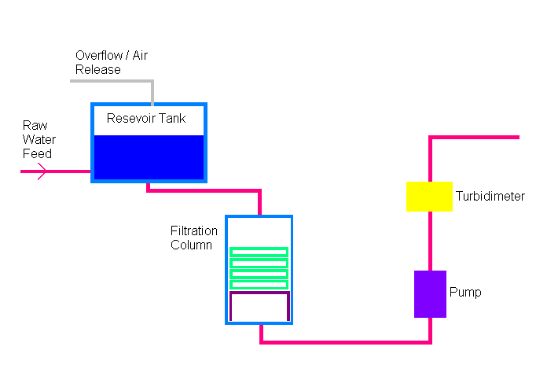
Series 1: Experiment Set Up

Slide 20
Experiment 1.1 Conditions
60 ppi foam
Flow rate of 100 m/day
  Typical flow through an AguaClara sedimentation tank. This would indicate that the filtration unit will have the same plan area as the sedimentation tank.

Slide 21
Experiment 1.1: pC* vs time
Notes:
The percent removal is approximately constant with time, though it does show some improvement in the first several hours.
Even when the raw water turbidity dropped after 14 hours, the percent removal of colloids remained constant, shows that the percent colloid removal is independent of influent raw water turbidity, within this range of values.
While this indicates that the filter material does indeed achieve a significant level of colloidal removal at about 60% , we would like this value to be higher, around 90%.
21

Slide 22
Experiment 1.2 Conditions
90 ppi foam
  Smaller pore size, hope to achieve a higher level of colloid removal
Ramp State: Flow Rate varies with time
  Over a period of 12 hours, the flow rate increased from 50 m/day to 200 m/day

Slide 23
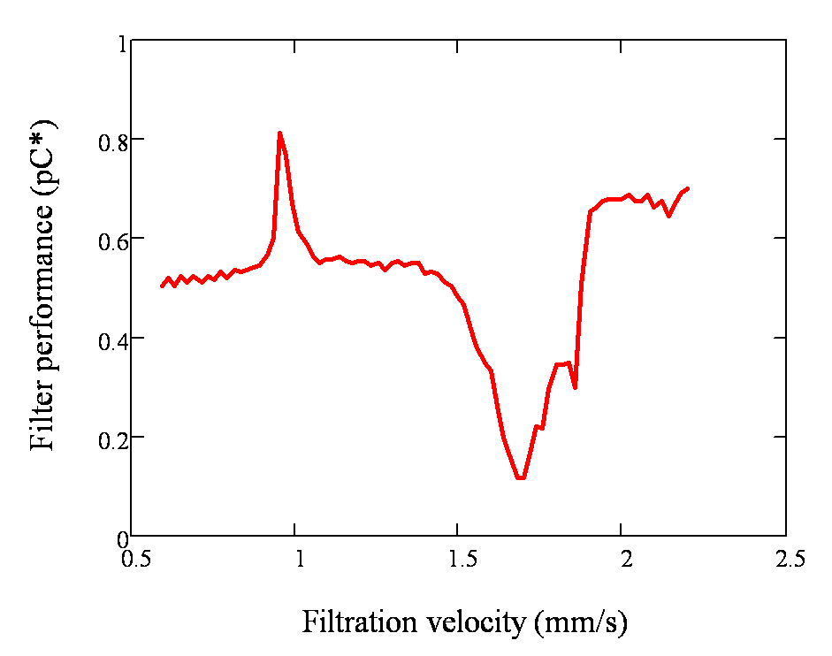
Experiment 1.2: 90 ppi, Ramp State
Notes:
*note that the dip in pC* occurs because the effluent turbidity failed and was no longer at 5NTU
23

Slide 24
Experiment Series 2
Add Alum and a Rapid Mix Tube to the experiment set up!
  Test the foam under more realistic conditions since particles we are trying to filter in an AguaClara plant will have been exposed to an alum dose.
  Hope to achieve higher levels of colloid removal since the particles will be larger.

Slide 25
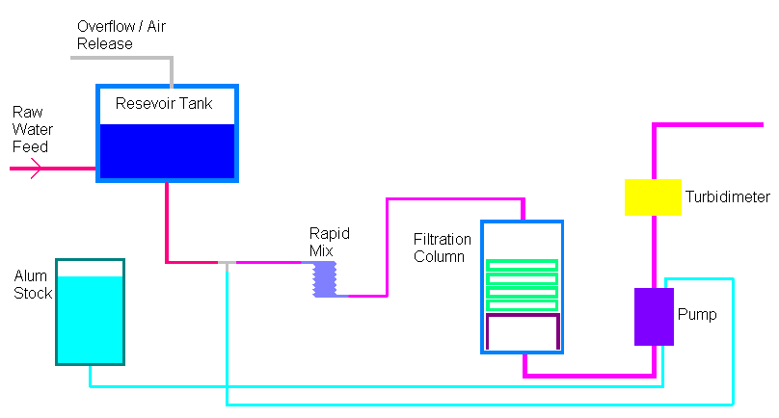
Series 2: Experimental Set Up
Notes:
Specified raw water turbidity levels are achieved using raw water pump- monitors turbidity and adds clay from stock tank as needed
Alum is connected to the same pump as the water, so as the flow rate increases, so will the alum dose.
25

Slide 26
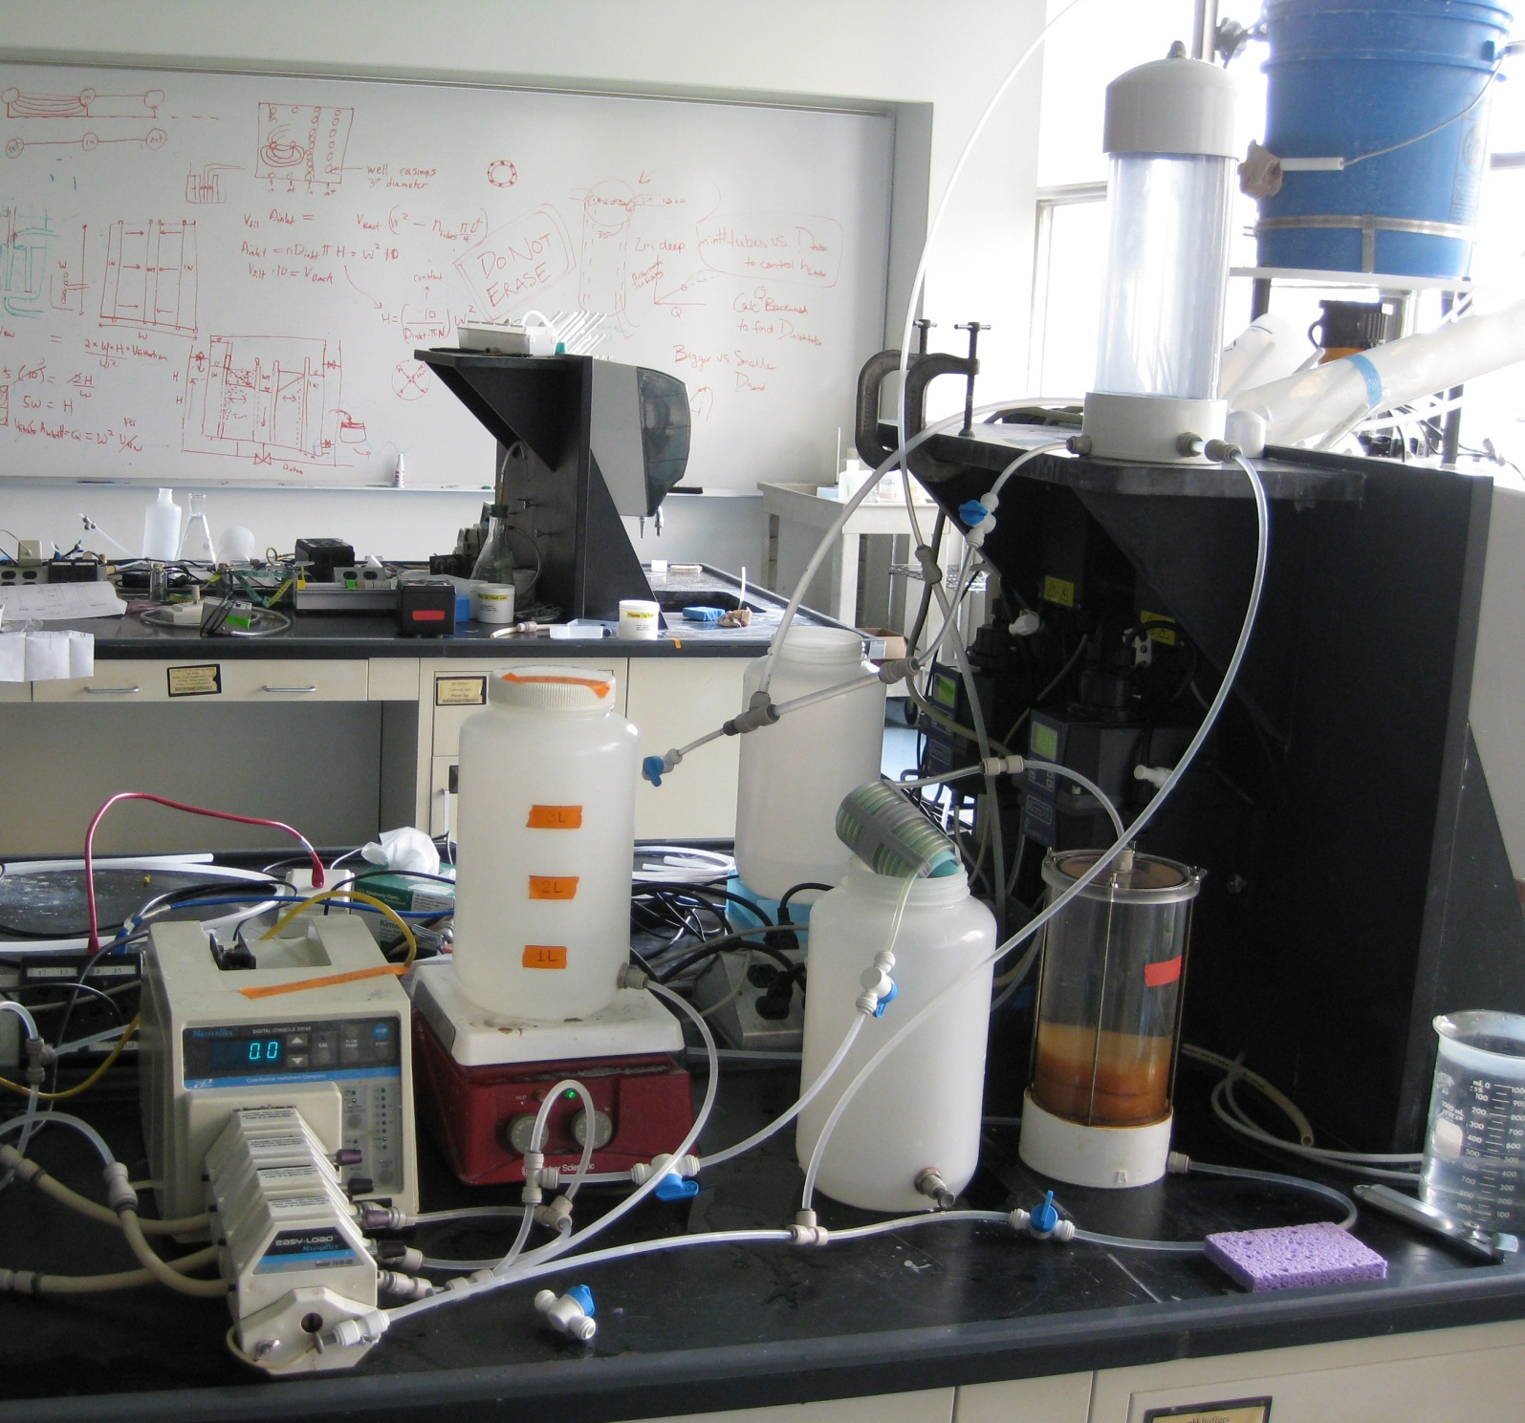
Experimental Setup
Notes:
26

Slide 27
Experiment 2.1 Conditions
90 ppi foam
Ramp State: Flow rate varies from 50 to 190 m/day over a 9 hour period
Tested two different alum doses
  25 mg/L- a very high alum dose
  1.5 mg/L- a more realistic alum dose
Notes:
-the 1.5 mg/L alum dose is more realistic because the original alum dose is 25 mg/L. 95% of particles are filtered out in the sedimentation process (100NTU is reduced to 5 NTU). Therefore, 5% of the alum dose will remain at the end of sedimantation
27

Slide 28
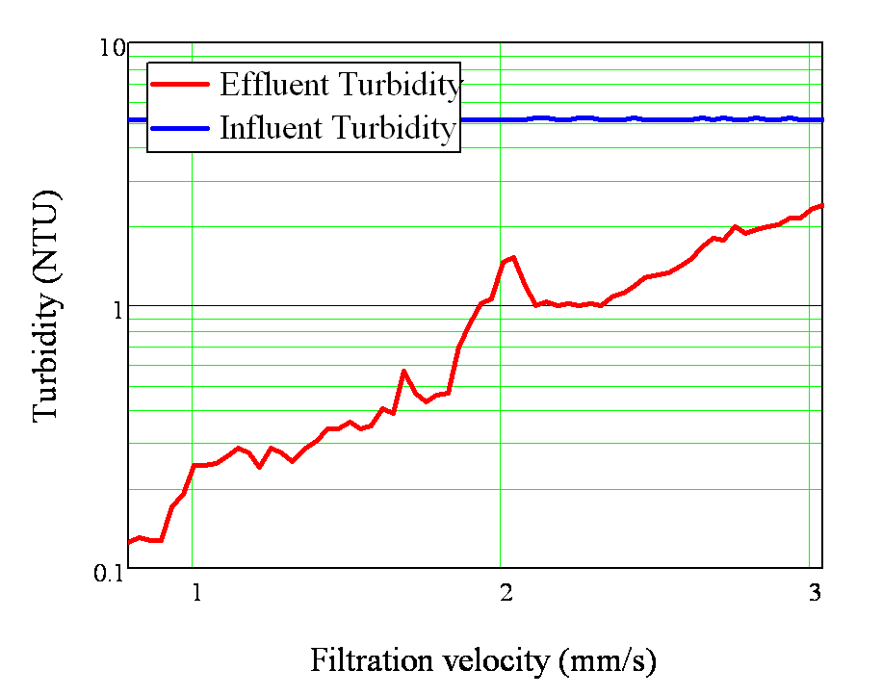
Experiment 2.1: 90 ppi, Ramp State, Alum Dose = 25 mg/L
Notes:
Filter has good performance for filtration velocities up to about 1.9 mm/s (AguaClara plant velocity is 1.157 mm/s)
28

Slide 29
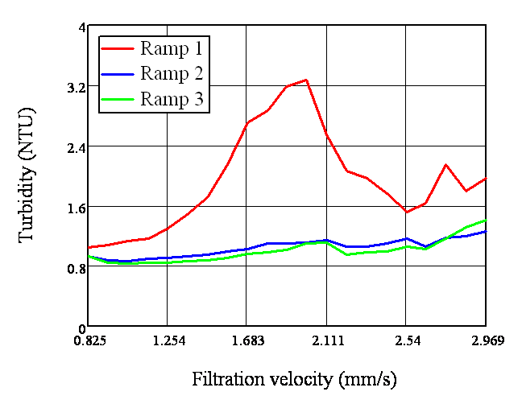
Experiment 2.1: 90 ppi, Ramp state, Alum Dose = 1.5 mg/L
Notes:
The three ramp states were run all in a row- first one did not have great performance, second two were good
29

Slide 30
Experiment 2.2 Conditions
90 ppi foam
Constant Velocity at 1.157 mm/s
  Corresponds to the AguaClara plant velocity
Experiments run for 22 hours
Alum dose = 1.5 mg/L
Vary the depth of the foam
  3- 1inch sheets
  1- 1 inch sheet

Slide 31
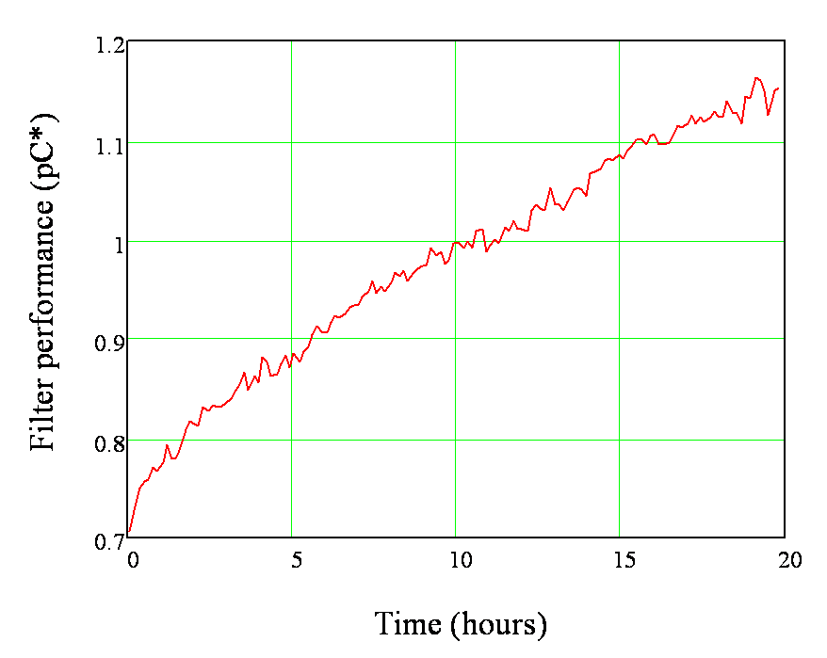
Experiment 2.2, 90 ppi foam, 3- 1 inch sheets, flow rate = 1.157 mm/s

Slide 32
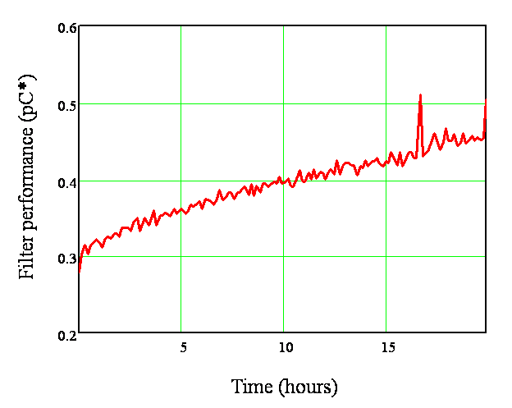
Experiment 2.2, 90 ppi foam, 1- 1 inch sheet, flow rate = 1.157 mm/s

Slide 33
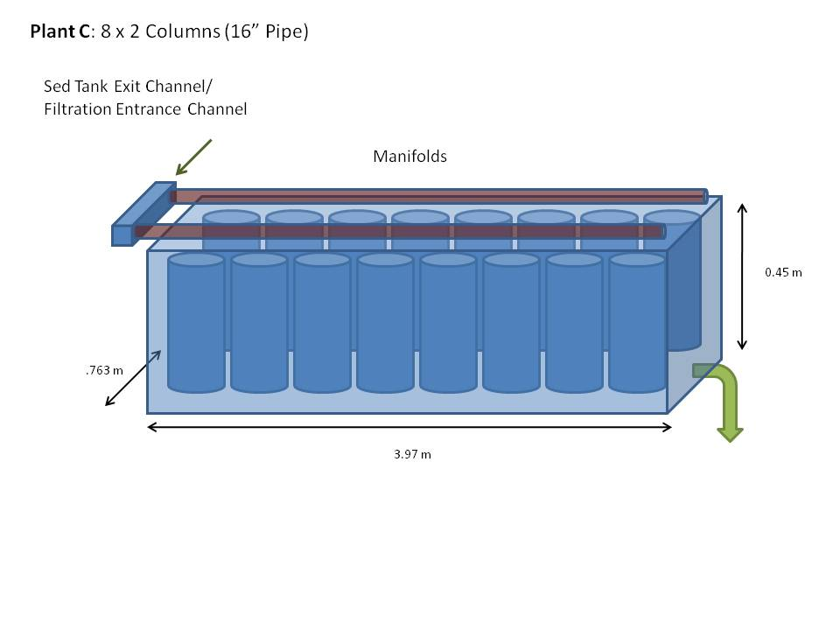
Possible Plant-A

Slide 34
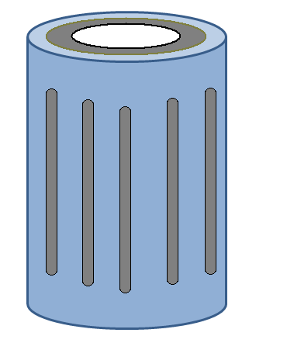
Foam Column
Influent
Foam (gray)
Effluent
Slotted pipe

Slide 35
Experiment 2.3 Conditions
90 ppi foam
3- 1 inch foam sheets
Flow rate = 1.157 mm/s
Rotated filter column on its side
  Does not allow film to form
  Will test to see how the film affects filter performance

Slide 36
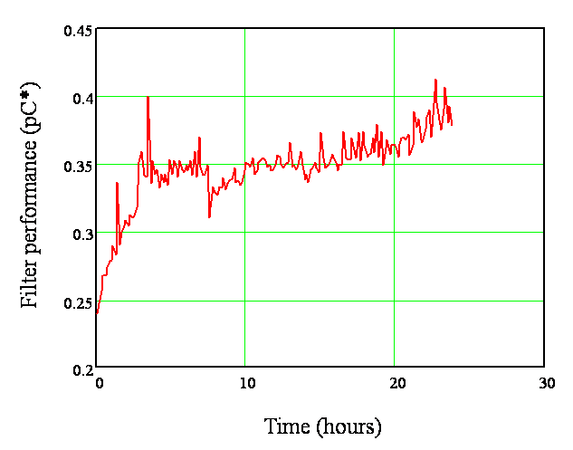
Experiment 2.3, 90 ppi foam, flow rate = 1.157 mm/s, sideways column

Slide 37
Results/Discussion
Foam appears to be an effective filtration method under the right conditions
  Need to utilize these conditions in plant design
Further tests need to be run with foam column on its side to determine filter performance without film

Slide 38
Challenges/Future Work
Run more tests with column on its side to confirm preliminary results
Determine how long the foam can effectively filter before failure
  Corresponds to how often the operator will have to clean the filters

Slide 39
Stacked filtration theory
Conventional rapid sand filtration:
  We assume most of the filtration occurs in the top 20cm of the sand bed.
  Backwash is required to expand the sand bed and wash out the colloids captured in the interstitial space
  Backwash velocity should be 10 times the downflow velocity
  After backwash, when downflow mode resumes, initial filtrate is usually wasted

Slide 40
Stacked filtration theory
In a conventional rapid sand filter, the backwash cross-sectional area is the same as the downflow cross-sectional area
  Therefore, you cannot use the downflow velocity to backwash
  Flow rate and approach velocity are both different in downflow and backwash modes
We want to develop a filter that uses the same flow rate for downflow and backwash but can achieve different approach velocities for downflow and backwash
  Increase the cross-sectional area of downflow within the sand bed without increasing the cross-sectional area of backwash

Slide 41
Stacked filtration:
Manipulating downflow “cross-sectional” area
Introduce the influent to different layers within the sand bed
  Use PVC screens that prevent sand particles from entering the pipes yet enables the flow of water
Assume the downflow area is not equal to the area of the orifices through which the influent water flows
  The headloss in the sand bed is an order of magnitude greater than the headloss out of the orifices
  Flow out of the influent PVC screens will converge as it moves through the sand bed
  Flow moves both up and down
    One layer of influent PVC screens can distribute flow across twice the area being backwahsed.

Slide 42
Hypothesized flow convergence in filtration zone: Flow coming out of the orifices on the slotted pipes will quickly converge and move through the sand as a uniform plane.

Slide 43
Stacked filtration:
Manipulating backwash “cross-sectional” area
If you stack these layers one on top of the other within a sand bed, you increase the area for downflow without increasing the area of backwash
The footprint of the sand bed does not change as you vertically stack layers of influent PVC screens
    The backwash velocity remains the same
increasing the downflow distribution area into multiple layers within the sand bed allows different approach velocities given the same flow rate

Slide 44
Determining How Many Planes of Filtration We Need:
Very Conservative Values for
Filtration and Backwash:
Plant Flow Divided by N of Filters:
Design Constraint, Half of Maximum
Plant Flow Available for Backwash:

Slide 45
Determining How Many Planes of Filtration We Need:
So for a 4 Filter System,
5 Planes of Filtration
For
1 Plane of Backwash
5 Plane Areas
of Back Wash
1 Plane Area of Back Wash

Slide 46
Calculation of Pipe Sizes:
Making the head loss through the sand dominate by making the
head loss in the pipe 1/10 of the head loss in the sand.
Inlet manifold from Sedimentation Tank
To Distribution Tank
3 Inch
7.62 cm
0.5 Inch
1.27 cm
20cm between each layer
0.75 Inch
1.905 cm

Slide 47
Calculation of Other Design Parameters:
Height difference between sedimentation tank weir and bottom of filtration unit = 2.6m
Sedimentation tank and weir
Height difference between water level entering the inlet pipe and the backwash gutter equals the head loss (HL) that occurs in the expanded bed during backwash:
HL inlet pipes + HL in elbows + HL manifold + HL slotted tubes + HL expanded bed = 1.057m
Gutter level
Depth of sand + height of expanded bed + 10% Safety
= 1.5m
Distribution tank
Bottom of filter

Slide 48
Design Parameters for Agalteca:
Sedimentation tank and weir
0.474m
1.057m
4 Filtration Unit System:
5 Planes of Filtration Per Filter
Pipe Size:
1.27 cm Filter Tube
1.905 cm Bottom Tube
7.62 cm Manifold
Gutter level
Distribution tank
1.5m
Bottom of filter

Slide 49
Agalteca and Stacked Filter Plan View
0.474m
0.474m
Filter 1
Filter 2
Filter 3
5.46m
Filter 4
4m

Slide 50
Agalteca + Stacked Filter Side View
0.474m
1.96m
1.8m
1.5 m
4m
Filter

Slide 51
Design Parameters for Bench Scale Model:
4 Inch=10.16cm
20 cm of sand layer
0.5 Inch=1.27cm
Inlet Tube
Outlet Tube

Slide 52
Future Challenge#1:20 cm of Sand Enough?
Clogging Time?
Actual Effluent NTU?
Outlet Tube:
Less than 1 NTU
Inlet Tube: 10 NTU Influent

Slide 53
Future Challenge#2:
Backwashing with
10 NTU water?
After Backwash:
Clogging Time?
Effluent NTU?
Does efficiency
drop?
Inlet Tube: 10 NTU Influent

Slide 54
Future Challenge#3:
Vary the Pipe Number 1, 2, …
How does this ratio affect
the forming of the Plane
which affects:
-effluent NTU?
-clogging time?
Can we visually see sand
that is never being used?

Slide 55

Spring 2010 Filtration Design Tracker
 | No Electricity | Effluent 1 NTU | Open System | No Special Parts | Cost Less Sed Tank & Floc Tank | Minimize Use of Water | Easy To Operate
Clear Well Back Wash
Siphon-Aided Back Wash
Foam Filtration
Stacked Filtration

Slide 56
Questions?

