Slide 1
1) Fill in the physiologic alterations induced by pregnancy.
Variable | Change (↓,↑, NC)
Heart Rate
Cardiac Output
PCV, Hb, TS
Arterial BP
Oxygen consumption
Gastric emptying time
GFR
↑
↑
↓
NC
↑
↓
↑

Slide 2
2) Why should the time spent in dorsal recumbancy be minimized in pregnant animals?
The posterior vena cava and aorta can be compressed by enlarged uterus and contents= decreased venous return and cardiac output with resultant decreased uterine and renal blood flow.

Slide 3
3) Large repeat doses of oxytocin has what effect on the cardiovascular system?
A) tachycardia
B) vasodilation
C) vasoconstriction
D) bradycardia
B. Peripheral vasodilation which can lead to hypotension

Slide 4
4) During pregnancy, progesterone can have all of the following effects on the respiratory system EXCEPT?
A) decreased pulmonary resistance
B) increased ventilatory minute volume
C) increased functional residual capacity
D) increased sensitivity to PaCO2
C. during pregnancy there is decreased FRC, but this is largely due to anterior displacement of the diaphragm and abdominal organs.

Slide 5
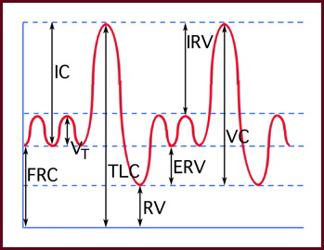
Spirometry:

Slide 6
5) True or False. Induction with gas anesthetics is more rapid and MAC values reduced in pregnant v. non-pregnant patients
True. Induction accelerated by increased alveolar ventilation and decreased FRC. Can require a little as ¼-1/5 the time required for nonprego patients

Slide 7
6) Pregnant patients undergoing anesthesia are at greater risk for aspiration pneumonia for which reason(s):
A) decrease LES tone
B) decreased mucociliary clearance
C) delayed gastric emptying
D) A and C
E) All of the above
D. progesterone decreases gastric emptying, pain of labor can make this worse.

Slide 8
7) All of the following are benefits of Atropine in pregnant patients EXCEPT:
A) no fetal effects, doesn’t cross placental barrier
B) decreased salivation
C) antinausea
D) maintain vagal tone with uterus traction
A. Glycopyrrolate does not cross but atropine does. Antinausea effects controversial, but shown in humans

Slide 9
8) The longest time documented for the fetus to clear opioids is?
A) 1 day
B) 2 days c) 4 days d) 6 days
D. elimination is typically between 2-6 days

Slide 10
9) True or False. The degree of neonatal depression is not related to the depth of anesthesia induced in the mother.
False. The degree of depression is proportional

Slide 11
10) Which drug has the lowest effect on the fetus (ie does not diffuse well across the placenta)?
A) Morphine
B) Succinylcholine
C) Propofol
D) Ketamine
B. Diffusion is determined by molecular weight, the degree to which the drug is bound to maternal plasma proteins , lipid solubility and the degree of ionization. Most anesthetics diffuse readily d/t low MW, High lipid solubility, low ionization and low protein binding. Muscle relaxant are highly ionized and have low lipid solubility

Slide 12
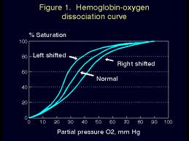
11) The fetal oxygen saturation curve is shifted compared to that of the mother. Which of the following graphs shows the relation of the fetal curve to mom.
A
B
Mom

Slide 13
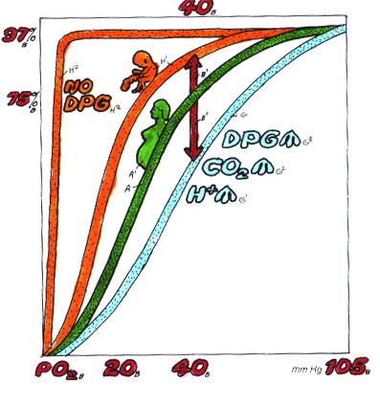
Fetal red cells have a lower 2,3 DPG than adults. This allows the fetal Hb to carry more oxygen at low oxygen tensions, which is important b/c of the lower oxygen tensions the fetus is exposed to (umbilical vein)

Slide 14
12) Which of the following anesthetic protocols would be the best choice for a canine dystocia?
A) epidural, ketamine and dexmed induction, sevoflurane maintanence
B) hydromorphone and valium induction, sevoflurane maintanence
C) epidural, fentanyl and propofol induction, sevoflurane maintanence
D) Line block, etomidate induction, isoflurane maintanece
C. Other recommendations would be the addition of an anticholinergic or muscle relaxant.

