Slide 1
Relative Adrenal Insufficiency or
Critical Illness Related Corticosteroid Insufficiency
Kelly Blackstock
Board Review
March 29, 2011
Cornell University

Slide 2
Overview
Normal anatomy and physiology
Physiologic function of steroids
Changes in to HPA axis during stress
Relative adrenal insufficiency
Role in human medicine
Role in veterinary medicine

Slide 3
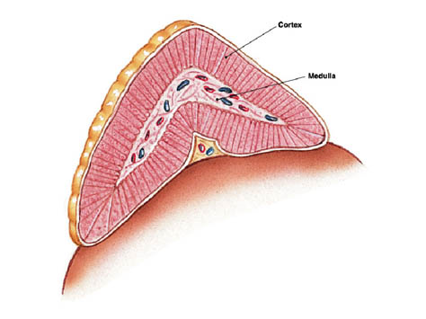
Normal Anatomy and Physiology
Adrenal Cortex
  Zona glomerulosa- mineralocorticoids
  Zona fasiculata- glucocorticoids
  Zona reticularis- androgens
Adrenal Medulla
  Catecholamines
    Cats primarily epinephrine
    Dogs primarily norepinephrine
Typical hormonal feedback mechanism

Slide 4
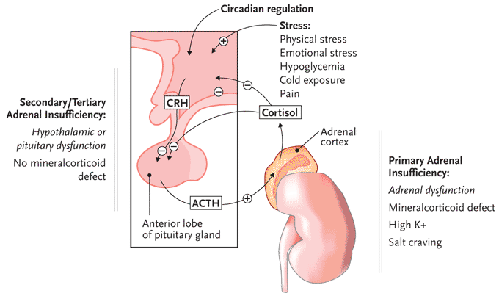
Hypothalmic-Pituitary Axis (HPA)
Angiotensin II
ADH
Tissue injury Cytokines
Hypotension
Hypoxemia
+
Oxytocin
-
+
+
ADH
Notes:
During stress high levels of endogenous cortisol will not effectively inhibit ACTH secretion (overpowered by stimulus of stress) , however exogenous sources will suppress

Slide 5
Steroid Basics
Precursor is cholesterol
Conversion requires cytochrome P-450
Cholesterol desmolase is the rate limiting enzyme in the pathway
Majority of cortisol is bound to corticosteroid binding globulin (CBG)
Unbound or free cortisol is the active component
Notes:
Cholesterol desmolase is stimulated by ACTH

Slide 6
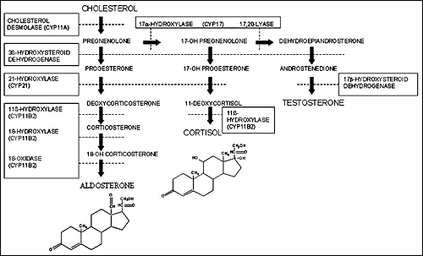
ACTH

Slide 7
Importance of Steroids
COH, protein and lipid metabolism
Immune function/Anti-inflammatory
Enhanced synthesis and action of catecholamines
Cardiac contractility
Wound healing
Maintains vascular tone
Endothelial integrity
Normal vascular permeability

Slide 8

Normal response with illness
Level of cortisol increases with illness, up to factor of 6
Response is adaptive, time-limited
Shown to improve survival
Roughly proportional to degree of illness
Level of increase correlates with GCS and APACHE score

Slide 9
Physiologic Changes to Axis during Illness
Diurnal variation lost
Increased production CRH and ACTH
Decrease in negative feedback of cortisol
Low levels of cytokines
  stimulate of CRH release
  Enhance tissue sensitivity to cortisol
Decrease in levels of corticosteroid binding globulin, increasing free cortisol levels

Slide 10
Protective Role in Critical Illness
Actions on beta adrenergic receptor synthesis and cell density
Prevention of beta adrenergic desensitization/uncoupling
Inhibition of NO synthase
Maintains reactivity to angiotensin II, epinephrine, and norepinephrine
Notes:
contributing to the maintenance of vascular tone, cardiac contractility, and blood pressure

Slide 11

Impairment Stress Response
Acute disease that directly affect HPA
Primary adrenal insufficiency
Impaired synthesis
Increased metabolism
Direct inhibition of HPA
Tissue resistance
Relative insufficiency
Drugs
Notes:
Impaired synthesis and increased metabolism are largely due to drugs

Slide 12
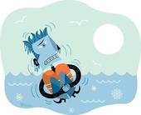
Acute Disease affect HPA Axis
Head Injury
CNS depressants
Infarction
Hemorrhage
Hypothermia

Slide 13
Primary Adrenal Insufficiency
Autoimmune
HIV
Metastatic disease
Systemic fungal infections
Tuberculosis
Trauma

Slide 14

DRUGS
Impaired synthesis
INCREASED METABOLISM
  Etomidate
  Ketoconazole
  Metyrapone
  Mitotane
Rifampin
Phenytoin

Slide 15


Direct Inhibition
Exogenous steroid administration
High level cytokines
HIV

Slide 16
Tissue Resistance
Sepsis
SIRS
ARDS
Trauma
Burns
Pancreatitis
Liver Failure
Postoperative cardiac surgery
HELLP syndrome

Slide 17

A Rose by Any Other Name…
When first investigated was coined Relative Adrenal Insufficiency
“Koala-stress” syndrome
New recommendation is “Critical Illness Related Corticosteroid Insufficiency” (CIRCI)

Slide 18
CIRCI Inclusion Criteria
Patients without structural defects in HPA axis
Transient in nature
Acute severe critical illness
Inadequate cellular corticosteroid activity for the severity of the patients illness
Diagnostic testing
Notes:
Thresholds have been found to be more useful with minimal responses below which RAI is likely and maximal threshold responds above which RAI in unlikely. Many proposed but so far none are entirely statisfactory.

Slide 19
Why does CIRCI happen
Decreased delivery of cholesterol to adrenal cells
Inhibition by cytokines (TNFα, IL-6, IL-1)
Chronic stimulation eliminates “reserve”
iNOS induced neuronal apoptosis in hypothalamus
Direct influence of LPS
Tissue resistance to ACTH and cortisol
CCM 2011, 39(3); 597
Notes:
Tumor necrosis factor- impairs corticotropin-releasing hormone stimulated corticotropin release and cortisol synthesis (50–53).
LPS shown to downregulate Toll-like Receptor 4 and ACTH Receptor expression
Neutrophil corticostatins and viruses

Slide 20
Incidence
Varies greatly within the literature with percentages ranging from 0%-77%
Specifically within critically ill patients, 10%-20%
Specifically within septic shock patients, roughly 60%
Highest within septic shock, ARDS, liver disease (possibly pancreatitis)

Slide 21

Clinical Signs
Clinical manifestations are from exaggerated pro-inflammatory immune response
Hypotension, refractory to both IVF and vasopressors
Possible eosinophilia, hypoglycemia
Hyponatremia, hyperkalemia are RARE
Notes:
Due to limitation of physical exam findings as well as biochemical evidence, threshold for investigation should be low, especially with patients with septic shock

Slide 22
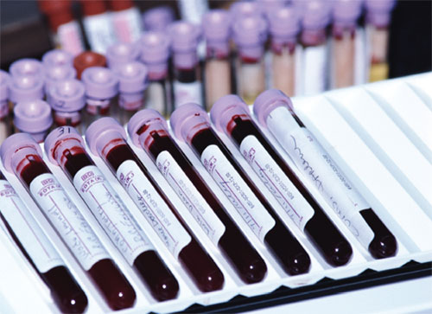
Diagnostics?
Still controversial
Options:
  Insulin-tolerance test
  Baseline cortisol
  Free cortisol
  ACTH levels
  ACTH stimulation (High dose v. Low dose)
  Δ cortisol
Notes:
Proposed:
Baseline ranges from 10μL/dL-34μL/dL
Δ cortisol <9μL/dL
At the current time, there are no clinically useful tests to assess the cellular actions of cortisol; the accurate clinical diagnosis of CIRCI therefore remains somewhat elusive

Slide 23
Diagnostics?
No clinically useful tests to assess the cellular actions of cortisol
Thresholds most reliable, not entirely satisfactory
Current recommendation
  random (stress) cortisol of less than 10 μg/dl
  Δ cortisol of less than 9 μg/dl after a 250 μg ACTH stimulation test
Notes:
the accurate clinical diagnosis of CIRCI therefore remains somewhat elusive

Slide 24
Why is CIRCI challenging?
Baseline [cortisol] changes with disease severity
High and low [cortisol] have been associated with poor prognosis
Binding to CSB globulin/free levels
No measure for tissue specific resistance
Testing on critical patients difficult
Which test, when, dose of ACTH stimulation
Notes:
Cant predict how much steriod particular disease needs, This makes it difficult to define normal ranges
Changes in binding make estimate of free cortisol difficult
Resistance factors will vary based on patients condition

Slide 25
Treatment
Human studies:
  Hydrocortisone treatment (200-300mg/d)
  More rapid shock reversal
  Improved outcome in septic shock and early ARDS
  Effects often independent of adrenal testing
Hydrocortisone is steroid of choice
Moderate dose treatment associated with better outcomes and less adverse effects

Slide 26
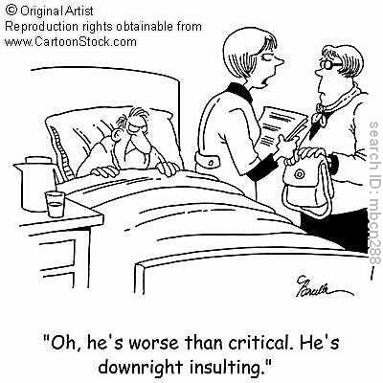
CIRCI in Human Literature
  Hundreds of articles now exist evaluating incidence, how to measure, when to measure, treatment, dose, disease occurance, etc
  Only 2 large randomized, prospective controlled studies for sepsis
  Four recent meta-analyses
  Current recommendations from
  the American College of Critical
  Care Medicine

Slide 27
Annane et al. JAMA 2002, 288(7);862
Placebo-controlled, randomized, double-blind, parallel-group trial performed in 19 intensive care units
  300 patients with septic shock, treatment included fludrocortisone
  76% found to be non-responders
  RAI patients receiving low dose steroids had decreased 28d mortality compared to placebo
  Increased vasopressor use in placebo group
  Similar adverse effects in both groups

Slide 28
CORTICUS study
Sprung et al. NEJM 2008, 358; 111
multicenter, randomized, double-blind, placebo-controlled study, 52 ICUs
500 patients with septic shock
46% were found to be non-responders
No difference in mortality with treatment
Shock reversal was quicker in treatment group
More episodes of super-infection, new sepsis and septic shock with treatment
Notes:
Low power of study, were supposed to have 800
Low death rate, perhaps less sick than those in Annane study
May have had selection bias (sickest patients, Dr may have resisted refusal of treatment)

Slide 29

Meta-Analysis
Annane et al. and Monneci et al.
  Includes sepsis and septic shock, high and low dose steroid therapy
  Low dose is better than high dose
  No difference in mortality with treatment
  Quicker resolution of shock
  If stratified by disease severity, less severe=harm, more severe=benefit

Slide 30
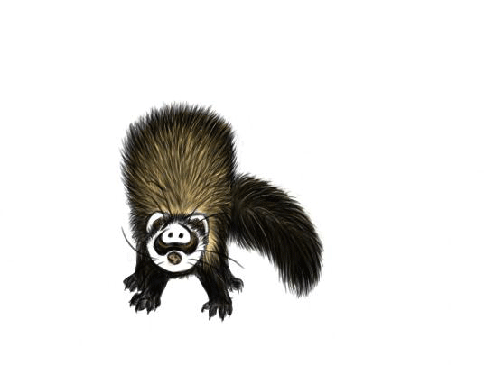
Meta-Analysis
Marik et al. and Sligl et al.
  Only included studies involving septic shock and low dose steroid therapy
  No benefit in mortality
  Quicker reversal of septic shock
  No adverse effects or super-infection

Slide 31
Consensus Statements
Marik et al. CCM 2008, 36(6); 1937
Should be referred to as CIRCI
Avoid terms relative and absolute in context of critical illness
Best diagnosed by a Δ cortisol (after 250 μg cosyntropin) of <9 μg/dL or a random total cortisol of <10 μg/dL
Free cortisol measures should not be used, as it is not readily available

Slide 32
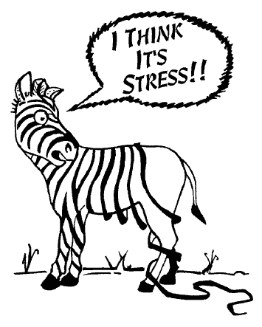
Consensus Statements
Marik et al. CCM 2008, 36(6); 1937
ACTH stimulation should not be used to identify patients with septic shock or ARDS who should receive GC
Hydrocortisone best choice for sepsis
Moderate dose GC should be considered in early severe ARDS and before day 14 in unresolving ARDS

Slide 33
Consensus Statements
Marik et al. CCM 2008, 36(6); 1937
Dose of Hydrocortisone: 200mg/d in four divided doses or as a bolus on 100mg, followed by CRI of 10mg/hr. ARDS: 1mg/kg/d methypred as CRI
Duration > 7d with sepsis, >14d with ARDS
Treatment should be tapered
Fludrocortisone is optional
Dexamethasone not recommended

Slide 34
Does CIRCI happen in Small Animals?
Case Reports
  “Suspected relative adrenal insufficiency in a critically ill cat.” Durkan et al, JVECC 2007, 17(2); 197-201
  “Critical illness-related corticosteroid insufficiency in a dog with septic shock.” Peyton et al, JVECC 2009, 19(3); 262-268
Notes:
5yr DSH, HBC, day 3 hernia with entrapped bowel and bladder, normal cortisol with poor stimulation, hypotension responded to dexamethasone, repeat stimulation was normal
15mos old Stan Poodle, aspiration pneumonia, needed ventilation, became septic, low baseline cortisol, no response to stimulation, hypotension resolved with administration of hydrocortisone, no repeat sample

Slide 35

Research in Small Animal
Incidence 0%-48%
All published studies involve dogs
Abstracts with cats presented at IVECCS and AVCSC
Disease processes include neoplasia, critical illness and sepsis
None evaluated treatment with
steroids
Notes:
(AVCSC) Annual veterinary cancer society conference

Slide 36

Prittie et al. JAVMA 2002, 220(5);615-619
20 dogs, critically ill (40% acute, 60% chronic)
ACTH + every day of hospitalization
35% overall mortality, 0% incidence of CIRCI
No difference in baseline cortisol and survival
No difference in + cortisol and survival
No difference in ACTH levels and survival
Notes:
Only 3/20 were septic
None of the baseline cortisol levels were low
None of the + cortisol levels were low
If + cortisol was on lower end of normal, predictive that it would increase

Slide 37
Goy-Thollot et al. Revue Méd Vét 2006, 157(4);213-218
34 dogs, thought to die without txt, but with treatment would likely live >24hrs
ACTH +, ACTH levels, aldosterone levels
26% overall mortality
Non-survivors > [cortisol] than survivors (NS)
Non-survivors when compared to both controls and survivors had greater
  Stimulated cortisol levels
  Δ cortisol
  Baseline aldosterone levels
  Stimulated aldosterone levels

Slide 38
Burkitt et al. JVIM 2007, 21; 226-231
33 dogs, known or suspected sepsis or SIRS
ACTH + and baseline ACTH on admission
42% overall mortality, 48% incidence CIRCI
As Δ cortisol decreased, so did risk of hypotension
Threshold of <3 μg/dL for δ cortisol most accurate at predicting hypotension, survival to discharge and 28d survival (only significant one hypotension)

Slide 39
Burkitt et al. JVIM 2007, 21; 226-231
Threshold <3 μg/dL associated with survival but not significant
  If less than, 4.1x more likely to die
Δ cortisol was significantly less in non-survivors when compared to controls
Sensitivity 64%, Specificity 75%

Slide 40
Martin et al. JAVMA 2008, 233(1); 87-95
31 critically ill dogs, acute disease <48hrs
ACTH + and baseline ACTH within 24 hrs
32% overall mortality, 42% were septic
55% had at least one marker for CIRCI
None had a low baseline cortisol
 | Low ACTH stimulation | Low baseline ACTH
Septic Patients, n=13 | 5 | 1
Trauma Patients, n=10 | 4 | 3
GDV Patients, n=8 | 2 | 1

Slide 41
Martin et al. JAVMA 2008, 233(1); 87-95
Presence of CIRCI not predictive of any morbidity factor or mortality
However, with threshold of < 83 nmol/L, dogs were 5.7x more likely to have received pressors (2.28 μg/dL)
This threshold did not show significant difference in terms of outcome
Notes:
Morbidity factors included duration of hospitalization, hypoxemia, cardiac arrthymias, hypotension

Slide 42
Conclusions
CIRCI likely exists is a subset of patients with severe sepsis, that are non-responsive to either IVF or vasopressors
Diagnosis is challenging, and may not be warranted.
  Best markers so far are [cortisol] <10 μg/dL or Δ cortisol of < 9 μg/dL
Treatment of choice is hydrocortisone
Possibly exists in small animal, more research is needed

Slide 43
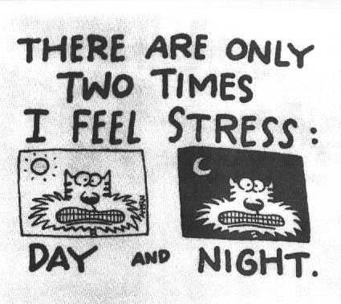
QUESTIONS?

Slide 44
List 4 ways that drugs can alter the availability of steroids and give one drug example for each category.
Increased metabolism by the liver: rifampin and phenytoin
Increase of binding to proteins: synthetic estrogens
Direct suppression of HPA axis: iatrogenic steroids
Decreased synthesis: etomidate and ketoconazole

