Slide 1
1) Which of the following is not a pathologic grouping of Ehrlichia? a) Monocytotrophic b) Thrombocytotrophic c) Basophilotrophic d) Granulocytotrophic
C

Slide 2
2) E. canis predominately infects what type of cell? a) neutrophils b) monocytes c) platelets d) eosinophils
B. E. canis is monocytotrophic where as other ehrlichia or anaplasma species infect other cell lines

Slide 3
3) Which of the following has not been associated with increased severity of E. canis infection: a) virulence of strain b) immunodeficiency c) age d) concurrent tick bourne disease
C

Slide 4
4)What breed is associated with worse outcome with E. canis infection? a) Labrador Retreivers b) Doberman Pinchers c) German Shorthaired Pointers d) German Shephards
D

Slide 5
5) Which of the following tick bourne infections does not have a natural occuring chronic phase? a) E. ewingii b) A. phagocytophilum c) A. platys d) E. canis
B. Clinical findings are almost exclusively from acute disease, during the bacteremic phase. Natural chronic infection has not been documented, possible as been induced experimentally

Slide 6
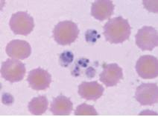
6) Which agent is most likely seen in this picture? a) E. ewingii b) A. phagocytophilum c) A. platys d) E. canis
C

Slide 7
7)What is the most common laboratory abnormality associated with Ehrlichia infection?
Thrombocytopenia

Slide 8
8) What diagnostic test is consider the screening test of choice for Ehrlichia infection: a) ELISA b) PCR c) Western blot d) FA serology
D

Slide 9
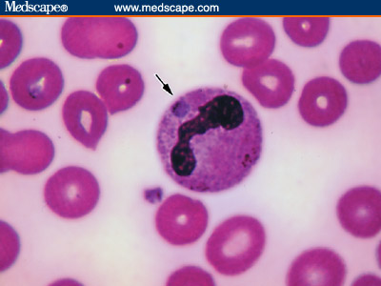
9)What is the following structure associated with Anaplasma infection called? a) inclusion body b) morula c) indium d) quaser
B

Slide 10
10) True or False. A negative FA test of Anaplasma is adequate to rule out infection.
False. requires acute and convalescent titers as 40% of ill animals are seronegative on presentation

Slide 11
11)What is the treatment of choice for Anaplasma? a) Clindamycin b) Doxycycline c) Imipenim d) TMS
B

